Slide 1
LED Flip-Sign
Tyndall Darnell - EE
Peter Guarner - EE
Tyler Stokes - CpE
Sean O’Shaughnessy - CpE
Dr. Michael Young - Sponsor

Slide 2
Motivation
Creating a way to communicate quickly and easily
Sporting Events
Festivals
Uber/Taxi drivers
Communication in traffic
Airport pick-ups
Crowded areas
Notes:
Ty

Slide 3
Objectives
Produce an LED display that can illuminate words/phrases as defined by the user.
Handheld and Compact
Visible during the day/night
Intuitive interface/easy to use
Rechargeable
Compatible with Windows and Android
Programmable messages
Low production cost
Notes:
Ty
Objectives specified by the sponsor
Competition with other team. Stipend for successful, winning product

Slide 4
Specifications
Dimensions | 12” x 6” x 3”
Resolution | 56 x 24 pixels
Battery Lifespan | > 30 min. Rechargeable
Brightness Adjustment | Manual - 4 levels
Illumination | Red Surface Mount LEDs
Connectivity | Bluetooth iOS
Message Presets | Up to 4
Notes:
Ty

Slide 5
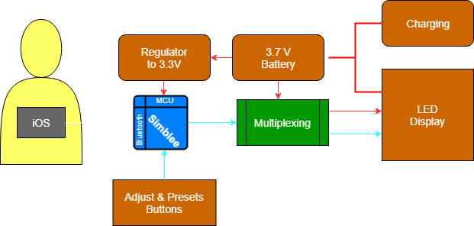
Overview
Red Arrow | Power Connection
Blue Arrow | Control Signal
Orange | Hardware
Gray | Software
Green | HW and SW
Notes:
Peter
Data transfer, communication method, hardware, power.

Slide 6
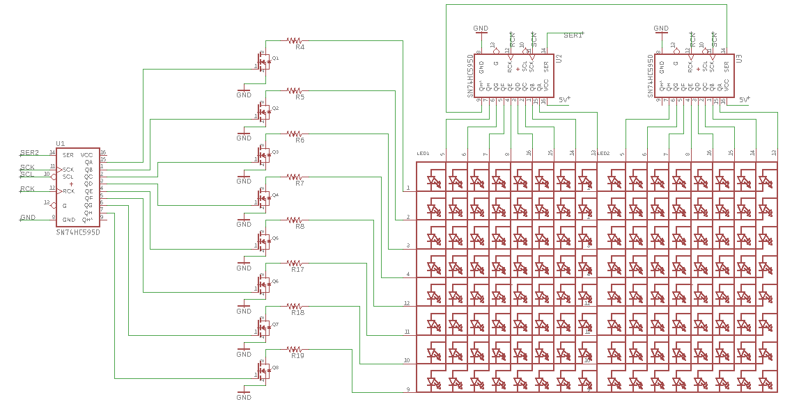
LED Matrix
Multiplexing Options
Counter/ Demultiplexer
Shift Registers
Current Drive
Transistors Sink (1.8 A)
Registers Source (20 mA)
PWM
Screen Refreshing
Access particular patterns
Saves power
Frequency (>40 Hz)
Notes:
Peter
Shift registers reach out to more LEDs than MUXes; Adjustable output - based on desired sequence
Less pins required
PWM with shift register OE

Slide 7
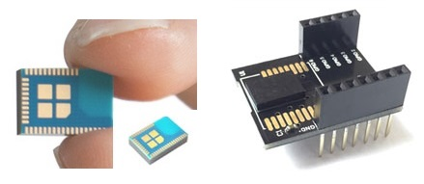
Simblee (RFD22102)
Microprocessor and Bluetooth
Integrated on-chip
16 MHz Crystal embedded
30 GPIO pins
iOS interface for mobile application
Extensive libraries provided
Reduced cost and board space

Slide 8
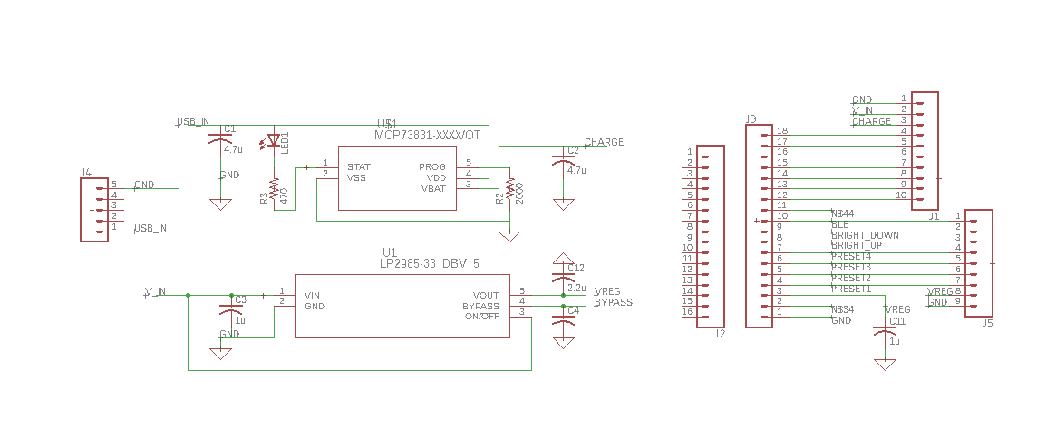
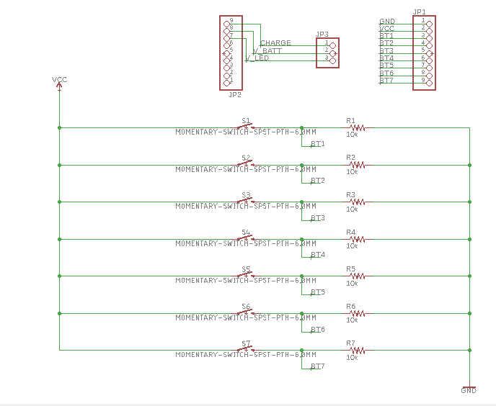
Secondary Boards
Designed as a second PCB that will attach to the LED array with pin headers for several reasons:
To keep design encasing as small as possible.
To use only 2 layer boards.
Easier design implementation.
Contains the following systems:
Voltage regulation
Battery recharging
MCU
Bluetooth
Connects to user input PCB with pin headers and cables.
Notes:
4 layers is more expensive

Slide 9
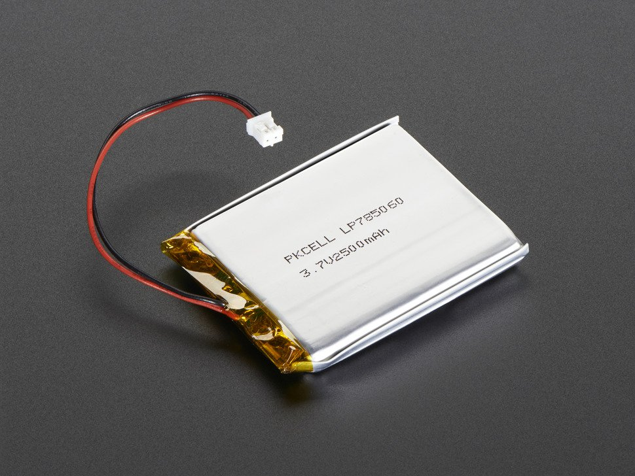
Power
3.7-Volt lithium-ion polymer battery
Rechargeable
Conveniently shaped
Large storage capacity
Part | Manufacturer | L” X W” | Height | Volt. | Capacity | Price
ID: 258 | Adafruit | 2.4 x 1.3 | 0.2 | 3.7 V | 1200 mAh | 9.95
ID: 328 | Adafruit | 2.55 X 2 | 0.3 | 3.7 V | 2500 mAh | 14.95
932MIKROE | MikroElektronika | 2.4 x 1.7 | 0.264 | 3.7 V | 2000 mAh | 13.90
UBP001 | Ultralife | 2.1 x 1.4 | 0.43 | 3.7 V | 1750 mAh | 15.70
Notes:
Had to use Li-ion for thin profile, 3.7 voltage delivery, and the ability to recharge
Picked for the high charge capacity at a relatively low cost;
Size was sufficiently compact for our needs - we had the room for it
Could handle more continuous output current.

Slide 10
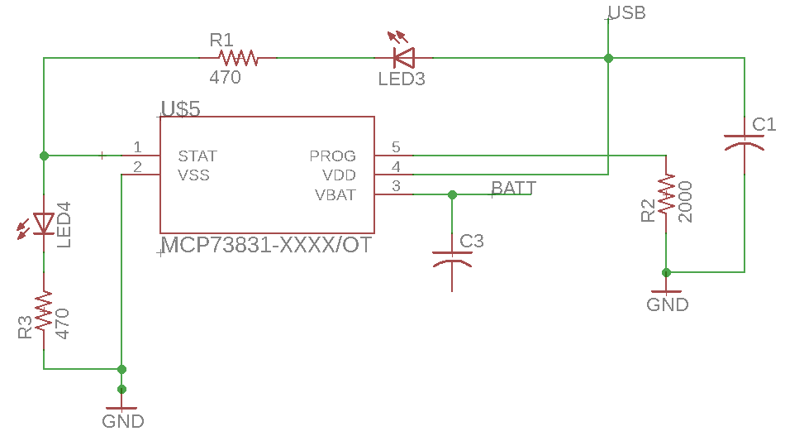
Battery Charger
Battery charger chips for Li-ion rechargeability
Needed high charge voltage accuracy
Relatively few external components required
Relatively low cost
Part | Manufacturer | Charge Voltage Accuracy | Price
MCP73831T-4A | Microchip | 0.75% | $0.68
TP4056 | NanjingTop Power ASIC | 1.5% | $5.60
BQ24250RGET-2A | Texas Instruments | 0.75% | $3.47
Notes:
Higher accuarcy, cheaper, didnt have to de-solder, less exeternal components

Slide 11
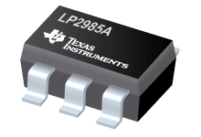
Voltage Regulator
Needed to regulate voltage down to 3.3V for the Simblee.
High tolerance
Low noise
Low cost
Notes:
Down from 3.7v to 3.3v since max is 3.6 for mcu

Slide 12
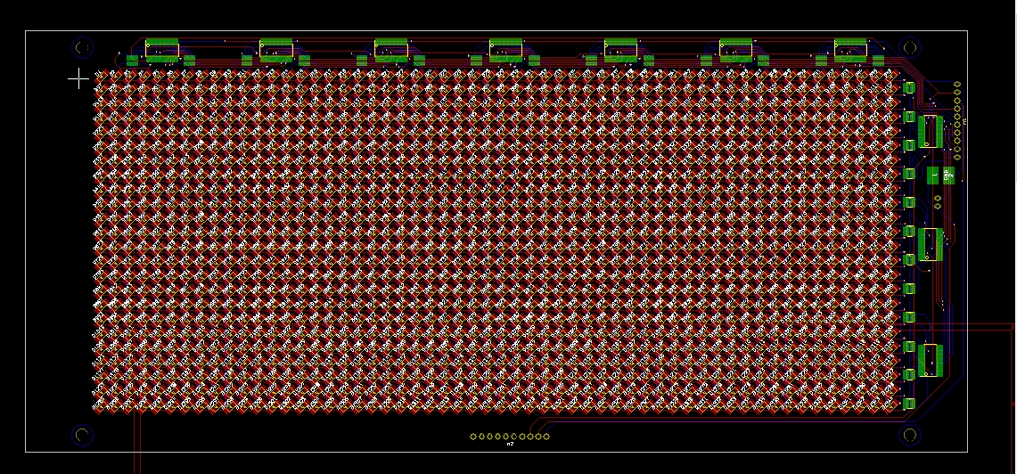
PCB Layouts

Slide 13
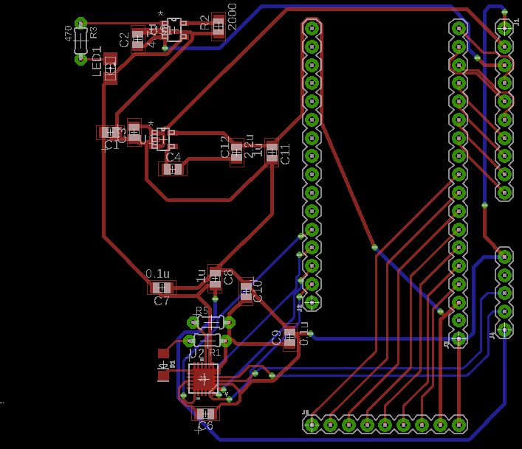
PCB Layouts

Slide 14
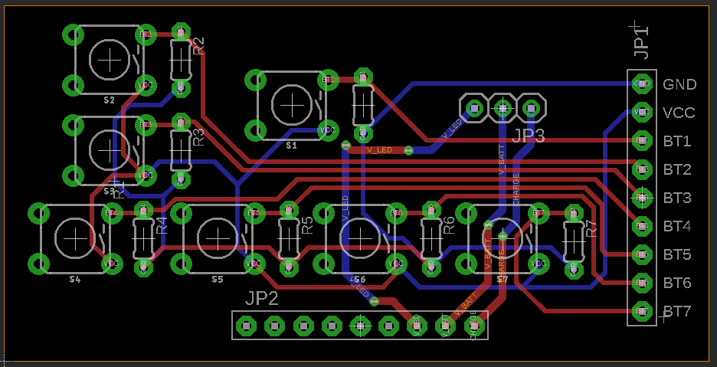
PCB Layouts

Slide 15
Code Overview
Refresh rate: Brightness by modulation
Control design: Simple for users
Internal logic: Feature implementation

Slide 16
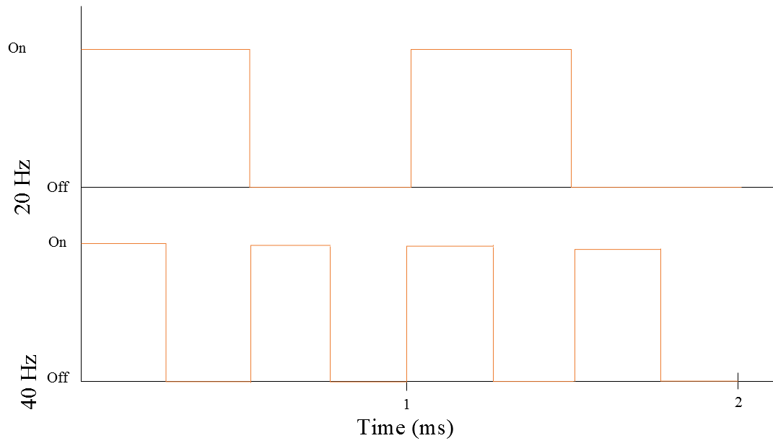
Frequency Importance

Slide 17
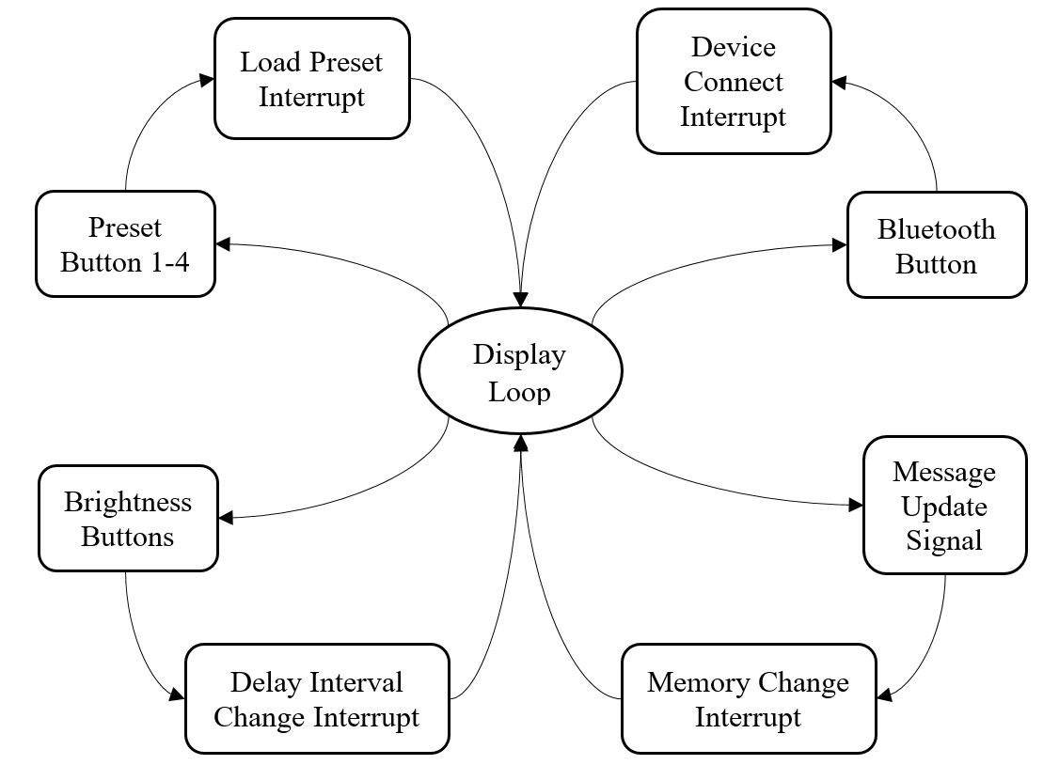
MCU Control Flow Diagram

Slide 18
Hard-Coded Font Options
Every single character must have a hard coded representation
This includes all letters and symbols to be displayed, as well as the different sizes of these letters and symbols.
The software will offer single line and double line sized font.
Letters A and B, in a 8x8 font, would be…

Slide 19
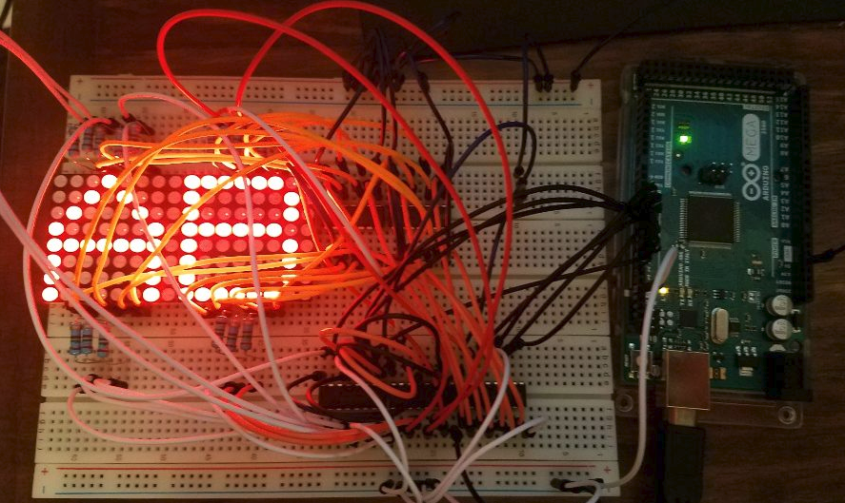
Prototyping

Slide 20
Graphical User Interface
Opening Screen
Up to 4 preset messages
Toggle switch for multiple lines
Reset messages
Update screen test on the fly
Multi-step scroll speed control

Slide 21
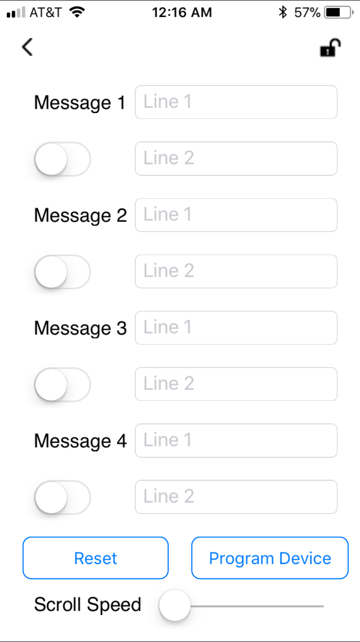
Graphical User Interface
Opening Screen
Message Configuration
Up to 4 preset messages
Toggle switch for multiple lines
Reset messages
Update screen test on the fly
Multi-step scroll speed control

Slide 22
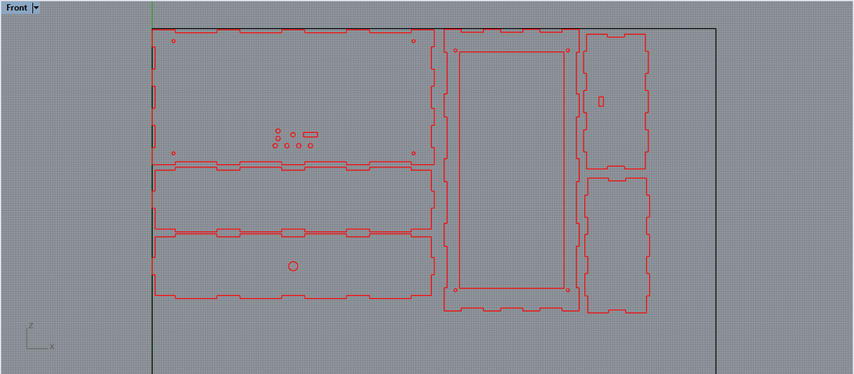
Device Enclosure
Material: ⅛” Clear Acrylic Plastic
Designing: Rhino 3D Drafting Layout
Manufacturing: Machine Laser Cut with tolerances of ~2um
Dimensions: 12” x 6” x 3”
Assembly: Interlocking tabs with PVC Adhesive
Handle: Bolted wooden handle
Accessibility: Removable backing to change battery or modify electronics
Notes:
Designed and printed using Fusion.
PCB should slide into the enclosure on guide rails.
Removable handle.
None of us are too familiar with this so we're tackling this all together

Slide 23
Prototyping Cost
Part | Qty. | Price per unit | Total
LED block | 4 | $2.50 | $10.00
Resistor array (56 Ohms) | 10 | $0.58 | $5.83
Demultiplexer | 10 | $0.67 | $6.70
Decoder | 10 | $0.34 | $3.40
Quad NPN Transistors | 4 | $4.42 | $17.68
Resistor array (500 Ohms) | 2 | $0.75 | $1.50
Counter (4-bit) | 2 | $0.55 | $1.10
LED Display Driver | 2 | $2.08 | $4.16
RN-4020 Development Kit | 1 | $30.00 | $30.00
RN-4020 Chip | 1 | $10.60 | $10.60
Adafruit Bluefruit Module | 1 | $17.50 | $17.50
3.7 V 2500 mAh Li-ion Battery | 1 | $14.95 | $14.95
Voltage Boost Chip | 1 | $1.44 | $1.44
CC2564MODA BLE Chip | 2 | $19.86 | $39.72
TP4056 Battery Charger Module | 2 | $6.50 | $13.00
ATmega2560 Development Board | 1 | $35.00 | $35.00
Wire packs | 2 | $4.99 | $9.98
Breadboards | 1 | $9.99 | $9.99
Total |  |  | $232.55
Notes:
Tyler
Includes every part and prototyping tool
With prototyping we don't end up using every part we buy.

Slide 24
Final Product Cost:
Part | Unit | Production (~1000)
DMN2215UDM-7 MOSFET (x12) | 6.36 | 1.85
Red LED SMD (x2000) | 40 | 20
74HC595 Shift Register (x10) | 5.72 | 4.76
CP2130 USB to SPI Interface | 2.16 | 1.62
EXB-38V820 Resistor Array(x6) | 0.72 | 0.03
Miscellaneous Resistors | 1.5 | 0.01
Simblee MCU Estimated | 17.01 | 10
LP2985 Voltage Regulator | 0.58 | 0.25
MCP73831T | 0.68 | 0.45
USB Port | 0.7 | 0.36
SMD Capacitors(x10) | 5.8 | 1.2
Encasing (Laser cut) Estimated | 55 | 10
Tall Momentary Switches (x7) | 3.5 | 0.73
Power switch | 3.83 | 1
PCB Manufacturing Estimated | 55 | 5
Total | 198.56 | 57.26
Notes:
Tyler
Only considers the parts needed to produce the ‘x’ amount of devices

Slide 25
Division of Labor
 | LED Array | Control Board | Button Board | MCU Logic | GUI
Peter Guarner | P | S | P
Tyndall Darnell | S | P | S
Tyler Stokes |  |  |  | S | P
Sean O’Shaughnessy |  |  |  | P | S
P = Primary
S = Secondary

Slide 26
Questions?

