Slide 1
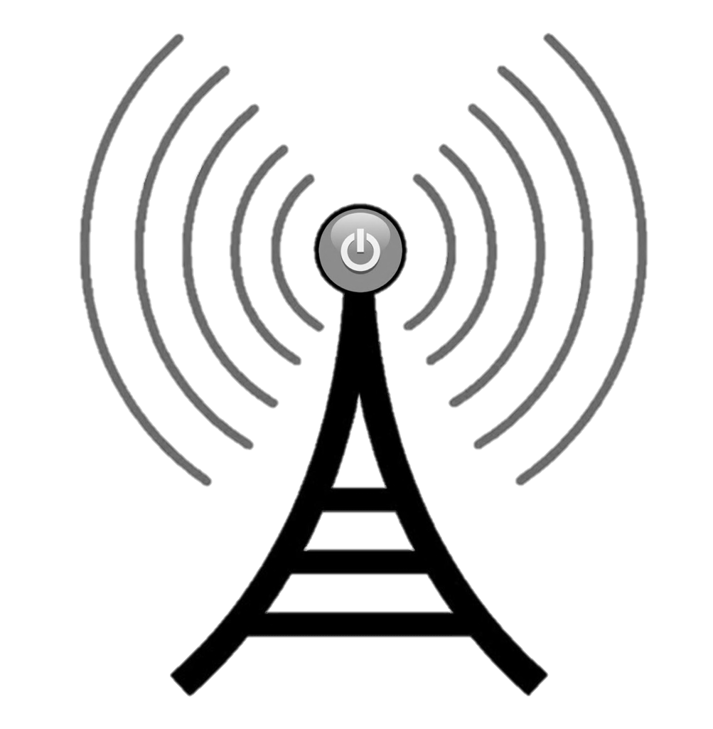
RF Energy Harvesting
for Medical Devices
Group 18
Joey Sleppy
John Foster
Zeke rosenbluth
Notes:
Joe

Slide 2
The Problem is… Batteries Die
Notes:
Joe

Slide 3
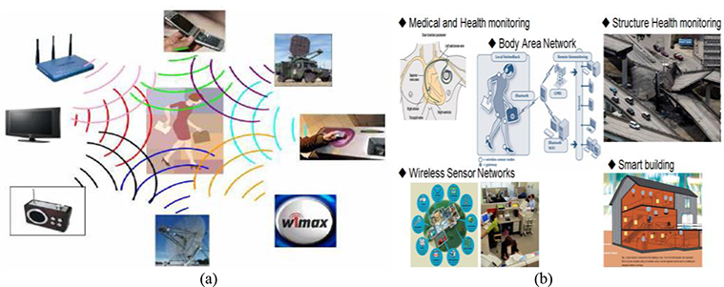
Motivation
Notes:
Joe

Slide 4
Motivation
Reduce stress for user’s who rely on batteries for their health
Offer a potential power source to next-gen medical devices such as bio-sensors and artificial organs
Industrial market trends suggesting this could be worth a lot of money
Notes:
Joe

Slide 5
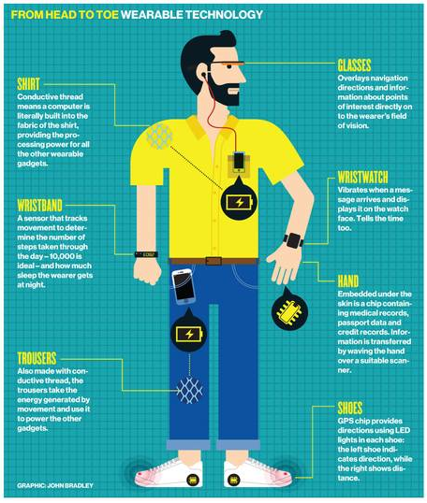
Goals & Objectives
Consistent Communication with user
Little to no user input required
Invisible ~ Comfortable ~ Lightweight

Slide 6
Specifications
Component | Parameter | Spec
Circuit Size (Wearable) | Size | <4in^2
Output Power | Magnitude & Efficiency | >1mW 25% System Efficiency
Monitoring | Accuracy | 95% True Value
Monitoring | Frequency | Upon user request
Development | Cost | $1,500
Notes:
Joe

Slide 7
A Tale of Two Loads
Larger Load (Insulin Pump)
Requires more support systems
Power monitoring flaw
Small Loads (Sensors)
Require voltage & little current
Easier to scale to broader impacts
Notes:
Joe

Slide 8
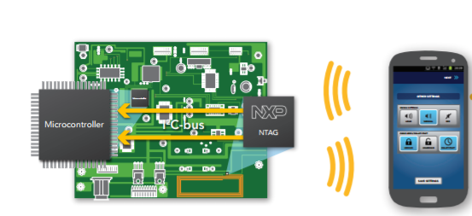
NFC Communication Basics
Little to no power consumption
Simple mobile phone integration
No communication overhead
Notes:
Cam

Slide 9
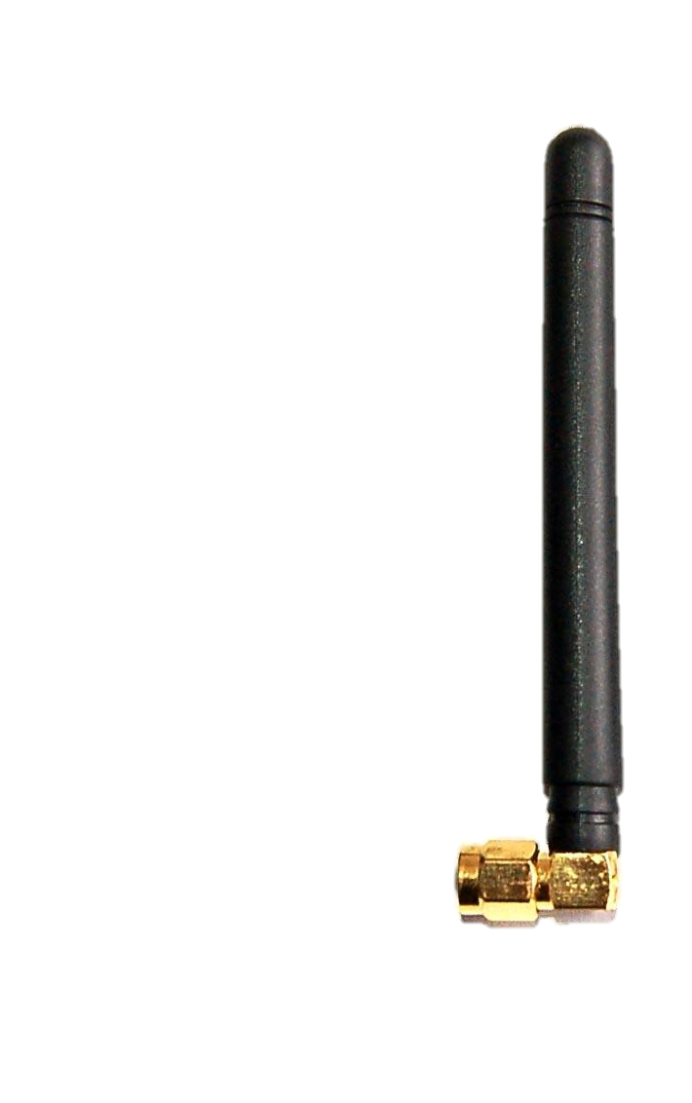
Block Diagram
1) RF Signal Sources
2) Signals Received to Antenna
3) Energy Harvested & Delivered
4a) Data read from sensors
5) Data Transmission
Powercast IC
Micro-controller
NFC to App
Thermal Sensor
Heartrate Sensor
Wireless Connection
Wired Connection
Notes:
Joe

Slide 10
Block Diagram
1) RF Signal Sources
2) Signals Received to Antenna
3) Energy Harvested & Delivered
4a) Data read from sensors
5) Data Transmission
Powercast IC
Micro-controller
NFC to App
Thermal Sensor
Heartrate Sensor
Wireless Connection
Wired Connection
Notes:
Joe

Slide 11
RF Signals
Signal Source | Avg. Strength | Abundance (%) | Volatility | Score
Wi-Fi | -50dBm | 50% | 90% | -22.5
Cellular Receiving | -90dBm | 95% | 90% | -76.95
Cellular Transmitting | 0dBm | 100% | 100% | 0
Radio signals are weak
TV signals are tough to find
Score = strength * abundance * volatility = Higher is Better
Notes:
Joe

Slide 12
Antenna Basics
Parameter:
Monopole
Medium Gain
Small Size
High Efficiency
Notes:
Joe

Slide 13
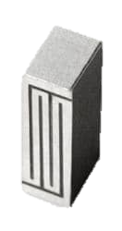
Antenna Selection
Specifications:
Chip
<70% Efficiency
2dBi Gain
100mm^2
W3012 Ceramic Chip
by Pulse Electronics
Notes:
Joe

Slide 14
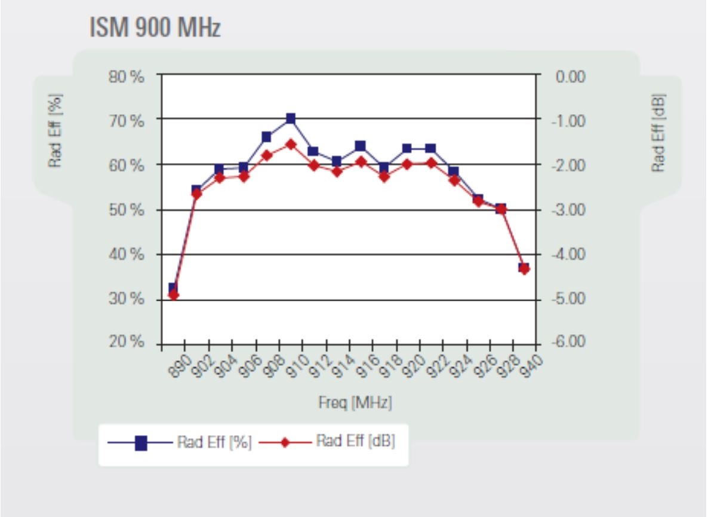
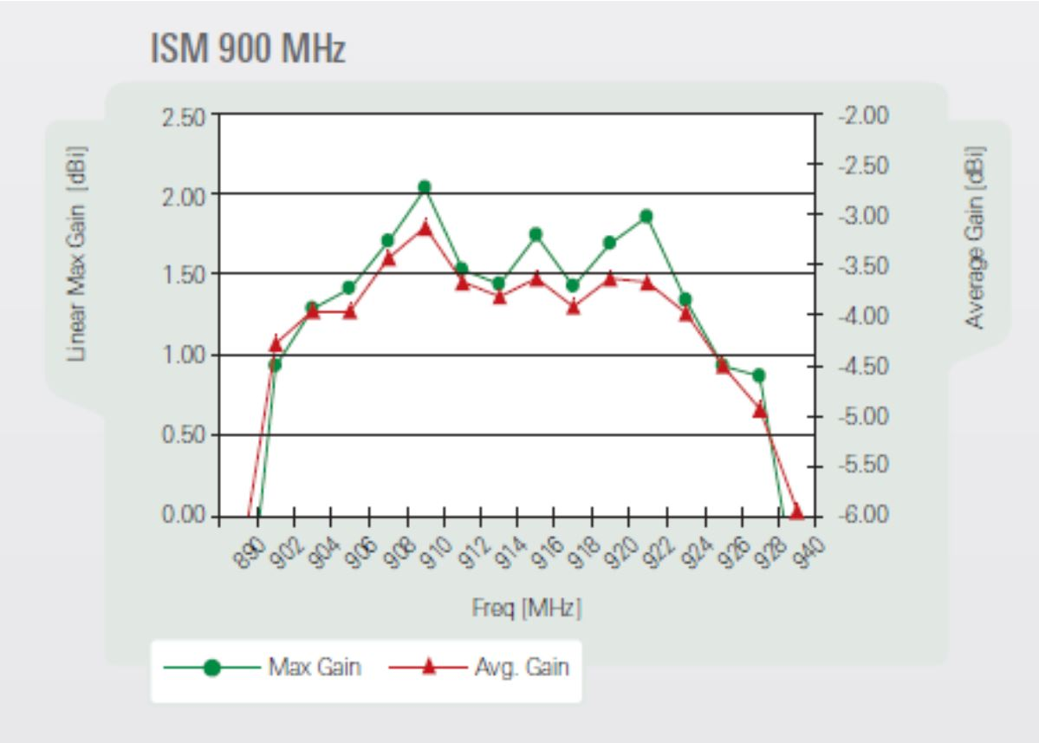
Most Efficient
Around 900MHz
Return Loss
of -6dB is bad
Notes:
Joe

Slide 15
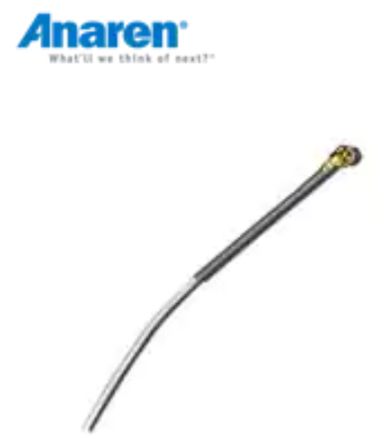
Actual Antenna Selection
Specifications:
Whip
Omni-directional
3dB Gain
3.22” in Length
11.96dB Return Loss
<10% of signal returned
A1101R09C Whip
by Anaren
Notes:
Joe – needs updating here

Slide 16
Block Diagram
1) RF Signal Sources
2) Signals Received to Antenna
3) Energy Harvested & Delivered
4a) Data read from sensors
5) Data Transmission
Powercast IC
Micro-controller
NFC to App
Thermal Sensor
Heartrate Sensor
Wireless Connection
Wired Connection
Notes:
ca,m – be sure to mention that power cast output is enough to power the microcontroller and two sensors and that they are connected in parallel requiring voltge and little current. That the microcontroller needs a buck first.

Slide 17
Powercast IC
2110B Receiver By Powercast Co.
Notes:
cam

Slide 18
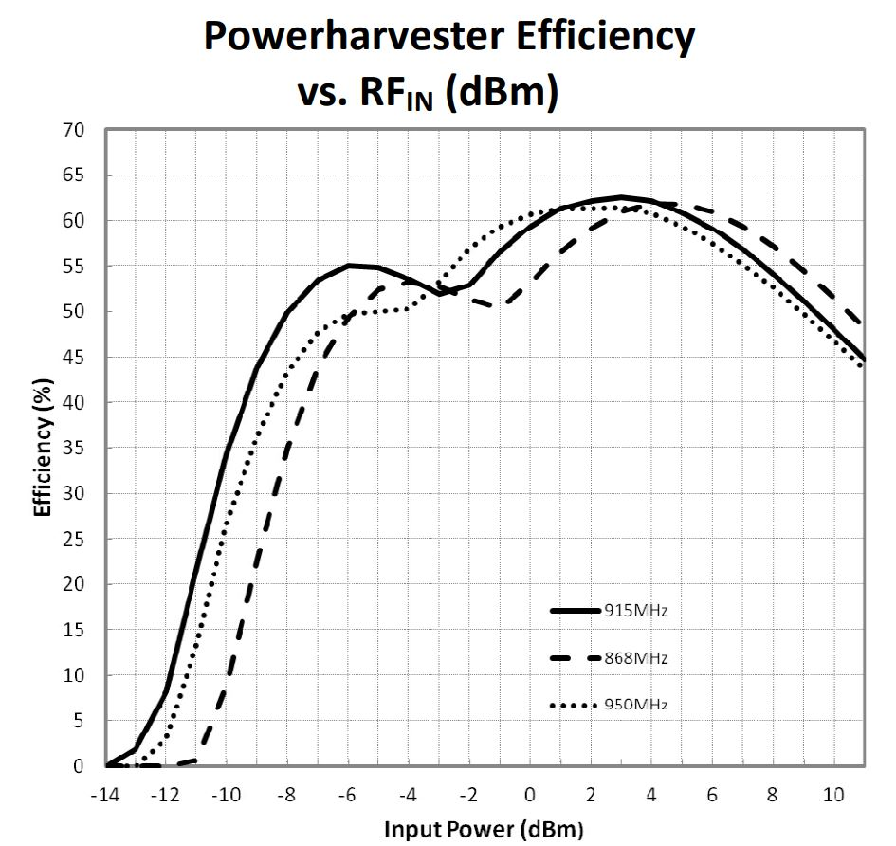
Selection: Powercast IC
Optimized for Cellular Signal
Input Power < Cellular Signal Power
Easily Controlled output voltage with Resistor
2110B Receiver By Powercast Co.
Notes:
cam

Slide 19
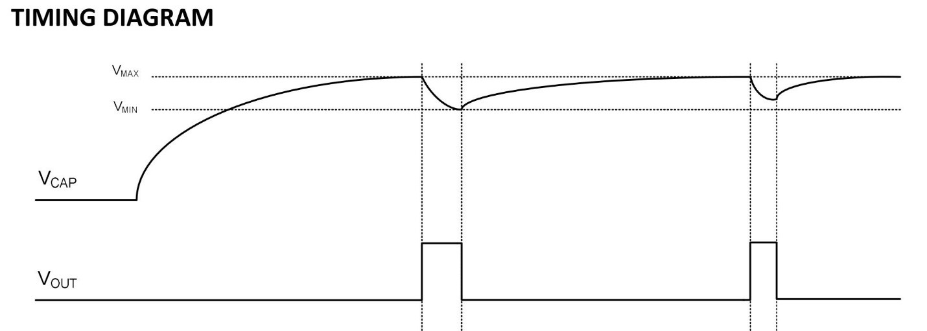
Powercast IC
C= 15*V_{o}*I_{o}*t_{on}
Rout = 1M(Vo -1.21)
(3.32-Vo)
2110B Receiver By Powercast Co.
Notes:
Cam – mention that this cap should actually be huge and our learning from it – point out the huge cap. They will like seeing our problem solved skills

Slide 20
Block Diagram
1) RF Signal Sources
2) Signals Received to Antenna
3) Energy Harvested & Delivered
4a) Data read from sensors
5) Data Transmission
Powercast IC
Micro-controller
NFC to App
Thermal Sensor
Heartrate Sensor
Wireless Connection
Wired Connection
Notes:
Cam

Slide 21
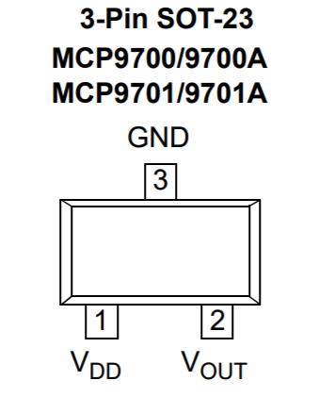
Sensors
Temp Sensor:
Operates between 2.3V and 5.5V
Output data to ADC linearly in microcontroller
Notes:
Cam update this slide please – pics, specs, etc…

Slide 22
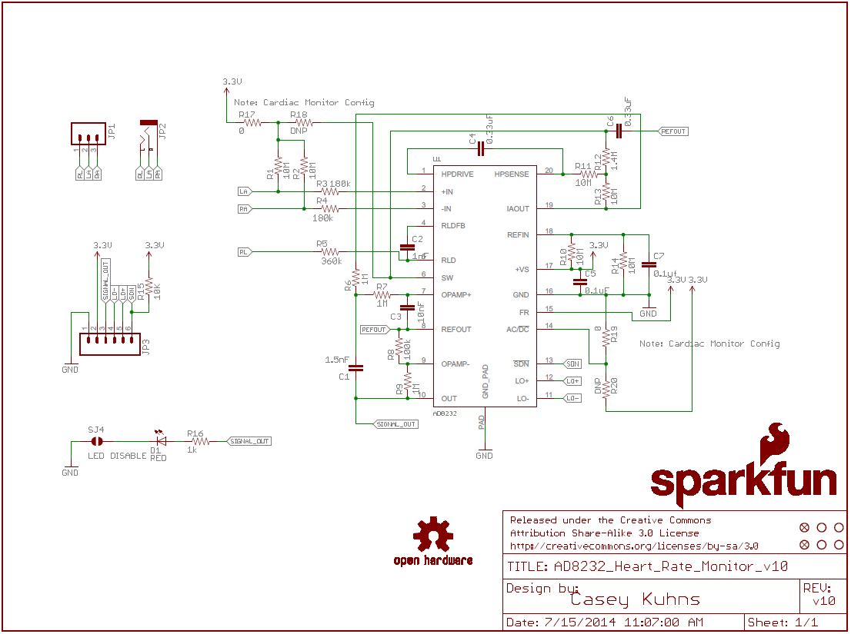
Sensors
Notes:
Cam update this slide please – pics, specs, etc…

Slide 23
Microcontroller
Specifications RF430FRL152h:
Entirely powered from host NFC tag
On board MSP430 with ADC to easily read sensor output data
ISO15693 Protocol enbaled
Notes:
Cam

Slide 24
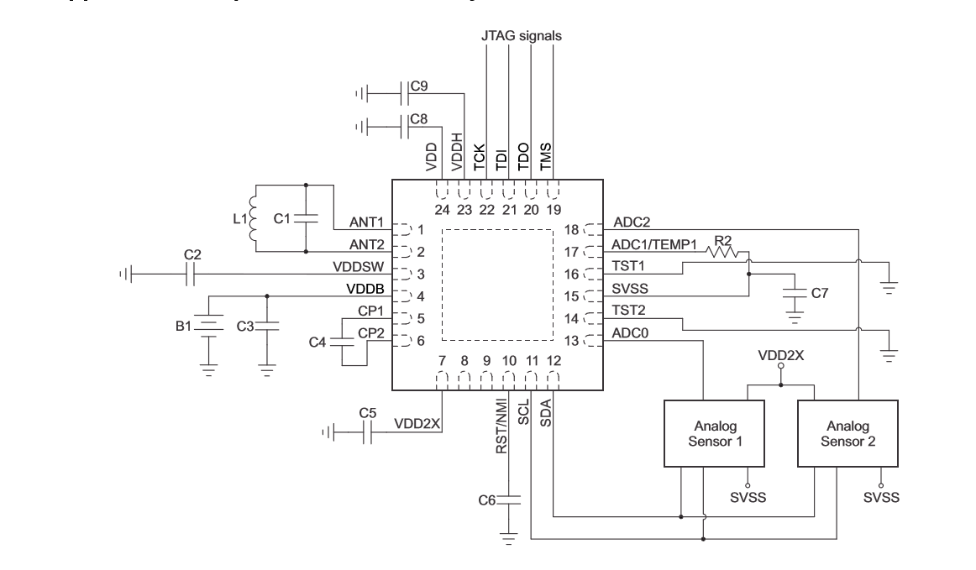
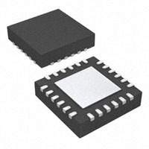
Notes:
Cam

Slide 25
Block Diagram
1) RF Signal Sources
2) Signals Received to Antenna
3) Energy Harvested & Delivered
4a) Data read from sensors
5) Data Transmission
Powercast IC
Micro-controller
NFC to App
Thermal Sensor
Heartrate Sensor
Wireless Connection
Wired Connection
Notes:
Zeek

Slide 26
Software
Internal Sensing System
RF430FRL152H
External Sensing System
Android Application
Notes:
Zeek

Slide 27
Software: Sensing System
Programming done in Code Composer Studio
RF430FRL152H
2 pages of memory designated for RF messages
0xF868 – 0xFC33, 0xFC34 – 0xFFFF
Notes:
Zeek

Slide 28
Software: Sensing System
Input:
Voltage level (ADC)
System:
Low power mode
Using firmware of RF430
ISO15693 Protocol
Notes:
Zeek

Slide 29
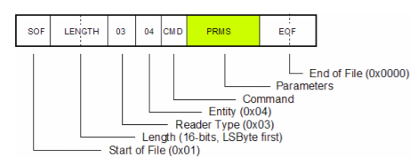
ISO15693
Notes:
Zeek

Slide 30
Storage
Reads values from sensor until buffer is full
Phone sends read command for each block
Phone sends write command to config block
Notes:
Zeek

Slide 31
Software: Sensing System
Programmed in Android Studio
Take data from RF430
Plot values on a line graph
Display average temperature recorded
Notes:
Zeek

Slide 32
Software: Android App
AndroidManifest.xml
Send NFC action tag discovered to Main Activity
Enable NFC permissions
MainActivity
Send ISO15693 commands and display values
Notes:
Zeek

Slide 33
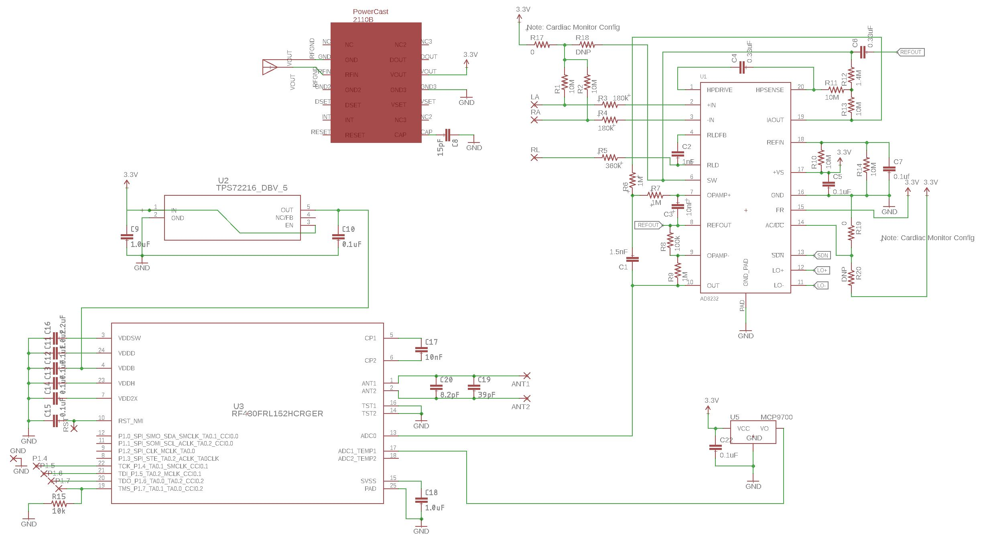
Schematic
Cell signals
received
& harvested
Voltage dropped from 3.4V to 1.5V (buck)
RF Energy Harvesting
Power Monitoring
User Communication
Heartrate Sensor
Temperature
Sensor
Data read by microcontroller
Notes:
Cam

Slide 34
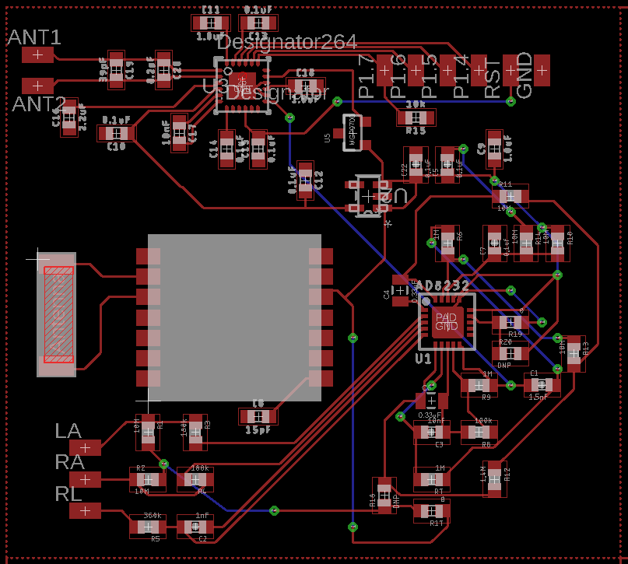
Dimensions:
1.2” by 1.8”
Notes:
Cam

Slide 35
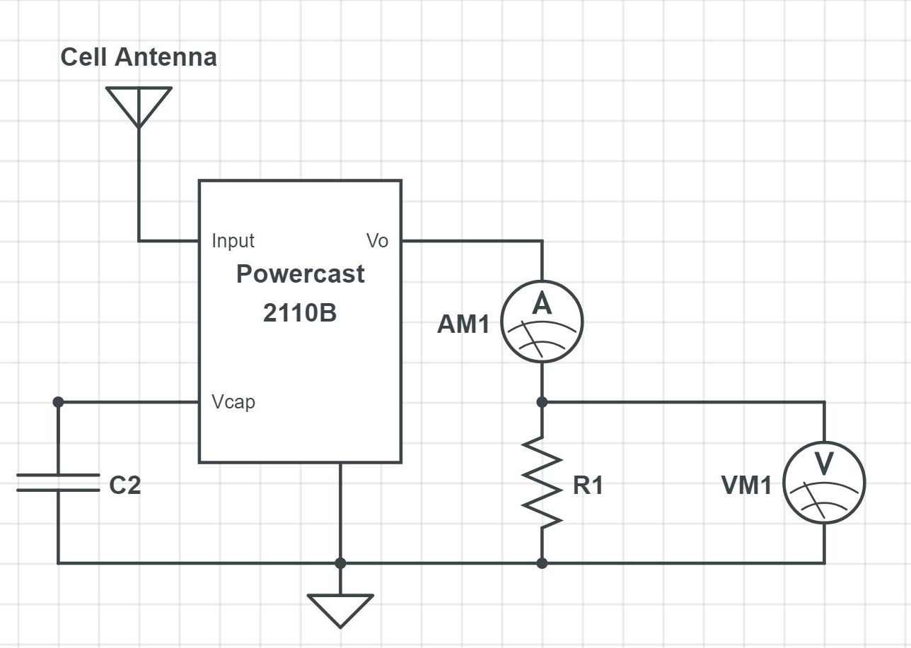
Prototyping
Goals:
Prove concept
Generate ~3V
Determine C2
Expected Behavior & Performance
Antenna
Powercast
Timing
Capacitor
Notes:
Cam

Slide 36
Prototyping Test Results
Results
~3mW peak
<1% of source harvested
Notes:
Cam

Slide 37
Administration
Notes:
Joe

Slide 38
Work Distribution
HARDWARE SOFTWARE
Joe Sleppy
PCB Design
Energy Harvesting
Zeke Rosenbluth
Monitoring
NFC
John Foster
Energy Storage
Hardware Software Integration
Notes:
Joe

Slide 39
Budget
Component | Cost per unit | Total Cost
Components | $800 | $700
PCB Fabrication | $700 (first attempt) $60 (second attempt) | $760
Equipment | $100 | $200
Development Board & Transmitter | $150 | $150
Misc. | $300 | $300
Total Cost |  | $2,110
Notes:
Joe need updating

Slide 40
Progress
Notes:
joe

Slide 41
Future Work Section
Antenna selection and circuit implementation improvement & optimization
Reduction in size
Investigation of sound waves and other alternative sources vs RF signals
Notes:
joe

Slide 42
Questions?
Notes:
joe

