Slide 1
Energy Harvesting
Power Delivery
Antenna & Conditioning
Alternative Source
Collects and conditions RF signals
Manages Solar
& Thermoelectric source
Converts RF signals to power
via Powercast IC
Controls, monitors, and delivers power to insulin pump

Slide 2
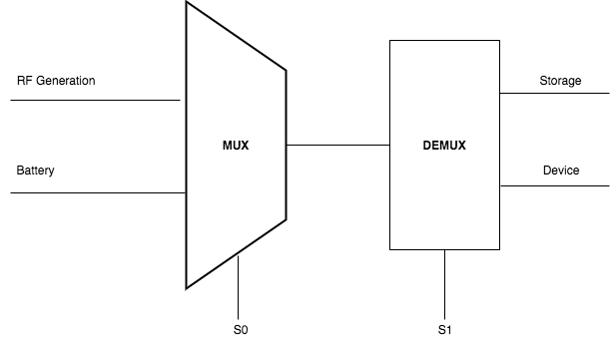
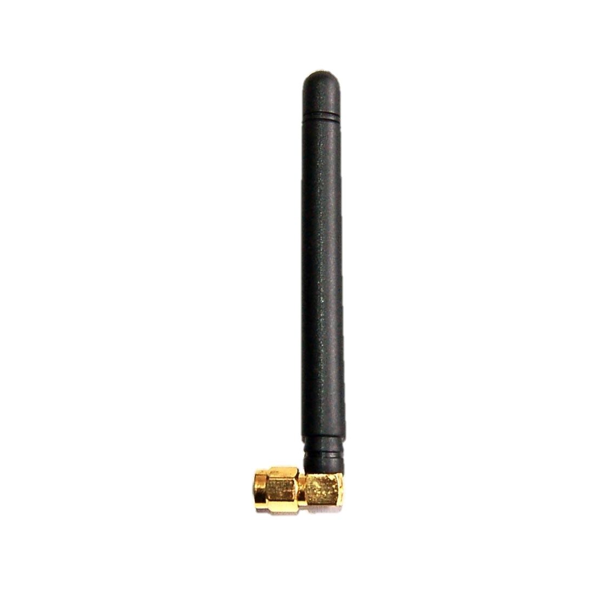
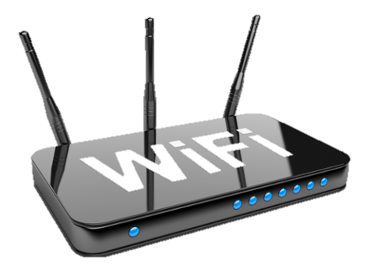
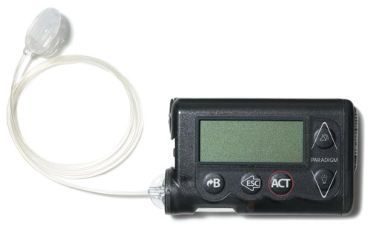

1) RF Signal Sources
2) Signals Received to belt
3) Signals Conditioned
4) Energy Harvested
5) Power Conditioned
Powercast IC
Power Controls
Rectifier Noise → DC
Solar or Thermo-
electric Backup Energy Source
Power Monitor
Combine Signals
Modulate to 900Mhz

Slide 3
Energy Sources
Signal Conditioning
Solar or Thermo-
electric Backup Energy Source
Load Conditioning
Cellular Receiving Signals (-90dbm)
50 Ω antenna;
0.158m Cu wire
Rectifier
Diode + Capacitor (nF)
DC Voltage Combination
Storage
Solar
Source/Load Impedance Controller
Frequency Modulation IC to 900Mhz
RF Energy
Cellular Transmit Signals (36dbm)
50 Ω antenna;
0.158m Cu wire
Rectifier
Diode + Capacitor (nF)
Control Voltage w/ output Resistor
Wifi Signal Receiving (-60dbm)
50 Ω antenna;
0.059m Cu wire
Rectifier
Diode + Capacitor (nF)
Microprocessor Controller
Mobile App NFC Monitor
Power Regu-lator
Energy Harvesting - PowerCast IC
5V Insulin Pump (load)
Hardwire Connection
Power Monitor

