Slide 1
Active Component Learning Aid (A.C.L.A)
UCF Senior Design Team Spring 2018
Group 12:
Inalvis Alvarez-EE
Justin Berte-EE
Richard Bielski-CpE
Zachary Freer-CpE
Advisor: Dr. Chan

Slide 2
Goals & Objective
Create a user interactive simulation of active electronic components using water flow as an analogy to electric current.
Serve as a learning aid for students who are newly introduced to circuit theory.
Facilitate visualization and understanding of electrical components.
Notes:
Inalvis

Slide 3
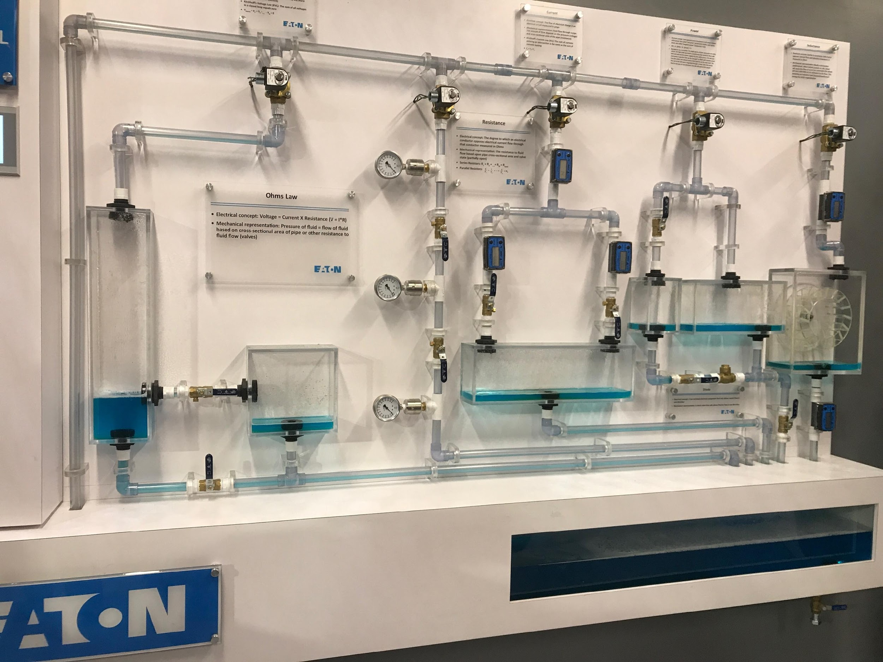
Inspiration and Motivation
Eaton Experience Center has a similar system demonstrating resistor, capacitor, KVL, KCL, and inductor.
Notes:
Inalvis

Slide 4
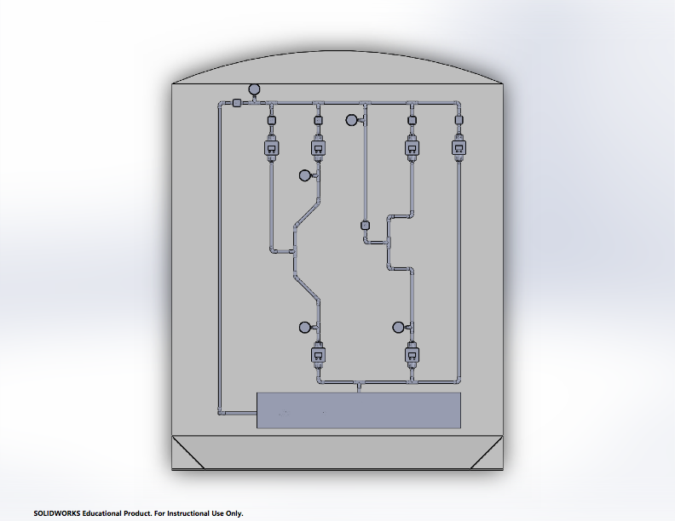
Features
Circuit representations:
Diode
BJT
MOSFET
Interactive dashboard
Motorized valves
LEDs to demonstrate current flow.
Measurements
Electrical Equations
Notes:
Inalvis
Nema 1.26Nm Stepper Motor used to control valve openings to represent resistor, diodes, and control voltages
Pressure transducers used to measure and correlate water pressure to voltage
LEDs along the pipes to demonstrate current flow
Touchscreen displays GUI for user to select what component to operate as well as displays the pressures at various points in the systems.
Raspberry Pi and microcontroller for system control

Slide 5
Specifications
Parameter | Design Specification
Power Consumption | Less Than 400 Watts
Latency | Less Than 75 ms
Max Pressure | Less Than 15 psi
Setup Time | Less Than 10 minutes
GUI Size | Less Than 250 MB
Total Size | Less Than 8’ x 7’ x 1’
Notes:
Inalvis

Slide 6
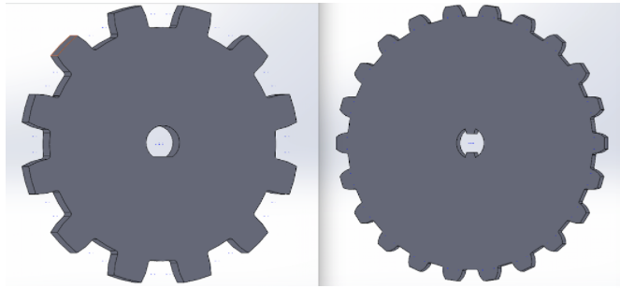
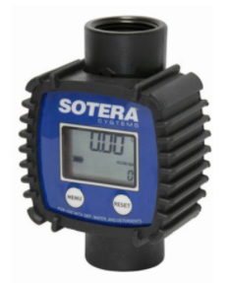
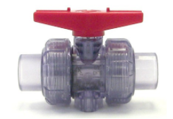
Physical System
Clear PVC pipe and joints
Clear low torque ball valve for easy control using stepper motors
Gears made to increase torque and turn valves
Flowmeter used to measure current flow
¼ HP water pump to be able to obtain the necessary pressure throughout the system
Notes:
Inalvis

Slide 7
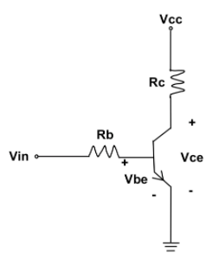
Circuit Representation
Vcc and Vin are set by the user and valves are adjusted accordingly
Rc and Rb are set by the user through the GUI
Mode of operation depends on Vce voltage and is regulated by utilizing the valves
Notes:
Inalvis: FA and saturation modes based on Vce value

Slide 8
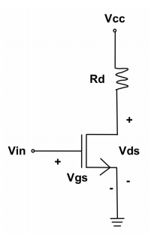
Circuit Representation
Voltages Vcc and Vin controlled by valves and input by the user
Vds is measured by using the transducers, the pressure will be manipulated based on the MOSFET mode of operation
Rd will be input by the user
Notes:
Inalvis: saturation or triode mode depending on value of vds

Slide 9
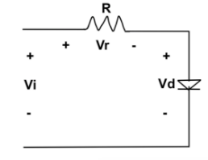
Circuit Representation
Vin and R are both set by the user
Vd is maintained at a constant value by varying the opening of the valve.
Notes:
Inalvis

Slide 10
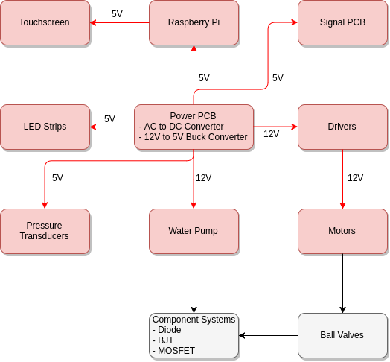
Hardware Block Diagram
Notes:
Justin

Slide 11
Hardware Block Diagram
Notes:
Justin

Slide 12
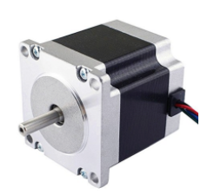
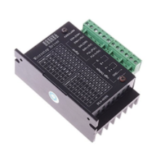
Motor and Driver
Motor
NEMA 23 Bipolar Stepper Motor
Degree of precision: 1.8
Maximum current: 2.8A
Torque: 1.26Nm. Torque was increased by using gear teeth ratio of 1.25.
Driver Voltage: 12V
SMAKN® TB6600
DIR: High/Low set direction of rotation CW/CCW
EN: High/Low to turn off/on motor
PUL: Pulse signal to allow rotation
Notes:
Justin

Slide 13
Hardware Block Diagram
Notes:
Justin

Slide 14
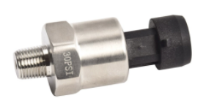
Pressure Transducers
Eyourlife Universal 30PSI
5V DC input voltage
Converts PSI into an analog voltage
PSI range: 0-15 PSI
Overall application accuracy of 3%
Applied Air Pressure | Measured Output Voltage
0 PSI | 0.46 V
3 PSI | 0.86 V
4 PSI | 1.01 V
5 PSI | 1.22 V
6 PSI | 1.31 V
7 PSI | 1.40 V
8 PSI | 1.49 V
Notes:
Justin

Slide 15
Hardware Block Diagram
Notes:
Justin

Slide 16
Power Distribution
Voltage Rail (Volts) | Component | Current Draw (Amps) | Quantity | Total Current Draw (Amps) | Total Power Draw (Watts)
5 | Pressure Transducers | 0.00167 | 12 | 0.02 | 0.1
 | Signal PCB | 1 | 1 | 1 | 5
 | Raspberry PI | 2.5 | 1 | 2.5 | 12.5
 | LED Strips | 1.8 | 3 | 5.4 | 27
12 | Stepper Motor Drivers | 1.4 | 6 | 8.4 | 100.8
Notes:
Justin

Slide 17
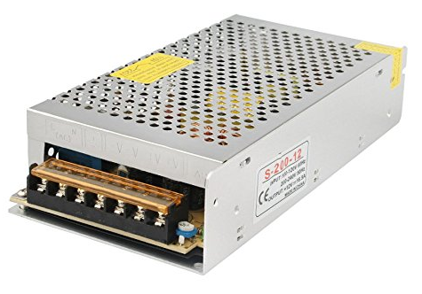
AC to DC Converter
12 Volt rail current draw is roughly 9A, which corresponds to a power draw of approximately 110 Watts.
5 Volt rail current draw is approximately 9.5A, which corresponds to a power draw of 47.5 Watts.
Maximum total power draw of system is approximately 157.5 Watts, therefore the AC to DC converter chosen was the GALYGG 12 volt 200 Watt switching power supply.
https://www.amazon.com/dp/B06XRBN2L3/ref=twister_B0753BTC3Z?_encoding=UTF8&psc=1
Notes:
Justin

Slide 18
Switching Regulator
Regulator | BOM Count | Efficiency at 9A | Cost (Dollars)
TPS40305 | 19 | 95.13% | $2.27
LM2743 | 23 | 96.94% | $2.49
LM27402 | 26 | 95.39% | $3.08
Due to low component count as well as low cost per chip, the TPS40305 high power switching regulator was chosen even with its slightly lower efficiency at 9 amps.
Notes:
Justin

Slide 19
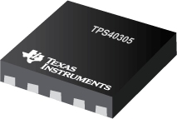
TPS40305
Parameter | Value
Output Voltage | 5 V
Input Voltage | 5.1-20 V
Maximum Output Current | 25 A
Switching Frequency | 1.2 MHz
Notes:
Justin

Slide 20
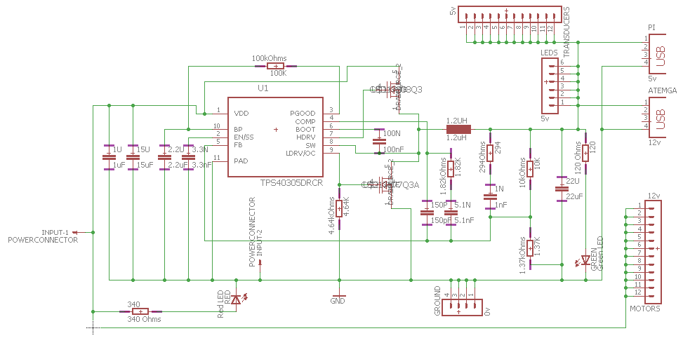
Power PCB Schematic
Notes:
Justin

Slide 21
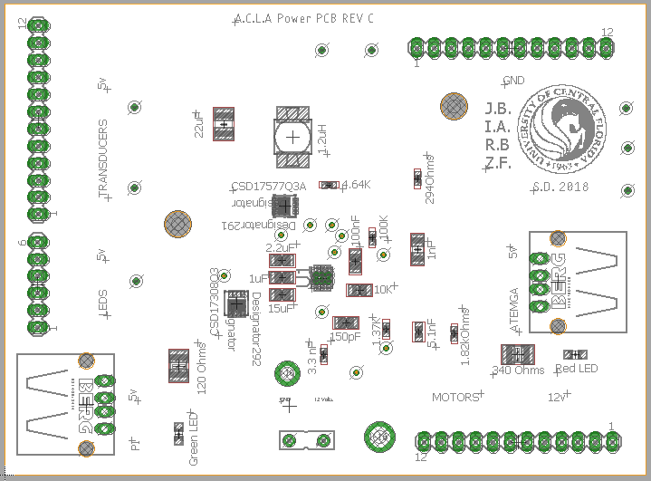
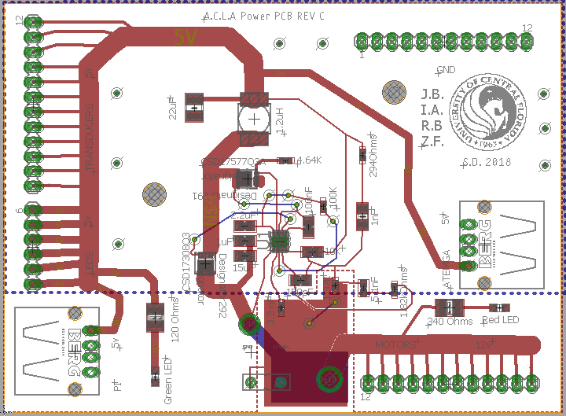
Power PCB Layout
Notes:
Justin

Slide 22
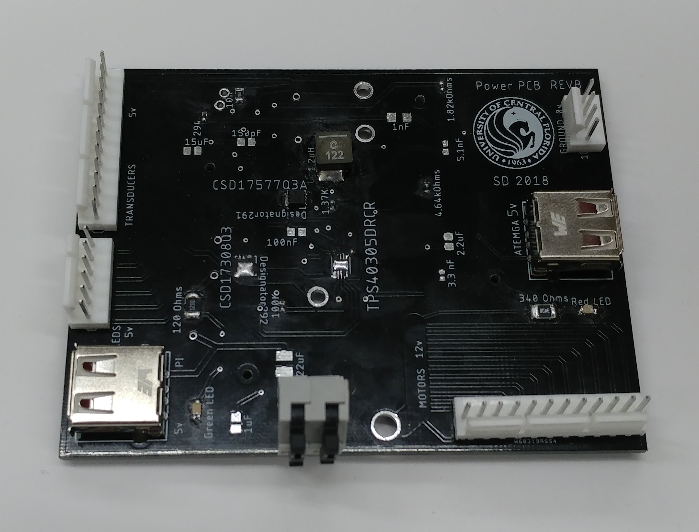
Power PCB
Notes:
Justin

Slide 23
Hardware Block Diagram
Notes:
Justin

Slide 24
Microcontroller Functions
The ATmega2560 is responsible for all interaction with other hardware devices.
Drivers
Control stepper motors
Transducers
Read analog voltages
LEDs
Assist flow visualization
Pump
Enabling / Disabling
Raspberry Pi 3
I²C user input from Pi
 | Digital I/O | PWM | Analog Input
MSP430G2 | 32 | 3 | 12
ATSAMD21G18 | 24 | 20 | 14
ATmega328P | 23 | 6 | 8
ATmega2560 | 86 | 16 | 16
Notes:
Zac
msp430: http://www.ti.com/product/MSP430G2553/compare
atmega328: http://ww1.microchip.com/downloads/en/DeviceDoc/Atmel-42735-8-bit-AVR-Microcontroller-ATmega328-328P_Summary.pdf
SAMD21: https://www.microchip.com/wwwproducts/en/ATSAMD21G18
mega2560: http://ww1.microchip.com/downloads/en/DeviceDoc/Atmel-2549-8-bit-AVR-Microcontroller-ATmega640-1280-1281-2560-2561_Summary.pdf
COrtex a8: http://www.ti.com/lit/ds/symlink/am3358.pdf

Slide 25
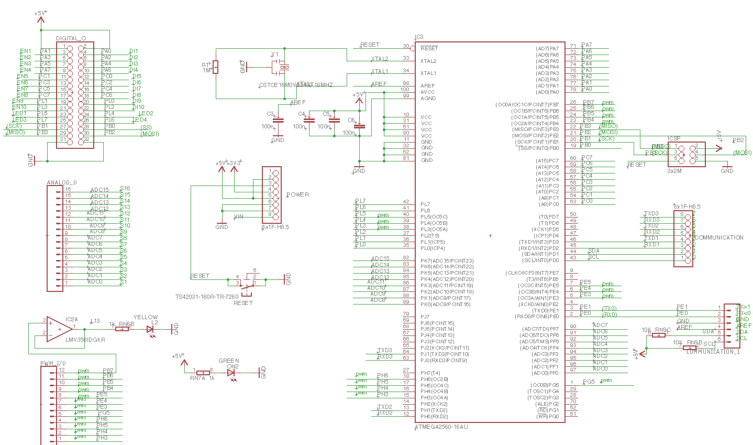
Signal PCB Schematic
Notes:
Inalvis

Slide 26
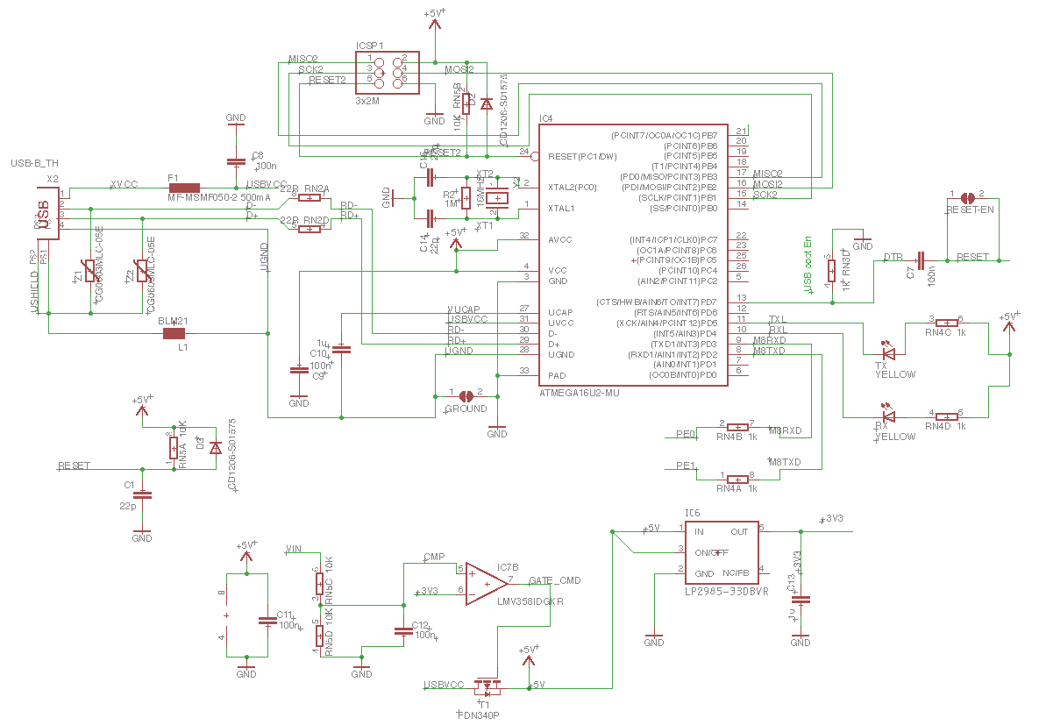
Signal PCB Schematic
Notes:
Inalvis

Slide 27
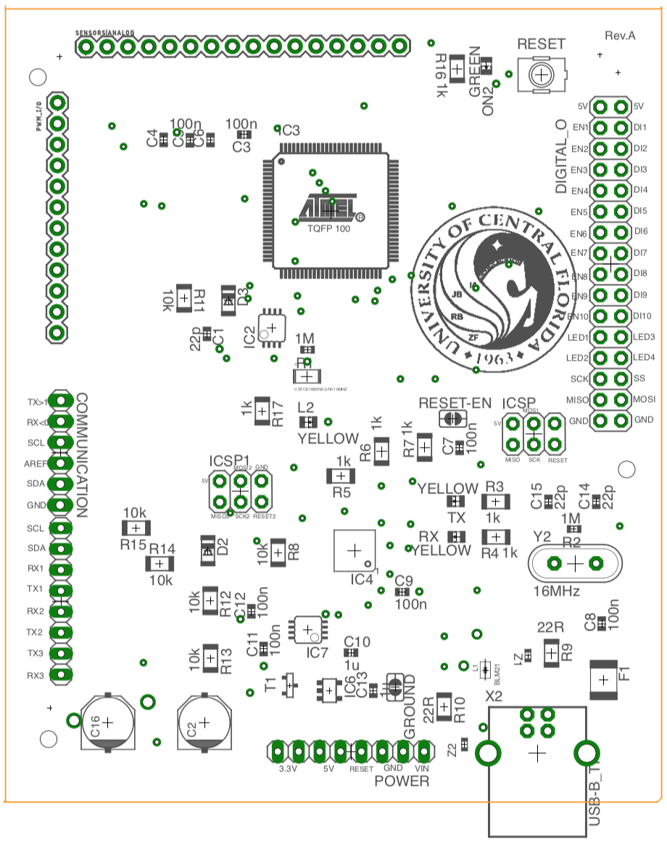
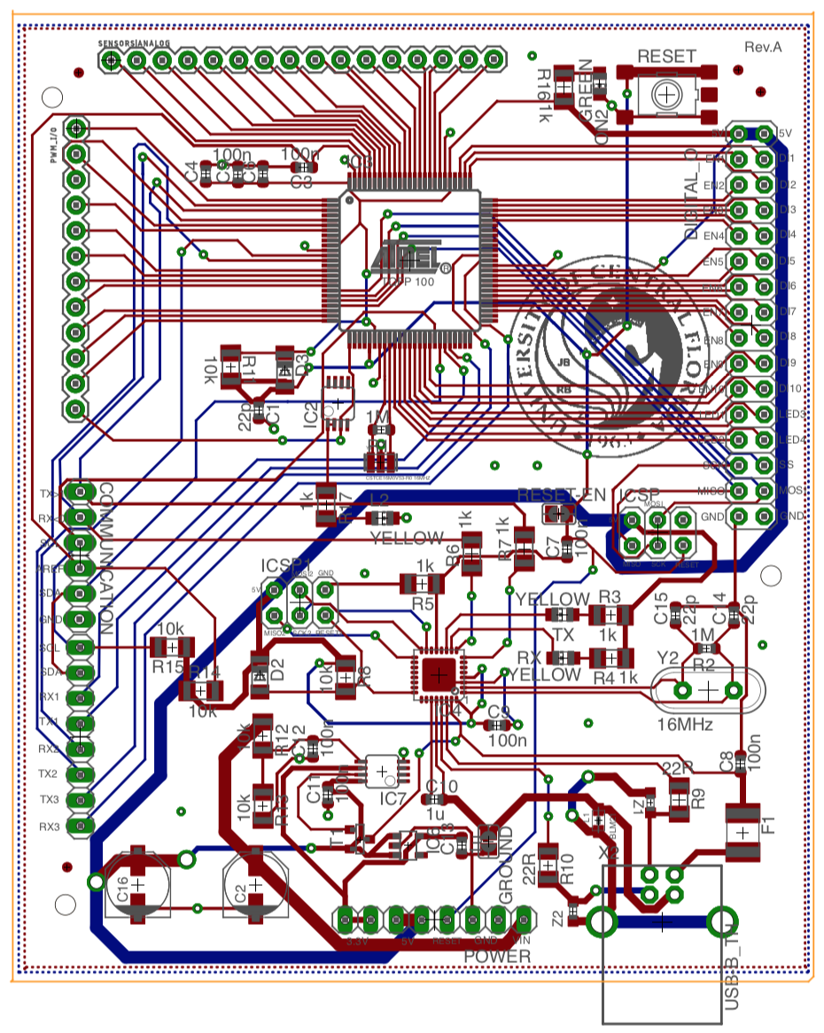
Signal PCB
Notes:
Inalvis: Insert PCB

Slide 28
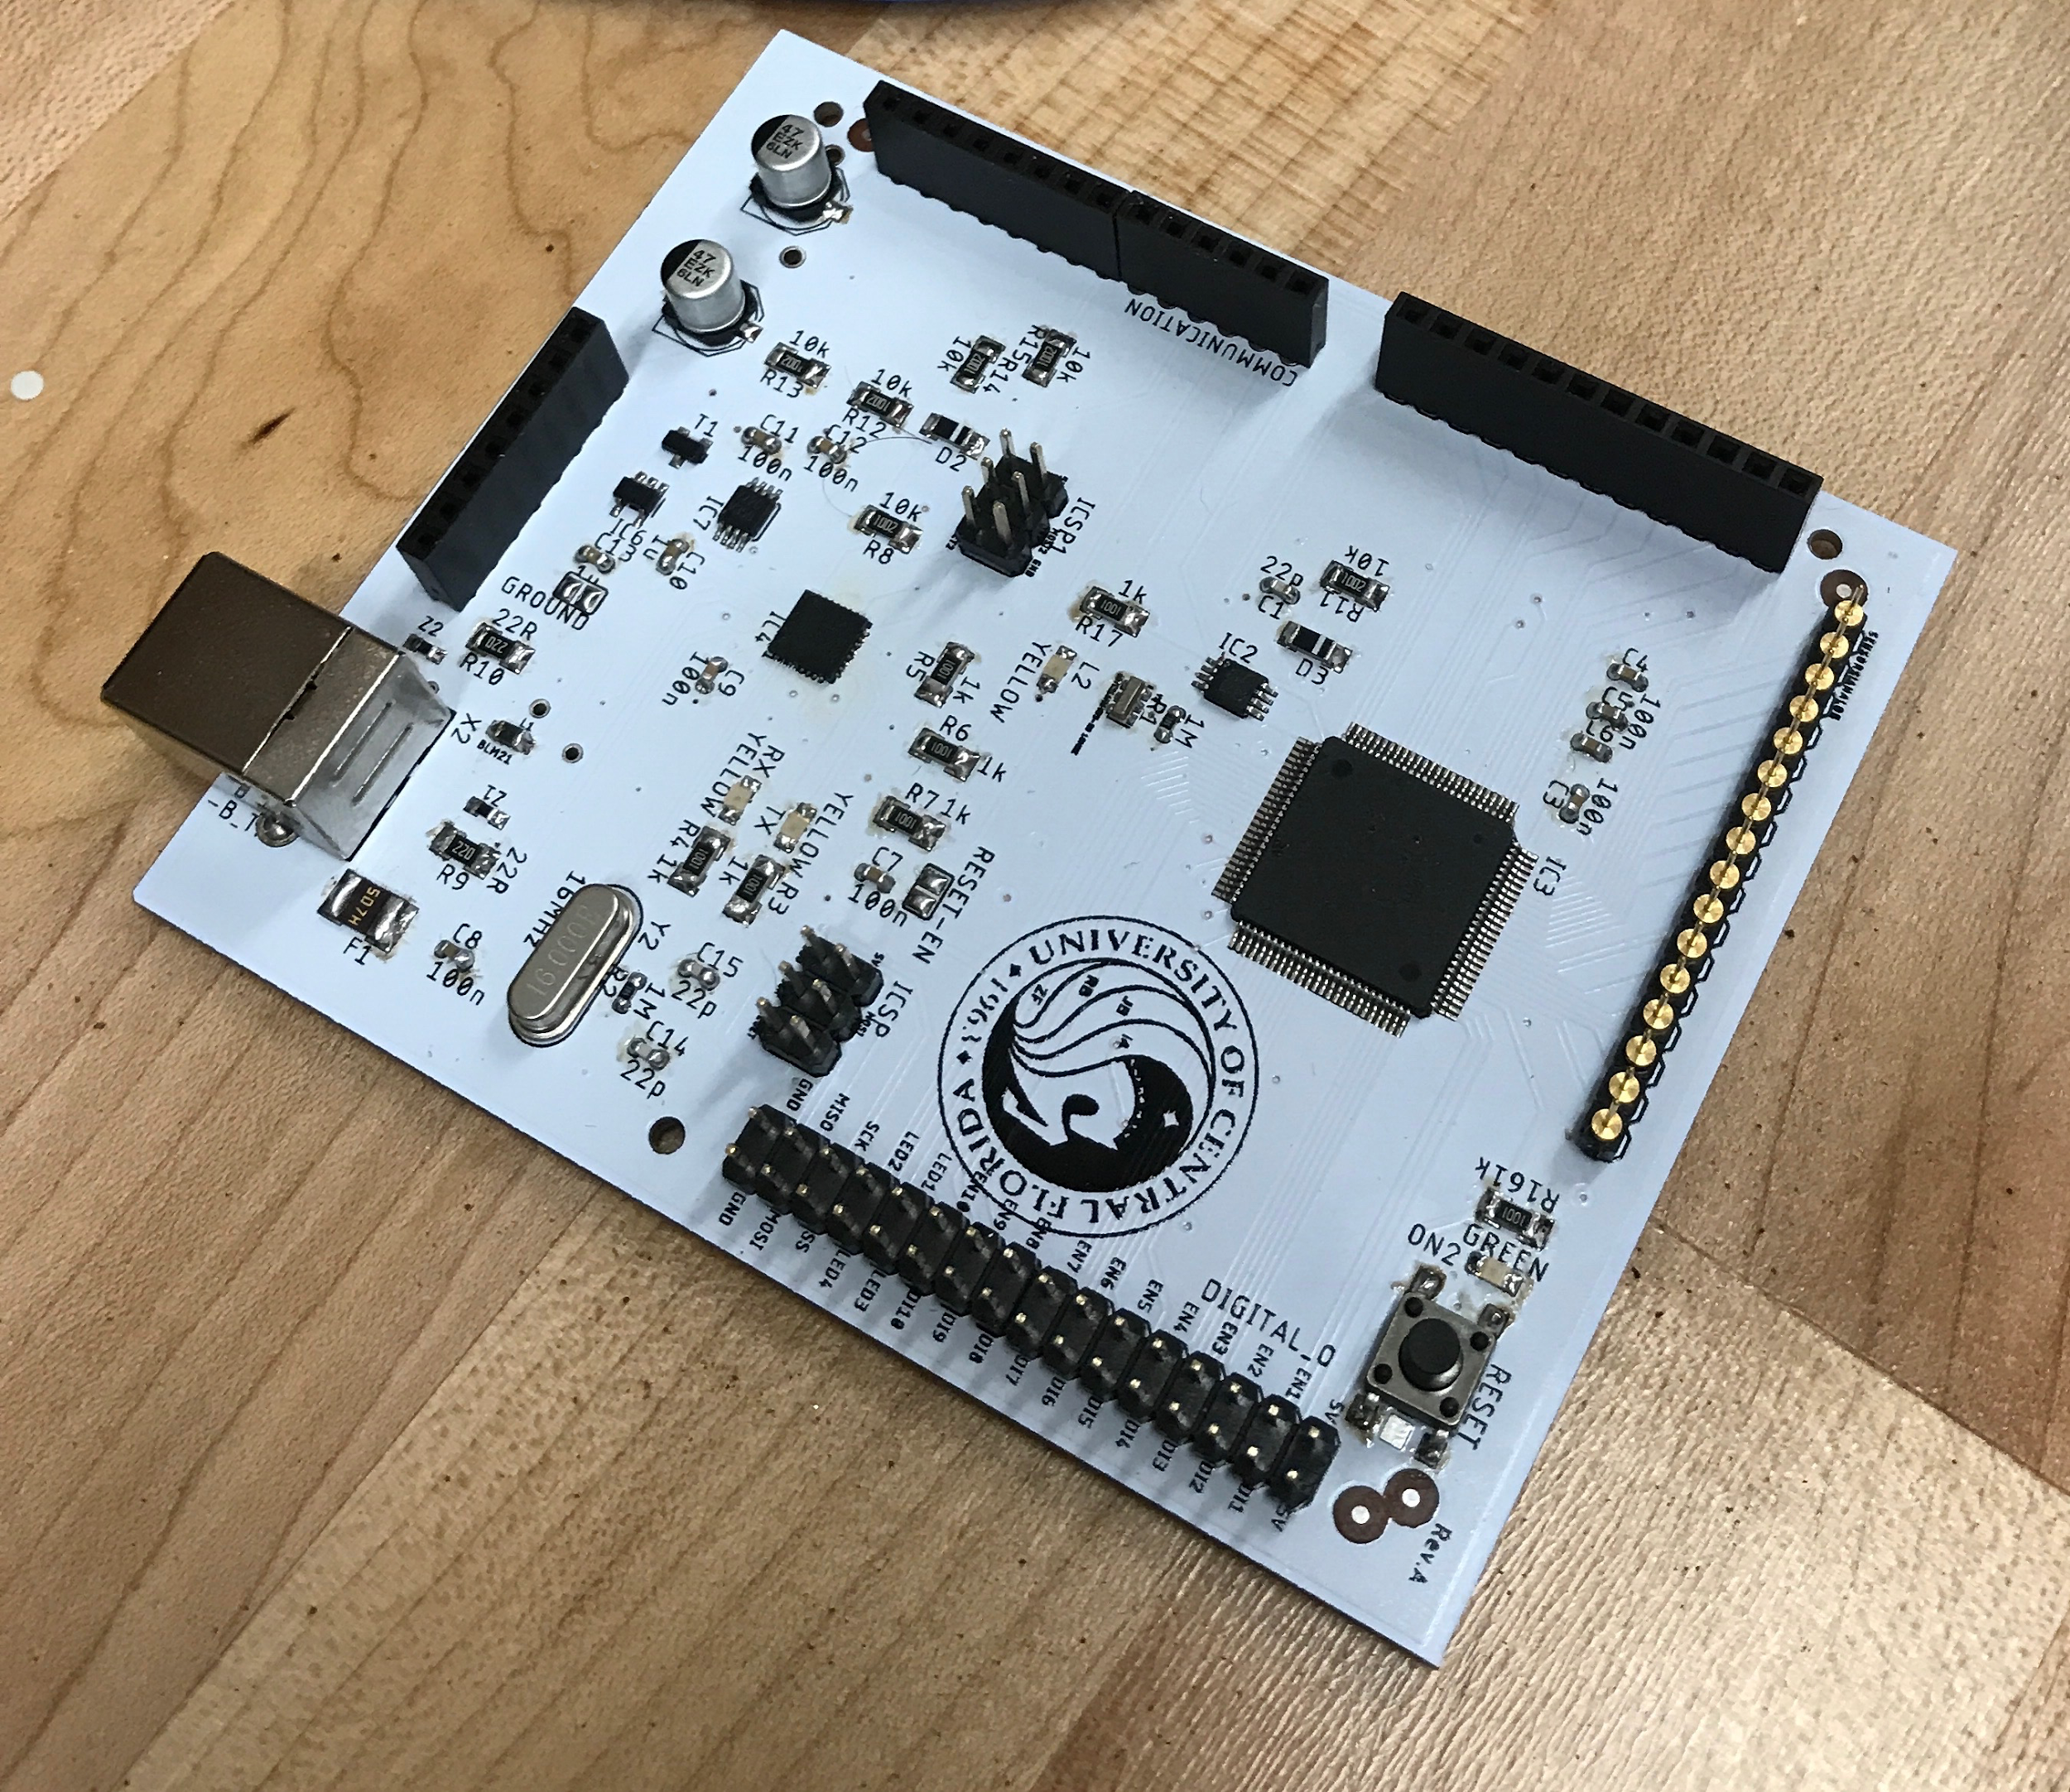
Signal PCB
Notes:
Inalvis:

Slide 29
Hardware Block Diagram
Notes:
Zac

Slide 30
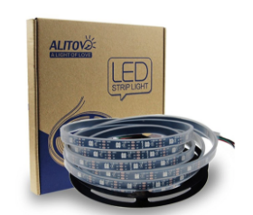
Alitove LEDs
RGB 150 pixels
Individually addressable LEDs
Waterproof
5V DC supplied by Power PCB
Data controlled by Signal PCB
Notes:
Zac
Amazon choice

Slide 31
Hardware Block Diagram
Notes:
Zac

Slide 32
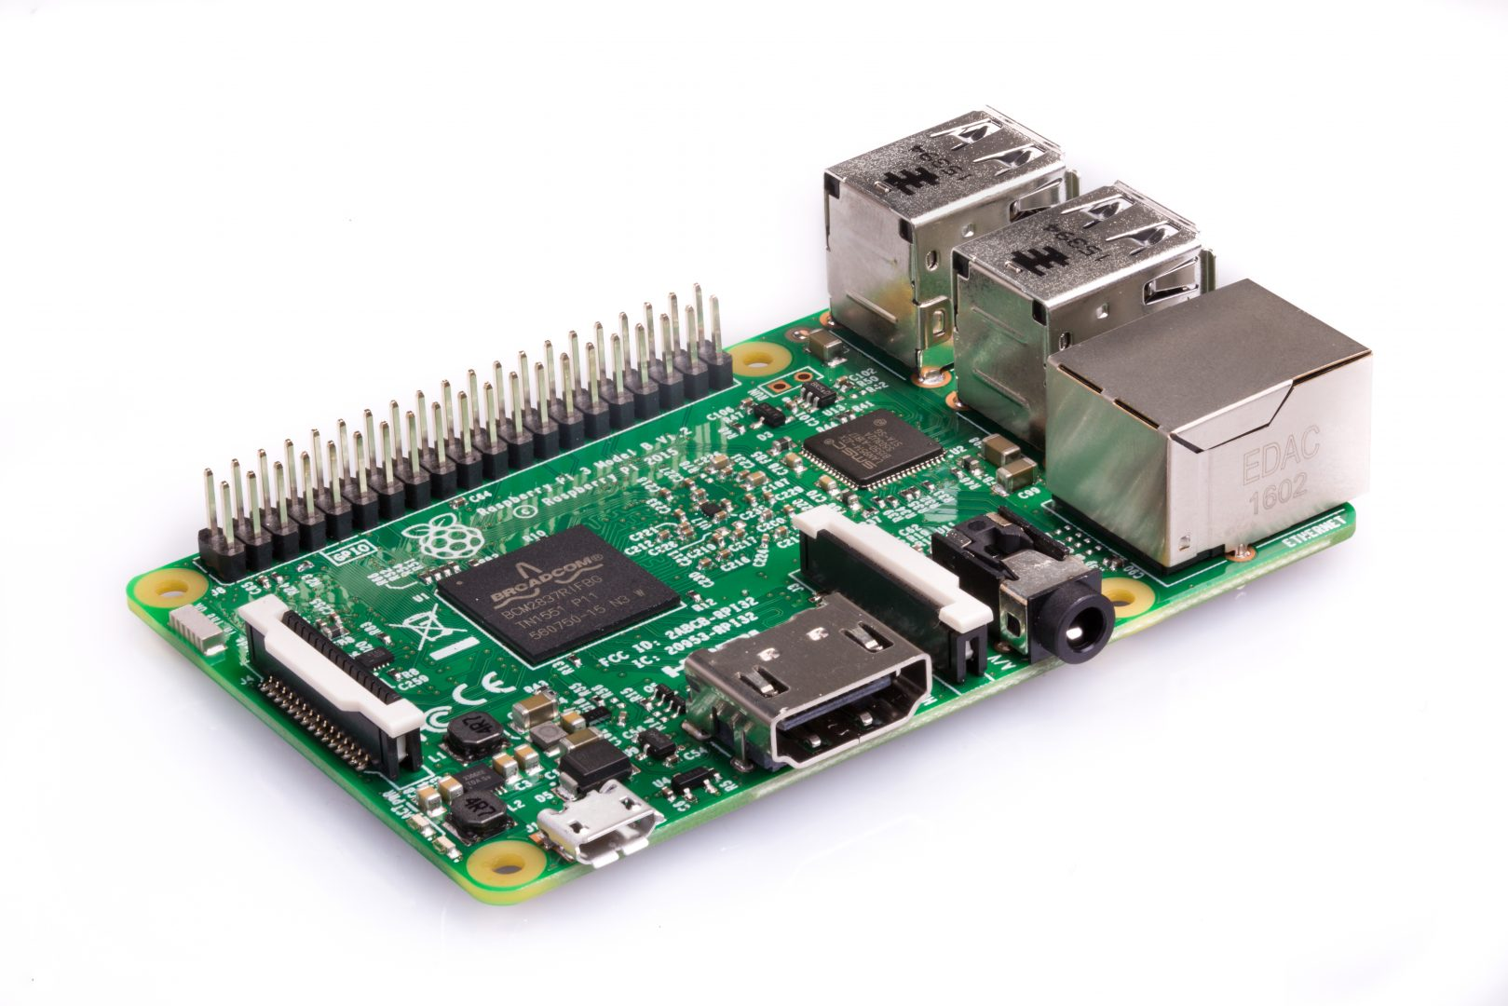
Raspberry Pi 3
Operating System
Linux distribution Raspbian
Data analysis
Understanding sensor values
Stores data for implementation
User interface
Touch Screen friendly
Remote desktop service compatible
Communication with the Signal PCB
Notes:
Zac

Slide 33
Hardware Block Diagram
Notes:
Justin

Slide 34
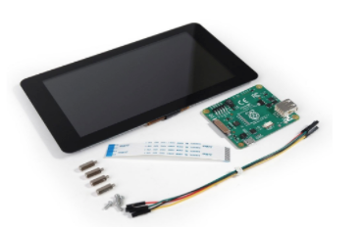
Touchscreen
Technology
Capacitive not Resistive
Connection
DSI Port and 2 pins needed
Simplicity
No additional hardware or software required
Size
7 Inch screen - consumed minimal space on our display board
Notes:
Zac

Slide 35
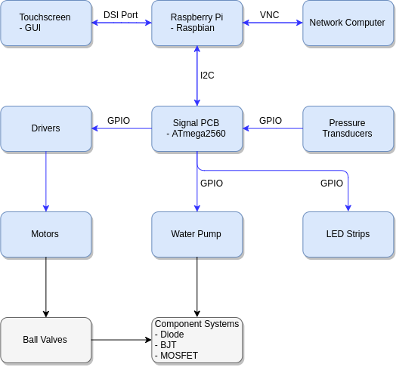
Software Block Diagram
Notes:
Richard

Slide 36
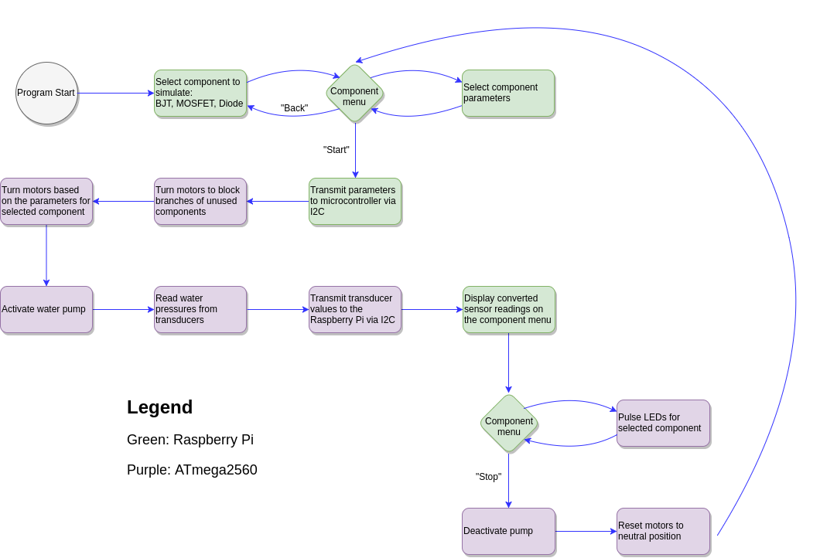
Software Flowchart
Notes:
Richard

Slide 37
Software Block Diagram
Notes:
Richard

Slide 38
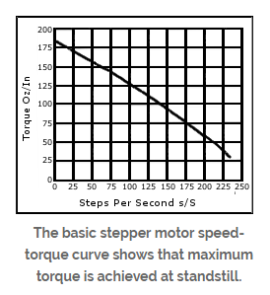
Microcontroller Programming
Pump
On and Off function
LEDs
Adafruit_NeoPixel library
Drivers/Motor
Step rotation ratio
Torque and steps correlation
Transducer
Analog Inputs
Pi
Communication
Notes:
Richard

Slide 39
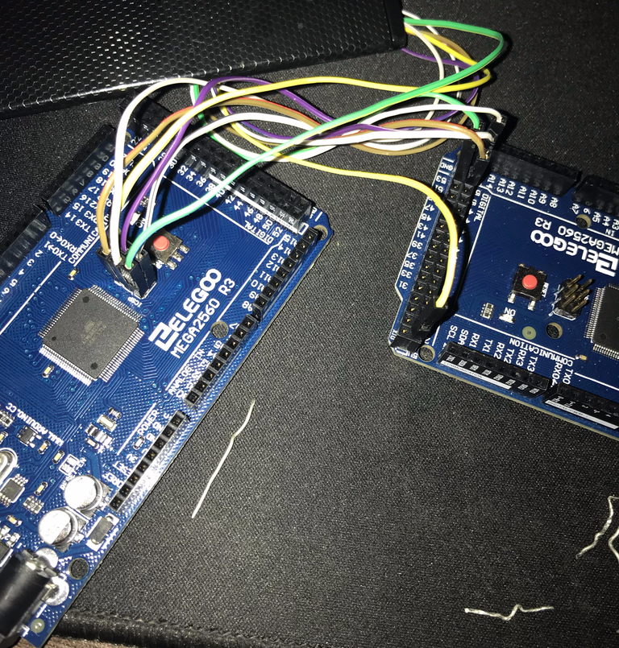
Software Development
In-circuit serial programming
Master Left
Arduino ISP
Slave Right
Connection :
5V, Ground, MISO, MOSI, SCK, and Reset pins
Notes:
Richard
5V, Ground, MISO, MOSI, SCK, and Reset pins. arduino isp

Slide 40
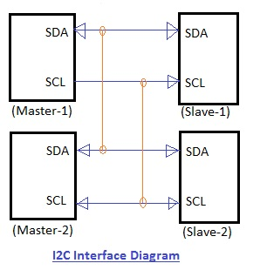
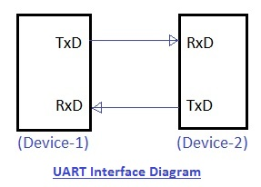
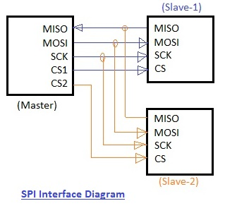
Communication
SPI has a faster data rate, but speed wasn’t a concern
SPI supports full duplex (unnecessary) where as I²C is half duplex
I²C requires fewer wires (GPIO usage was a constraint)
I²C offers the simplest flexibility (less wires and multiple masters)
Notes:
Zac

Slide 41
Software Block Diagram
Notes:
Zac

Slide 42
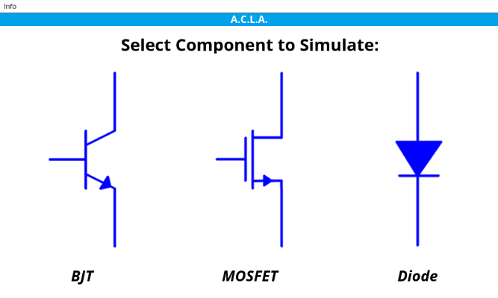
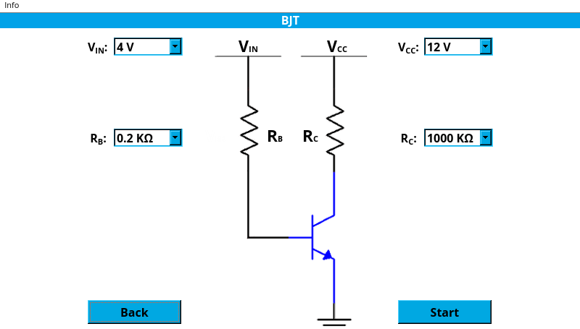
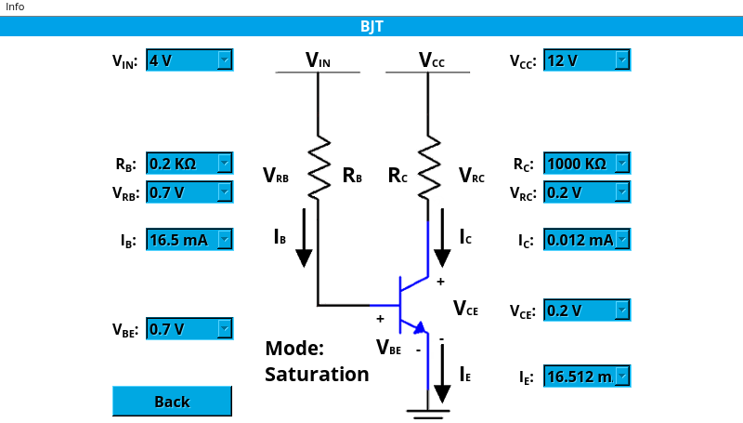
User Interface
PyQt5: Python bindings of the C++ Qt framework
Qt Designer: Development tool
Personal experience with Qt and its tools made it more appealing over TkInter
Notes:
Zac
Change Images

Slide 43
Software Block Diagram
Notes:
Richard

Slide 44
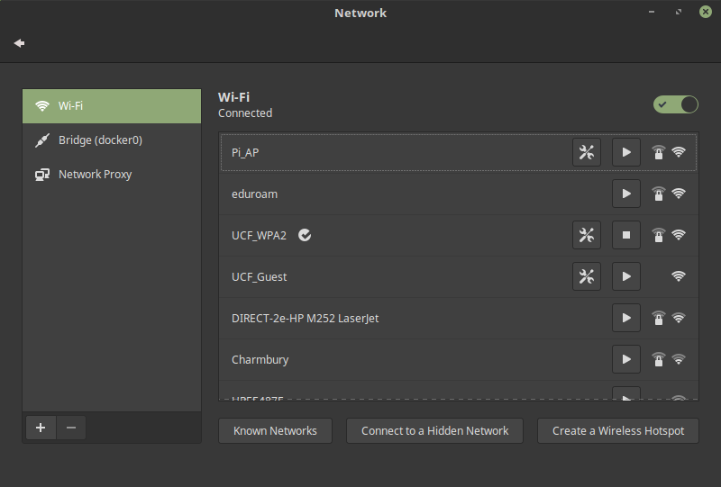
Ad Hoc Network
Motivation
Tools
Hostapd
Udhcpd
Network Standards
WPA2
802.11n
2.4 GHz
Notes:
Richard

Slide 45
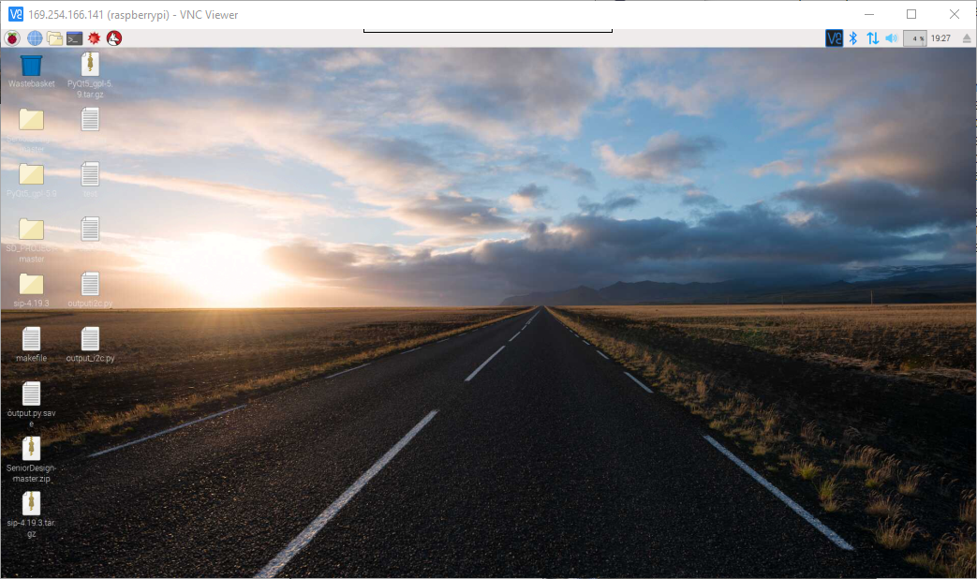
Remote Desktop Connection
Motivation
Ability for an audience to follow what is happening on the user interface
RealVNC
Server on Pi
Client on User’s device
Notes:
Richard

Slide 46
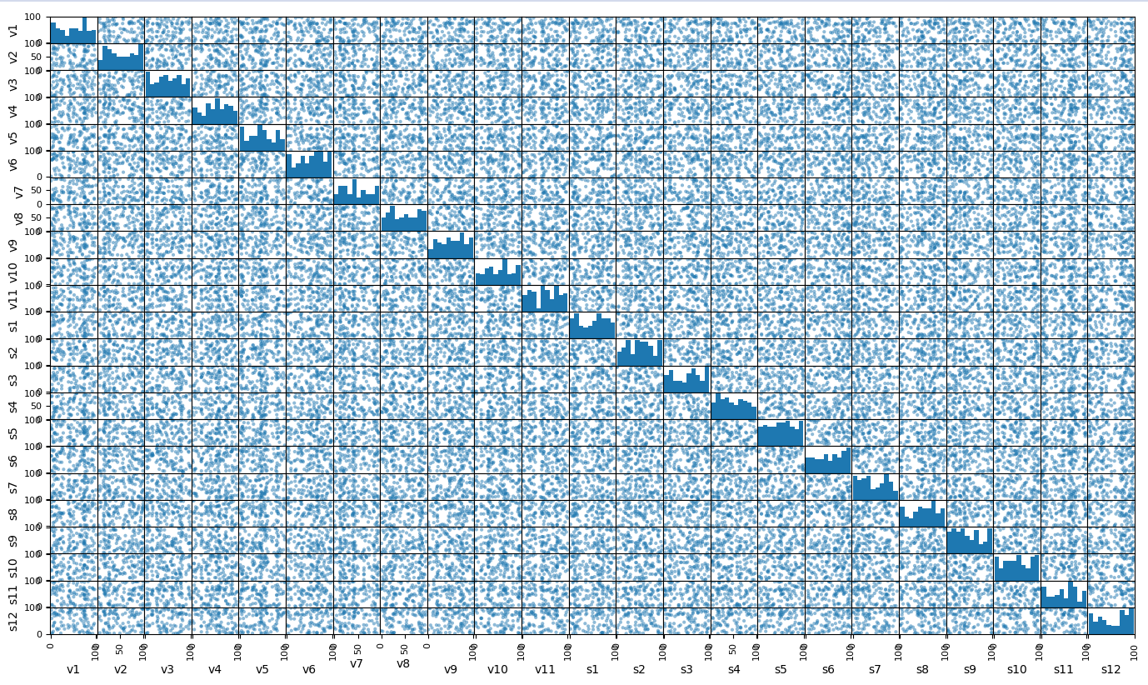
Machine Learning
Machine Learning
Supervised Learning
Gathering Data
0-80 degrees 10 degree increments
Libraries
pandas
matplotlib
sklearn
Notes:
Richard

Slide 47
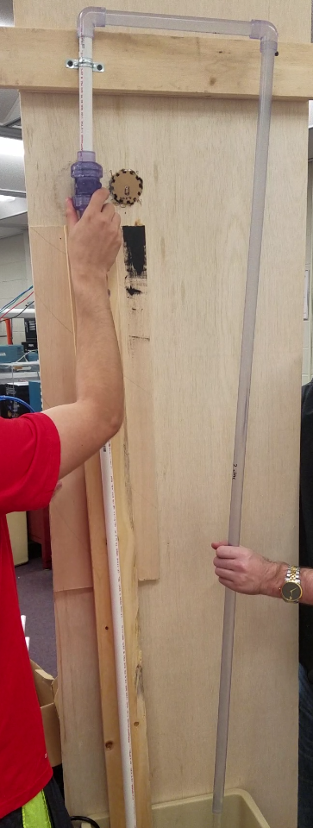
Prototyping
Stepper Motor Prototype
Mount
Motor: Mounted through the back of the board exactly as in the future system
PVC: Mounted using metal brackets similar to the acrylic supports in the future system
Wiring
Motor Driver powered by a power supply to simulate PCB
Microcontroller Powered by a laptop to simulate Pi connection
Code
Basic step from 0 to 80 degrees and return to 0 (Looped)
Result
Valve was successfully turned reasonably quick and accurately with water flowing through the system.
Notes:
Richard

Slide 48
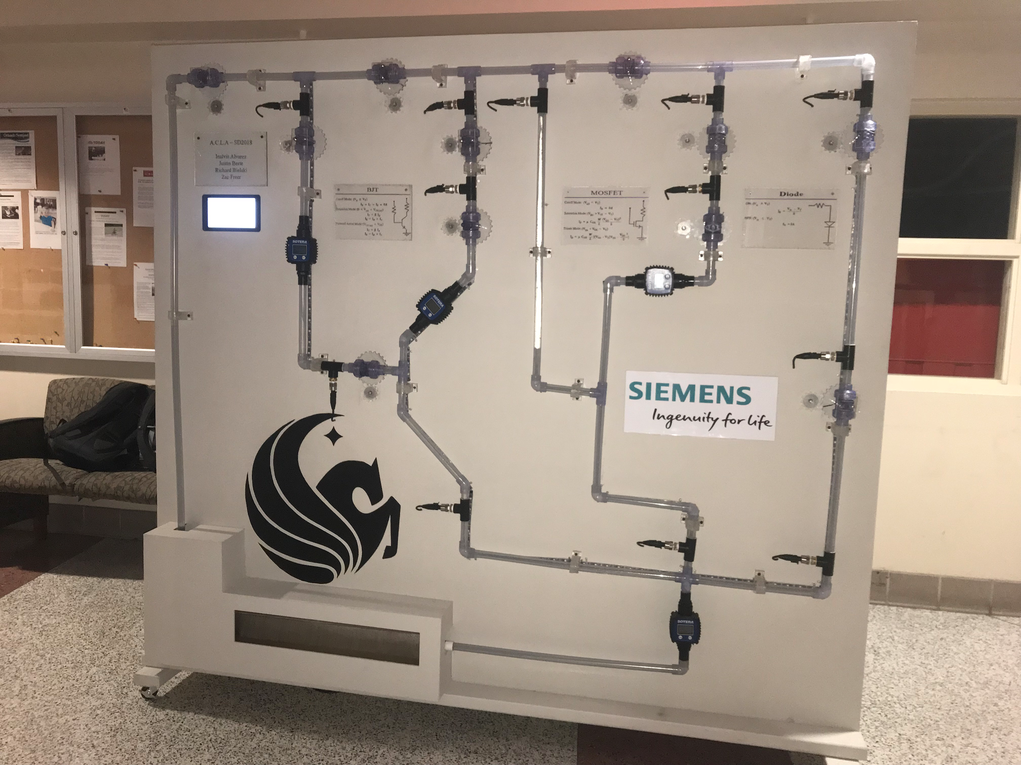
Final Product

Slide 49
Issues
Water leakage
Gear Accuracy
Backflow of water when system is turned off
Transducers Accuracy
Minimal Alterations caused issues to Machine Learning
Replacing transducers
Understanding of fluid dynamics
Turbulent Flow
Notes:
Richard

Slide 50
Work Distribution
Tasking | Inalvis | Justin | Richard | Zac
Power Distribution | Secondary | Primary
Signal | Primary | Secondary
User Interface Development |  |  | Secondary | Primary
Communication Programing |  |  | Secondary | Primary
Driver/Motor Programing |  |  | Primary | Secondary
Transducer Programing |  |  | Primary | Secondary
Hardware Prototyping | Primary | Primary | Secondary | Secondary
Construction | Collaborative
Administrative Work | Primary
Notes:
Zac

Slide 51
Collaboration
IEEE PES:
KVL, KCL, Capacitor and Inductor
Interactive dashboard
Manual system control
Senior Design Team:
BJT, MOSFET, and Diode
Interactive dashboard
Hands-free system control
Notes:
Zac

Slide 52
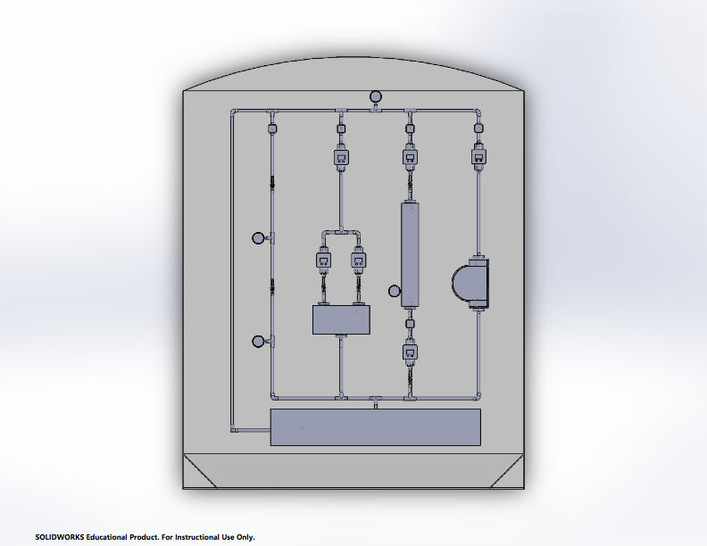
SD Team vs. PES
Notes:
Zac

Slide 53
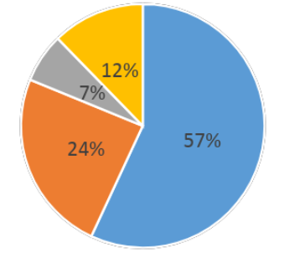
Sponsorship
Item | Total | Item | Total
Clear PVC related expenses | $448 | Raspberry Pi 3 | $111
Clear Ball Valves | $204 | Raspberry Pi Touchscreen Display | $70
1/2" NPT Polypropylene Bulkhead Fitting w/ NBR Gasket | $12 | Flowmeters | $324
PVC adapters | $57 | NEMa 23 CNC Stepper Motor | $286
1/4 HP Water Pump | $90 | Motor Drivers | $165
Acrylic Sheet | $200 | Pressure sensors | $306
Alitove 16.4' LED Strip | $81 | Stepper Motor Supports | $132
Prototyping Materials (cables, bread boards, etc) | $24 | PCB related expenses | $200
ATMega 2560 | $12 | Building Expenses | $200
Total Spent |  |  | $2,922
Mechanical System
Electrical System
Mounting
Misc.
Notes:
Zac

Slide 54
Questions?
Notes:
Zac

