Slide 1
Laser Skeet
Group 8
Kevin Ratliff
Sean Brown
Clayton O’Rourke
Alexander Spencer

Slide 2
Motivation
Create a system design that incorporates the different disciplines and practices of Electrical, Photonic, and Computer engineering.
Utilization of RF, IR, Power Systems, Programming and Innovation.
Remove hazards from this firearm sport.
Provide a safe countermeasure and alternative to combustive ammunitions, target practice, and ammunition pollution.
Create a Electronic Version of the sport which enables users to practice in safe public environments, reduce the amount of litter caused by target rounds

Slide 3
Goals & Objectives
Hardware – Design and implement two separate PCBS that can communicate on a 2-channel communication system via IR transmission detection and then RF transmission and detection
Software – Relay and control data acquired between the PCBs communication systems via PWM matching and frequency detection.
User Interface – Design a simple structure to operate the two separate devices.
Power Supply – Utilize a common rechargeable battery pack for the primary laser rifle while using regulators for component functionality. Secondary device will utilize small and light weight power sources.
Laser Driver – IR technology used will abide by FDA requirements and limitations, appropriate safety measures and markings will be provided.
Communication – RF processing over the 915MHz FCC Freeband spectrum in compliance to FCC regulations on power and range restrictions.

Slide 4
Specifications
Laser Rifle System | Skeet Target System
Approximate weight of 10lbs | Approximate Weight of 110g
Achieve an effective range of 15 yards | Activate upon hit detection of 15 yards
Dimensions – 50" Length, Standardized | Size of 110mm diameter x 25mm height
Modularized Shot Design, simulating various rifle types(Semi/auto/spread) | Capable of detecting modularized shots
0.5 in of effective spread per yard of distance | Capable of detecting sensitively designed IR constraints
RF Communications within FCC Standards | RF Communications within FCC Standards
System operates under 750mW | System operates under 750mW

Slide 5
Requirements
Laser Rifle
Structural design and safety countermeasures to ensure the device follows Florida statutes regarding replications of firearms. Retaining all safety requirements for the possession of a mock rifle.
Hold all laser safety requirements, consisting of but not limited to visual laser warnings, active laser indicators, orange barrel tip, iris...etc.
RF communications abides by FCC standards.
IR transmissions follow FDA standards.
Skeet Target
RF communications abide by FCC standards.
Dimensions are that of a regulation skeet pigeon.
Cost
Retain a cost ceiling of $750 for initial prototyping and housing of electronic materials.
Obtain high performance IR and RF components.

Slide 6
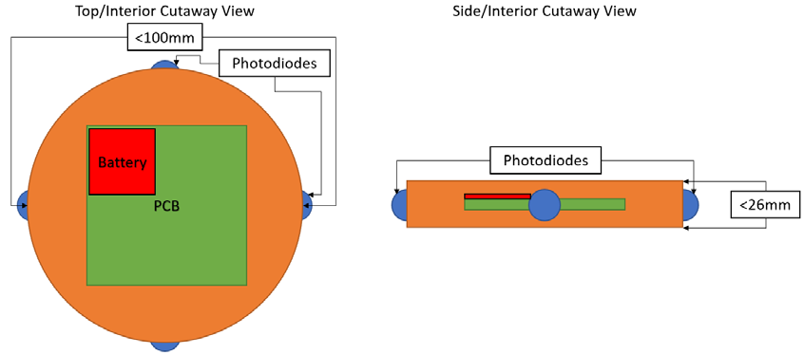
Design Diagrams
Photodetector
Photodetector

Slide 7
Block Diagram (Laser Rifle)
MCU
Key Components
Power Line
Power
Laser Safety Device
Control Line
Mains Supply
LCD Screen
MCU
Speakers & Motors
RF Comms
Battery Charger
Safety Switch
Laser Driver
User Panel
9.6V
Rechargeable Battery
Key Locked Power Connector
5V
Regulator
3.3V
Regulator

Slide 8
Block Diagram (Skeet Target)
MCU
Key Components
Power Line
Power
Laser Safety Device
Control Line
Visual LED system
MCU
Flight Destabilizer
RF Comms
Laser Detection System
6V Coin Cell Stack
Power Switch
3.3V
Regulator

Slide 9
Power

Slide 10
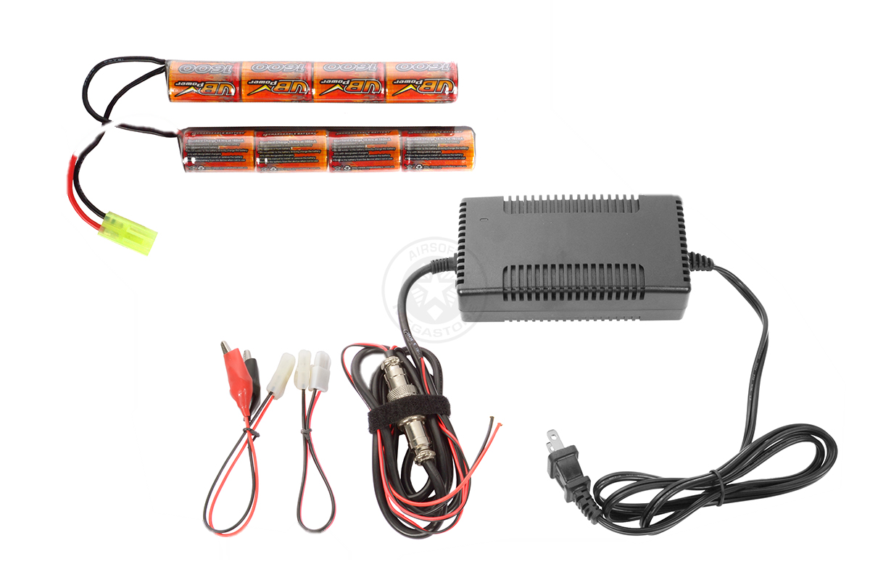
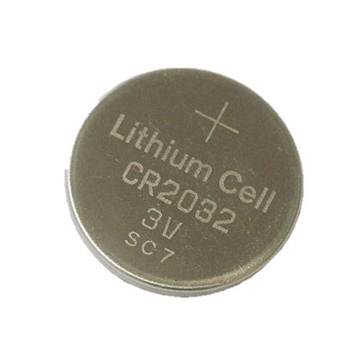
Power Systems
Rechargeable 9.6VDC - NiMH
1600 mAh
Primary power source to be regulated to 5V and 3V respectively for the main devices and MCU.
Common Mini-Tamiya connector type
Two 3V CR2032 Coin cell batteries
Necessary for small and lightweight power on the skeet target

Slide 11
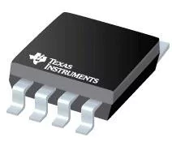
Power Amplification & Regulation
Utilizing the TLV2472CDR Precision Amplifiers Dual Lo-Pwr R-to-R Input / Output Op Amp
Great slew rate for high frequency operation
Necessary for operation of non-negative signal and control processing
1.5V/µs slew rate , 0V-6V V_Supply , 600µA output current
Regulators used LM7805 and TI's uA78M33
Laser rifle will contain both regulators for the peripheral devices, and MCU.
Skeet Target will only use the uA78MM33 for MCU control and low powered peripheral devices.

Slide 12
Laser Detection

Slide 13
Laser System
Laser system contains five main components.
Modulation via PWM
Laser Diode
Collimator
Beam Corrector
Beam Expander
Power
MCU
PWM
Laser Diode
Collimator
Beam Corrector
Beam Expander

Slide 14
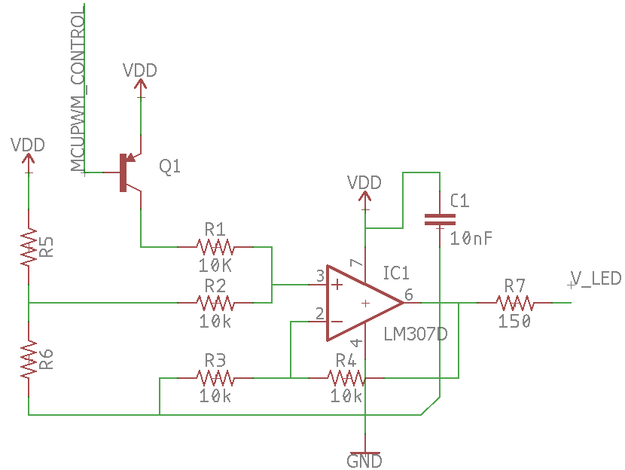
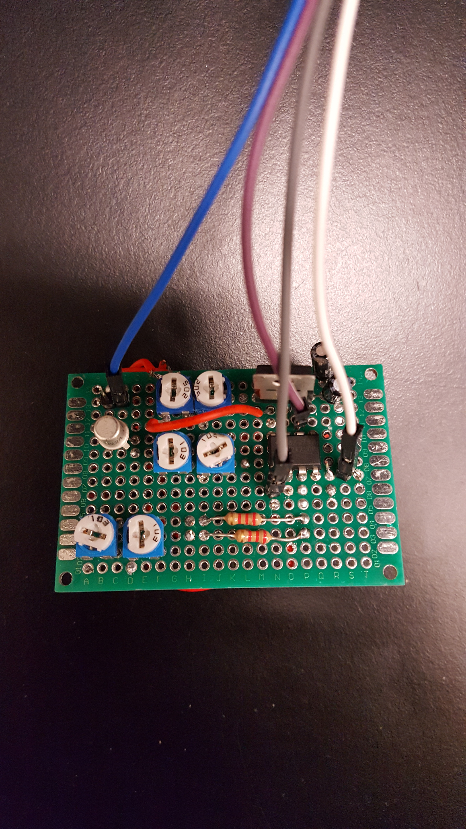
Laser PWM
System consists of a 30kHz input signal
Non-Inverting summation amplification provides a mixed signal output
System retains an off state until the skeet rifle is powered
System safety is removed, LED is powered to below the threshold emission power level
MCU signal to fire the laser is provided and controlled.

Slide 15
Laser Diode
Small portable laser requiring relatively low power.
Wavelength chosen for low interference from sunlight and reduced cost.
Wavelength 980 nm.
Within Silicon region for detectors and emitters.
ThorLabs has a family of 980 nm diodes.

Slide 16
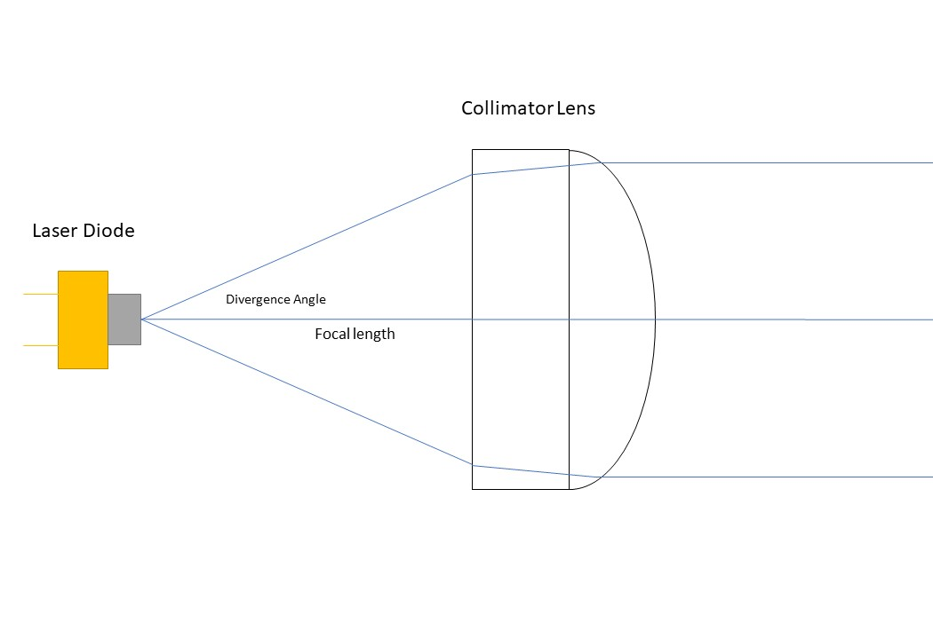
Collimator
Single lens system designed to bend the laser beam so that the beam is parallel.
Laser diodes have large divergence angles ( 30 degrees), so they need to be collimated before more beam shaping.
Allows for a small spot size at distance.

Slide 17
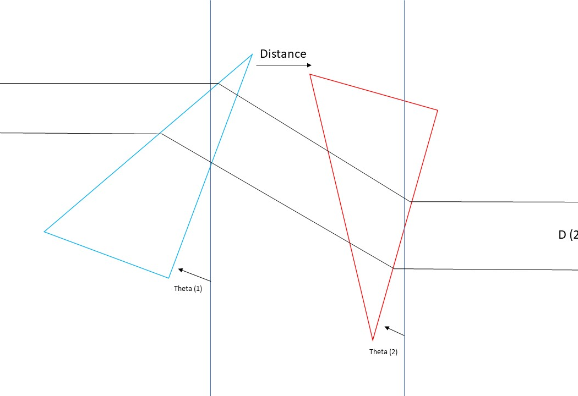
Beam Correction
Laser diode does not create a circular beam, but an elliptical beam.
Anamorphic prism pairs expand one axis of the laser beam to correct for this.

Slide 18
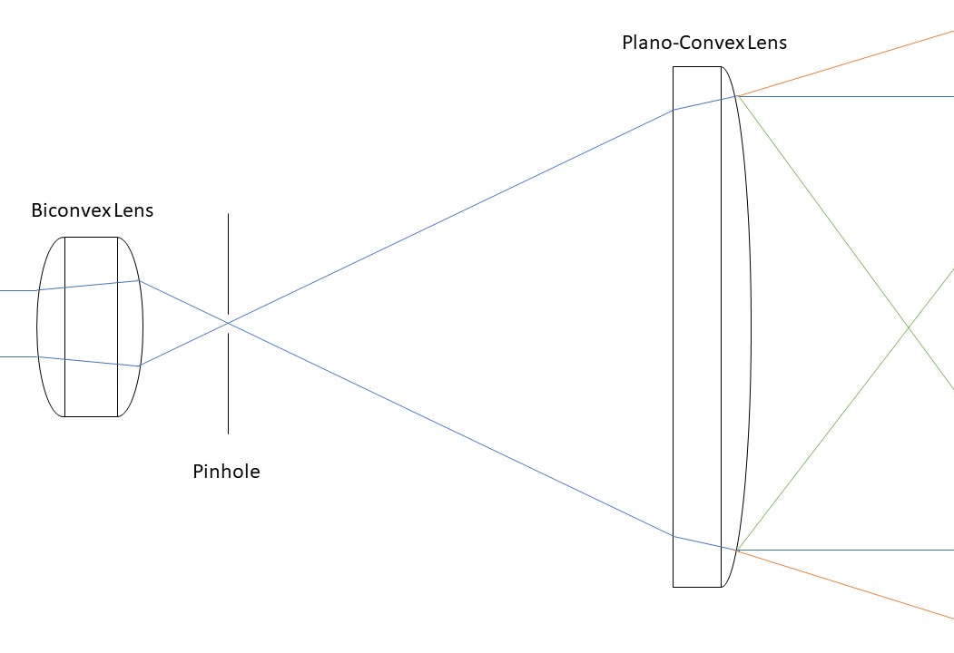
Beam expander
A beam expander will be used to both expand the laser beam to create a more realistic gun shot.
The beam expander will also cause the beam to diverge by adjusting the Plano Convex lens backwards.
Pinhole to clean the laser beam.
A physical stop will be placed in front of the Plano Convex lens to prevent the beam from focusing outside the system.

Slide 19
Laser Detection System
Wavelength detection filtration & output states to MCU
Modulator laser light will allow current to flow through the phototransistor.
Solar filters are used to remove unwanted sun light from adding noise to the input signal.
Output of the phototransistor will be passed through a bandpass filter to reduce noise and amplify signal.
Output of the bandpass filter will be passed to a comparator circuit.
Power
Laser Light
Phototransistor
Bandpass filter
Comparator
MCU

Slide 20
Laser Detection Problems
Three main parameters to determine detection:
Output Power
Increase for better detection, but decreases safety.
Beam spot Size
Decrease spot size for better power density.
Sensor sensitivity
Different photodetectors with different sensitivities have different needs.

Slide 21
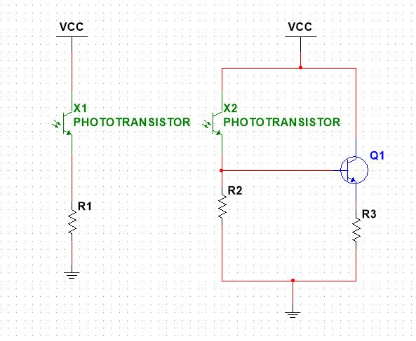
Detection
Phototransistors
Only need positive voltage to work.
Wide field of view (60 degrees).
Darlington phototransistor array.
Enhanced Sensitivity.
Sum currents of all phototransistors to get signal.

Slide 22
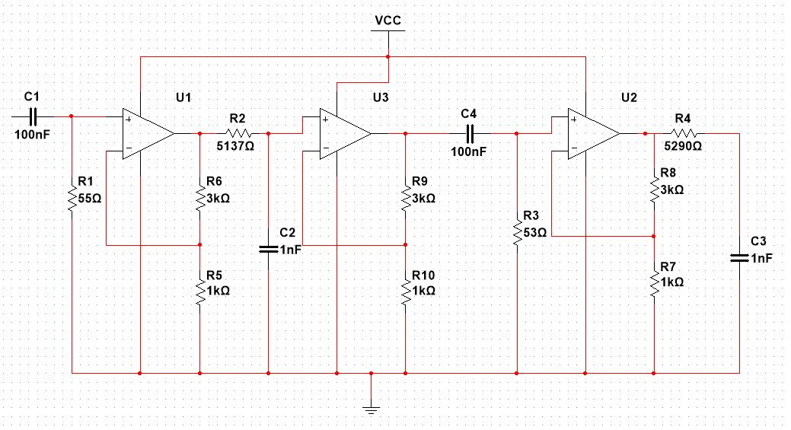
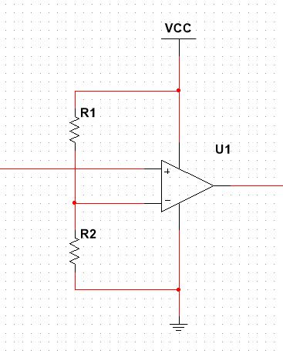
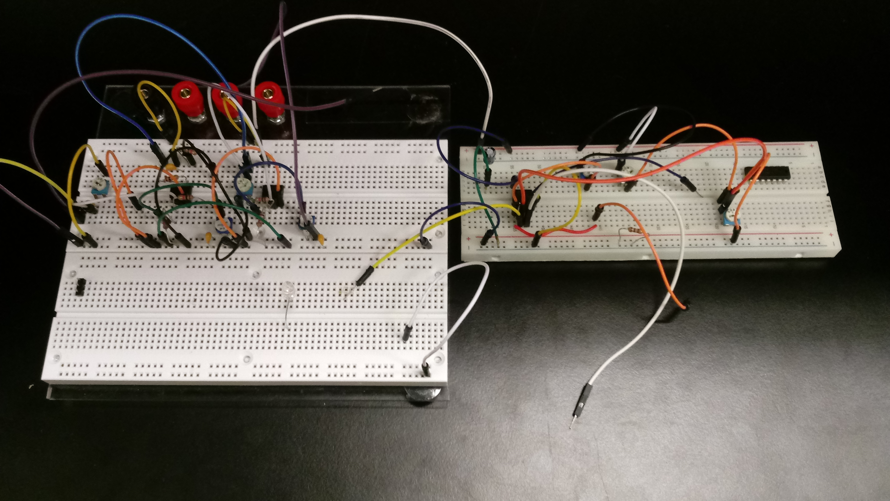
Filter and Comparator
Multiple first order filters connected by op amps.
Only requires positive voltage for op amps.
Comparator will interrupt MCU for signal detection.

Slide 23
MCU

Slide 24
MCU Control Systems
Project needs
General purpose I/O for user button controls and detector inputs
General purpose I/O for LED and feedback output
PWM for laser modulation and on/off control
PWM for buzzer tone
SPI for display driver
RF communication capability
Low power
Most MCU available are able to handle most of our needs.
RF interface and power requirements are main deciding factors.

Slide 25
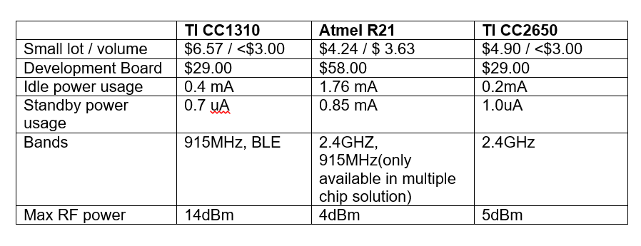
MCU Selection
TI CC1310 selected for use.
Other choices examined were eliminated due to poor availability, cost of development boards, and lack of combined RF transmitter.

Slide 26
Software

Slide 27
Vendor Provided OS and SDK
Both TI-RTOS or Free-RTOS Supported
TI-RTOS selected as it is from same vendor and better compatibility and completeness of driver support is expected.
OS Device Drivers (PWM, Display, GPIO, ...)
802.15.4 communication stack
OS needed to provide necessary real-time functionality for proper responsiveness in the communication stack.
Communication between threads and OS by Semaphores, Queues, and Call-back functions.

Slide 28
Starter Application
Central data collector with multiple Sensor nodes
Star topology
Provides PAN network initialization, node joining, message sending and receiving thread intercommunication
Provides configuration options for channel, encryption, frequency hopping, beaconing, and TX power level.
About 125 files not including the OS for each board type (Collector & Sensor)

Slide 29
SW Multiple Threads Needed

Slide 30
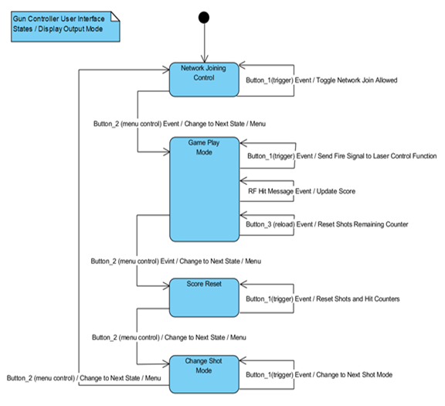
SW User Controller States
Display and control button actions are determined by four different operation states.

Slide 31
SW Functionality To Be Added To Starter Project Template
New message type
New message structure
Function to handle new message
Control menu state flow.
New display output functions for our needs.
Remove demo temperature sensor updates.
New functions for PWM initialize, and control.
New functions to initialize, set, and handle callbacks for RTOS clock timers for the new shot, feedback, and tone operations.
Add additional button I/O

Slide 32
MCU and SW Challenges
MCU mounting due to being small surface mount
Integrating with SDK SW and communication stack without breaking operation.
Learning curve required to understand complex starter project.
Multiple layers of abstraction in TI SW to accommodate their multiple product lines without SW rewrite.
Restriction to C to integrate with Drivers and Stack.

Slide 33
Peripherals

Slide 34
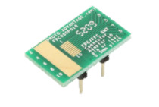
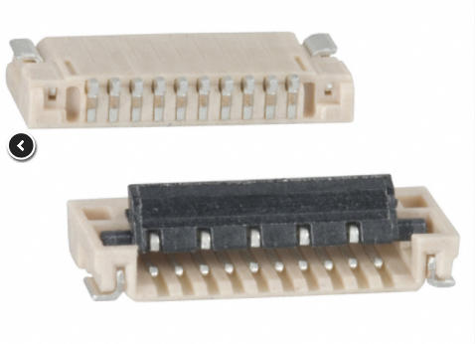
Display: Sharp LS013B7DH03
Display hits, misses, and shooting statistics
128 x 128 Pixel resolution
Uses SPI
Resources available with use on T.I. boards

Slide 35
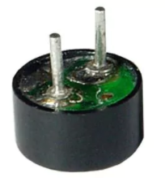
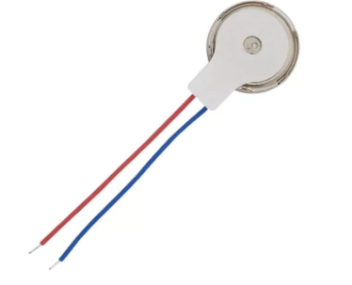
Peripheral Devices
Speaker
Vibration Motors
PUI Audio AS06608PS-WR-R
MCU controlled
Signals start up, hit, and misses to user
Parallax Vibration Motor 28821
MCU controlled
Activated when rifle is fired
Flight Destabilization

Slide 36
RF

Slide 37
RF Communication
IEEE 802.15.4 at 915 MHz
Star/ Point to Point topology
Lesser used frequency
Compatible with MCU
Johanson Technology 0915AT43A0026E Antenna
Gain of –4 dB
Offers good strength in most directions except rear
FCC Requirements
FCR Title 47 Section 15.5: General Conditions of Operations met
No more than five will be developed and prototyped
Good engineering practices will be used to the best ability possible.

Slide 38
Impedance Matching
Schematic By Texas Instruments

Slide 39
Administrative

Slide 40
Significant Design Components & Choices
Various engineering disciplines used within this project are integrated using the TI-CC1310 MCU
RF Communications match specifications
IR Communications possible due to the MCU capabilities
I/O Controls are capable from multiple pins to provide or take values
Operates on common language types for programming
Enables this project to combine the MCU and RF into a single component decreases space limitations
Provides a framework for our disciplines to be visualized and executed
Notes:
KR – Suggest that this is included in each separate area and not together

Slide 41
Work Distribution
Lead | O​
Support | X​
 | Power | RF | IR | Optics | MCU | Programming | Peripherals | PCB | Admin
Alexander | O |  | X |  |  | X | X | O | O
Clayton | X |  | O | O |  |  |  |  | X
Kevin |  |  |  |  | O | O | X |  | X
Sean |  | O |  |  |  |  | O | X | X

Slide 42
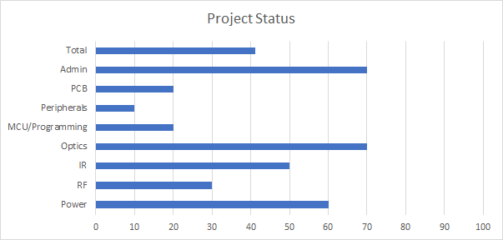
Current Project Status Update

Slide 43
Project Budget & Financing
 | Prototype Budget | Actual Current Expenses | Leading Cost Item | Budgeted
E Components | $50 | $20 | Antenna | -
Optics | $150 | $120 | Laser Diode | -
Dev-board MCU | $60 | $12 | TI-CC1310 | -
Peripherals | $40 | $35 | Parallax Motor | -
Materials | $40 | $20 | Vector Boards | -
Total | $340 | $207 |  | $750
*Total Budget is locked at $750, various optical components can be swapped for more sensitive components. Therefore, the final performance is also a factor of project cost.

Slide 44
Present Status and Difficulties
Obtaining a mock replica rifle to which the team can store components and electronics in safely.
This comes with a task of finding one that is ready to use, can house our IR system and have enough material to which electronics can be seamlessly wired through.
Worst case scenario, we make our own of raw materials to house the devices without taking a final aesthetic appeal into consideration.
Impedance Matching holds complex variables between connections and fine tuning components
Various sources have contradicted the PCB installation and a mild amount of resources provide valuable insight.
Further lab testing required, development boards work in conjunction with one another however.
IR communication
Ratio of Spot size, output power, and sensor sensitivity optimization.
Different designs available: photodiode instead of phototransistor; Phototransistor array
Dealing with integrating functionality into TI SW
Challenge of surface mount work is yet to come

Slide 45
Next Steps
Continue to keep up with independent research and productivity
Continue vector board and lab testing across peripheral devices.
Collect various values, data required for constructing a PCB
Experiment and develop a PCB layout for final schematic.
Develop involved MCU programs for combining sub-systems
Establish new RF Communicaitons
Extended IR Range & Susceptibility
Establish a final product
Housing and containment of sub-systems for demo trials

Slide 46
QUESTIONS?

