Slide 1
Medlock
Group 6
Nick Arnold EE
Shanice Dublin EE
Nick Macri CpE
Cray Winfrey CpE

Slide 2
Motivation
President Trump declared opioid addiction as a “national health emergency” on October 26, 2017
According to a study by the CDC “115 people die per day in the United States alone” [1]
Heavily addictive medication is much to easily accessible to the general population, with many options to obtain said drugs

Slide 3
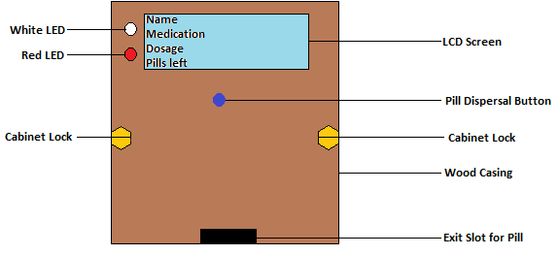
Proposed Solution
The Medlock system aims to combat opioid addiction
It is an automated pill dispenser designed to prevent the misuse of prescription drugs
Features include a 2-tier notification system, use of a infrared sensor for security purposes and a LCD display
It is a first level safeguard against opioid addiction

Slide 4
Specifications/Requirements
23 GPIO pins minimum needed on MCU
No greater than a 6” x 6” x 3” casing around PCB
Dispenses one pill in under 3 seconds after button push
70 – 80 dBA of sound from buzzer
Stores over 15 pills

Slide 6
LCD Selection
Part Name | LCM-S01602DTR/M | NHD-0440AZ-FL-YBW | NHD-0416BZ-NSW-BBW
Character Size | 16x2 | 40x4 | 16x4
Cost | $9.18 | $23.50 | $18.65
Polarization | Reflective | Transflective | Transmissive
LCD Controller | None | ST7066U | ST7066U

Slide 7
LCD Screen
16x4 LCD screen
Displays what a pill bottle would show
Transmissive screen polarizing
5V for high contrast
Built-in Controller
NHD-0416BZ-NSW-BBW

Slide 8
Buzzer and LEDs
Piezoelectric buzzer
Sounds at 2.8kHz from 70 – 80 dBA
Alerts user if medication isn’t dispersed within 10 minutes
White LED flashes when medication is ready
Red LED flashes when medication is missed
Through-hole vs SMD/SMT
PS1240P02BT
L1-0-W5TH70-1 (White)
L2-0-R5TH50-1 (Red)

Slide 9
IR Sensor

Slide 10
IR Sensor
IR Break Beam Sensor from Adafruit

Slide 11
Servomotor Selection
Part Name | HK15328D | HK15178 | HXT900
Weight | 58g | 10g | 9g
Cost | $9.18 | $2.35 | $3.05
Voltage | 4.5V-6V | 4.8V-6V | 3V-6V

Slide 12
Servomotors
Size!!
One servos for each pill column
Low voltage
HXT900

Slide 13
Microcontroller Selection
Controller | MSP430FR5847 | MSP430FR5857 | MSP430FR5858 | CC2650[2]
UART | 2 | 2 | 2 | 1
Non-Volatile Memory(kb) | 32 | 32 | 48 | 128
RAM(kb) | 1 | 1 | 2 | 8
GPIO Pins | 33 | 33 | 33 | 31
Timers – 16-bit | 5 | 5 | 5 | 8
Ultimately the deciding factor was the ability to program the Bluetooth notifications without an additional module being bought.
The CC2650 does that and also allows notifications in IOS and Android.

Slide 14
Overview of MCU

Slide 15
Main Power Rail

Slide 17
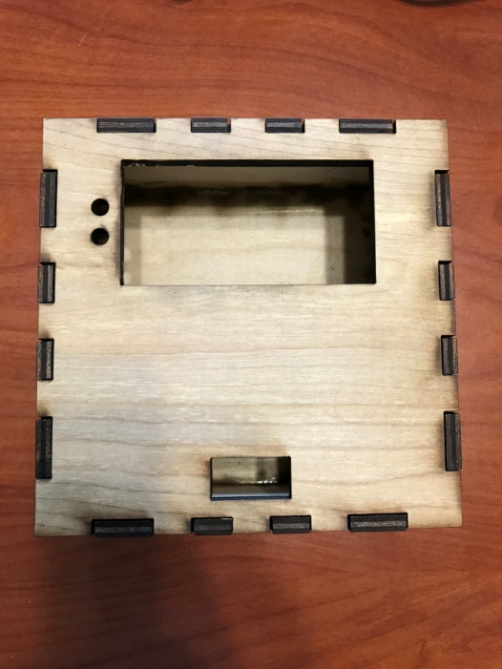
Device Casing
3D printing vs. Laser cutting
3D printing allows for more customization but is more expensive and time consuming.
3D printing requires specific software and knowledge on 3D modeling.
Laser cutting is much less time consuming and very cheap.
Device casing was made from laser cut 5.22mm thick wood.
Allowed for a semi-custom casing.
Once cut, easy to assembly because of finger design on edges.
Easily fit all components and servers its purpose very well.

Slide 18
Software Design Approach
Make timers interrupt driven
Coded using C language in Code Composer Studios IDE
Additional external programming done using Arduino IDE and Visual Studios
Software will be split into three major systems
Pill Disbursal system driven by task prioritization using kernel library

Slide 19
Software Goals
Develop software using the CC2650 that allows for pill disbursal
Notify users when the pill is ready
Have an LCD Display that reads like a pill bottle label
Have the LCD Display keep track of amount of pills
Notify users when the case has been improperly opened

Slide 20
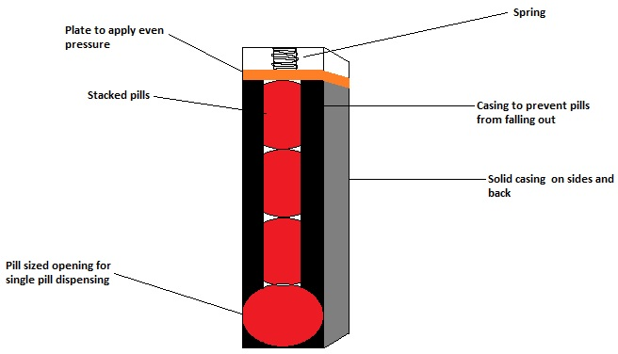
Pill Disbursal System
Has an interrupt driven timer
The timer is used to determine how long it has been since last pill dispensing
There’s a Boolean variable called Toggle that will start as false and change to true when the time interval reaches the time between dosages.
When that variable is true a push button will be able to dispense the pill, the timer will reset to zero and the Boolean to false.

Slide 21
Notification System
The visual notification occurs when the Boolean variable Toggle becomes true, this is shown via a white LED
There is a second timer that will start when the pill is ready
This timer is used to determine when or if the audio notification goes off
If the timer hits a specified time and the Boolean Toggle is still true then a 2nd Boolean variable piezoToggle flips from false to true
When piezoToggle becomes true the audio notification activates and the Piezo buzzer goes off

Slide 22
Servo Motor
This was discussed pretty well previously in the presentation
The motors use Pulse Width Modulation to turn
When Toggle is true and the push button is pushed the servo will rotate and dispense the pill
The pill dispensing is done using a plunger attached to the servo arm that pushes the pill out when rotated
There are 2 servos and we switch from one to another when half the pills have been dispensed

Slide 23
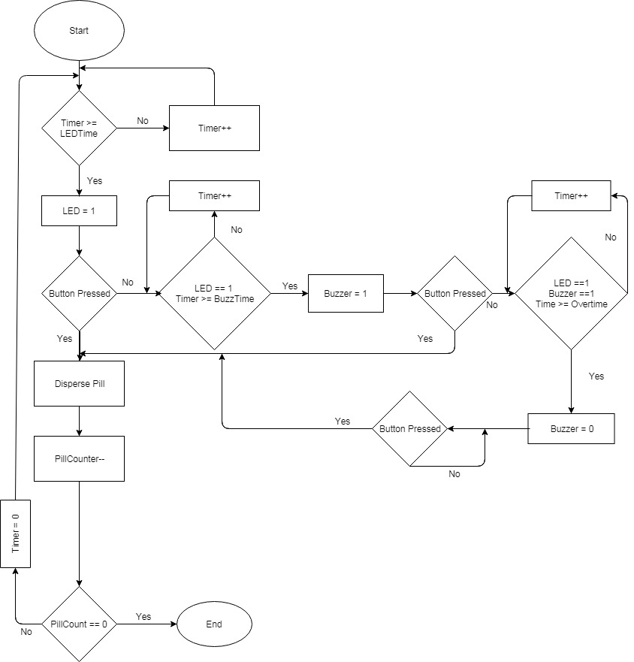
Pill Disbursal Flowchart

Slide 24
Security Sensor
There is a constant voltage being sent to the infrared sensor
When the voltage sent is changed that means the case has been opened
The IR sensor pins are treated as a push button
Therefore when the case is opened the IR sensor views it like a button push
When the case is opened improperly, a red LED is activated

Slide 25
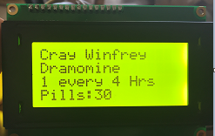
LCD Screen
LCD screen has a sleep and active mode
The LCD displays user’s name, medication name, dosage, and pills remaining
An Arduino Uno is used to control the screen, with the Liquid Crystal driver in the Arduino IDE
When the button to release the pill is pressed the LCD comes out of sleep mode and decrements the pills remaining
The Arduino is connected to the PCB and receives a pulse each time a pill is disbursed telling it to decrement the pill count
When no pills are left the screen reads “Out of Pills”

Slide 26
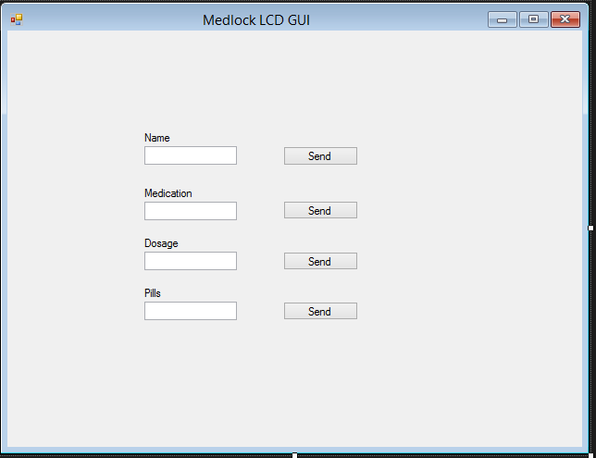
LCD GUI
GUI made using C# in Microsoft Visual Studios
GUI allows for the user to input the variables that will be displayed on the LCD
Data is sent from computer to Arduino via USB

Slide 27
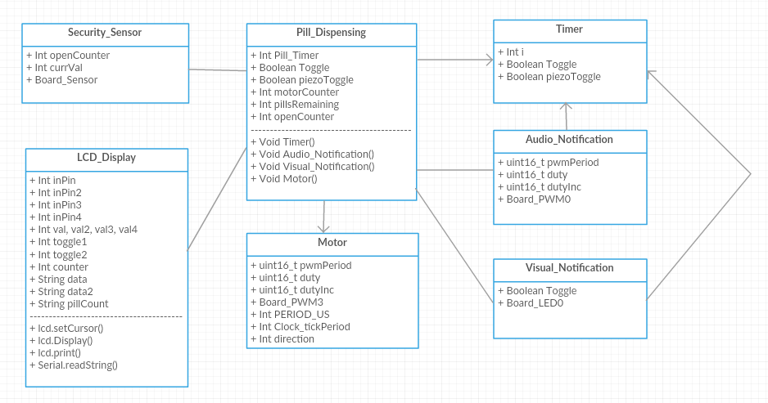
Function Diagram

Slide 28
Task Prioritization
Done on the CC2650 using the imported kernel library
The lower the number the higher priority, -1 is used to deactivate a task
Our program has 4 tasks that are managed, timer, audio notification, and the 2 servos
The 2 servos and the piezo buzzer tasks start as -1, the timer begins at 3
Whenever the servos or buzzer are used they are set to a higher priority than the timer then reset to -1
Avoided the use of task for security sensor (acts as push button) and visual notification (simple activation of a pin)

Slide 29
Administrative

Slide 30
Work Distribution
Names | PCB Design | Internal Power Supply | Software Development | Security | Signal Processing
Nick Arnold | X | X |  | X
Shanice Dublin | X | X |  | X
Nick Macri |  |  | X | X | X
Cray Winfrey |  |  | X | X | X

Slide 31
Budget
Item | Number of Items | Unit Cost | Development Cost
Microcontroller | 3 | $2.45 | $14.70
LED(White) | 3 | $0.49 | $1.47
LED(RED) | 3 | $0.49 | $1.47
IR Sensor | 3 | $6.50 | $19.50
Button | 3 | $1.49 | $4.47
Piezo Buzzer | 3 | $0.72 | $2.16
Servo | 3 | $2.99 | $26.91
LCD | 1 | $5.16 | $5.16
Schmart Board | 2 | $10.00 | $20.00
Battery | 1 | $34.99 | $34.99
Vector Board | 2 | $8.75 | $17.50
PCB1 | 3 | $33.87 | $101.60
PCB2 | 10 | $12.50 | $125.00
Soldered Components | 3 | $49.81 | $149.44
Total |  | $169.71 | $524.37

Slide 32
References
[1] “Opioid Overdose,” Centers for Disease Control and Prevention, 30-Aug-2017. [Online]. Available: https://www.cdc.gov/drugoverdose/epidemic/index.html. [Accessed: 02-Nov-2017].
[2] “CC2640 and CC2650 SimpleLink™ Bluetooth® low energy Software Stack 2.2.1.” Texas Instruments, Oct-2016.

Slide 33
Questions?

