Slide 1
Medlock
Nick Arnold
Shanice Dublin
Nick Macri
Cray Winfrey

Slide 2
Motivation
President Trump declared opioid addiction as a “national health emergency” on October 26, 2017.
According to a study by the CDC “115 people die per day in the United States alone.”
Heavily addictive medication is much to easily accessible to the general population, with many options to obtain said drugs.

Slide 3
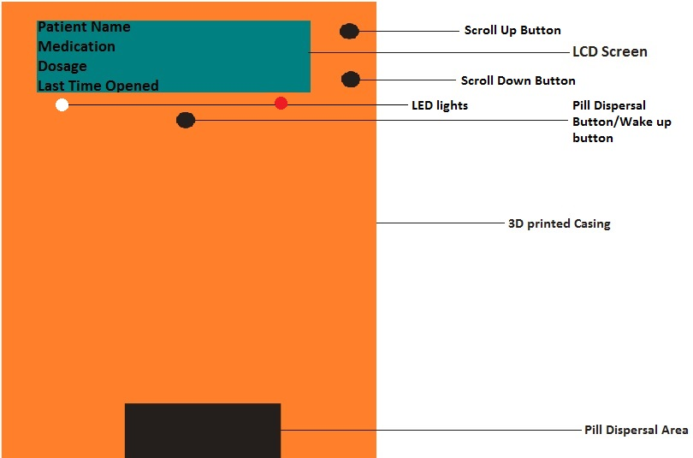
Proposed Solution
The Medlock system aims to combat opioid addiction.
It is an automated pill dispenser designed to prevent the misuse of prescription drugs.
Features include a 3-tier notification system, use of a infrared sensor for security purposes and a LCD display.

Slide 4
Specifications/Requirements
3.7 V Li-ion Battery Power Supply
~24 Wh minimum (depending on usage)
17 GPIO pins minimum needed on MCU
No greater than a 6” x 3” x 5” casing around PCB
Dispenses one pill in under 5 seconds after button push
70 – 80 dB of sound from buzzer
Stores 30 pills

Slide 5
Peripherals

Slide 6
Peripherals

Slide 7
LCD Screen
16x4 LCD screen
Displays what a pill bottle would show with the addition of a timing interval
Transmissive screen polarizing
5V for high contrast

Slide 8
Peripherals

Slide 9
Buzzer and LEDs
Piezoelectric buzzer
Sounds at 2.8kHz from 70 – 80 dB
Alerts user if medication isn’t dispersed within 10 minutes
Red LED flashes when battery is 10%
White LED flashes when medication is ready

Slide 10
Peripherals

Slide 11
IR Sensor
5V Break beam IR Sensor
Fastened inside the casing facing one another
An interruption in their signal is logged in the MCU for the pharmacist

Slide 12
Peripherals

Slide 13
Servomotors
Two servos are used for two pill columns
Pulse width: 600 µs – 2400 µs

Slide 14
Microcontroller Selection
Controller | MSP430FR5847 | MSP430FR5857 | MSP430FR5858 | CC2650
UART | 2 | 2 | 2 | 1
Non-Volatile Memory(kb) | 32 | 32 | 48 | 128
RAM(kb) | 1 | 1 | 2 | 8
GPIO Pins | 33 | 33 | 33 | 31
Timers – 16-bit | 5 | 5 | 5 | 8
Ultimately the deciding factor was the ability to program the Bluetooth notifications without an additional module being bought.
The CC2650 does that and also allows notifications in IOS and Android.

Slide 15
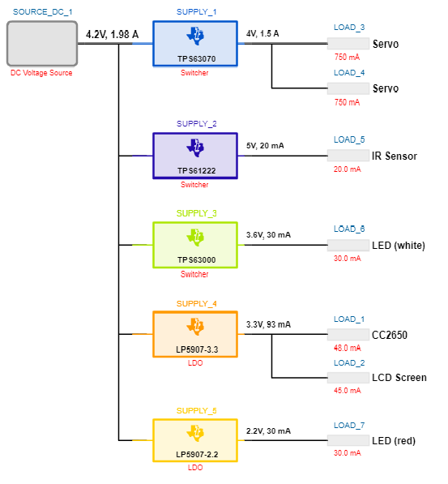
Power System

Slide 16
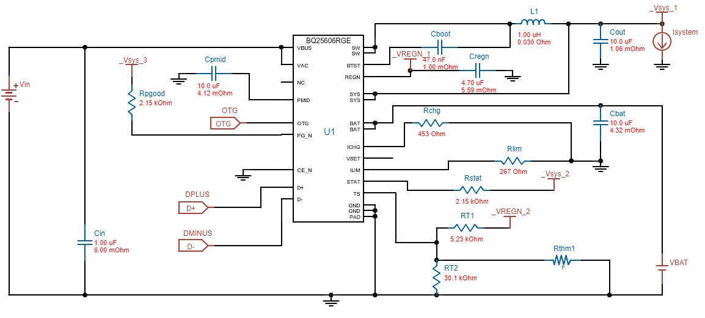
Battery Charger

Slide 17
Software Design Approach
Make timers interrupt driven
Coded using C language in Code Composer Studios IDE
Implement a real time clock
Software will be split into five major functions

Slide 18
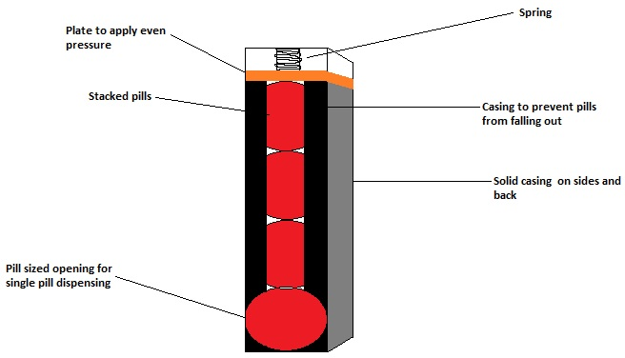
Pill Disbursal System
Has an interrupt driven timer
The timer is used to determine how long it has been since last pill dispensing
There will be a Boolean named pillReady that will start as false and change to true when the time interval reaches the time between dosages.
When that variable is true a push button will be able to dispense the pill, the timer will reset to zero and the Boolean to false.

Slide 19
Notification System
The Bluetooth and visual notification will occur when the Boolean variable discussed in the previous slide is true
There will be the use of a second timer that will start when the pill is ready
This timer will be used to determine when or if the audio notification goes off
If the timer hits 10 minutes and the Boolean pillReady is till true then the audio alert goes off.

Slide 20
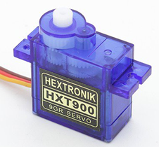
Servo Motor
This was discussed pretty well previously in the presentation
Basically the motors will use a few variables for the angle, delay, and rotation
When pillReady is true and the push button is pushed the servo will rotate and dispense the pill

Slide 21
Security Sensor
This will require the use of the global clock that we discussed previously
As stated earlier, there will be a constant voltage being sent to it
When the voltage being sent is changed that means the case has been opened
Whenever the case is opened the time on the global clock will be converted to a string
This string is then sent to an array of strings
The array will have a max of 10 entries, with the oldest one being replaced with the new one

Slide 22
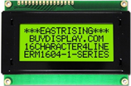
LCD Screen
LCD screen will have a sleep and active mode
This will display several strings including name, medication, case openings, etc
A driver will be used within the programming of this
There will be 3 push buttons
Up and Down will change the display, and enter will take it out of sleep mode and all disburse the pill

Slide 23
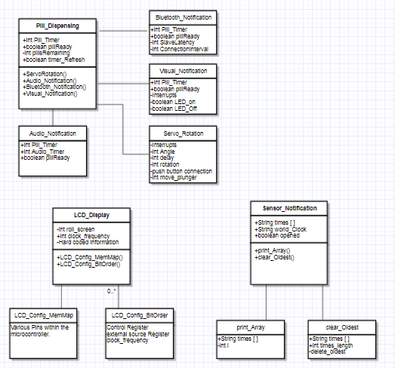
Class Diagram

Slide 24
Class Diagram

Slide 25
Class Diagram

Slide 26
Class Diagram

Slide 27
Device Casing
The device casing will be made using a 3D printer.
3D printing will allow for a custom casing to be made specifically for the device with precision.
ABS plastic is the plastic of choice because it allows for some durability and flexibility.

Slide 28
Administrative

Slide 29
Work Distribution
Names | PCB Design | Internal Power Supply | Software Development | Security | Signal Processing
Nick Arnold | X | X |  | X
Shanice Dublin | X | X |  | X
Nick Macri |  |  | X | X | X
Cray Winfrey |  |  | X | X | X

Slide 30
Budget
Item | Number of Items | Unit Cost | Productions Cost | Development Cost
Microcontroller | 3 | $2.45 | $2.45 | $7.35
LED(White) | 3 | $0.49 | $0.49 | $1.47
LED(RED) | 3 | $0.49 | $0.49 | $1.47
IR Sensor | 3 | $6.50 | $6.50 | $19.50
Button | 3 | $1.49 | $4.47 | $4.47
Piezo Buzzer | 3 | $0.72 | $0.72 | $2.16
Servo | 3 | $2.99 | $5.98 | $8.97
LCD | 1 | $5.16 | $5.16 | $5.16
Schmart Board | 2 | $10.00 | $0.00 | $20.00
Battery | 1 | $34.99 | $34.99 | $34.99
Vector Board | 2 | $8.75 | $0.00 | $17.50
PCB | 1 | $60.00 | $60.00 | $60.00
Total |  | $134.03 | $121.25 | $183.04

Slide 31
Progress

Slide 32
Questions?

