Slide 1
BreathaLock Breathalyzer Integrated Onto A Key fob
Group #31
Nicholas Fraser, Electrical Engineer
Nam Ngo, Electrical Engineer
Charles Taylor, Computer Engineer

Slide 2
Motivation
About 1,825 college students between the ages of 18 and 24 die from alcohol-related unintentional injuries, including motor vehicle crashes.
The Alaska DMV estimates that over 5 years, a DUI costs the convicted driver almost $25,000, and Tennessee estimates that figure at between $5,000 and $10,000.
Already existing alternatives do not address DUI cases from being in “physical control” (essentially inside the car, not driving) of the vehicle but not actually driving it.

Slide 3
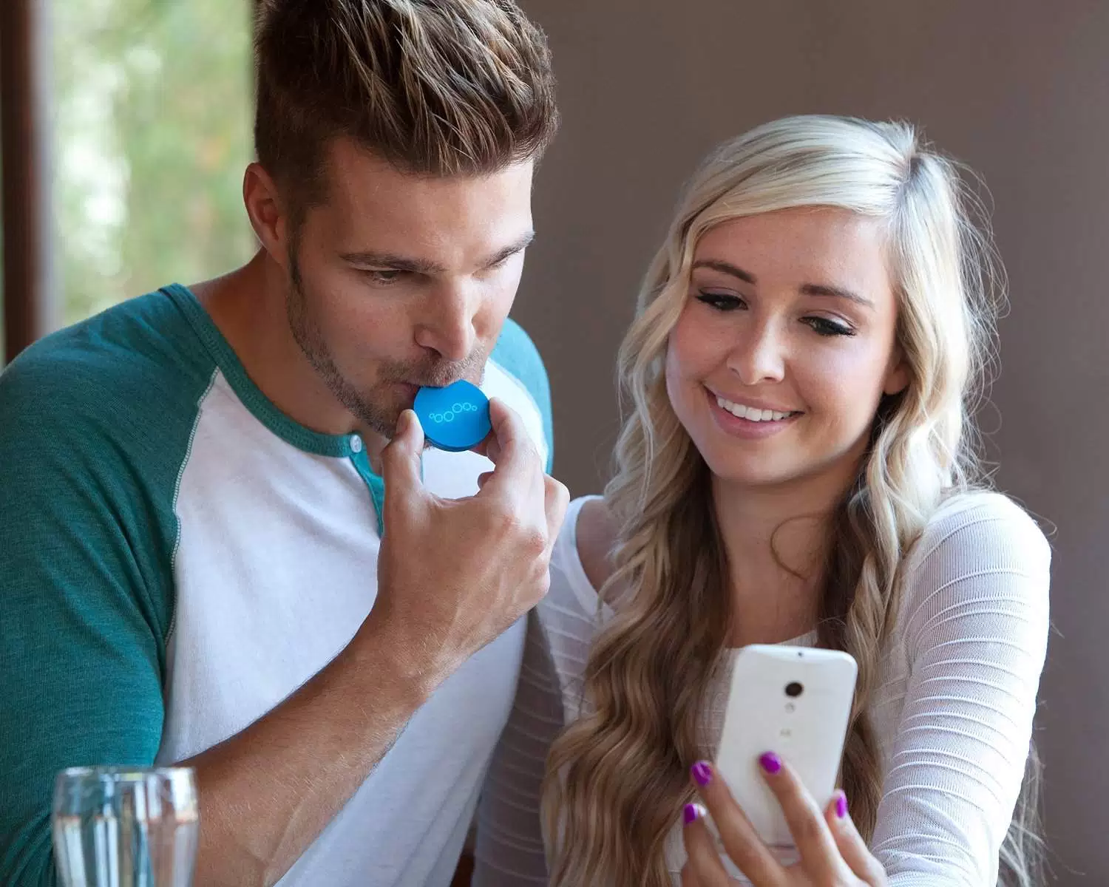
Goals and Objectives
Mitigate drunk driving by adding barriers and better alternatives
Provide a inexpensive barrier for users that frequently drunk drive
Build a breathalyzer that links to phone via Bluetooth
Upon a satisfactory alcohol limit the device will allow the unlock signal
Create a device small comparable in size to existing personal devices
Provide a civic service to our peers

Slide 4
Specifications and Requirements
Size | No more than 3” x 3” x 7”
Weight | No heavier than 1lb
Power | Within 4W of power
RF transmission | Lock signal is always enabled If identified user verifies sobriety unlock signal can be sent
Alcohol detection | Detect if user is blowing vs. ambient air Must distinguish between above and below legal alcohol limit
Biometric Verification | Must be able to store and verify fingerprints

Slide 5
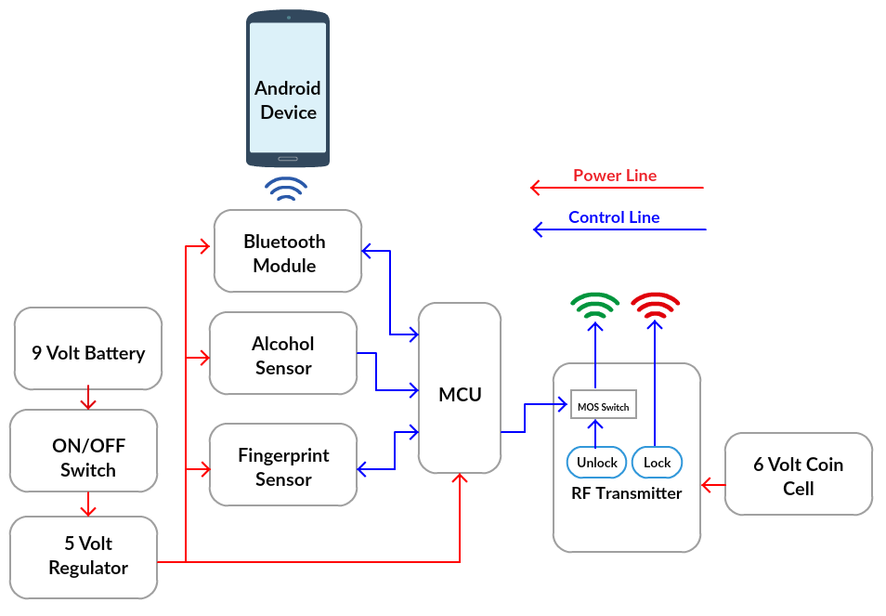
Overall Block Diagram

Slide 6
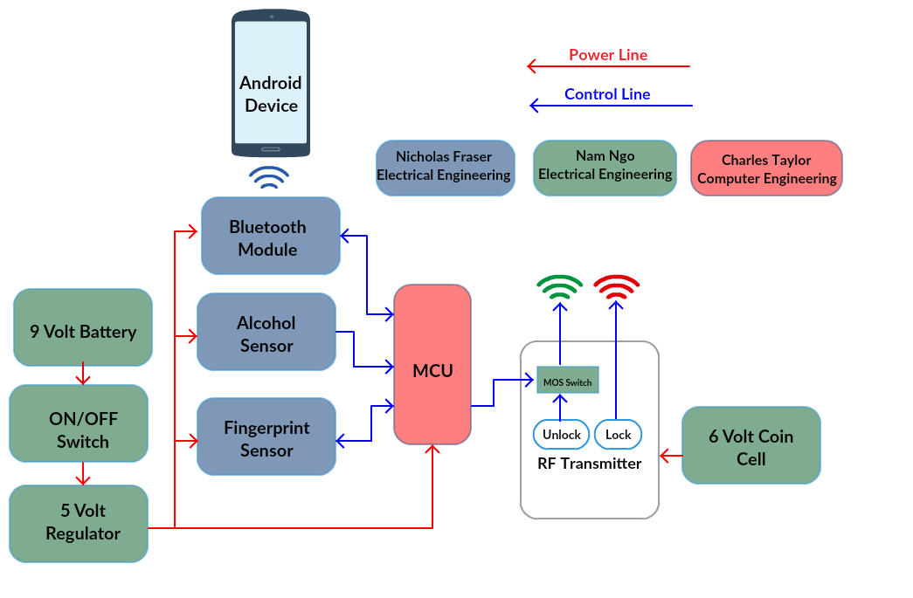
Work Distribution Diagram

Slide 7
Sensor Workflows

Slide 8
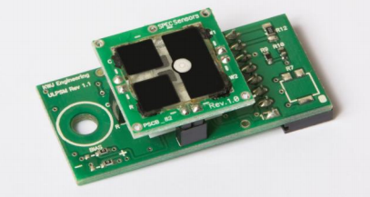
Alcohol Sensor Options
Component | MQ-3 | SPEC ULPSM-Ethanol 968-007
Cost | $4.95 | $50.00
Read Data | Analog | Analog Voltage
Voltage Required | 5v | 3v
Product Support | Low | High
Deciding Factor: | MQ-3 for overall product cost

Slide 9
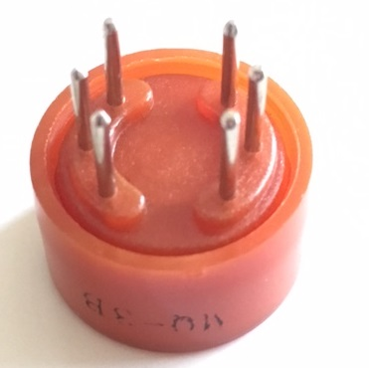
Alcohol Sensor Characteristics
Component | MQ-3
Sensor Type | Semiconductor
Target Gas Type | Alcohol
Detection Range | 25-500ppm alcohol
Heater Voltage | 5.0V
Output Voltage | 2.5-4.0V
Notes:
We chose to use the MQ-3 alcohol sensor because of its simplicity, sensitivity, and fast response time. This sensor provides an analog output that can be read and analyzed by a microcontroller to decipher the sobriety of the user.

Slide 10
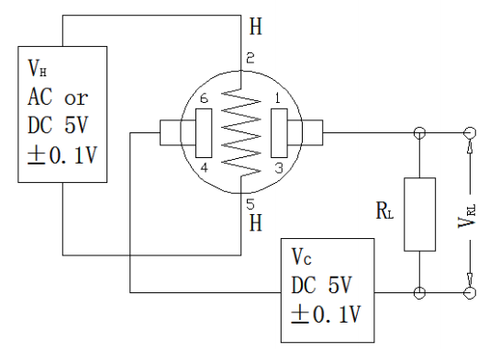
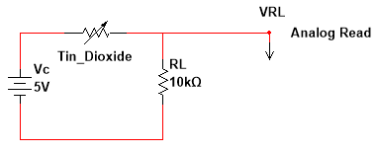
Alcohol Sensor Subsystem
The MQ-3 sensor operates by heating a piece of tin dioxide and passing current through it.
Tin dioxide’s conductive properties change in the presence of alcohol.
Using the effect of a voltage divider we can read the voltage across a load resistor and relate that to alcohol presence.
Notes:
The MQ-3 sensor operates by heating a piece of tin dioxide and passing current through it. Tin dioxide’s conductive properties change in the presence of alcohol.
Using the effect of a voltage divider we can read the voltage across a load resistor and relate that to alcohol presence.

Slide 11
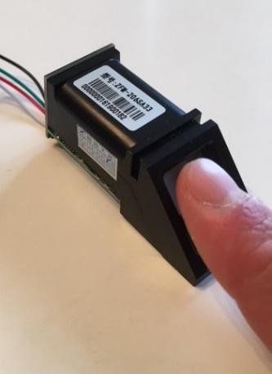
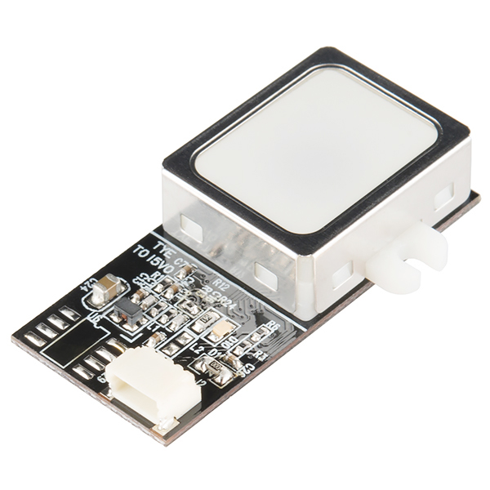
Fingerprint Sensor Options
Name | ZFM-20 (Adafruit) Series Fingerprint Sensor | GT-511C3
Cost | $49.95 | $31.95
Baud Rate | 9600-57600 | 9600
Voltage Required | 3.6-6v | 3.3-6v
Required Pins | Vcc, GND, Tx, Rx | Vcc, GND, Tx, Rx
Product Support | High | Some
Deciding Factor | Product support and the ZFM-20 is more modular and size effective.

Slide 12
Fingerprint Sensor Characteristics
Component | Fingerprint Sensor
Supply voltage | 3.6-6.0VDC
Peak Current | 120mA
Imaging time | Less than 1 second
Interface | TTL Serial
Dimension | 56 x 20 x 21.5mm
Weight | 20 grams
Modes | Enrolling, Searching and Deleting

Slide 13
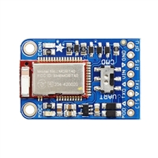
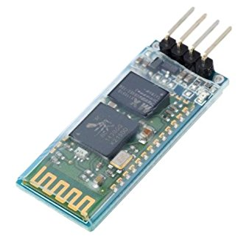
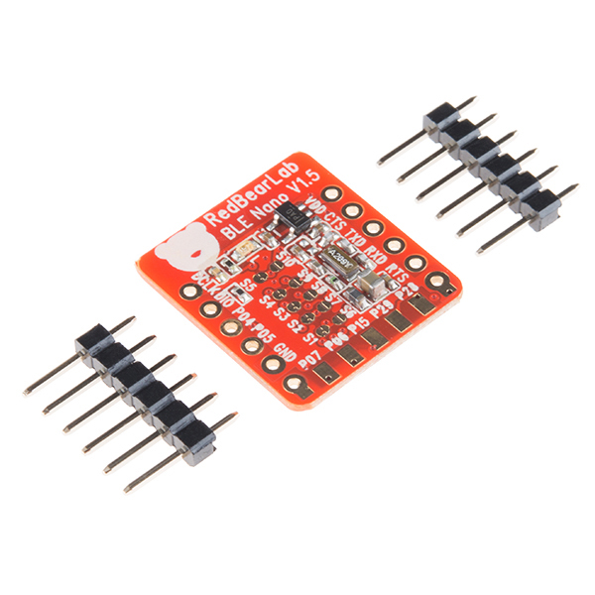
Bluetooth Module Options
 | Bluefruit LE UART Friend | Phantom YoYo JY-MCU Bluetooth | BLE Nano –nRF51822
Cost | $17.50 | $11.99 | $24.95
Power Consumption | Low | Moderate | Low
Compatibility | IOS/Andriod | IOS/Andriod | IOS/Andriod
Technical Support | High | Low | High
Deciding Factor | Price and product support
Notes:
Deciding Factor: price and product support

Slide 14
Bluefruit LE UART Friend
Component | Bluefruit LE UART Friend
Onboard Processing | ARM Cortex 16Mhz
Flash Memory | 256KB
RAM | 32KB SRAM
Baud Rate | UART at 9600 Baud
Supply Voltage | 5v-safe input with onboard voltage regulation
Dimensions | 21 x 32 x 5mm
Weight | 3.4g

Slide 15
Power System

Slide 16
Power options
Main PCB (9V)
 | Pros | Cons
9V Standard | Compact Long shelf life Light Weight Moderate Capacity (~330mAh) | Awkward dimension
6 x 1.5V AA | High capacity (~2100mAh) | Heavy Not compact
3 x 3V coin cell | Ultra-compact Light weight | Low capacity (~250 mAh)
Transmitter(6V)
 | Pros | Cons
2 x 3V Coin-cell | Ultra compact Shelf life | Low capacity (~250 mAh)
4 x 1.5AA | High capacitance (~2100 mAh) | Heavy Not compact

Slide 17
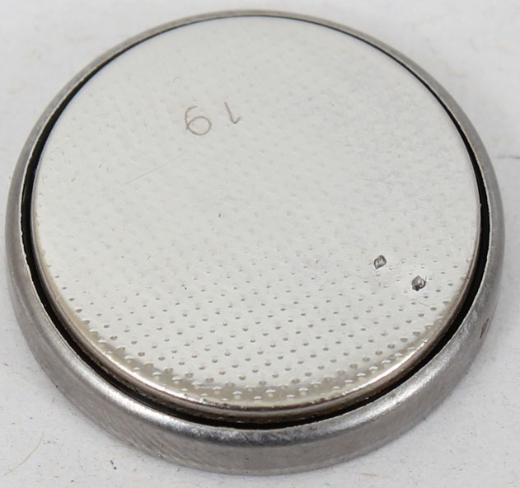
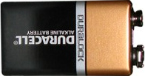
Battery Selection
Main PCB:
Standard 9V battery
Lithium ion, Lithium polymer, nickel-metal hydride
Rechargeable, nonrechargable
RF transmitter:
2x 3V coin-cell
Lithium ion

Slide 18
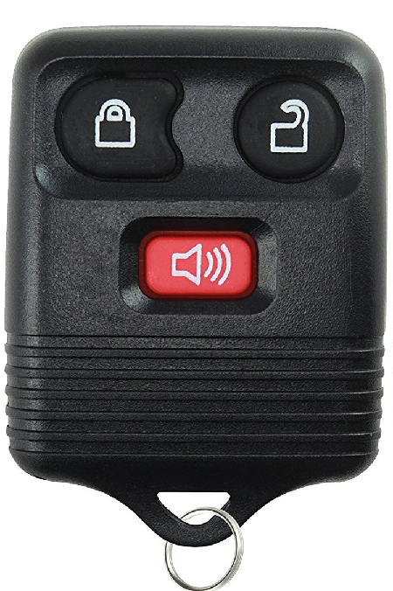
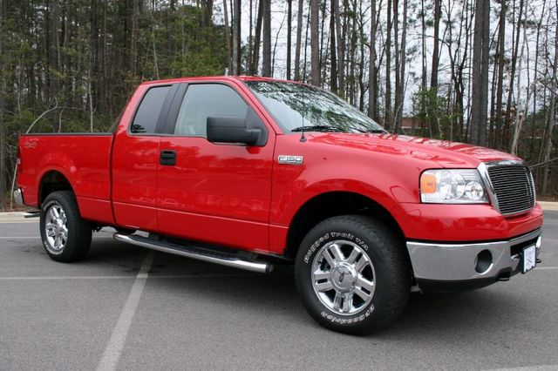
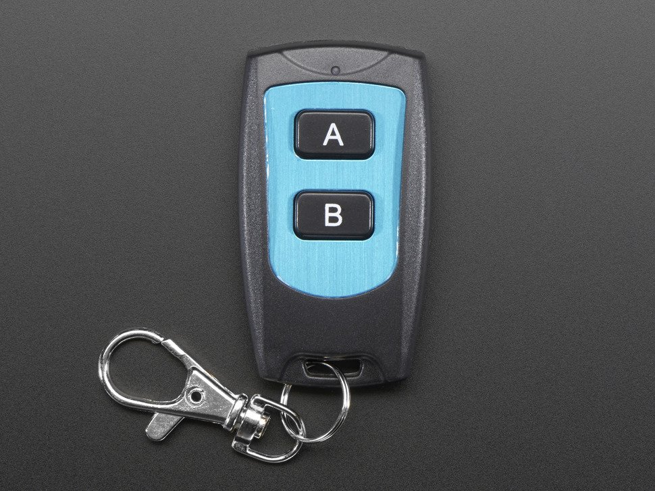
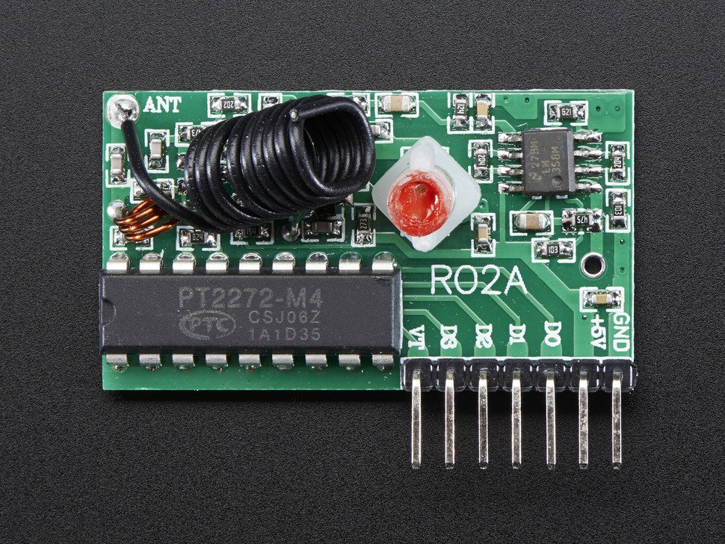
RF integration
Initial Intent
Implementation
Manufacture Specific
Cost ineffective
Poor testing Environment
One to one
Easier to demonstrate concept
Practical testing environment

Slide 19
Modeling RF transmitter
Blackbox Model
Knowns:
Device output given device input
Operating voltage of 4-6V
LED status output given an input
Unknowns:
Circuit schematic
Input | Output
Unlock Pushbutton | Red LED & Unlock signal
Lock Pushbutton | Red LED & Lock signal

Slide 20
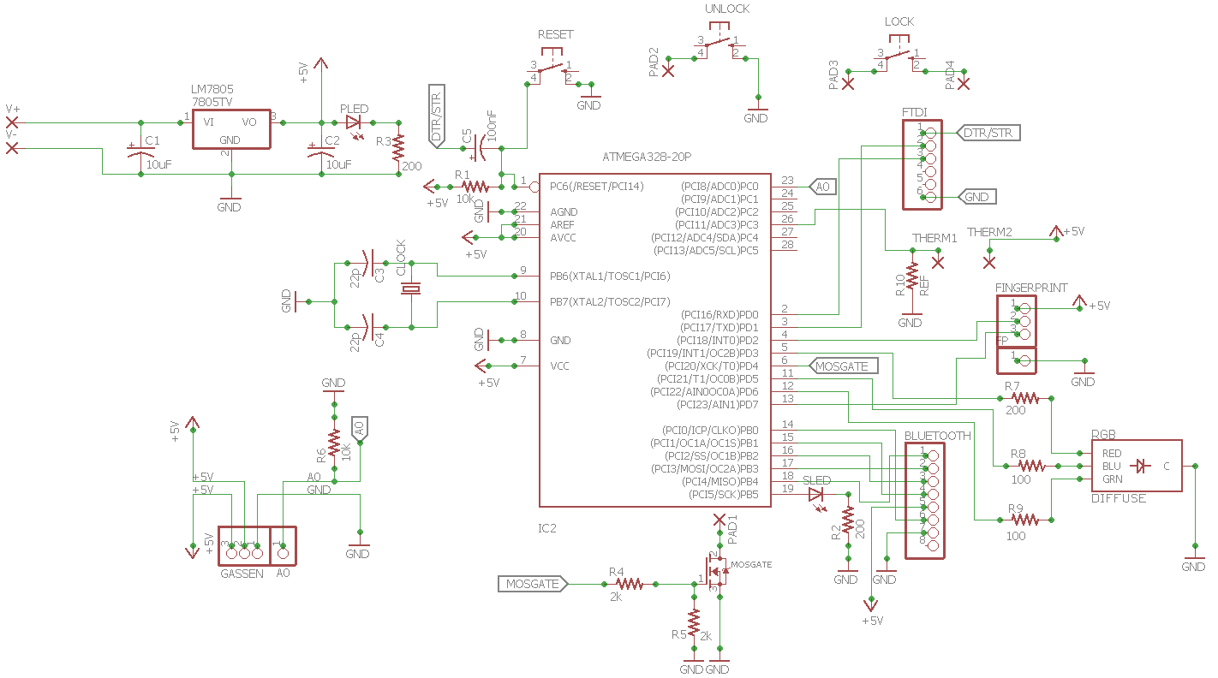
Overall PCB Schematic

Slide 21
Power Supply
Regulated power supply

Slide 22
Sensor Integration
Fingerprint Sensor
Gas Sensor
Bluetooth Module

Slide 23
Microcontroller
Microcontroller

Slide 24
Transmitter integration Schematic
Unlock/ Lock Pushbuttons
MOSFET Switch

Slide 25
LED Integration Schematic
Power LED
Status LED
RGB LED

Slide 26
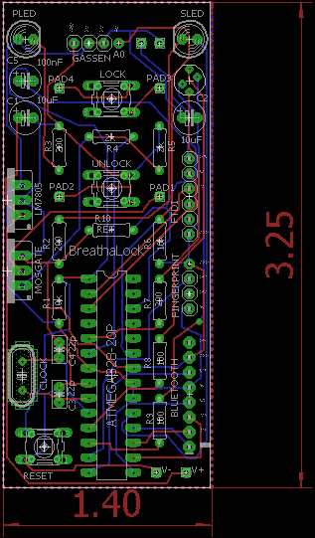
PCB Board Layout
1.40” x 3.25”
Two Layer Board
Symmetric
Notes:
NAM can you add words to fill up white space

Slide 27
Software & MCU

Slide 28
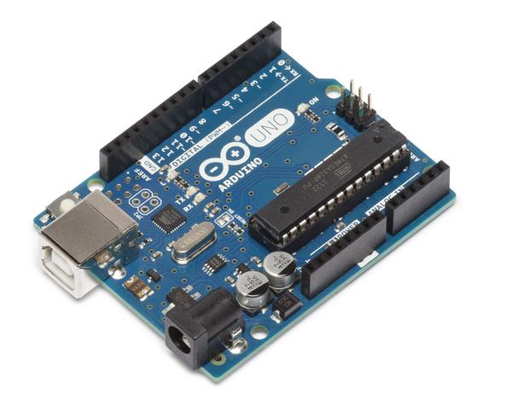
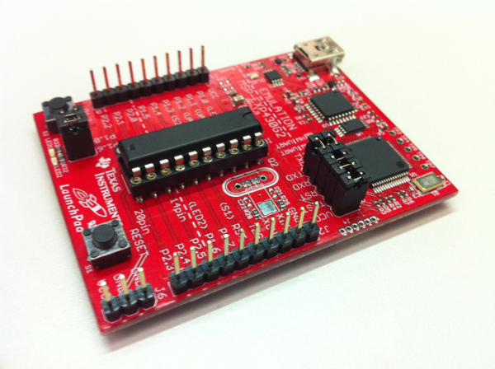
Microcontroller Development Environment
 | Arduino | MSP430
Pros | Well documented Easy to use Removable microcontroller User friendly Group was very familiar | Low power Removable microcontroller Fast Performance
Cons | Slow performance | Moderate Understanding
Deciding Factor | Based on experience, user documentation, and user friendliness we went with the Arduino for development purposes

Slide 29
Project Microcontroller
 | ATmega328p | MSP430G2212IN20
CPU speed | 16MHz | 16MHz
Program Memory Size | 32KB | 2KB
RAM Memory Size | 2KB | 256 Byte
Operating voltage | 5V | 1.8V-3.6V
Number of I/O | 26 | 16
Cost | $2.18 | $1.65
Experience | High | Moderate
Documentation | Great | Moderate

Slide 30
Android vs. IPhone
 | Android | Apple iOS
Cost | Free | $99/yr + $500+ (Computer)
Software Experience | High | Low
User Engagement | ~52% of the market | ~37% of the market
Technical Support | High | High

Slide 31
Software Flow

Slide 32
Software States
On Device Turn on
Warm up phase/Initialization phase
Fingerprint
MQ3 Warmup phase
Idle Phase
isUserBlowing
Collect ADC value
Evaluation/Comm
isTheUserSober
Send over Bluetooth status

Slide 33
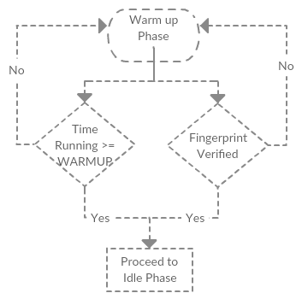
Warm Up Phase
After powering Breathalock on, before proceeding the user must
Validate Fingerprint
Wait 15 seconds for MQ3 to warmup
As per the datasheet warmup time is required

Slide 34
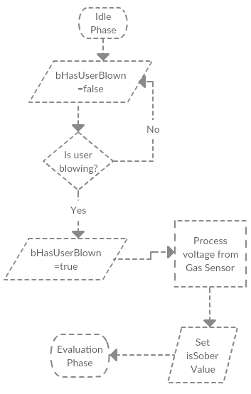
Idle
Check if the user has blown (implemented to avoid workarounds)
Set the userHasBlown value
Process two voltage reads and compare the delta between the two
Positive delta the user has some alcohol present and may be inebriated
Inebriated checks against our tolerance value
Negative delta determines the user is sober

Slide 35
Evaluation
Compare the sensor value read to our sober limit
If so keep the MOSFET gate voltage low for the Unlock button
Otherwise allow the user to utilize the UNLOCK button on the keyfob
If connected begin streaming data to the Android app

Slide 36
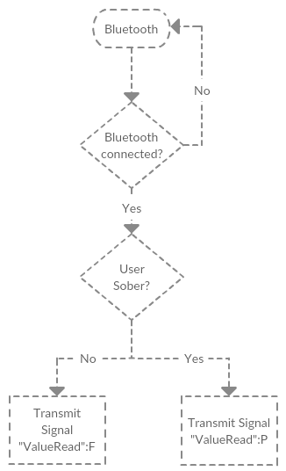
Bluetooth
Check if Bluetooth android app is connected
Value is sent as one String in the format of “ValueRead”:P|F Where
ValueRead is the voltage value read from the gas sensor
Where P and F is pass or fail

Slide 37
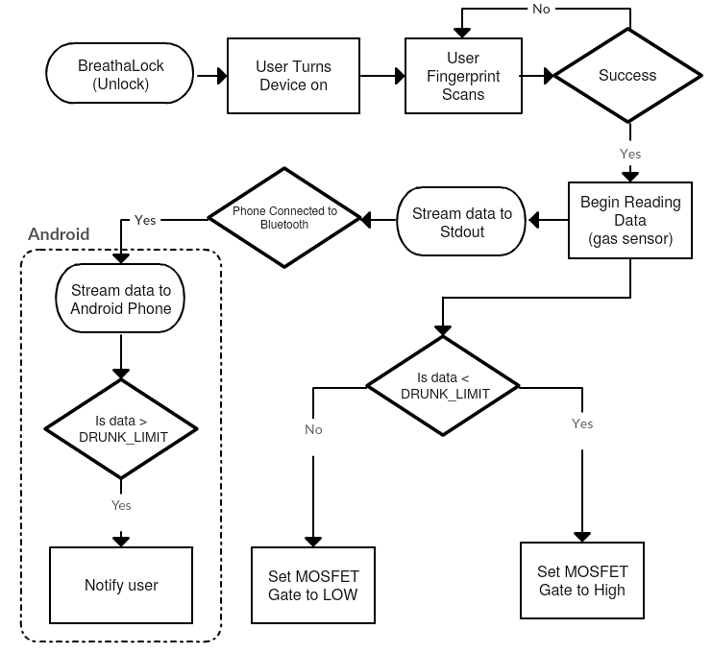
Total Process Flow

Slide 38
LED status lights
Green | Power is on
Yellow | 15 Second alcohol warm-up timer
RGB- Blue | Recognized user fingerprint
RGB- Red | User above legal limit
RGB- Green | MOSFET switch is enabled
RGB- Yellow | User not recognized

Slide 39
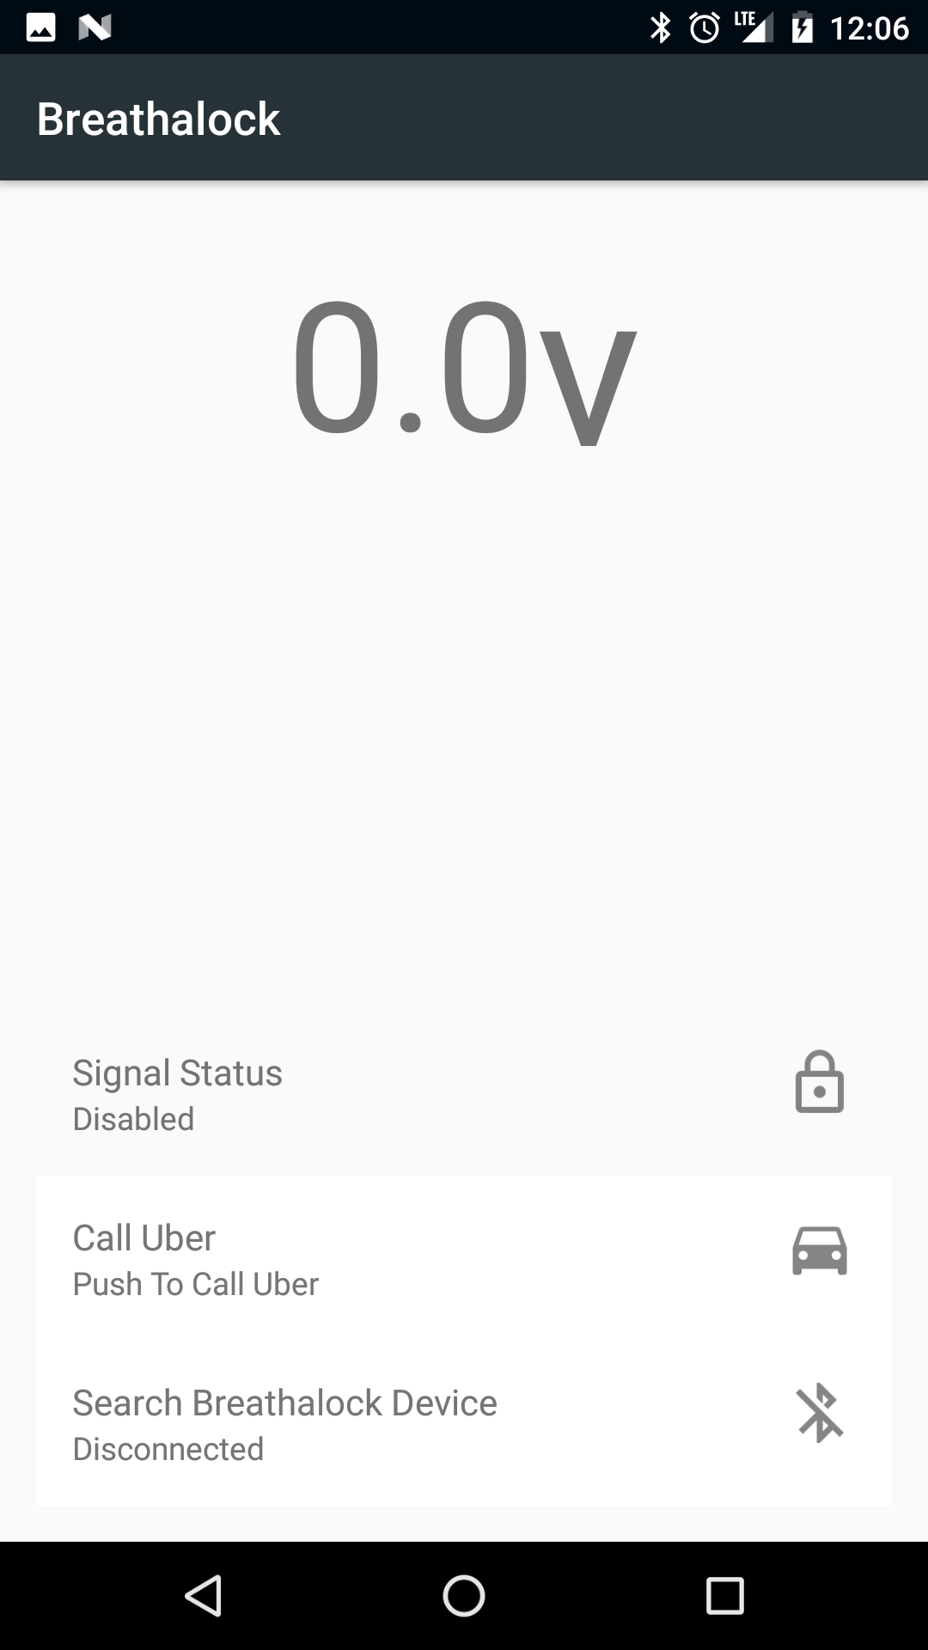
Android App Features
Display
Signal Status
Call Uber
Search for Breathalock Devices
Icon corresponds to device state for user feedback

Slide 40
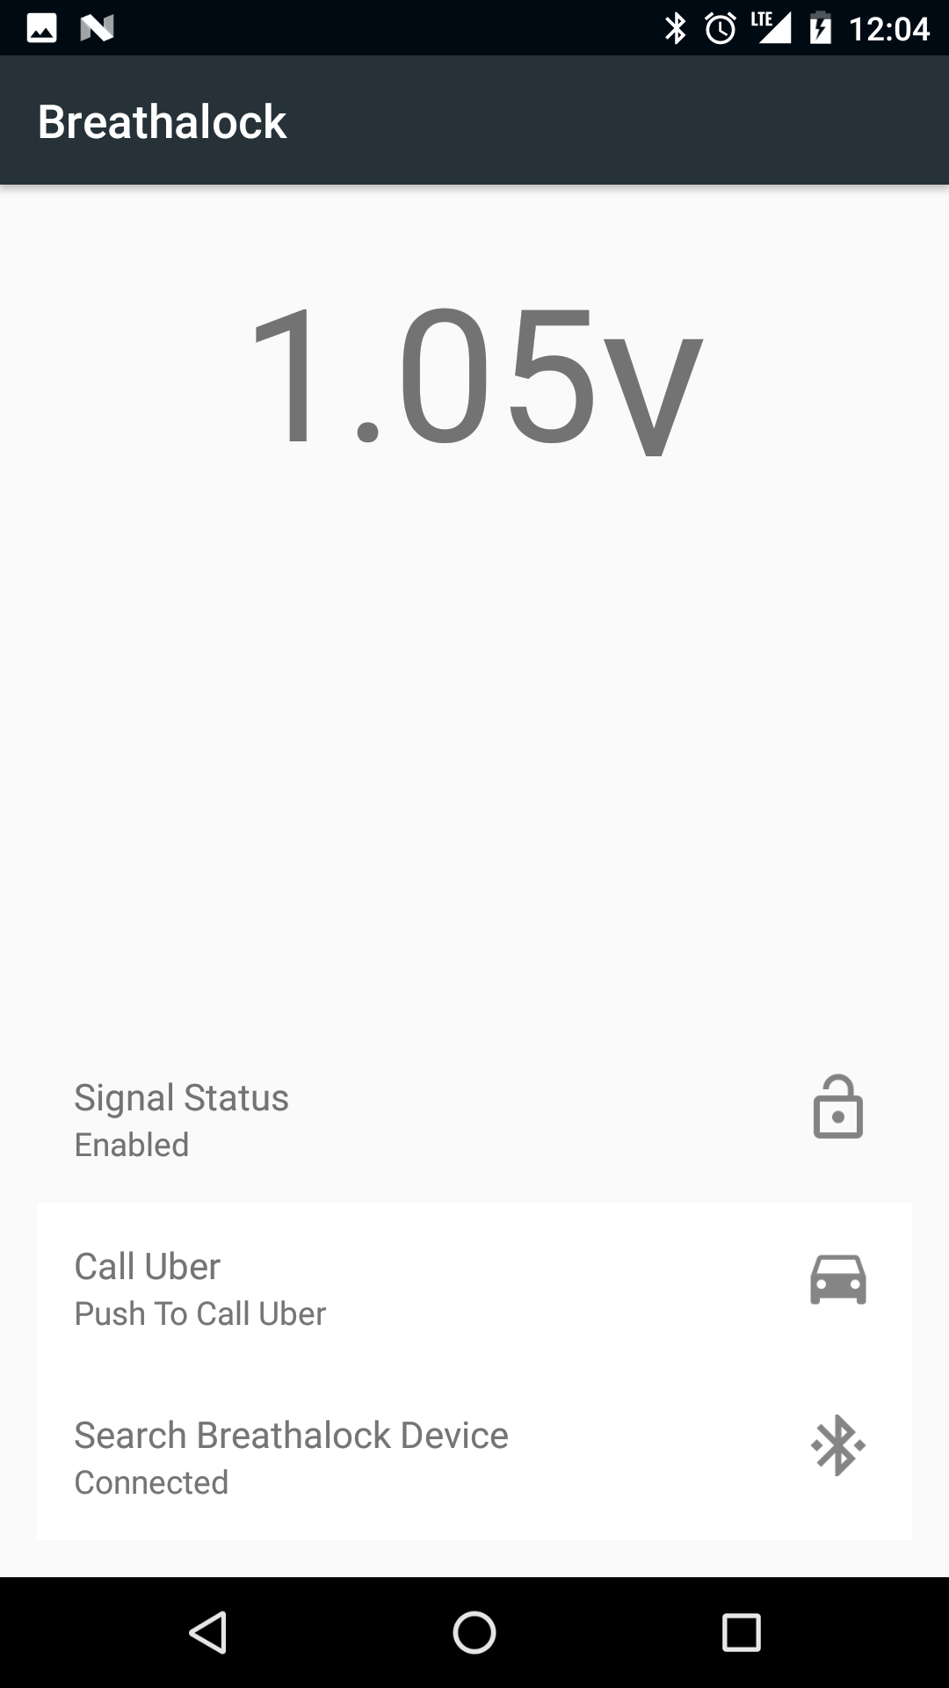
Procedure
Uber option always available
When measuring over the limit the unlock button becomes unavailable on the device
You are prompted with an alert which includes

Slide 41
Prototyping
Pictured Development Board (left to right):
Fingerprint Sensor
Alcohol Sensor (MQ-3)
Bluetooth
Development Board

Slide 42
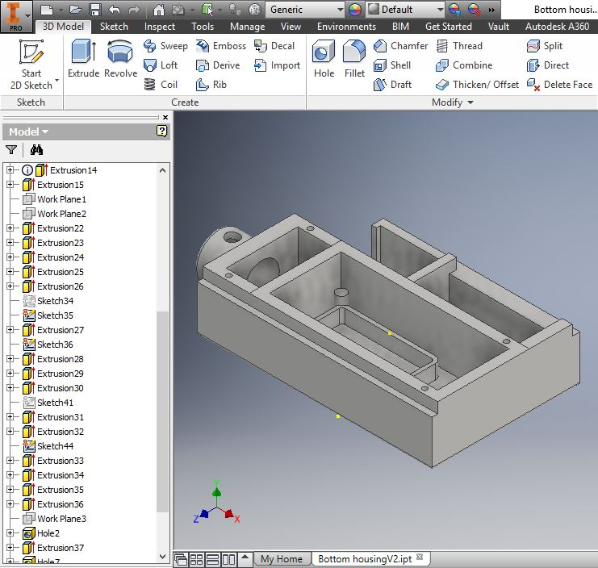
Enclosure Design
Designed in Autodesk Inventor
Dimensions
2.86” x 1.55” x 5.15”
Printed in PLA

Slide 43
Final Product
Pictured Development Board (left to right):
Dimensions
2.86” x 1.55” x 5.15”
Weight
0.41lbs
PLA Custom 3D Printed Case

Slide 44
Administrative Content

Slide 45
Work Distribution
Name | Power | Component Testing | PCB Schematic | PCB Board Layout | Software | Mobile Application
Nick | Secondary | Primary | Primary | Secondary | Secondary
Charles |  | Secondary |  |  | Primary | Primary
Nam | Primary |  | Secondary | Primary |  | Secondary

Slide 46
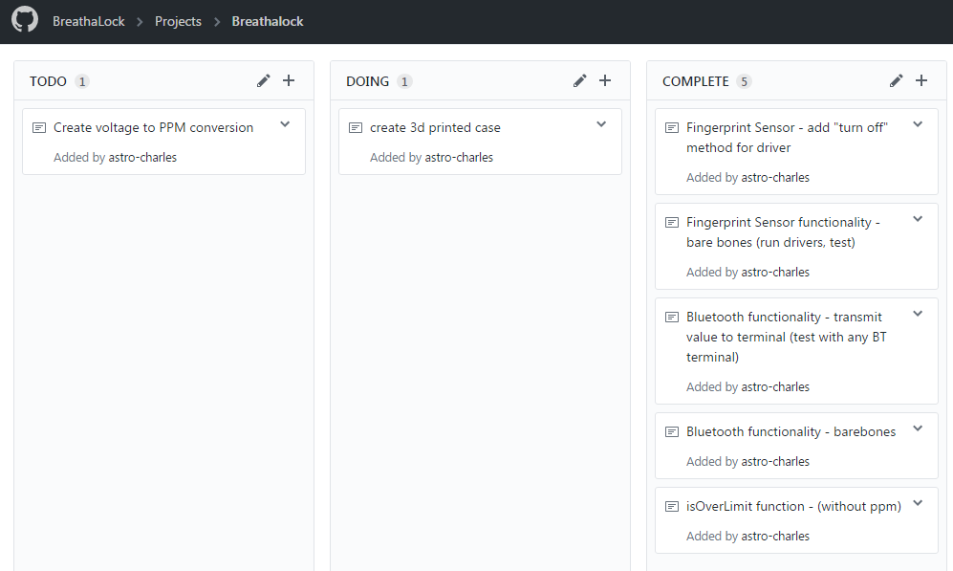
Kanban – Workflow

Slide 47
Budget Analysis
Estimated Cost
Part | Quantity | Cost | Total
Microcontroller | 2 | $10-$20 | $20-$40
Fingerprint Sensor | 2 | $30-$45 | $60-$90
Bluetooth Module | 2 | $20-$35 | $40-$50
Blood alcohol Sensor | 2 | $30-$45 | $60-$90
Battery | 6 | $3-$5 | $6-$10
Remote Key | 2 | $20-$30 | $40-$60
PCB | 3 | $20-$30 | $60-$90
Estimated Total |  |  | $376-$430
Actual Costs
Part | Quantity | Cost | Total
Microcontroller | 3 pieces | $5 | $15
9v Battery | 4 | $3.50 | $14
Fingerprint Sensor | 2 | $45 | $90
Bluetooth Module | 1 | $20 | $20
Gas sensor | 2 | $5 | $10
RF transmitter | 3 | $7 | $21
RF receiver | 1 | $5 | $5
FTDI board | 1 | $8 | $8
Crystal Oscillators | 10 | $0.60 | $6
N-channel MOSFET | 7 pieces | $1 | $7
Dip Socket | 10 pieces | $0.70 | $7
Total |  |  | $203
Notes:
Estimated, bought multiple components, and does not include PCB yet

Slide 48
Cost Analysis (per item)

Slide 49
Financing
No sponsorship
We are self-funded and have no sponsorships therefore, are able to create the product to our own preferences with no constraints.
We paid for everything ourselves.

Slide 50
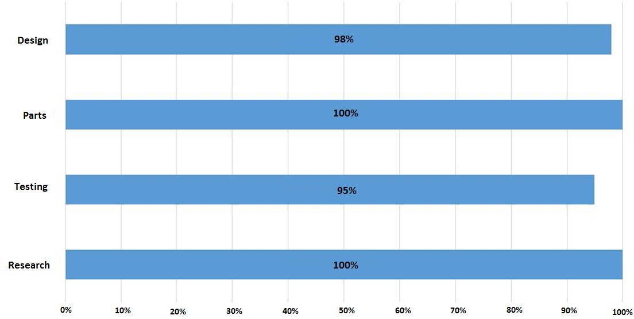
Project Progress

Slide 51
Specifications and Requirements Met
 | Required Specifications | Implementation
Size | No more than 3” x 3” x 7” | 2.86” x 1.55” x 5.15”
Weight | No heavier than 1lb | Weighed at 0.41lbs
Power | Within 4W of power | (9V)(0.365A) = 3.258 W
RF transmission | Lock signal is always enabled If identified user verifies sobriety unlock signal can be sent | Lock signal is always enabled MOSFET Switch Controls the unlock signal
Alcohol detection | Detect if user is blowing vs. ambient air Must distinguish between above and below legal alcohol limit | Software blow detection Distinguishable values
Biometric Verification | Fingerprint storage Fingerprint recognition | Fingerprint storage Fingerprint recognition

Slide 52
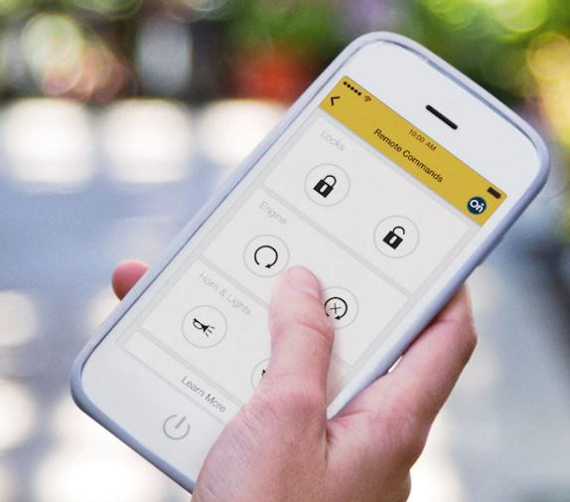
Forward Thinking
Manufacturers are integrating cellphone control of locks, ignition, etc.
We already communicate with cell phones and could provide data to these applications.
With the help of big name car manufacturers it would be possible to integrate BreathaLock features.

Slide 53
Questions?

Slide 54
Demo!

Slide 55
Fingerprint Process Flow
After powering Breathalock on before proceeding the user must
Have a fingerprint stored
Scan your finger
The user will place their finger on the scanner
The scanner takes roughly 2 seconds to scan
The device then compares that image to

Slide 56
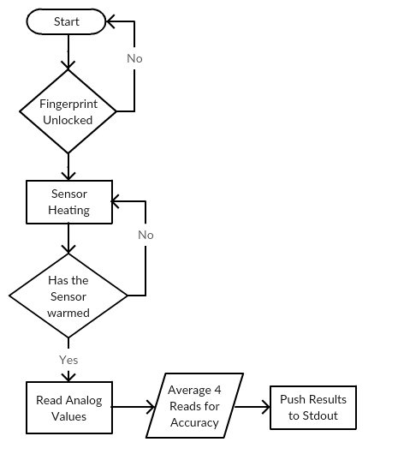
Gas Sensor Software Flow
Before processing Alcohol content in air the user must
Unlock the device with the fingerprint sensor
Wait for warming time
The device will begin reading the analog values passed over the sensor
To mitigate abnormal readings we average four readings together
Push the results to standard out

