Slide 1
Portable Finish Line for Sprinters Group 30
Michael Colucciello – Computer Engineering
Jamal McNab – Electrical Engineering
Tyler Snell – Electrical Engineering
Argeny Batista – Electrical Engineering

Slide 2
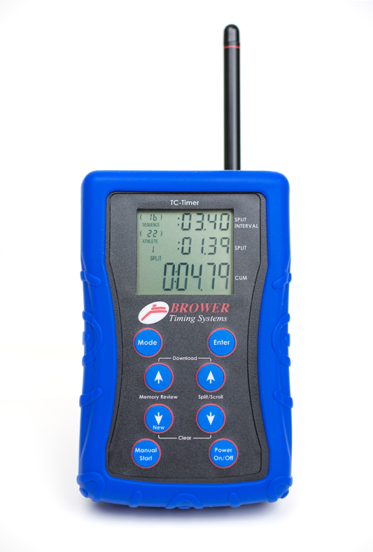
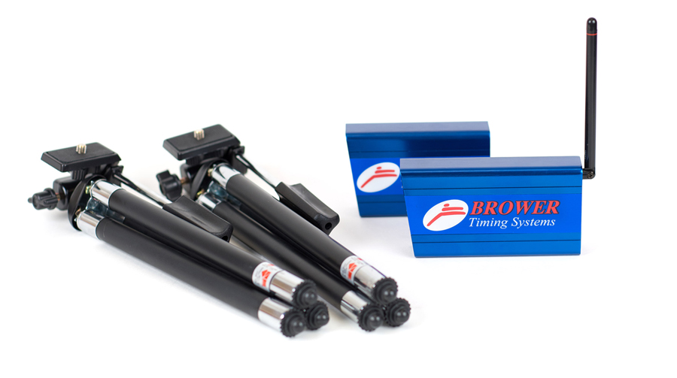
Motivation
Most sprinters rely on a human with a stopwatch in practice
Lack a convenient method of tracking improvement and progress
Few sprinters have convenient access to automatic timing
Fully Automatic Timing systems typically only used in competition
Want to bring the precision of automatic timing to practice
Most personal Fully Automatic Timing systems not affordable or convenient
Photo Credit to Browertiming.com

Slide 3
Goals
Bring Fully Automatic Timing systems to practice
Have an affordable option for sprinters of all skill levels
Rechargeable, Lightweight, and portable to be carried to and from practice
Provide a mobile application to wirelessly connect to the device
Streamlined UI for navigation
Track previous times and improvement over time

Slide 4
Specifications
Parameter | Design Specification
Battery life on full charge | 3 hours
Wireless connectivity range | > 100 m
Timing accuracy | To the nearest 0.1 second
Size | 1’2’’ x 1’2’’ x 1’2’’
Weight | < 10 lb
Volume of speaker | 70 dB at 1 meter

Slide 5
Overall High Level Design

Slide 6
Power System

Slide 7
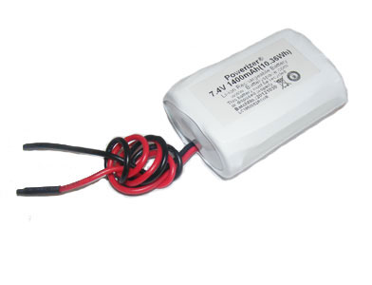
Batteries
Battery Information
7.4V 1400mAh Polymer Li-ion Battery Pack
Nominal Voltage | 7.4V (working) 8.4V (peak) 4.8 V (cut-off)
Nominal Capacity | 1400 mAh min. (10.36 Wh)
Chemistry | cylindrical 18500 rechargeable cells
Terminal | Charging / Discharging terminals: 6.0" (1007) 22AWG wire for charge / discharge
Charging Rate | Standard: 1.2 A
Max Discharging Rate | 2 amps limited by the PCB
Cycle Life | Greater than 500 cycles (If charged and discharged properly)
Dimensions (L x W x H) | 51mm x 38.1mm x 19mm
 | 2.0" x 1.5" x 0.75"
Weight | 2.5 oz. (70.8g)
There will be 2 batteries necessary
Main concerns:
Space
Potential overheating

Slide 8
Battery Charger
Charger Characteristics
Input Voltage | 100 -240VAC 50/60Hz / US AC power plug
Output Voltage | 8.4VDC
Charging Current | 1.2A
 | Charge time = (Ah rate of the pack x 1.5) / 1.2A charge current
Protection | Reverse Polarity and over charge protection
LED Indicator | Red - Charging
 | Green - Fully charged
 | Dim Green/no LED - you are trying to charge a fully charged battery. Solution - discharge/drain the battery first and recharge again.
Dimension (LxWxH) | 88mm(3.5") x 52mm(2.0") x 30mm(1.2")
Weight | 4.9Oz (139grams)
This smart battery charger designed to charge 7.4V Li-Ion/Polymer battery with capacity >= 1600mAh
Automatically cut-off power when battery pack is full at 8.4V

Slide 9
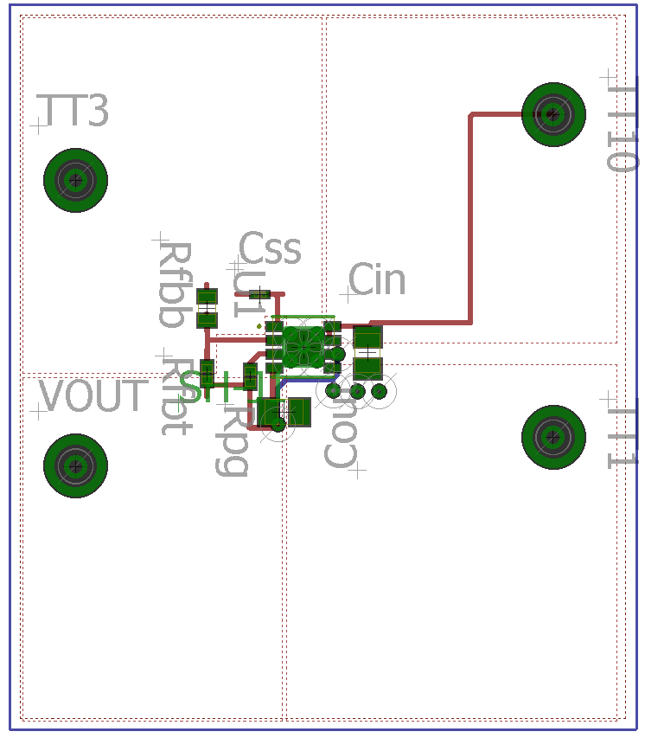
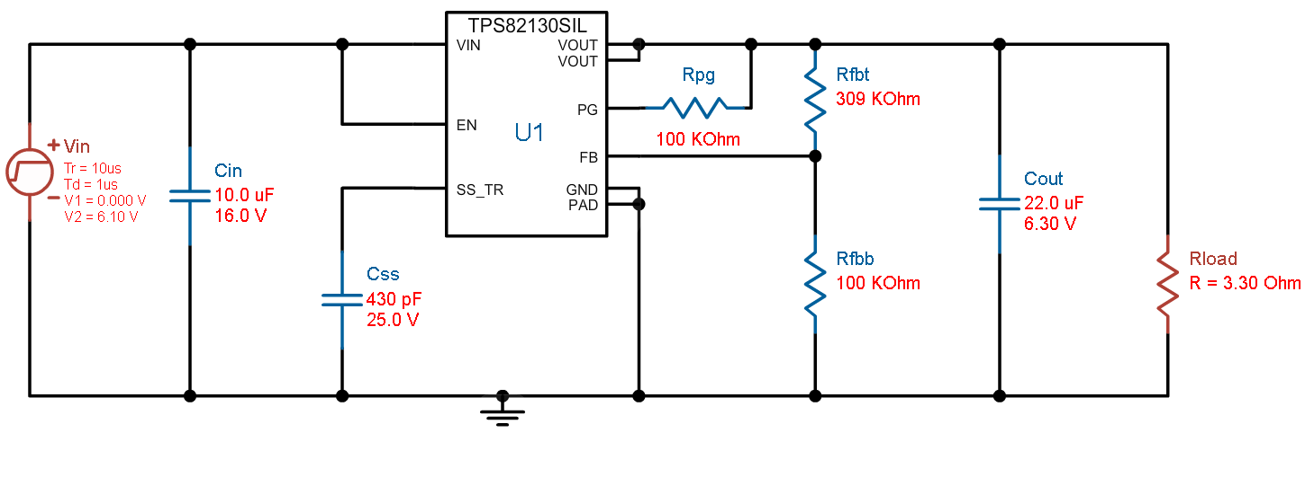
Voltage Regulators
Both a 5V and a 3.3V Rail necessary
Both in main pylon, only 3.3V rail in laser pylon
3.3V Reg: TPS82130
High efficiency 92.44%
Low foot pring

Slide 10
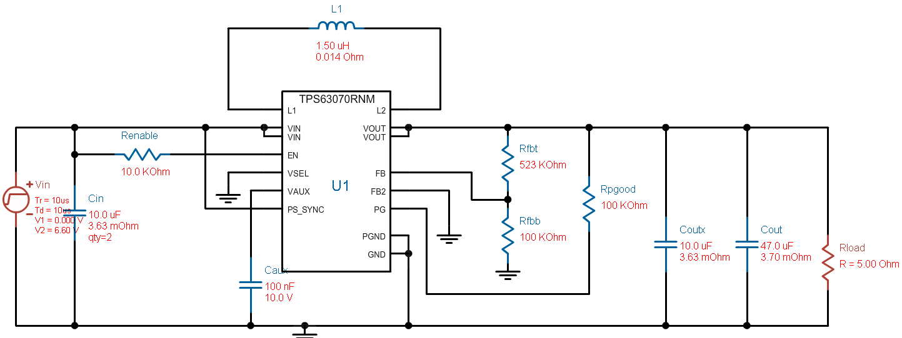
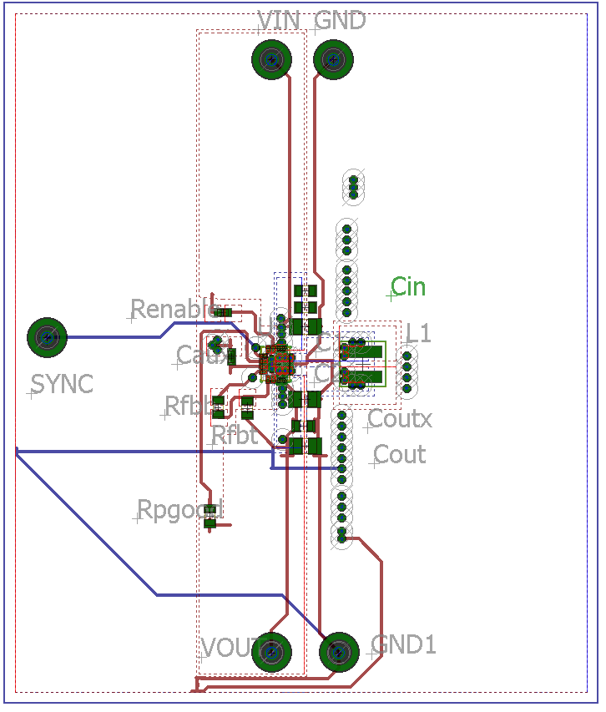
Voltage Regulators
5 V Reg: TPS6307
High efficiency 92.58%
Low Footprint

Slide 11
Microcontroller and Sensors

Slide 12
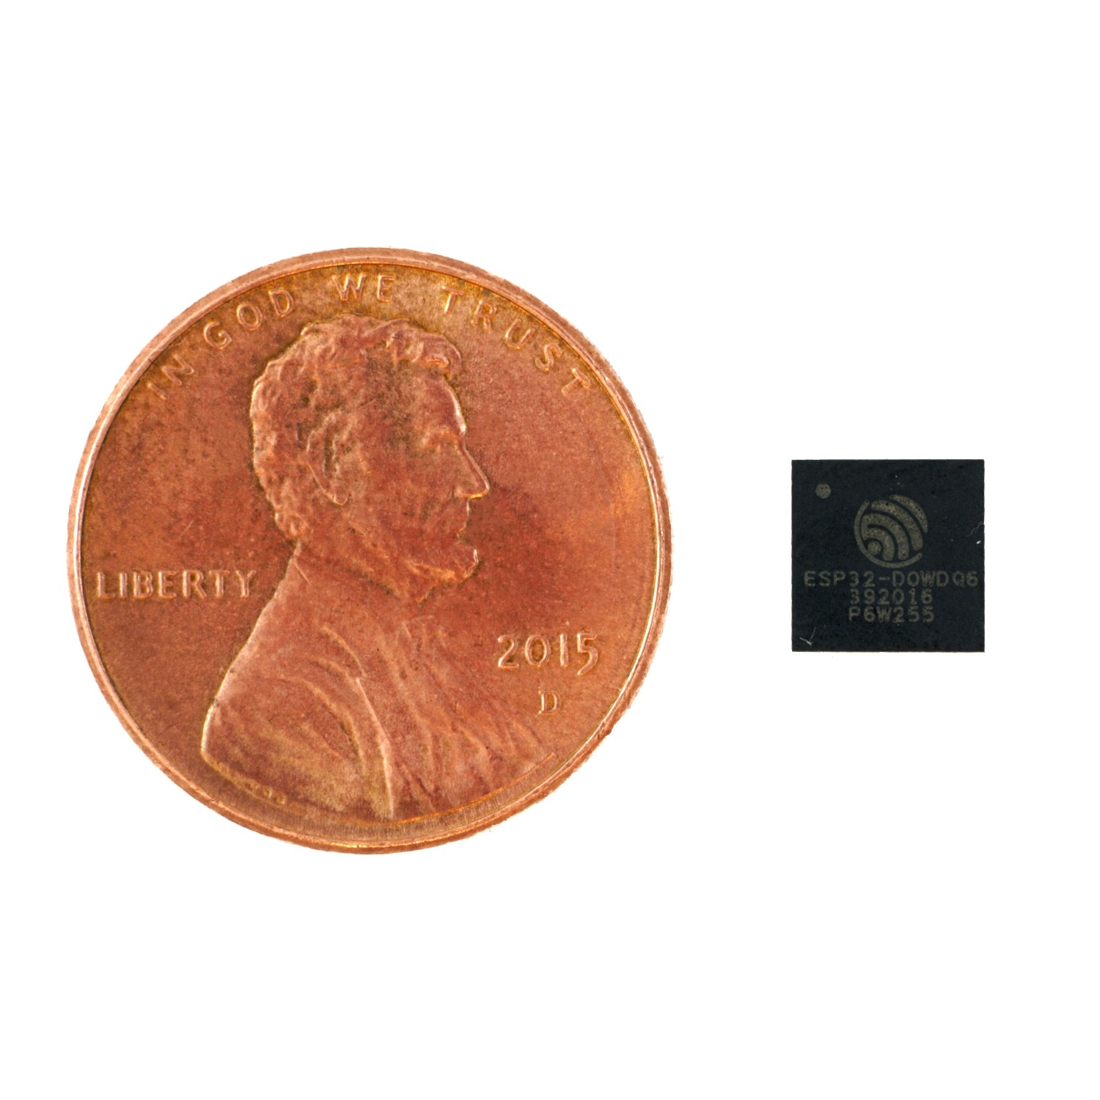
Microcontroller Selection
Criteria
Wireless capabilities
Cost
CPU Clock Speed
Package size
ESP 32 chip size
Courtesy of gridconnect.com
 | Esp 32 | Arduino Uno (Atmel) | MSP430/cc3200
Cores | 2 | 1 | 2
Architecture | 32bit | 8bit
CPU Frequency | 160/240MHZ | 16MHz | 80MHz
WIFI | Integrated | None | Integrated
Bluetooth | Integrated | None | None
RAM | 512KB | 2KB | 256KB
Flash | 16MB | 32KB | 16MB
Operating Temp | -40 to 125C | -40 to 105C | -40 to 80C
Low Power Deep Sleep | 2.5 uA | 72 uA | 250 uA
Cost | $ 2.50-9 | $3.00 | $9.20

Slide 13
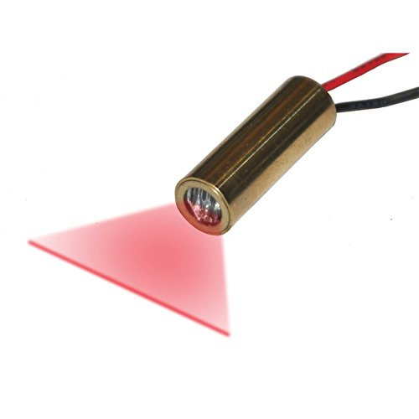
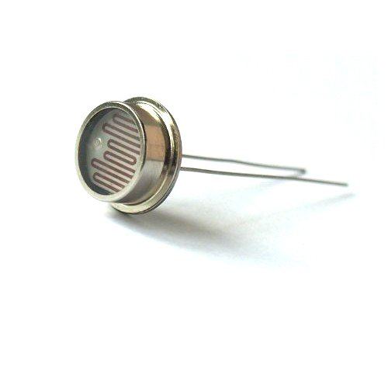
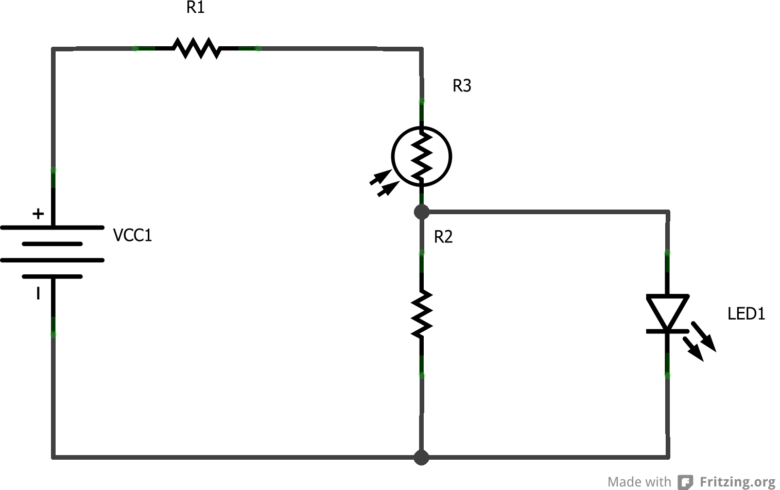
Trip sensor
Line Laser And LDR Sensor
Wave Length: 650nm
Class II less than 1mW
Line width: 1.2mm @ 1 meter
Operating Voltage: 5v
Easy to implement
Easy to Align with LDR sensor from a distance
CONS
Other light sources may interfere with LDR reading

Slide 14
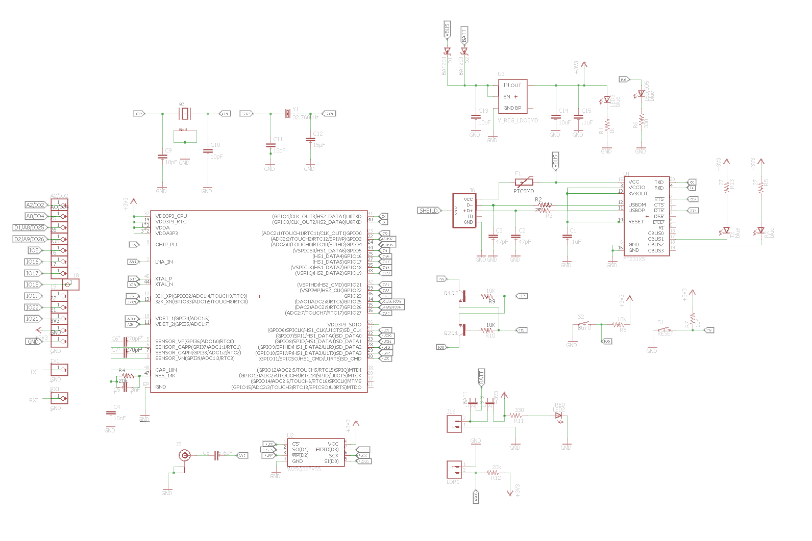
Schematic
3.3 VREG
FTDI (USB)
Latching Pins
JST

Slide 15
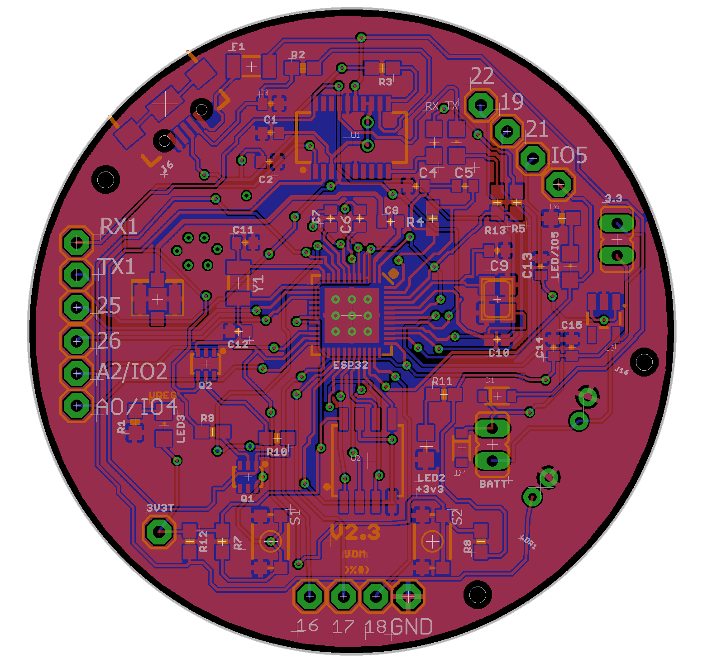
End Result...
Rough estimate of Boards $5-$7 !!!

Slide 16
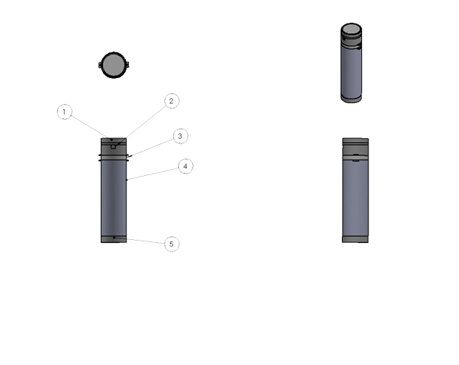
Prototype Structure
Rapid prototyping
3D printing
ABS Plastic
2x towers to house all electronics
Diagram Breakdown
Top Cover
Laser or LDR with Speaker enclosure
Acrylic structure for LED ring
Housing for wireless charger, Power sources and main Board components
Bottom cap

Slide 17
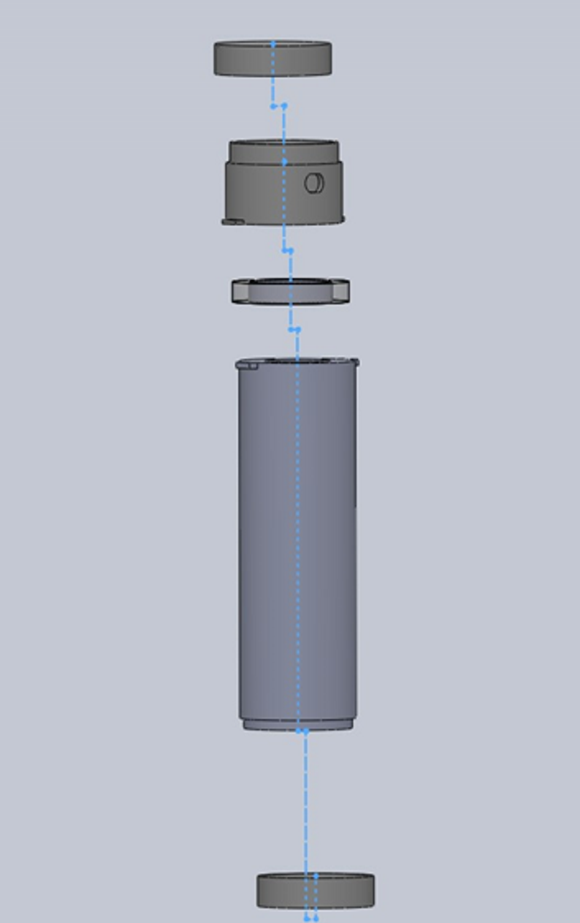
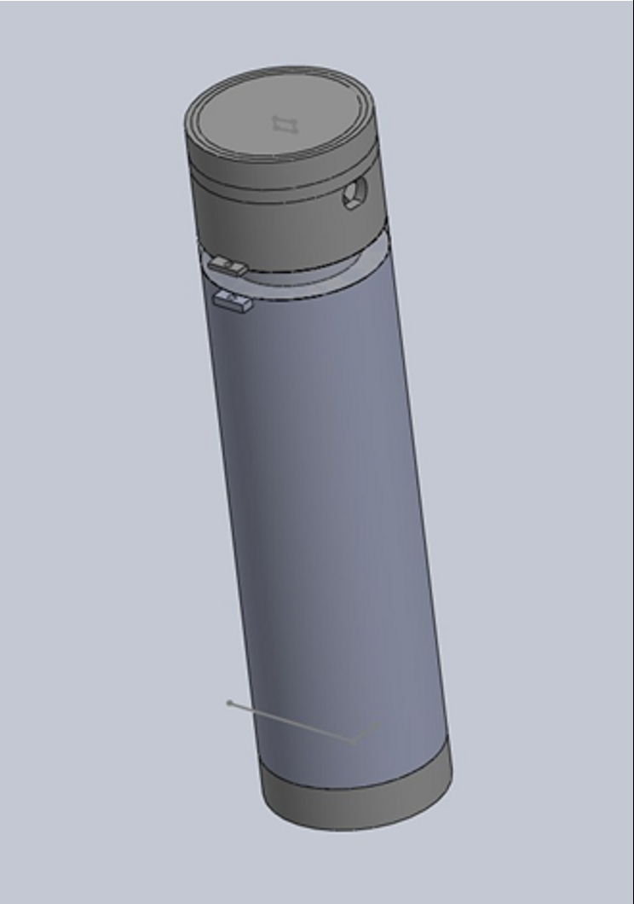
Exploded View
Assembled View

Slide 18
Android Application

Slide 19
Android Application
Developed in Android Studio
Android ver. 4.2 (API Level 17)
Bluetooth Low Energy
Prioritize ease of use in UI and design
2 main modes of operation
Sprint History
Sprinting

Slide 20
Use Case Diagram

Slide 21
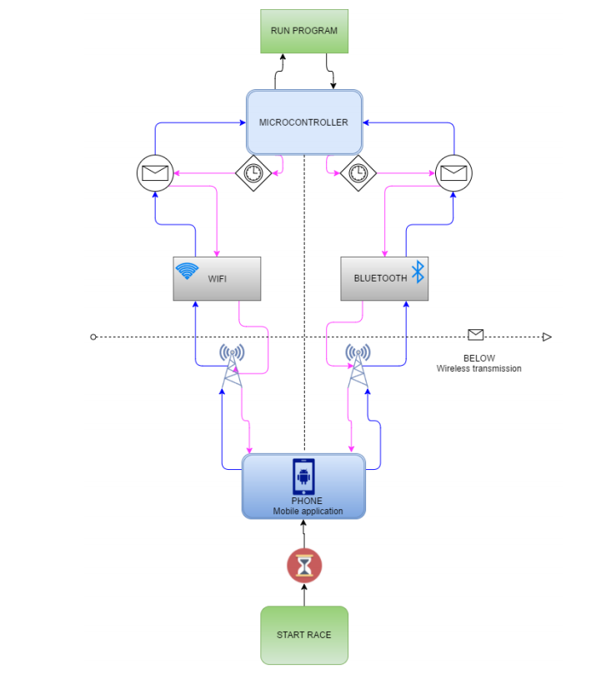
Wireless Communication
Bluetooth Low-Energy
Wi-Fi
Implement both
Bluetooth for general purpose
Wi-Fi for extended range cases

Slide 22
Microcontroller Programming

Slide 23
Microcontroller Software Design
Utilize interrupts and low power modes
Optimal for extending battery life
Perform all timing on microcontroller

Slide 24
Accounting for Multiple Sprinters
Need to ignore errors of one sprinter recording more than one time in a race
Microcontroller will have a “grace period”
Once finish line is crossed, don’t take input for very short amount of time
Grace period length optimized through testing

Slide 25
Audio and Visual Subsystem

Slide 26
Audio and Visual Subsystem
Give the sprinter a stimulus to know when to start running
Provide a visual and auditory countdown for the start of the race
When the user starts the app and chooses to time a new “sprint” this will start a countdown
After a period of time, signals will alert the user when the race will start

Slide 27
3 instances where the LEDs will blink red with a simultaneous beep from the speaker
The fourth instance the LED will blink and hold green with a simultaneous beep
This will trigger the app to start recording the time

Slide 28
Speaker Selection
Speaker | Size (diameter) | SPL (dB) | Power Rated
CDM-20008 | 20 mm | 92 | 300 mW
CDMG15008-03A | 15 mm | 92 | 300 mW
PSR-50F08S-SQ | 50 mm | 92 | 250 mW
PSR20N08AK | 20 mm | 92 | 250 mW

Slide 29
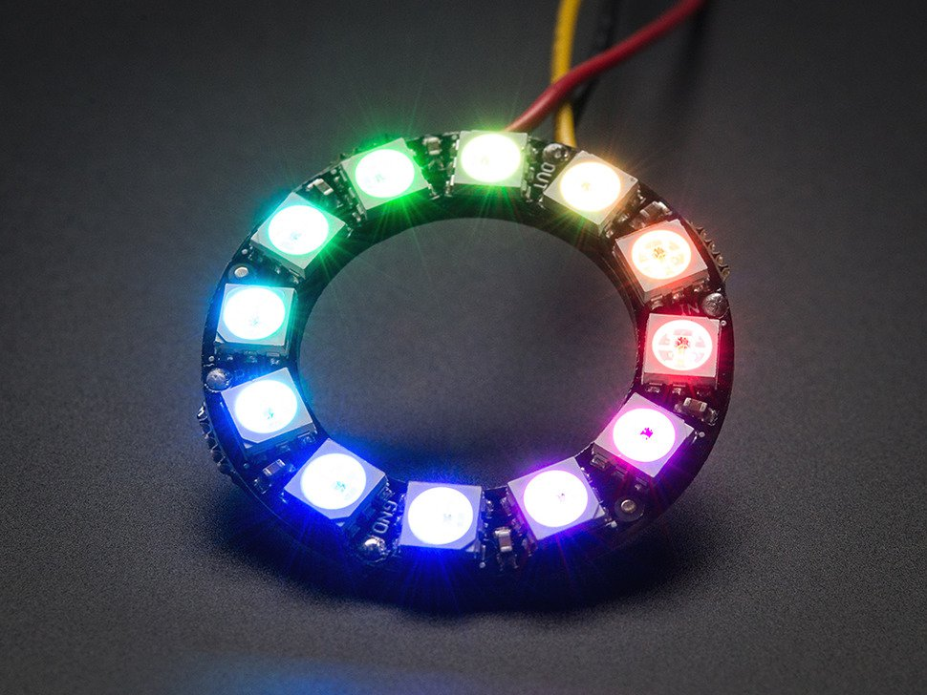
Why the Neopixel Ring
Pros
Cons
Programmable
Adjust brightness and delay, etc.
RGB
Easier to synchronize
Price
Increases the length of code

Slide 30
Choosing an Amplifier
Audio Amp | Operating Voltage | PSRR | Output Power
TPA721 | 2.5-5.5 | 85 dB | 0.7 W
TPA701 | 2.5 | 78 dB | 0.7 W
LM386N-3 | 4-12 | 50 dB | 0.5-0.7 W

Slide 31
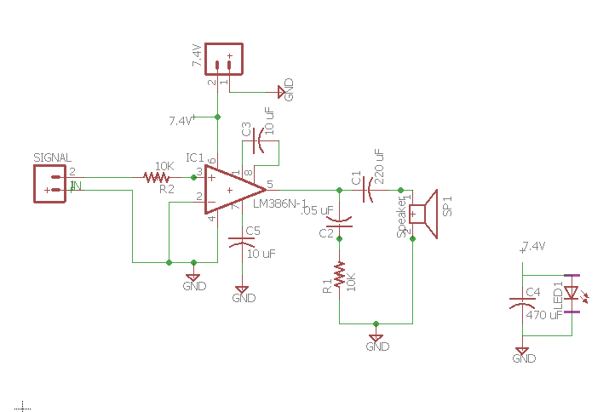
Audio Amplifier and LED Schematic

Slide 32
Administrative Content

Slide 33
Budget & Finance
Self funded project
Estimated necessary budget initially min ~$250
Project Budget
Power Distribution components | $15.96
Batteries | $43.00
Charger Components | $21.50
LED Components | $7.74
Audio Components | $4.28
Laser Components | $4.46
PCB orders | $160.00
Microcontrollers | $5.00
Total Cost | $261.94

Slide 34
Work Distribution
Work Distribution
Subsystem: | Tyler | Jamal | Argeny | Micheal
Power Distribution | P |  | S
Microcontrollers |  | P
Laser/LDR |  | P
LEDs | S |  | P
Audio |  |  | P
Software Architecture & Interface |  | S |  | P
Smartphone App |  |  |  | P

Slide 35
Questions?

