Slide 1
Dancing Water Display
An Audiovisual Spectrum Analyzer
Spring 2016 - Group 37
Timothy Le (EE)
Katie Corini (EE) Esha Hassan (EE)
Joshua Fabian (CpE)
Sponsored by Boeing/Leidos

Slide 2
Project Description
Physical representation of spectrum analyzer using water pumps
LEDs that flash to audio input
Connect to music-playing devices
Mobile application to control power, light, and pump settings
Wireless connectivity
User friendly

Slide 3
Motivation
Aesthetically pleasing product
Expand on existing water speakers in the market
Integrate signal processing with art
Gain experience in software, embedded, and mechanical development

Slide 4
Goals and Objectives
Portability and efficiency
Stable structure
Secure sealing
User friendly smartphone application for customizability
Built-in speakers
Simple design
Functionality at room temperature

Slide 5
Project Specifications
Water Pumps
16 divisions
Variable heights for water streams
Specific frequency range for each division
Consistent flow rate of approximately 53GPH (or 240 l/h)
Each pump should not exceed 70 grams
MCU
Bluetooth connectivity
Direct audio input
Operates at 15V

Slide 6
Project Specifications (cont.)
LEDs
96 RGB illumination LEDs
5mm rounded top
Luminous intensity of 8000 mcd
Display
Dimensions within 3’ x 1.5’ x 1.5’
Weight approximately 10 pounds
Plexiglass tank dimensions within 10” x 31.75” x 2.75”
Plexiglass tank is leak-free
Wooden mounting surface for water pumps within 31.75” x 2.75”
Portable

Slide 7
Project Specifications
Software
Wireless communication: Bluetooth
Android availability
User-friendly
Power, LED, and pump settings

Slide 8
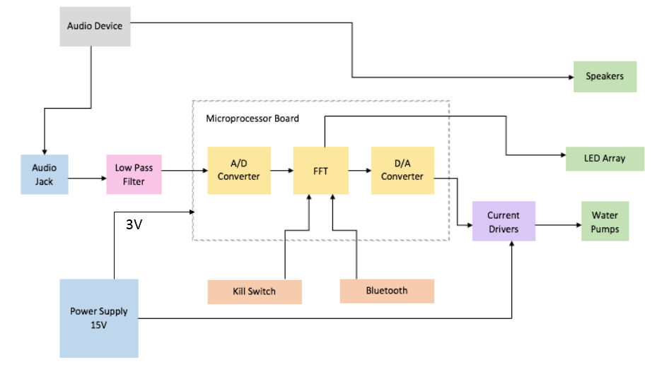
Top Level Block Diagram

Slide 9
Hardware Development

Slide 10
Top Level Overview

Slide 11
Audio Signal Characteristics
Audio voltage from -2 to 2 V
Standard range of frequencies for music from 0-4000 Hertz
Signal into processor needs to be 0-3.3V

Slide 12
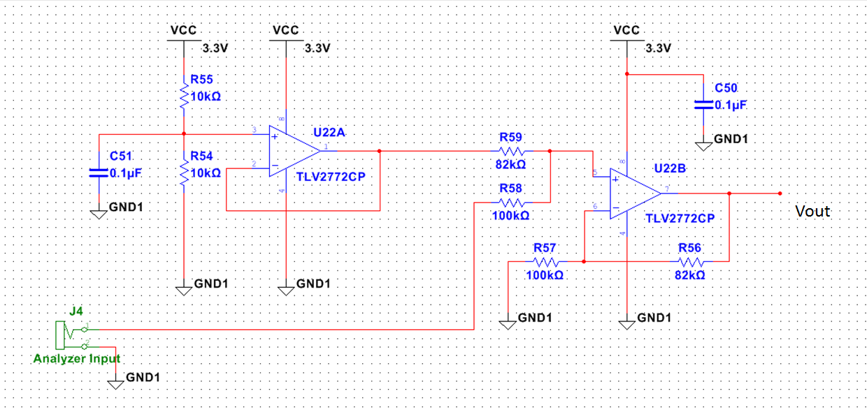
Level Shifter
Must shift voltage by 2V and attenuate to 3.3V
Following Schematic was used to achieve proper gain

Slide 13
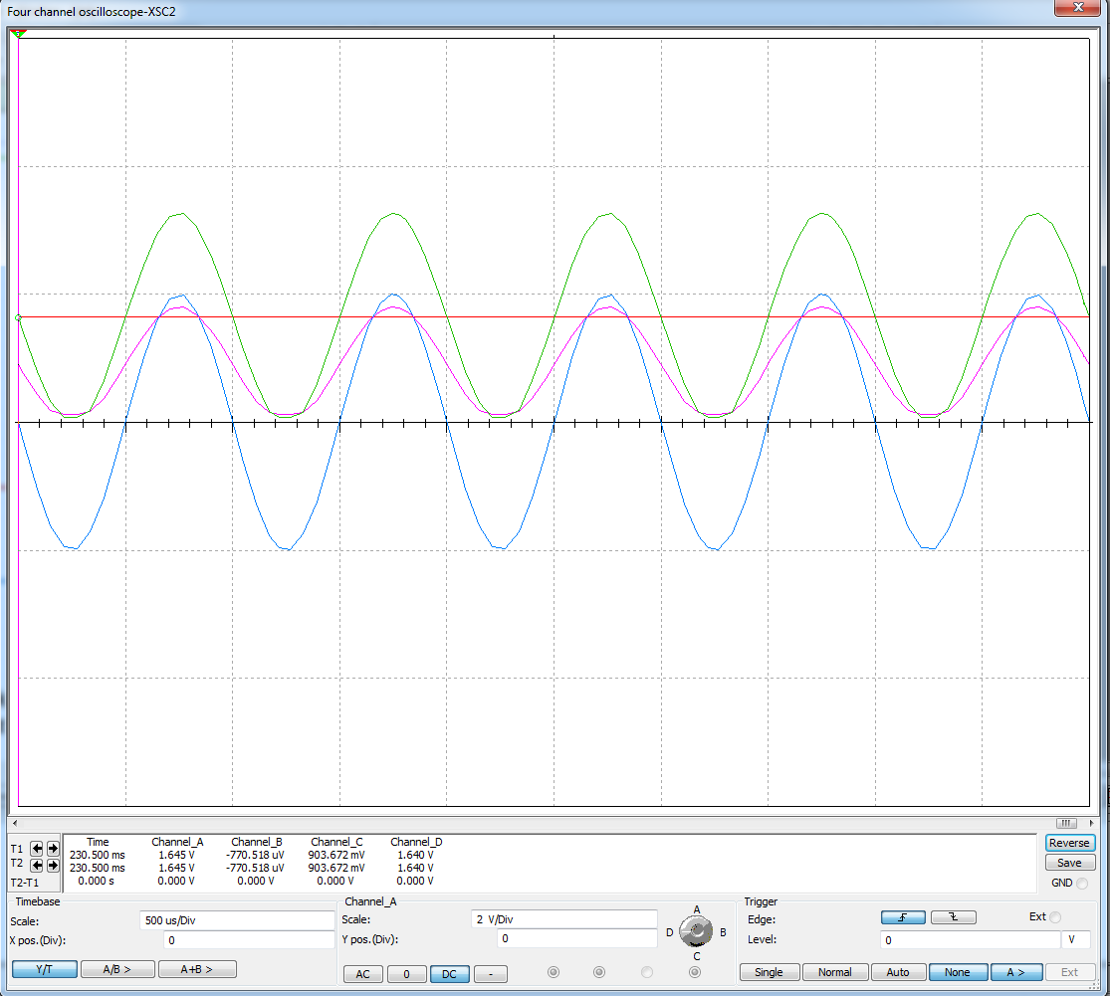
Level Shifter

Slide 14
Low Pass/Antialiasing filter
Low pass filter to limit to 4 KHz
Wanted to emulate ideal brick wall filter
Elliptic filter had steepest roll off rate
Maxim MAX7404 filter chip. 8th order, low pass, elliptic, switched capacitor filter, DIP version

Slide 15
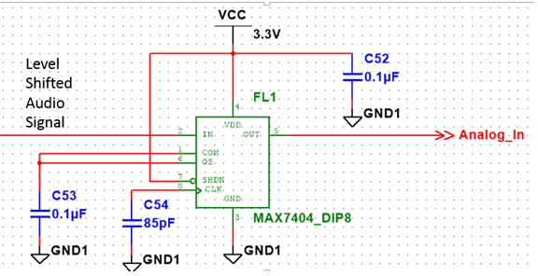
Filter Schematic

Slide 16
Microprocessor Board

Slide 17
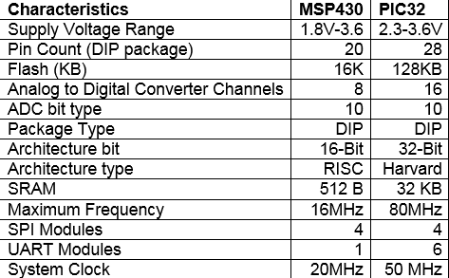
Microprocessor Selection
Project requires large amount of software programming
Microcontroller needed
Center of management of the spectrum analyzer.
Decided between MSP430 and PIC32

Slide 18
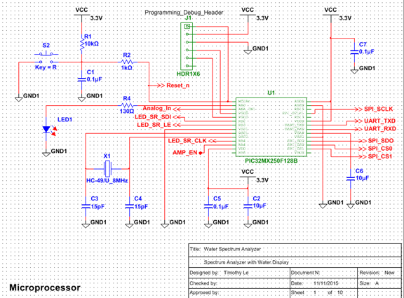
MCU Schematic

Slide 19
A/D Conversion
Analog Signal must be converted to digital
PIC32 comes with internal successive approximation (SAR)
Sampled at 10kHz
Signal transformed using a Fast Fourier Transform algorithm, described in the software section

Slide 20
D/A Converter
Continuous signal must be sent to the water pumps to display.
16 independent outputs, each corresponding to a water pump
Each output assigned to a specific frequency range
Decided to use LTC 1665 Micropower DAC
Serially addressable (SPI)
DACs need to be daisy chained

Slide 21
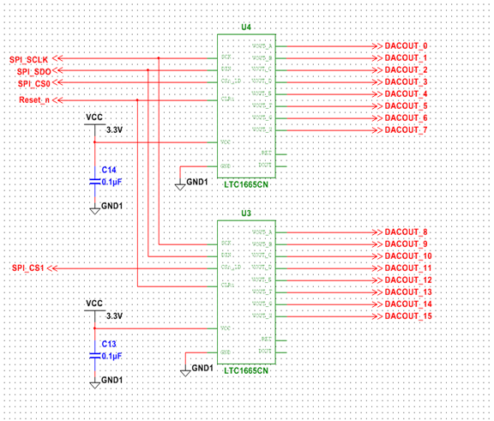
DAC Schematic

Slide 22
Power Drivers

Slide 23
Pump Drivers
Signal from DAC needed to be amplified to voltage pump can use
Implemented 16 power operational amplifiers
Used OPA548T op amp

Slide 24
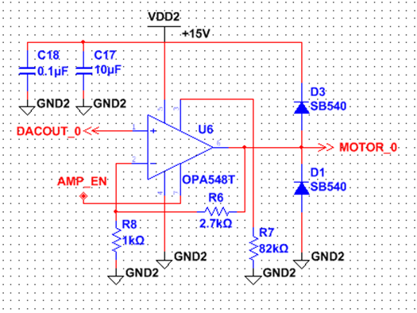
Pump Driver Schematic

Slide 25
PCB Development
Used Ultiboard Software to model PCB board
Sunstone for manufacturing
Used two separate boards, one for low voltage processing, and the other for pump drivers
Used DIP package for ease of soldering

Slide 26
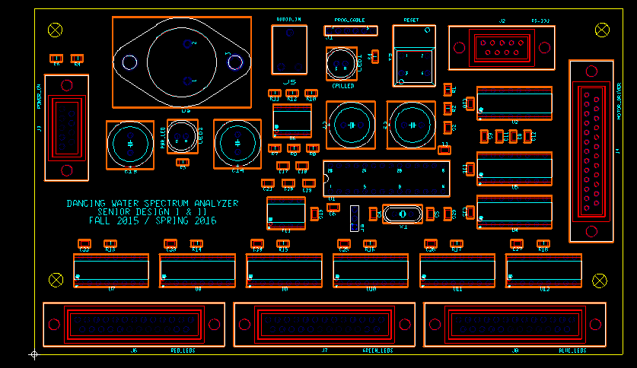
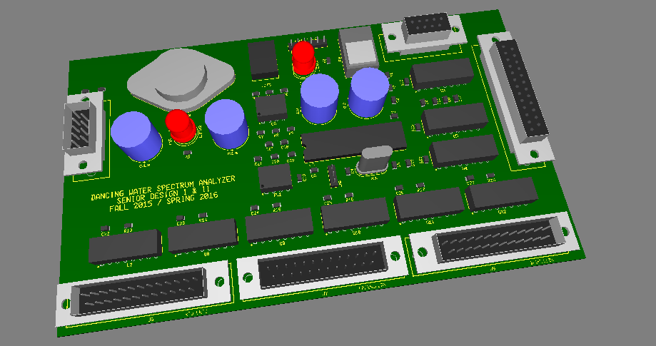
Low Power PCB

Slide 27
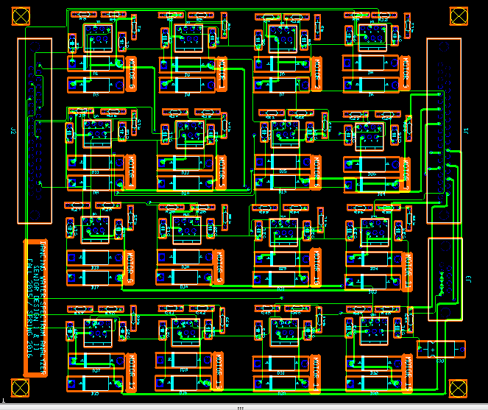
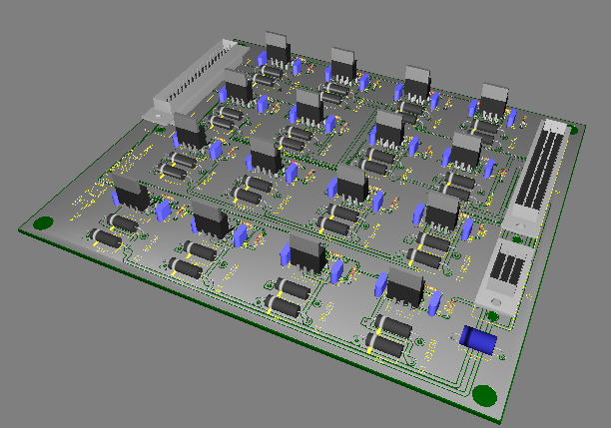
High Power PCB

Slide 28
LED Array

Slide 29
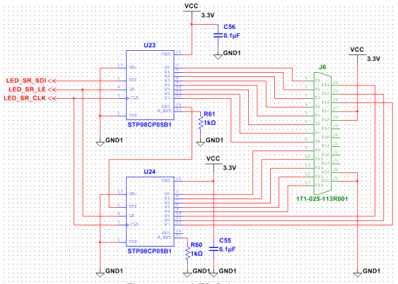
LED Shift Register

Slide 30
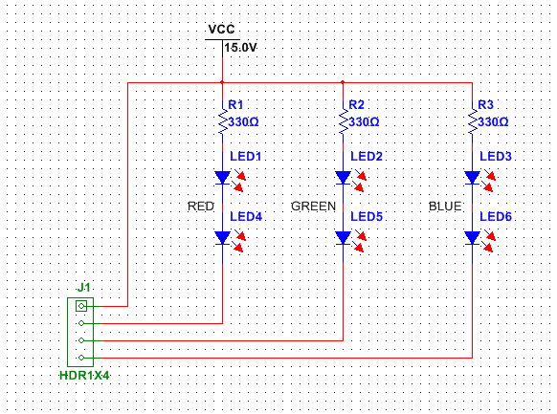
LED Schematic

Slide 31
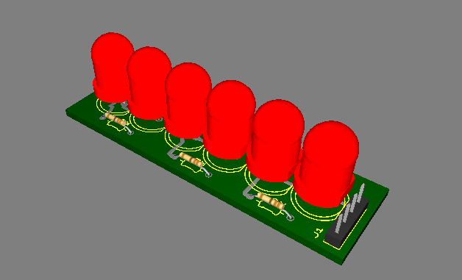
3D Model of LEDs

Slide 32
Mechanical and Power Design

Slide 33
Water Pumps
Water Display Options
Single large water pump
PVC pipe network
16 Solenoid rotary shutters
Display would show frequency as on or off
16 small water pumps
Individually controlled
Vary water height
Display would show frequency magnitude levels

Slide 34
Water Pumps
Comparison of Various Pumps
 | PonicPumps | Unliclife | Docooler | Magicfly
Voltage | 120VAC | 120VAC | 12VDC | 12VDC
Power | 6W | 4W | 4.8W | 4.2W
Dimensions | 65x42x49.5mm | 47x43x30m | 52x46x55mm | 51x34x42.7mm
Weight | N/A | N/A | 65g | 50g
Price | $14.99 | $7.99 | $11.69 | $10.99
Notes:
Talk about AC vs DC Voltage

Slide 35
Power Supply
Types of Power Supplies
Non-switching
Large transformer
Linear regulators
Switching
Small transformer
Switching regulators
Difficulties building a high Power Supply
Webench
No schematics
Power^{e}Sim
Difficult parts
Notes:
Difficulties with

Slide 36
Power Requirements and Power Supply
Water Pump | 16x Magicfly
Voltage | 12VDC
Current | 5.6A
Power | 67.2W
Length | 808mm/31.8in
Weight | 800g/1.76lbs
Power Supply | SP320-15
Input Voltage | 120VAC
Output Voltage | 15VDC
Output Current | 20A
Output Power | 300W
Price | $64.37

Slide 37
Power Flow Chart
Wall Outlet
120VAC
Power Supply
300W
15VDC
16x Op-Amp
12VDC
16x Water Pump
Switching IC
5VDC
Microprocessor Board

Slide 38
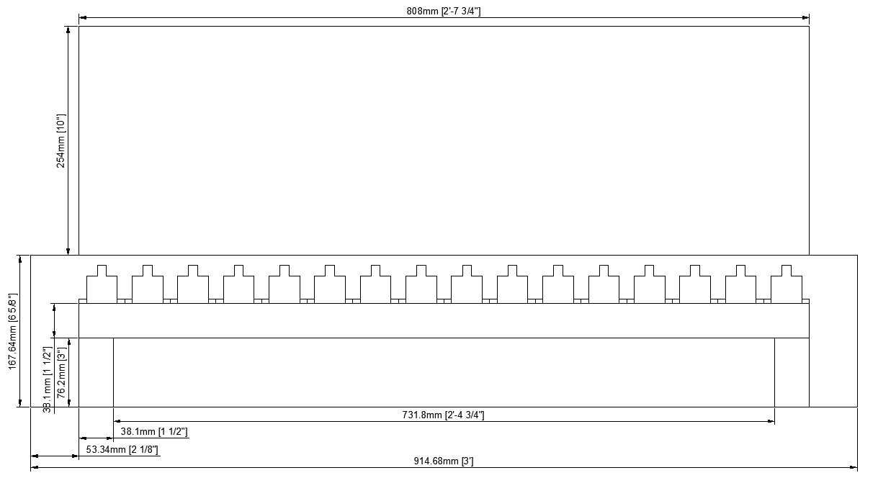
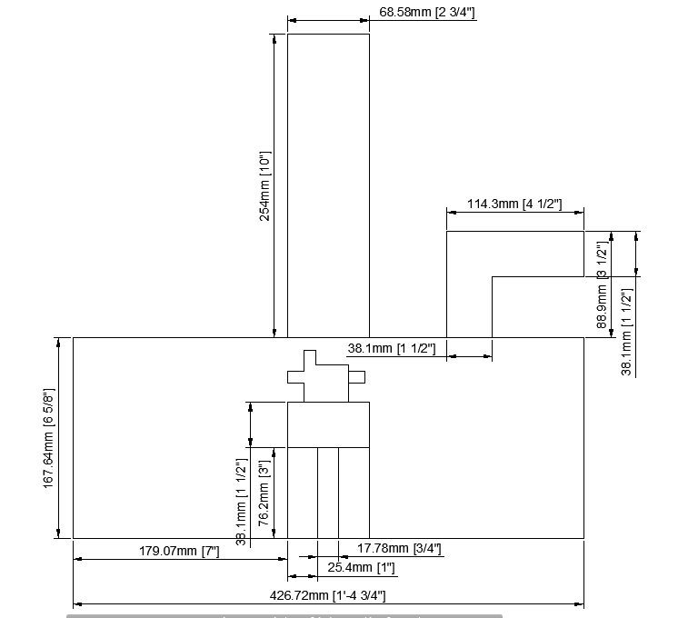
Display Frame
Front View
Side View

Slide 39
Software Development

Slide 40
Embedded Software
Performing a Fast Fourier Transform on an input analog audio signal
Analyzing the magnitudes of the different frequencies in the input
Outputting control signals to regulate power supplied to water pumps
Outputting control signals to the various LEDs in the display
Responding to physical button presses
Responding to wireless signals

Slide 41
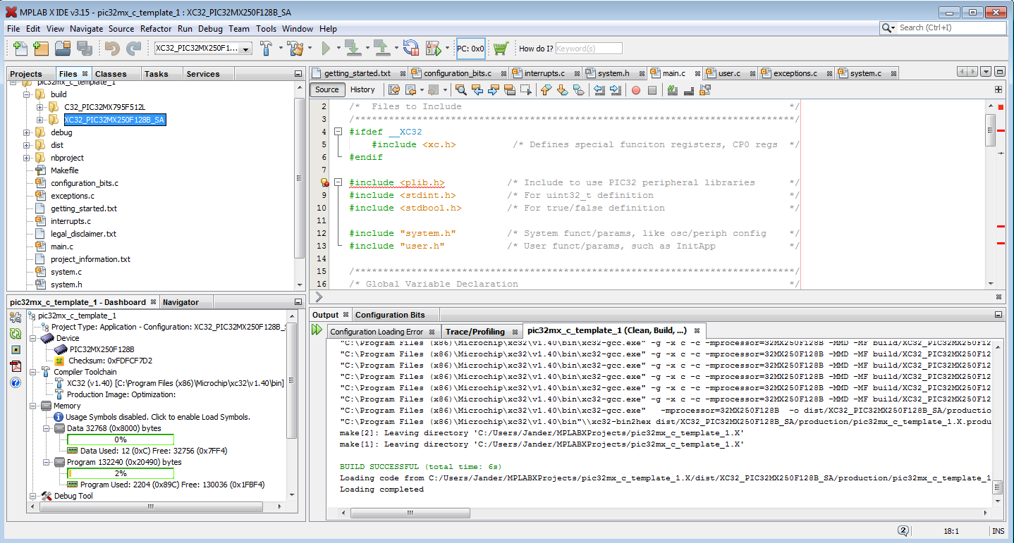

Slide 42
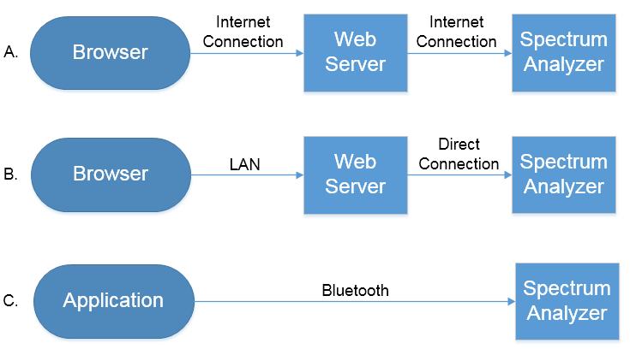
Platform Selection

Slide 43
Application Software
Availability on at least one major brand of smartphone
Decided on Android
Android Studio
Java
An easy-to-use user interface with intuitive controls
Responsive performance
Ability to communicate wirelessly with the spectrum analyzer
Send control signals (power, LED control)
Stretch goal: send music

Slide 44
Wireless Communication
Effective Range
Throughput
Cost
Reliability

Slide 45
Wireless Options
 | Bluetooth v4.0 | 802.11n Wi-Fi | ZigBee | NFC
Operating Frequency | 2.4 GHz | 2.4 GHz or 5 GHz | 2.4 GHz | 13.56 MHz
Maximum Throughput | 270 kbps | 300 Mbps | 250 kbps | 424 kbps
Power Consumption | 2.5 mW | 300 mW + | ~ 1 mW | Minimal
Maximum Range | 10 m | 20 m | 10 - 20 m | 10 cm
Approximate Cost | $10 | $25 | $34 | $27

Slide 46
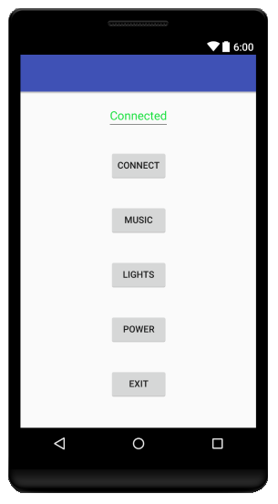
User Interface

Slide 47
Administrative Content

Slide 48
Work Distribution
 | Display Frame | Hardware Design | PCB | Software Design | Wireless Connectivity | LED coding | Power Supply
Tim |  | X | X
Katie | X |  |  |  |  |  | X
Esha | X |  |  |  |  | X
Josh |  |  |  | X | X

Slide 49
Budget and Finances
Item | Cost | Status
PCB Manufacturing | $400 | Received
Water Pumps | $176 | Received
LEDs | $30 | Estimate
Bluetooth Module | $60 | Estimate
Circuit Components | $50 | Received
Casing | $40 | Estimate
Power Supply | $65 | Received
Total | $931

Slide 50
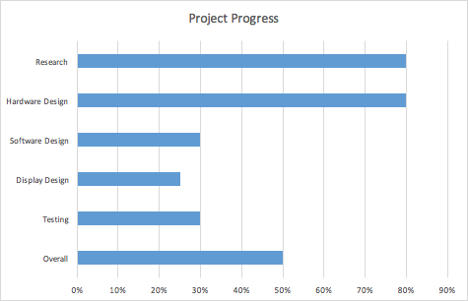
Project Progress

Slide 51
Challenges
Programming PIC32
Creating an application
Implementing Bluetooth
Making the structure watertight
Making the display aesthetically pleasing

Slide 52
Acknowledgments
Dr. Richie
Dr. Lei Wei
Boeing/Leidos
UCF

Slide 53
Questions?

