Slide 1
Nerf-Battlebot
Red Team
Group 9
Aaron Hoyt
Daniel Agudelo
Rachel Gremillion
Rafael Ramirez
EE.
CpE.
CpE.
CpE.

Slide 2
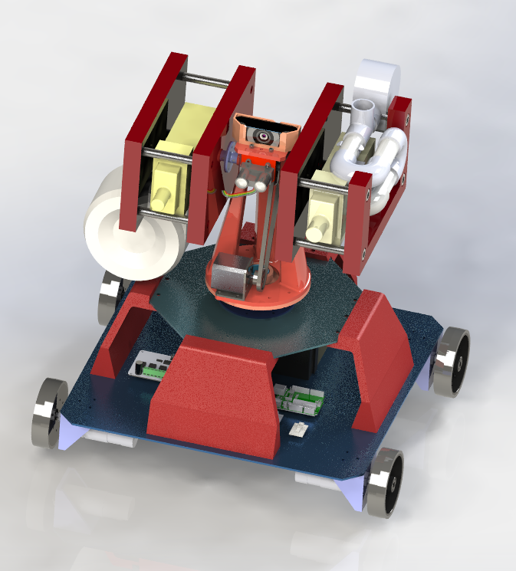
Motivation
Lockheed Martin mentorship
Collaborate with other engineering disciplines
High quality components
Annie

Slide 3
Goals and Objectives
Design a modular system
Provide robot with powerful as well as precise movement
Onboard processing
Combine two sensor modalities

Slide 4
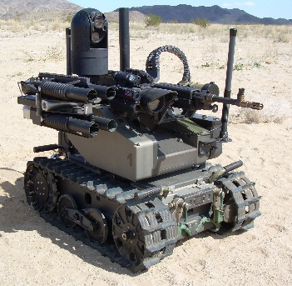
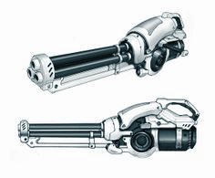
Customer Requirements
Dimensions and Mobility
Budget
Sensor
Weapon System
Target Detection
Physical Platform
& Movement
3 ft. x 3 ft. x 3 ft. (L x W x H)
Must be able to traverse battlefield
Prototyping budget of $2K
Maximum as-demonstrated cost of $1K
Use at minimum one sensor
Must acquire and fire at selected targets
Max ammo store: 50 rounds per gun
Video highlight overlay on detected targets
Wireless connection

Slide 5
Engineering Requirements
Power
Movement Speed
Aiming Accuracy
Processing time
Be able to last two 10 minute rounds
Be able to obtain a minimum speed of 1.0 ft/s
Hit 2ft. x 2ft. targets from max range of 40 ft.
Be able to detect and fire upon target within a 3 second time frame

Slide 6
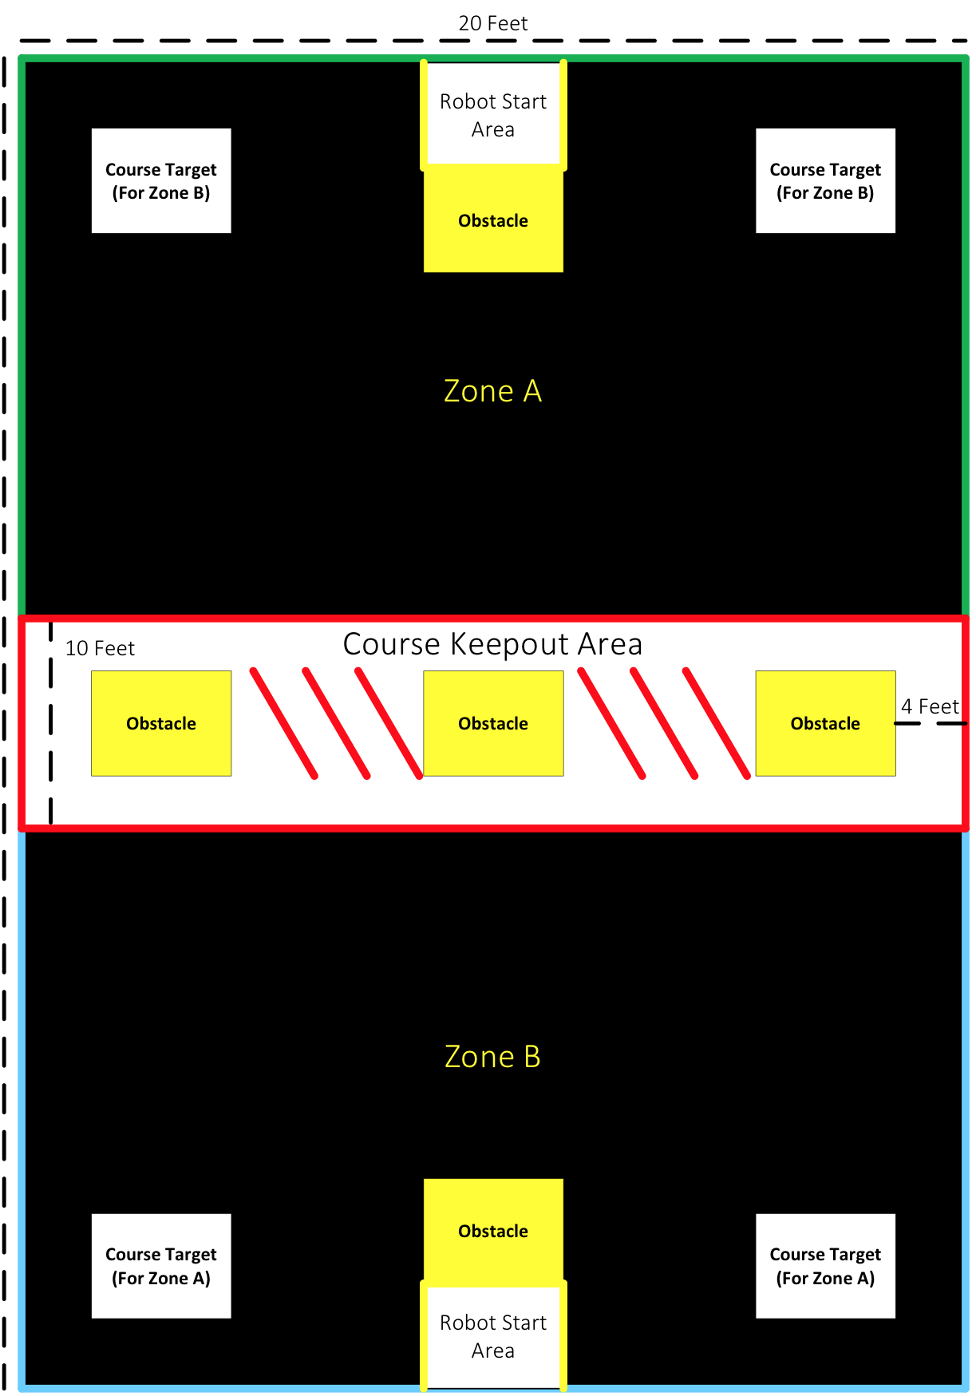
Competition
Arena 40ft. by 20ft. Two Zones 15ft. by 20ft. Course Keepout Area In the middle 10ft. by 20ft.
Rounds One-to-one robot battle 10 minutes Three rounds Red vs. Green Red vs. Blue Green vs. Blue
Point System Enemy Bot Nerf Ball (2) Enemy Bot Nerf Dart (4) Enemy Medic (8) Course Target [Max 2] (2) Entering Restricted Area (-5)

Slide 7
Robot Architecture
Deliberative paradigm
Find all targets
Distinguish target type
Fire upon appropriate targets

Slide 8
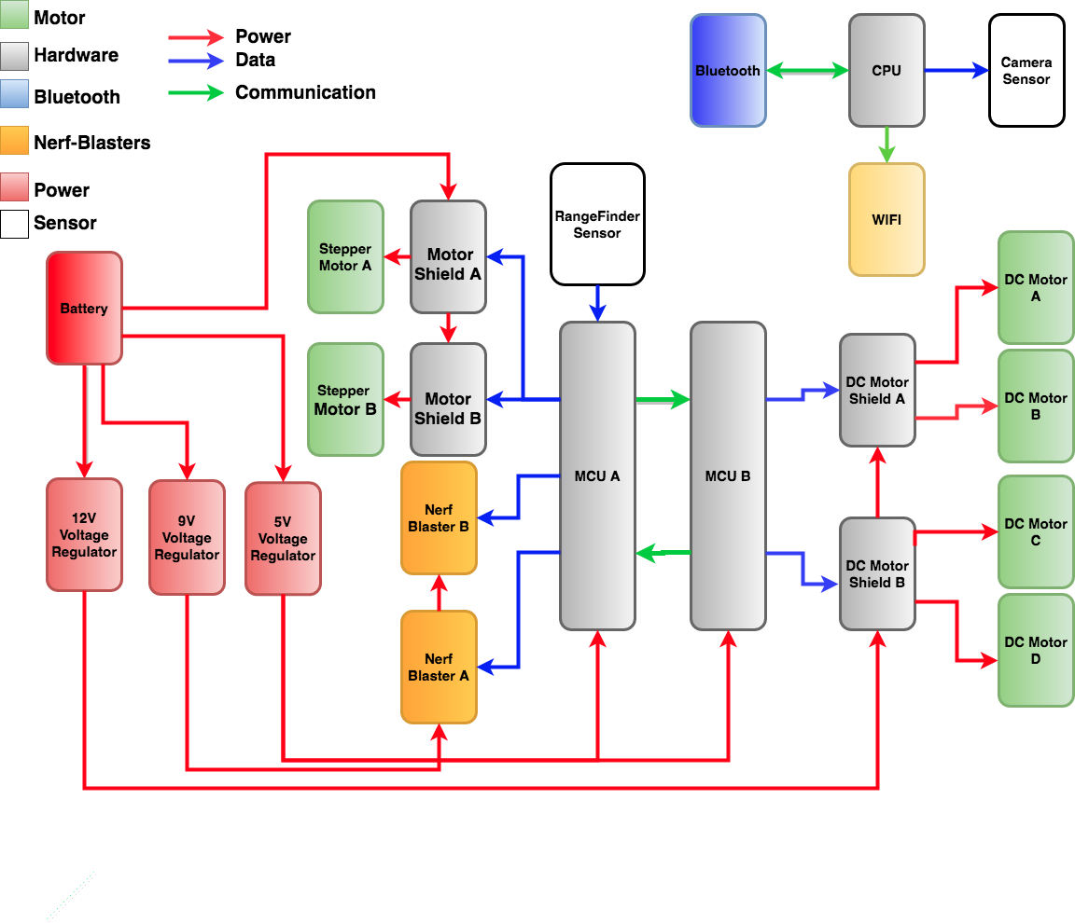
Block Diagram

Slide 9
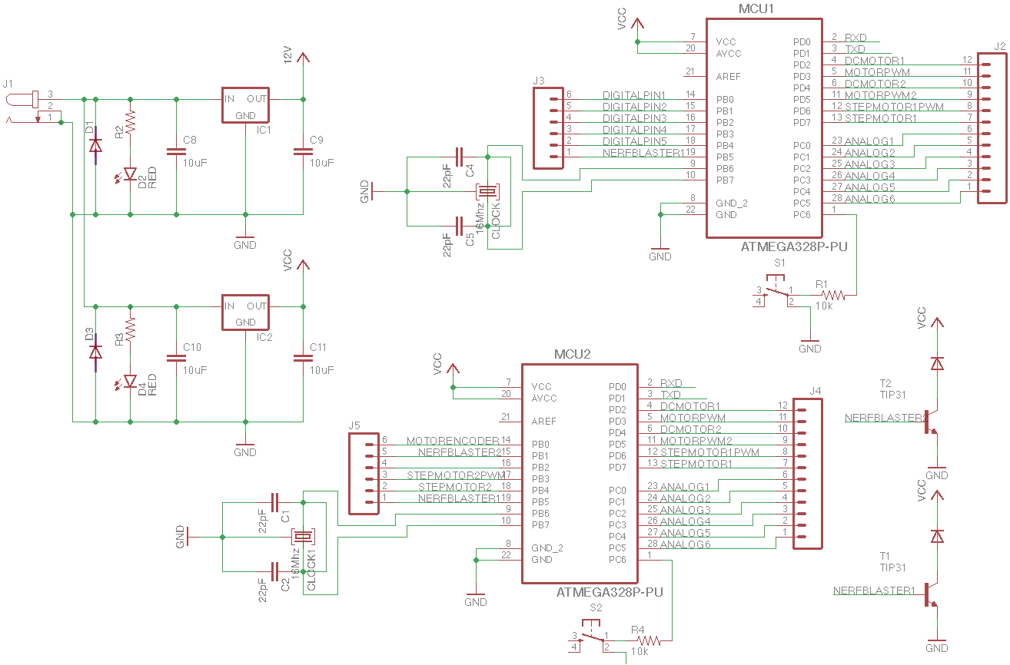
PCB Schematic

Slide 10
Hardware Selection

Slide 11
Sensors

Slide 12
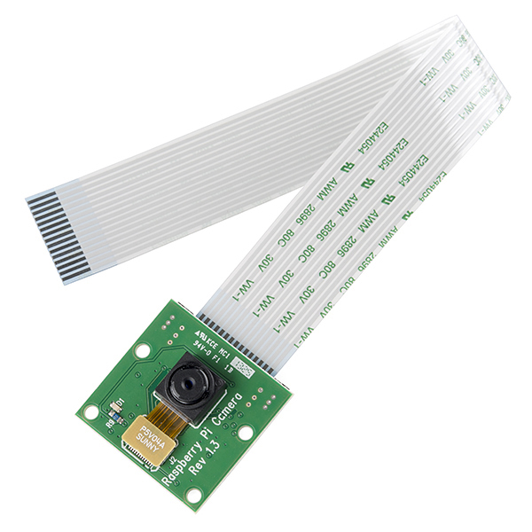
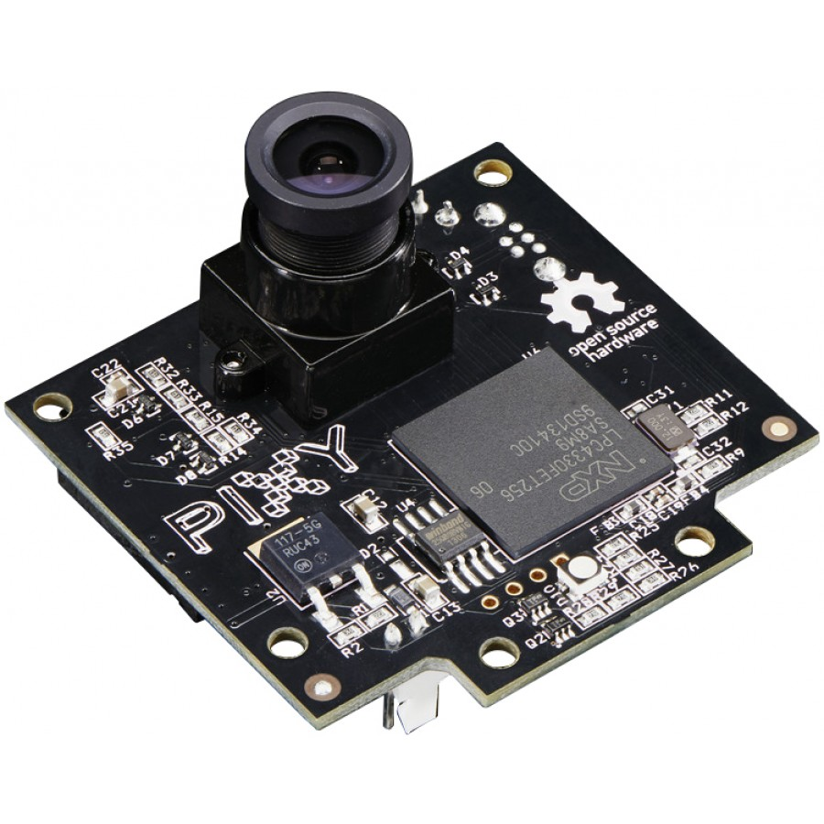
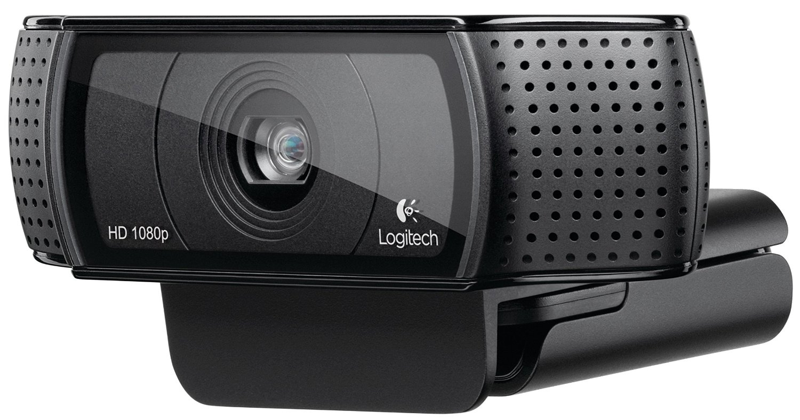
Logitech C920 Webcam
Built-in H.264 video compression
Low video transfer bit rates
Plug and play via USB
Included USB cable reaches top of robot from base
Logitech C920 Webcam
Raspberry Pi Camera Module v2
Pixy CMUcam5
• $52.49
• 1080p
• 6 ft USB • 7 x 4.8 x 9.2 cm
• 70 x 43 FOV
• $25.00
• 1080p
• Ribbon Cable
• 2.5 x 2.4 x 0.9 cm
• 62 x 48 FOV
• $67.00
• 800p
• Multiple plugins • 5.3 x 5 x 3.6 cm
• 75 x 47 FOV

Slide 13
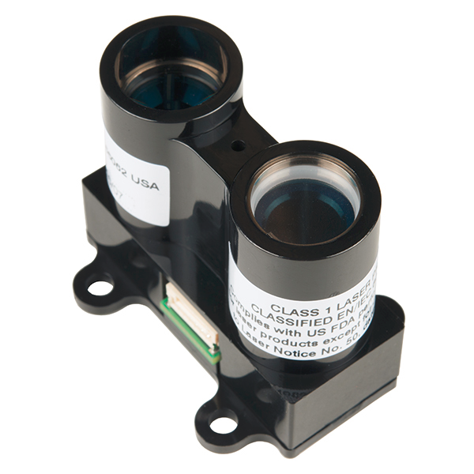
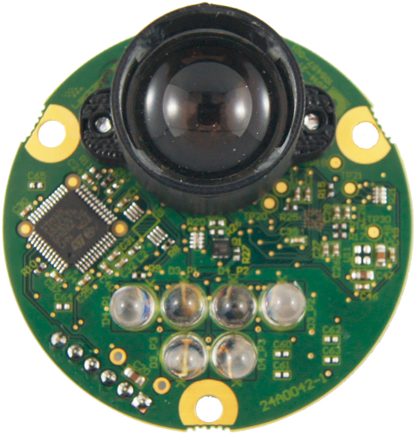
LIDAR-Lite Rangefinder
LIDAR-Lite v3
TeraRanger Duo
LeddarTech Leddar One
Affordable
Best performance over cost
Longest distance detection
Comparable accuracy
Small form factor
• $149.99
• 131 ft
• +/- 2.5 cm • 2 x 4.8 x 4 cm
• $207.20
• 46 ft
• +/- 2 cm
• 5.3 x 4.4 x 2.5 cm
• $115.00
• 49 ft
• +/- 5 cm • 2” in diameter

Slide 14
Microcontrollers

Slide 15
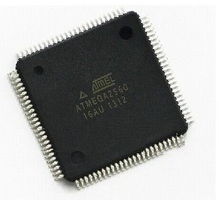
Microcontrollers
ATmega328p-pu
20 input/output pins
14 digital (6 of which are PWM)
6 analog (can be used as digital pins)
5V operating voltage
6-20V input voltage allowed
ATmega2560
ATmega2560
70 input/output pins
54 digital (14 of which are PWM)
16 analog (can be used as digital pins)
5V operating voltage
6-20V input voltage allowed
ATmega328p-pu

Slide 16
Microcontroller Complications
Device overload
Insufficient pin availability
Reduce functionality to reduce pin count
Potential processing delay
Sending commands to multiple devices simultaneously
Dual ATmega328p
Split performance load
Increase complexity via device communication

Slide 17
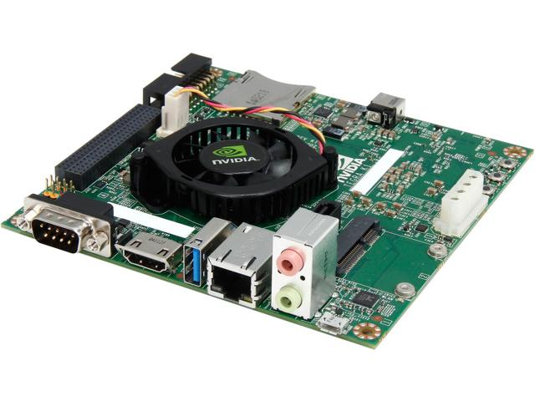
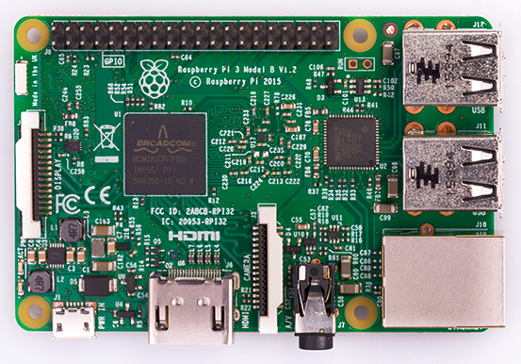
Image Processing
NVIDIA Jetson Tegra K1 (TK1)
$129 with student discount (Original $192)
2.3 GHz Quad Core
GPU optimized for OpenCV
2GB RAM
NVIDIA Jetson TK1
Raspberry Pi 3 Model B
$35.69
1.2GHz Quad-Core
1GB RAM
Introductory grade level of processing
Raspberry Pi 3 Model B

Slide 18
Motors and Drivers

Slide 19
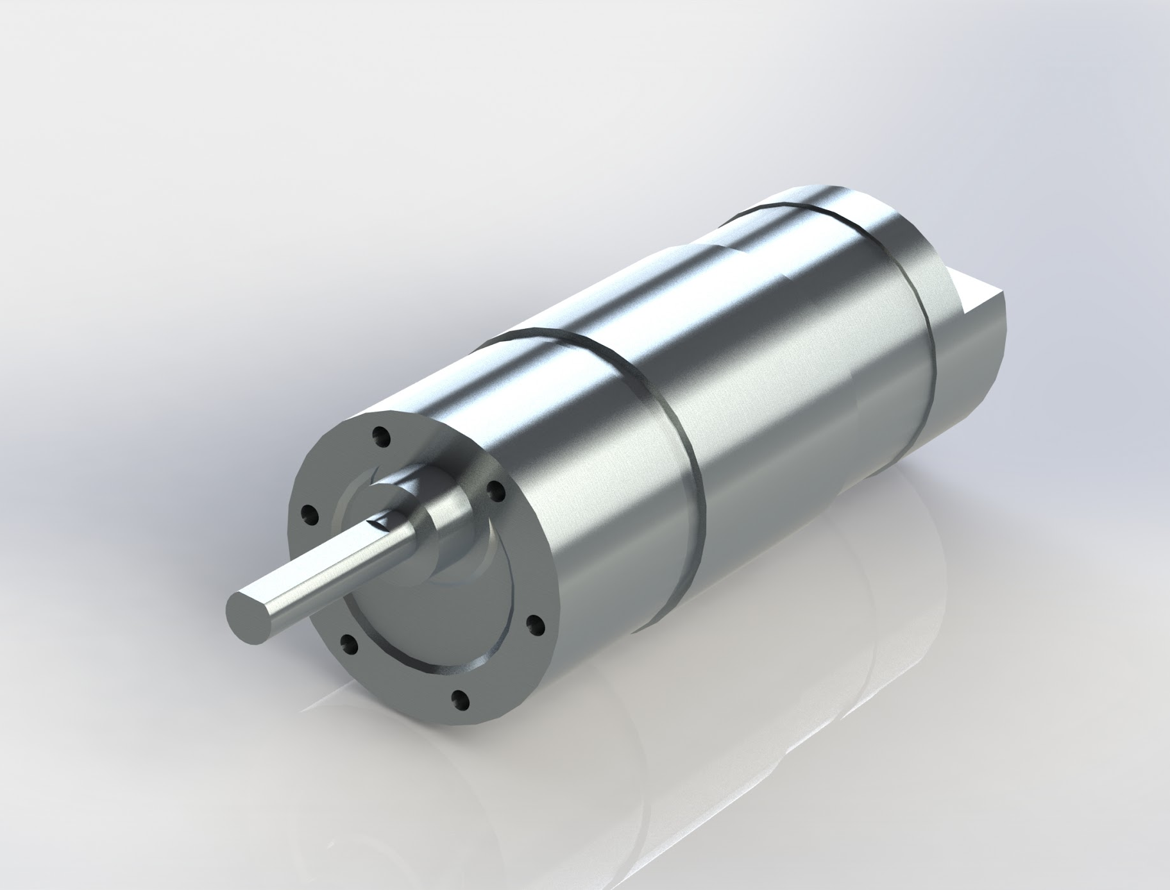
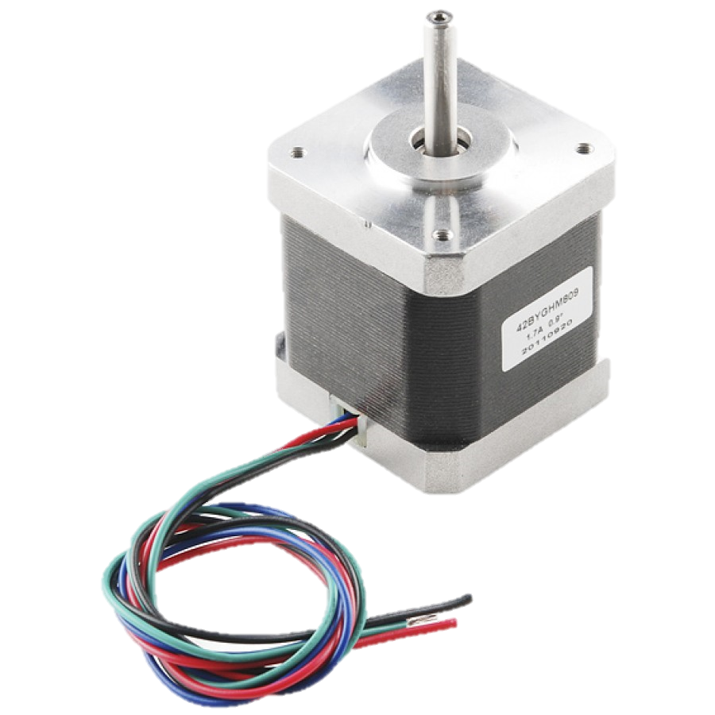
Motor Selection
DC Motor
Will be used for Battlebot manual navigation
Maximum velocity of 3.3ft/s using four motors
Equipped with Encoders
Operating at 12V, 1.3A
Stepper Motor
Will be used for pan/tilt of the turret
68 oz-in to supply enough force to adjust Nerf Blasters
0.9 step angle for precise accuracy
Operating at 3.06V, 1.7A
NeveRest 40 Gearmotor
Hybrid Stepper Motor

Slide 20
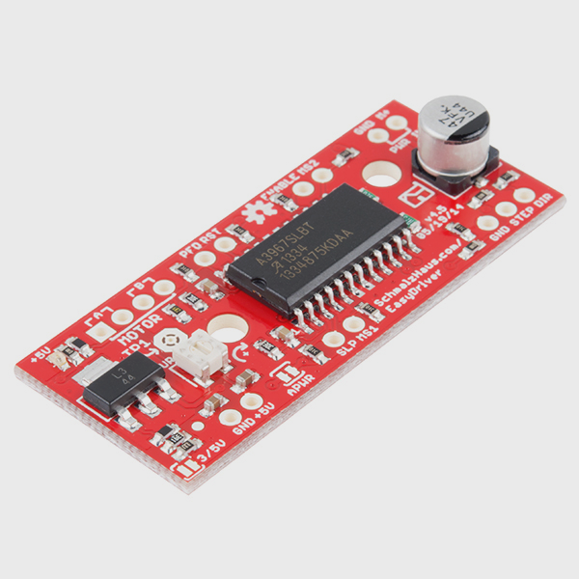
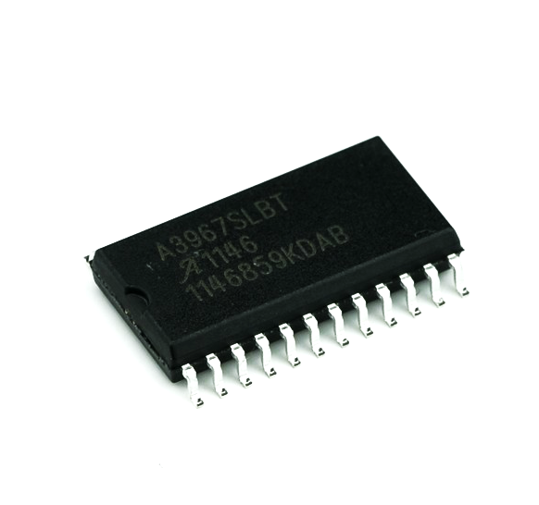
Stepper Motor Driver
EasyDriver Stepper Motor
6V to 30V supply voltage
Any voltage of stepper motor
Current control from 150mA/phase to 700mA/phase
A3967SLB chip
Step, Direction, MS1, and MS2 Input Pins
Two logic inputs allow for full, half, quarter, and eighth step
Compatible with bipolar motors
EasyDriver Stepper Motor
A3967SLB

Slide 21
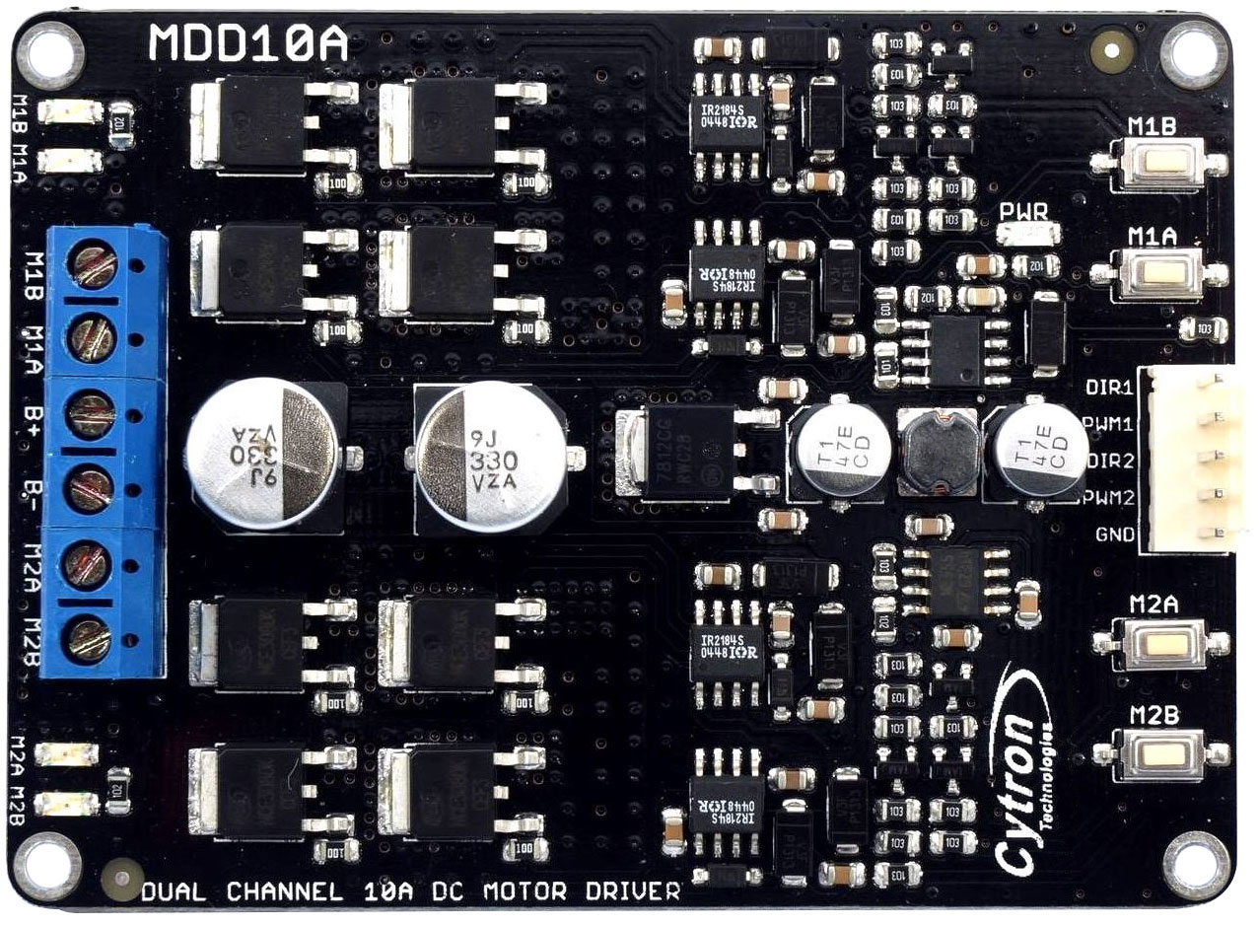
DC Motor Driver
Dual Channel DC Motor Driver
Drives two DC motors
Bi-directional control
PWM1, PWM2, DIR1, DIR2
5V to 25V motor voltage
Maximum 10A continuous
PWM frequency up to 20 KHz for speed control
Dual Channel DC Motor Driver

Slide 22
NERF-Blasters

Slide 23
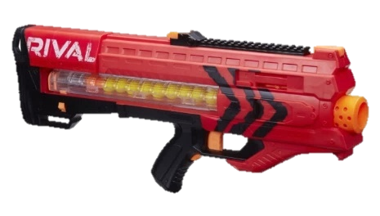
NERF-Blasters Selection
Name | Ammo Type | 0-Angle Range | Velocity | Price
Rival Zeus MXV-1200 Battle Gun | Ball | 65-75 feet | 100 feet/second | $39.99
N-Strike Vulcan EBF-25 | Dart | 25-35 feet | 49 feet/second | $44.99
N-Strike Elite Rampage | Dart | 50 feet | 50 feet/second | $31.99
Rapidstrike CS-18 | Dart | 55 feet | 75 feet/second | $39.99
Rapidstrike CS-18
Rival Zeus MXV-1200 Battle Gun

Slide 24
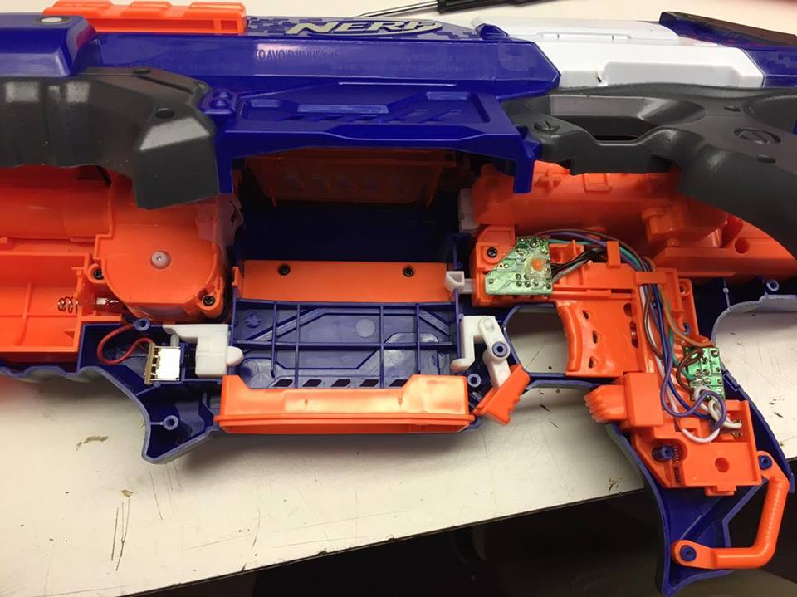
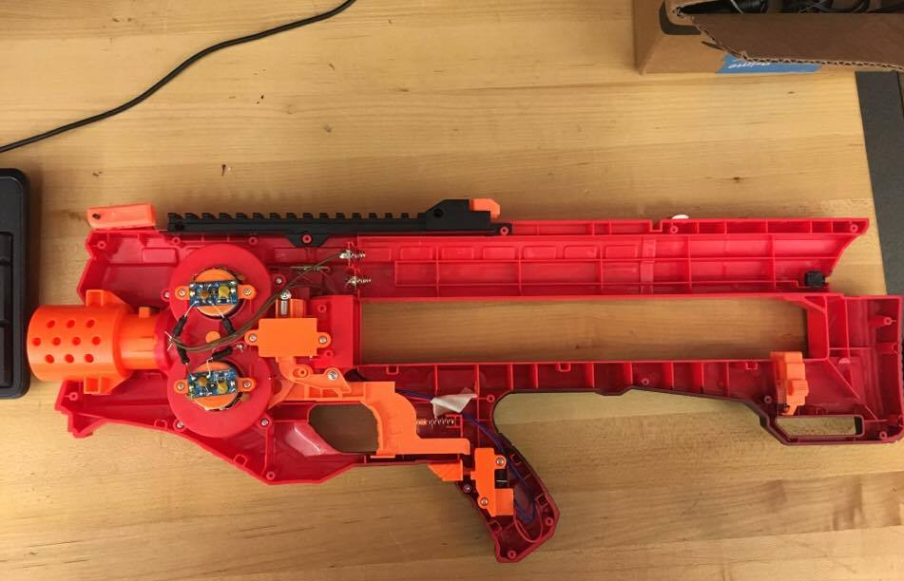
NERF-Blasters Integration
Rapidstrike CS-18
Power: 6V, 1.2A
Utilizes two motor systems
Rival Zeus MXV-1200
Power: 9V, 1A
One motor system and mechanical latch
Rapidstrike CS-18
Rival Zeus MXV-1200 Battle Gun
Notes:
Copied Slide content from mechanical’s slides
Perhaps remove table because need to talk about triggering

Slide 25
Power

Slide 26
Power Consumption
Component | Quantity | Voltage(V) | Total Current(mA) | Mostly On/Off | Power(W)
Microcontroller | 2 | 5 | 46.5 | ON | 0.46
DC Motor | 4 | 12 | 4800 | OFF | 57.60
Stepper | 2 | 3 | 3400 | OFF | 10.20
Nerf-Blaster (Darts) | 1 | 6 | 1500 | OFF | 9.00
Nerf-Blaster (Ball) | 1 | 9 | 1500 | OFF | 13.50
Jetson TK1 | 1 | 12 | 2500 | ON | 30.00
LIDAR Lite | 1 | 5 | 130 | OFF | 0.65
Total Power |  |  |  |  | 121.41

Slide 27
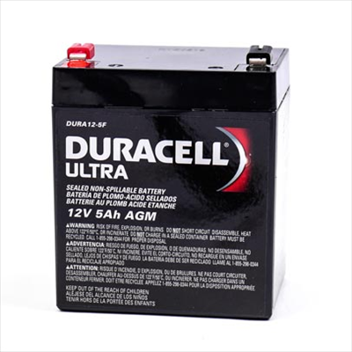
Battery Selection
Sealed Lead Acid Battery
12V, 5 aH
15 minute run time
Supplies high current
Low cost: $15

Slide 28
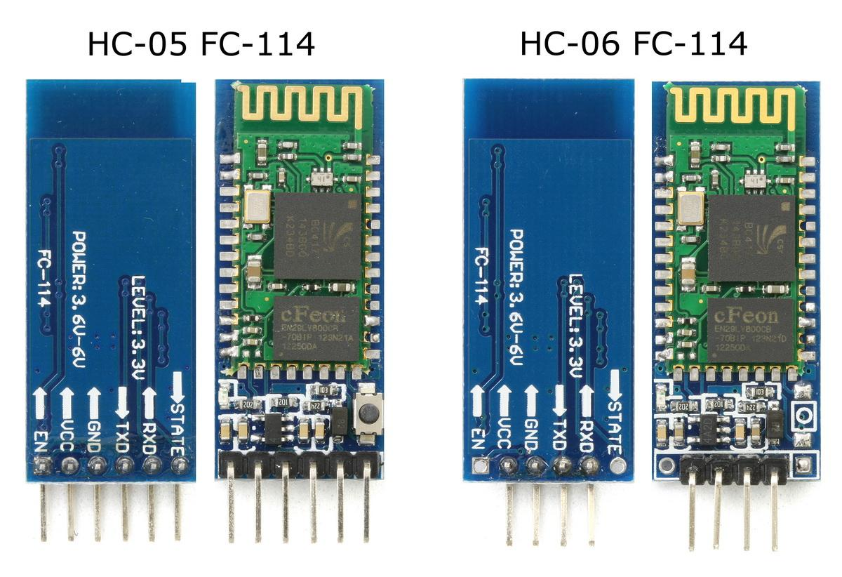
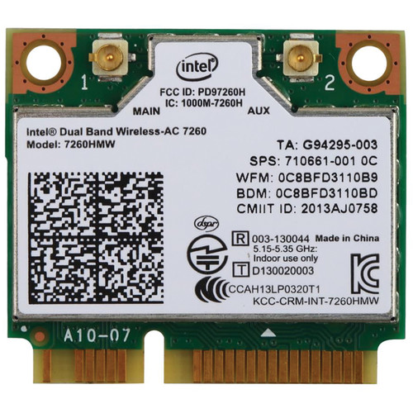
Communication
Onboard Processing
Bluetooth One module per MCU HC-05 Master/Slave HC-06 Slave | I2C CPU- Master MCU- Slave
Remote Workstation
Intel Dual Band Wireless WiFi, Bluetooth PCIe Remote Control Upstream video feed
Bluetooth Modules HC-05, HC-06
Intel Dual Band Wireless-AC 7260

Slide 29
Software Involvement
Deliverables
DC Motor, Stepper Motor, LIDAR-Lite, and Nerf Blaster control algorithms for use by CS team
i.e. sending speed, direction, distance outputs to motors and retrieving target range data from sensors
Assistance
Provide help to CS team on computer vision algorithms
Testing functionality

Slide 30
Administration

Slide 31
Work Distribution
 | PCB Design | Motor Control | Sensors | Firing System | Communication | Software
Aaron H. | ✘ | ✘ |  | ✘
Daniel A. |  |  | ✘ |  | ✘ | ✘
Rachel G. | ✘ | ✘ |  | ✘
Rafael R. |  |  | ✘ |  | ✘ | ✘
Notes:
Change the columns. It’s just a template.

Slide 32
Design Budget
Component Name | Qty | Unit Cost | Cost
NVIDIA Jetson TK1 | 1 | $129.00 | $129.00
LIDAR-Lite v3 | 1 | $112.49 | $112.49
Logitech C920 Webcam | 1 | $52.49 | $52.49
10A Dual Channel Bi-Directional DC Motor Driver | 2 | $23.49 | $46.98
ATmega328p-pu (3-pack) | 1 | $13.48 | $13.48
Powersonic PS-1250 F1 12V | 1 | $17.32 | $17.32
Voltage Regulator L7805CV 5V 1.5 A | 1 | $5.45 | $5.45
Component Name | Qty | Unit Cost | Cost
Voltage Regulator 5V 1A | 1 | $15.00 | $15.00
16 MHz Crystal | 3 | $0.86 | $2.58
SparkFun EasyDriver Stepper Motor Driver | 2 | $13.46 | $26.92
DC Barrel Plug to 2-Pin Terminal Block Adapter | 1 | $1.95 | $1.95
TIP31C Transistor | 5 | $1.06 | $5.30
Voltage Regulator 12V | 5 | $1.50 | $7.50
Total |  |  | $436.46

Slide 33
Testing Budget
Component Name | Qty | Unit Cost | Cost
USB 2.0 A-male to B-male | 1 | $4.99 | $4.99
Elecgoo Upgraded Electronics Fun Kit | 1 | $16.86 | $16.86
ZJchao 9V 1A Power Adapter for Arduino | 1 | $5.59 | $5.59
Arduino Uno R3 Microcontroller A000066 | 1 | $16.06 | $16.06
Sparkfun USB to Serial Breakout Board | 1 | $13.46 | $13.46
Total |  |  | $56.96

Slide 34
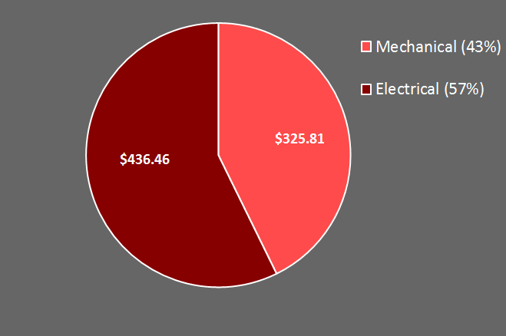
Division of Budget
 | Total
Mechanical | $325.81
Electrical | $436.46
Budget Used | $762.27
Budget Remaining | $237.73

Slide 35
Issues and Future Plans
Issues
Balancing $1000 on demonstrated cost
Optimizing output pins on microcontrollers
Drop two DC Motors
Backup Plan
Provide own chassis and backup programming
Future Plans
Triggering Nerf-blasters
Finalize PCB design

Slide 36
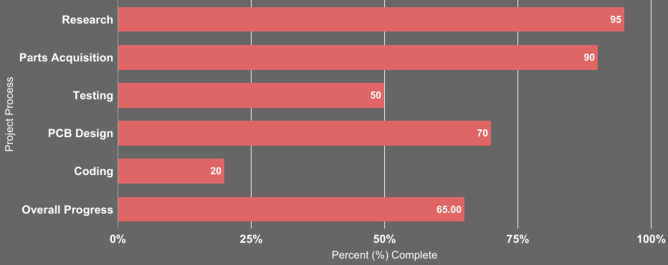
Progress

Slide 37
Questions?

