Slide 1

Laboratory Control System (LCS)
UCF Engineering I Cleanroom Laboratory
Borgess, A. Kozorezov
J. Ossa, M. Aleksich
Sponsor: Dr. Reza Abdolvand, UCF
Notes:
Anatoly

Slide 2
Motivation
Antiquated logging system
Laboratory equipment control and usage tracking
Ability to reserve machines online
Provide monthly usage reports for billing
Notes:
Aaron

Slide 3
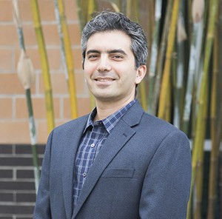
Sponsor requirements
User-serviceable parts, long lasting
System expandability
Diagnostic tool (PCB design)
Integrated with UCF network
Online reservation system
User manual
Notes:
Aaron

Slide 4
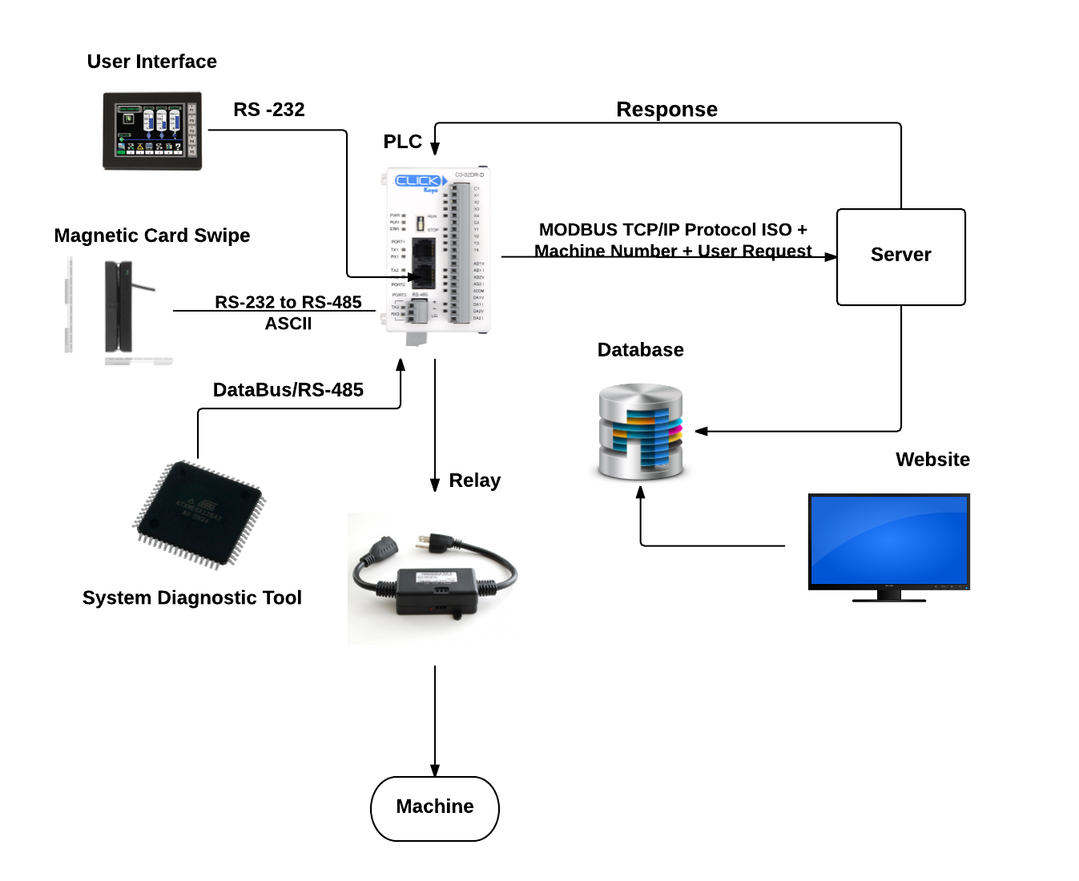
System overview
Notes:
Aaron

Slide 5
System overview
Jimmy
Miguel
Anatoly
Aaron
Notes:
Aaron

Slide 6
Design specifications
Description | Requirement
User interaction time | Less than 20 seconds
System longevity | 3 years or more
Machine capacity | 22+ machines
Machine voltage relays | 5VDC, 12VDC, 120VAC, 220VAC
Billing increments | Per hour or once per day
Data encryption | SSL
Size of system | Medicine cabinet 14”x16”x8”
Notes:
Aaron

Slide 7
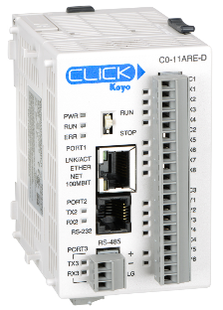
PLC Selection
Brand | Pros | Cons
Automation Direct | Free software Free tech support Free shipping Many features Expandability | Proprietary software
Every other brand (Allen Bradley, Unilogix) | More features More powerful | Purchase software separately Tech support not guaranteed Expensive to expand
Notes:
Anatoly

Slide 8
Card swipe
Magnetic Card Reader | Operating Voltage | Current | Magnetic Head Life Span | Physical Interface | Price
SU90 (RS-232) | DC5V±0.5 | 10mA | 800,000 | DB9, PS/2 | $44.95
ZAUM120-PL MSR112A (RS-232) | DC 3.3V | 5.5 – 6.5 mA | 500,000 | DB9 | $62.00
POSMATE MSR (USB) | N/A | 3mA | 500,000(min) | USB | $40 ($20 + USB-Serial converter)
Notes:
Anatoly

Slide 9
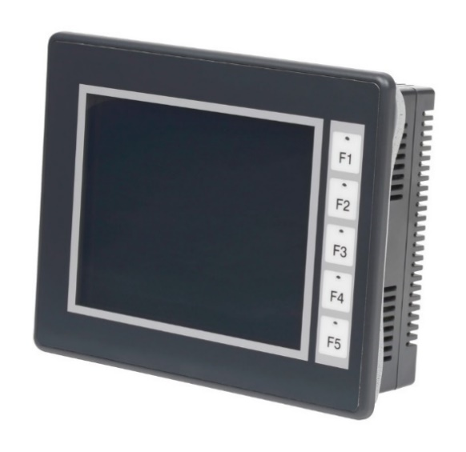
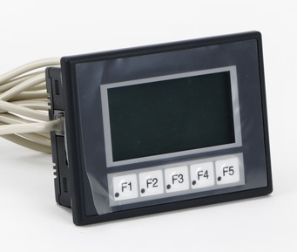
User interface (touch screen)
3” panel
$205
128 x 64 display
5.7” panel
$299
320 x 240 display
Notes:
Anatoly

Slide 10
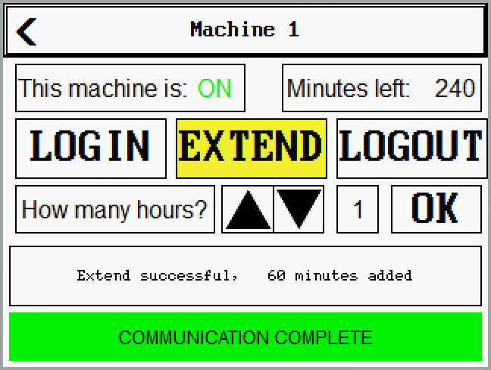
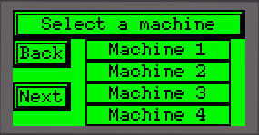
User interface (touch screen)
3” panel
$205
128 x 64 display
5.7” panel
$299
320 x 240 display
Notes:
Anatoly

Slide 11
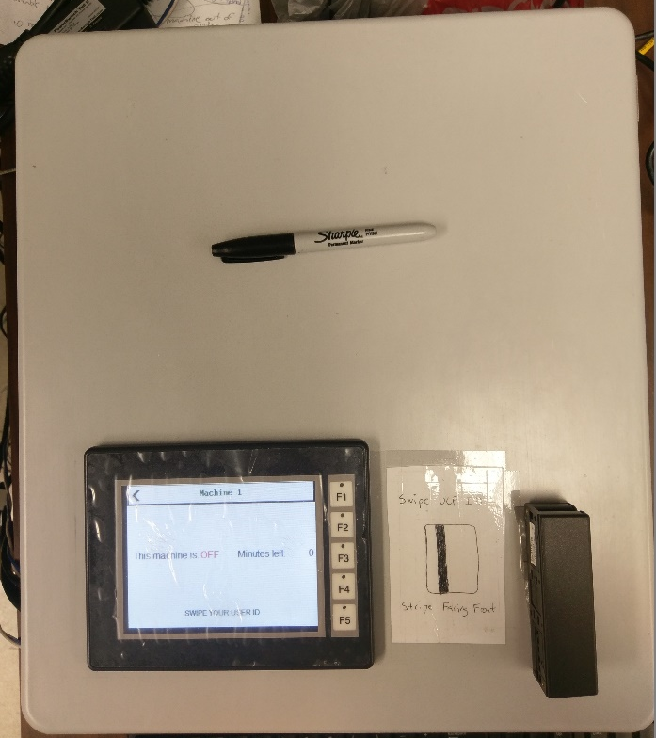
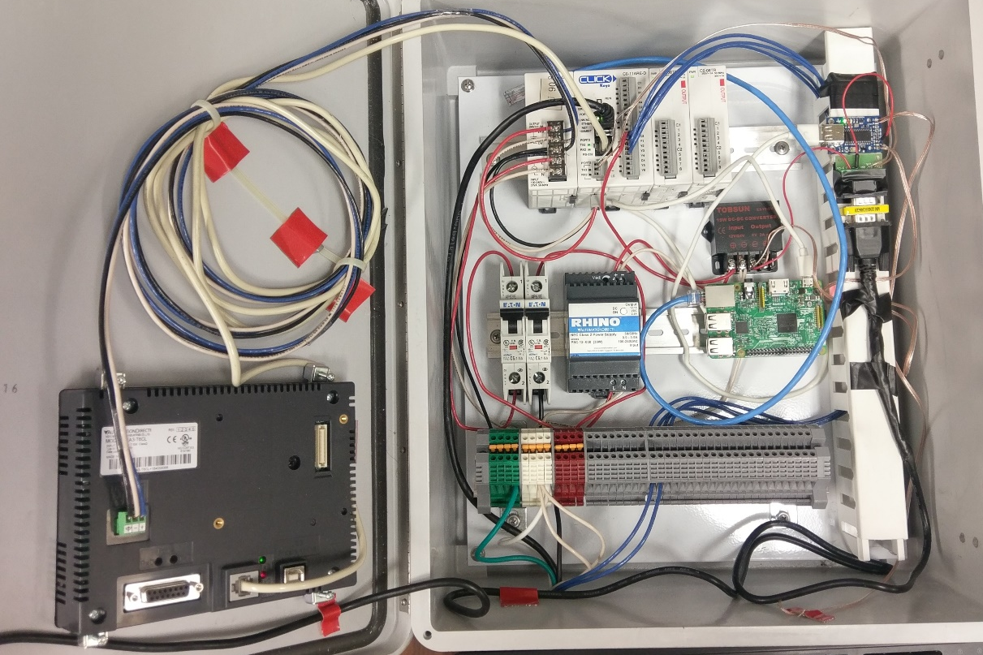
Panel prototype
Notes:
Anatoly

Slide 12
Panel prototype
Card swipe
PLC +
Expansion
Raspberry Pi
6”
Card swipe
6”
Card swipe
Touch screen
Power +
circuit breakers
Terminal
strip
Notes:
Anatoly

Slide 13
Panel power flow
Notes:
Anatoly

Slide 14
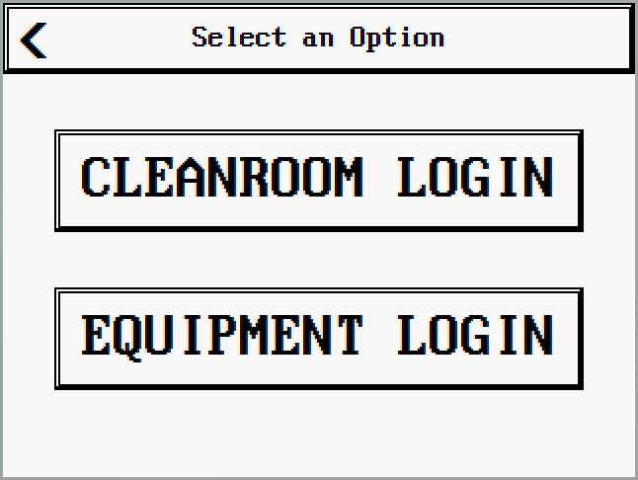
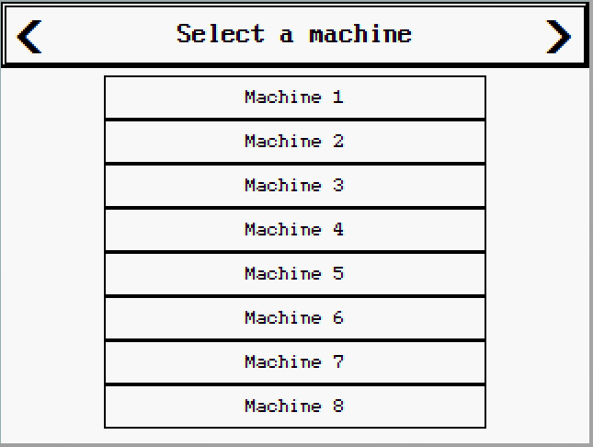
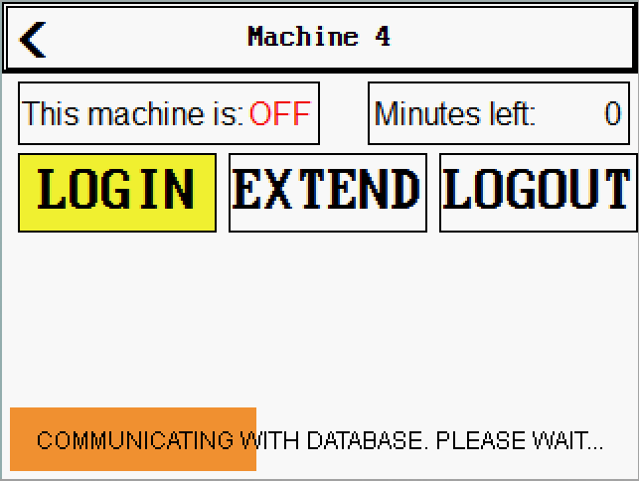
User interface (panel)

Slide 15
PCB – The Diagnostic Tool

Slide 16
Diagnostic Tool Overview
Runs Parallel to the control system
Provides quick administrative access to the PLC
User friendly interface

Slide 17
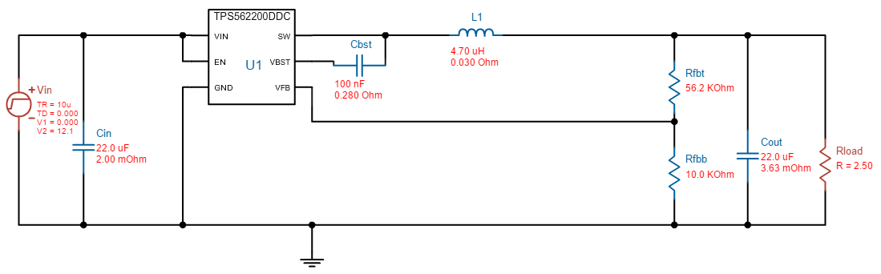
Buck Converter (TPS562200)
Highly Efficient ~ 90%
Complex design, can be costly, high-frequency switching can be noisy

Slide 18
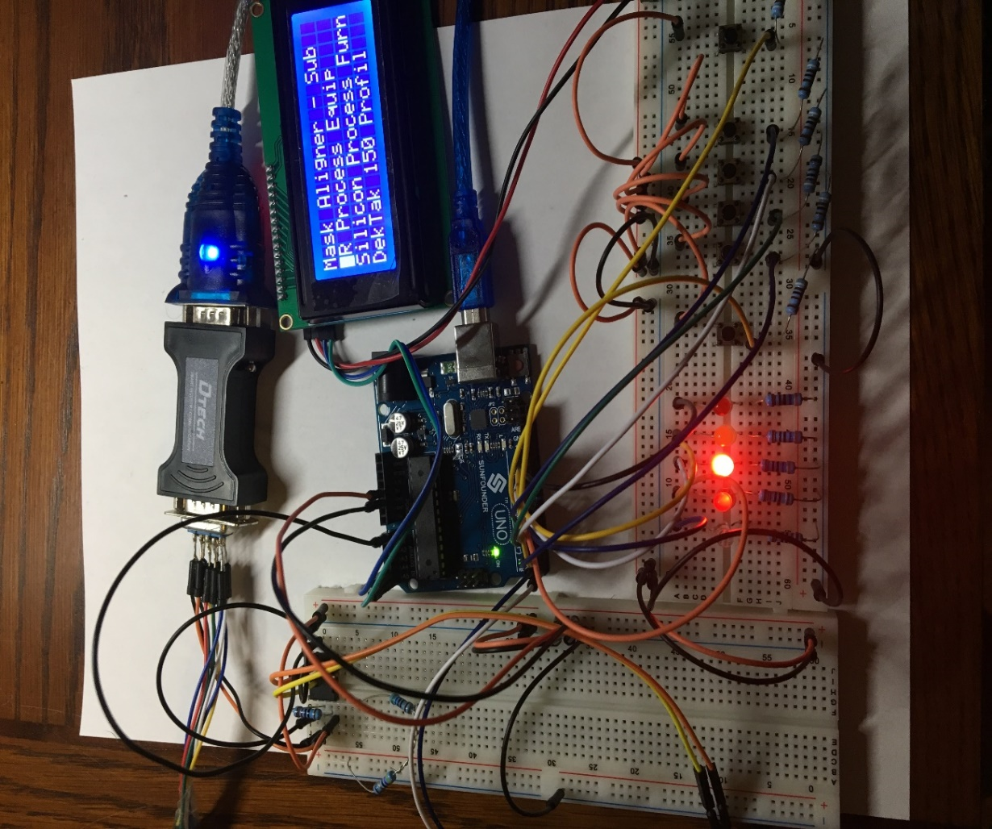
ATMega 328P and Arduino
WHY THIS?
Cheap
Option to already have Arduino Optiboot
Open Source
Easy to Use
CONFIGURATION
LCD using I2C (SCA, SDA)
TX, RX to implement RS485 Communication
8 digital I/O pins configured for PLC
6 push buttons
16 MHz Crystal Oscillator

Slide 19
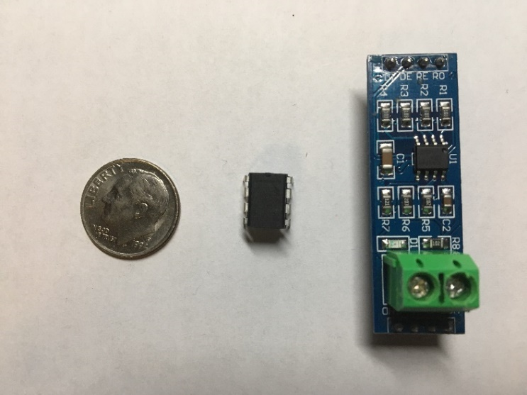
RS485 Communication (MAX 485)
Differential Data Transmission
Half Duplex
Maximum Input/output Voltage: -7 to 12 V
9600 Baud Rate
Twisted Pair to create noise immunity

Slide 20
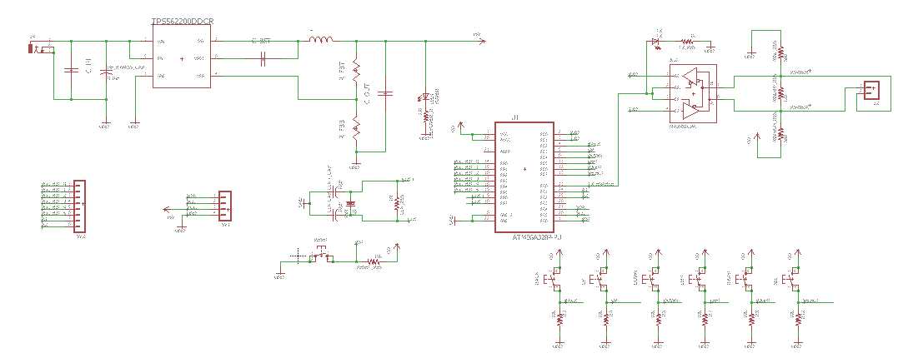
PCB Schematic
Power Regulation
RS485 Communication
I/O PLC
Comms
I2C LCD
Comms

Slide 21
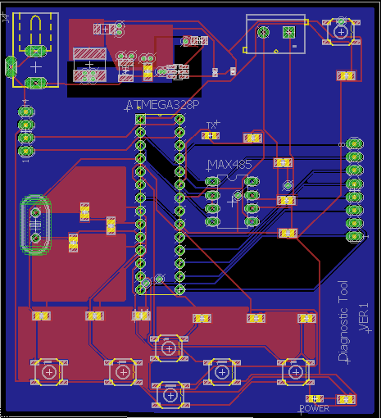
PCB Layout

Slide 22
Machine Relays/
Machine Control

Slide 23
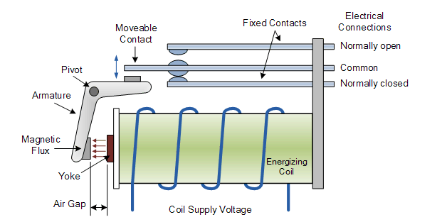
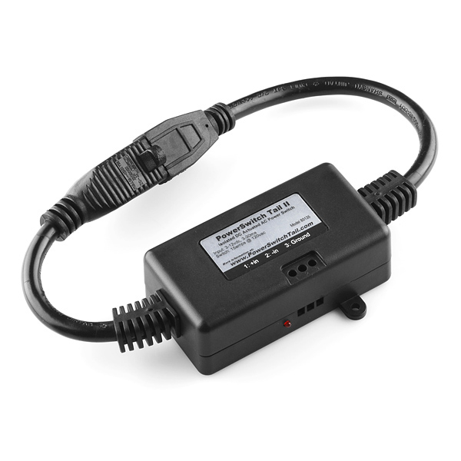
Power switch Tail II Relay
Enables power from standard outlet 120 VAC
Optional Normally Open or Normally closed
Large Input voltage range (3-12VDC)
SPST Configuration

Slide 24
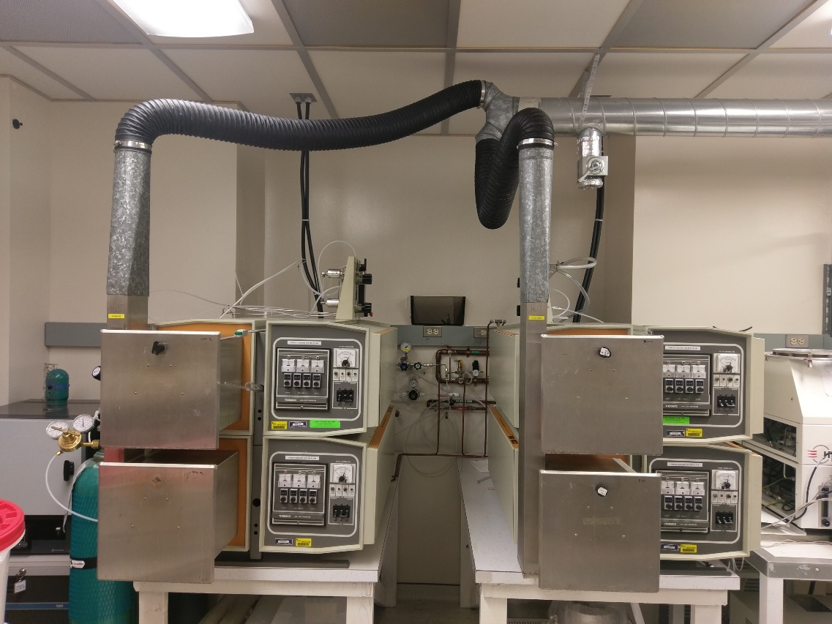
How to Control These????
Electronic/
Magnetic Locks
Lee Electric,
SECO-LARM

Slide 25

Communications
Data must be transferred from one component to another
Must be consistent to allow for seamless communication

Slide 26
Overview

Slide 27

Choices
PyMod
JaMod
Modbus Master
PhpModBus

Slide 28
From PLC to Raspberry Pi
TCP FRAME FORMATS FOR MESSAGES SENT
Name | Length | Function
Transaction ID | 2 Bytes | Identifies each message sent over the protocol
Protocol ID | 2 Bytes | Is set to zero for the TCP implementation
Length | 2 Bytes | Identifies the length of the message after this field. (2 + the size of the Data transmitted)
Unit ID | 1 Byte | Set to 1 for communication over the protocol
Function Code | 1 Byte | Identifies the action to be performed
DATA | Dynamic in size | The accompanying data that could be written to the registers

Slide 29
FROM PLC TO RASPBERRY PI
Create A Socket
Constant Monitor
Gets Request
Send acknowledgement
Separate message to bytes and shorts
Decide the next action to follow

Slide 30
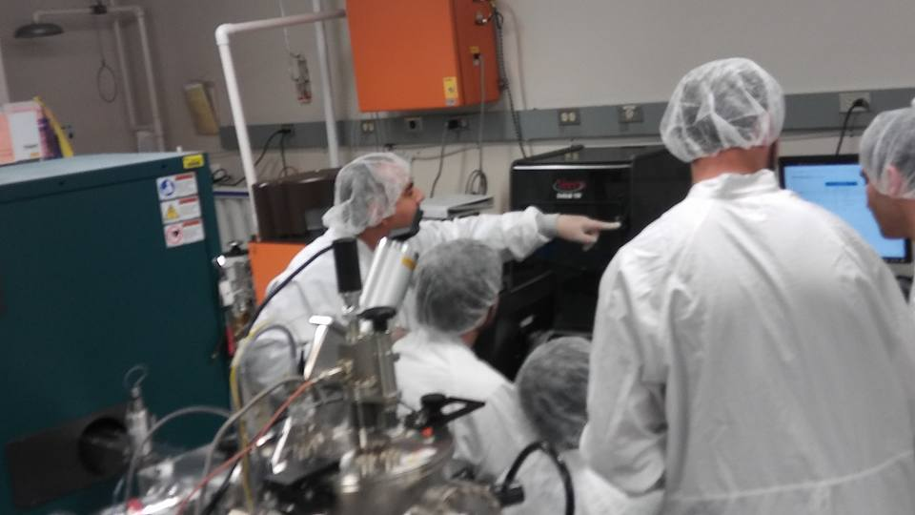
From Raspberry Pi to Database
Send ISO and Machine Number
Take a timestamp
Check ISO and Machine Number
Check Schedules

Slide 31
Database Back to Raspberry Pi
Calculate total time
Lots of math (originally)
Still lots actually but
interesting way to get around it
Milliseconds since the Great Epoch

Slide 32

Raspberry Pi to PLC
Package the final message
Send message
Update the database
Continue to listen

Slide 33
Web Development
Front-End
Back-End
Database Design
UCF Network

Slide 34



Front-End Development
2 Websites — dynamic and static
CSS, HTML, and JavaScript
  Bootstrap
    jQuery DataTables
WordPress

Slide 35


Back-End Development
Supported by Windows and Ubuntu machines
Supported by UCF Network
XAMPP – Cross platform development environment
Free to use
MySQL
PHP
Apache

Slide 36


Database
MySQL | PostgreSQL
Large Community | Large Community
Moderate Performance | Great Performance
Support Transactions | Support Transactions
Bundled with XAMPP | Separate Install

Slide 37
Database Design
Contains User Information
User groups
  Admin
  Faculty
  Student
Machine Information
Reservations and Lab Use
Authorizations

Slide 38
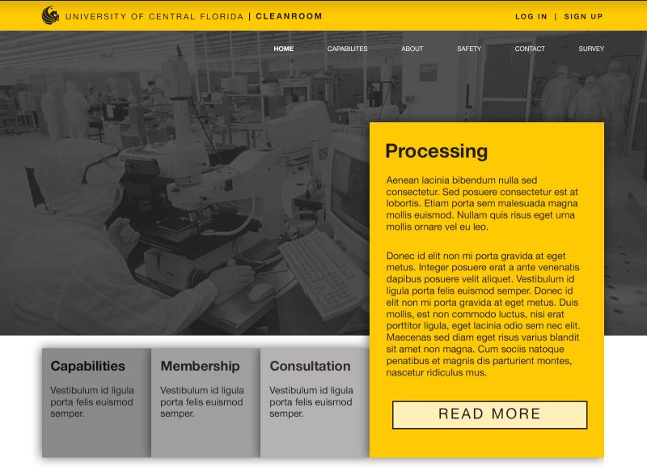
WordPress Site

Slide 39
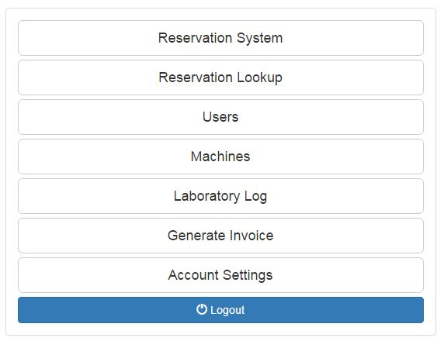
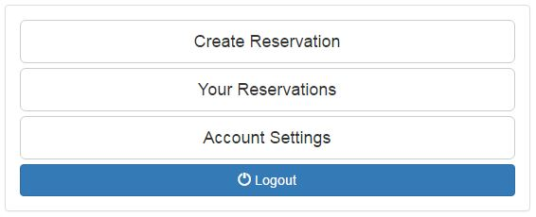
Website Application (Navigation)
Admin | Student

Slide 40
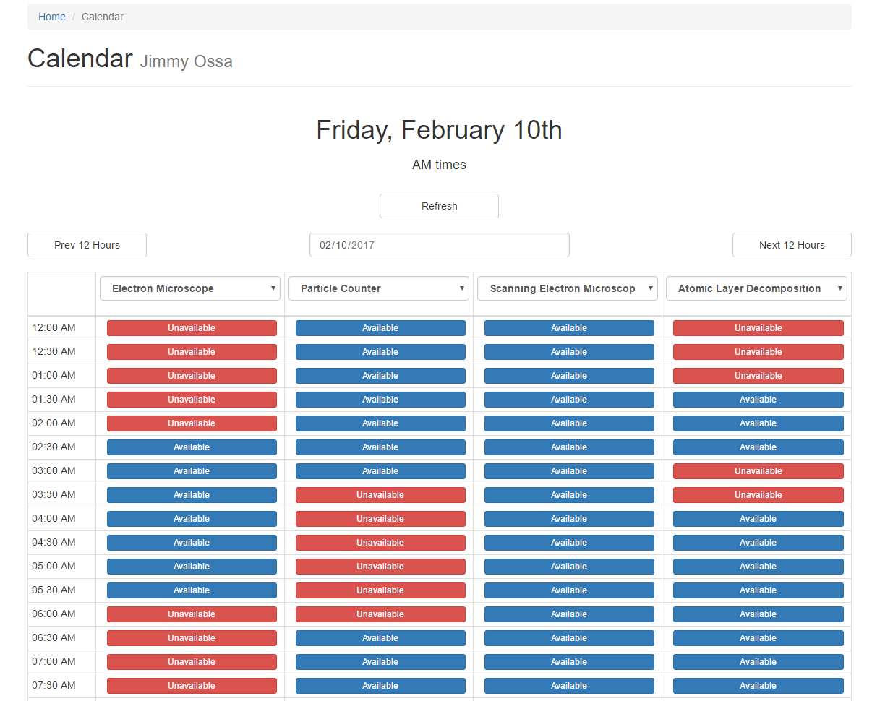
Web Application
(Reservation System)
24 hour reservation system
12 hours displayed
at a time
Mobile friendly

Slide 41
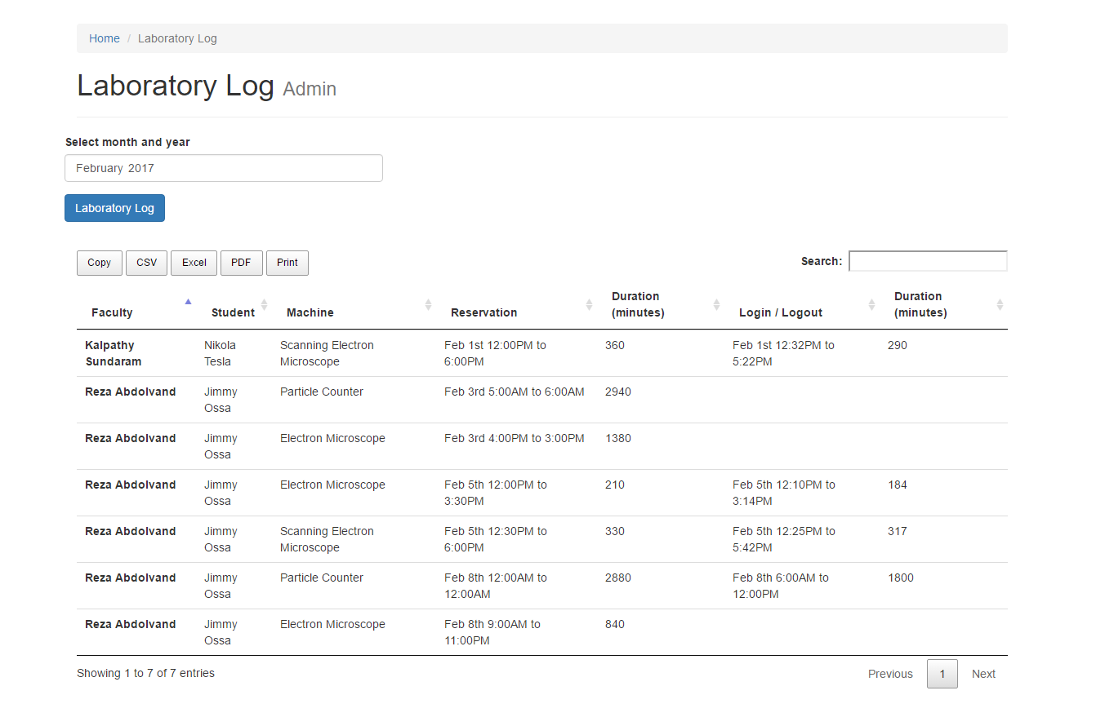
Web Application (Admin Controls)

Slide 42
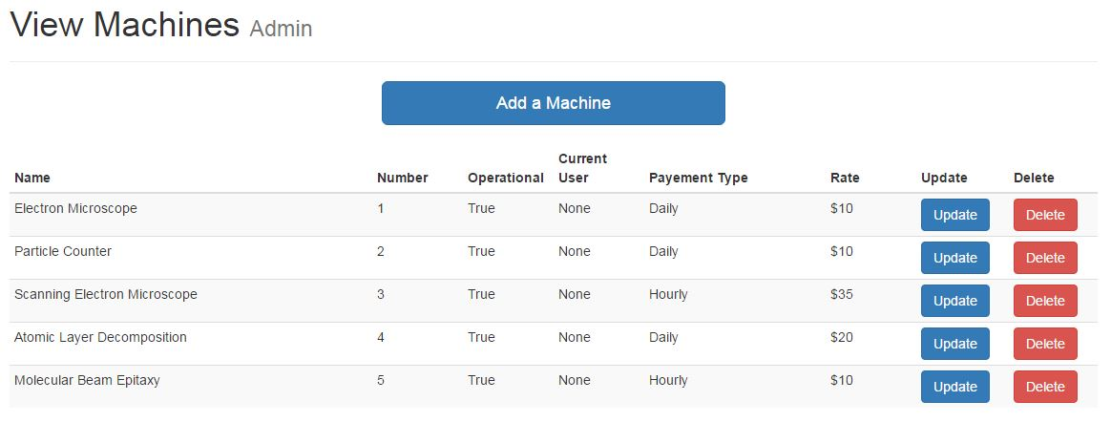
Web Application (Admin Controls)

Slide 43
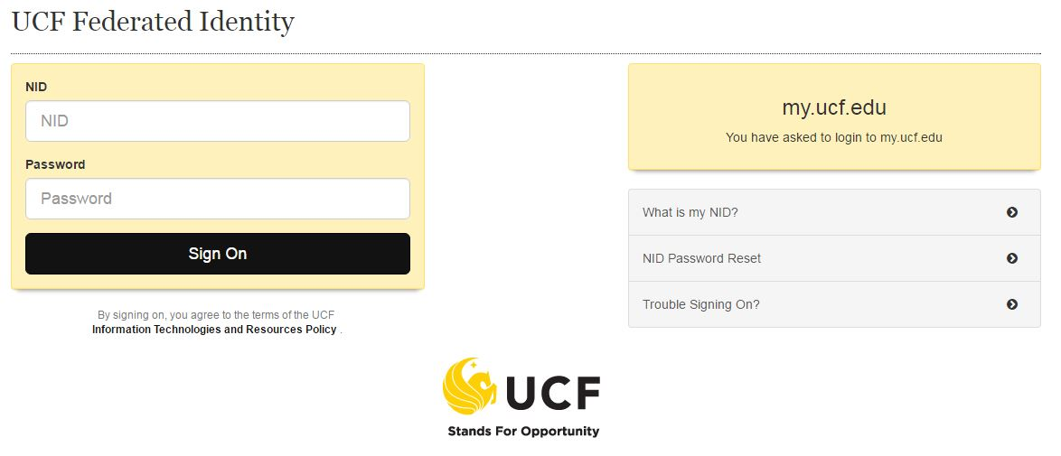
Integrating with UCF Network
Working with Tech Support
UCF Federated Identity Login

Slide 44
Administrative Content

Slide 45
Work Distribution
Section | Primary | Secondary
Main panel | Anatoly | Aaron
DT/Machine control | Aaron | Anatoly
Website | Jimmy | Miguel
Connector | Miguel | Jimmy

Slide 46
Progress

Slide 47
Progress

Slide 48
Issues
RS232-RS485-TCP/IP Modbus comms
  Card swipe to PLC
  PLC to PC
  DT to PLC
Database records
  Calculating begin and end times
  Reservation requirements/rules
User interface
  Touch screen
  Website/reservation system
Security – SSL, UCF door security, UCF IT

Slide 49
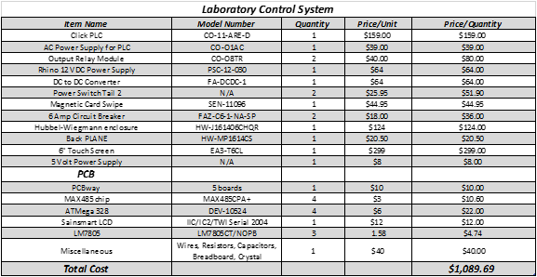
Budget

Slide 50
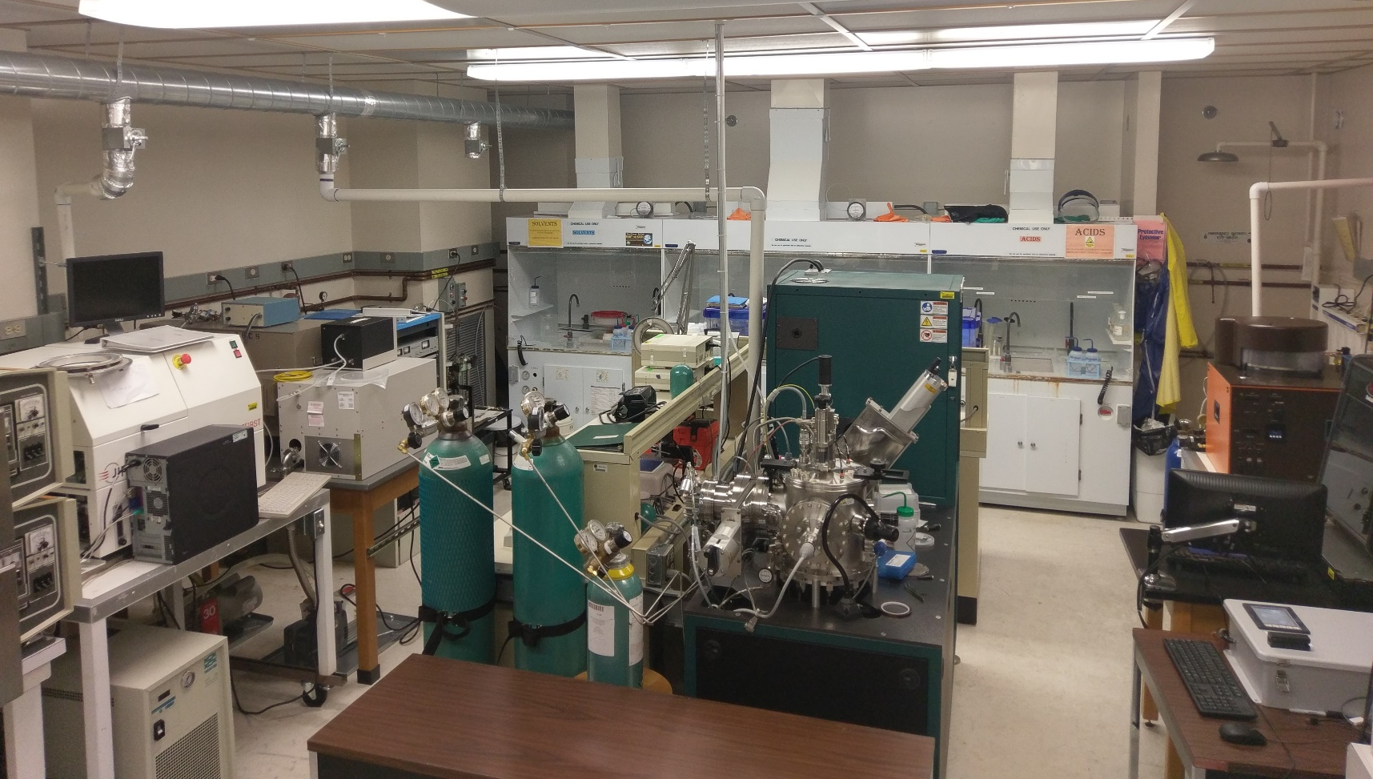
Questions?

