Slide 1

The LDT-AIR Project
Derek Clark (PSE)
Josh Jordan (PSE)
Ken Figueiredo (CpE)

Slide 2
Motivation
To have a secure channel to transfer data
Rugged and reliable.
Send data over land that you don’t own.
Immune to Electromagnetic interference.
Cheaper hassle-free alternative conventional wire/fiber.

Slide 3
Requirements & Goals
Requirements:
  At least a 1Mbps connection speed with less than a 15% error rate.
  Be able to create a connection over a distance of 15 feet.
Goals:
  Reach a transfer speed on par with Wi-Fi (54Mbps – 600Mbps)
  Be able to create a connection greater 30 feet.
  A bit error rate of zero.

Slide 4
Project Specifications
Speeds comparable to Wi-Fi (54Mbps).
Transmit and receive data >15ft.
Send text messages, files, music and video.

Slide 5
Block Diagram

Slide 6
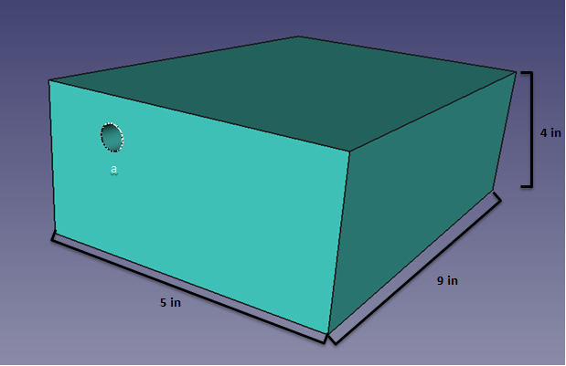
Transmitter Housing

Slide 7
Fiber Pigtail
Single Mode Fiber | Multi-Mode Fiber
Expensive | Less expensive
Smaller Numerical Aperture | Larger Numerical Aperture
Lower Dispersion | Higher Dispersion and attenuation

Slide 8
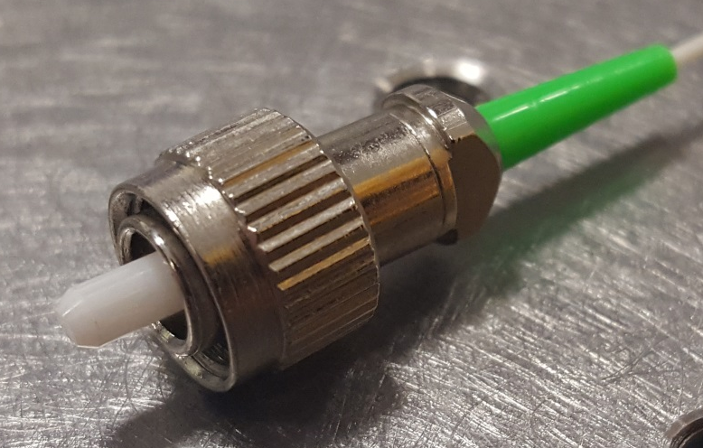
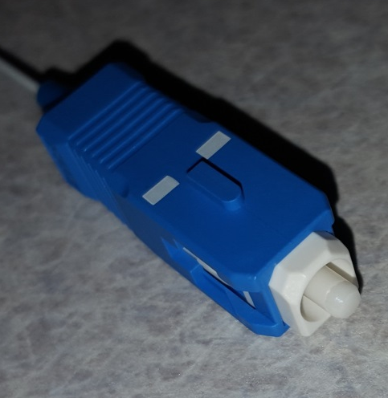
Laser Fiber Connector
Pigtail laser package comes with FC/PC adapter.
Coupling loss is associated with adapters.
Replaced with SM adapter.
Makes alignment of the system easier.
Allows for troubleshooting. laser is bad.

Slide 9
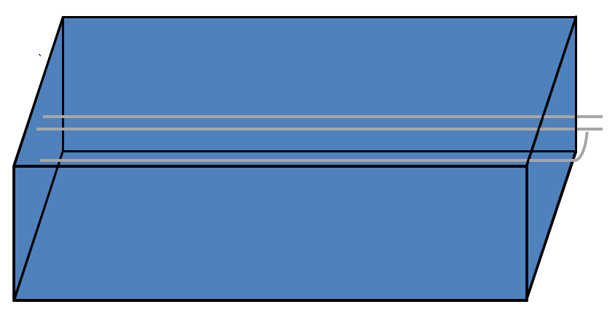
Lens Housing

Slide 10
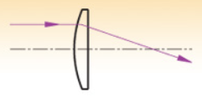
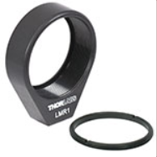
Lens Type
Plano-convex lens with no AR coating.
Focal length at 25mm.
Designed specifically for 1550nm wavelength.
Associated lens holder was incorporated to make fastening easy.

Slide 11
Power

Slide 12
AC/DC Regulator Comparison
 | Supply Current | Seller | Supply Voltage | Number of Adapters | Cost $
NA | 1000mA | Skycraft | 2-12V | 6 plugs | $9.99
Original Power Powerline | 1300mA | Walmart | 3-12V | 7 Plugs | $11.65
Velleman PSSMV1USA | 1500mA | Amazon | 3-12V | 8 Plugs | $14.99
Enercell | 1000mA | Radioshack | 3-12V | 0 Plugs | $19.99

Slide 13
3.3V Regulator Comparison
 | Components | Bill of Materials Cost | Efficiency | Frequency | Temperature
TPS62122 | 7 | $0.68 | 72% | 874kHz | 35°C
TPS62120 | 8 | $0.69 | 72% | 874kHz | 35°C
TPS563200 | 7 | $0.89 | 84% | 78kHz | 31°C

Slide 14
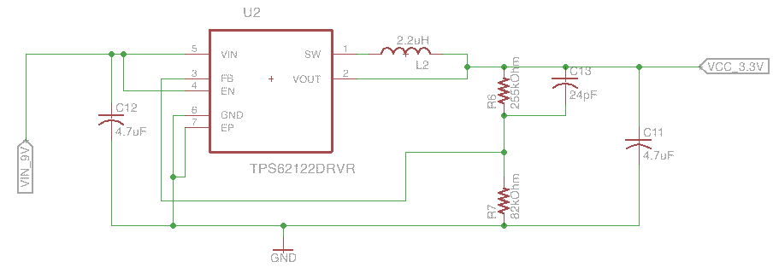
3.3V Regulator Circuit

Slide 15
5V Regulator Comparison
 | Components | Bill of materials | Efficiency | BOD Footprint
TSP62153 | 6 | $1.17 | 94% | 80
TPS562209 | 8 | $0.82 | 94% | 112
TPS563209 | 8 | $1.37 | 95% | 116
TSP62153 was easy to incorporate.
Smaller in design.

Slide 16
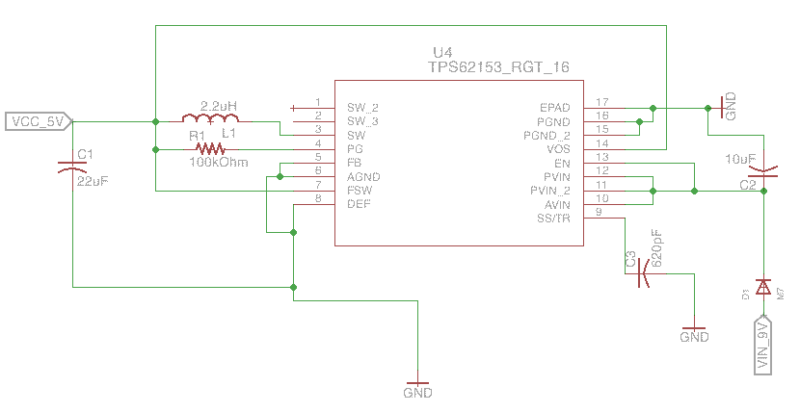
5V Regulator Circuit

Slide 17
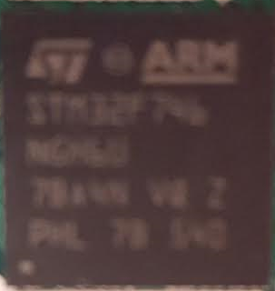
STM32F746NGH6
Operating Voltage: 1.8V - 3.6V
ARM 32bit Cortex – M7 core
Pros:
    216 MHz clock speed
    108 MHz GPIO speed
    Allows for Ethernet PHY connectivity.
Cons:
  Difficult to program, limited documentation
  Base software has large overhead.
  216 ball grid array pin out
10mm
10mm

Slide 18
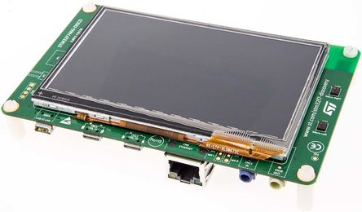
STM32F7 - Discovery
Evaluation board for the STM324746NG microcontroller
Pros:
  Has all connections already completed
  Allows for quicker prototyping
Cons:
  Same as microcontroller.
  Official ARM compiler does not fully support all features of the board.
    Specifically: Ethernet, USB 2.0, USB 3.0

Slide 19
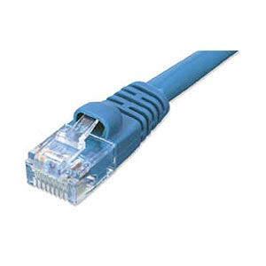
PC Connection : Ethernet
Easier to implement than USB with the chosen microcontroller.
Less overhead than the USB 3.0 connector.
Ethernet protocol utilizes FreeRTOS which allows threading within board software.

Slide 20
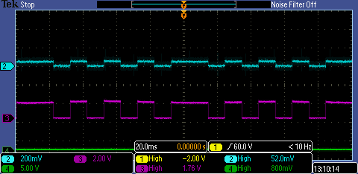
Signal modulation
Signal is created by turning a GPIO pin on / off dependent on the data received from the PC.
The transmission signal uses two different time delays for ease of framing the packets.
  Bit delay, Time between each bit. Determines output frequency.
  Frame delay, Time between each frame. (bitDelay * 2)
Syncing the transmitter and receiver

Slide 21
Signal modulation
Syncing the transmitter and receiver

Slide 22
Software breakdown

Slide 23
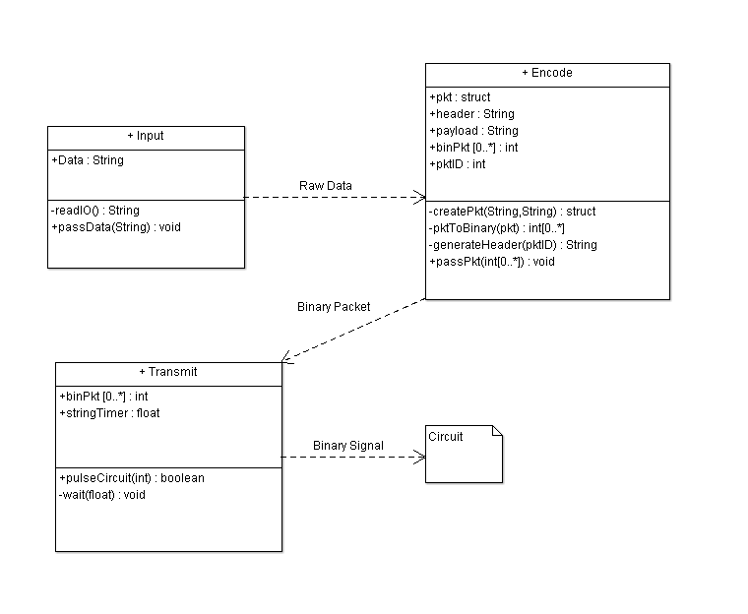
Transmitter code structure
Notes:
Here you can see the class diagram of how the transmitter side PCB will receive input from the PC.
We will take the user input in a String, encode into a packet with a header, with a packet ID.
Once the data has been encoded we will pass that data to the MCU to pulse the laser.

Slide 24
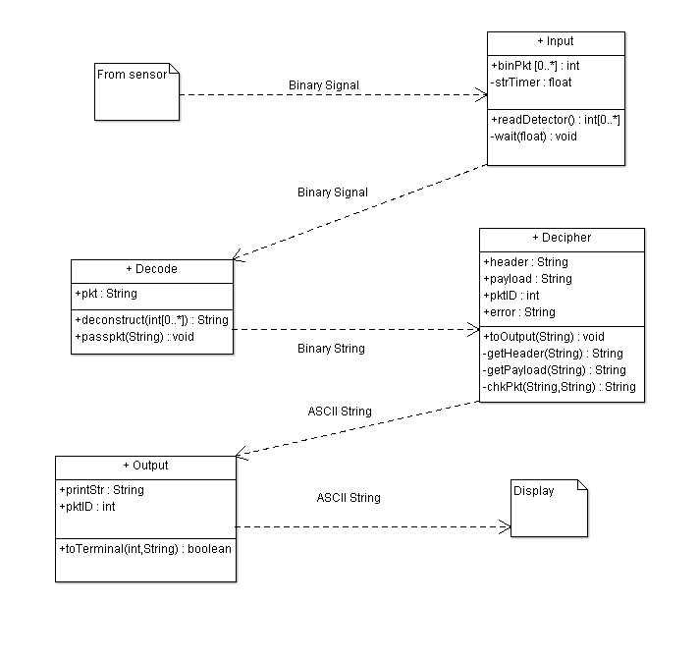
Receiver code structure

Slide 25
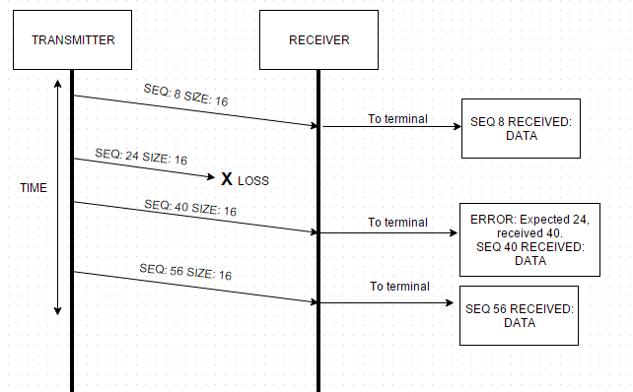
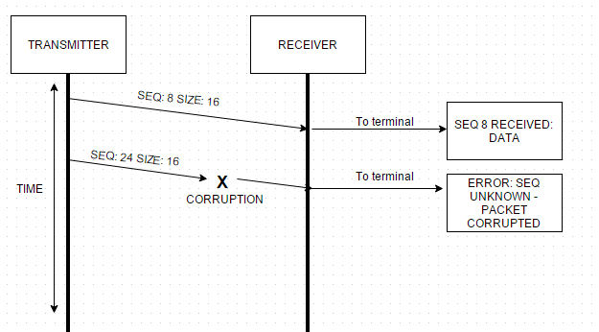
Error handling
Packet Loss
Signal Interference

Slide 26
Laser Wavelength
Selected 1550nm wavelength.
Standard in Telecommunication.
Safe operating wavelength.
Sunlight spectrum will not interfere with the photodetector.

Slide 27
Laser Comparison
 | Wavelength Range (nm) | Operating Voltage (V) | Threshold Current (mA) | Output Power CW (mW) | Pulse Width (ns) | Price $
Diode Only Quantum Well Laser
Panasonic LNCT28PF01WW | 656-665 | 2.4 | 50 | 100 | 30 | 15.62
Panasonic LNCT22PK01WW | 777-791 | 2.5 | 45 | 200 | 100 | 15.62
Diode Only Vertical Cavity Surface Emitting Laser
TT Electronics OPV300 | 860 | 2.2 | 3 | 1.5 | .2 | 14.65
TT Electronics OPV314AT | 860 | 2.2 | 3 | .6 | .210 | 20.50
Pigtail Package Quantum Well Laser
US-Lasers MM850-0 | 840-860 | 2.4 | 20 | 5 | - | 76.0
Renesas NX7338BF-AA | 1310 | 2.5 | 20 | 10 | 4 | 266.0
Renesas NX7538BF-AA | 1550 | 2.5 | 45 | 10 | 4 | 285.95
14 Pin Butterfly Package Quantum Well Laser
Mitsubishi FU-68SDF-V802M | 1550 | 1.8 | 10 | 6 | .150 | 148.50

Slide 28
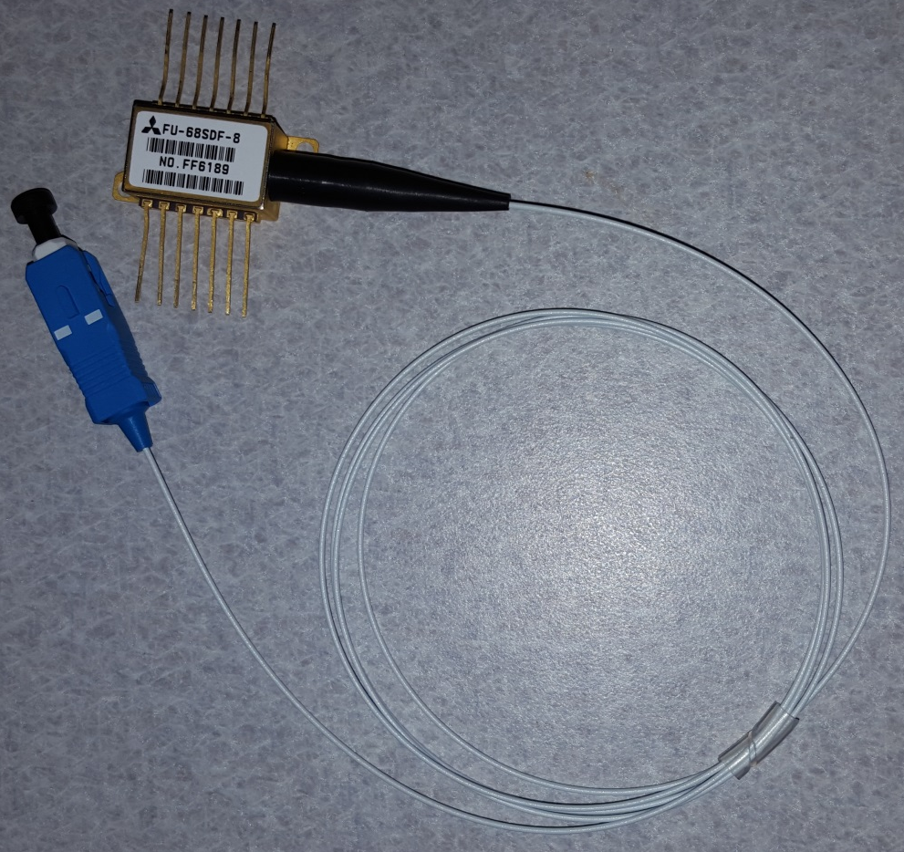
Laser Package
Small, and flexible design.
Easy to implement with lens design.

Slide 29
Laser Driver Comparison
 | Supply Voltage (V) | Min Bias Current (mA) | Packaging Configuration | Data Rates (Gbps) | Pulse Width (ps) | Price $
Texas Instruments ONET1101L | 3.3 | 5 | QFN Package | 2-11.3 | 60 | Sample
Mindspeed M02067 | 3.3 | 4 | Tray | up to 2.1 | <150 | 8.50
Philips TZA3047A | 3.3 | 5 | BCG | .030-1.25 | 300 | 10
Texas Instruments ONET4201L | 3.3 | 5 | QFN Package | .155-4 | 60 | Sample
MAX3736 | 3.3 | 5 | QFN Package | 4Gbps | 90 | 3.50

Slide 30
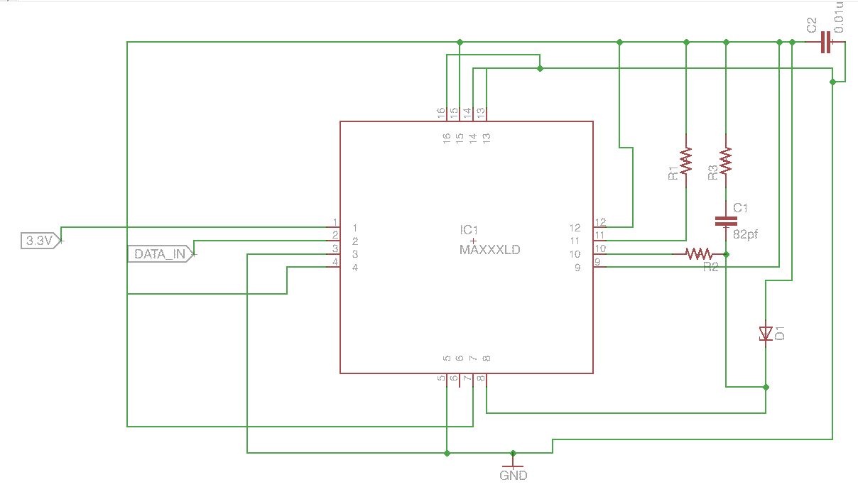
Laser Driver Circuit

Slide 31
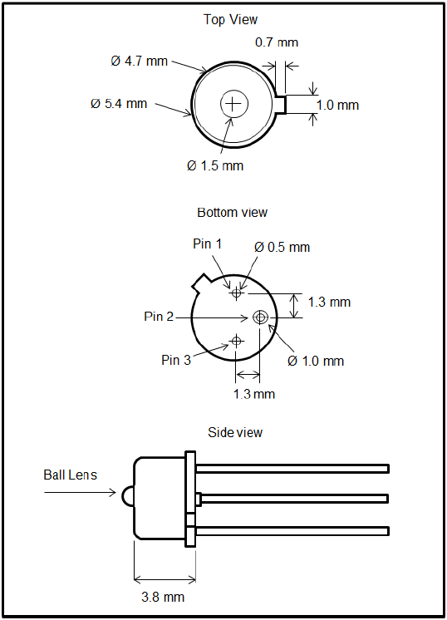
Photodetector
Thorlabs FGA01 ($56.70)
InGaAs material
Wavelength range: 800 - 1700 nm
Responsitivity: 1.003 A/W
NEP@1550nm,20V: 4.5x10^-15W/Hz
Reverse Bias: 20V (max)
Dark Current: 0.05 nA, 2 nA (max)

Slide 32
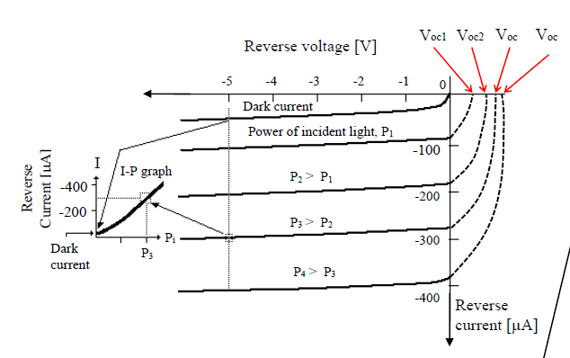
Operation Mode
Photovoltaic
  solar cell
Photoconductive
  photodetector

Slide 33
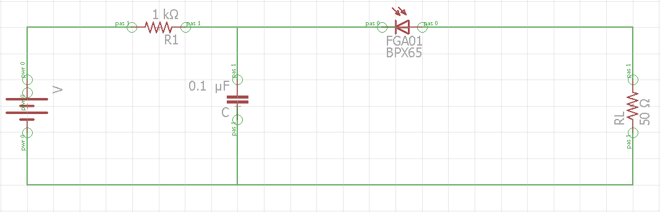
Photodetector Circuit
Prototype circuit using IR LEDs
2 Mbps max rate
ATMEGA2560
Radioshack parts
($3.99).

Slide 34
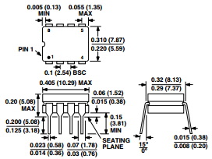
Operational Amplifier
AD744
Cost: $1.00
Cerdip (Q) package
Dimensions: in. (mm).
13 MHz gain bandwidth

Slide 35
Operational Amplifier
OP27EP
Cost: $2.00
Cerdip (Q) package
Dimensions: in. (mm).
8 MHz gain bandwidth

Slide 36
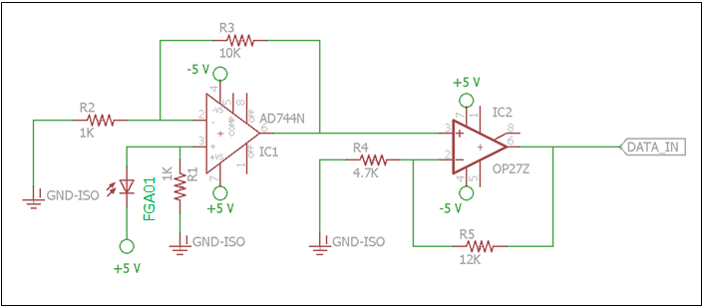
Operational Amplifier Circuit

Slide 37
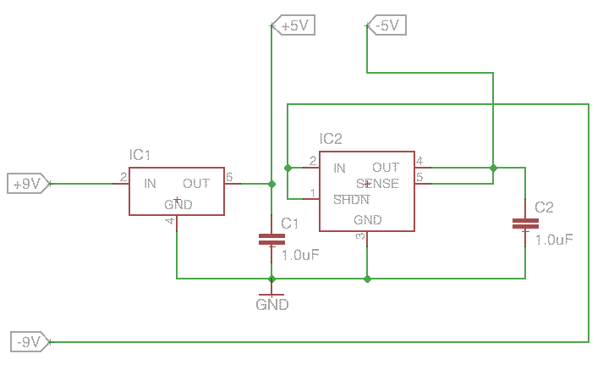
Receiver Voltage Regulator

Slide 38
Receiver issues
Small active area diameter: 0.12 mm
Beam Dispersion
Atmospheric Absorption

Slide 39
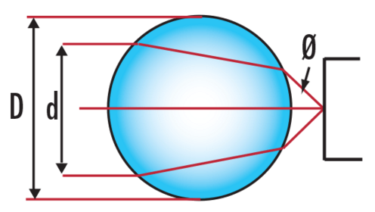
Accommodations
Ball Lens
0.06” diameter
In door experiments

Slide 40
Budget
 | Amt. | Cost
Infrared emitter & detector | x1 | $ 9.99
Thorlabs FGA01 | x1 | $ 56.70
Mitsubishi Laser FU-68sdf-v802m | x1 | $ 148.50
opamps | x2 | $3.00
Circuit Board | x1 | $4.00
Inductor Kit | x1 | $ 14.44
Capacitor Kit | x1 | $ 14.00
Laser Driver | x3 | $ 3.57 (free)
Transimpedance Amplifier | x2 | $ 7.85 (free)
Dip Adapter | x3 | $15.00
AC – DC converter | x2 | $10.00
Heat Sink | x1 | $4.95

Slide 41
Budget Cont.
Coaxial Cable | 12 feet | $2.50
Lens | x1 | $24.30
Lens Housing | x1 | $15.23
Hardware for lens | NA | $5.31
Hardware for Electric circuit | NA | $33.55
2.1mm PowerJack | x1 | $0.75
Lexan Sheet | x1 | $60.00
Brackets/Bolts/Nuts | NA | $6.00
Perforated Circuit Board | x1 | $6.99
STM32F746 Discovery Board | x2 | $100.00
Infrared Card | X1 | $73.00
Total: |  | $624.75
Allotted Budget: |  | $500.00

Slide 42
Work Distribution
 | Transmitter | Receiver | Microcontroller | Power System
Derek | P | S | S | P
Josh | S | P | S | S
Ken |  |  | P | S

Slide 43
Future Applications
Temporary network in case of disaster
Satellite / Aircraft communication
LIDAR
Can send data over multiple laser beams to one photodetector.
Temporary network in case of a disaster.

Slide 44
Successes and Difficulties

Slide 45
Questions?

