Slide 1
EnergyGuard
Home Management & Control System
Spencer Sullivan, EE
Tyler Ensey, EE
Gabriel Holland, CpE
Omar Mohammed, CpE
Sponsored By:

Slide 2
Motivation
We wanted to create a product that could be used domestically
That promotes energy efficient practices
Has significant hardware & software components to satisfy all members
Utilizes cyber-security in its software design
Is easily installed with little cost and doesn't require major home modification
Uses knowledge acquired from embedded systems

Slide 3
Design Requirements
Plug and Play hardware design
Report Data to user via app. Data includes Energy consumption per for system and per device
A server will be used as a HUB for the system. All devices will send data to the server
Android App will report all data and statistics reported by the Server HUB.

Slide 4
Design Specifications
Power supply of 120 V 15 A given from household wall outlet
3 outlets each with a 120 V 15 A given from the power supply
2-3 sensors that will track occupancy and possibly provide security
Each outlet must have a relay capable of handling a volatage supply of 120V AC
Also supply 3.3-5V DC line for MCU, LED’s etc.
Less than 1% error for power readings

Slide 5
System Hardware Block Diagram

Slide 6
Power Strip
3 outlets to power devices
Power supplied from wall outlet
Circuits to read current and voltage and calculate power

Slide 7
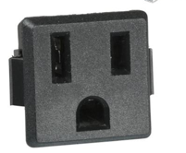
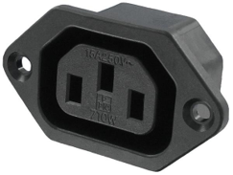
Connectors
Decided on the part shown since it will be applicable to our design
Originally we chose the C14 connector for our design
Decided against it since we noticed that the inputs were square
Manufacturer Part Number | 738W-X2/01
Voltage Rating | 125 V
Current Rating | 15 A
Mouser, DigiKey, Amazon | $0.58-$7.00

Slide 8
Power SUPPLY
Supplied from Wall outlet at 120 V 15 A
Neutral and live will come from wall outlet and pass through and AC/DC converter
Output a 0 and 5 V line and 5 V will go to linear regulator for a 3.3 V line

Slide 9
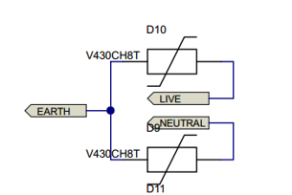
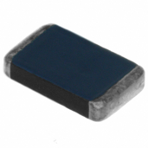
Surge Protection
Each of the 3 outlets will have a circuit similar to the one shown.
The Power supply connection will also have one.
May have an issue with cost.
Varistor
Manufacturer Part Number | V430CH8T
Voltage (Max) | 275 VAC
Clamp Voltage | 389 V
DigiKey | $11.84

Slide 10
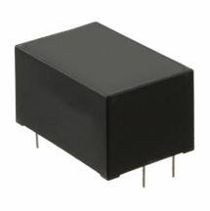
VSK-S2-5U AC-DC Converter
Up to 2W Continuous Power
Compact Board Mount Design
85-305VAC/12—430VDC Input
5VDC Output
Used to power relays and relay driver
Output is connected to a LDO voltage regulator, which outputs 3.3V that powers the MCU
102-2589-ND, Digi-Key, $13.25

Slide 11
TPS77033DBVT LDO Linear Regulator
50mA Low-Dropout Regulator
3.3V Fixed-Output
Only 17µA Quiescent Current at 50mA
Dropout Voltage Typically 35mV at 50mA
Over Current Limitation
Used to power the MCU
TPS77033DBVT, TI, $1.34

Slide 12
Voltage Sensing Circuit
$V_{RMS}=K_{V}×\sqrt{\frac{1}{N}\sum_{i=1}^{N}{V_{samp\left(i\right)}^{2}}}$

Slide 13
Current Sensing Circuit
$I_{RMS}=K_{I}\sqrt{\frac{1}{N}\sum_{i=1}^{N}{I_{samp\left(i\right)}^{2}}}$

Slide 14
Power Calculations
$P=K_{P}\frac{1}{N}\sum_{i=1}^{N}{V_{samp\left(i\right)}×I_{samp\left(i\right)}}$
$Q=K_{P}\frac{1}{N}\sum_{i=1}^{N}{V_{samp,90\left(i\right)}×I_{samp\left(i\right)}}$
$S=\sqrt{P^{2}×Q^{2}}$
$PF=cosθ=\frac{P}{S}$

Slide 15
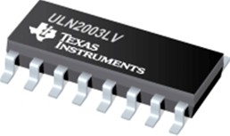
ULN2003LVDR Relay Driver
Used to control or “drive” the three relays
7-Channel High Current Sink Drivers
Supports a Wide Range of 3V-to-5V Relays
Compatible to 3.3V and 5.0V Microcontrollers and Logic Interface
Input RC-Snubber
Low Input and Output Leakage Currents
ULN2003LVDR, TI, $0.63

Slide 16
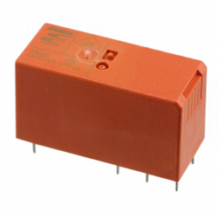
PB1696-ND Relays
Contact Arrangement – SPDT (1 Form C)
Rated Voltage – 250VAC
Rated Current – 16A
Polarized Bistable Version with 2 Coils
Reinforced Insulation
Operate/Reset Time Max – 10/10ms
PB1696-ND, Digi-Key, $5.93

Slide 17
HVAC/Dryer System
Motivation: Power Grid Congestion
Functionality: Dryer and HVAC system will never be on at the same time
When HVAC system is running, the dryer will turn off until the house has reached the desired temperature. The dryer will reactivate itself once the HVAC is off.
Appliance | Average Power Consumption (Watts)
HVAC | 5,000
Dryer | 3,400
Oven | 3,000
Hair Dryer | 1,500
Dishwasher | 1,500
Coffee Machine | 1,500
Microwave | 1,500
Toaster | 1,100

Slide 18
Smart Thermostat
The design was influenced by the NEST Learning Thermostat.
Push functionality to switch between “OFF,” “COOLING,” and “HEATING.”
Switch functionality to turn the dryer on and off.
Rotational functionality to change the desired temperature.

Slide 19
Embedded Design
Choices, Decision, & Design

Slide 20
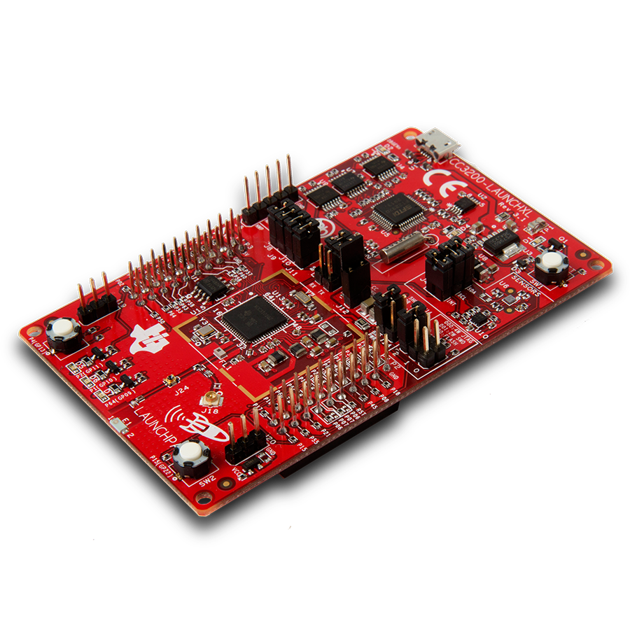
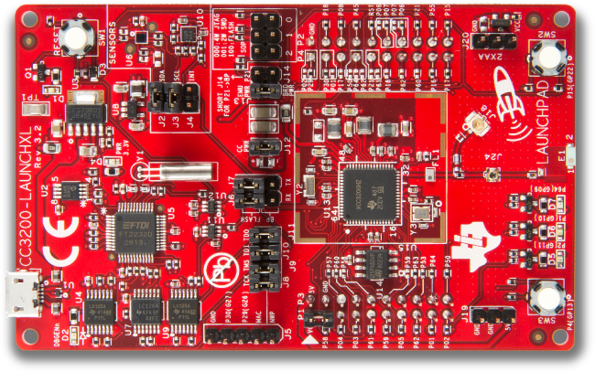
CC3200
We chose the CC3200
Cheaper Option
Designed with IoT in mind
Wifi-Experience unnecessary
Although there are some limitations,
12-bit ADC
Less Memory - Enough for tasks

Slide 21
Embedded Software
Divided into six components
Pin Configuration
Connectivity to Access Point & Server
Data Collection
Calculation
Post Values
Send Socket Status

Slide 23
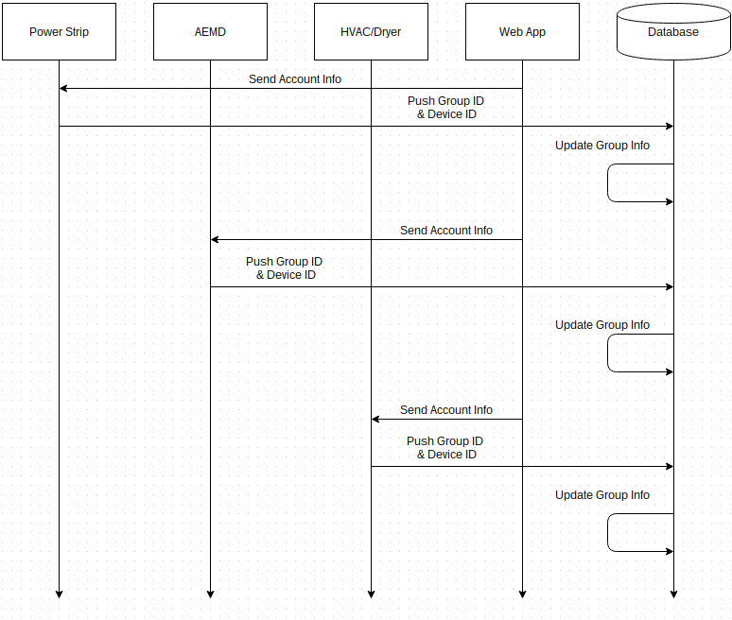
Startup Sequence Diagram

Slide 24
General Function Sequence Diagram

Slide 25
Cyber-Security
Implementation & Overview

Slide 26
Login/Create Account Screen
The "Gatekeeper" of our app
Most important page for security
Three-attempt login protocol
Device ID & device signal synch needed for account creation
Special Characters Restricted for Username/Password
Public/Private Key Encrption

Slide 27
Defensive Programming
Prevents crashes & misuse
Design code to handle unforeseen circumstances
Strict input specifications-Whitelisting
Don't trust users or APIs to function properly-Maintainability
Assign variables for data type sizes
2-Tier User Privileges
Server Side Authentication

Slide 28
Application
Summary & Design

Slide 29
APPLICATION – FUNCTIONALITIES
The front end will be implemented using JavaScript, HTML, and CSS.
The back end will be implemented using JavaServer Pages (JSP).
The HTML will have event listeners that will trigger the JavaScript code.
The JavaScript will then trigger the JSP using jQuery methods.
The JSP will connect to the database on the server, and will push or pull data, as necessary.
PhoneGap will be used to package the code into a mobile application.
The application will be placed on a tomcat web server that will connect to a postgresql database.
The web server will be the central hub of the application.
The web server will be put on a host on the internet.

Slide 30
APPLICATION – Implementation
The front end will be implemented using JavaScript, HTML, and CSS.
The back end will be implemented using JavaServer Pages (JSP).
The HTML will have event listeners that will trigger the JavaScript code.
The JavaScript will then trigger the JSP using jQuery methods.
The JSP will connect to the database on the server, and will push or pull data, as necessary.
PhoneGap will be used to package the code into a mobile application.
The application will be placed on a tomcat web server that will connect to a postgresql database.
The web server will be the central hub of the application.
The web server will be put on a host on the internet.

Slide 31
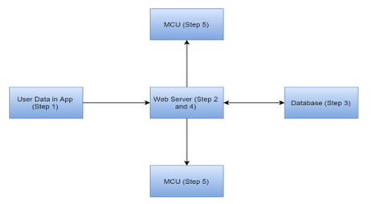
APPLICATION – Data Flow
Data flows from Application to the web server
The web server will execute correct JSP file, and save the data in the database.
The data will be sent out to the microcontrollers.

Slide 32
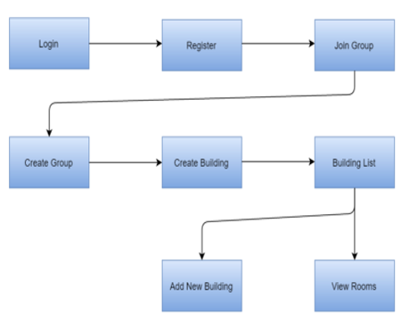
APPLICATION – Page Flow
New user flow; takes user through initial process.
The user registers his or her account information, and can either join an existing group or create a new group.
If the group does not have an associated building, the user can create a building. Otherwise, he or she will be taken to the building list.

Slide 33
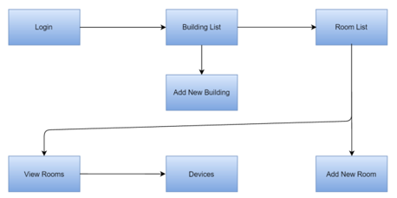
APPLICATION – Page Flow
Existing user flow; taken directly to the building list on login.
From the Building List, the user can add a building or view the rooms associated with the building.
From the Room List, the user can add a room or view the room and device details.

Slide 34
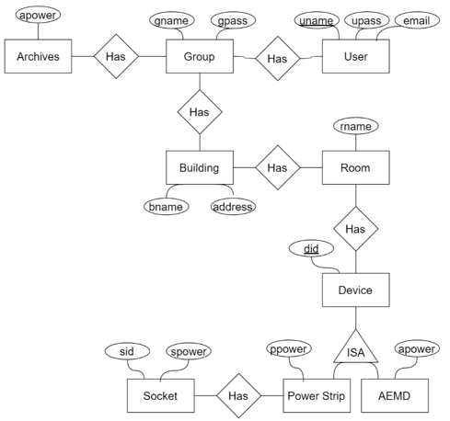
APPLICATION – ER Diagram
Entities
Group
User
Building
Room
Device
Power Strip
Above Entrance Mounted Device (AEMD)
Socket
Archives

Slide 35
Work Distribution
Component | Primary Engineer | Secondary Engineer
Socket Design | Spencer | Tyler
Relay & Relay Driver Design | Tyler | Spencer
Power & Current Measurement Design | Spencer | Tyler
Power Strip PCB | S/T | N/A
Embedded Programming | Gabriel | Omar
Smart Thermostat PCB | Spencer/Tyler | N/A
Power Strip LED Design | Spencer | Tyler
Cyber Security | Gabriel | Omar
Component | Primary Engineer | Secondary Engineer
Surge Protector Design | Spencer | Tyler
Smart Thermostat Display | Tyler | Spencer
Smart Thermostat LED Design | Tyler | Spencer
Dryer Representation | Tyler | Spencer
MCU Peripherals | Gabriel | Omar
Web App | Omar | Gabriel
Database | Omar | Gabriel
Server | Omar | Gabriel

Slide 36
Budget
Item | Quantity | Price/Unit | Total Cost |  | Item | Quantity | Price/Unit | Total Cost
S108T02 Relay | 3 | $5.00 | $15.00 |  | Rocker Switch | 1 | $0.93 | $0.93
ULN2003LV Relay Driver | 3 | $0.56 | $1.68 |  | Push Button Switch | 1 | $0.53 | $0.53
INA226 Current and Power Monitor | 3 | $4.03 | $12.09 |  | Soldering Iron | 1 | $50.00 | $50.00
Passive Components | Many | Varying | $20.00 (Approximate) |  | Solder | 1 | $10.00 | $10.00
Female Socket | 3 | $4.20 | $12.60 |  | Printed Circuit Boards | 3 | $33.00 | $99.00
Male Socket | 1 | $2.30 | $2.30 |  | Diodes | Many | Varying | $20.00 (Approximate)
Extension Cord | 1 | $10 | $10 |  | LEDs | 40 | $0.30 | $12.00
Smart Thermostat Housing (wood & plastic) | 1 | $30.00 | $30.00 (Approximate) |  | CC3200 LaunchPad | 1 | $30.00 | $30.00
Power Strip Housing (Plastic) | 1 | $20.00 | $20.00 (Approximate) |  | CC3200 Microcontroller | 1 | $17.00 | $34.00
Potentiometer | 1 | $0.95 | $0.95 |  | TDC1011 Ultrasonic Sensor | 2 | $1.80 | $3.60
Wire | 1 | $25.00 | $25.00 |  | TDC7200 Time to Digital Converter | 1 | $2.25 | $2.25
2-Digit 7-Segment Display | 2 | $2.74 | $5.48 |  | TMP007 Thermal Sensor | 1 | $1.90 | $1.90
CD4511 BCD-to-7 Segment LED Latch/Decoder/Drivers | 2 | $0.57 | $1.14 |  | Shipping & Handling | N/A | N/A | $150.00 (Approximate)
 |  | Estimated Cost: | $156.24 |  |  |  | Estimated Cost: | $414.21
 |  |  |  |  |  |  | Total Estimated Cost: | $570.45

Slide 37
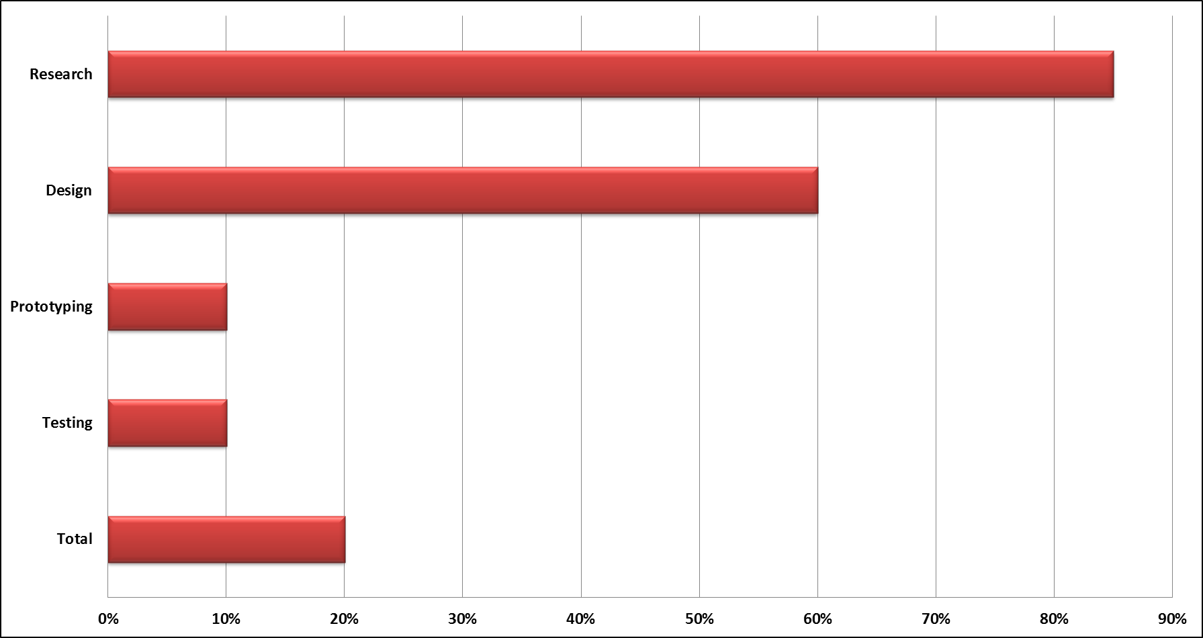
Progress

Slide 38
Questions?
.

