Slide 2
Motivation
Bring new features that have been recently been added to different types of vehicles to motorcycles.
Improve upon similar products currently available in the market.
To give riders easy access to data such as the proximity of potentially hazardous objects in his or her blind spots, details of the bike (e.g. cardinal direction, speed), and general details (e.g. time).

Slide 3
Goals and Objectives
Easy to charge.
Helmet module should be small in order to be easily mounted.
The screen should be easily read but not obstructive to the rider’s field of vision.
Left, right, and rear facing sensors should increase the rider’s safety and awareness of surroundings.
The rider be able to see the information without having to look down.

Slide 4
Requirements and Specifications
Attribute | Value
Number of sensors | 3
Sensor detection distance | 2-400cm (1in - 13 ft)
Sensor measuring angle | 30 degrees
Sensor power consumption | 5-15 mW
Sensor frequency | 40kHz
Display size | 2.2”
Display resolution | 320 x 240 resolution, 18 bit color
Display current consumption | 100mA
Display voltage | 3.3-5V
Microcontroller current consumption | 0.1uA-0.2mA
Wireless communication module operating range | 10 meters
Notes:
No parasitic draws from bike
Not increase helmet weight by 1.25

Slide 5
Requirements and Specifications Continued
Solar panel output | 50mA at 4.8V
Solar panel dimensions | 73mm x 94mm
Battery capacity | 2000 mAh
Battery voltage | 3.7 V
Real time clock accuracy | +/- 2 minutes/year
Real time clock operating voltage | 3.3 V
Real time clock current consumption | 110 uA (standby); 200uA (active)
Electronic compass operating voltage | 2.5 V
Electronic compass current consumption | 1uA (standby); 300uA (active)
GPS operating voltage | 3.0- 4.3 V
GPS current consumption | 180uA - 25mA
GPS position accuracy | 2.5 m
Overall weight increase | < 600 grams

Slide 6
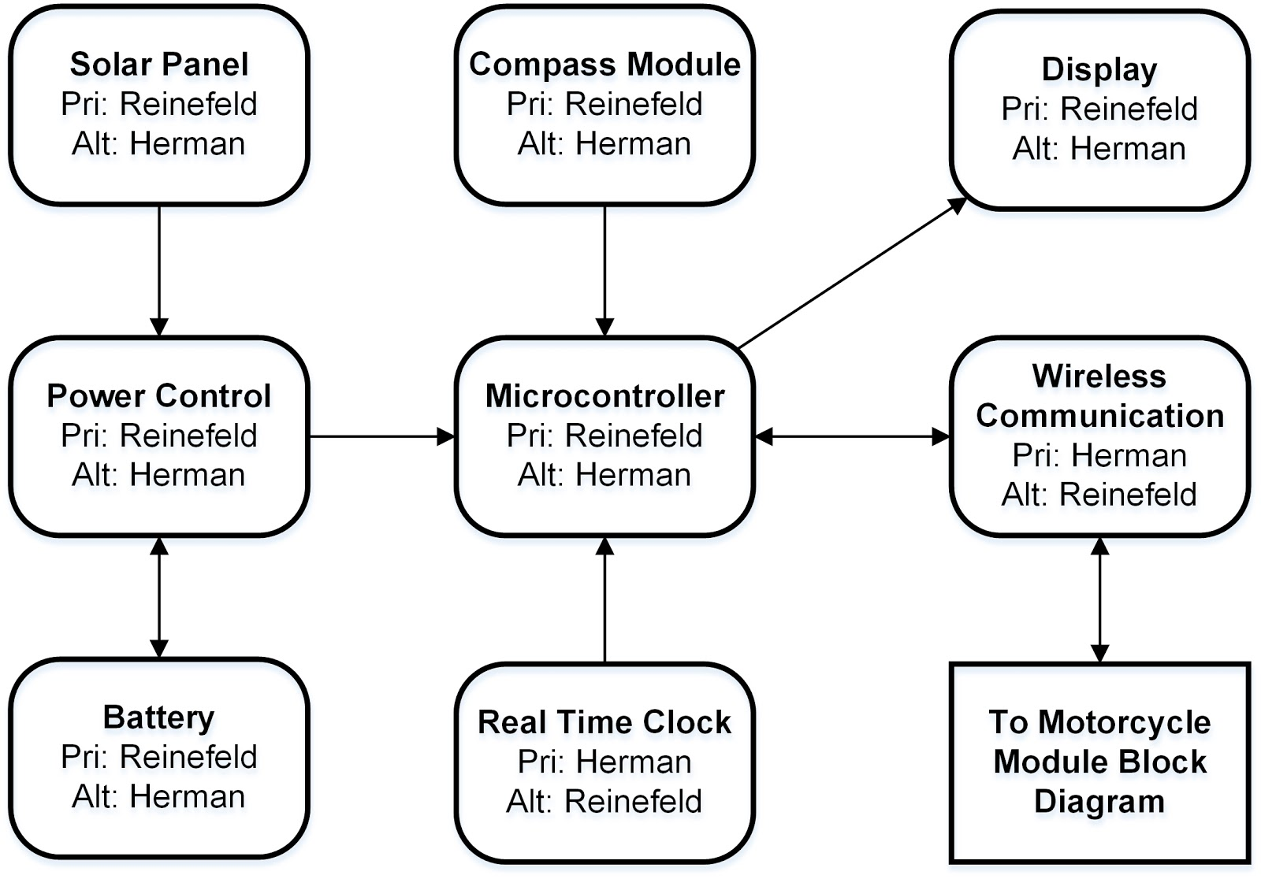
Helmet Hardware Block Diagram

Slide 7
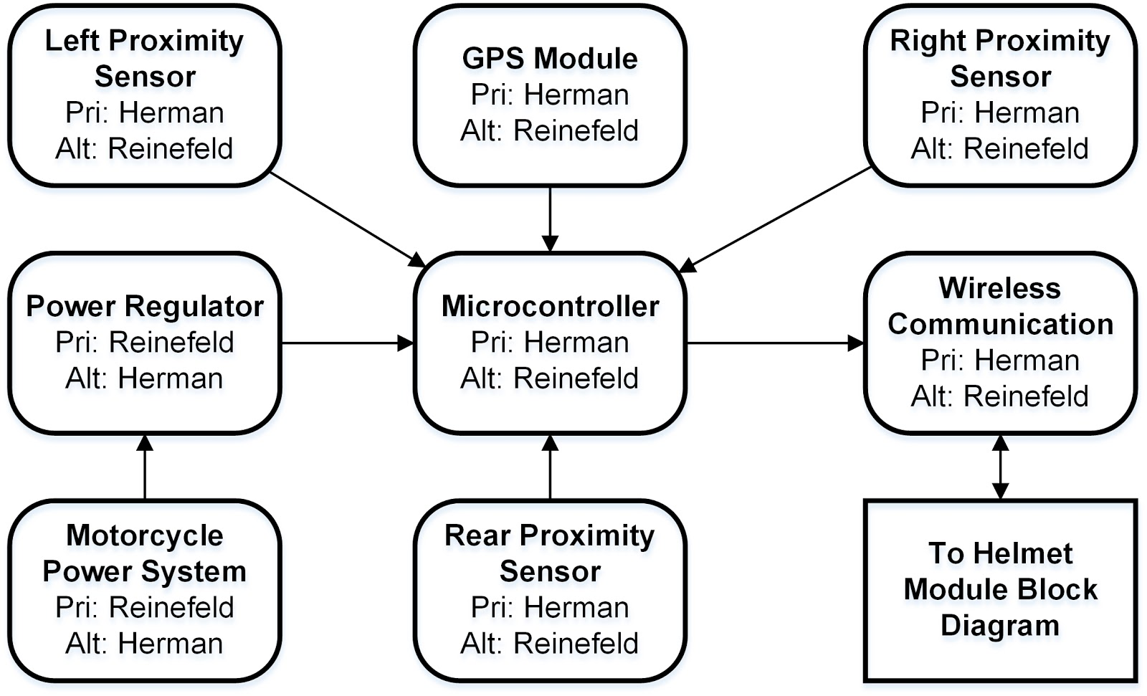
Motorcycle Hardware Block Diagram

Slide 8
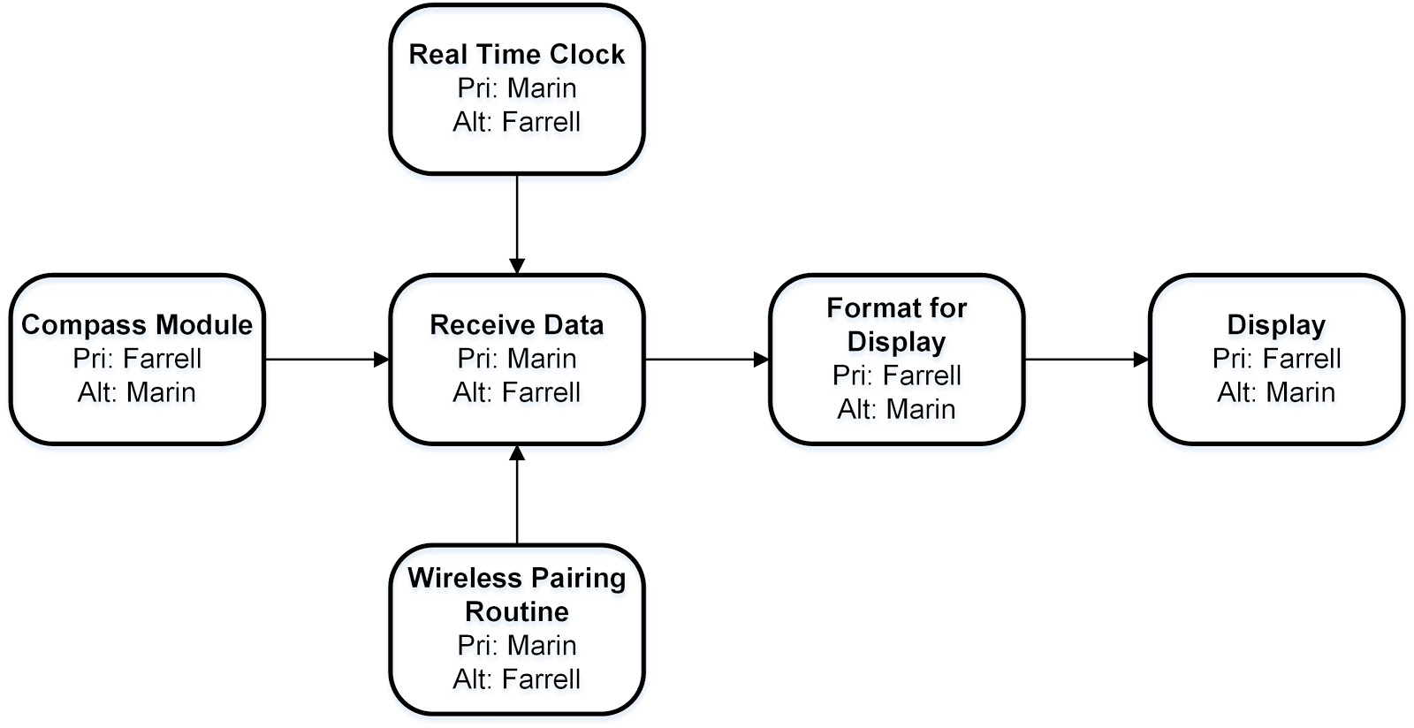
Helmet Software Block Diagram

Slide 9
Motorcycle Software Block Diagram

Slide 10
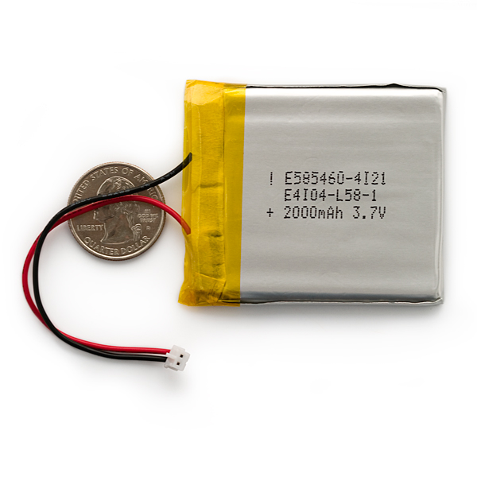
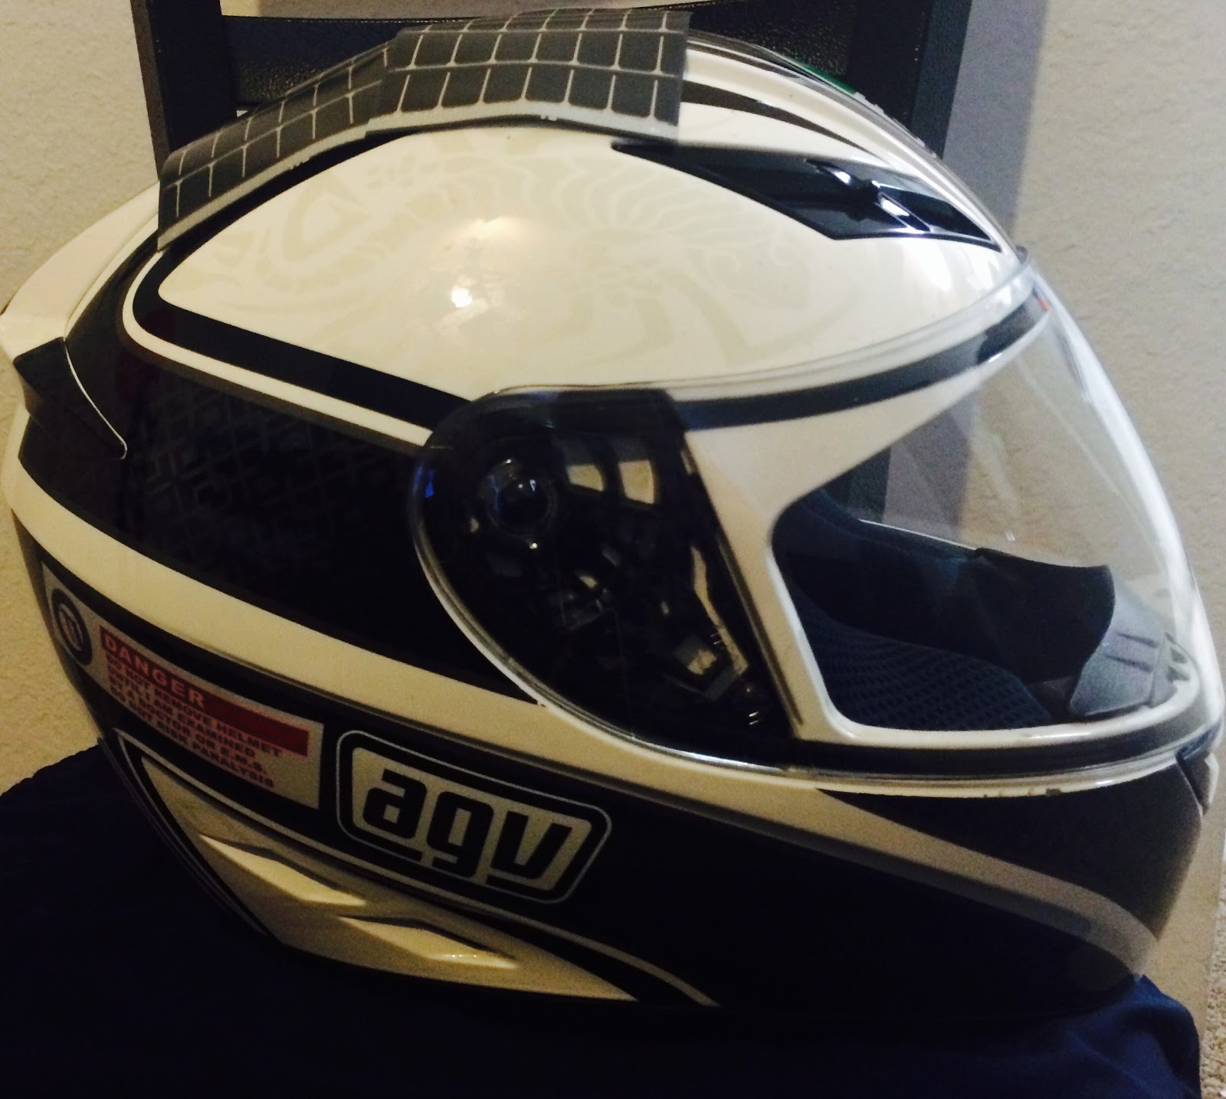
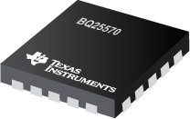
Helmet Module Power System
Components

Slide 11
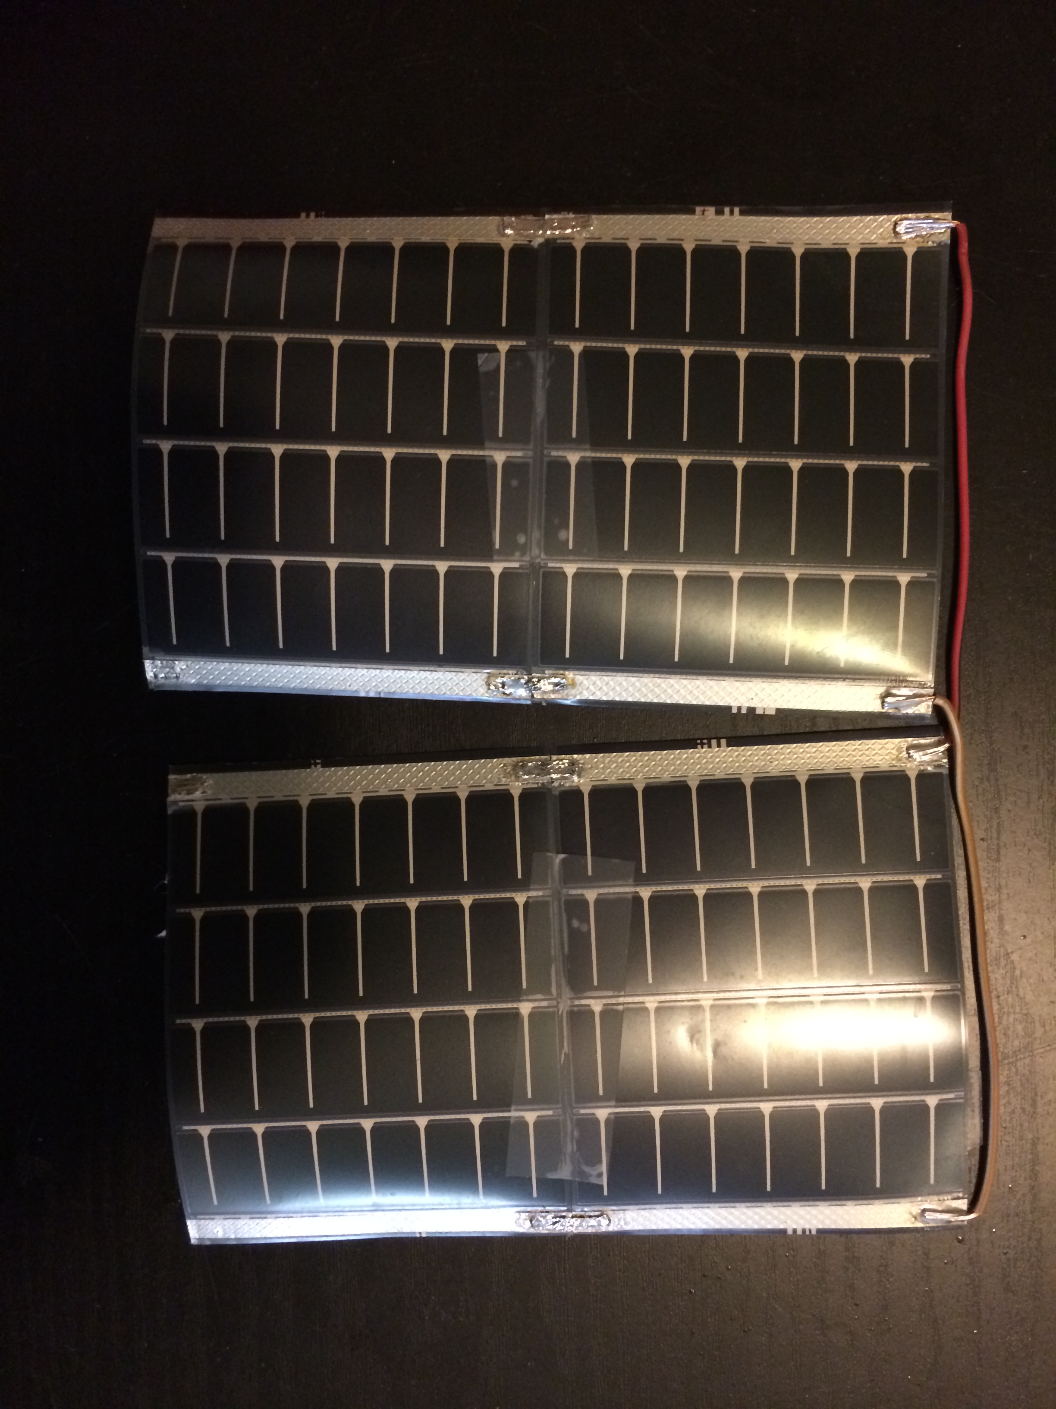
MPT4.8-75 Solar Panel
Purpose: Provide power to the helmet system.
Flexible enough to be molded to helmet.
Output voltage of 4.8 V.
Output current of 50 mA per panel.
Small enough so four can fit on top of helmet with room for more if necessary.
Total current needed: 0.18A
Manufacturer | PowerFilm Solar
Cost | $7.24/ea

Slide 12
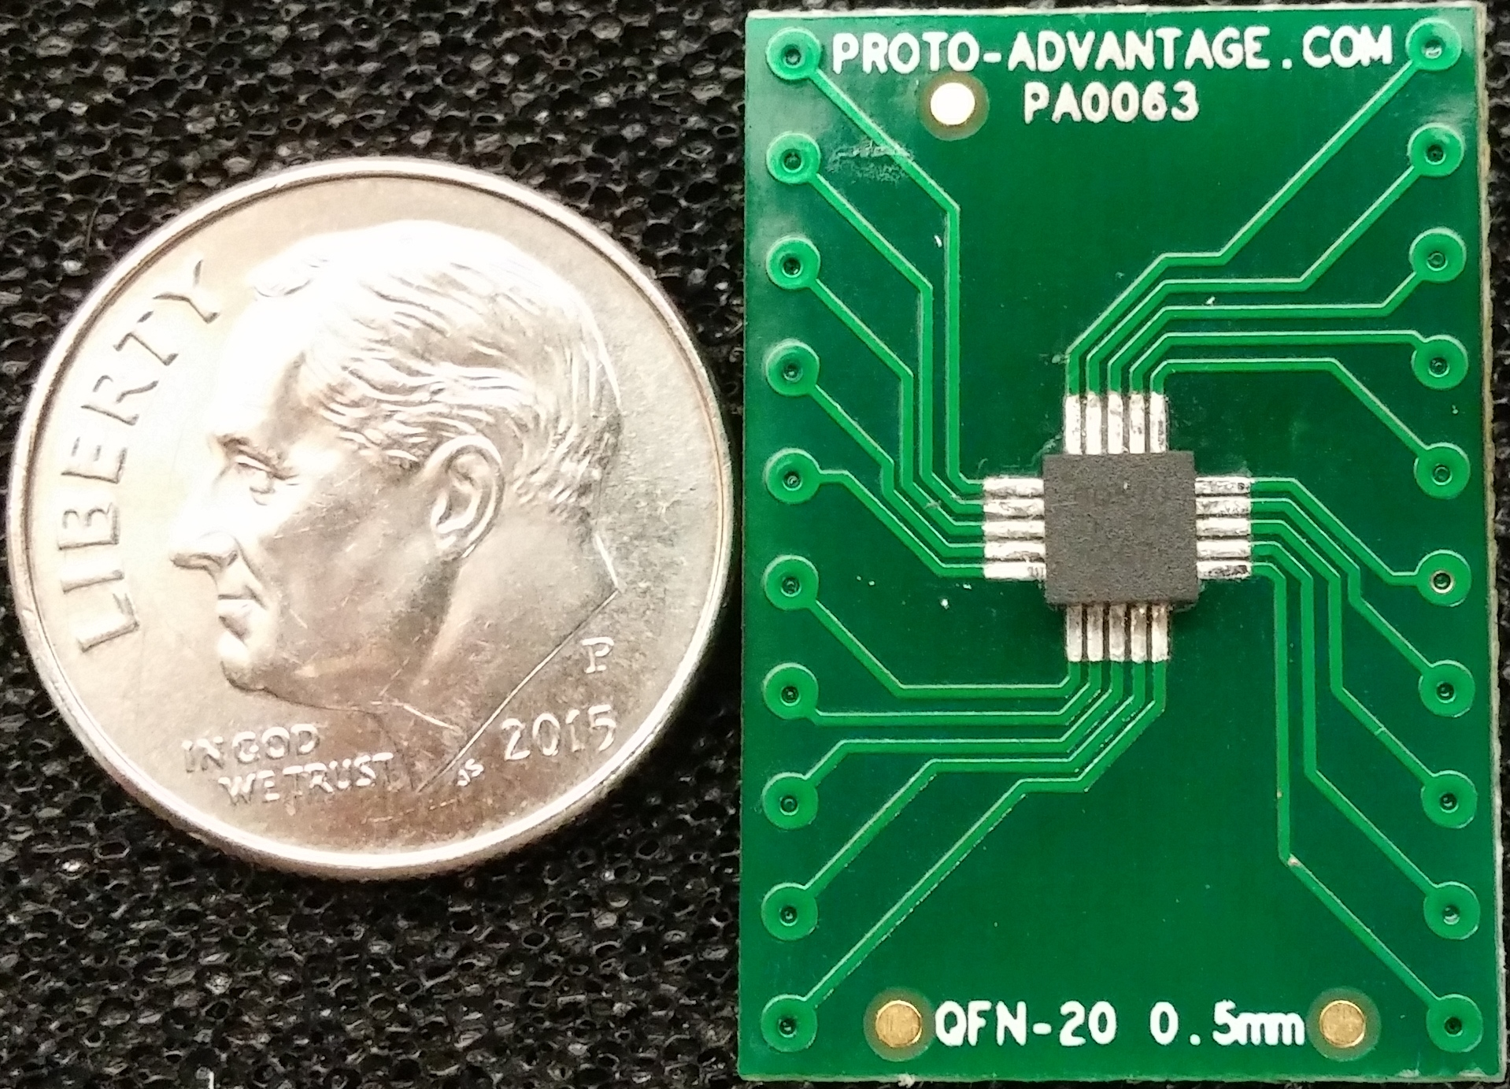
BQ25570 Nano Power Boost Charger and Buck Converter
Purpose: Manage battery charging and voltage input to all modules on helmet system.
Specifically designed for energy harvesting applications.
Provides battery charging and protection.
Provides 3.3 V input to microcontroller, compass, Bluetooth module, and screen.
Extremely small but difficult to mount.
Manufacturer | Texas Instruments
Cost | $21.60

Slide 13
Polymer Lithium Ion Battery
Purpose: Store power from solar panels on helmet.
3.7 V at 2000mAh.
Comes with standard 2-pin JST-PH connector.
Lithium polymer is safer for the rider to wear.
Small size makes for easy placement on helmet.
Manufacturer | UNIONFORTUNE
Cost | $12.95

Slide 14
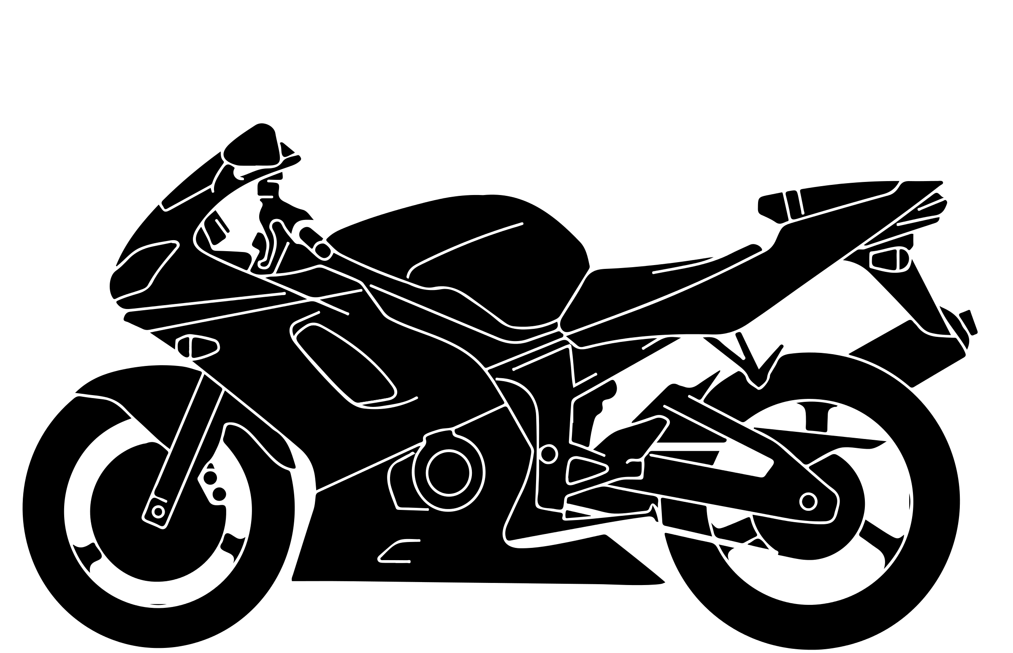
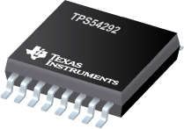
Motorcycle Module Power System
Components

Slide 15
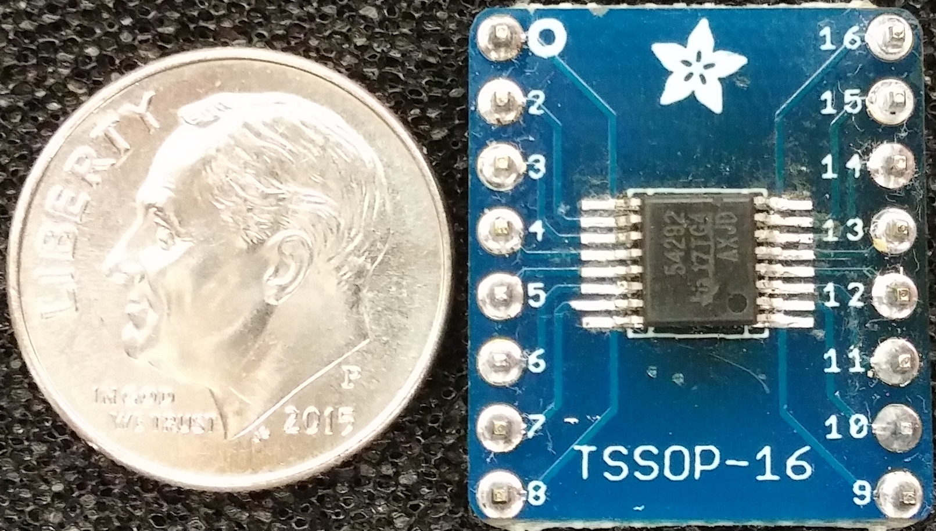
TPS54292 Dual Synchronous Step-Down Converter
Purpose: Step down voltage from motorcycle battery.
4.5 V to 18 V input range.
Dual output to be set to 3.3V and 5 V.
Overcurrent protection 2.2A/3.8A
Thermal shutdown protection at 145° C.
Manufacturer | Texas Instruments
Cost | $18.90

Slide 16
Microcontroller Unit (MCU) Selection
Selection of ATMEGA328P
Fair compromise between processing power and power consumption
Ample memory
Sufficent number of I/O pins
Popularity of this family of MCUs has resulted in an abundance of development boards, compatible accessories, and relevant open source code
Negligible cost
Attribute | MSP430 G2553 | MSP430 FG4618 | ATMEGA 328P | ATMEGA1280 | ARM STM32F405VG
Power Use | 7.9mW | 9.6mW | 26mW | 50mW | 144mW
I/O Pins | 16 | 80 | 23 | 86 | 82
Comm. Ports I²C/SPI/UART | 1/2/1 | 1/1/1 | 1/2/1 | 1/5/4 | 3/3/4
Processor Frequency | 16MHz | 8MHz | 20MHz | 16MHz | 168MHz
Memory Flash/RAM | 16kB/0.5kB | 116kB/8kB | 32kB/2kB | 128kB/8kB | 1MB/194kB
Cost | $1.00 | $8.35 | $1.85 | $9.50 | $6.65

Slide 17
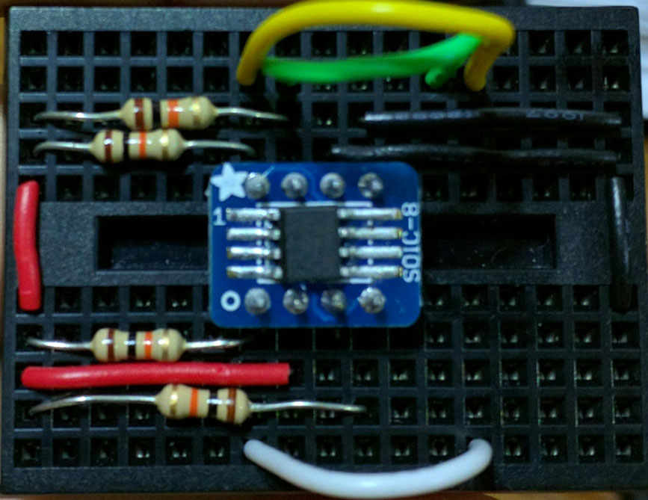
DS3231 Real Time Clock
Purpose: Allow the Head On unit to provide accurate time even after the unit is powered on and off
Initial time will be set by a connected computer. The user can set the time at any moment thereafter.
Keeps track of days, month, and year along with automatic adjustment for leap years and months with less than 30 days.
I²C serial interface for reduced pin use
Low power consumption (1 µA draw for timekeeping) makes it capable of running for years off of a coin cell battery.
Manufacturer | Maxim Integrated Products
Part No. | 0002271370
I/O Lines | SCL, SDA, Vcc, Gnd
Power Supply | 3.3 V

Slide 18
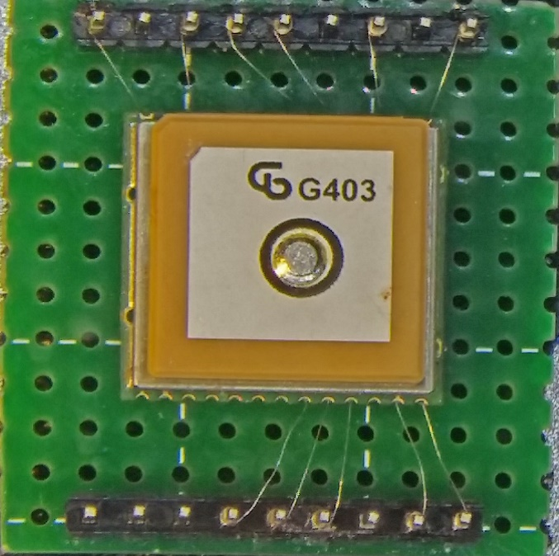
Global Positioning System (GPS)
Purpose: Allow the Head On unit to provide acurate speed information to the rider
Low power consumption: >140mW peak search >73mW average tracking, >90uW in standby
I²C compatible but connected to the hardware UART for dedicated communication with MCU
Horizontal position accuracy of < 2.5 meters
Built-in antenna and LNA with close to 20dB gain
Supports major Satellite Based Augmentation Systems (WAAS, EGNOS, MSAS, GAGAN)
Manufacturer | Maestro Wireless Solutions Limited
Part No. | A2235-H
Cost | $14.42

Slide 19
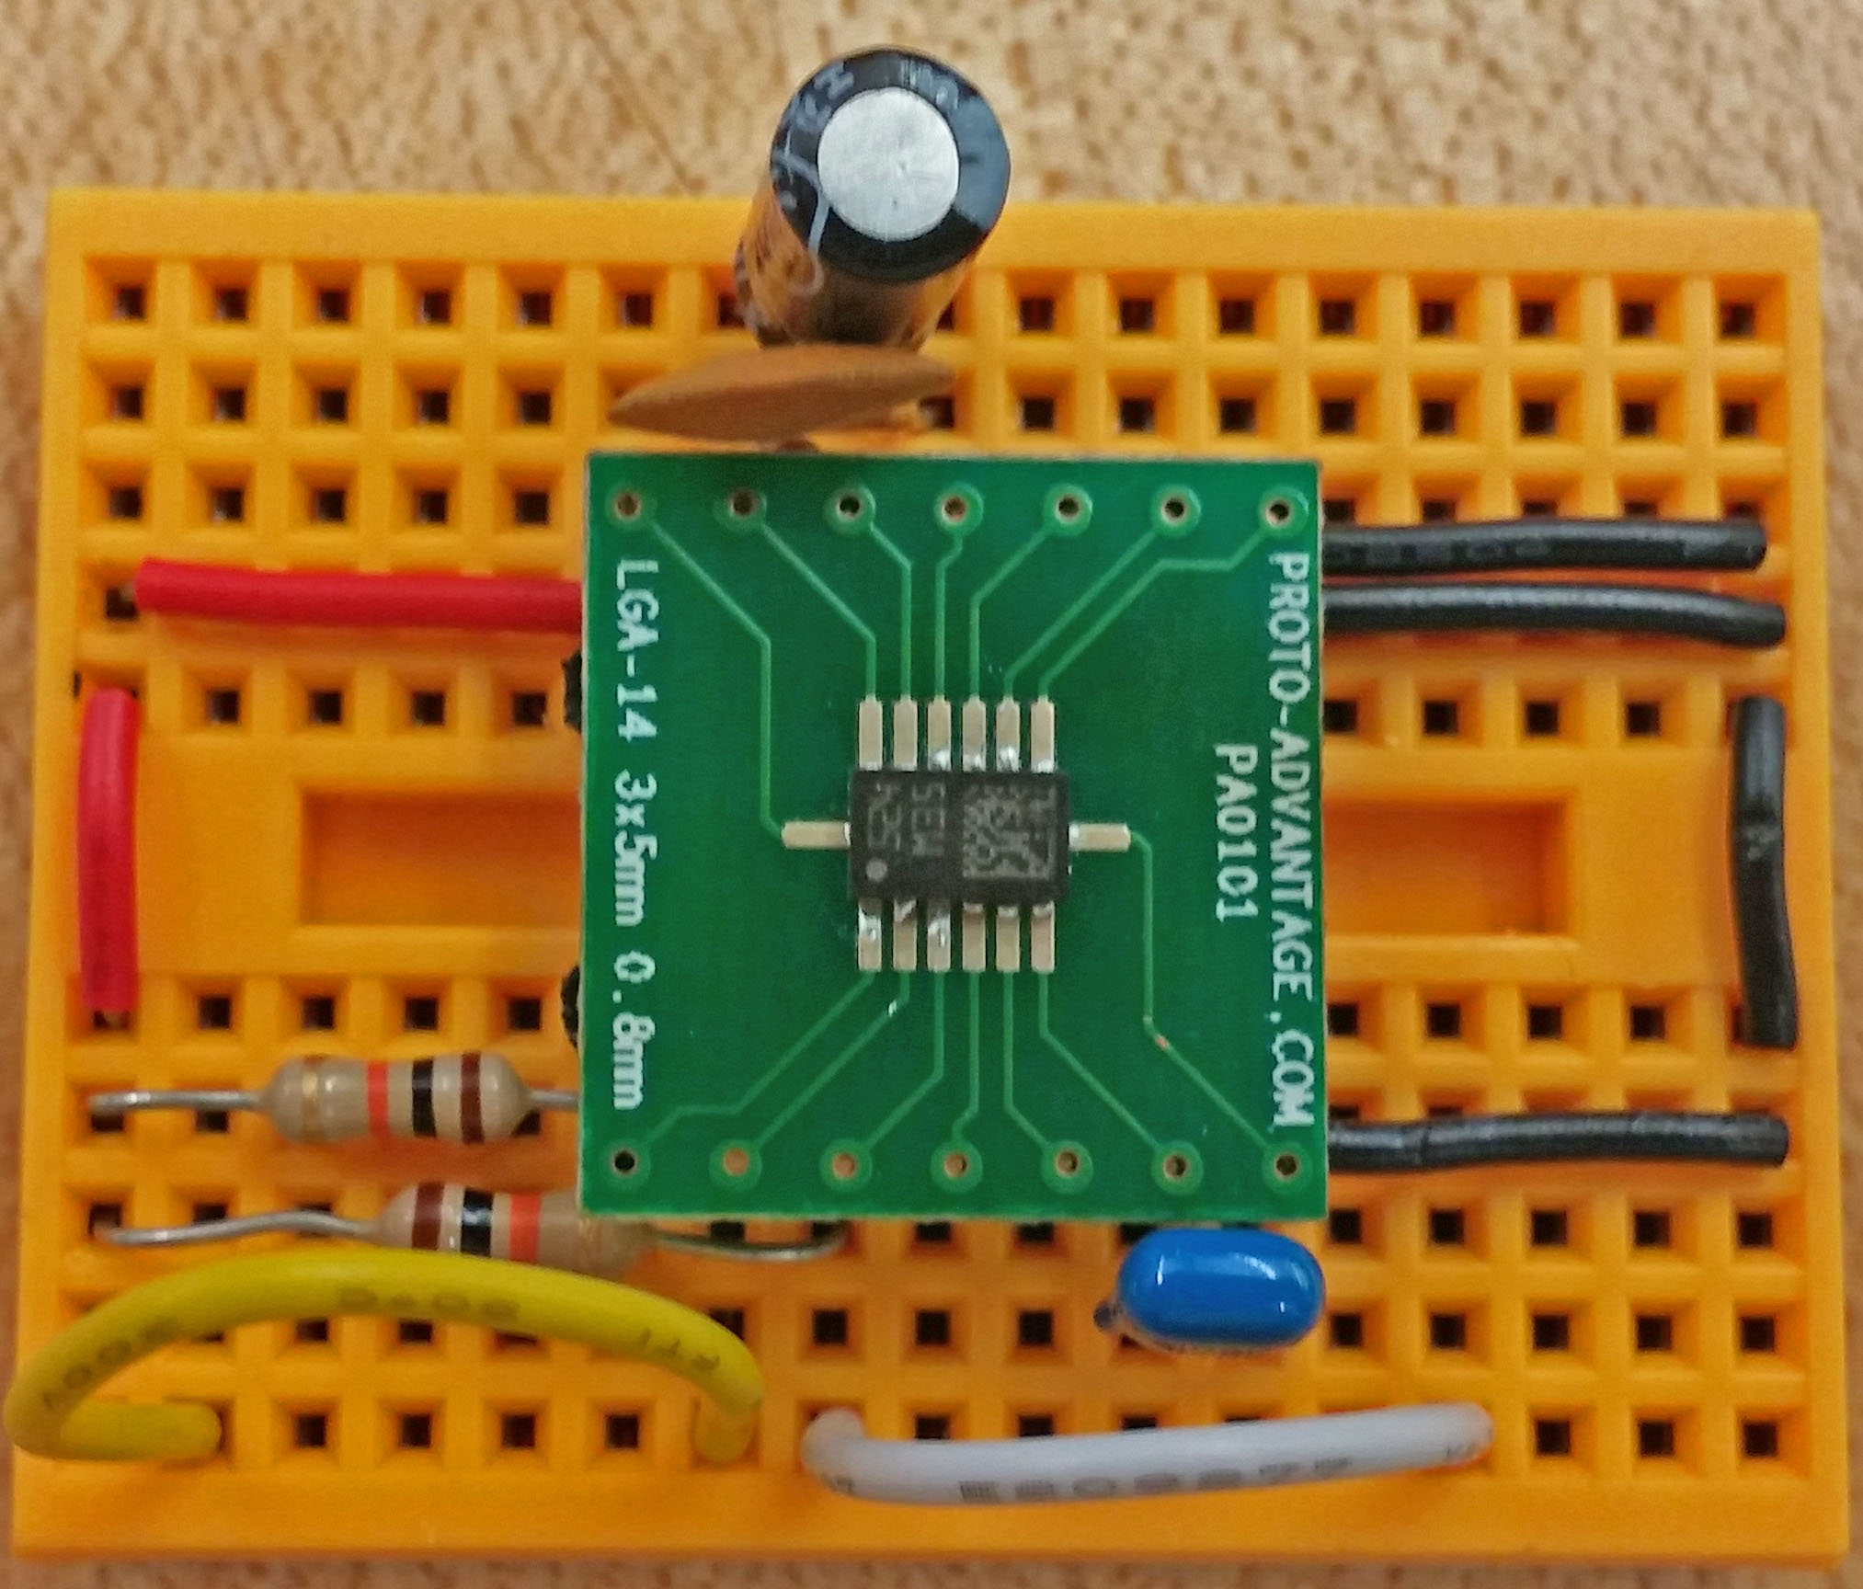
LSM303D Electronic Compass
Purpose: Provide the rider with proper cardinal direction at all times, especially when the rider is not moving.
I²C serial interface for reduced pin use
Integrated 3 axis accelerometer for possible use as a tilt sensor
Implementation on the helmet unit allows the rider to be further aware of directionality by only needing to turn his or her head instead of entire motorcycle
Magnetometer and accelerometer can be turned on and off individually for low power consumption. Normal eCompass consumption is 300 μA
Manufacturer | STMicroelectronics
Part No. | LSM303DLHC
I/O Lines | SDA, SCL, Vin, Gnd
Power Supply | 2.5 - 5.5 V

Slide 20
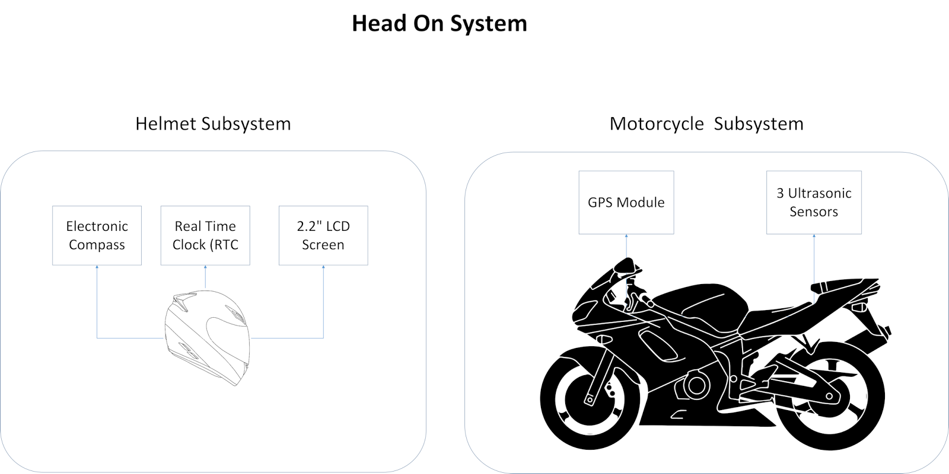
Wireless Communication
The motorcycle unit and helmet unit required a way to communicate data from the GPS and ultrasonic sensors on the bike.
Wired technology was considered at first; however, the hassle of having an extra wire on the rider and safety risk of having the rider attached to the bike ruled it out.
Three forms of wireless technology were considered: ZigBee, Wi-Fi, and Bluetooth

Slide 21
Wireless Communication Selection
Attribute | Wi-Fi | ZigBee | Bluetooth (Class 2)
Standard | 802.11 (a,b,g,n) | 802.15.4 | 802.15.1
Frequency | 2.4 and 5 GHz | 2.4 GHz | 2.4 GHz
Operating Range | 100 meters | 10 - 100 meters | 10 meters
Data Throughput | 25 Mbps (g) | 250 kbps | 0.7 - 2.1 Mbps
Network Acquisition | 3-5 s | 30 ms | < 10 s
Security | High | High | Low
Relevant Power Consumption | High | Very Low | Medium
Example Battery Life | Hours | Months to years | Months to years
ZigBee featured both high security and the lowest power consumption , yet the lowest data throughput of the three technologies
Wi-Fi allowed operation on a lesser used band with high security; however, had high power consumption and implementation complexity.
Bluetooth consumed less power than Wi-Fi, provided ample throughput, less complex, and more than sufficient operating range

Slide 22
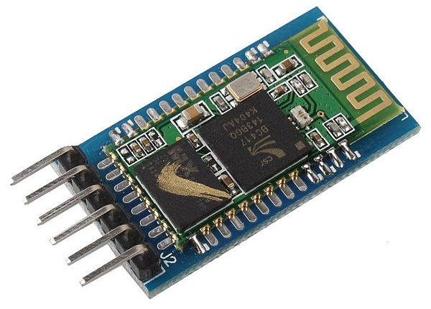
HC-05 Bluetooth Module
Purpose: Allow the motorcycle and helmet units to interface with each other
Low connection setup complexity
Flexibility of setting each module to a master or slave
Capable of remembering the last paired device for auto pairing
Low power consumption with 30 mA maximum draw
Features two modes:
- Command mode
- Data mode
Manufacturer | Sunkee
Part No. | B00CDG65F8
I/O Lines | Rx, Tx, Vcc, Gnd
Power Supply | 3.3 V, 5 V

Slide 23
LCD Screen Selection
 | 1.8” color TFT LCD display | 2.2” 18-bit color TFT LCD display | Serial Graphic LCD 160x128 | 3.2” Serial TFT LCD with touchscreen | 16x2 Parallel Character LCD
Manufacturer | Adafruit | Adafruit | Sparkfun | Sparkfun | Crystalfontz
Part No. | 358 | 1480 | 08884 | 11677 | CFAH1602D-YTI-ET
Power | 3.3/5V @ 100mA | 3.3/5V @ 50mA | 6/7 V @ 220mA | 4/5.5V @ | 3.3/5 @1.2mA
Cost | $19.95 | $24.95 | $69.95 | $84.95 | $10.72
Overall dimensions | 1.35" x 2.2" x 0.25" | 1.59" x 2.61" x 0.23" | 4.0” x 5.0” x 0.65" | 2.21” x 3.63” x0.63” | 3.35” x 1.18” x 0.52”
Purpose: Display indicator signals to the rider based on input from the modules
Factors to consider:
Size
Cost
Compatibility with GUI design

Slide 24
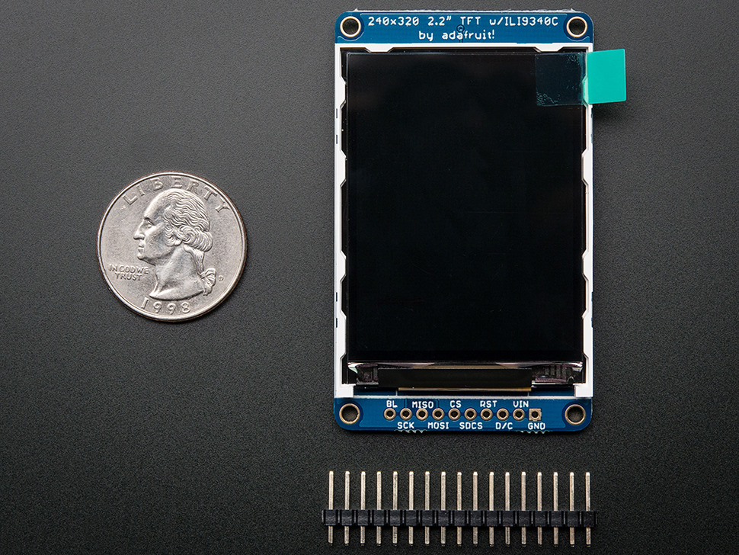
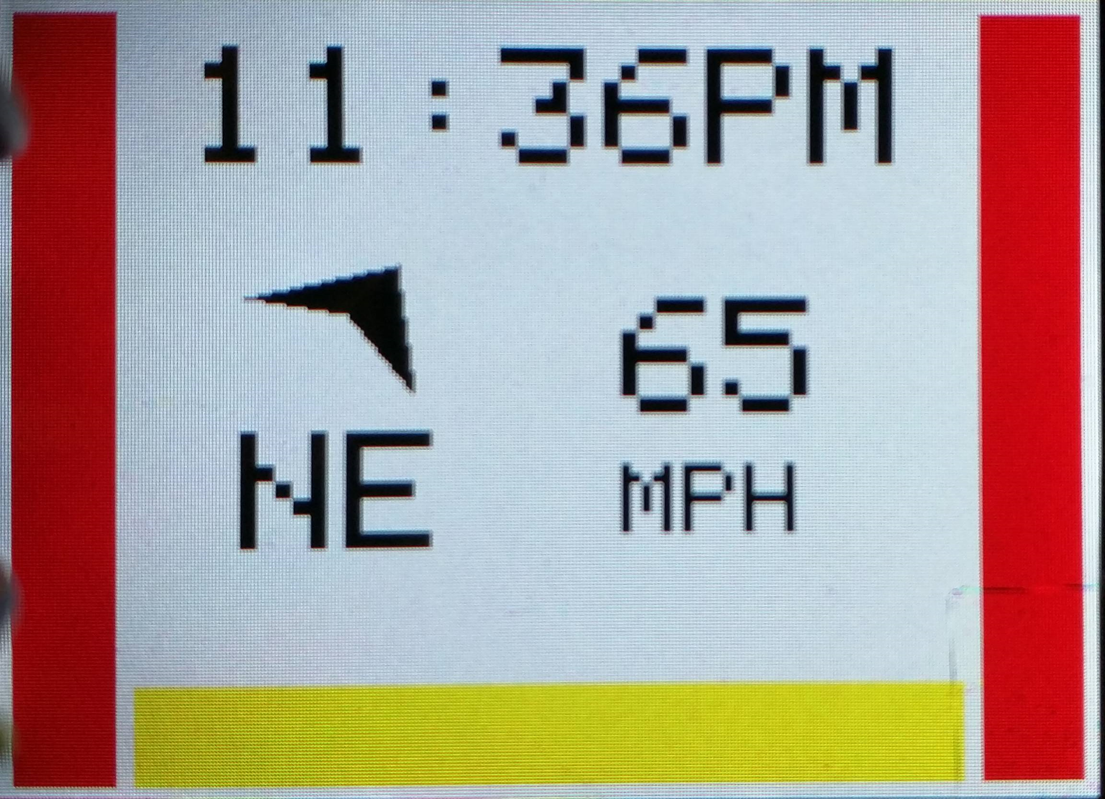
Adafruit 2.2” TFT LCD Display
Screen: 55.23mm x 40mm x 2.46mm
Backlight
4 wire SPI
320x240 color pixels
Indicators will change based on data from the modules

Slide 25
Sensor Selection
Purpose: Detect objects to the left, right, and rear of the rider.
Factors to consider:
Cost
Detection distance
Both sensors were tested to determine actual range
- HC-SR04 sensors were only
accurate to about 90cm
- LV-MaxSonar-EZ sensors were
accurate to approximately 600cm
 | HC-SR04 Ultrasonic Sensor | LV-MaxSonar-EZ 1010 Ultrasonic Sensors
Manufacturer | RobotLinking | MaxBotix
Part No. | 746591610098 | MB1000
Maximum range | 400cm | 645 cm
Resolution | 0.3cm | 1”
Power | 75 mW | 5-15 mW
Cost | $8.69/5 sensors | $29.95
Overall dimensions | 45 x 20 x 15mm | 19.9 x 22.1 x 15.5mm

Slide 26
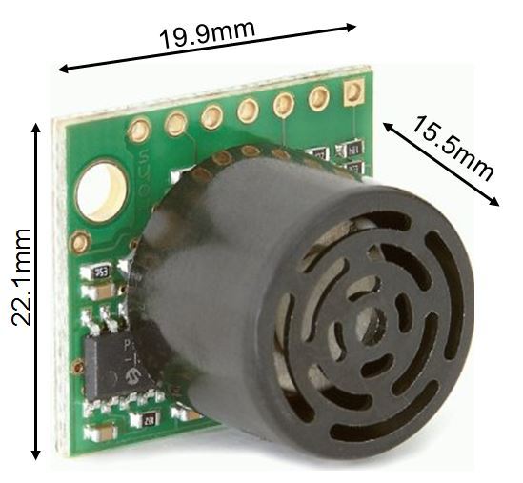
LV-MaxSonar-EZ 1010 Ultrasonic Sensors
Independent connections
Each sensor would need to receive its own trigger signal and data connection
Slower detection rate but less sensor interference
Multiple sensors per connection
Uses fewer pins
Less processor interaction
The entire array can be triggered at the same time providing simultaneous range data
Requires only one trigger signal connection, but an individual data connection for each sensor
Faster detection rate but increased potential for interference between sensors
Manufacturer | MaxBotix inc.
Cost | $24.95

Slide 27
Sensor Threshold Levels
 | Left Sensor | Rear Sensor | Right Sensor
Warning | > 450 cm | > 600 cm | > 450 cm
Danger | ≤ 360 cm | ≤ 360 cm | ≤ 360 cm
 | No Hazard | Warning | Danger
Indicator Color

Slide 28
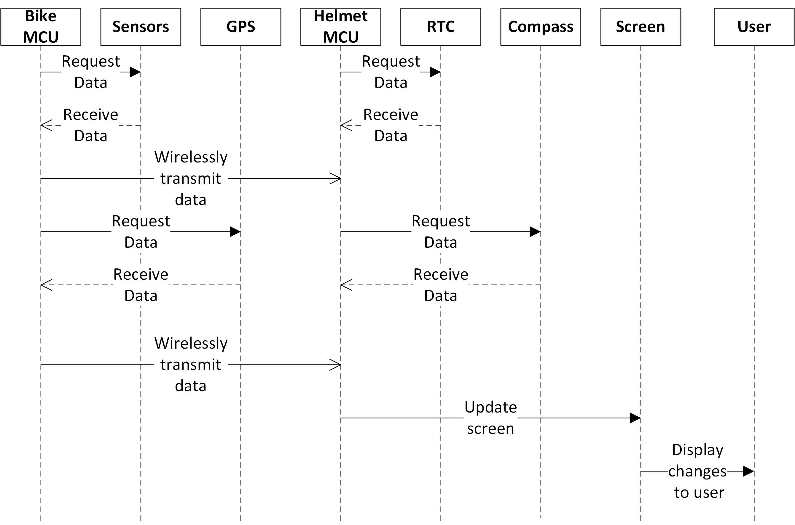
Sequence Diagram

Slide 29
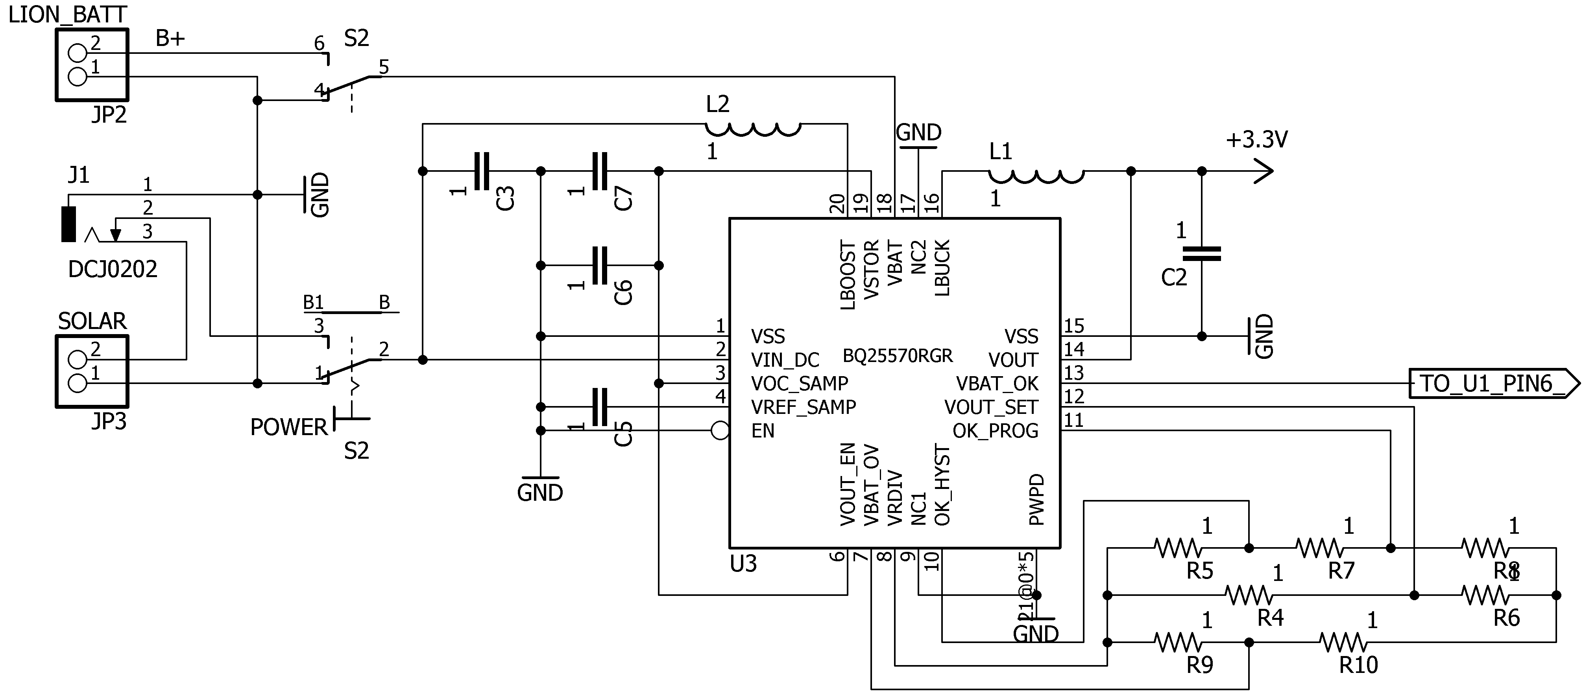
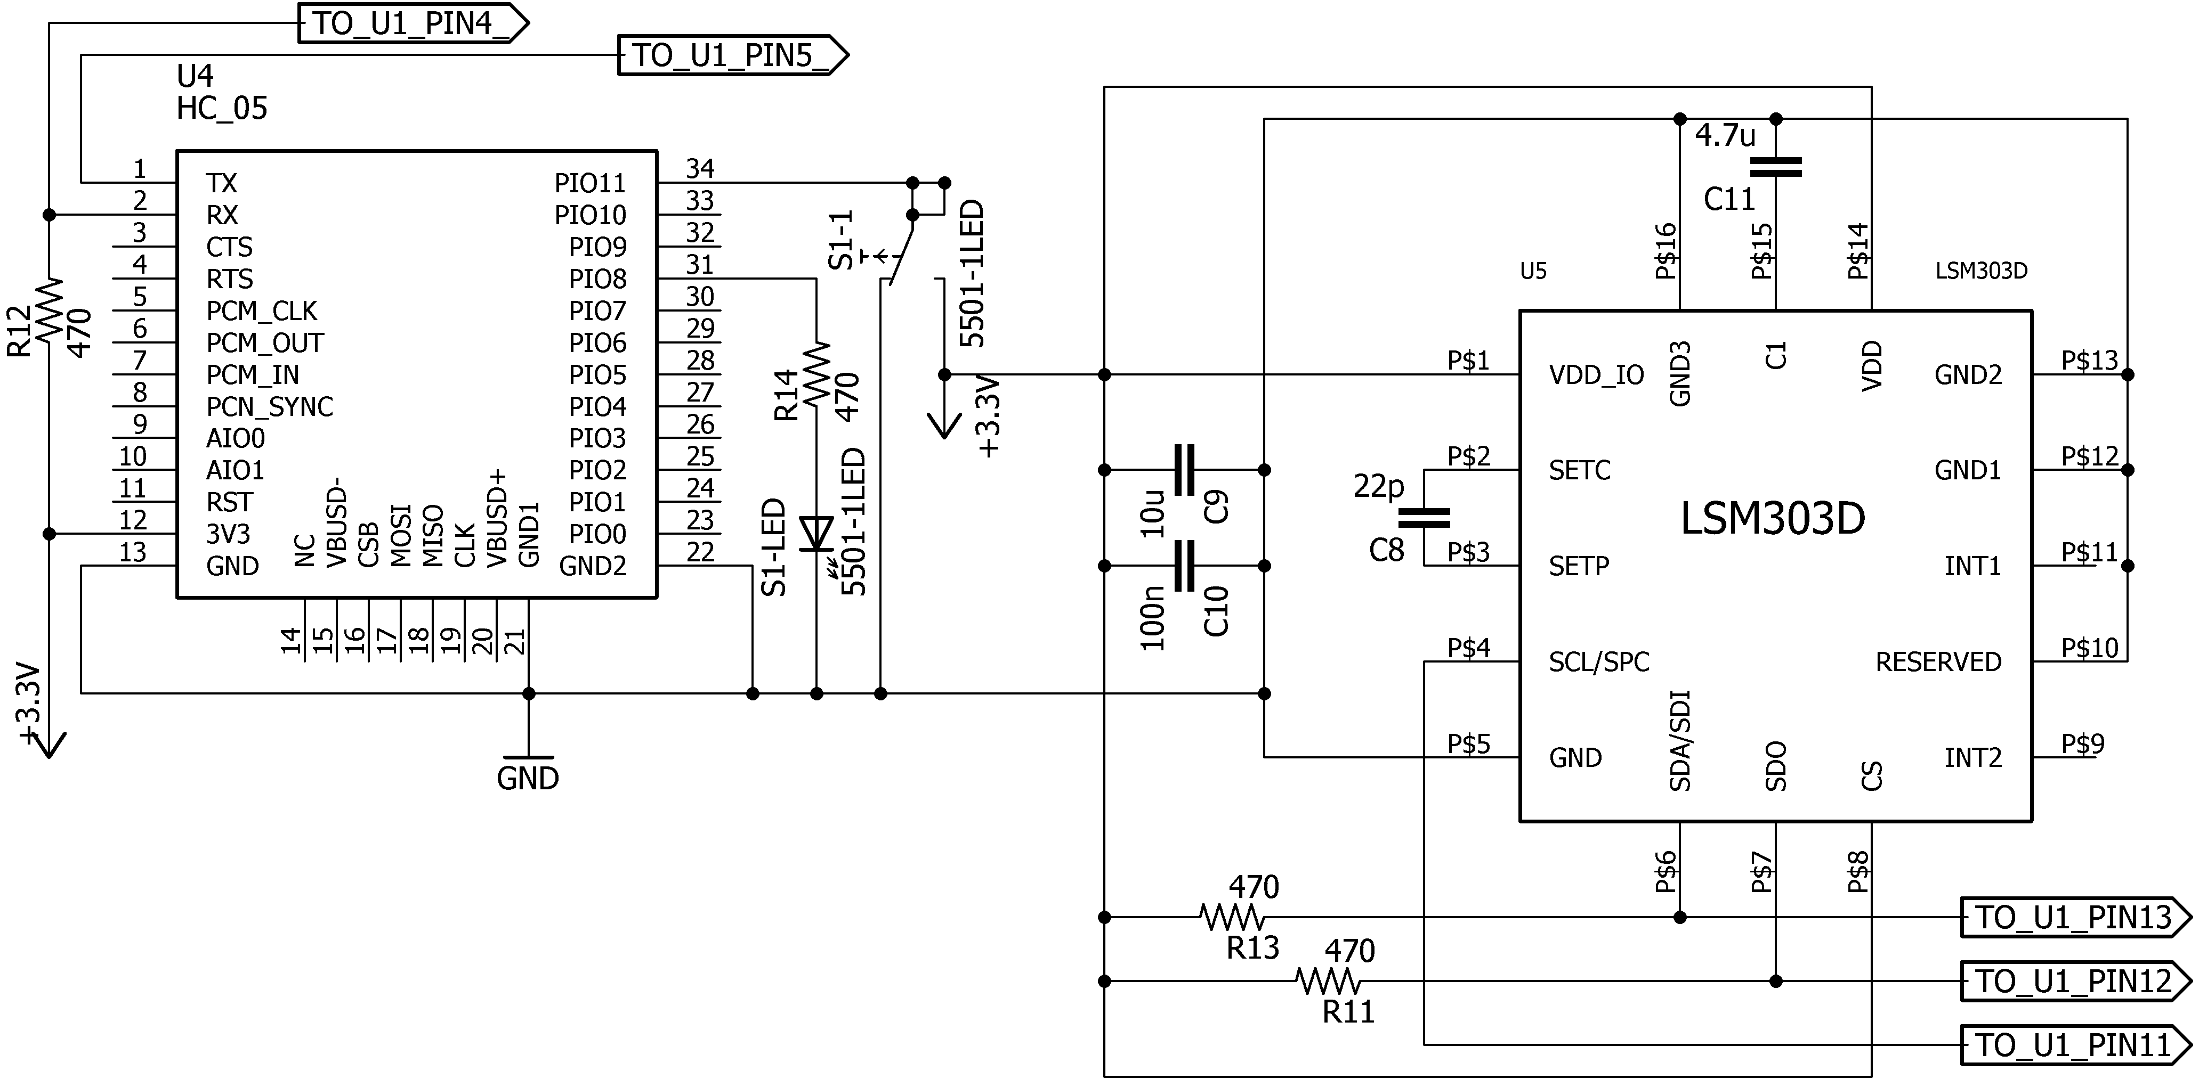
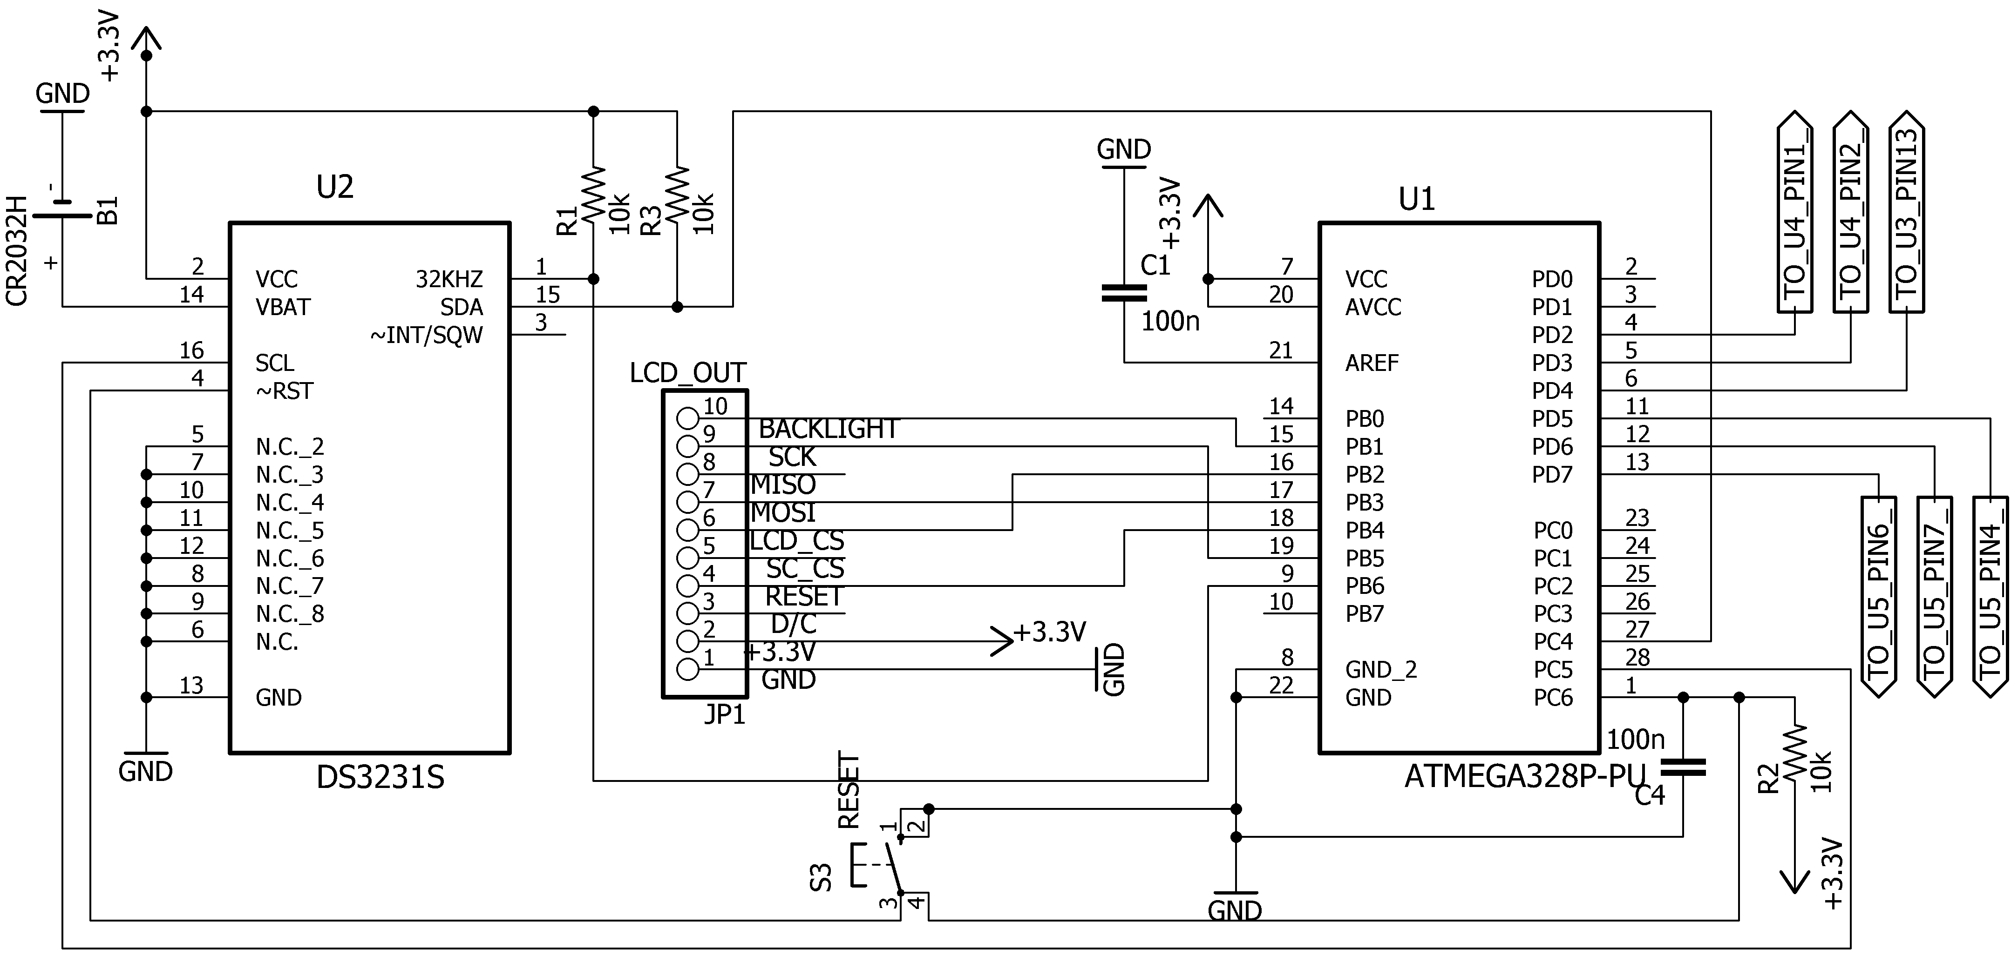
Helmet System Schematic

Slide 30
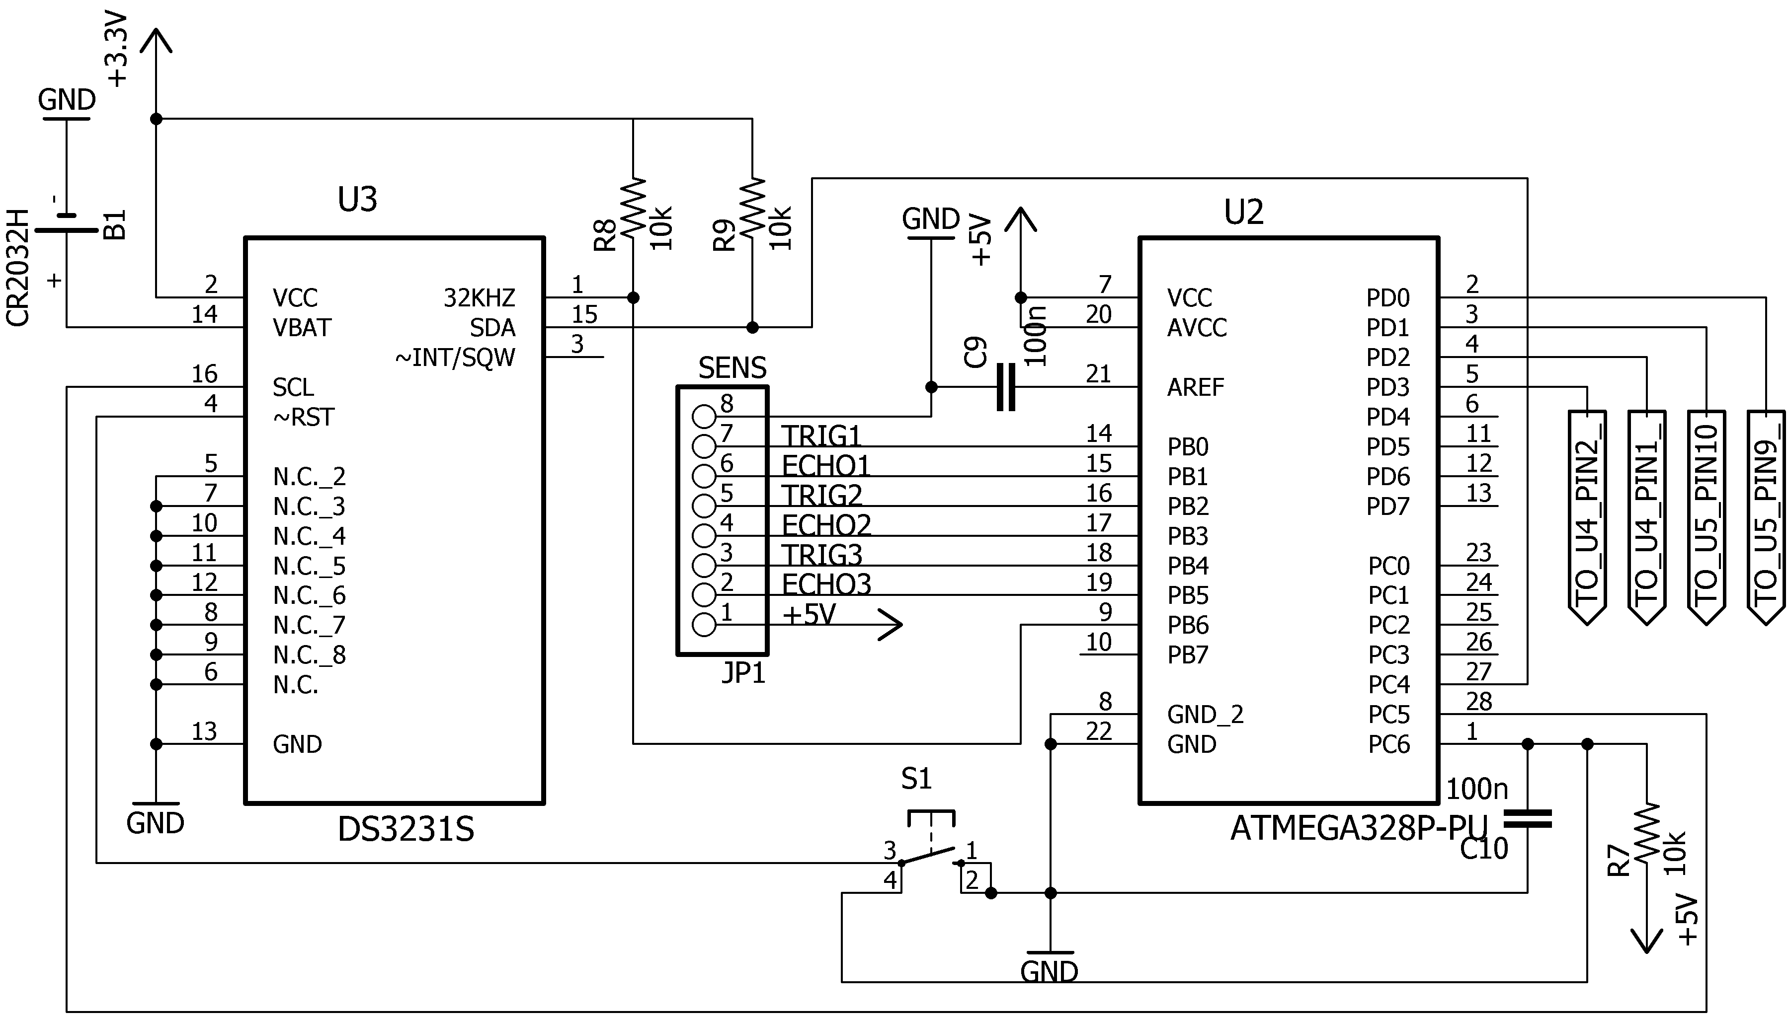
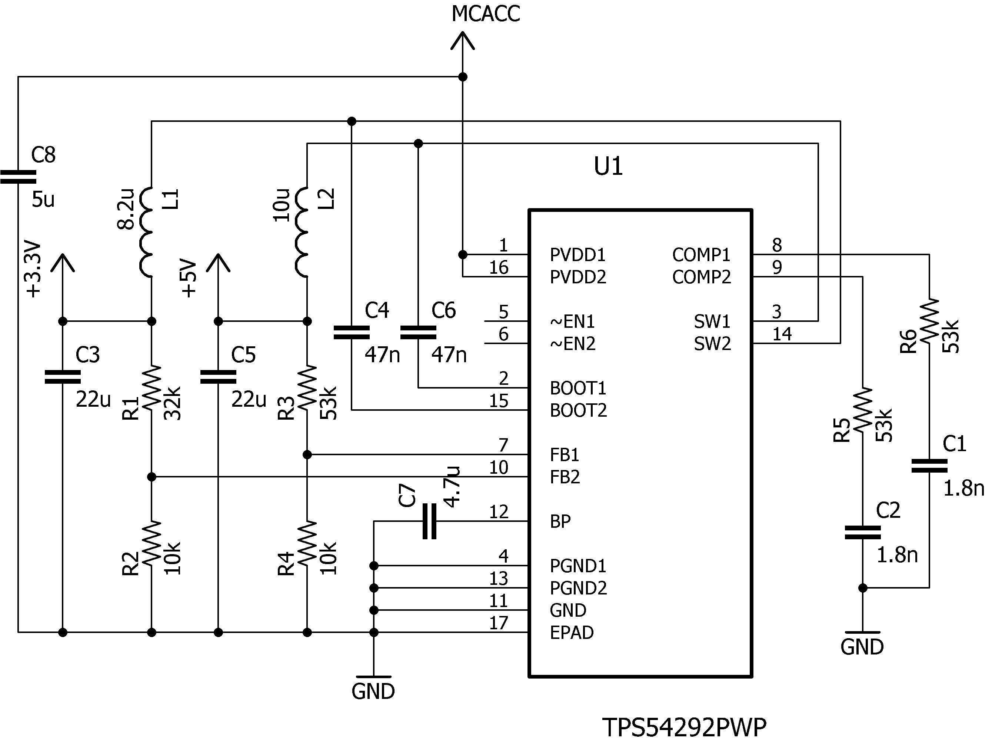
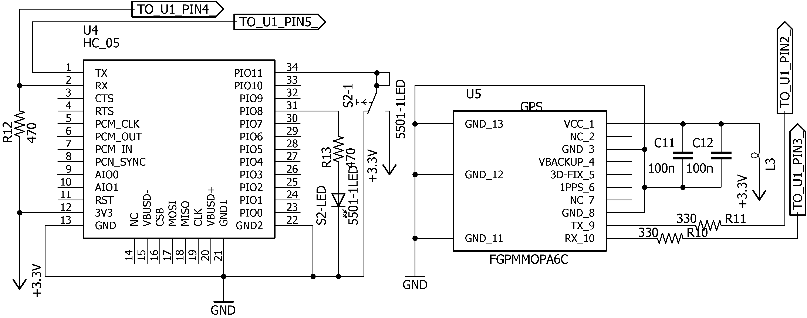
Motorcycle System Schematic

Slide 31
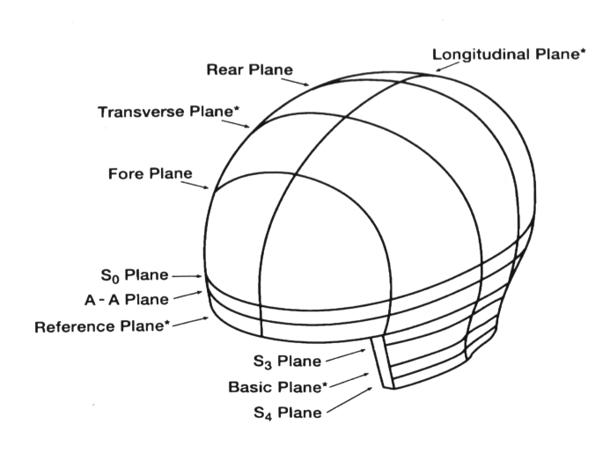
Standards
Federal Motor Vehicle Safety Standard No. 218 (Department of Transportation)
-Section 5.4: “The helmet shall provide peripheral vision clearance of at least 105 degrees
to each side of the mid-sagittal plane.” (shown below)
-Section 5.5: “A helmet shall not have any rigid projections inside its shell. Rigid projections
outside any helmet's shell shall be limited to those required for operation of essential
accessories, and shall not protrude more than 0.20 inch (5 mm).”

Slide 32
Standards
Snell Memorial Foundation Helmet Safety Standards
- “Any feature projecting more than 7 mm beyond the outer surface must readily break
away; all other projections on the outer surface shall be smoothly faired and offer minimal
frictional resistance to tangential impact forces.”
- “The helmet shall provide peripheral visual clearance as measured using a reference
head form appropriate to the size of the helmet. This peripheral vision includes a
horizontal clearance of at least 210º, an upward clearance of at least 7º and a downward
clearance of at least 30º.”
American Association of State Highway and Transportation Officials
- Maximum lane width is 12 feet.

Slide 33
Budget and Spending
Supplier | Part Number | Nomenclature | Total
Mouser | BAT-HLD-001 | CR2032 Battery Holder | $0.56
Mouser | A2235-H | GPS Modules | $28.84
Mouser | LSM303DLHC | Accelerometers E-compass | $11.60
Texas Instruments | TPS54292PWPR | Dual Buck Converter | $18.90
Texas Instruments | BQ25570RGRR | Boost Charger and Buck Converter | $21.60
Adafruit | 1480 | 2.2" 18-bit color TFT LCD display | $49.90
Adafruit | 601 | ATmegaXX8 Pinout Sticker | $2.95
Adafruit | 1207 | SMT Breakout SOIC-16 or TSSOP-16 | $3.95
Adafruit | 1212 | SMT Breakout SOIC-8, MSOP-8 or TSSOP-8 | $2.95
Sparkfun | PRT-00116 | Break Away Headers | $1.50
Sparkfun | PRT-08483 | Polymer Lithium Ion Battery - 2000mAh | $12.95
Supplier | Part Number | Nomenclature | Total
Maxim Integrated | DS3231MZ/V+ | ±5ppm, I2C Real-Time Clock | $0.00
Amazon | HC-05 | Bluetooth RF Transceiver Module | $25.53
Amazon |  | QFN-20 to DIP-20 SMT Adapter | $5.29
Amazon |  | LGA-14 to DIP-14 SMT Adapter | $4.79
Amazon | MB-102 830 | 830 Point Breadboard | $11.98
Amazon | MB-1010 | Ultrasonic Distance Sensor | $89.85
Amazon | HC-SR04 | Ultrasonic Module Distance Sensor | $8.59
Amazon | Atmega328P-PU | MCU w/ Arduino UNO Bootloader | $13.49
 |  | Shipping | $46.96
 |  | Total | $362.18
 |  | Funding | $532.48
 |  | Budget | $592.00

Slide 34
Progress to Date

Slide 35
Immediate Plans
Test operation of the two subsystems communication together
Test accuracies of GPS and electronic compass
Power supply prototyping and testing
Minor component selection
Prototype and test completed module
Finalize PCB design and send out to be manufactured
Begin design of subsystem enclosures

Slide 36
Questions?

