Slide 1
SMART WATER ROCKET SYSTEM GROUP 6
CONNOR PHILLIPS (EE)
KYLE MORAN (CE)
GABRIEL FERNANDEZ (EE)

Slide 2
SPONSOR

Slide 3
Demonstration

Slide 4
SPACE TREK'S WATER ROCKET PROGRAM
Space Trek is a summer camp at Kennedy Space Center for middle school, high school, and college students
One of their many science experiments is a water rocket capable of launching up to 100 feet in the air
Prior to launch there is a pre-flight analysis simulation that lets students adjust and test different flight parameters (water volume, air pressure, launch angle)

Slide 5
WATER ROCKET CONTD.
Once the camp attendees have their flight specifications, they move outside to a field to launch the water rockets
The rocket is filled and then pressurized using a bike pump, mounted on the Launchpad, and then fired by pressing a red button
When the rocket reaches the peak of its trajectory, a gyroscope activates a mechanical system to release the parachute
After retrieving the rocket measurements are recorded from the on-board altimeter

Slide 6
GOALS AND OBJECTIVES
Automate the rocket launches to create a better experience for both students and staff
Replace on-board altimeter with custom altimeter with wireless data transmission capabilities
Allow students to use a mobile application to review the data from their launches and easily compare between groups

Slide 7
SPECIFICATIONS
Altimeter must be less than 10 grams and fit into the rocket without changing its center of mass
Launch pad angle plate must be motorized for more precise angles
Data must be transmitted wirelessly without the need to take the altimeter out of the rocket
Altimeter must be water resistant in case of leakage

Slide 8
BLOCK DIAGRAM

Slide 9
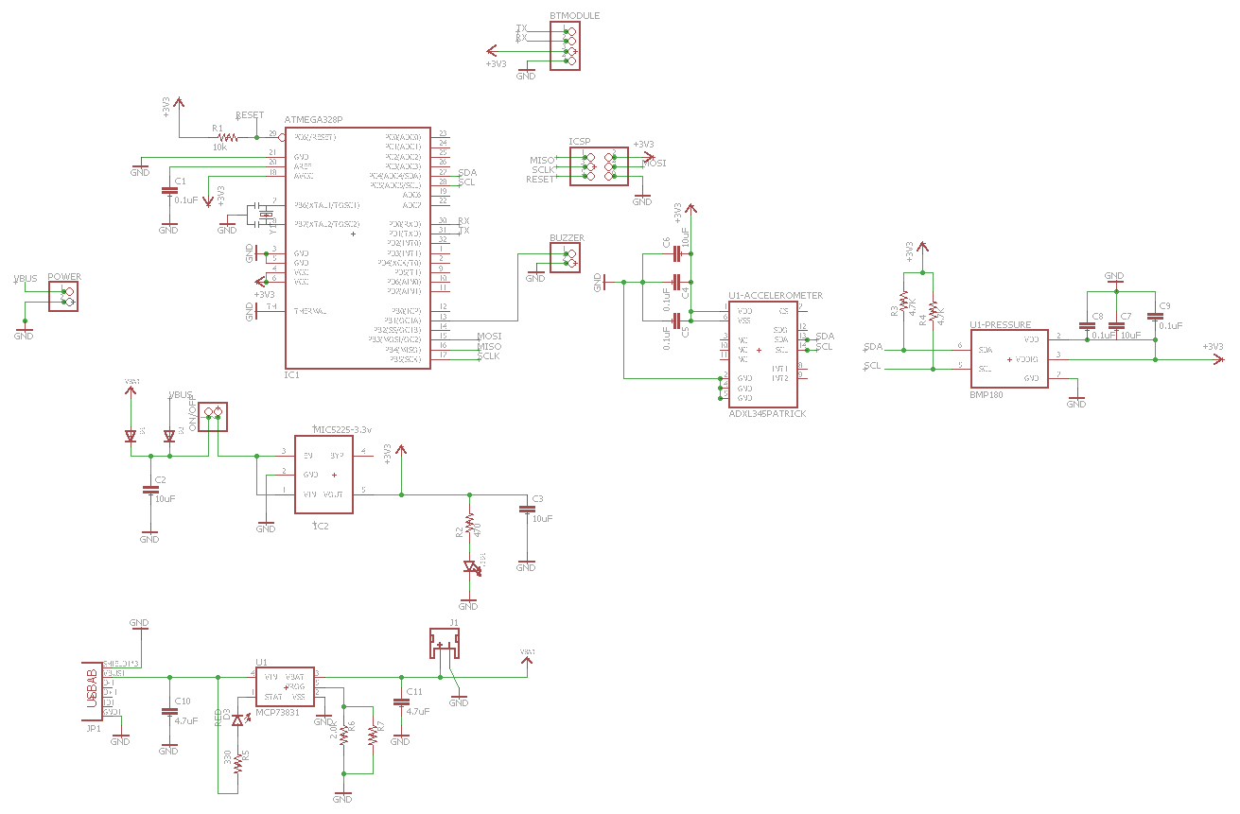
System Schematic

Slide 10
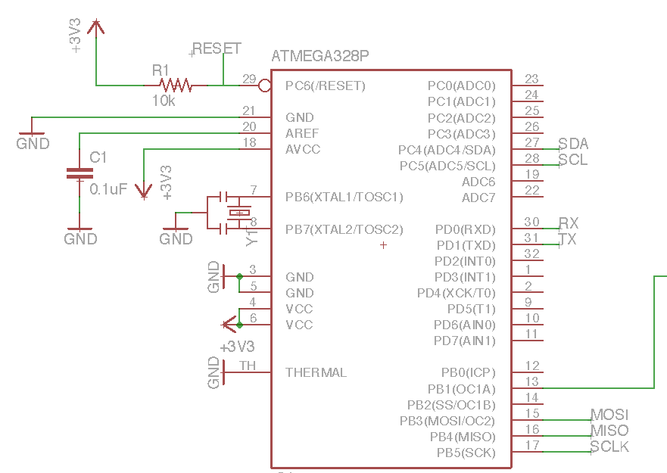
MCU
ATMega328P-MLF32
Operating voltage = 3.3V
Effective frequency = 16MHz
Effective Pins:
SCL
SDA
TX
RX

Slide 11
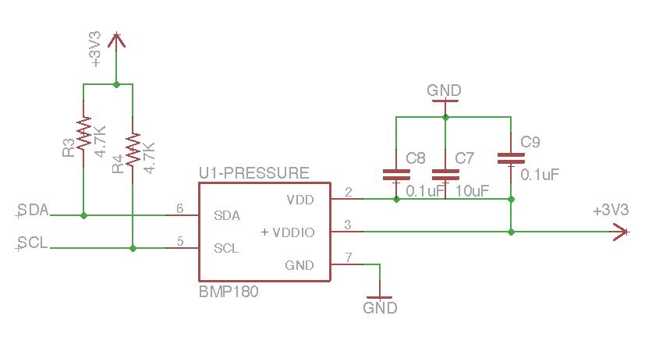
BMP-180
PRESSURE
Pros:
Cheap
Low voltage
Cons:
Slightly inaccurate
** Chosen over GPS or Radar based on PCB real estate and current draw

Slide 12
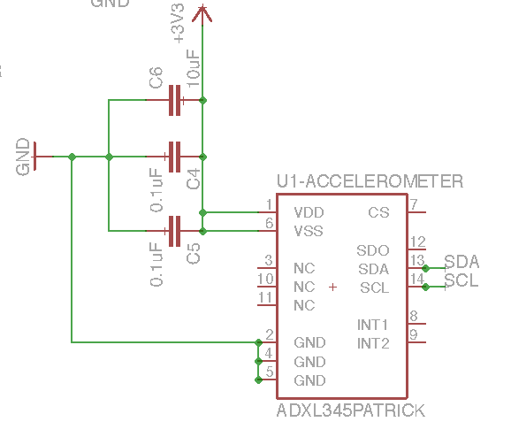
ADXL345
Operating Voltage = 3.3V
Triple Axis Accelerometer
I2C
~16uA current draw

Slide 13
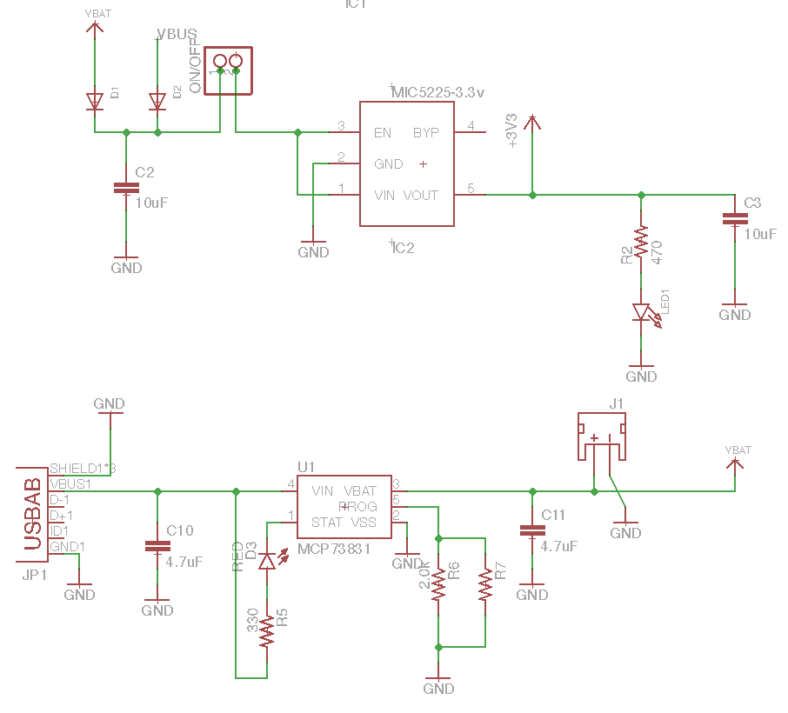
Altimeter’s Power System
Voltage regulator (MIC5225)
~3.7V -> 3.3V
Guaranteed constant 150mA output.
Battery Manager (MCP73831)
510uA charge rate
Physical power “switch”

Slide 14
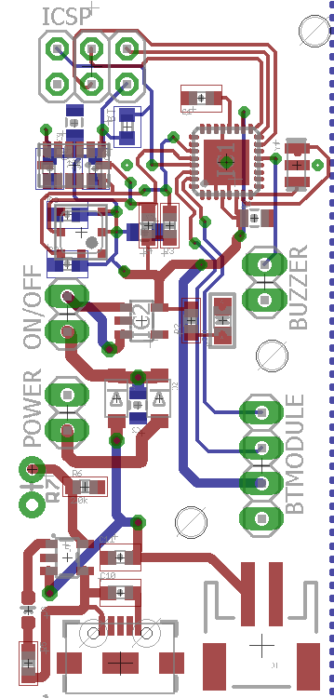
PCB

Slide 15
COMMUNICATIONS
Bluetooth
Pros – straightforward implementation, handles data well when paired
Cons – bad range, might not show data in real time, can lose data when unpaired
Wi-Fi
Pros – works at greater ranges than Bluetooth and won't lose data
Cons – Wi-Fi connection in the launch zone isn't strong

Slide 16
PROGRAMMING MICROCONTROLLER
Collect data from sensors – max velocity and height
Sensors include a pressure sensor and accelerometer
Transmit data wirelessly to ground
Provide reliable data for quick review
Essentially designing an altimeter with wireless transmissions

Slide 17
MOBILE APPLICATION
Mobile device located at launch station
Accepts data from custom altimeter in rocket
Displays max height and velocity once rocket lands
Stores data on mobile device
Maintains an established bluetooth connection

Slide 18
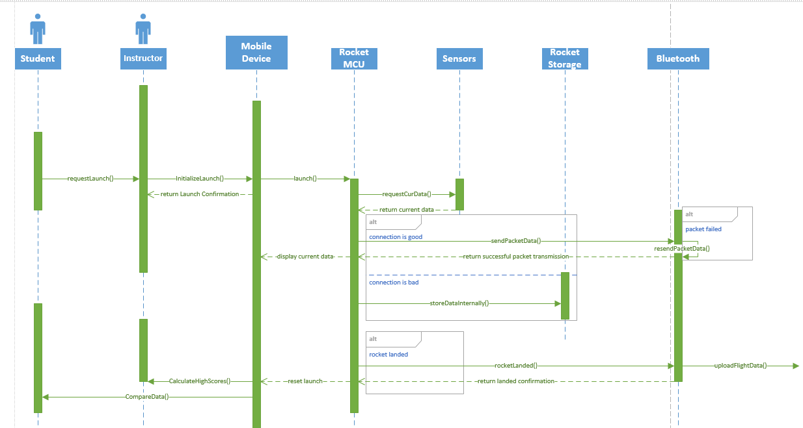
Sequence Diagram

Slide 19
SEQUENCE DIAGRAM
Shows flow from altimeter receiving data to transmitting back to the ground
Takes into account failed packets and bad connections
Will store data onboard temporarily until a good connection has been made
Instructors will assist students on performing rocket launch

Slide 20
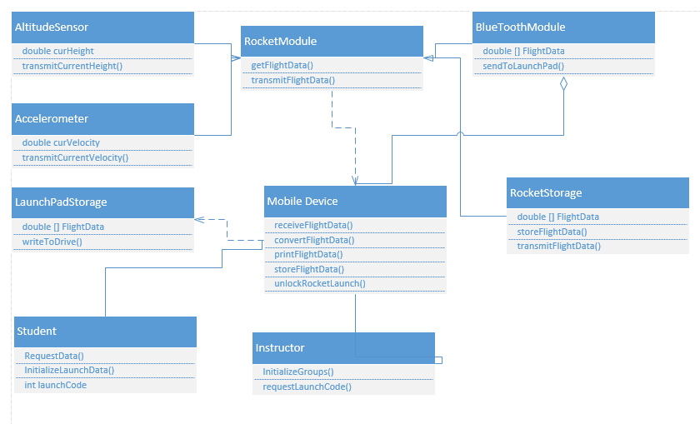
CLASS DIAGRAM
Shows relationship between different modules of the rocket and how it connects to the tablet on the launch pad

Slide 21
CLASS DIAGRAM (cont)
Altimeter in rocket will gather data from onboard sensors and transmit wirelessly to the mobile device
Data will be stored in rocket module in case lost connection and will be stored in the mobile device for immediate viewing
Rocket MCU will take raw pressure and acceleration readings and calculate height and velocity and transmit the max values for each

Slide 22
Designing Android Application
An Android Tablet can be used for low cost and easy replacement
More familiarity designing in Android with Android Studio
Many easy to use libraries for establishing bluetooth connection
Works well with Arduino and has many helpful online resources
Interacts with MCU in the rocket to transmit and receive data

Slide 23
LAUNCHPAD AUTOMATION
An inspiration for the project was Space Trek has always wanted the launch platform to be automated with motors
The current water rocket platform involves an angle plate that is adjusted by manually loosening and tightening a knob to set a desired launch angle
A stepper motor is fixed to the angle plate to rotate the launcher
Space Trek has a 3D Printer on site that can be used to modify the launcher

Slide 24
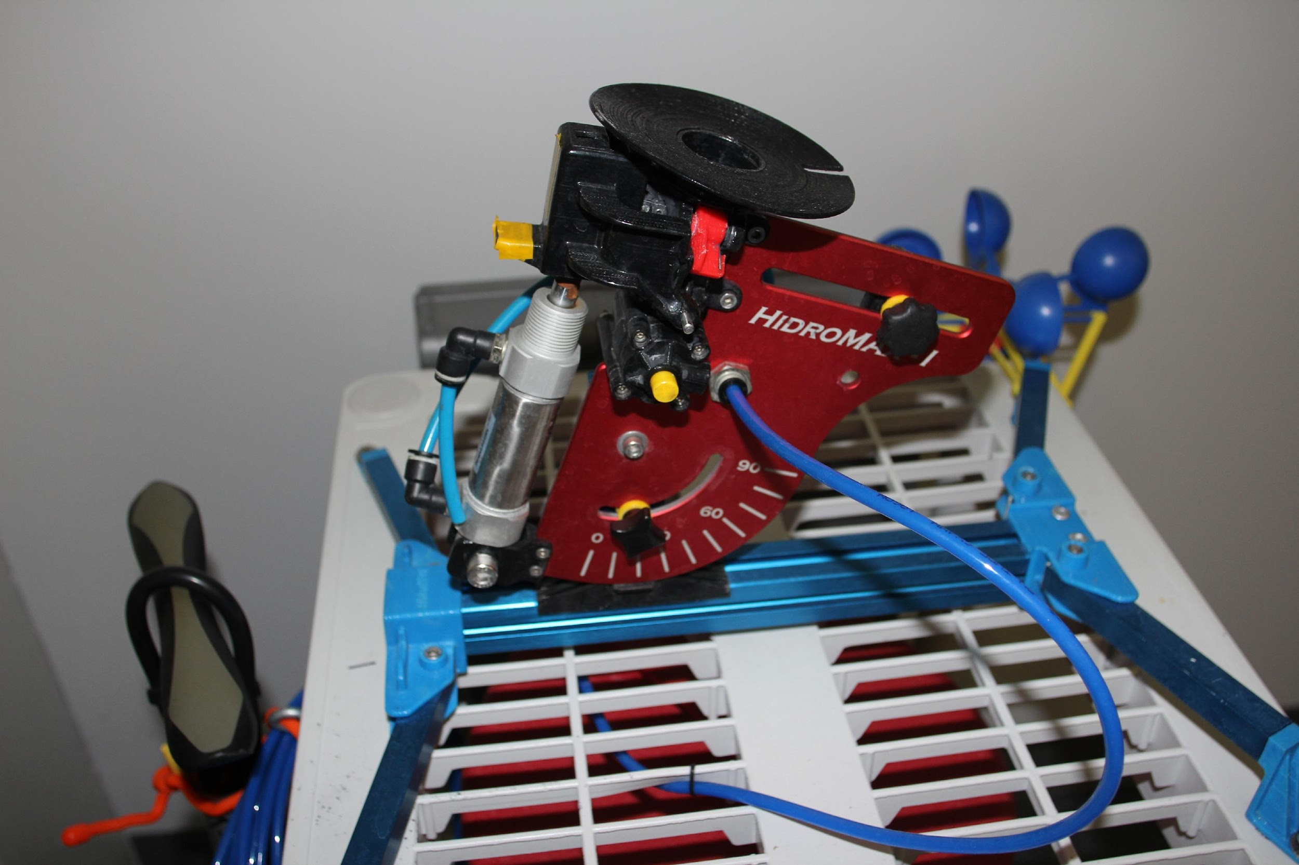

Slide 25
AUTOMATION DESIGN
The motor is mounted underneath the axis of rotation
A belt system was derived to rotate the launcher between two gears
Angle plate modified to mount 3D printed gears of 2:1 ratio to increase turning power while decreasing step angle for precision
Plexiglass enclosure will be developed to protect stepper system from water rocket thrust

Slide 26
STEPPER MOTOR SELECTION
Stepper Motors are best for LaunchPad Automation because of power, precise control, and cost efficiency.
The motor selected is 200 Steps/Revolution (1.8º Step Angle), 12V Rated Voltage, 0.33A rated current.
Can be easily programmed with the Adafruit Motor Shield library and Arduino Uno

Slide 27
Lead-Acid Battery
Stepper motors require continuous power by design
Large capacity to endure all of the launches during experimentation
Durable because it will be used outdoors
Chose lead-acid because they are relatively cheap so that they can be replaced
High capacity, reliable and long lasting

Slide 28
COSTS
Component | Cost
Lead-Acid Battery & Charger | $24
Fuse Holders and Fuses | $14
Stepper Motor Mount and Heat Sink | $9
Motor Mount | $17
Time Belt & Gears | $15
Arduino Uno | $25
Adafruit Shield | $13
ATMega328p (x4) | $24
BMP180 | $4
ADXL345 | $7
Bluetooth Module (x2) | $20
Li-Po Battery | $10
Misc. Mechanical Parts | $30
Misc. Electronics | $80
Breakout Boards | $16
PCB | $170
TOTAL | $478

Slide 29
WORK DISTRIBUTION
 | Launchpad | Altimeter | Software
Connor Phillips | X |  | S
Gabriel Fernandez |  | X | S
Kyle Moran |  | S | X

Slide 30
QUESTIONS?

