Slide 1

SPIDRONE
Group 2
Benjamin Atsu - EE
Daniel Camargo - CpE
Kyle Ferriss - CpE
Jonathan Obah - EE

Slide 2
Motivation
Our motivation stemmed from a mutual interest in drones and advances in technology that is impacting our everyday life. The technologies that grabbed our attention was the use of wireless charging for appliances, solar power for green energy, and automation to minimize human interaction.
Notes:
We need to shorten this.

Slide 3
Project Description
The SPIDRONE (Solar Powered Inductive Drone) is an environmentally friendly UAV that can follow a user’s path autonomously, and land precisely land on a dock. The dock will be equipped with solar panels and capable of charging the SPIDRONE inductively, which minimizes human interaction.

Slide 4
Goals and objectives
Low operating and maintenance costs.
Environmentally friendly.
Autonomous user tracking and flight planning.
Autonomous landing and charging.
Wireless charging.
Failsafe for low battery.

Slide 5
Design Constraints
Economic - Constructing a drone can be expensive.
Time - Scheduling.
Legal - FAA regulations and registration.
Environmental - Outdoor testing required, weather, and humans.
Safety - Chemicals, fire, propellers.
Social - Some people may think we’re using the drone for unethical purposes.

Slide 6
Specifications - Charging Docks
4W, 12V Solar panel
3V – 5.5V Wireless Receiver
12V input Wireless Transmitter
Rechargeable Lithium Polymer (Li-Po)- 5200 mAh

Slide 7
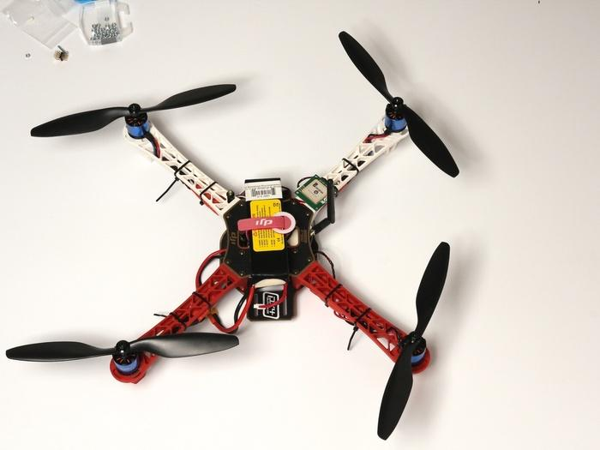
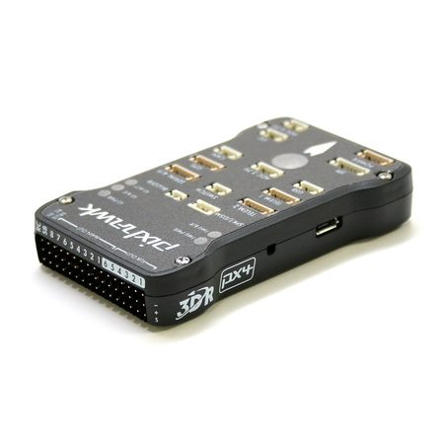
Specifications - Drone
Flamewheel F450 Frame
3S 3300 mAH Lithium Polymer Battery
Pixhawk Flight Controller
ESC: 30A
800 KV Motors
10x4.7 Propellers

Slide 8
Flight Controller Software
ArduPilot
Open source.
Built in battery failsafe.
Different flight sequences already included: Land, Follow Me, and Return to Launchpoint.
  While already included these flight modes need to be rewritten to support the features we outlined for the SPIDRONE.
Chosen over OpenPilot and PX4 for the large amount of information and resources available.

Slide 9
Design Approach - Automatic Landing
GPS will be used to get the drone close to its charging dock.
Optical recognition will be used for precision alignment.
Camera will be mounted to bottom of drone.
Video feed will be processed by a PC.
PC will calculate and issue commands to align the drone.

Slide 10
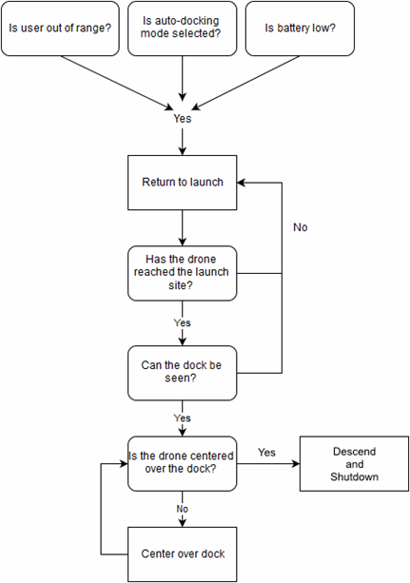
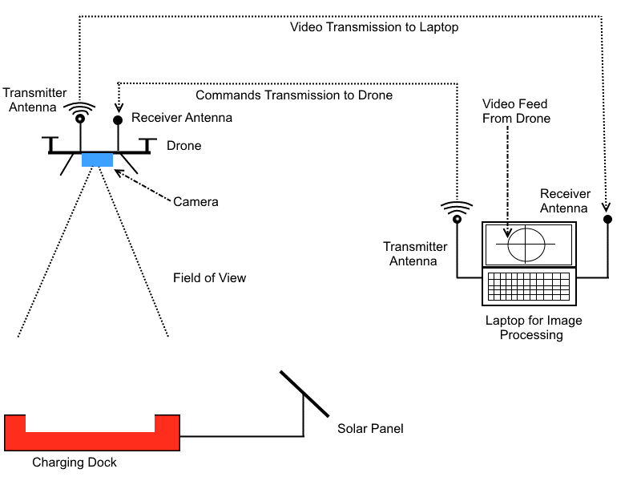
Design Approach -
Automatic Landing

Slide 11
Design - User Tracking
Majority of the population own a smartphone capable of transmitting data and GPS coordinates.
Develop an app that will track a user’s GPS coordinates and create a path.
Upload those coordinates to a server for the drone to download and follow.

Slide 12
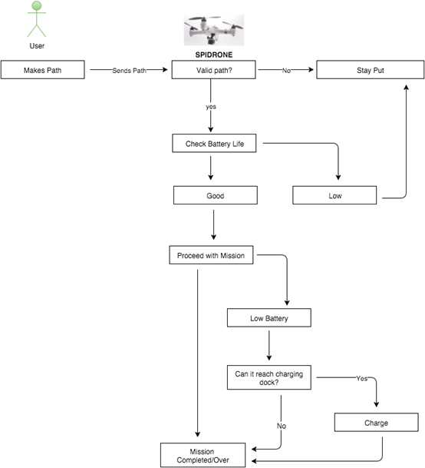
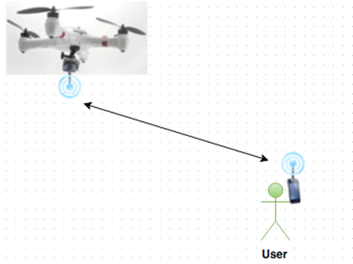
Design - User Tracking

Slide 13
Specifications - Power Source : SOLAR PANEL
•Mono-crystalline silicon 18V,5W
•No-load voltage: 18-23V DC
•Load voltage: 18V
•Output current: 250-280mAh (0.2A-0.28A)
•Size: 320x120x5mm/12.6*4.7*0.19inch
•Weight: 0.323kg/ 11.4oz.

Slide 14
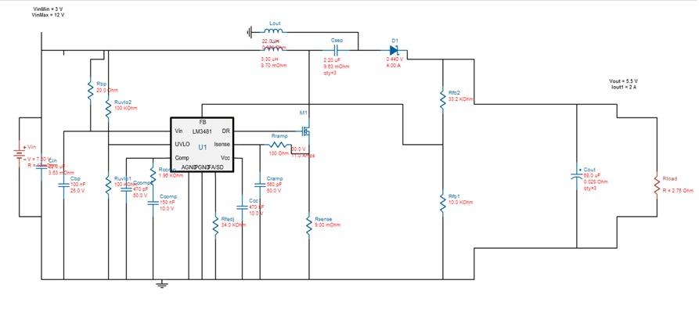
Design Approach - DC-DC Converter
TI LM3488 Uncoupled Inductors SEPIC
Refrence Design :Ti Webench
Input Voltage 6.5V -10 V
Ouput Curent=2A
Efficiency about 88%
Reference Design: Ti Webench

Slide 15
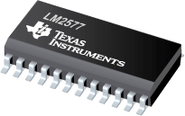
Specification - DC-DC Auto Step Up Step Down Power Supply Module (SEPIC)
Input 3-35V
Output 1.25V-30V
Biggest current 2A
Conversion efficiency 92%
Frequency 50KHz
Output ripple 40mV
Temperature -40℃ to +85℃
LM2577

Slide 16
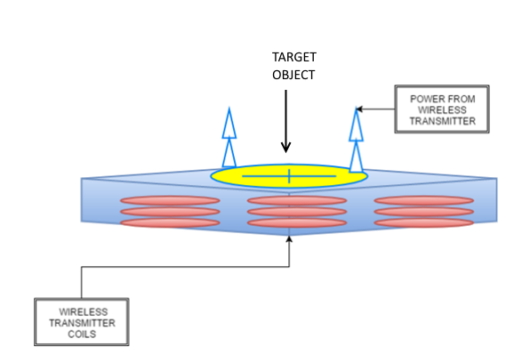
Design Approach - CHARGING STATION
The Charging station shall:
House the wireless transmitter
Bear the target object for the optical recognition

Slide 17
Design of Wireless Charging Station
Input Voltage | 3.3V – 5.5V
Output Voltage | 11.1V
Output Current | 0.658A
Wireless Resonant Frequency | 129.5kHz

Slide 18
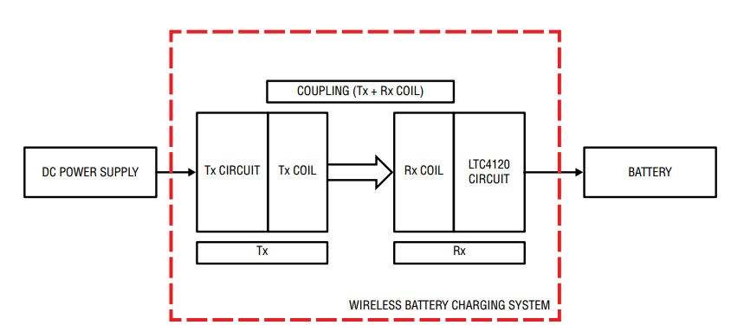
Wireless Battery Charging System

Slide 19
Transmitter circuit parameters 10.5mm Gap
SPECIFICATION | WITH RECEIVER (NO LOAD) | WITH RECEIVER (1.535W LOAD)
Operational Frequency | 130.2kHz | 128.8kHz
Input Voltage | 4.99V | 4.95V
Input Current | 0.156A | 0.658A
RMS Value of Tx Output AC Voltage | 10.8V | 10.5V
Peak Value of Tx Output AC Voltage | 15.2V | 15.2V
Receiver Output DC Voltage | 17.4V | 13.9V
Standby Loss | 0.777W | N/A
Efficiency | N/A | 46.9%

Slide 20
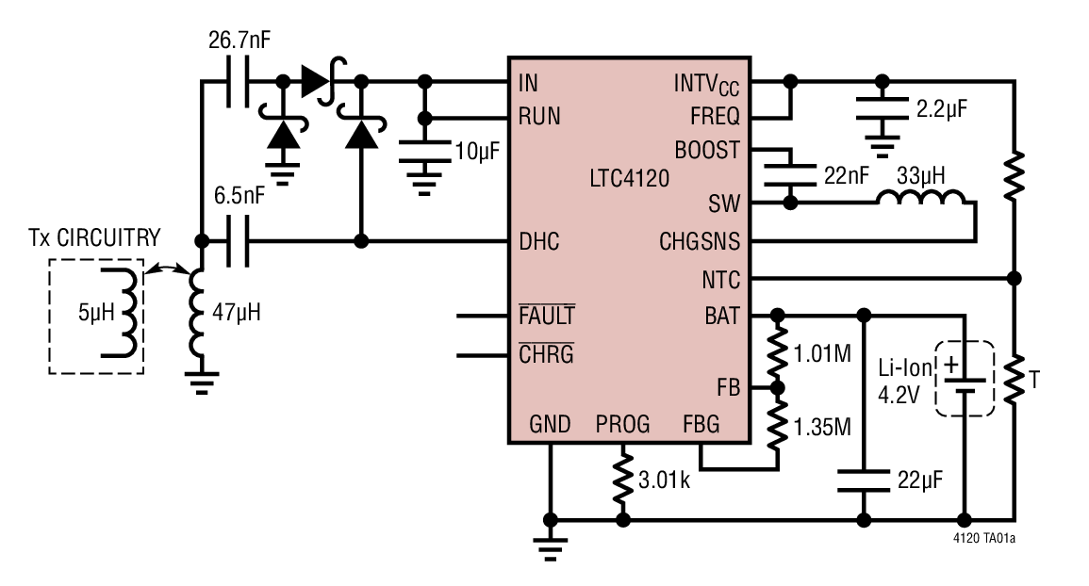
Wireless Receiver and 400mA Buck Battery Charger (LTC4120)
Schematic of LTC4120

Slide 21
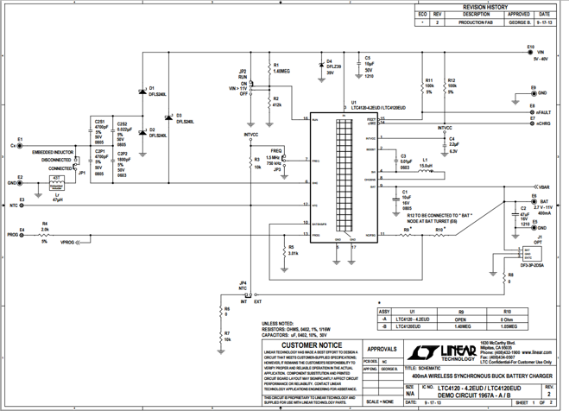
Schematic for 400mA Wireless Synchronous Buck Battery Charger (Connect Drone Battery to E6)

Slide 22
Battery Charger specifications
Battery Parameter | Minimum | Typical | Maximum | Units
Charge Current | 383 | 402 | 421 | mA
Standby Current | - | 2.5 | 4.5 | uA
Shutdown Current | - | 1100 | 2000 | nA
Regulation Voltage | 2.370 | 2.400 | 2.407 | V
Recharge Threshold Voltage | –38 | –50 | –62 | mV
Low Battery Linear Charge Current | 6 | 9 | 16 | mA
Low Battery Threshold Voltage | l 2.15 | 2.21 | 2.21 | V

Slide 23
Development Approach
Hardware | Software
Design Prototype | Acquire Necessary Software
Prototype Development and Testing | Code Development
Design PCB | Code Testing
Final Product Build | Prototype Integration
Final Product Testing | Final Product Integration

Slide 24
Printed Circuit Board
Software: CadSoft EAGLE - Allows an easy to use interface to design the circuit board. It is also free to use.
Suppliers: ExpressPCB, BatchPCB, 4PCB, DorkbotPDX. The decision on which supplier to use will be made when the PCB has been designed and is ready to be ordered due based on the budget and deadline.
Backup: Should a PCB get damaged/malfunction, we will have backup PCBs to accommodate these issues.

Slide 25
Final Product Testing
Wireless charging can be lab tested, but other functions will require a large outdoor test environment.
Software testing for both the Landing system and the tracking system.
  Landing precision on the charging station.
  Loading user coordinates to drone.
The solar panel would be tested outdoors
DC-DC converters would be tested in the lab for voltage and current requirements.

Slide 26
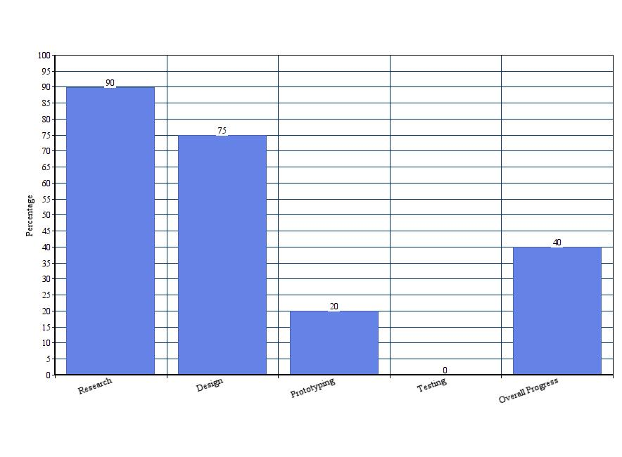
Current Progress

Slide 27
Financing
While most of our project is sponsored by Boeing and Leidos, we expect there to be expenses that come out of our pocket.
The upfront costs and reimbursement will be Kyle Ferriss’s responsibility, and any costs not covered by the sponsorship will be divided evenly amongst the group.

Slide 28
Budget
Item | Cost
Microcontroller | $20.00
PCB Manufacturing | $100.00
Induction Coil | $10.00
Document Printing | $50.00
Camera | $50.00
Servo | $10.00
Propellers | $20.00
DC Motors | $40.00
Wiring | $10.00
Controller | $20.00
Solar Panels | $20.00
Wireless Transmitter and Receiver | $225
Accelerometer | $20.00
Drone Frame | $30.00
Materials (wood, plastic) | $50.00
GPS | $50.00
Altimeter | $15.00
Misc. | $300.00
Total | $1034.00
Sponsorship from Boeing/Leidos | -$745.65
Estimated Out of Pocket Costs | $288.35

Slide 29
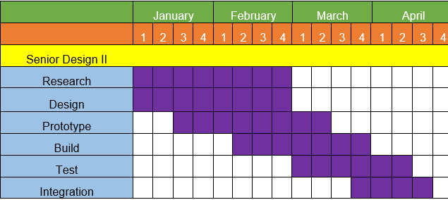
Milestones

Slide 30
Work Distribution
Name | Auto-Landing | User-Tracking | Power and DC-DC Conversion | Wireless Charging | Budget Management
Benjamin Atsu
Daniel Camargo
Kyle Ferriss
Jonathan Obah

Slide 31

Questions?????

