Slide 1
Helium MP3
Group 34
Brandon Jones CpE
Giovanni Goris EE
Aaron Ford EE
Nick Guillote EE

Slide 2
Goals
To create a standalone MP3 player
With internet connectivity
With graphic equalization
To develop an algorithm for determining users listening preferences
For time of day
For weather
For new songs
To develop a mobile app
For tracking preferences
For control

Slide 3
Objectives primary
The device will be able to:
Decode ‘.mp3’ audio files
Adjust the gain (volume) of various frequencies
Store audio files, playlists, and user preferences on itself
Identify nearby users carrying a RFID tag
Connect to the internet
Query a database
Determine its location
Determine the weather at its location
Generate playlists based on user preferences (smart playlists)
Determine the time of day
Communicate wirelessly with nearby mobile devices

Slide 4
Specifications overview
The project will consist of two devices: the first, a standalone mp3 player; the second an RFID scanner. The devices are separated so that the mp3 player’s location is not limited to locations convenient to the RFID scanner, which has a low range.
The first device will now be referred to as the Primary Device and the second device will now be referred to as the Secondary Device.
The project will also make use of an external database, now referred to as the Server.

Slide 5
Specifications part one
Objectives | Minimum | Desired | Current
Audio files playable | .mp3 | .mp3, .wav, .wma | .mp3
RFID read distance | 10cm (the typical maximum range for NFC) | 10m + (the length of a typical living room) | < 10 cm
Graphic EQ Band Count | 5 bands | 10+ bands | 10
Total On-Device Storage | 1 GB | 10 GB | 12 GB
On Device Song Storage | 50 songs (~500 MB) | 1000 songs (~1 GB) | 15,000+ songs
External Song Storage | 1000 songs (~1 GB) | 1000+ songs | 175,000+ songs

Slide 6
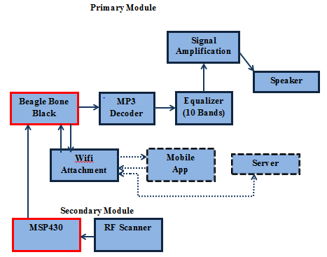
Hardware Overview

Slide 7
Primary MCU Beagle Bone Black
Options
Beagle Bone Black ~ $55
Lots of pins!
Raspberry Pi ~ $30
Fruit?
Edison ~ $70
Didn’t he crash a train?
Arduino ~ $25
Not enough pins

Slide 8
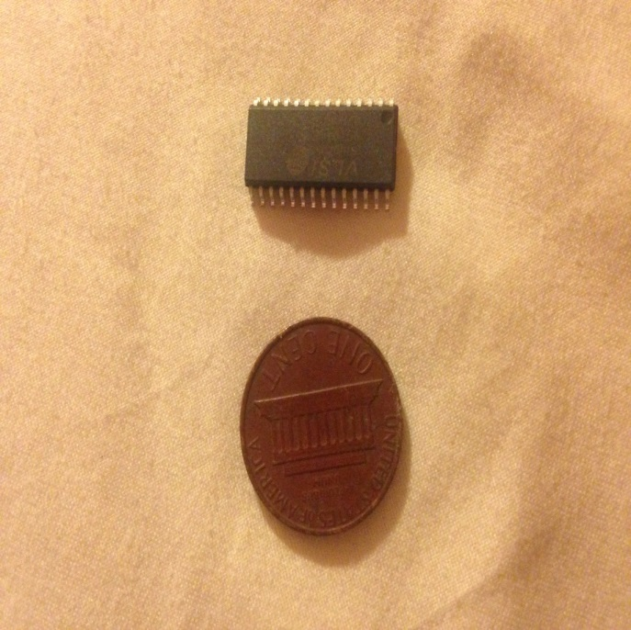
Mp3 decoding VS1011
Options
Hardware (an mp3 decoder chip)
Software
VS1011
Decodes MP3
Full 320 Kbit/s with 12 MHz external clock
Stereo Output
Low power operation
Operates with single 12 - 13 MHz or 24 - 26 MHz external clock

Slide 9
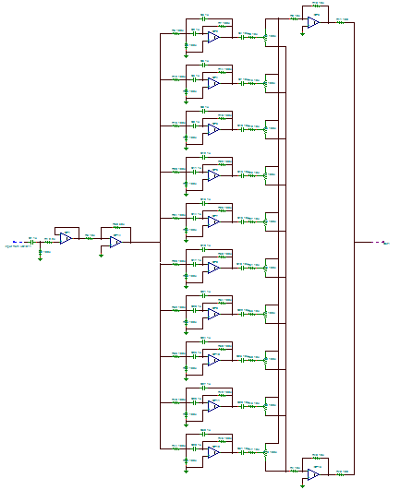
Equalizer
10 Band Graphic Equalizer
Constant Q factor of $\sqrt{2}$
Circuit is comprised of 4 main stages
Input Stage
Filter Stage
Boost Stage
Cut Stage

Slide 10
Quality Factor
$Q=\frac{f_{0}}{∆f}=\frac{f_{0}}{f_{2}−f_{1}}$
$$f_{0}$$ | $$f_{1}$$ | $$f_{2}$$
31 Hz | 22 Hz | 44 Hz
63 Hz | 44 Hz | 89 Hz
125 Hz | 88 Hz | 177 Hz
250 Hz | 177 Hz | 354 Hz
500 Hz | 354 Hz | 707 Hz
1 kHz | 707 Hz | 1.414 kHz
2 kHz | 1.414 kHz | 2.828 kHz
4 kHz | 2.828 kHz | 5.657 kHz
8 kHz | 5.657 kHz | 11.314 kHz
16 kHz | 11.314 kHz | 22.627 kHz

Slide 11
Importance of Constant Q Factor
Non-constant Q factor
Constant Q factor

Slide 12
Input Stage
First op-amp inverts the voltage
Second op-amp determines how much gain can be applied
Feeds into the filter stage

Slide 13
Filter Stage
Comprised of 10 Multiple Feedback Bandpass Filters
10 different center frequencies
Covers the entire frequency range
Each filter feeds into a potentiometer

Slide 14
Boost and Cut Stage
Boost stage activated by the high end of the potentiometer
Cut stage activated by the low end of the potentiometer

Slide 15
Speaker
Human audible range is 20 Hz to 20 kHz
4 main factors to consider
Frequency range
Power
Volume
Cost
Speakers considered cover 200 Hz – 20 kHz
20 Hz – 200 Hz is barely audible

Slide 16
Speaker Options
Product | Peerless PMT30N18AL04-04 19mm (3/4”) Full Range | Peerless TC5FB00-04 1.5" Full Range Paper Cone | Peerless TC7FD00-04 2.5” Full Range 4 ohm
Range | 250 Hz – 20 kHz | 200 Hz – 20 kHz | 130 Hz – 20 kHz
Power | 1.5 W | 5 W | 20 W
Volume | 78 dB | 80.1 dB | 82.4 dB
Cost | $9.15 | $9.75 | $9.85
All have similar cost and frequency range
Power and volume became deciding factors
2 dB gap between each option
Ultimately, the power was the most important

Slide 17
Peerless 1.5" Full Range Speaker

Slide 18
Power Regulation voltages needed
 | Voltage | Current
VS1011 | -0.3 to 3.6V for Analog and Digital Positive Supply | (+,-) 50 mA
Equalizer/Amplification | (+,-) 10V
Beaglebone | 5V | Up to 1 A
MSP430 | 5V | 0.6 mA

Slide 19
Power Regulation voltage regulators
* Courtesy of TI

Slide 20
Amplification

Slide 21
Secondary MCU msp430
The MSP430g2553 is a low power device that can accomplish all the requirements for the RFID. Will use SPI and UART to communicate with the transceiver.
Plenty of example codes for each section of the programming
There is plenty of support for this product.
TI E2E community
43oh.com
Simple modifications of the code needed for the project.

Slide 22
RFID Scanner TRF7907A
Supports NFC along with different reader protocols.
ISO 14443
ISO 15693
ISO 18000-3
ISO 18092
Support from TI
There plenty of code samples for this device
Low power consumption
100-200 mW

Slide 23
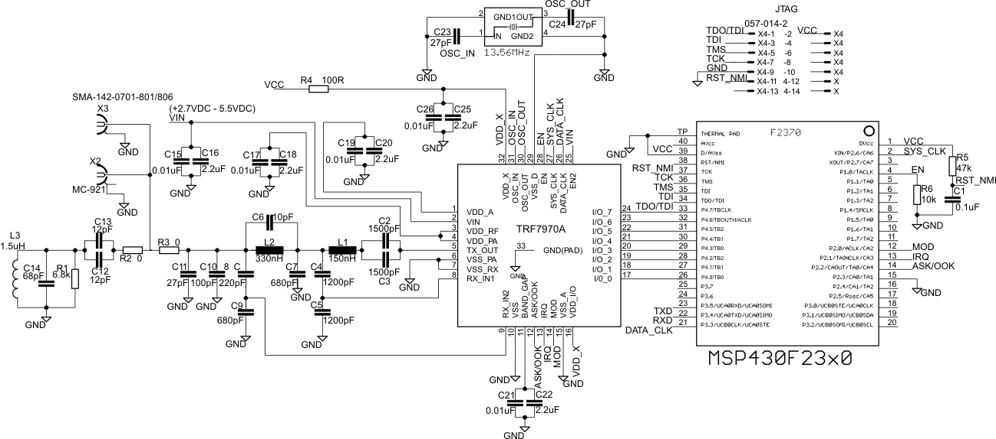

Slide 24
Software Overview
Most of the software on the Primary device was written in Java (for readability), with portions developed using Python (for ease of development).
The content server is written in Python.
NOIP is used to handle DDNS
The mobile app will be developed using jQuery.

Slide 25
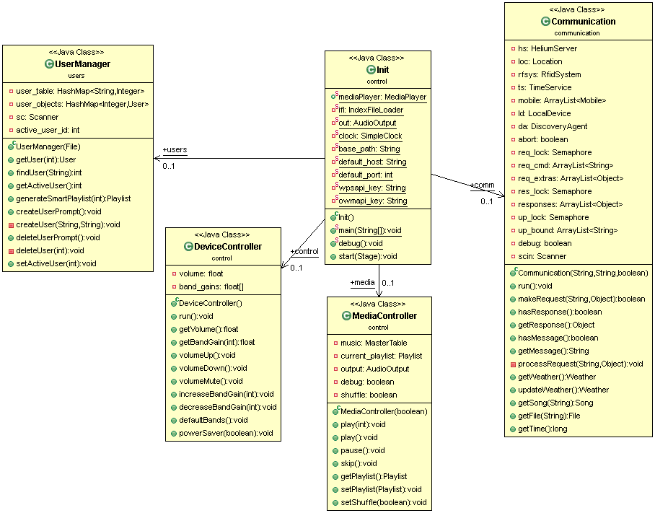
Three threads:
Init (main)
Communication
AudioOutput (in the MediaController)

Slide 26
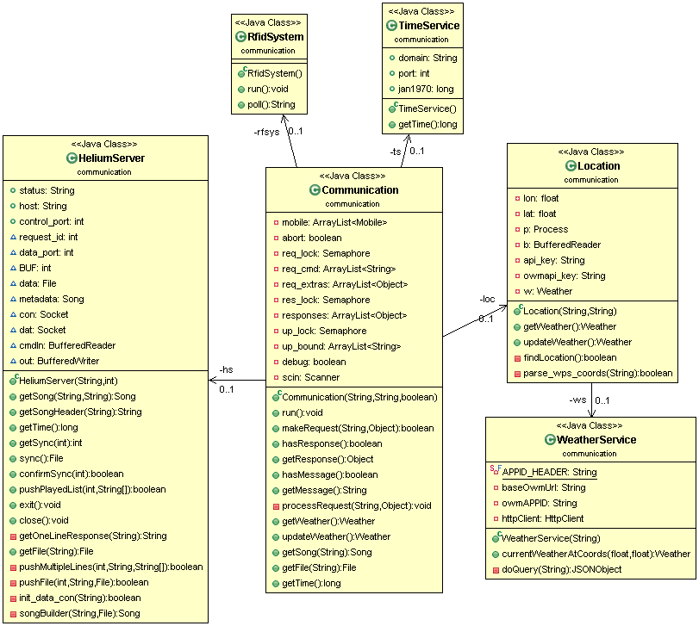
Communication receives requests from above and processes them in the order received. Reponses are generated for every request and stored in a queue.
HeliumServer: The content server; sd2helium2.ddns.net
Location: Skyhook WPS API
WeatherService: Open Weather Map
TimeService: NIST Internet Time Servers

Slide 27
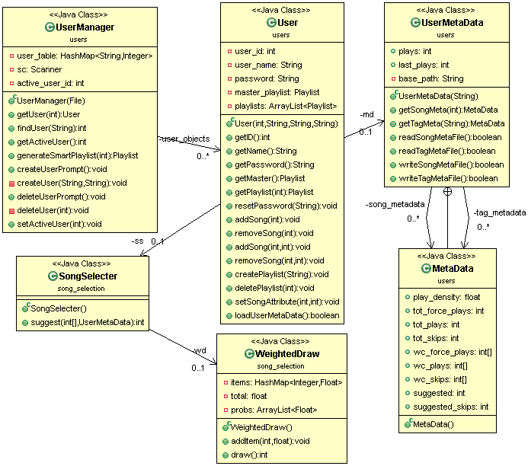
Users will have a master playlist containing all the songs that they own.
For each song, a user’s listening habits will be tracked and parameterized for the song selection algorithm (executed in each user’s SongSelecter)

Slide 28
Song Selection
The goal: to circumvent the need for a user to create playlists or indicate what song they would like to hear
Learn a user’s listening preferences based on:
Time of day
Weather
Time since last played
Play density for custom tags created by the user; such as:
Female Vocals
Artsy
Punk

Slide 29
Song Selection The Algorithm
Setup:
For every song listened to and skipped, record when and under what conditions;
Plays and Force Plays (willfully selected songs) are recorded separately;
Modify counts over time: PC = PTW + (PLW)/2 *Pc = playcount, TW = this week, LW = last week
Not implemented: bi-/tri-grams (with Good-Turing Smoothing)
To Select:
For each song calculate a play weight based on the current conditions
SW =

Slide 30
Storage
All songs will be stored on the main server and a subset of songs will be stored on the primary device.
All user data will be stored on both the main server AND on the primary device.
A simple database will be made from scratch (using Python) on the main server.
The group probably won’t need all of the features that a MySQL database offers

Slide 31
Work Distribution
 | Brandon | Giovanni | Aaron | Nick
Management | X
Algorithms | X
Control (PD) | X
Control (SD) |  | X
Mobile App | x |  | X
RFID |  | X
Equalizer |  |  |  | X
Power |  | x | X
PCB |  |  | X | x
X: primary
X: secondary
PD: Primary Device
SD: Secondary device

Slide 32
Original Budget
Unit | Item | Details | Cost
MCU | BeagleBone Black |  | $55.00
Memory | Included with MCU | BeagleBone Black includes 512 MB of memory. | -
MP3 Decoder | VS1011 | http://www.vlsi.fi/en/products/vs1011.html | $20.64
RFID Scanner | TBD | For detecting people | $600
WiFi Card | TBD | For connecting to the internet | $20
A/D converter | Team will build | For converting analog audio input to digital audio input | -
Amplifier | TBD | For amplifying analog audio output | TBD
Equalizer | Team will build | A graphic equalizer with 6+ bands | -
Microphone | TBD | Accepts voice input for implementing voice commands | $20
Server Space | TBD | For external storage and processing | Already acquired
Additional Parts and Tools | Various; TBD | Emergency funds | $71.56
 |  | Estimated Total Cost = | $787.20

Slide 33
Current Budget
Item Price /unit Unit Total | Item Price/unit Unit Total
RFID System | MCU system
Trf7970aBP $20.00 1 $20.00 | Beagle bone $55.00 1 $55.00
LCD Module $10.99 1 $10.99 | DS touchscreen $12.00 1 $12.00
MSP430f5529 $7.00 2 Free | Micro SD card $16.00 1 $16.00
MSP430g2553 $10.20 2 $10.20 | RN4020 $10.61 1 $10.61
Bluetooth $10.61 1 $10.61
Amplifier and audio system | Miscellenaous
10k potentiometer $3.97 2 $7.94 | Resistors $9.64 1 $9.64
Digital potentiometer $0.61 11 $6.72 | Capacitors $20.00 1 $20.00
Tl084 $7.43 1 $7.43 | CD74HC4016 $1.40 5 $7.00
LM339 $11.48 1 $11.48 | PCB
VS1011 $20.64 1 $20.64 | Total $236.26

Slide 34
Issues
WE ARE BEHIND!
Lack of decisiveness
Stuck waiting on critical parts
Scheduling issues
Distribution of work?
We are under budget though…

Slide 35
Questions? Suggestions? Donations?

