Slide 1
Group 33 – Electronic LEGO Sorter
Nike Adeyemi (CpE)
David Carey (CpE)
Katrina Little (EE)
Nick Steinman (EE)

Slide 2
Project Goals/Specifications
Why a Lego sorter?
Specific Objectives
Minimal user dependency
Speed vs. Accuracy
Overall Objective Statement

Slide 3
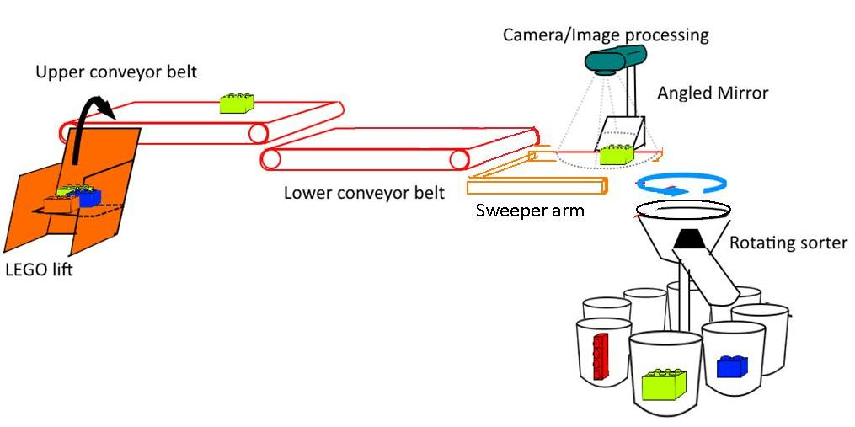
Project Design
Subsystems
User Interface
Lift system
Dual conveyor system
Image Processing system
Rotating Arm system

Slide 4
Division of Labor
Nike – User Interface
David – Image Processing Chamber, Lift Arm Construction
Nick – Rotating Arm ,conveyor systems, embedded PCB
Katrina – Power Supply, Lift arm and conveyor systems construction

Slide 5
MCU choice: ATmega34U2
32KB integrated flash memory for code
2.5KB SRAM
16MHz clock rate
SPI, I2C, UART
7 PWM pins
12 ADC channels
5V logic

Slide 6
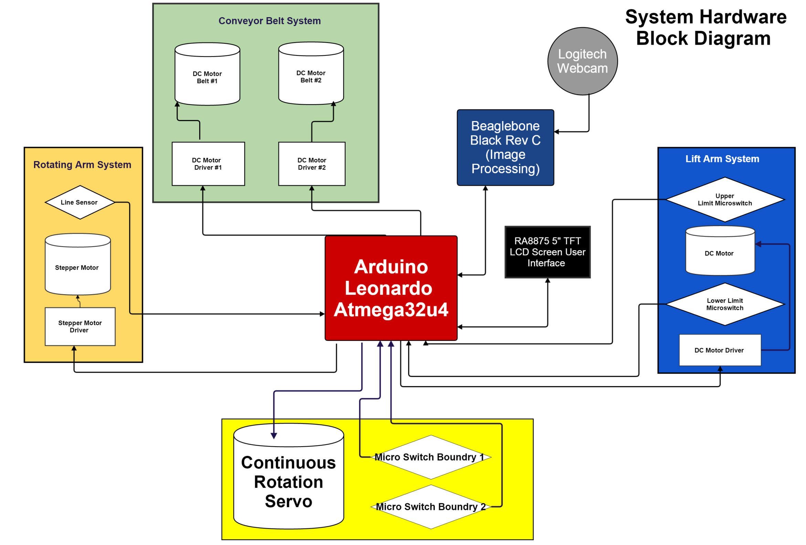

Slide 7
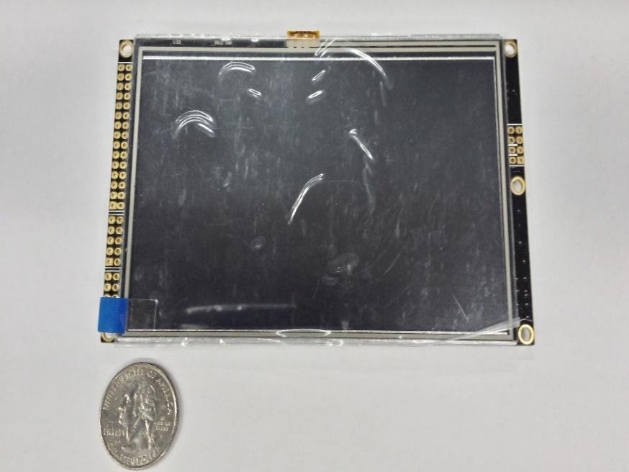
LCD Touch Screen User Interface
Purpose: To give the user options on how to sort the Legos
Designed with simplicity in mind
Uses touch screen control
ATMega32u4
Will act as a touch screen controller
Compatible Touch screen Library
RA8875 TFT Resistive Touch Screen
Display interface for the user and control the system

Slide 8
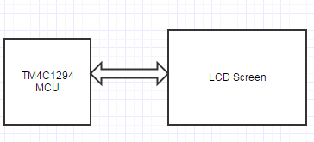
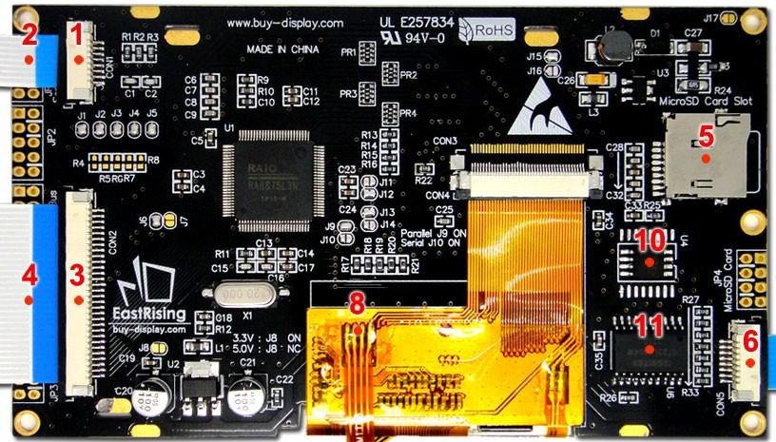
LCD Touchscreen - TFT 5 inch LCD Display Module w/Controller Board Serial I2C RA8875
Offers parallel or serial interfacing
Resistive touch screen
Display format – 480 x 272
Colors – 256/65K
Supply – 3.3V or 5V
Draws 180 mA with 5V supply.
40 mA for backlight
Atmega32u4

Slide 9
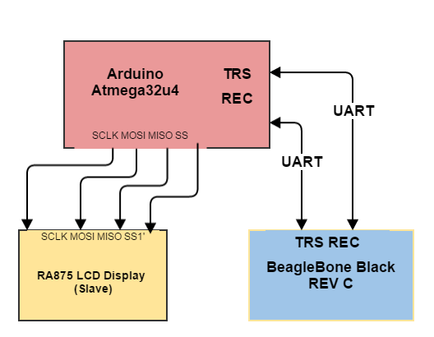
Communication Interface
Arduino Atmega32u4 communicate via 4-wire SPI Interface with RA8875 LCD Controller
Arduino Atmega32u4 communicates with BBB Rev C via UART Transmit & Receive Pins

Slide 10
Flow

Slide 11
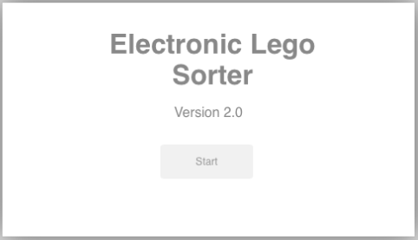
Start Screen

Slide 12
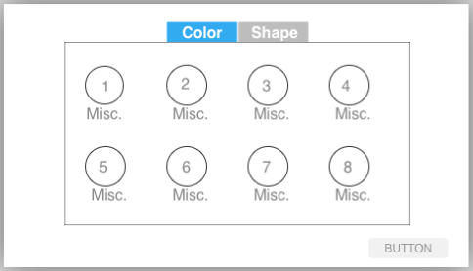
Choice Screen

Slide 13
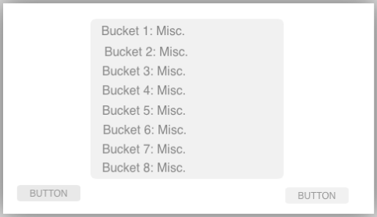
Confirmation Screen

Slide 14
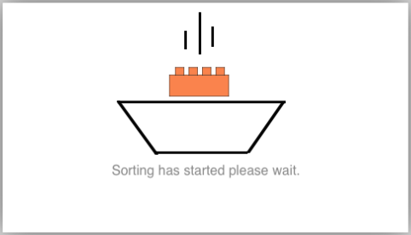
Status Screen

Slide 15
Conveyor Belts
Two conveyor belts help distance LEGO pieces from one another.
Lower belt moves quicker than upper belt.
Need high torque, low speed motors

Slide 16
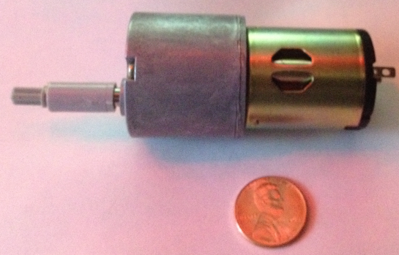
Conveyor Motors
High torque geared motor
Torque rated at 60 N x cm
12V DC
120 RPM at 12V
Speed can be lowered and varied with PWM control

Slide 17
Conveyor motor circuit considerations
The motors only need to rotate in one direction.
12V
Motors will need to utilize PWM control for speed variance.
3.3V logic control signal from MCU.
Motors will be turned on and off periodically.

Slide 18
Conveyor Motor Circuit And Operation
Transistor Q1 acts as switch
Current limiting Resistor R1
DC motor M1
Flyback diode D1
Resettable fuse S1
PWM module on ATmega32U4 will be
used to send varying width
pulses to control motor speed.

Slide 19
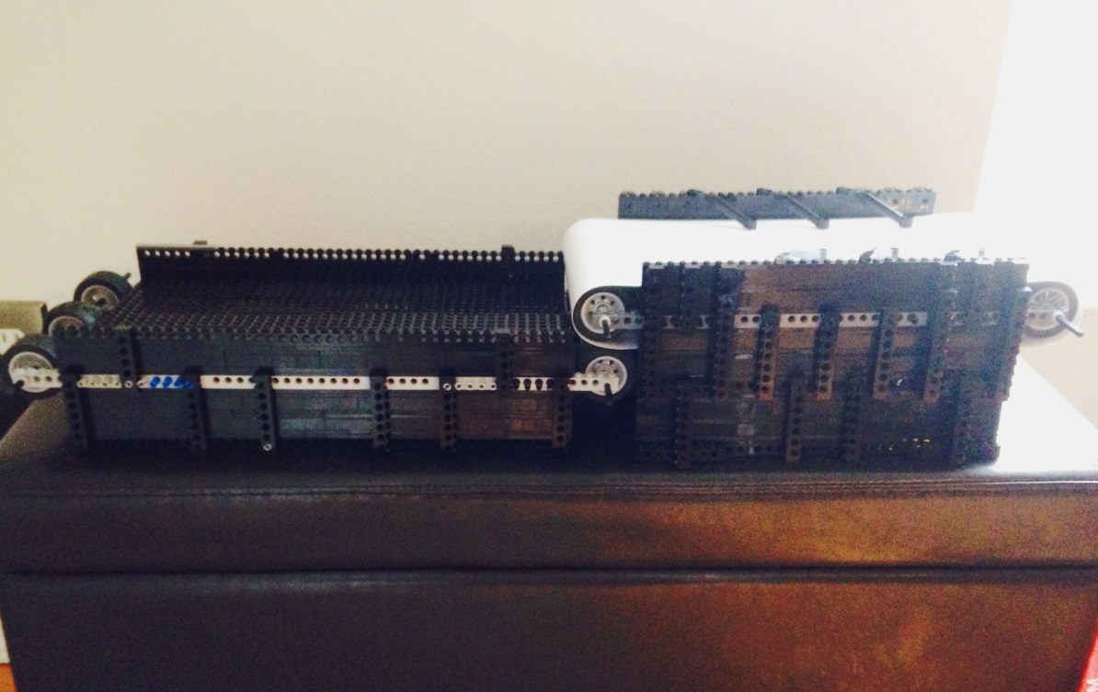
Conveyor Belt Mechanical Construction
The conveyor belts were constructed out of Lego Technic parts. They have many lego “pins” supporting the structure.
The motors were coupled to a lego part to attach to the belt rod.
The belt material is constructed from photo paper.

Slide 20
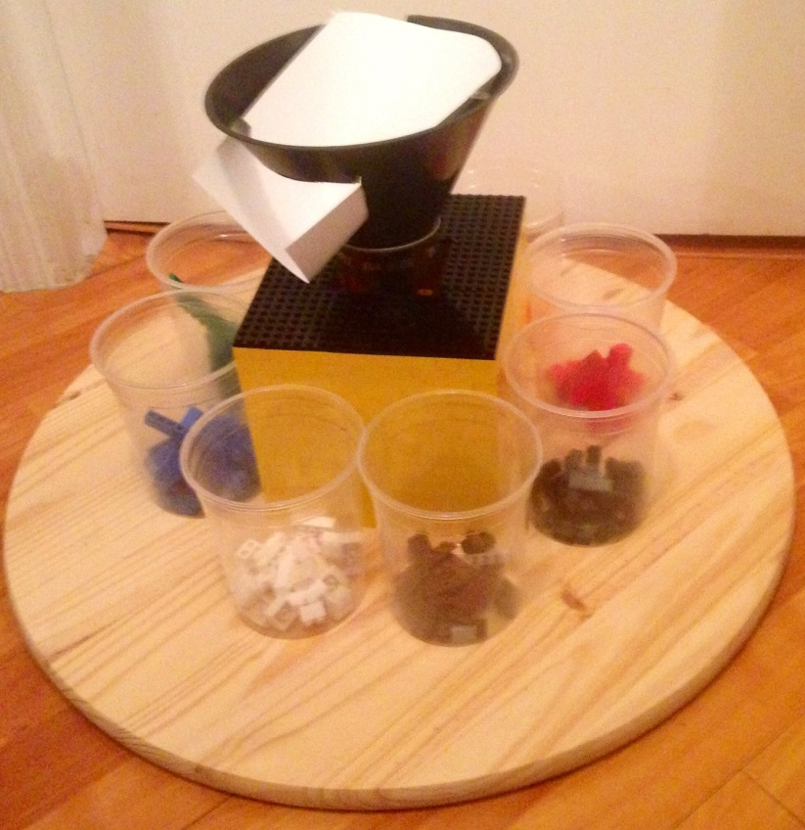
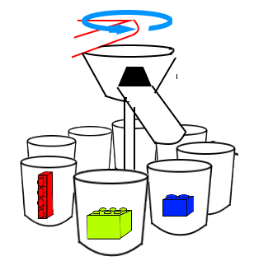
Rotating Arm Considerations
Arm should be light weight.
Arm should rotate a full 360° to access all sorting bins.
Rotation needs to be precise enough to deposit a LEGO in up to 10 bins surrounding the rotating arm.
Need a feedback sensor for relative positioning.

Slide 21
Rotating Arm Motor
5V unipolar stepper motor.
Draws ~250 mA stalled.
4 phases, 5 wires.
1/64 reduction ratio using full-step. 360° / 64 = 5.625° per step
Half step switching sequence allows for 512 steps per shaft revolution at resolution of ~0.703° per step.
Possible issue – Actual gear ratio measured around 63.68395 : 1.

Slide 22
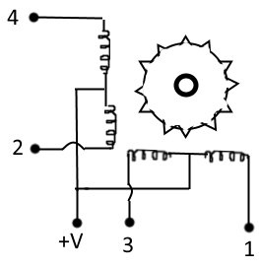
Half-Step Motor Sequence
8 coil energizing sequences per half-step.
512 total half-steps per revolution
Wire | 1 | 2 | 3 | 4 | 5 | 6 | 7 | 8
4 | 1 | 1 | 0 | 0 | 0 | 0 | 0 | 1
3 | 0 | 1 | 1 | 1 | 0 | 0 | 0 | 0
2 | 0 | 0 | 0 | 1 | 1 | 1 | 0 | 0
1 | 0 | 0 | 0 | 0 | 0 | 1 | 1 | 1

Slide 23
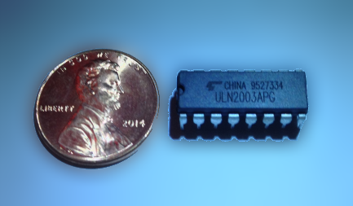
Stepper Motor Driver
ULN2003A Darlington array.
7 Darlington array circuits in space-saving IC package. Will only need to use 4 of the 7
Clamp diodes for inductive load switching.
Very low current draw from the MCU.
Motor draws 250 mA max per coil winding.
Maximum ratings
Output current per channel | 500mA
Output Voltage | 50 V
Input Voltage | 30 V

Slide 24
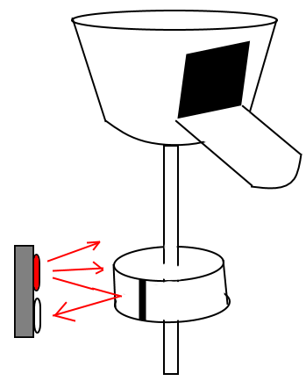
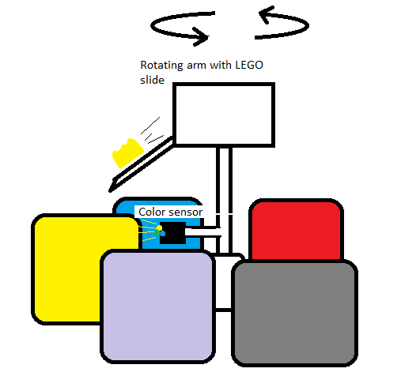
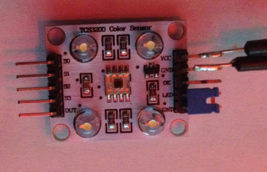
Rotating Arm Sensor Comparison
TCS3200 Color sensor
Advantages
Provides constant feedback relative to sorting bins.
No worry of stepper motor losing accuracy over time.
Disadvantages
More pins.
Relatively complex coding.
MCU resource intensive.
Tangled wires.
QRE1113 IR reflectance sensor
Advantages
One pin to MCU.
Simple code.
No worry about wires tangling.
Disadvantages
Feedback of position not constant.
Program must keep track of stepper motor position. Will lose accuracy over time.

Slide 25
QRE1113 IR Reflectance Sensor
5V and 3.3V compatible.
Infrared LED lights up nearby surface. Phototransistor reacts to reflected IR rays.
Analog output will use one ADC pin on MCU.
White ring around rotating arm with a black vertical stripe. The stripe absorbs IR rays and the sensor sends a lower value to MCU. The stripe acts as a homing position for the stepper motor. Program keeps track of step count.
ISSUE – stepper motor has non-integer gear ratio. Code calculations will lose accuracy over extended periods. Proposed solution – bring stepper motor to home position periodically for recalibration.

Slide 26
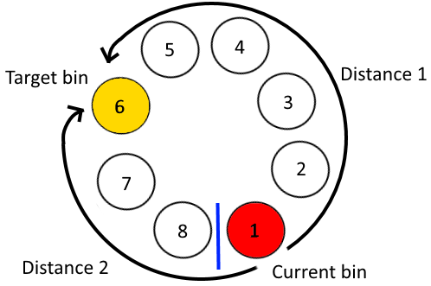
Movement Optimization
Goal: Take least amount of time positioning arm from bin to bin.
Function “bin_to_bin” calculates the distance of clockwise and counter-clockwise paths from the current bin to the target bin. Nested if statements determine whether to move clockwise or counter-clockwise.
Distance 1 = bigger bin – smaller bin;
Distance 2 = (number of bins – bigger bin) + smaller bin;

Slide 27
COMPONENT POWER CONSUMPTION
Component | Rated Voltage [V] | Rated Current [A] | Power Consumed [W]
Supply 1
Lift Arm DC Motor | 12 | 0.3 | 3.6
Conveyor Belt DC Motor #1 | 12 | 0.3 | 3.6
Conveyor Belt DC Motor #2 | 12 | 0.3 | 3.6
Atmega32u4 | 12 | 0.52 | 6.24
Total |  | 1.42 | 17.04
Supply 2
Lift Arm Microswitch #1 | 5 | 0.17 | 0.85
Lift Arm Microswitch #2 | 5 | 0.17 | 0.85
Lift Arm Controller (L293D) | 5 | 1.2 | 6
Rotating Arm Stepper Motor | 5 | 0.32 | 1.6
Rotating Arm Controller (UNL3003) | 5 | 0.5 | 2.5
Rotating Arm Photoelectric Sensor | 5 | 0.02 | 0.1
Beaglebone Black | 5 | 0.46 | 2.3
Total |  | 2.84 | 14.2
POWER RATING
 | Supply 1 | Supply 2
Rated Voltage [V] | 12 | 5
Rated Current [A] | 1.42 | 2.84
Rated Current +20% [A] | 1.7 | 3.41
Power Consumed [W] | 20.4 | 17.05

Slide 28
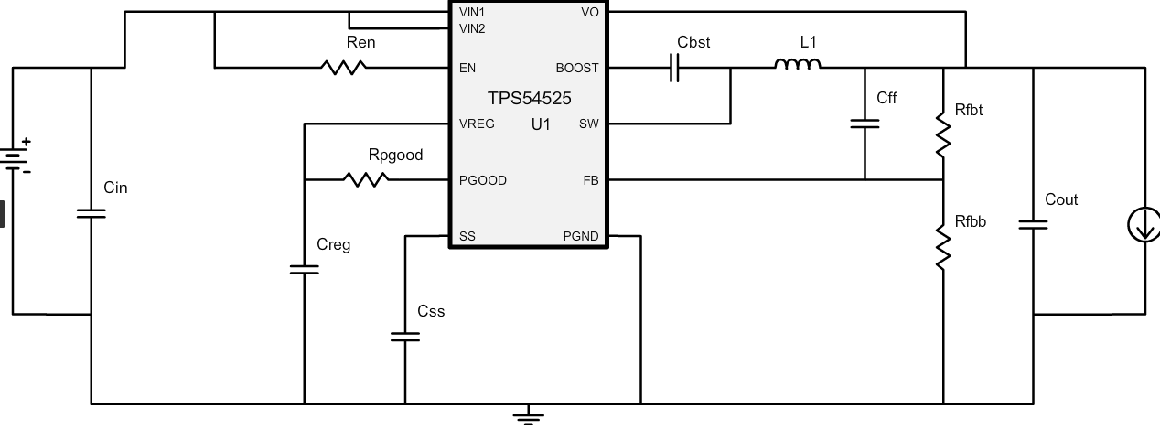
T.I. Webench DC Power Architecture SMPS Design
DC Voltage Source Manufactured by Honeywell Model: PS-45-12 Selected for the AC/DC conversion

Slide 29
Eagle Power Supply Schematic Files
The 12V 3.7A DC Input from Mean Well was wired to a simple home SPST 120V 15 A Switch to cutoff power.

Slide 30
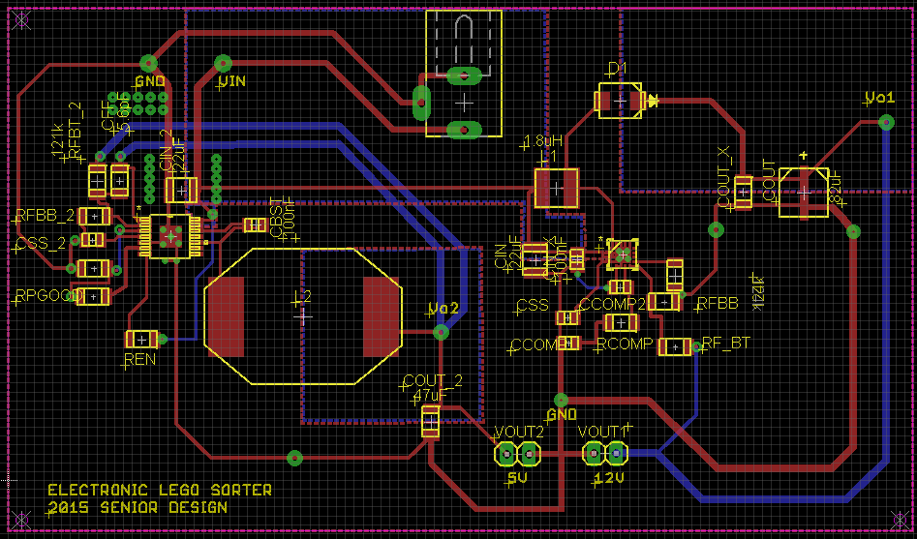
Eagle Power Supply PCB Board and Heat Sink Issues.
Vin Polygon Supply from Mean Well PS-45-12
Vo1 = 12V 1.70 A
Vo2 = 5V 3.41A

Slide 31
Embedded System Schematic

Slide 32
Embedded System PCB

Slide 33
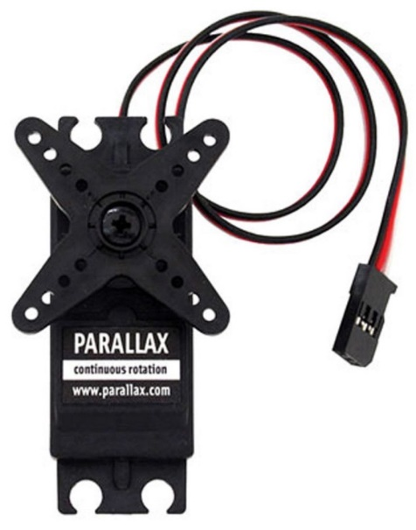
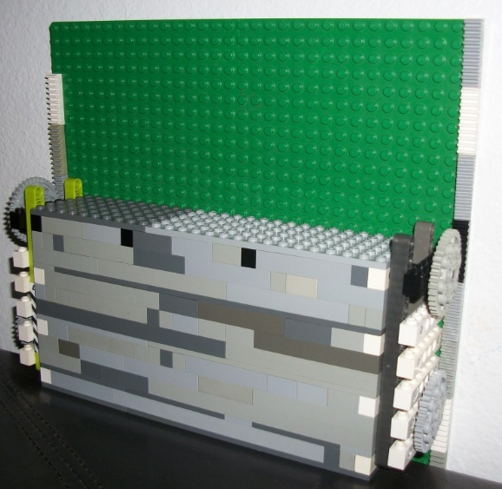
Lift Arm Initial Construction Plan
Parallax S148 Continuous Rotation Servo Motor
Advantage
Easy to control basic PWM 3 Lines: Ground, Supply, and Control
Disadvantages:
Price: $19.99 and Quantity of (2) motors for each side
Ultimately Not Enough Torque

Slide 34
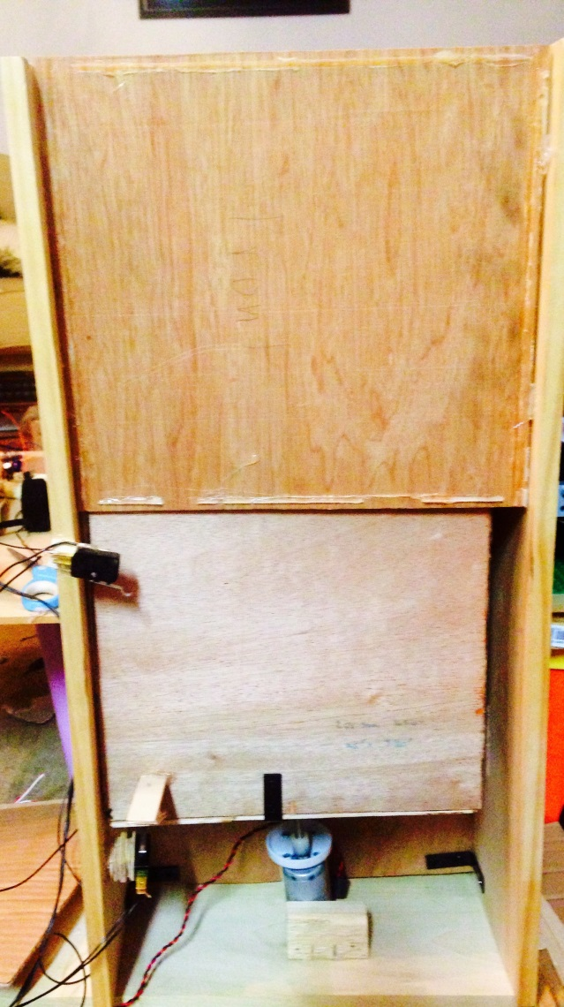
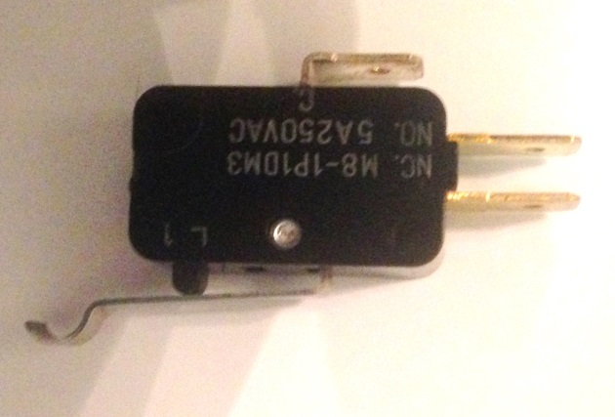
Lift Arm Final Construction Plan
Design Requirements: Ability to move the platform up and down quickly without surpassing the physical bounds.
A threaded rod was coupled to motor shaft. Another coupler was epoxied to the “moving platform”
A pair of mechanical Micro switches were selected to control the upper / lower boundaries of the system

Slide 35
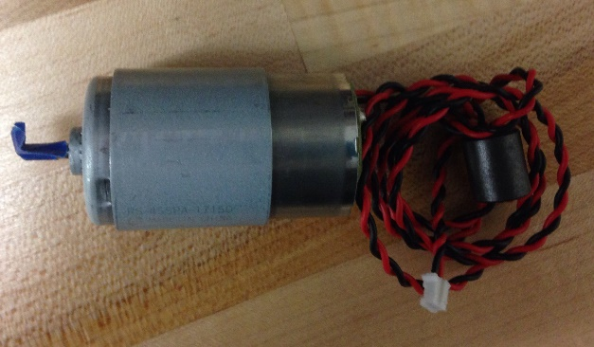
Lift Arm Motor Selection
RS-455PA DC Motor | No Load |  | Stall
Operating Voltage | Speed | Current [A] | Current [A]
12-42 [V] | 5500 [rev/min] | 0.055 [A] | 0.1 A
Linear Actuator Pros:
All in one construction
Easy to control
Built in limit switches
Linear Actuator Cons:
Extremely Expensive $80+
Constricted to set Size
RPM not quite high enough
Rev/min | Threaded Rod Specs [rev / in] | Time to move the platform in 1 direction [s] | Time to perform 1 iteration (up/down) [s]
5500 | 18 | 1.18 | 2.36
5500 | 23 | 1.5 | 3
5500 | 30 | 1.96 | 3.92
Stepper Motor Pros
Precise position control
Eliminates the need for limit sensors
Least Expensive $5
Stepper Motor Cons
Low RPM
RPM is robust for our application moving the platform very fast. This can be adjusted by using a threaded rod with more revolutions
DC Motor Pros
High RPM
Easy to control with H-Bridge Circuit
DC Motor Cons:
Must use sensors to control the boundaries

Slide 36
Sweeper Arm System
5V servo motor and gear rack
Servo motor on axel drives gear rack forward to push Lego piece into rotating arm system
Servo reverses to return sweeper to starting position
Micro switches on the front and back of sweeper to limit its movement

Slide 37
Image Processing Chamber
Camera and Mirror
Top view and side view
Lighting
Logitech Webcam
Creating Ideal conditions for software

Slide 38
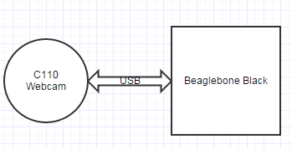
Webcam
Logitech C110
USB connectivity to Beaglebone
VGA resolution makes processing images quicker.

Slide 39
Image Processing Software
The images taken of the Legos will represent the top view and side view (using the mirror) which will then be used to gather details on the Legos
The consistent feed from the camera will also be used in software to determine when to process an image.
After the camera detects a Lego in its field of view, it analyzes the color for shape or size, based on user input, then sends the data to the MCU, which will change the position of the rotating arm accordingly, and then set the sweeper arm to push the Lego.

Slide 40
Image Processing
Beaglebone Black Rev C
512 MB RAM
1 GHz
4GB built in memory
USB connectivity for camera
3.3V I/O
SPI interface
Beaglebone faster and more memory than alternatives like MSP and Arduino MCUs.

Slide 41
Predicted Budget
Part | Quantity | Price | Total
Beaglebone Black | 1 | 59.99 | $59.99
ATMega32U4 | 1 | $5.99 | $5.99
6" Drawer Slides | 1 | 12.65 | 12.65
L293D H- Bridge | 1 | $1.39 | $1.39
RS-455 PA DC Motor | 1 | $9.20 | 9.2
TFT RA8875 LCD | 1 | $30.76 | 30.76
Microswitches | 4 | $1.50 | $6
Embedded PCB Components | 1 | $30 | $30
PCB | 2 | $30 | $120
Power PCB | 1 | $150 | $150
Stepper Motor 28BYJ-48 + UNL2003 Driver | 1 | $7.99 | $7.99
Mirrors | 2 | $1 | $2
Threaded Rod | 1 | $1.70 | $1.70
Coupler for Threaded Rod | 1 | $0.90 | $0.90
Wood | 1 | $15 | $15
Photo Paper | 2 | $5 / ft^2 | $10
Buckets | 10 | $1/3 Pack | $4
Legos | N/A | Donated | $0
Conveyor Belt DC Motor | 2 | $12 | $24
Webcam Logitech C110 | 1 | $19.50 | $19.50
QRE1113 Sensor | 1 | $2.95 | $2.95
Power Supply Components | 47 |  | $68
DPDT Killswitch | 1 | 4.75 | 4.75
LED | 1 | $3 | $3
 | Total |  | $569.80

Slide 42
Questions?

