Slide 1
Group 33 – Image Processing Based Lego Sorter
Nike Adeyemi (CpE)
David Carey (CpE)
Katrina Little (EE)
Nick Steinman (EE)

Slide 2
Project Goals/Specifications
Why a Lego sorter?
Specific Objectives
Minimal user dependency
Speed vs. Accuracy
Overall Objective Statement

Slide 3
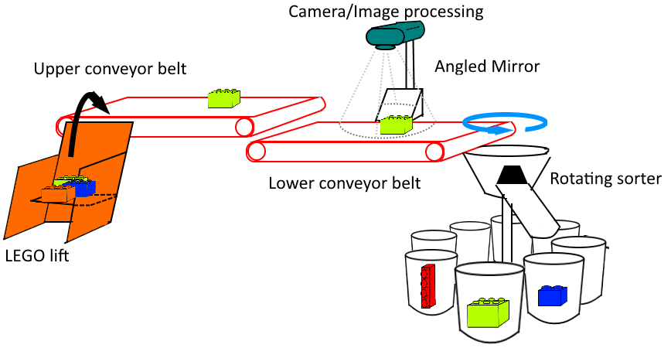
Project Design
Subsystems
User Interface
Lift Arm system
Dual conveyor system
Image Processing system
Rotating Arm system

Slide 4
Division of Labor
Nike – User Interface
David – Image Processing, Lift arm construction
Nick – Rotating Arm and conveyor systems
Katrina – Power Supply, Lift arm and conveyor systems

Slide 5
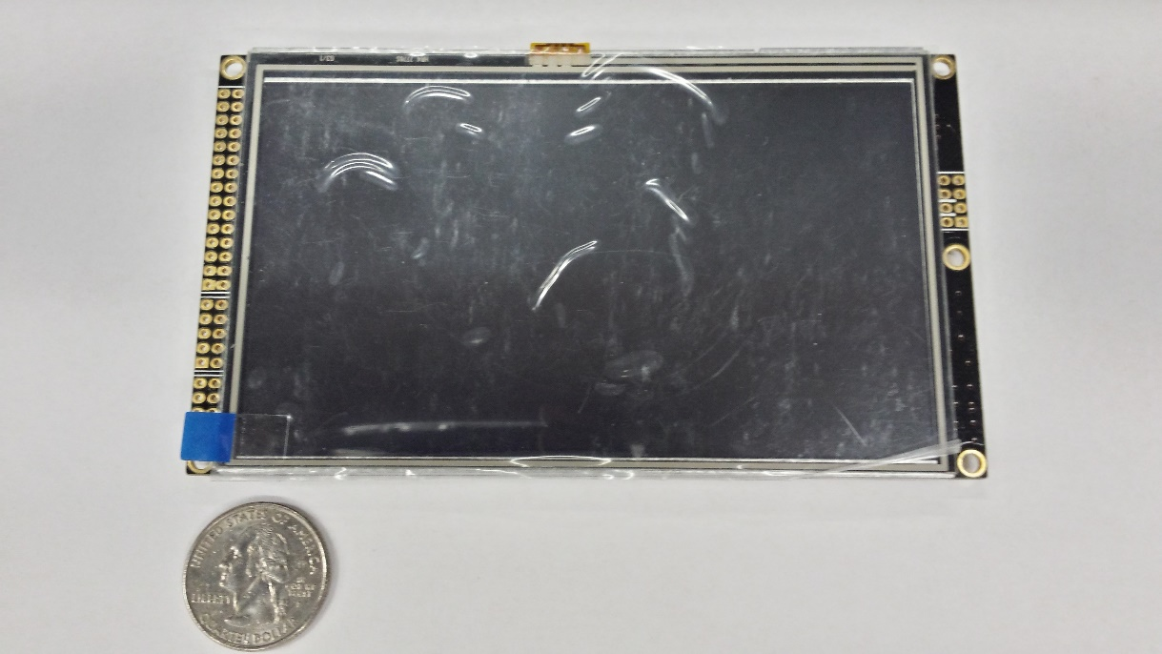
LCD Touch Screen User Interface
Purpose: To give the user options on how to sort the Legos
Designed with simplicity in mind
Uses touch screen control
Tiva C TM4C1294NPDCT
Will act as a touch screen controller
Four master-slave modules
Built in LCD Library
RA8875 TFT Resistive Touch Screen
Display interface for the user and control the system

Slide 6
Flow

Slide 7
Start page

Slide 8
Set up page

Slide 9
Confirmation page

Slide 10
Image Processing Chamber
Camera and Mirror
Top view and side view
Lighting
Logitech Webcam
Creating Ideal conditions for software

Slide 11
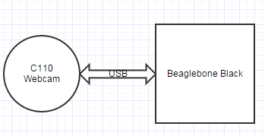
Webcam
Logitech C110
USB connectivity to Beaglebone
VGA resolution makes processing images quicker.

Slide 12
Image Processing Software
The images taken of the Legos will represent the top view and side view (using the mirror) which will then be used to gather details on the Legos
The consistent feed from the camera will also be used in software to determine when to process an image.

Slide 13
Conveyor Belts
Two conveyor belts help distance LEGO pieces from one another.
Lower belt moves quicker than upper belt.
Need high torque, low speed motors

Slide 14
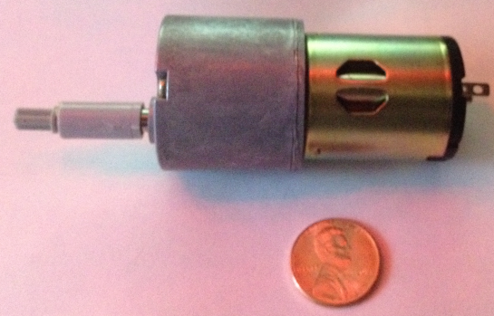
Conveyor Motors
High torque geared motor
Torque rated at 60 N x cm
12V DC
120 RPM at 12V
Speed can be lowered and varied with PWM control

Slide 15
Conveyor motor circuit considerations
The motors only need to rotate in one direction.
12V
Motors will need to utilize PWM control for speed variance.
3.3V logic control signal from MCU.
Motors will be turned on and off periodically.

Slide 16
Conveyor Motor Circuit And Operation
Transistor Q1 acts as switch
Current limiting Resistor R1
DC motor M1
Flyback diode D1
Resettable fuse S1
PWM module on Tiva C will be
used to send varying width
pulses to control motor speed.

Slide 17
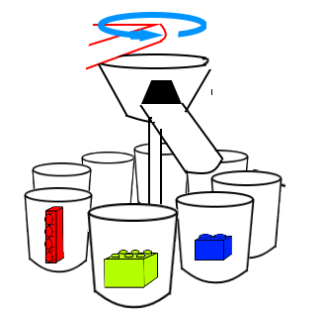
Rotating Arm Considerations
Arm should be light weight.
Arm should rotate a full
360° to access all sorting
bins.
Rotation needs to be precise enough to deposit a LEGO in up to 10 bins surrounding the rotating arm.
Need a feedback sensor for relative positioning.

Slide 18
Rotating Arm Motor
5V unipolar stepper motor.
Draws ~250 mA stalled.
4 phases, 5 wires.
1/64 reduction ratio using full-step. 360° / 64 = 5.625° per step
Half step switching sequence allows for 512 steps per shaft revolution at resolution of ~0.703° per step.
Possible issue – Actual gear ratio measured around 63.68395 : 1.

Slide 19
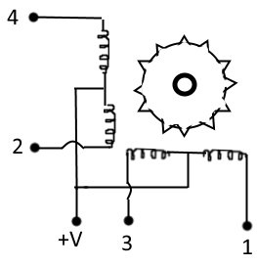
Half-Step Motor Sequence
8 coil energizing sequences per half-step.
512 total half-steps per revolution
Wire | 1 | 2 | 3 | 4 | 5 | 6 | 7 | 8
4 | 1 | 1 | 0 | 0 | 0 | 0 | 0 | 1
3 | 0 | 1 | 1 | 1 | 0 | 0 | 0 | 0
2 | 0 | 0 | 0 | 1 | 1 | 1 | 0 | 0
1 | 0 | 0 | 0 | 0 | 0 | 1 | 1 | 1

Slide 20
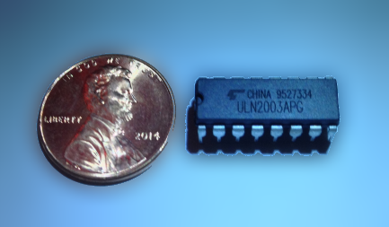
Stepper Motor Driver
ULN2003A Darlington array.
7 Darlington array circuits in space-saving IC package. Will only need to use 4 of the 7
Clamp diodes for inductive load switching.
Very low current draw from the MCU.
Motor draws 250 mA max per coil winding.
Maximum ratings
Output current per channel | 500mA
Output Voltage | 50 V
Input Voltage | 30 V

Slide 21
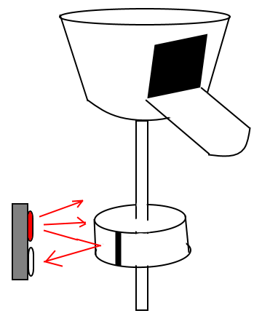
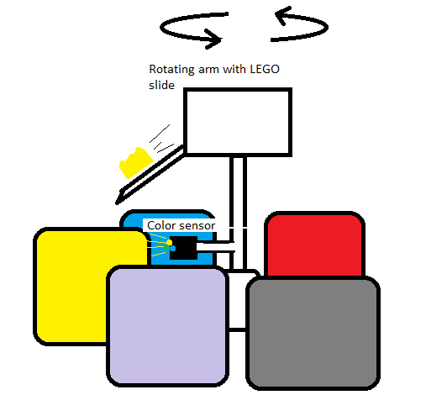
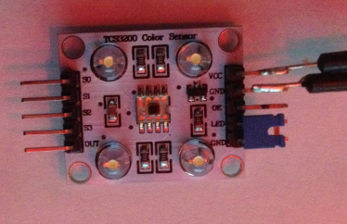
Rotating Arm Sensor Comparison
TCS3200 Color sensor
Advantages
Provides constant feedback relative to sorting bins.
No worry of stepper motor losing accuracy over time.
Disadvantages
More pins.
Relatively complex coding.
MCU resource intensive.
Tangled wires.
QRE1113 IR reflectance sensor
Advantages
One pin to MCU.
Simple code.
No worry about wires tangling.
Disadvantages
Feedback of position not constant.
Program must keep track of stepper motor position. Will lose accuracy over time.

Slide 22
QRE1113 IR Reflectance Sensor
5V and 3.3V compatible.
Infrared LED lights up nearby surface. Phototransistor reacts to reflected IR rays.
Analog output will use one ADC pin on MCU.
White ring around rotating arm with a black vertical stripe. The stripe absorbs IR rays and the sensor sends a lower value to MCU. The stripe acts as a homing position for the stepper motor. Program keeps track of step count.
ISSUE – stepper motor has non-integer gear ratio. Code calculations will lose accuracy over extended periods. Proposed solution – bring stepper motor to home position periodically for recalibration.

Slide 23
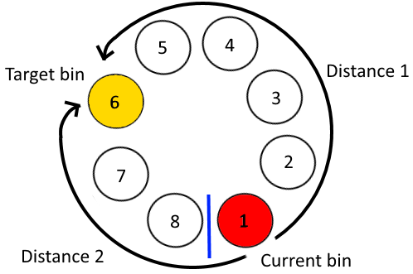
Movement Optimization
Goal: Take least amount of time positioning arm from bin to bin.
Function “bin_to_bin” calculates the distance of clockwise and counter-clockwise paths from the current bin to the target bin. Nested if statements determine whether to move clockwise or counter-clockwise.
Distance 1 = bigger bin – smaller bin;
Distance 2 = (number of bins – bigger bin) + smaller bin;

Slide 24
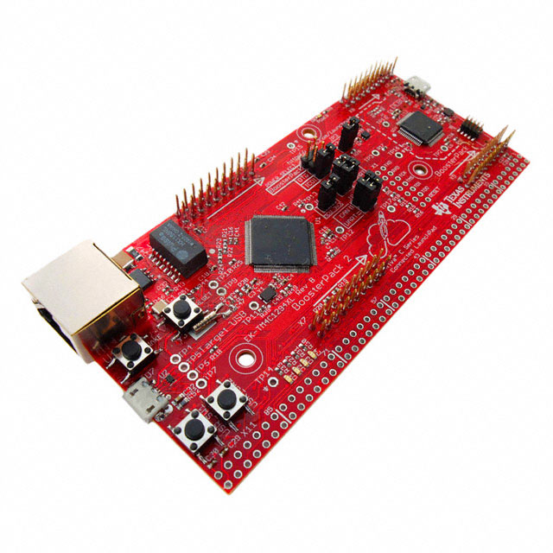
MCU choice: TM4C1294 (Tiva C)
1MB integrated flash memory for code
120MHz max speed
90 GPIO lines
SPI, I2C, UART
20 ADC channels with 12 bit resolution
3.3V logic

Slide 25
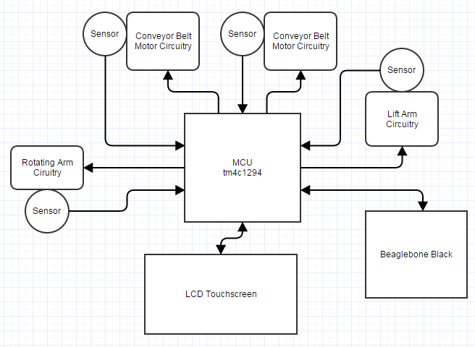
MCU Dataflow Diagram

Slide 26
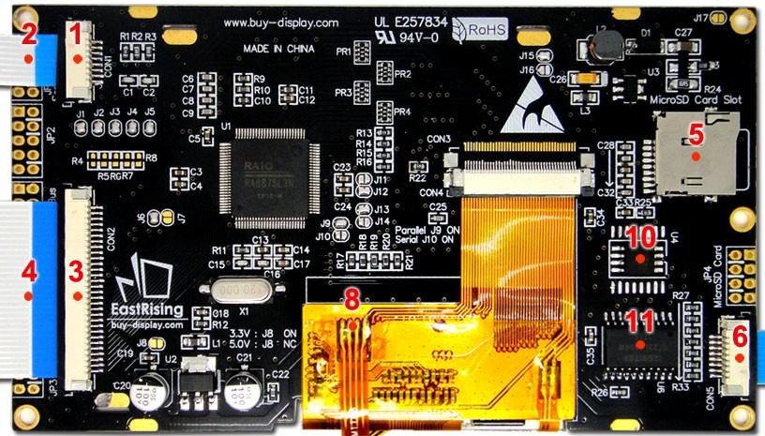
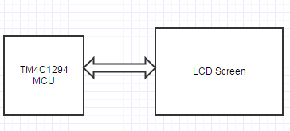
LCD Touchscreen - TFT 5 inch LCD Display Module w/Controller Board Serial I2C RA8875
Offers parallel or serial interfacing
Resistive touch screen
Display format – 480 x 272
Colors – 256/65K
Supply – 3.3V or 5V
Draws 180 mA with 5V supply.
40 mA for backlight

Slide 27
Image Processing
Beaglebone Black Rev C
512 MB RAM
1 GHz
4GB built in memory
USB connectivity for camera
3.3V I/O
SPI interface
Beaglebone faster and more memory than alternatives like MSP and Arduino MCUs.

Slide 28
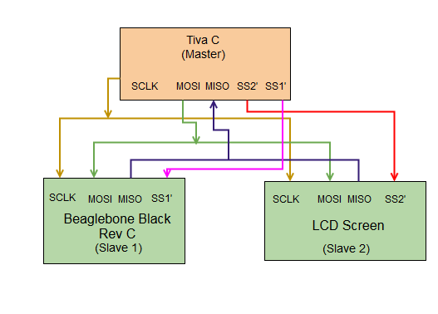
Master-Slave SPI Interfacing
Tiva C is the master device.
Beaglebone Black and LCD touchscreen are the slave devices.

Slide 29
Conveyor Belt Mechanical Construction
The conveyor belts will be constructed out of Lego parts & Hot Glued together. Hot glue does a good job of melting the plastic together into one solid structure.
There are also “technic” lego connectors that fit onto the motor shaft perfectly, which connects to the rod threaded to the belt’s wheels.
The belt material is constructed from photo paper. The photo paper costs $5 per square foot including printing 17% gray which was suggested for ideal image processing.

Slide 30
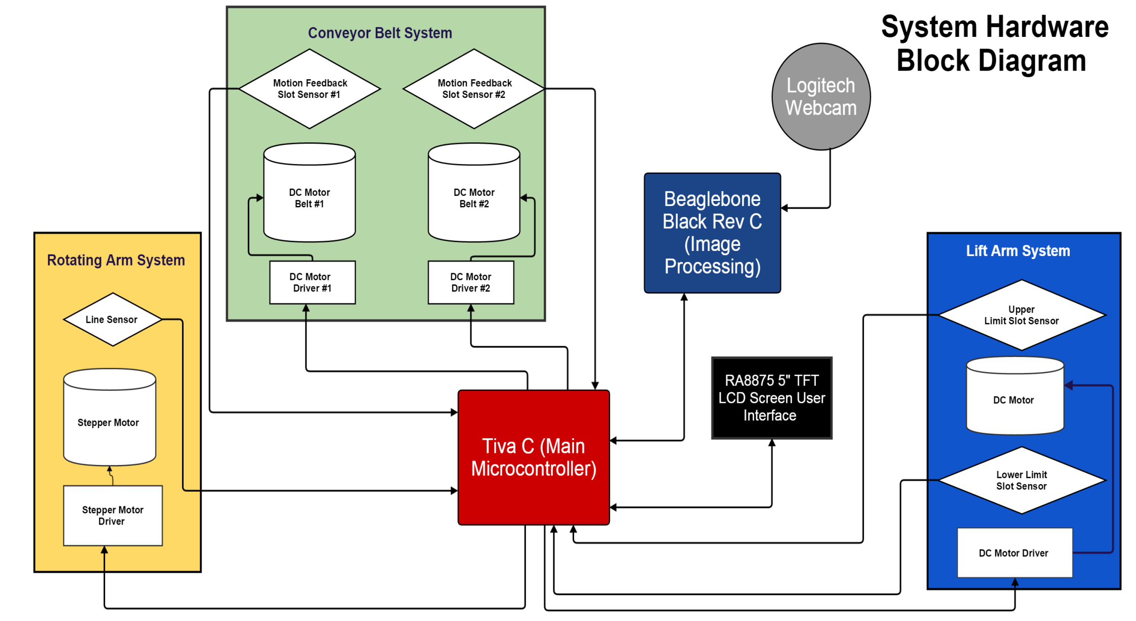

Slide 31
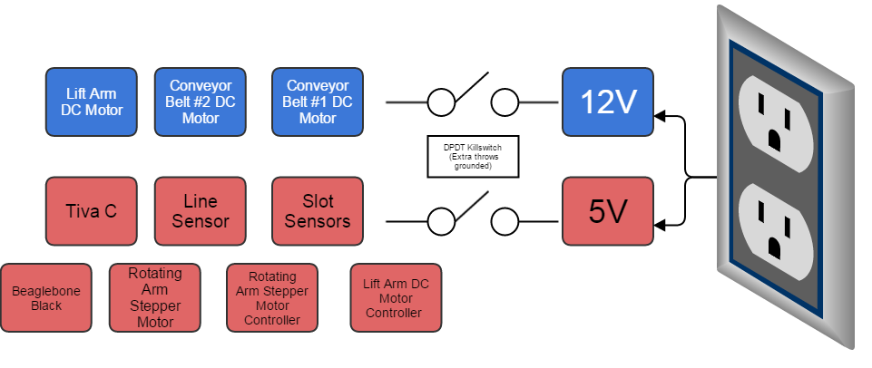
Subsystem Power
Component | Rated Voltage | Rated Current [A] | Power Consumed [W]
Lift Arm Slot Sensor #1 EE-SX670 | 5 | 0.07 | 0.35
Lift Arm Slot Sensor #2 EE-SX670 | 5 | 0.07 | 0.35
Lift Arm DC Motor | 12 | 1.85 A (Stall) | 22.2 W
Lift Arm Motor Controller (L293D) | 5 | 1.2 | 6
Conveyor Belt DC Motor 1 | 12 | 0.3 | 3.6
Conveyor Belt DC Motor 2 | 12 | 0.3 | 3.6
Conveyor Belt Slot Sensor #1 EESX670 | 5 | 0.07 | 0.35
Conveyor Belt Slot Sensor #2 EEsx670 | 5 | 0.07 | 0.35
Rotating Arm Stepper Motor | 5 | 0.32 | 1.6
Rotating Arm Motor Controller (UNL3003) | 5 | 0.5 | 2.5
Rotating Arm Photoelectric Sensor | 5 | 0.02 | 0.1
Tiva C | 5 | 0.3 | 1.5
Beaglebone Black | 5 | 0.46 | 2.3
Rated Power Supply
Supply [V] | ∑ Rated Curent [A] | ∑ Rated Curent +20% [A] | Power [W]
12V | 2.45 | 2.94 | 35.28
5 V | 3.08 | 3.7 | 18.5

Slide 34
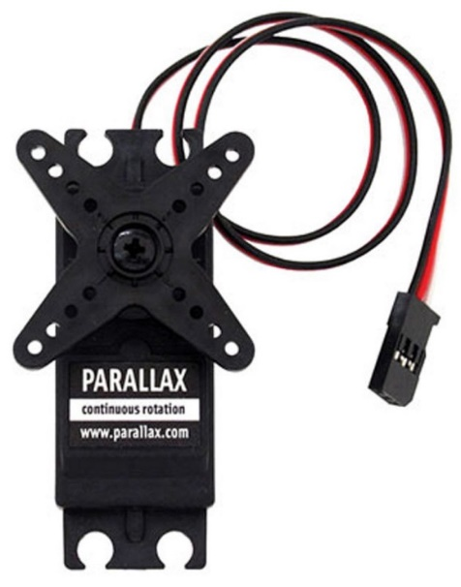
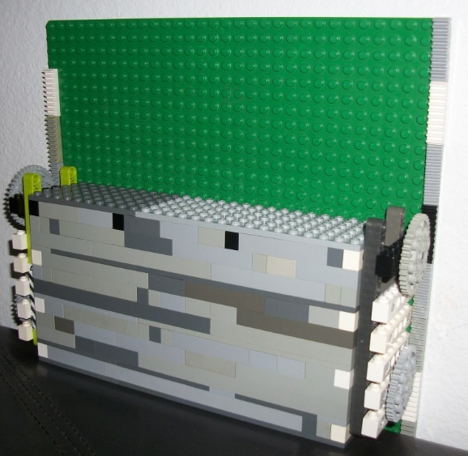
Lift Arm Initial Construction Plan
Parallax S148 Continuous Rotation Servo Motor
Advantage
Easy to control basic PWM 3 Lines: Ground, Supply, and Control
Disadvantages:
Price: $19.99 and Quantity of (2) motors for each side
Ultimately Not Enough Torque

Slide 35
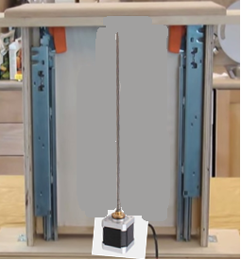
Lift Arm Final Construction Plan
Design Requirements: Ability to move the platform up and down quickly without surpassing the physical bounds.
Lift Arm DC Motor RPM Selection
Rev per Minute | Speed | Time to move the platform in one direction | Total time to perform one iteration (up/down)
600 RPM | 14.12 [mm/s] | 10.79[ s] up/down | 21.58 [s] total
1000 RPM | 23.57 [mm/s] | 6.47 [s] up/down | 12.93 [s]
1500 RPM | 35 [mm/s] | 4.35 [s] up/down | 8.71 [s]
3000 RPM | 70.53 [mm/s] | 2.16 [s] up/down | 4.32 [s]
Coupler to be fastened to the bottom of the moving platform
6” Drawer Rack Extension Slides to guide the platform
Threaded Rod to Be coupled to the motor shaft
*These calculations based on a threaded rod of 18 Rev/in
**A typical Linear actuator has a speed of around 12 [mm/s] which would take 25.4 [s] to perform one iteration of moving the platform up and down.
A pair of EESX-670 Slot Sensors were chosen to provide the boundaries of the lift arm system

Slide 36
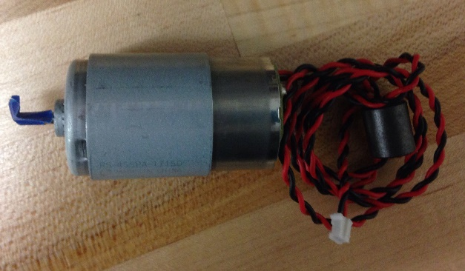
Lift Arm Motor Selection
RS-455PA DC Motor | No Load |  | Stall
Operating Voltage | Speed | Current [A] | Current [A]
12-42 [V] | 5500 [rev/min] | 0.055 [A] | 1.85
Linear Actuator Pros:
All in one construction
Easy to control
Built in limit switches
Linear Actuator Cons:
Extremely Expensive $80+
Constricted to set Size
RPM not quite high enough
Rev/min | Threaded Rod Specs [rev / in] | Time to move the platform in 1 direction [s] | Time to perform 1 iteration (up/down) [s]
5500 | 18 | 1.18 | 2.36
5500 | 23 | 1.5 | 3
5500 | 30 | 1.96 | 3.92
Stepper Motor Pros
Precise position control
Eliminates the need for limit sensors
Least Expensive $5
Stepper Motor Cons
Low RPM
RPM is robust for our application moving the platform very fast. This can be adjusted by using a threaded rod with more revolutions
DC Motor Pros
High RPM
Easy to control with H-Bridge Circuit
DC Motor Cons:
Must use sensors to control the boundaries

Slide 37
Predicted Budget
Part | Quantity | Price | Total
Beaglebone Black | 1 | 59.99 | $59.99
TM4c1294ncpdti3 | 1 | $17.75 | $17.75
Tiva C tm4c1294 Development Board | 1 | Donated | $0
6" Drawer Slides | 1 | 12.65 | 12.65
L293D H- Bridge | 1 | $1.39 | $1.39
RS-455 PA DC Motor | 1 | $9.20 | 9.2
TFT RA8875 LCD | 1 | $30.76 | 30.76
Omron Slot Sensor EESX-670 | 4 | $3.10 | $12.40
PCB | 1 | $33 | $33
Stepper Motor 28BYJ-48 + UNL2003 Driver | 1 | $7.99 | $7.99
Mirrors | 2 | $1 | $2
Threaded Rod | 1 | $1.70 | $1.70
Coupler for Threaded Rod | 1 | $0.90 | $0.90
Wood | 1 | $15 | $15
Photo Paper | 2 | $5 / ft^2 | $10
Buckets | 10 | $1/3 Pack | $4
Legos | N/A | Donated | $0
Conveyor Belt DC Motor | 2 | $12 | $24
Webcam Logitech C110 | 1 | $19.50 | $19.50
QRE1113 Sensor | 1 | $2.95 | $2.95
Power Supply Components | 47 |  | $68
DPDT Killswitch | 1 | 4.75 | 4.75
LED | 1 | $3 | $3
 | Total |  | $340.46

Slide 38
Current Progress

Slide 39
Goals Moving Forward
Complete remaining subsystems
This includes specific testing
Integrate subsystems with each other
Begin final stages of testing

Slide 40
Questions?

