Slide 1
ANTI
Automatic Note Taker
for the Impaired
Group 29
Roland Anderson - CpE
Patrick Galloway - CpE
Casey Miville - EE
Michael Sperrazzo - EE

Slide 2
Motivation
Replace paid student note takers
Hired students take insufficient notes
Lower costs for Student Services
Record presentations
Replay at a later date for review
Live broadcasting with in-stream captions

Slide 3
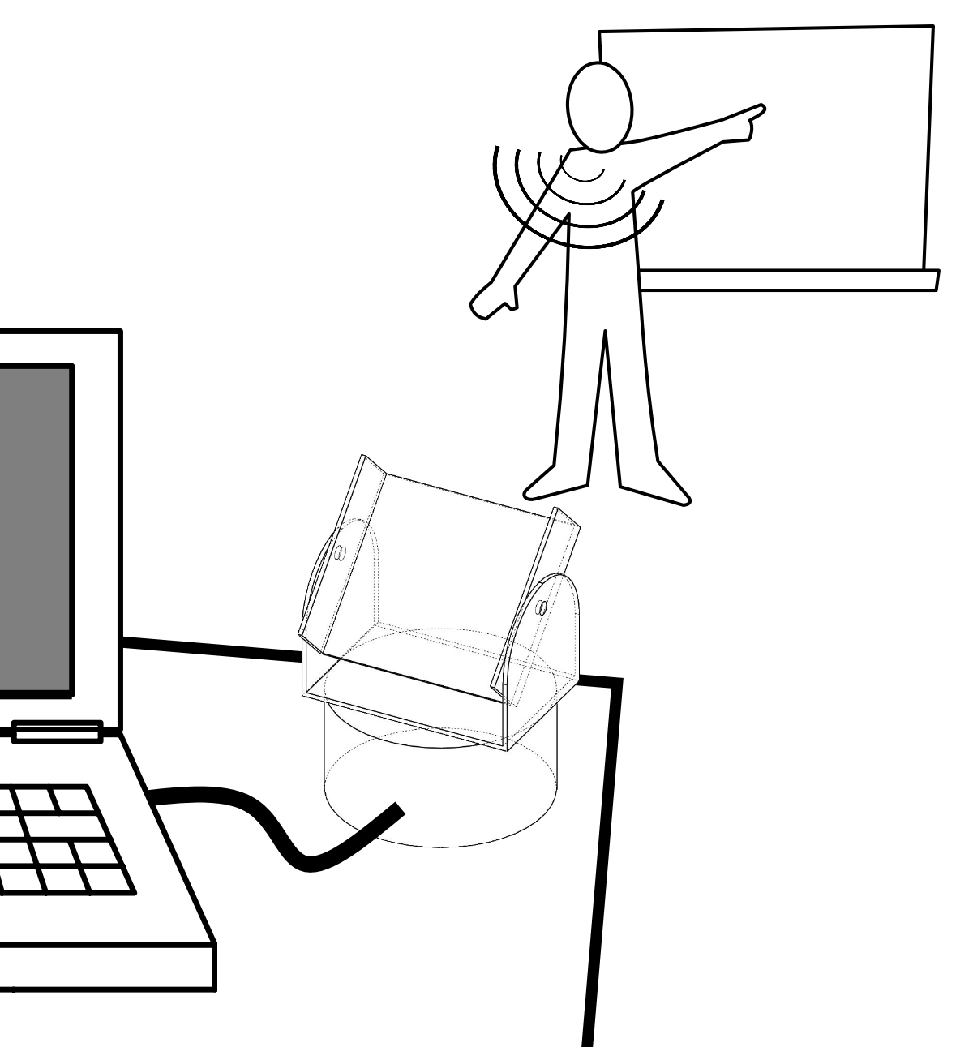
Specifications
Portable
Battery powered
Laptop USB interface
Robotic
Facial tracking
Point microphone at presenter

Slide 4
Objectives
Phase I
Speech to Text on laptop
Take notes in written digital form (.txt)
Phase II
Static scene shot with overlaid captions
Phase III
Additional overlay of tracked presenter’s face

Slide 5
Phase II
Phase III
5

Slide 6
Design
Tilt
Servo
Microphone
Pan
Motor
Image Sensor
Webcam
MCU
BeagleBone
Black
Laptop
Battery

Slide 7
Data
Tilt
Servo
Microphone
Pan
Motor
Image Sensor
Webcam
MCU
BeagleBone
Black
Laptop
Battery

Slide 8
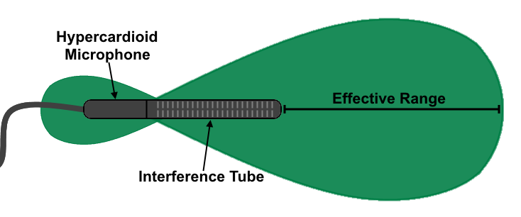
Data - Microphone
“Shotgun” Microphone
Sensitive
Directional pickup
Light and inexpensive
Element | Mono Condenser
Polar Pattern (Modes) | Normal: Cardioid Tele: Supercardioid
Frequency Response | 70Hz - 18kHz
Open Circuit Sensitivity | Normal: -56 dB Tele: -45 dB
Impedance | Normal: 1,000 ohms Tele: 2,200 ohms
Cables | 1m cable with 3.5mm TRC plug
Weight | 4 oz
Audio-Technica ATR6550:

Slide 9
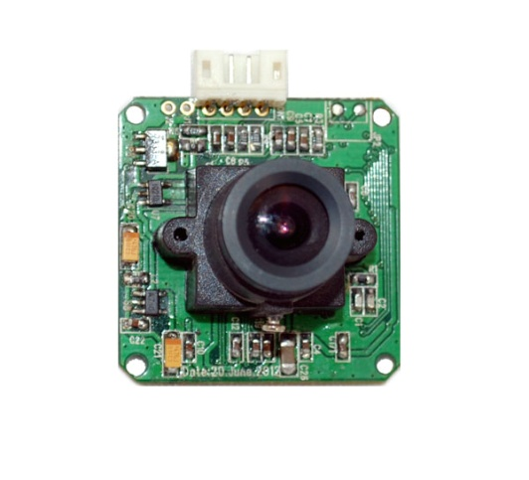
Data – Image Sensor
CMOS Image Sensor
Inexpensive
Adequate refresh rate
RS232 serial communication
On-board JPEG conversion
32mm
32mm
Sensor | 2 Megapixel CMOS
Frame Rate | 15fps at 1600x1200
Output | JPEG through serial RS232
Baud Rate | 115200
Voltage | 3.3V or 5V DC
Current | 80-100mA
Size | 32mm x 32mm
LS-Y201-2MP:

Slide 10
Data - Webcam
USB Webcam
Inexpensive
Easy use
USB power and communication
Field of view | 78-degree wide-angle
Color Depth | 24-bit true color
Frame Rate | 30 frames per second @ 720p and VGA mode
Photo Capture Resolution | 5 million pixels
Microphone | Built-in dual microphones
Output Interface | Hi-speed USB 2.0
HD video (720 x 1280) at 30 fps | CPU: Quad core 2.0 GHz or higher RAM: 2 GB or more Upstream bandwidth: 1.5 mbps
VGA video (640 x 480) at 30 fps | CPU: Dual core 1.9 GHz or higher RAM: 1 GB or higher Upstream bandwidth: 600 kbps
CIF (352 x 288) at 15 fps | CPU: Single core 1.5 GHz or higher RAM: 512 MB or higher Upstream bandwidth: 250 kbps
Logitech B910 HD Webcam:

Slide 11
Power
Tilt
Servo
Microphone
Pan
Motor
Image Sensor
Webcam
MCU
BeagleBone
Black
Laptop
Battery

Slide 12
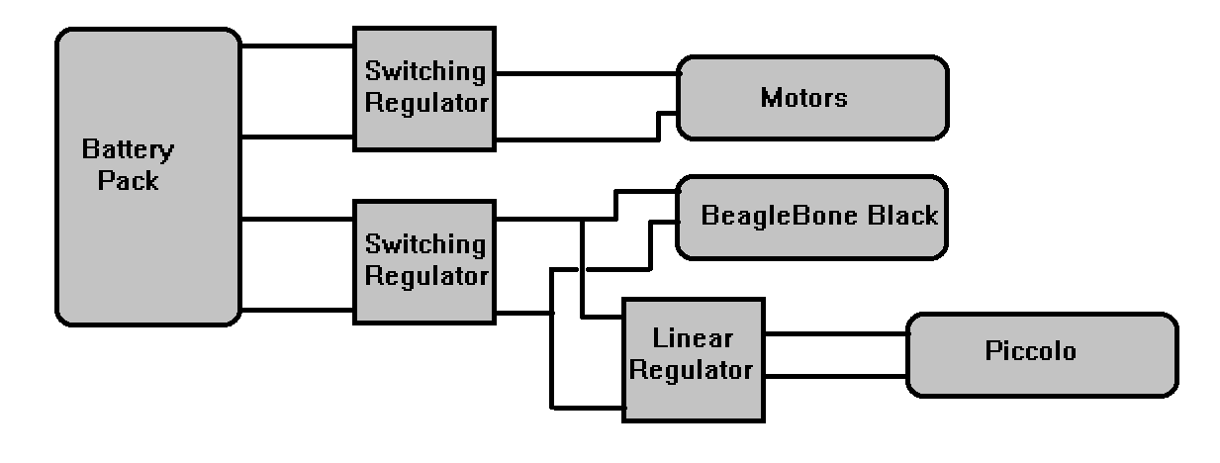
Power - Battery
12.8 V battery pack
Specifics to be determined
Regulated to operating voltages

Slide 13
Power – Voltage Regulation
3 separate voltage regulators
TPS73233
2x ADP2303ARDZ-5.0-R7
Part Number | TPS73233
Manufacturer | Texas Instruments
Input Voltage (Min/Max) | 1.7 V / 5.5 V
Output Voltage | 3.3 V
Quiescent Current | 0.4 mA
Dropout Voltage | 40 mV
Output Capacitor Type | None or Ceramic
Part Number | ADP2303ARDZ-5.0-R7
Manufacturer | Analog Devices, Inc.
Input Voltage (Min/Max) | 3 V / 20 V
Output Voltage | 5 V
Maximum Output Current | 3 A
Efficiency | >90% for Output Current >500 mA

Slide 14
Motion
Tilt
Servo
Microphone
Pan
Motor
Image Sensor
Webcam
MCU
BeagleBone
Black
Laptop
Battery

Slide 15
Motion
Pan/Tilt Assembly
Tilt Servo
Standard size RC servo
Pan Motor
Integrated encoder

Slide 16
Control
Tilt
Servo
Microphone
Pan
Motor
Image Sensor
Webcam
MCU
BeagleBone
Black
Laptop
Battery

Slide 17
Control - MCU
TI Piccolo MCU
TMS320F28069PNT

Slide 18
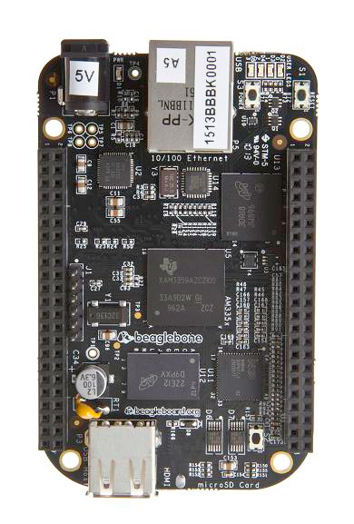
Control – BeagleBone Black
BeagleBone Black
AM3359
ARM Cortex 8
1 GHz clock rate
SPI to MCU
RS232 from Image Sensor
USB to Laptop

Slide 19
Software

Slide 20
Administrative - Budget
Category | Type/Subcomponent | Estimated Quantity | Estimated Price | Estimated Total
Circuit board:
 | PCB | 1 | $30.00 | $30.00
 | Processor | 1 | $15.00 | $15.00
 | Memory Component | 1 | $10.00 | $10.00
 | Cables | 2 | $20.00 | $40.00
 | PCB Components | 1 | $50.00 | $50.00
Pan/Tilt:
 | Pan/Tile Base | 1 | $25.00 | $25.00
 | Servo Motor | 1 | $9.00 | $9.00
 | Pan Motor | 1 | $20.00 | $20.00
Input devices:
 | Microphone | 1 | $55.00 | $55.00
 | Embedded camera | 1 | $55.00 | $55.00
 | Webcam | 1 | $30.00 | $30.00
Shipping:
 | Shipping Total | 1 | $50.00 | $50.00
 |  |  |  | $339.00

Slide 21
Administrative - Progress

Slide 22
Current Plans
Order Components
PCB & components
Battery
Tilt Servo
Microphone
Image Sensor
Pan/Tilt Assembly
Build Base
Testing

Slide 23
Q&A
Tilt
Servo
Microphone
Pan
Motor
Image Sensor
Webcam
MCU
BeagleBone
Black
Laptop
Battery

