Slide 1
Maze Twinbots
Group 28
Uyen Nguyen – EE
Ly Nguyen – EE
Luke Ireland - EE

Slide 2
Project Goals and Objectives
Create a team of maze solving robots that find the optimal solution to a maze using two algorithms
Robots must consume low power & be low cost
Robots must communicate via wireless technology
Serve the students as a learning experience on system design and integration

Slide 3
Brief Overview of Maze Solving Algorithms

Slide 4
3D Perfect Maze
No loop
No inaccessible areas
Has exactly 1 solution
Rectangular cells intersect at 90°
Start and exit at the outermost wall

Slide 5
Wall Follower
Left-hand robot
If possible, turn left
Else, go straight
Else, turn right
Else, turn around
Pros
Fast
Require little memory
Always find the exit if there’s one
Cons
Go in a circle if the start or the end points are inside the maze

Slide 6
Hardware Overview

Slide 7
Requirements
Component | Parameter | Value
Battery | Max Voltage | 4.8V
Microcontroller | Min. # of Analog Pins Min. # of Digital Pins Memory Clock Speed | 4 6 >24 kB >= 16 MHz
Motor | Speed Weight Torque | ~50 RPM <50 g >2 kg-cm
Sensor | Measuring Distance | 4-100 cm
Wireless | Range | > 3 m

Slide 8
Motor Selection
Parallax servo
Requires no external control circuit like DC and stepper motors
Doesn’t require modification for continuous rotation
Acquired for free

Slide 9
Servo Specifications
Voltage input: 4-6 V
Maximum current drawn: 140 +/- 50 mA at 6 V in no load condition
Weight: 42.5 g
Speed: 0 to 50 RPM

Slide 10
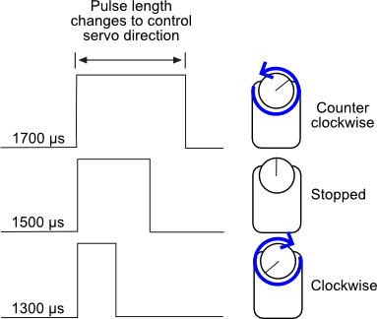
Pulse Width Modulation (PWM)
20 ms delay between pulses
Robots PWM:
  CCW: 1600
  CW: 1400

Slide 11
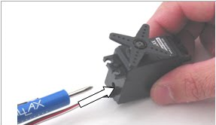
Servo Challenges
Requires multiple calibrations during tests
Servo centering
Lost positional control
  After scanning, front servo doesn’t return to center point
  Requires adjustment every 2-3 turns

Slide 12
Sensors
 | Advantages | Disadvantages | Specification
Ultrasonic | Not affected by colors, rain or dust | Can cross-talk with other ultrasonic sensors if not positioned properly | Voltage: 5 V Current: 15 mA Range: 2cm – few meters
Infrared | Cheap, low power | Can’t detect objects that are too close Cross interference | Voltage: 5V Current: 12 mA Range: 4cm – 30cm

Slide 13
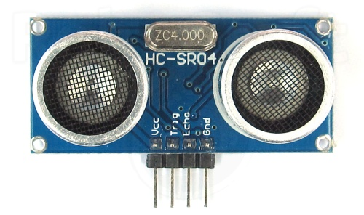
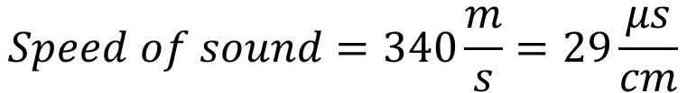
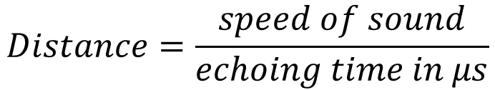
Ultrasonic sensor HC-SR04
$$Speed of sound=340\frac{m}{s}=29\frac{μs}{cm}$$
$$Distance=\frac{speed of sound}{echoing time in μs}$$

Slide 14
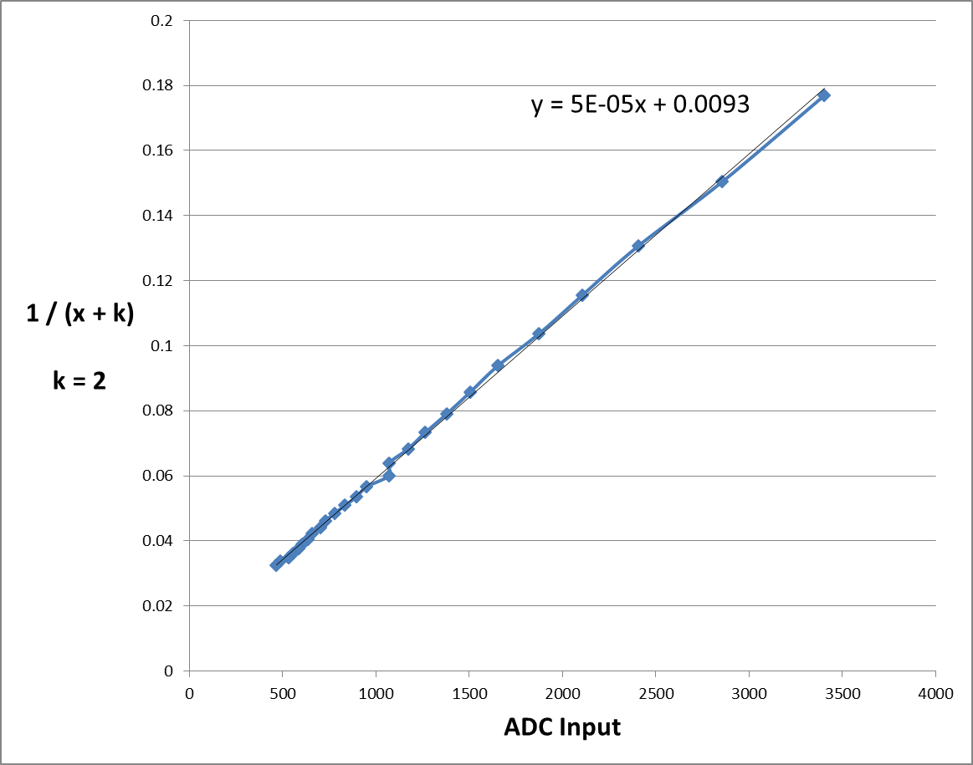
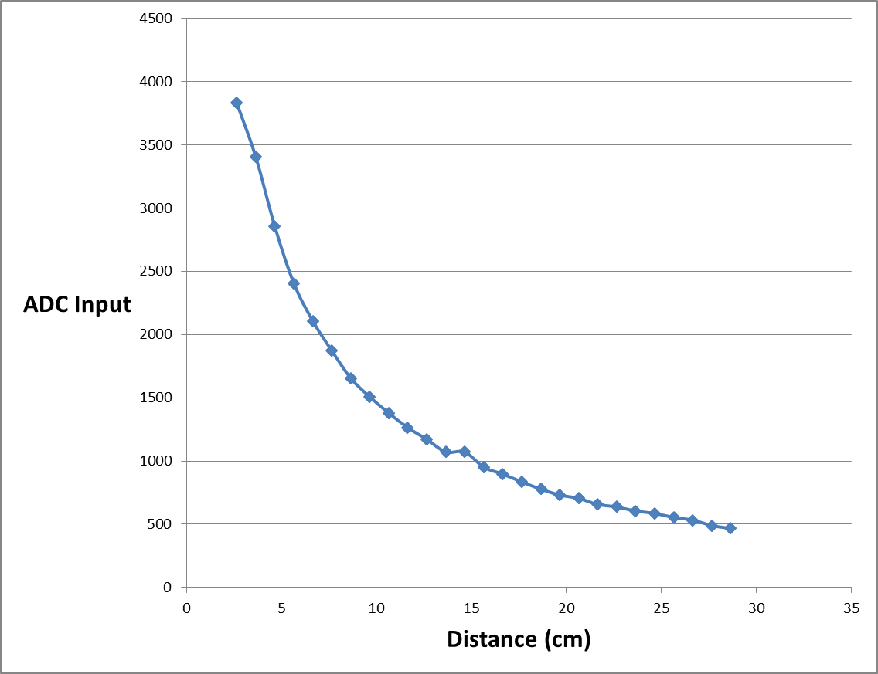
Linearize Sharp IR sensor

Slide 15
Microcontroller Selection:
MSP430F5529
Coincides with low power goals of the project
More than enough I/O pins (Analog and Digital)
All team members are familiar with it, LaunchPads available for prototyping
Plenty of documentation and support, E2E community
Energia IDE for programming
High enough clock speed for quick data processing (25MHz)
128 kB of memory to store program

Slide 16
Communication Decision
Sub-GHz RF
  Same advantages as Bluetooth (low power consumption)
  Has longer range than a 2.4 GHz counterpart (2.4 GHz requires about 8.5 dB additional input power for same range as 900 MHz)
  Could have used Bluetooth for our application since range is not large, team wanted to become familiar with a popular wireless communication technology being used in industry

Slide 17
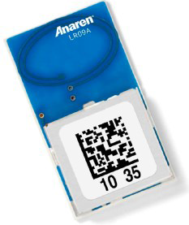
Communication Hardware
Anaren AIR Module
Integrate transceiver and antenna
Small package (9 x 16 x 2.5mm)
900-928 MHz operating frequency
Low power consumption (200 nA sleep mode current consumption , 15 mA in receive)
“Burst transmission” of up to 60 bytes
AIR Module Boosterpack from TI
Interfaces with SPI on MCU for easy configuration
Reprinted with permission from Anaren

Slide 18
Challenges with Communication Hardware
Understanding how to integrate AIR module to MCU
  Had to compare four different sets of documentation to understand what each pin needs
Deciding which pins to use to avoid eliminating UART communication capabilities

Slide 19
System & PCB Design

Slide 20
System Block Diagram
Left Sensor
Middle Sensor
Right Sensor
Battery
Switching Regulator
4.8V
5 V
Left Servo
Right Servo
Sensor data
4.8 V
LDO Regulator
3.3 V
Microcontroller
PWM Signal
PWM Signal
SPI bus data
Radio Module
3.3 V

Slide 21
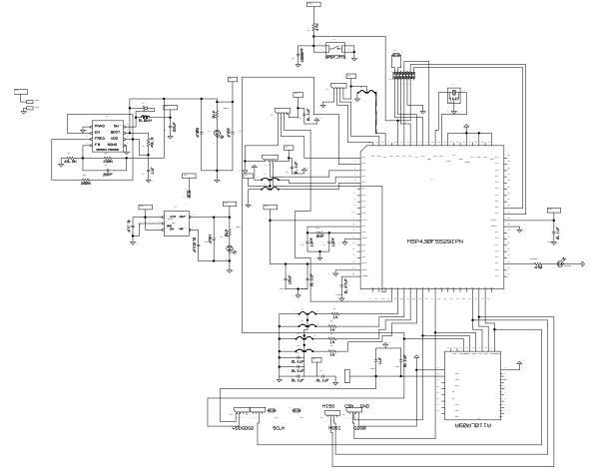
System Schematic

Slide 22
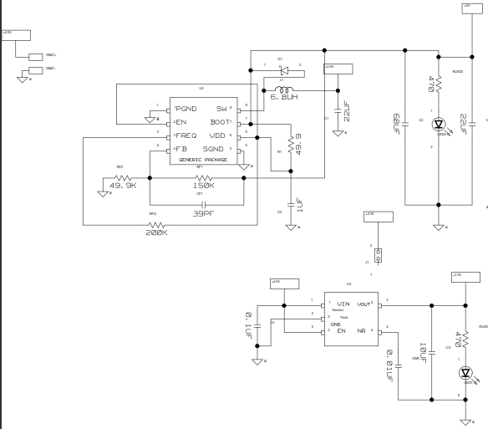
Power Supply

Slide 23
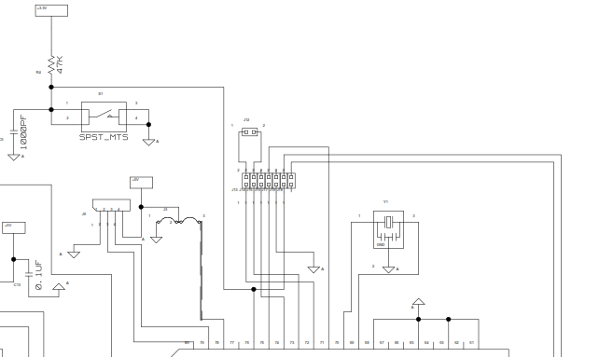
JTAG Interface

Slide 24
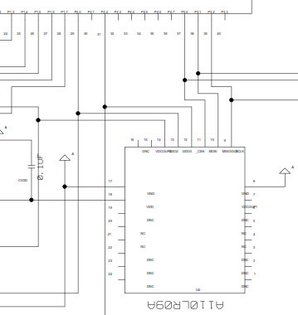
Anaren AIR Module

Slide 25
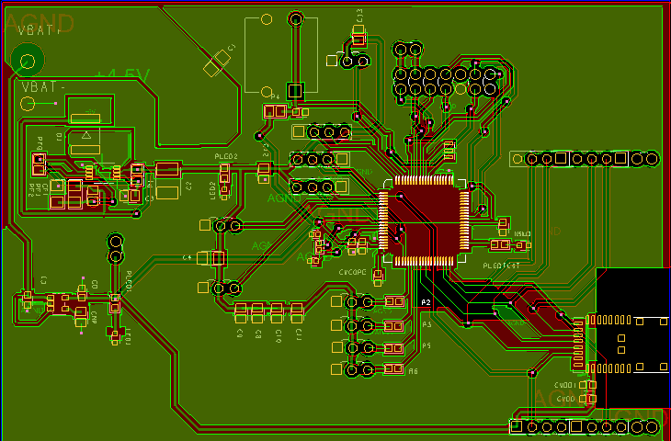
PCB Layout
2.95”
4.5”

Slide 26
Lessons Learned in Hardware Design
Reference designs should be utilized whenever possible
Components that are not necessarily in design libraries can be replicated with multiple components that meet same spacing and size requirements
More is not always better, simplifying a design can save hours in hardware troubleshooting and ease routing
Prototype as much as possible before creating PCB

Slide 27
Navigation Overview

Slide 28
Right-Wall Following
9 – 10 cm
Go straight
< 9 cm
Slight left
> 10 cm
Slight right
Read right sensor
Maintain straight

Slide 29
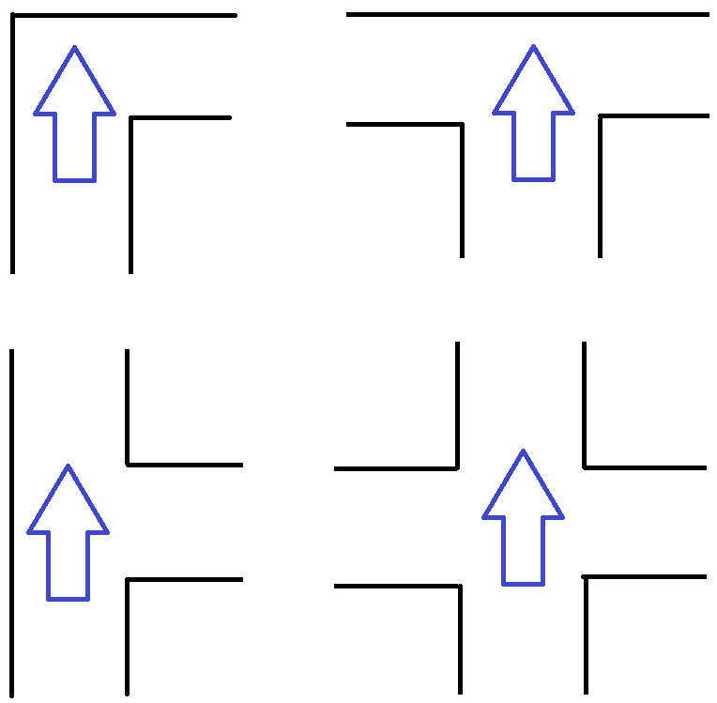
Right-Wall Following
Move up
Turn right 90 °
Move up
Adjust to maintain straight if right > 15 cm
Turn right

Slide 30
Right-Wall Following
Turn left

Slide 31
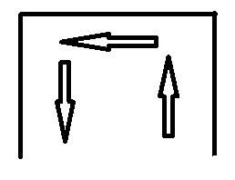
Right-Wall Following
Turn around

Slide 32
Sensors Challenges
Fluctuations when obstacles are far away
  40 cm – 100+ cm
More fluctuations during movement than stop
  Detect false junctions
Doesn’t have a 360° scanning of the environment
  Sometimes hit obstacles
Sensor placement is critical to maintaining straight and turning correctly
Navigation is highly dependent on individual sensors’ performance
Only one front sensor can detect 4-way junction

Slide 33
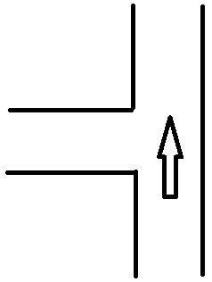
Sensor Challenge Resolutions
Filter out fluctuation by select the lowest value out of 10 samples
Sample every time the previous and next readings differ by 10 cm
Count number of reading jumps to eliminate false -| junction

Slide 34
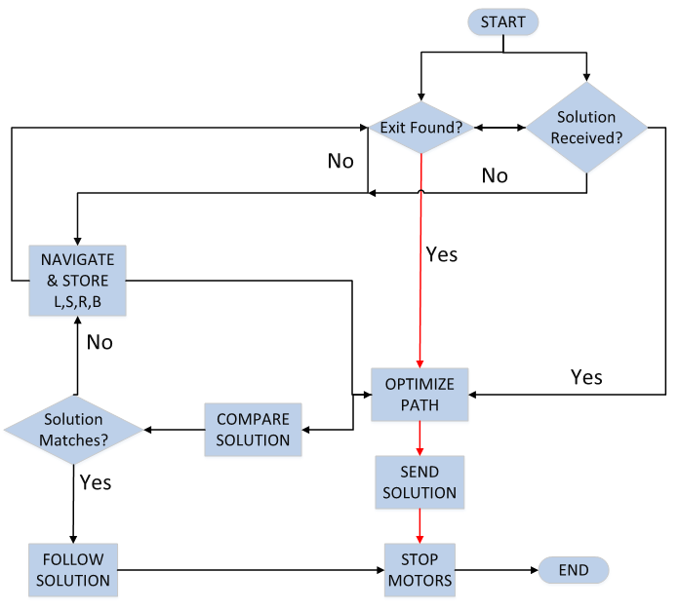
Maze Solving Algorithm Overview

Slide 35
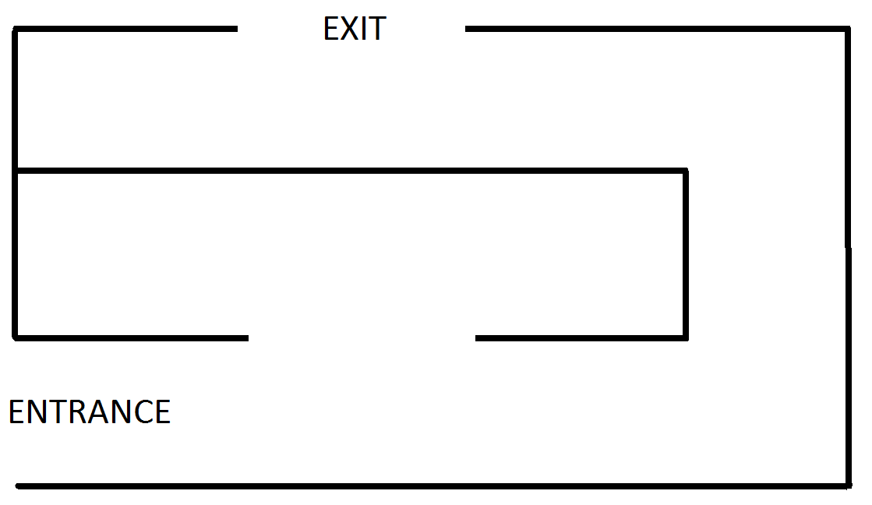
Example Maze

Slide 36
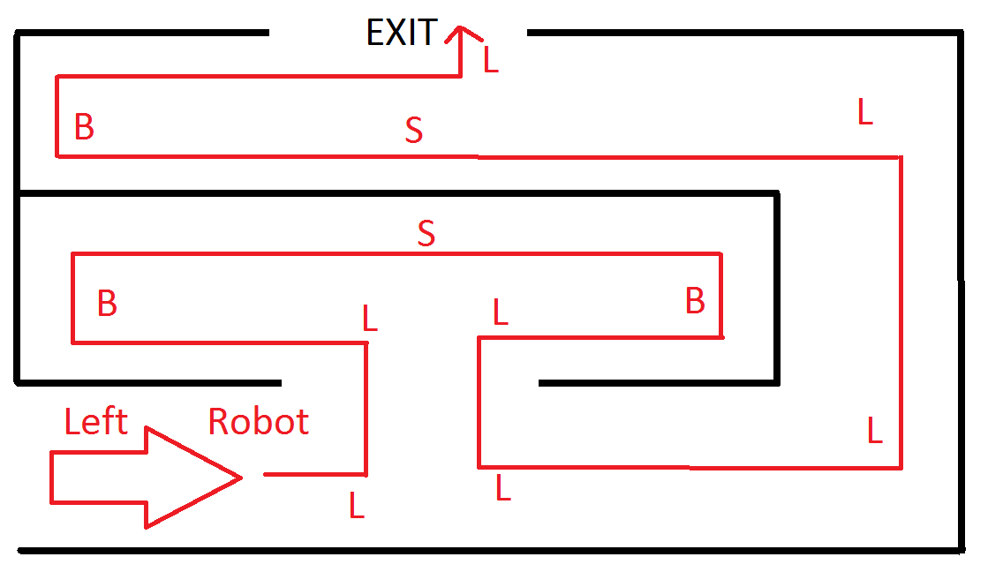
Left Robot Navigation = LLBSBLLLLSBL

Slide 37
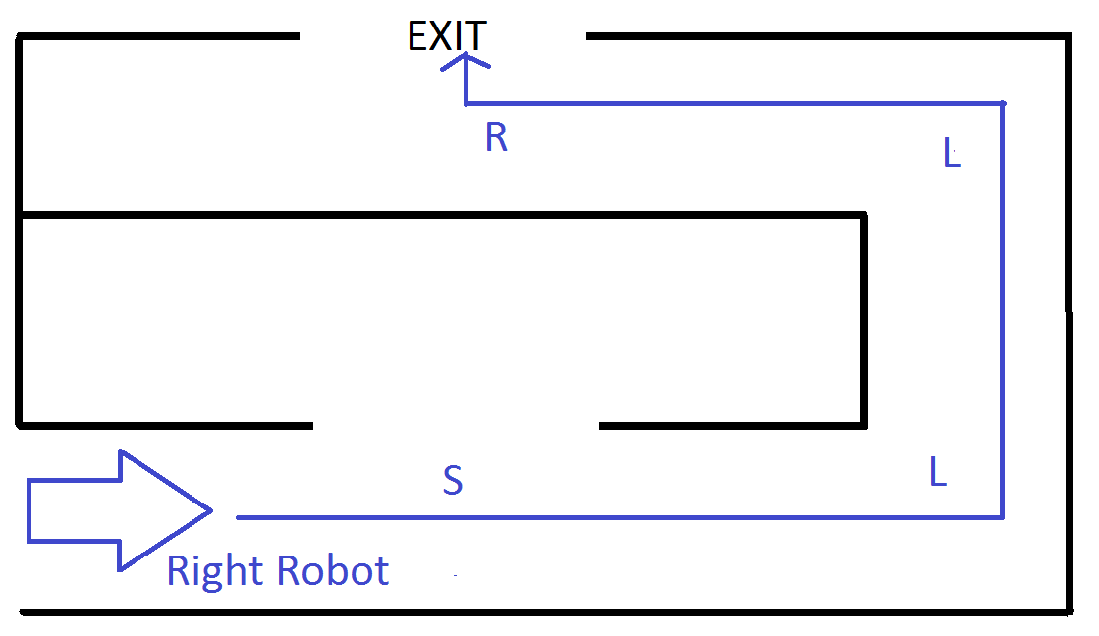
Right robot solution = SLLR

Slide 38

Communication
Transmit SLLR
Right Robot
Left Robot
Send a Y as acknowledgement

Slide 39
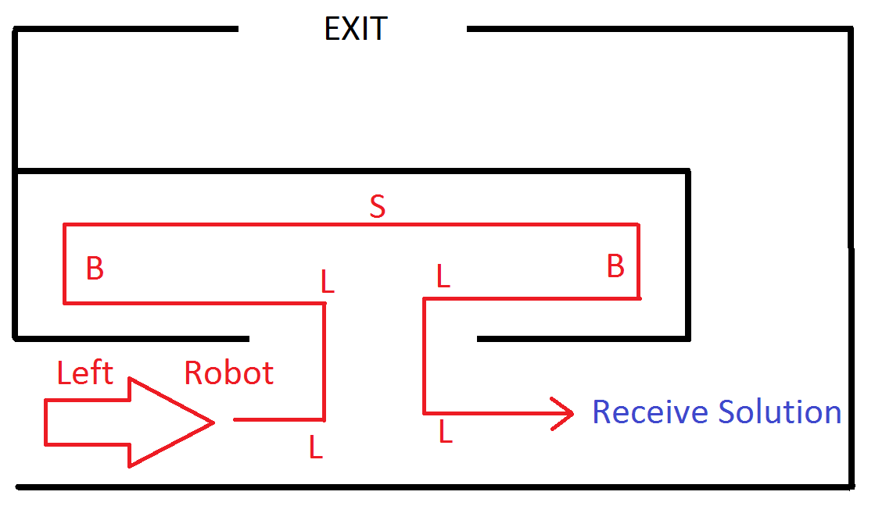
LLBSBLL → LRBLL
LRBLL → LBL
LBL → S

Slide 40
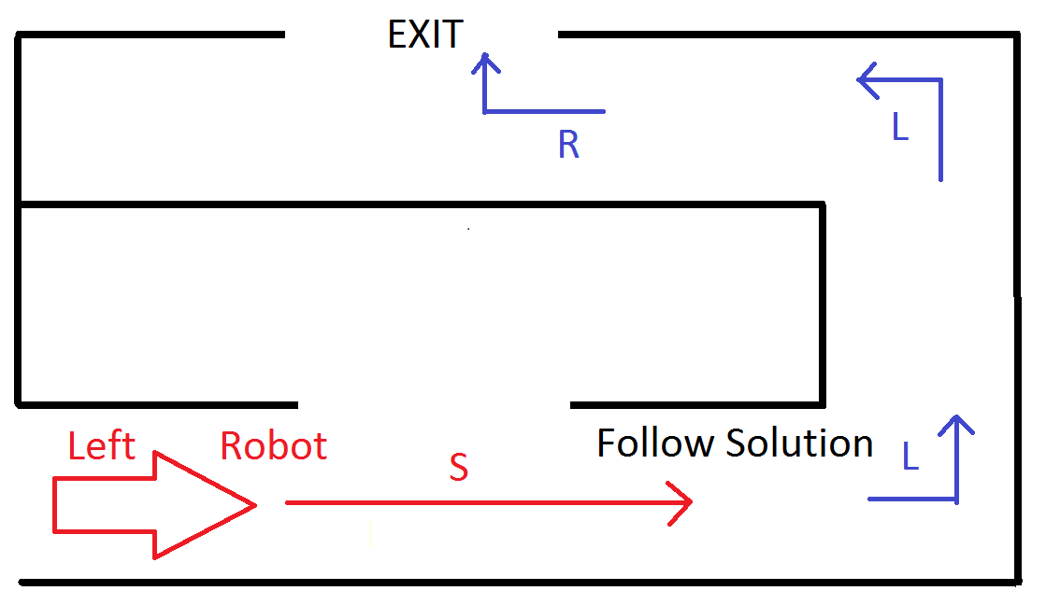
S is compared to solution SLLR
Match!

Slide 41
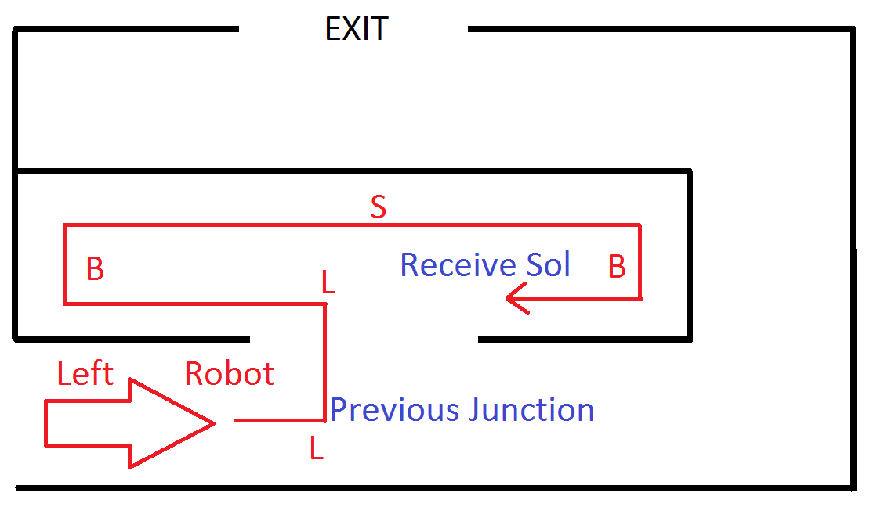
LLBSB → LRB
Compare to solution SLLR
Do Not Match!

Slide 42
Budget
Item | Cost
Jumper Wires | $24.72
13 Ultrasonic Sensors | $22.85
1 Chassis | $12.74
2 Breadboards | $7.98
2 Battery and Charger | $31.94
3 PCBs | $37.85
5 IR sensor cables, 1 sensor bracket | $23.70
Velcro Tape | $4.79
2 Crystals (4 MHz, 32.768 kHz) | $13.04
2 IR Sensor Cables | $13.74
2 Battery Holders | $5.31
6 Radio Modules | $109.93
2 Wheels, Rubber Bands for Wheels, 2 Servos | $43.04
Miscellaneous Components | $192.92
Wood | $27.96
Total | $572.51

Slide 43
Division of Labor
Uyen | Ly | Luke
Maze Solving Algorithm | Initial System Design | System & PCB Design/Layout & Assembly
Sensor Testing | Navigation Implementation | Communication Hardware Testing
 | Motor Testing

Slide 44
Questions?

