Slide 1
Maze Twinbots
Group 28
Uyen Nguyen – EE
Ly Nguyen – EE
Luke Ireland - EE

Slide 2
Project Goals and Objectives
Create a team of maze solving robots that find the optimal solution to a maze using two algorithms
Robots must consume low power
Robots must be low cost
Robots must communicate via wireless technology

Slide 3
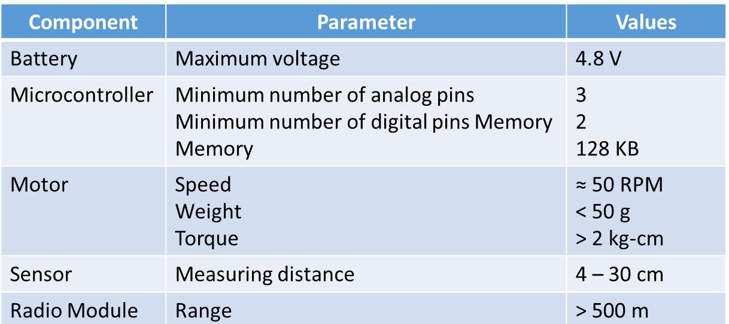
Specifications

Slide 4
Motor Selection
 | Stepper Motor | Servo Motor | DC Motor
Pros | Ideal for positional control | Precise and quiet | Ideal for speed control
 | Requires no tuning | Available in several standard sizes
Cons | Slow and noisy | Requires tuning | Requires an H bridge
 | Requires an external control circuit Limited sizes | Rotate up to 180° but can be modified for continuous rotations

Slide 5
Microcontroller Selection:
MSP430F5529
Coincides with low power goals of the project
More than enough I/O pins (Analog and Digital)
All team members are familiar with it
Plenty of documentation and support
Energia IDE for programming

Slide 6
Different Communication Methods
Wi-Fi- connection can be made anywhere that has internet access, however, this frequency and is highly susceptible from interference
Bluetooth- Low power, efficient, lots of support, however, has shorter range due to low power output in transmit
Sub-GHz- Low Power, farther range than 2.4 GHz, less noise in utilized frequency band

Slide 7
Communication Decision
Sub-GHz RF
  Same advantages as Bluetooth (low power consumption)
  Has longer range than a 2.4 GHz counterpart (2.4 GHz requires about 8.5 dB additional input power for same range as 900 MHz)

Slide 8
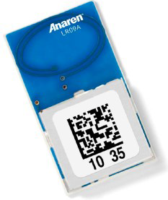
Communication Hardware
Anaren AIR Module
Integrate transceiver and antenna
Small package (9 x 16 x 2.5mm)
900-928 MHz operating frequency
Low power consumption (200 nA sleep mode current consumption , 15 mA in receive)
“Burst transmission” of up to 60 bytes
AIR Module Boosterpack from TI to use for prototyping
Interfaces with SPI on MCU for easy configuration

Slide 9
Challenges with Communication Hardware
Understanding how to integrate AIR module to MCU
  Had to compare four different sets of documentation to understand what each pin needs
Deciding which pins to use to avoid eliminating UART communication capabilities

Slide 10
Sensors
 | Advantages | Disadvantages
Magnetic | Operate at high frequency | Affected by external magnetic fields
Capacitive | Cheap, low power | Affected by temperature and humidity
Inductive | Accurate, high switching rate | Cannot detect non-metallic objects
Ultrasonic | Not affected by colors, rain or dust | Affected by air movements
Infrared | Cheap, low power | Can’t detect objects that are too close Cross interference

Slide 11
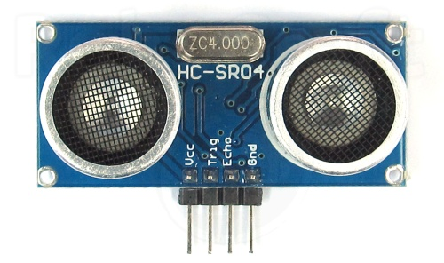
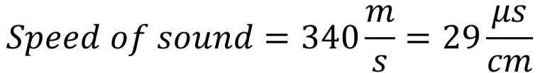
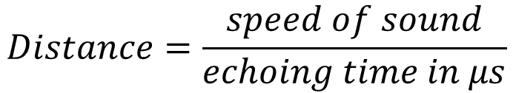
Ultrasonic sensor
$$Speed of sound=340\frac{m}{s}=29\frac{μs}{cm}$$
$$Distance=\frac{speed of sound}{echoing time in μs}$$

Slide 12
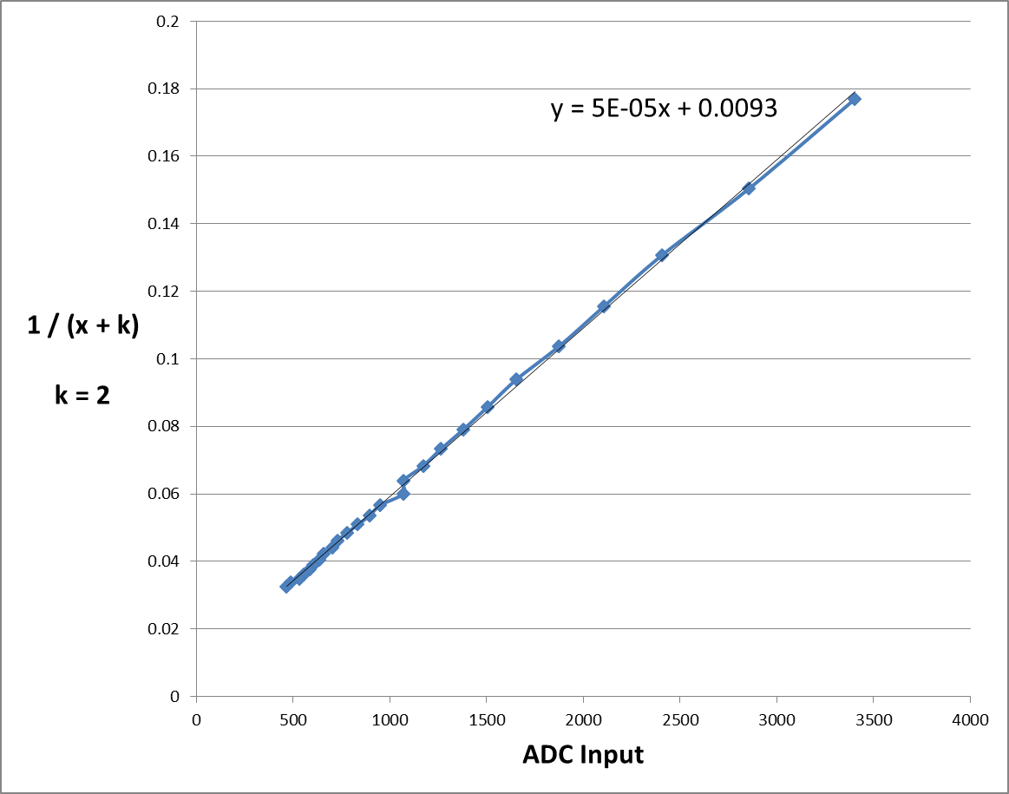
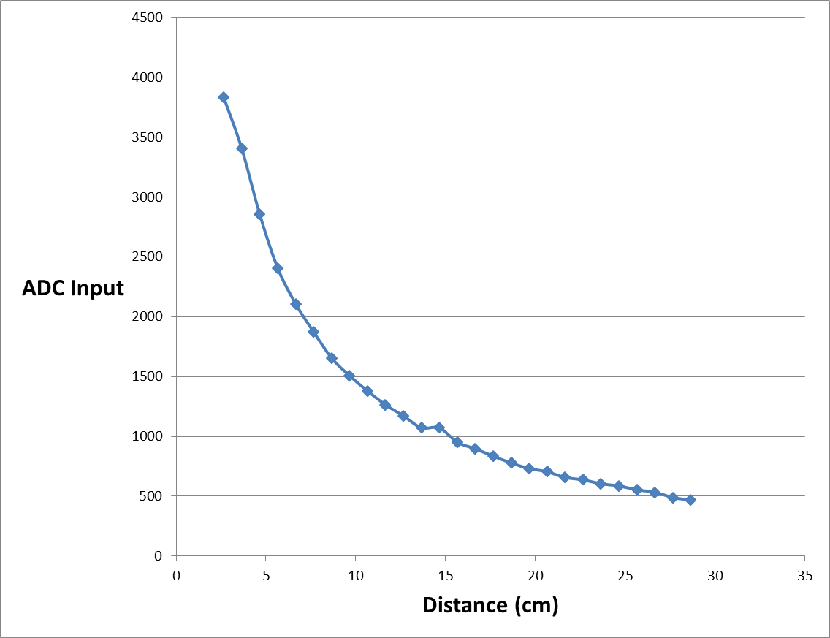
Linearize IR sensor

Slide 13
Dead End Filler
Good
Fast
Requires little memory
Bad
Cannot be used to solve the maze

Slide 14
Trémaux’s algorithm
Good
Prevent robot going in circle and visiting the same place more than twice
Bad
Need some sort of marking mechanism

Slide 15
Pledge Algorithm
Good
Require little memory
Bad
Not compatible with the maze structure

Slide 16
Wall following method
Good
Fast
Require little memory
Always find the exit if there’s one
Bad
Go in a circle if the start or the end points are inside the maze
If possible, turn left
Else, go straight
Else, turn right
Else, turn around

Slide 17
System Block Diagram
Left Sensor
Middle Sensor
Right Sensor
Battery
Switching Regulator
3.6 V
5 V
Left Servo
Right Servo
Sensor data
3.6 V
LDO Regulator
3.3 V
Microcontroller
PWM Signal
PWM Signal
SPI bus data
Radio Module
3.3 V

Slide 18
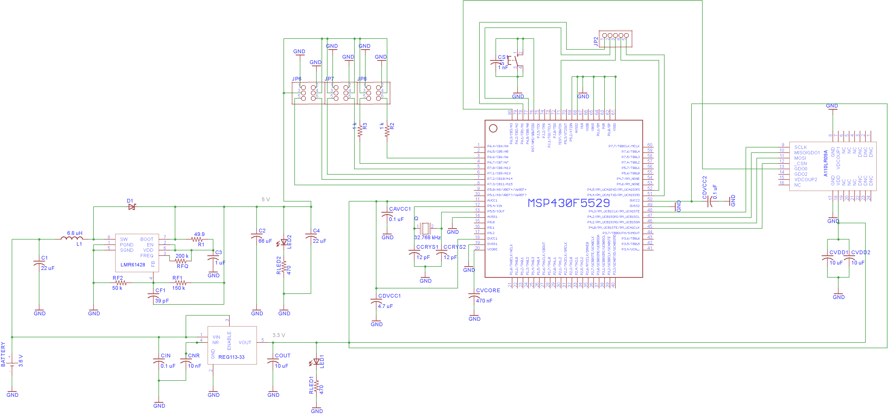
Schematic

Slide 19
Schematic
POWER REGULATION

Slide 20
Schematic

Slide 21
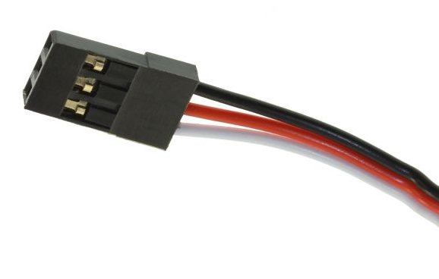
Schematic
SERVOS AND SENSORS HEADERS

Slide 22
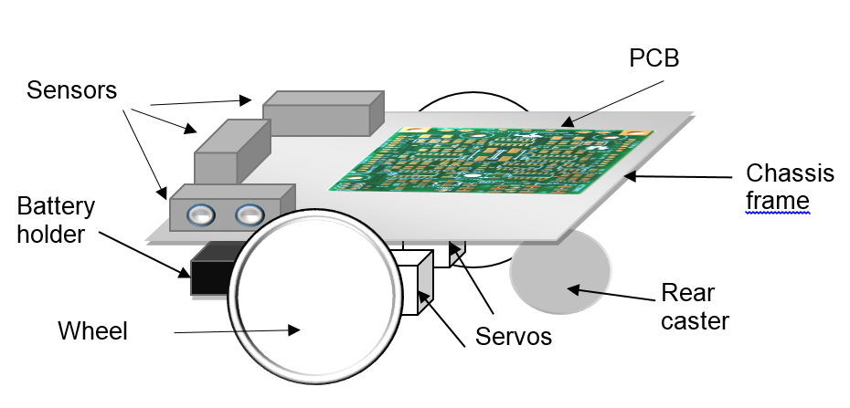
Robot Model

Slide 23
Maze Construction
One optimal solution
Walls will be approximately 8 inches tall
Pathways will be wide enough for robot to fully turn around
Maze will be made of wood and be reconfigurable

Slide 34
Budget

Slide 35
Division of Labor
Uyen | Ly | Luke
Sensor Integration | PCB Design/Layout | Communication Hardware
Maze Solving Algorithm | Hardware Integration | Maze Construction/Design
Software Integration | Motor Integration | PCB Assembly

Slide 36
Progress

