Slide 1
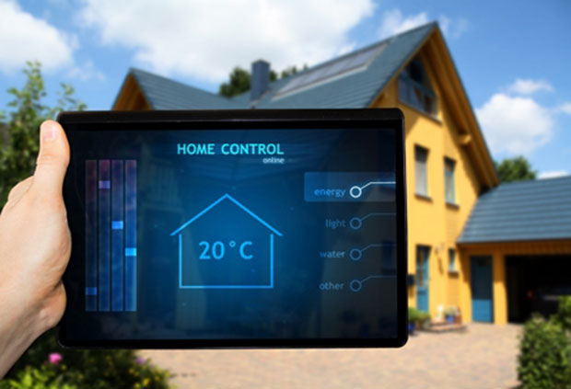
Group #26
Shawn Mahon Dennis Moy Junhao Liang
Sponsored by:
Duke Energy Leidos Texas Instruments Anaren

Slide 2
Project Description
The “Cool Roommate” system will be a third party, A.I. system, capable of controlling temperature environments using household infrastructure
Consists of four units
Master Controller (Thermostat)
3 Slave Controllers (Fan, Vents, and Blinds)
Units will be automated, and will read in data to adjust environments.

Slide 3
Goals
To maximize energy efficiency
Provide target climate control
Have automated response from system, to watch your house while you are away
Ideal for a variety of users

Slide 4
Objectives
Master Controller (Powered by Tiva C)
Evaluate current temperature conditions.
Actively monitor temperature conditions and response will be from requested user input
Specify “target” zones so a user can be able to focus on specific rooms to combine efficiency with specificity.
Transmit data to slave controllers to operate
Slave Controllers (Powered by MSP430)
Operate on command from Tiva C
Have automotive response to perform action
Wirelessly receive instructions from Master Controller.

Slide 5
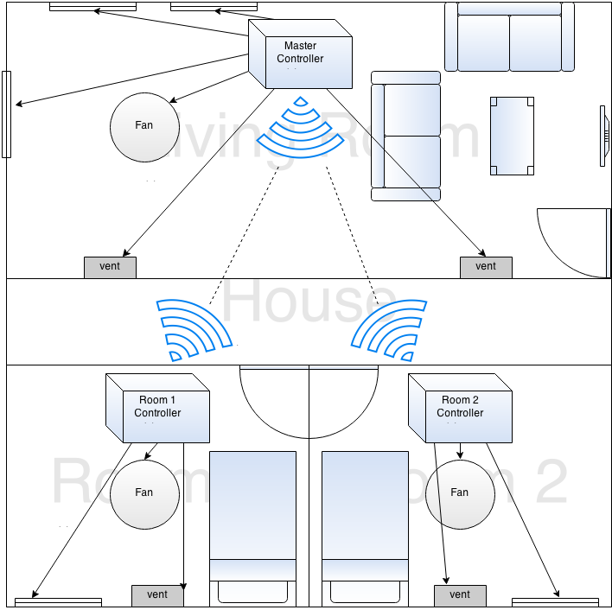
Physical Layout

Slide 6
Cool Roommate
Each function is independent and controlled by the Tiva C.
The Tiva C also takes feedback from the MSP430’s temperature sensors and send different signals to each control according to the reading.
Ex: Room is too hot, so it focuses the air circulation to cool off the room.
Slave controllers are not capable of communicating between each other. All messages are passed through the master.

Slide 7
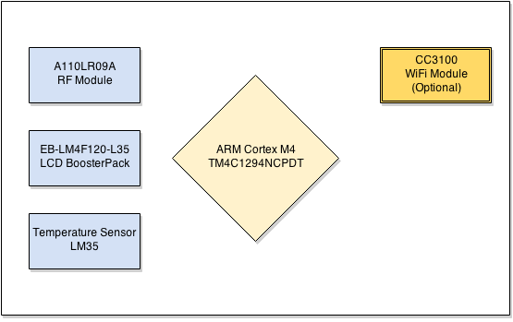
Hardware for Deliverables
Cortex M4 TM4C1294NCPDT
RF Module
LCD Display
Temperature sensor
Wi-Fi module (Optional).

Slide 8
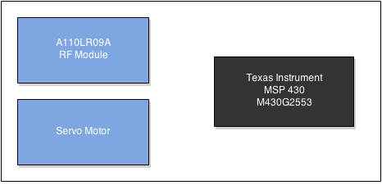
Cool Roommate Subsystem
RF Module MSP430 Servo Motor (Task Pending)

Slide 9
Choosing temperature sensor
 | LM35 | INA330 | TMP006
Supply Voltage Range | +4V to +20V | +2.7V to +5.5V | 2.2 V to 5.5 V
Operating Temperature Range | -55°C to 150°C | –40°C to +85°C | –40°C to +125°C
Typical Accuracy | ±1⁄4˚C | 0.009°C | ±0.5°C
Pin Count | 3 | 10 | 8
Price | $5.00 | $4.95 | $4.33
Notes:
LM 35 was free.

Slide 10
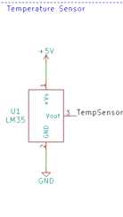
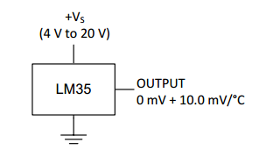
Thermometer Sensor
To receive the output for controllers to read and react.
High precision temperature sensors factory calibrated with a typical accuracy of ±1⁄4˚C.
Notes:
Advantages
Wide input range typically 4V to 20V
Typical accuracy of ±1⁄4˚C
Low cost
Rated operating range of −55˚ to +150˚C
Available in a variety of packages
Free courtesy of Texas Instruments

Slide 11
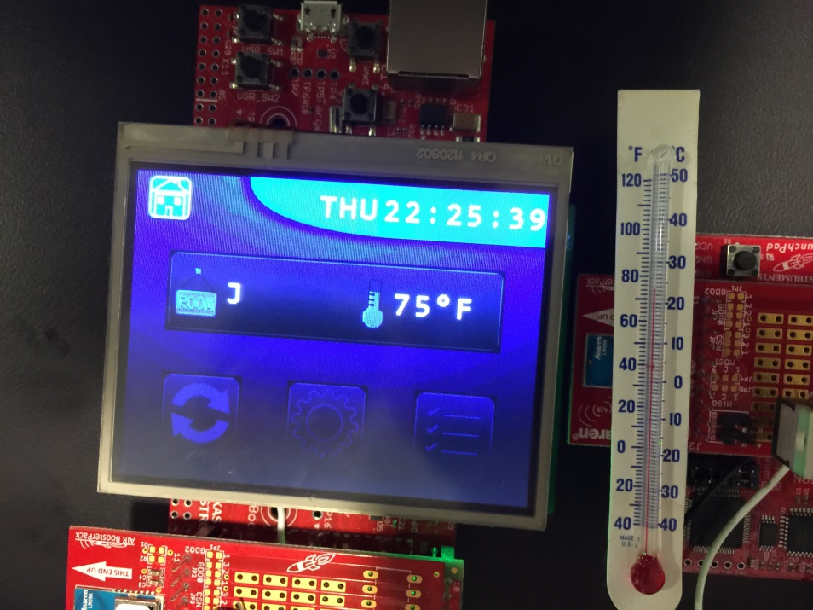
LM35 Implementation Test
$℃=\frac{V_{ref}∗V_{A}∗ratio}{resolution}$
$V_{ref}=3.3V$
$V_{A}=Raw Input Value to MCU$
$ratio=10\frac{mV}{℃}$
$resolution=1024$
The output voltage changes based on temperature

Slide 12
Vent Automation
Opted to purchase an automated vent from Vent-Miser.
As a result, resources and the budget had limited impact.
Mechanical issues avoided
Vent-Miser

Slide 13
Design Approach
Keep the system simple
Maximize efficiency and focus of product
Plug-N-Play design
Achieve precision and accuracy with sensors
LM35 is within 2% accuracy
Servos selected to maintain precise movements, know position at all times
Low Power to not overwhelm resources
Power Supply averages 78% efficiency
Notes:
Need formulas

Slide 14
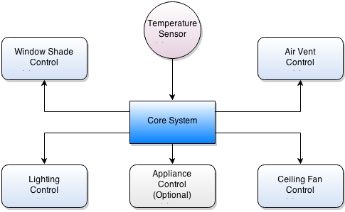
Core System Block Diagram
Notes:
Micro Controller CK

Slide 15
MicroController
 | Device | Flash | Pin Count | Max Frequency | RAM | CPU | Max I/O pins | SPI | Temp. Sensor | Min VCC | Max VCC | Active Power (μA/MHz) | Standby Power (μA) | Operating Temperature Range (ºC) | Package |  |  |  | Price
32-bit AVR UC3 | AT32UC3L032 | 32 Kbytes | 48 | 50 MHz | 16 Kbytes | 32-bit AVR | 17 | 5 | Yes | 1.62 V | 3.6 V | 165 | 0.6 | -40 to 85 | 48-pin TQFP/QFN/TTLGA |  |  |  | $9.07
megaAVR | ATmega328P | 32 Kbytes | 32 | 20 MHz | 2 Kbytes | 8-bit AVR | 23 | 2 | Yes | 1.8 V | 5.5 V | 200 | 0.75 | -40 to 85 | 28-pin PDIP | 32-lead TQFP | 28-pad QFN/MLF | 32-pad QFN/MLF | $4.21
MSP430 | MSP430G2553IN20 | 16 Kbytes | 20 | 16 MHz | 512 Bytes | 16-bit MSP430 | 16 | 1 | Yes | 1.8 V | 3.6 V | 330 | 0.7 | -40 to 85 | 32VQFN | 20TSSOP | 28TSSOP | 20PDIP | $3.64
Notes:
CK

Slide 16
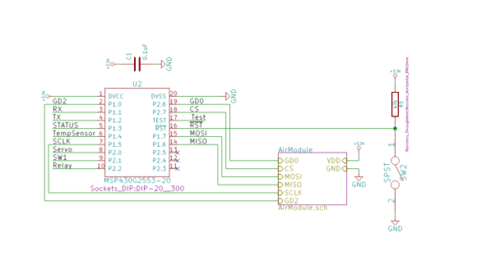
Slave Controller
Notes:
Capacitor is a low pass filter, suppress noise and block out high freq. The reset pin requires a resistor. Active Low reset. The switch is tethered to ground, so when the switch connects it becomes low. CK

Slide 17
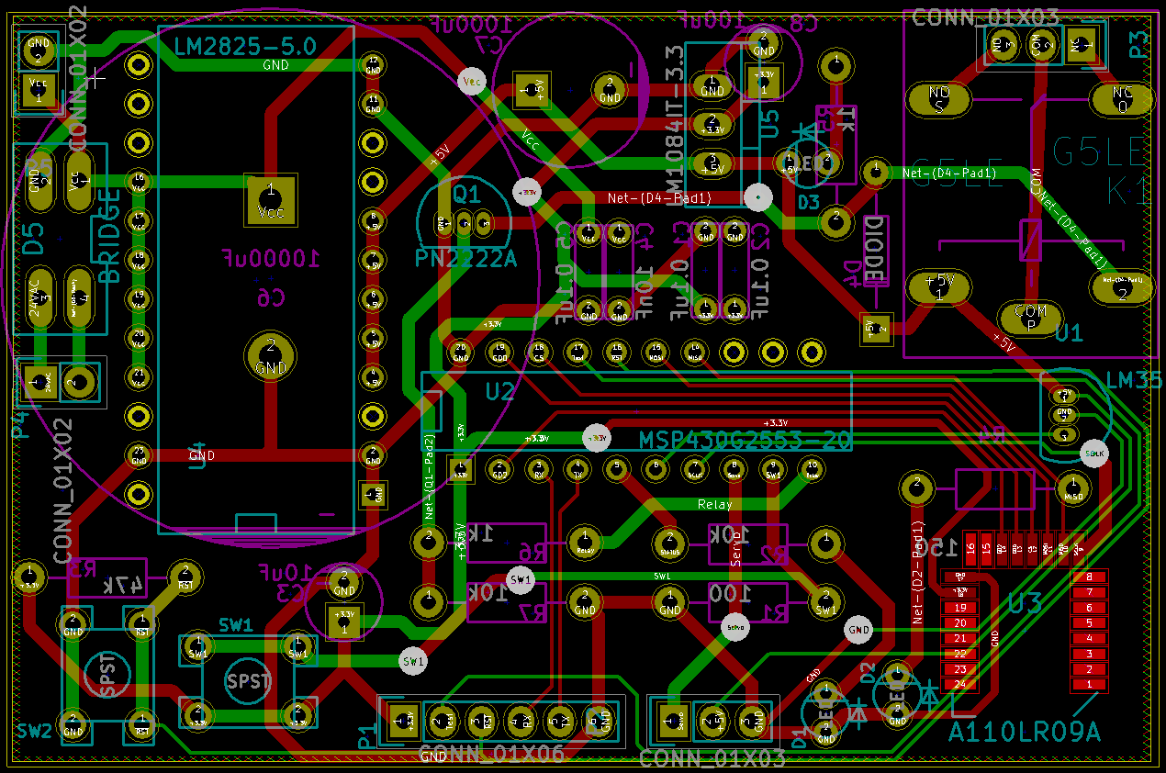
Notes:
CK

Slide 18
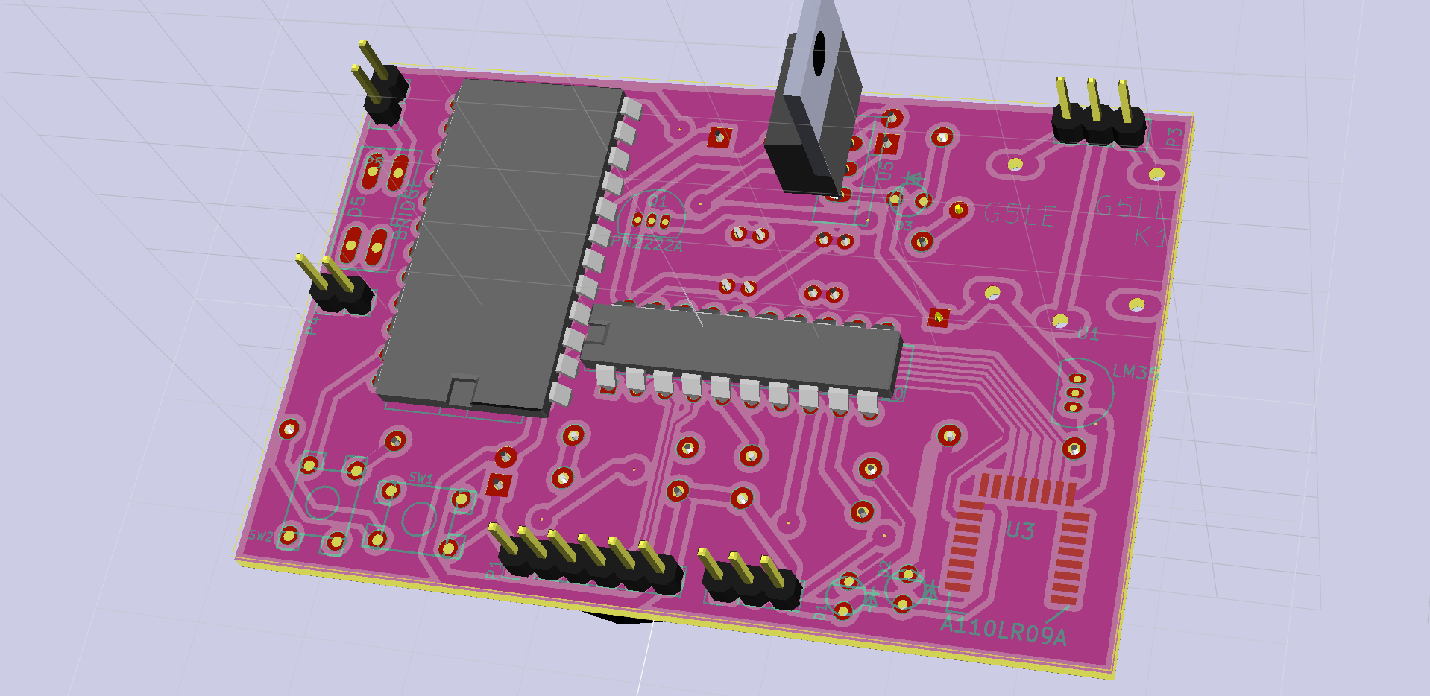
Notes:
CK

Slide 19
Liquid Crystal Display
Separate unit from the MCU
Attached to Tiva C
Plug-N-Play capabilities
Simplifying the need for parts and reducing load on integration
Less maintenance
Notes:
Dennis

Slide 20
Design Implementation
Notes:
Dennis

Slide 21
Design Implementation
3D printed a turn key for the vent.
Will be connected to servo that will receive commands
Tested and Working
Still need to integrate!
Notes:
Dennis

Slide 22
Blinds Integration

Slide 23
Notes:
Dennis

Slide 24
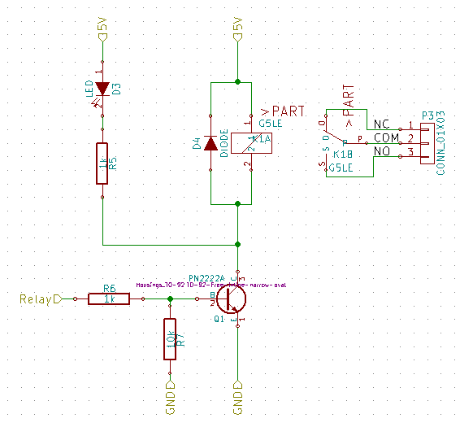
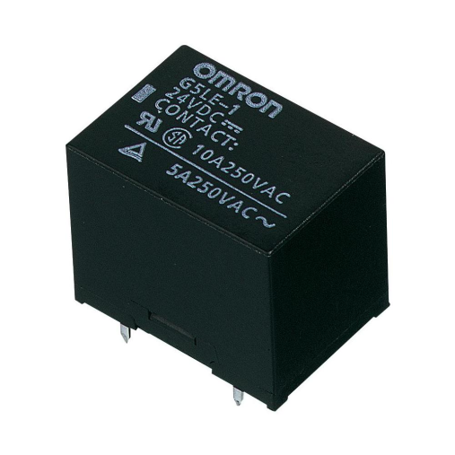
Relay for fan
Rating
Single-Pole Single-Throw
10A contact
5V coil
100mΩ max contact resistance
Notes:
Need a higher current relay because devices may be directly connected to the wall. Within the scope of the project to design efficiently and can allow for 300V. Have a light to show on and off. Diode is in reverse bias to protect the rest of the circuit. Typical applications include home appliances and vending machines.
Dennis

Slide 25
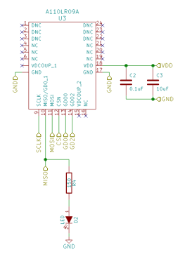
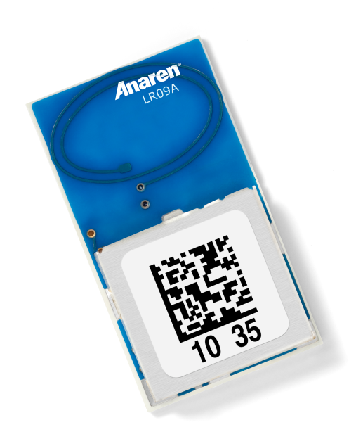
RF Wireless
A low-power wireless transceiver compatible with the MSP430 microcontroller
Advantages
Low power consumption
Low Cost
ISM Bands at 868/915MHz
Notes:
ISM Bands beneficial because it is in an uncongested frequency, better to pass through walls than the standard 2.4GHz
Dennis

Slide 26
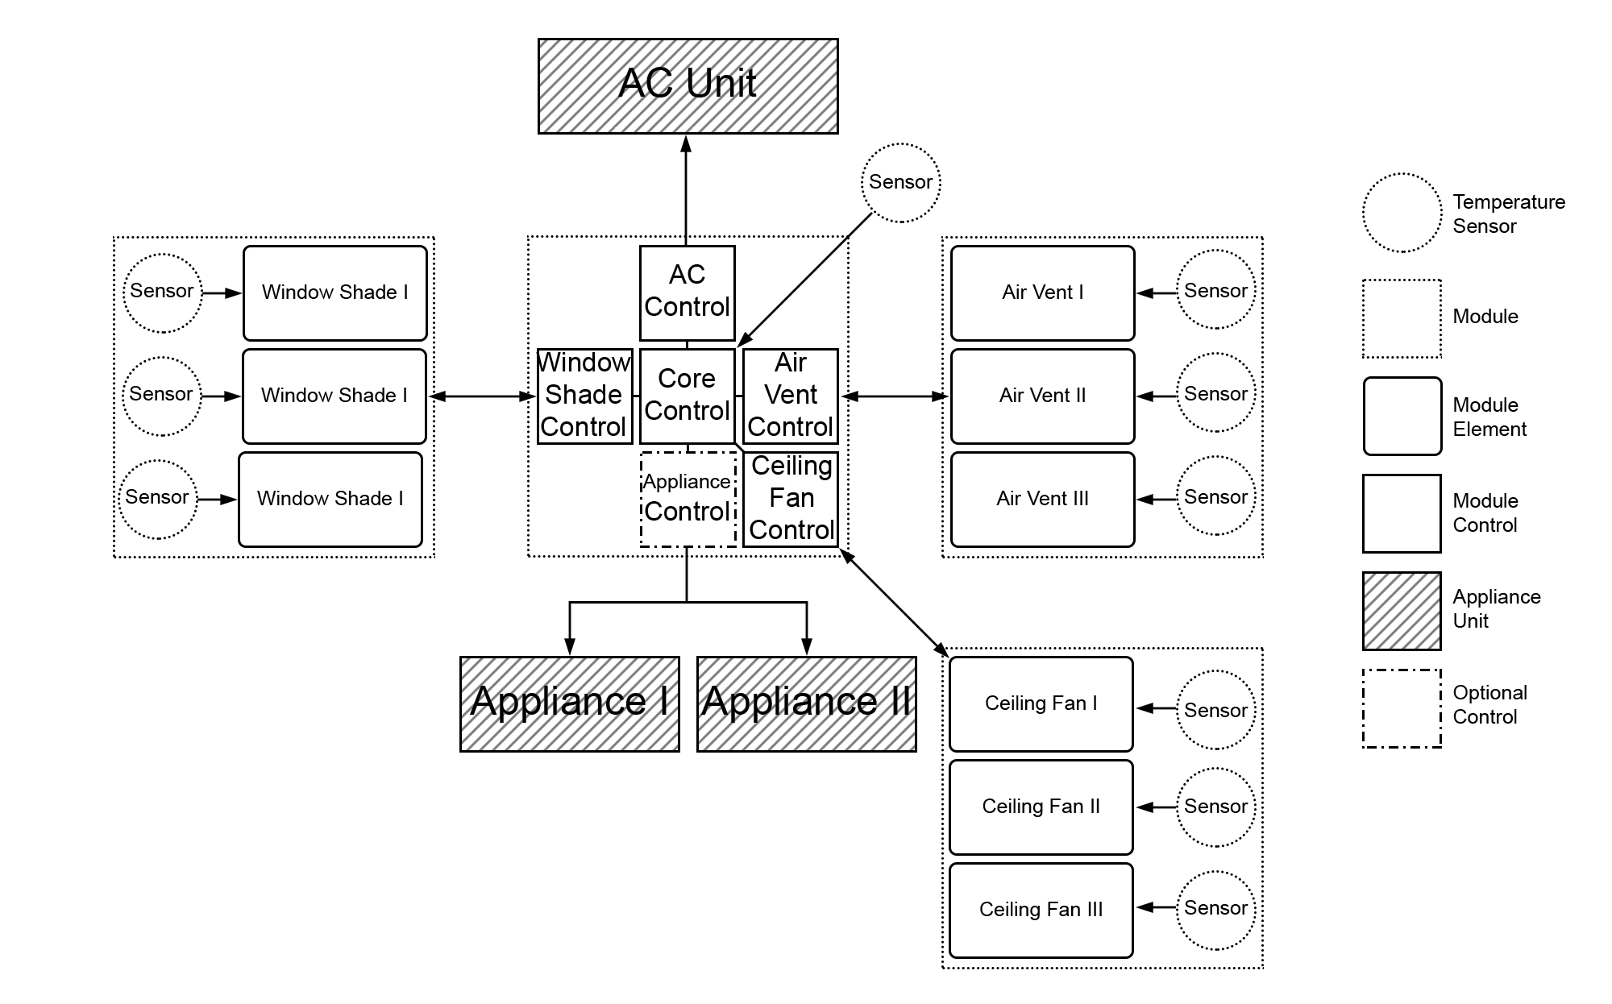
Notes:
Dennis

Slide 27
Development Environments
Language: C/C++
Testing: Energia
Implementation: Energia
Wireless: Unlicensed ISM Band 868/915MHz
Schematics: KiCad EDA
Notes:
CK

Slide 28
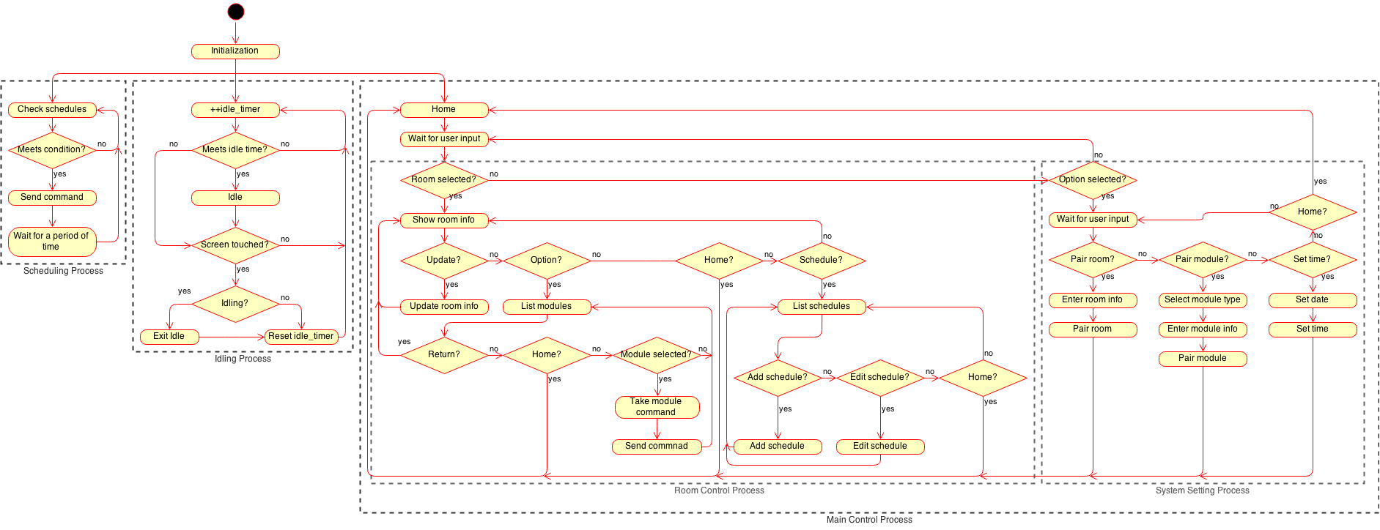
MCU Master Flowchart
Notes:
CK

Slide 29
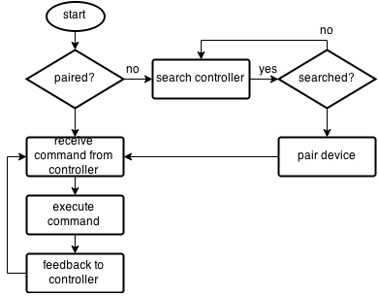
MCU Slave Flowchart
Notes:
CK

Slide 30
Tiva C Schematic
Notes:
CK

Slide 31
Relay Board
Notes:
Fan, Heat, and Cool each relay

Slide 32
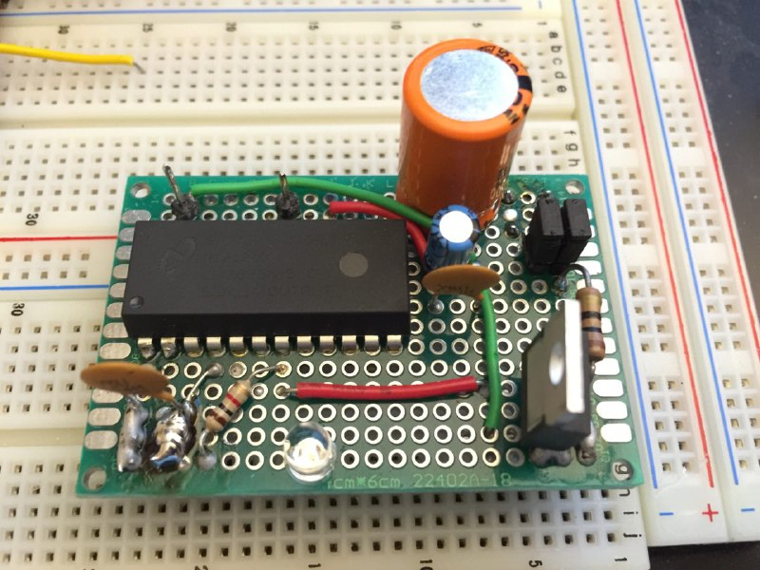
Power Management
Wide input range
4-40V DC input or 6-24V AC
5V 1A Output
Supply to LCD and Relays
3.3V 1.5A Output
MCU,RF transceiver, and other sensor units
Linear regulator improves efficiency
Notes:
The 3.3V is tethered to the 5V power rail, therefore limiting the output capabilities of the 3.3 rail to 5Watts. Data sheet for 3.3v suggests a 3Amp capability
CK

Slide 33
Low Voltage Power Supply
Notes:
CK

Slide 34
Voltage Ripple
Voltage ripple across the output power rails is currently
5V power rail has approximately 28mV ripple effect
3.3V power rail has approximately 24mV ripple effect
Notes:
If swing is too high, such as a one volt ripple can create a lot of noise as well as create an unwanted voltage swing.
CK

Slide 35
Current Market
Scalable
Efficient
Cost Effective
Future Growth Capabilities
Hard to integrate
Sacrifice quality for price
Advantages
Disadvantages
Notes:
shawn

Slide 36
Remaining Tasks
Finish Tiva C PCB Design
Order Board
Debug Debug Debug
Integration and Test
Notes:
shawn

Slide 37
Progress
Notes:
shawn

Slide 38
Budget
Current budget
Predicted spending
Subsystem
PCB | $25.55
Vent-Miser (2) | $15.11
Circuit Equipment | $57.97
Blinds | $25.88
Pizza and Steak | $1015.49??
Total | $124.51
Part | Quantity | Total
MCU | 4 | $100.00
Wireless Module | 4 | $100.00
PCB | 4 | $80.00
Sensors | 4 | $80.00
Servo Motor | 4 | $80.00
LCD Display | 4 | $400.00
Miscellaneous |  | $300.00
Alloted Budget |  | $1140.00
Notes:
shawn

Slide 39
Questions?

