Slide 1


G.A.R.V.I.S.
Gesture-controlled Automated Residency Via Intelligent System
Joshua Illes (EE)
Andres Mujica (EE)
Grant Schleich (EE)
Sarah Strauss (CpE)

Slide 2
Roles and Responsibilities
Joshua Illes- EE
  Board Design (PLC and Capacitive Touch)
  Mechanical Packaging
Andres Mujica- EE
  Embedded Systems
  Glove Interface
Jackson Schleich- EE
  Board Design (Microcontroller and Power)
  Algorithms
Sarah Strauss- CpE
  UI Design
  Software

Slide 3
Goals and Objectives
Make devices that are Plug and Play (Easy to install)
  Powerline Communication
Interface with the user in several ways
  LCD Screen, Android App, Smart Glove
Create “wearable tech” to control the system via gesture control
  Smart Glove
Gather useful data from every room of the house
  Smart Switch
Improve house environmental control
  Vent Control
Make an intelligent, autonomous, energy saving system
  Adaptive Algorithms
Notes:
Combine motivations and Goals and Objectives into 1 slide

Slide 4


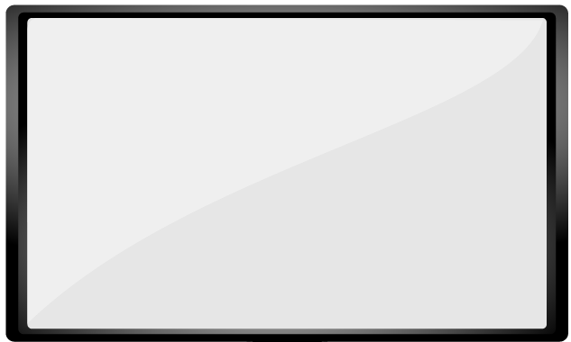
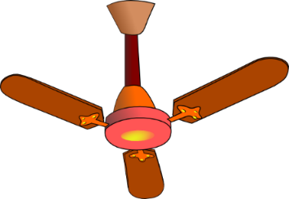
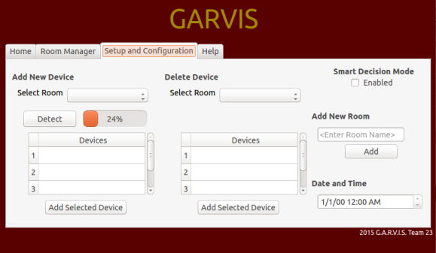
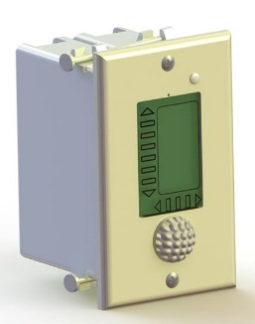
Project Overview
Glove
Load
Controller
Home Hardware
Central Manager
Vent
Controller
Home Hardware
Home HVAC
Smart Switch
User Interfaces
Automation Hardware
Notes:
Fix pictures, add more, talk about master/slave, mention

Slide 5
Central Manager
Glove
Load
Controller
Home Hardware
Central Manager
Vent
Controller
Home Hardware
Home HVAC
Smart Switch
User Interfaces
Automation Hardware
Notes:
Finish

Slide 6
Central Manager:
Hardware
Beaglebone
LCD Screen
Cape Requirements:
  Interface with PLC card
  Hold extra MSP430 for reading PLC signals
  Take power inputs for Beaglebone, LCD screen and PLC card
  Mounting headers for Xbee Module
  Control HVAC
Notes:
Finish

Slide 7
Processor Selection
 | BeagleBone Black Rev C | Raspberry Pi B+
Price | $54.49 | $39.95
Processor | AM335x 1GHz ARM Cortex-A8 | Broadcom SoC 700MHz
RAM | 512 MB | 512 MB
GPIO | 65 pins | 40 pins
Peripherals | 4 UARTs, 2 I2C ports, 2 SPI ports, 7 analog inputs, 8 PWMs, 4 timers | 1 UART, 2 I2C ports, 1 SPI port
*Other things to consider:
Library availability, capes/shields, personal preference

Slide 8
LCD Screen Selection
Requirements:
Touchscreen
Minimum 7” size
BeagleBone Compatability
 | 4D 7” LCD Cape | SainSmart 7” LCD Display
Price | $89.00 | $67.99
Resolution | 800 x 480 | 800 x 480
Driver | Included in Linux distro, plug and play | eGalaxTouch Driver for Linux
Power Source | via BeagleBone, 5V 2A | 5V 2A

Slide 9
Central Manager:
Software Design
Front end
  Qt GUI
  Android Application
Back end
  I/O Control
    Touchscreen I/O
    UART I/O
    HVAC I/O
  Algorithms
    Gesture Recognition
    Adaptive Command and Control
  Server

Slide 10

Operating System:
Embedded Linux Debian Distribution
Open source, helpful for our budget
More readily available drivers, allows touch screen to be plug and play
Plenty of documentation and online support
The team has previous knowledge of Linux

Slide 11
UI Framework: Qt
Qt is an application and UI framework for developing in C++
Cross platform – allows for use in desktop, mobile, and embedded applications
  Same application can run on both embedded Linux and Android
Qt kits allow for the correct configuration of build and run settings for cross platform compatibility
  Front end can remain the exact same while back end deals with variations in the OS being ran on
Small learning curve, very similar to C++
Easy to import libraries, BlackLib in particular

Slide 12
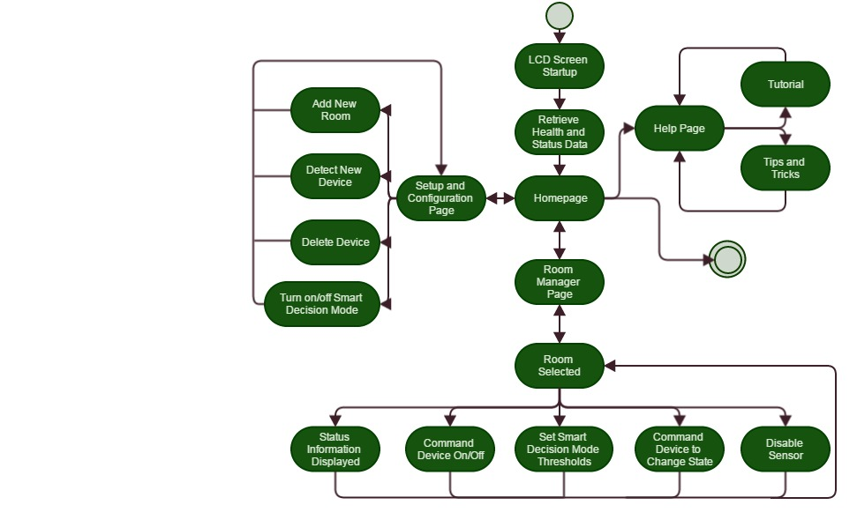
Central Manager GUI

Slide 13
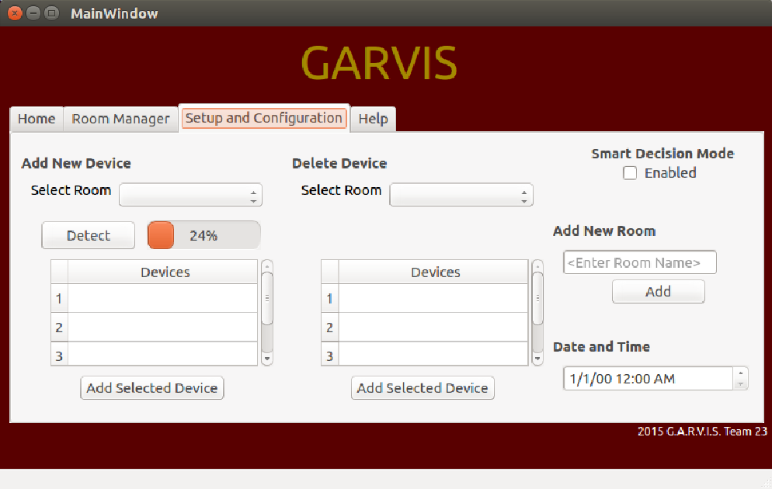
Central Manager GUI
Setup and Configuration
Add a new room
Select a room
  Start Detect Device Sequence
Enable/disable Smart Decision Mode

Slide 14
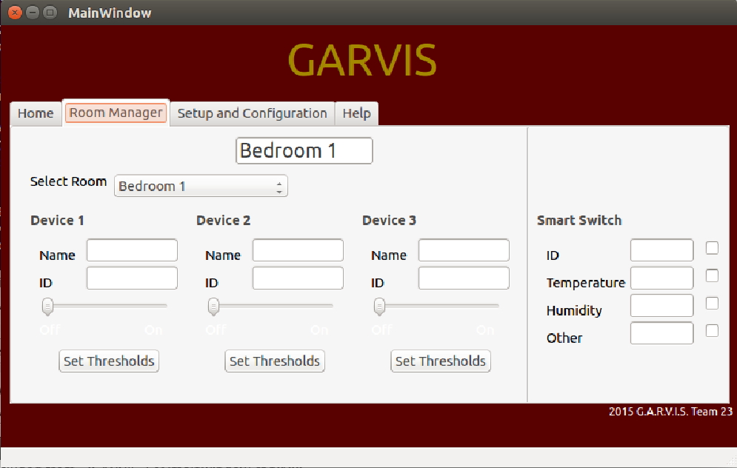
Central Manager GUI
Room Manager
Select a room
All devices in room can be configured and all sensor data is displayed

Slide 15
Adaptation
Smart Decision Mode enables autonomous adaptation
Adaptation Parameters: Fringe condition/error control with short term data
Adaptive Algorithms: Pattern recognition with long term server data
Parameter | Restraint
HVAC Ventilation Command | If commanded on, must remain on for a minimum of 10 minutes. If commanded off, must remain off for a minimum of 10 minutes.
Home Lighting Device Command | If commanded on, must remain on for a minimum of 5 seconds. If commanded off, must remain off for a minimum of 5 seconds.
Humidity Status | If humidity reaches dangerously high conditions for extended amounts of time, turn on ventilation system.
Temperature Status | If temperature reaches user defined maximum and minimum thresholds, automatically turn on/off AC/heater

Slide 16
Smart Switch
Glove
Load
Controller
Home Hardware
Central Manager
Vent
Controller
Home Hardware
Home HVAC
Smart Switch
User Interfaces
Automation Hardware

Slide 17
Smart Switch Overview
Front End Board
Microcontroller Board
Power Line Communication
Power Supply
Capacitive Touch Human Interface
Ambient Light
Microphone
Haptic Feedback
LEDs
Communicate with other chips
Communicate to PLC board
Temperature & Humidity Sensors
Use TI AFE031 to interface w/ mains
Handle signal filtering and conditioning
Transform digital data to mains transmissions
Input120VAC
Outputs 15, 5& 3.3 VDC
Notes:
Fix text – Josh, We need to mention how this is the main focus of the project

Slide 18
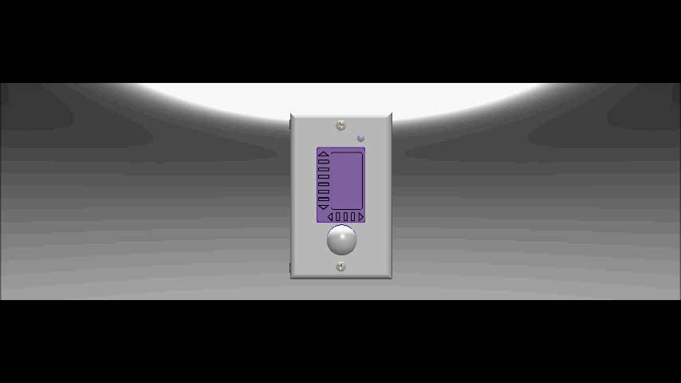
Smart Switch
Notes:
Add - Josh

Slide 19
Smart Switch Requirements
Specification | Value | Unit
Capacitive Reaction Time | 2 | Seconds
Temperature Accuracy | +/- 1 | Degree
Humidity Accuracy | +/- 5 | Percent
Passive Infrared Range | 12 | Meters
Ambient Light Sensitivity | 10 | Lumens
Physical Size | Must fit within single gang box
Notes:
Make this a table

Slide 20
Front End Design Choices
Front End Board
Microcontroller Board
Power Line Communication
Power Supply
TI TLC5947 - LED Driver
  Controls 24 separate PWM channels
  Uses serial interface to reduce total I/O
  Internal oscillator
Atmel QT1085 – Capacitive Touch Driver
  8 capacitive touch channels
  Embedded haptic engine

Slide 21
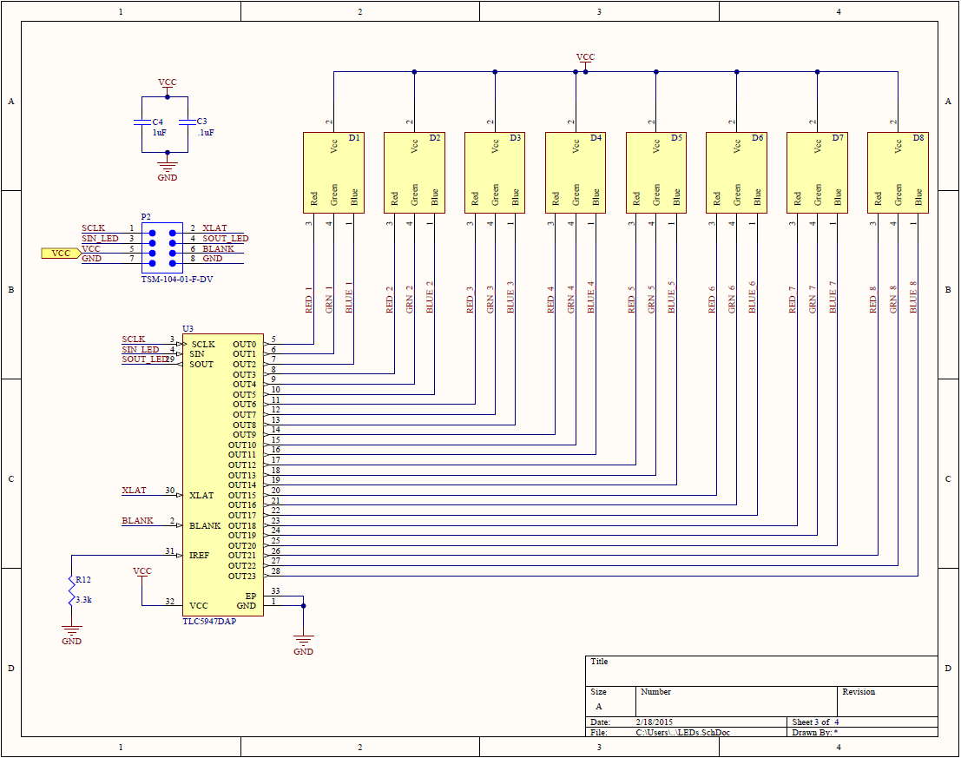
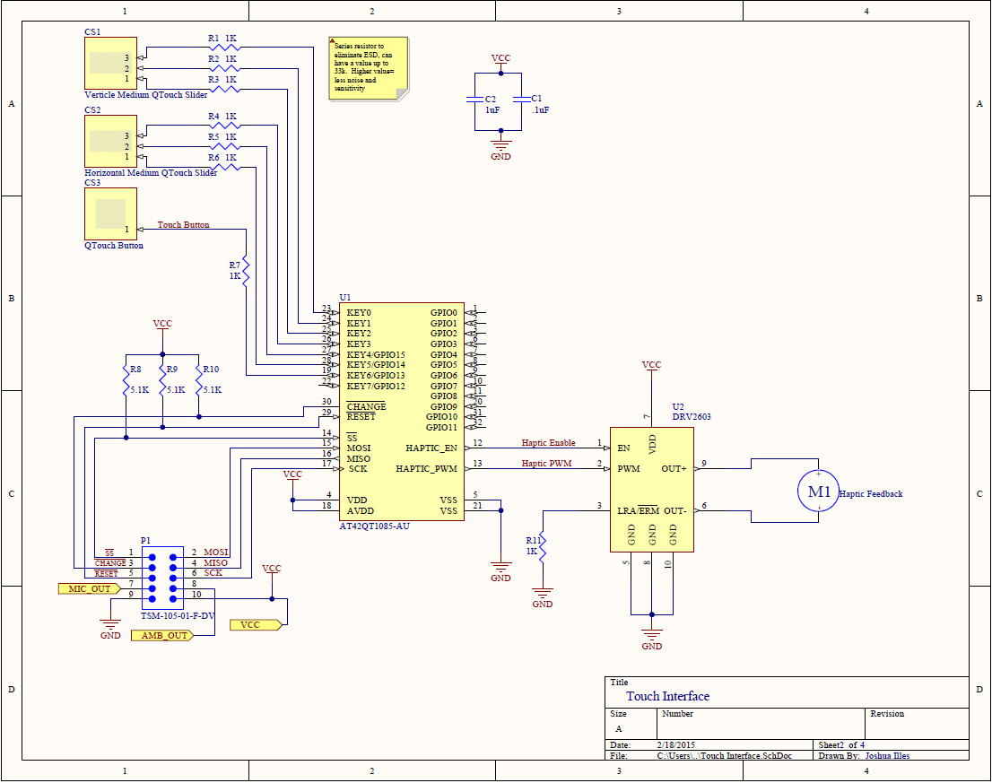
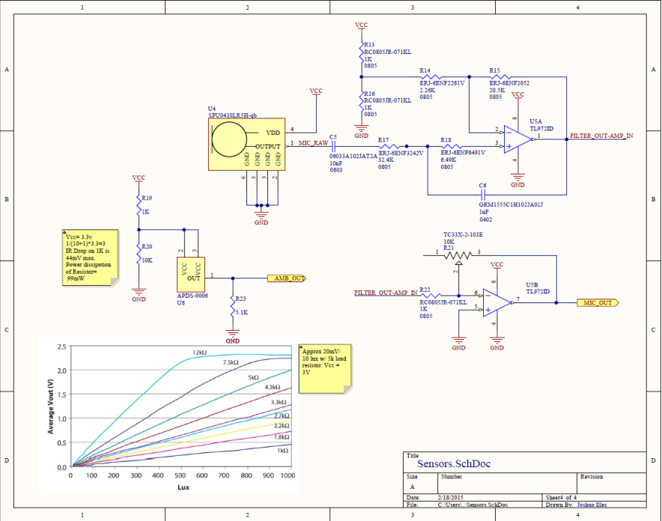
Front End Board
Microcontroller Board
Power Line Communication
Power Supply

Slide 22
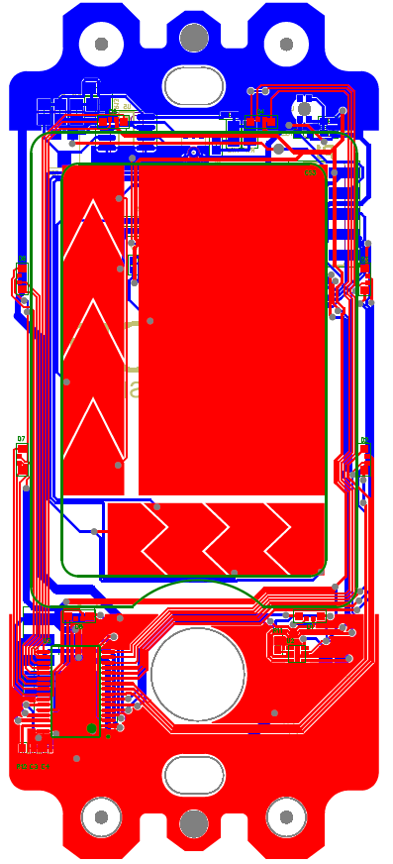
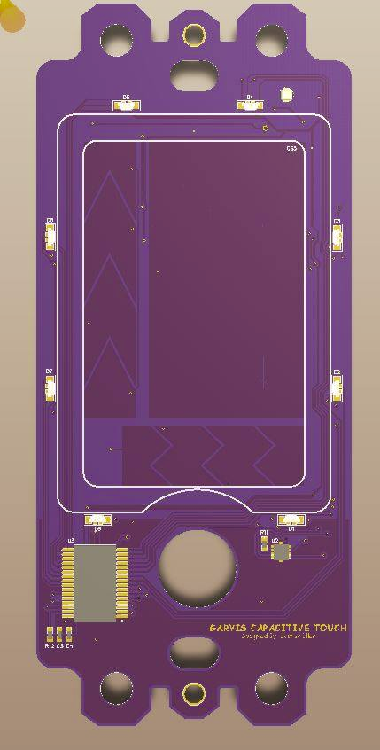
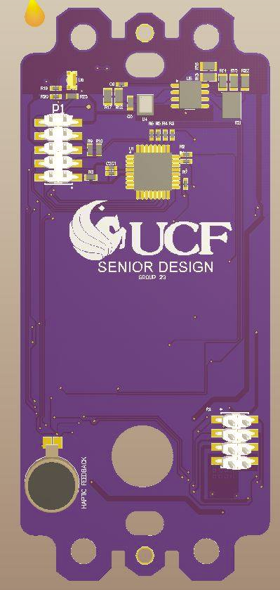
Front end PCB
Front End Board
Microcontroller Board
Power Line Communication
Power Supply
Layout
Physical Front
Physical Back
Notes:
Get rid of white on layout - Josh

Slide 23
Microcontroller Board Overview/Design Choices
Front End Board
Microcontroller Board
Power Line Communication
Power Supply
Must mate with surrounding boards
Electrical – Two microcontrollers
  MSP430G2553 – Reads PLC signals, translates Analog data to Digital signals
  MSP430F5529 – Interprets commands, monitors sensors, user interface
Features
  JTAG ports
  Debug I²C, LEDs & pins
Timing – 32.768 kHz crystal for real-time-clock
Notes:
Finish

Slide 24
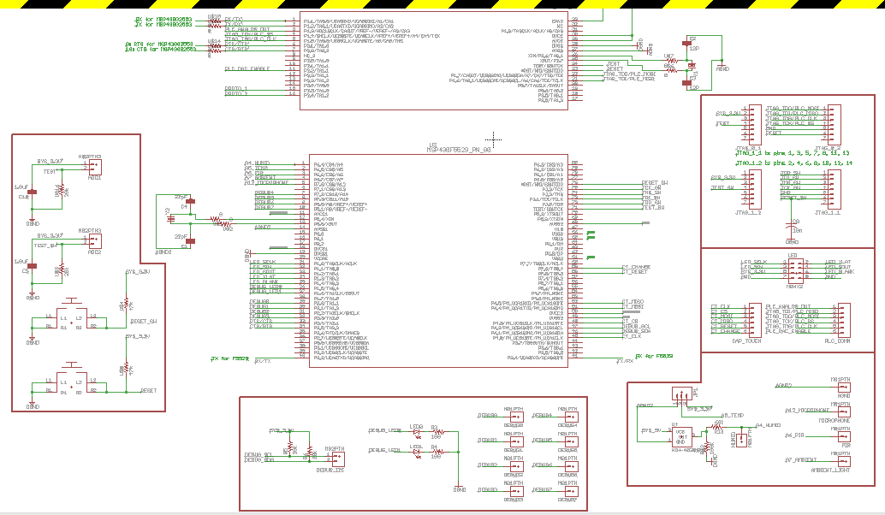
Front End Board
Microcontroller Board
Power Line Communication
Power Supply

Slide 25
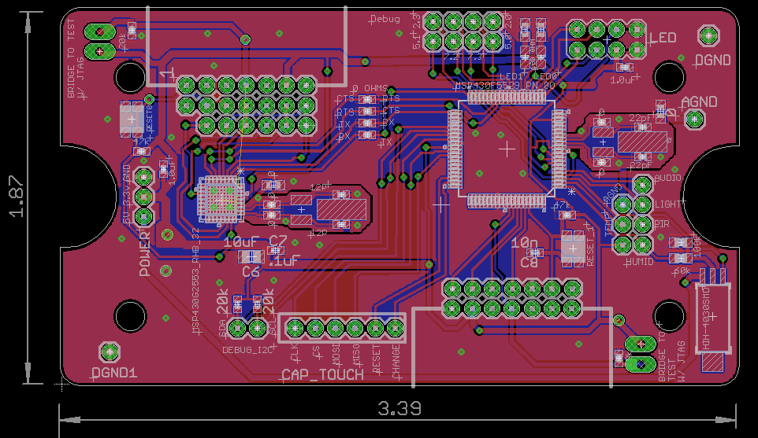
Front End Board
Microcontroller Board
Power Line Communication
Power Supply
Notes:
Grant, label the measurement units

Slide 26
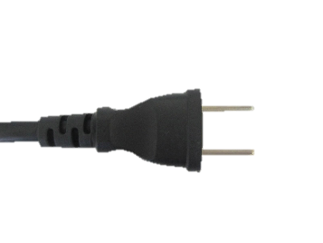
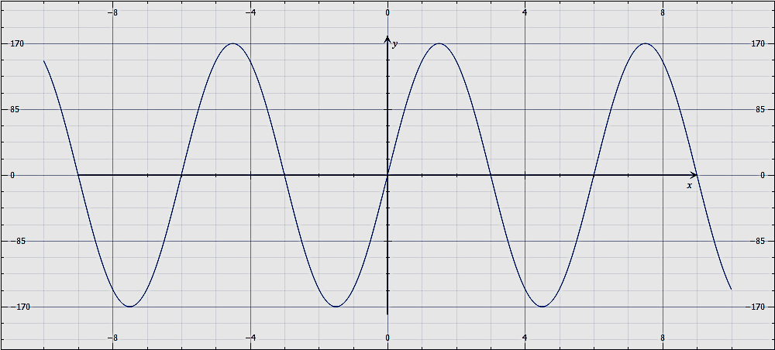
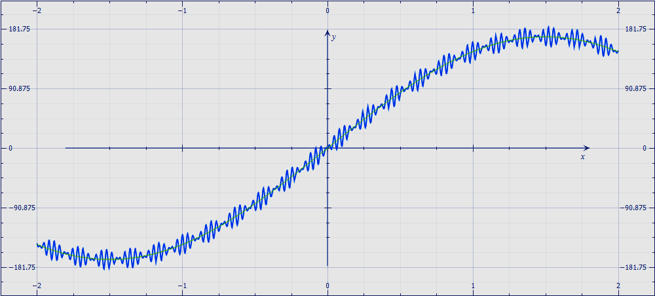
PLC Overview
Front End Board
Microcontroller Board
Power Line Communication
Power Supply
Transmit Data with 60Hz 120V Carrier Wave via Frequency Shift Keying
MSP430
Digital Data
Amplified FSK Sine Waves
High Pass Filter (block 60 Hz)
AC Mains
Carrier Wave
Carrier wave with data
Notes:
Finish - Josh

Slide 27
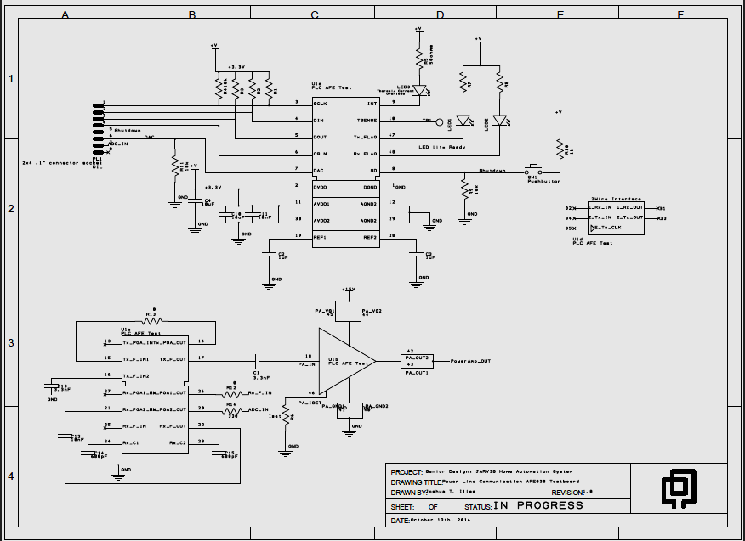
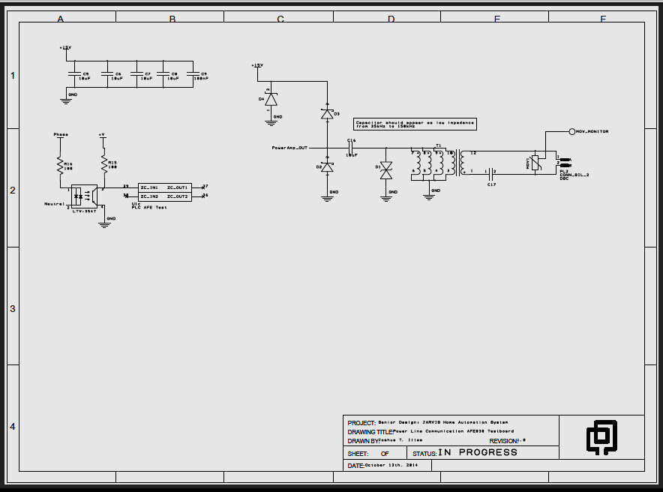
Front End Board
Microcontroller Board
Power Line Communication
Power Supply

Slide 28
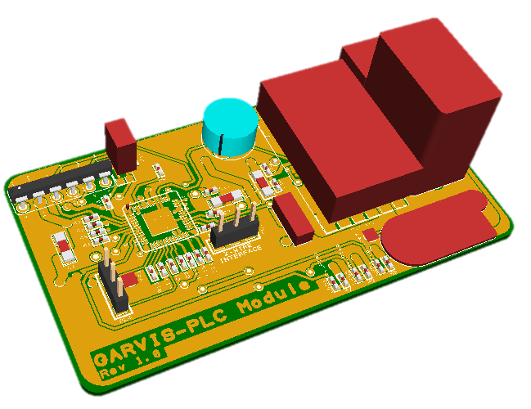
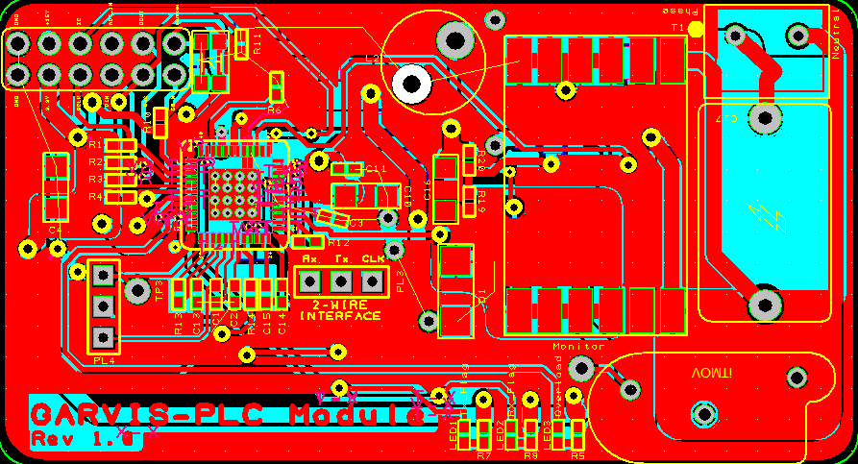
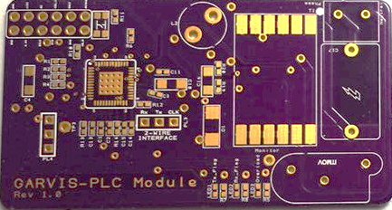
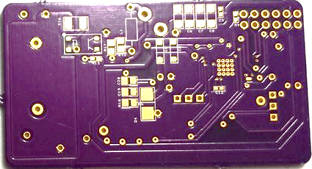
Front End Board
Microcontroller Board
Power Line Communication
Power Supply
1.5”
2.75”

Slide 29
Power Supply Board Overview
Front End Board
Microcontroller Board
Power Line Communication
Power Supply
Maximum Power Requirements
  15V – 9W – PLC communication, low duty cycle
  5V – 3W – Various sensors,
  3.3V - 2W – Powered off of 5V rail, Microcontrollers and ICs
Constraints
  Transformer and Bulk Capacitor Size
15VDC
120VAC
24VAC
33VDC
15V Regulator
TPS54336
5VDC
F48-250-C2-B Transformer
Z4DGP408L-HF Full Bridge Rectifier
1800uF Bulk Capacitor
5V Regulator
LM43602
3.3V Regulator
TPS61240
3.3VDC
Notes:
Fix picture, add bulk capacitor equations

Slide 30
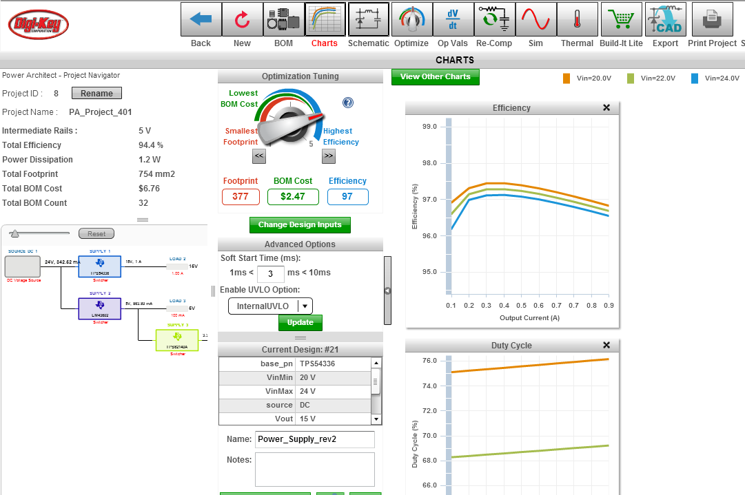
Smart Switch Power Supply
Front End Board
Microcontroller Board
Power Line Communication
Power Supply

Slide 31
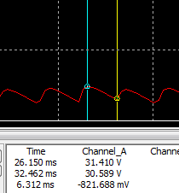








Smart Switch Power Supply
Front End Board
Microcontroller Board
Power Line Communication
Power Supply
$$V_{ripple,peak }\text{≅} \frac{V_{peak}}{R_{L}×C}×∆t \text{≅}1.7V$$
$$V_{peak}=24 ∗1.414−V_{diode}$$
$R_{l}≅\frac{V_{peak}}{I_{peak}} ≅90Ω$
$$C=1800μF$$
$$∆t=\frac{Period}{2}=1/120$$
Voltage (V) | I_{nominal} (mA) | I_{peak} (mA) | P_{nominal} (W) | P_{peak} (W)
15 | 200* | 600* | <1* | 9*
5 | 100 | 200 | .5 | 1
3.3 | 110 | 550 | ~.36×(2-e) | ~1.82×(2-e)
e = efficiency of 5V regulator
Max Power from Transformer
~12W
Bridge Rectifier e≈.97
*At max power
Voltage Regulator e≈.9
Available Power
~10.46W
$$×$$
$$×$$
$$=$$

Slide 32
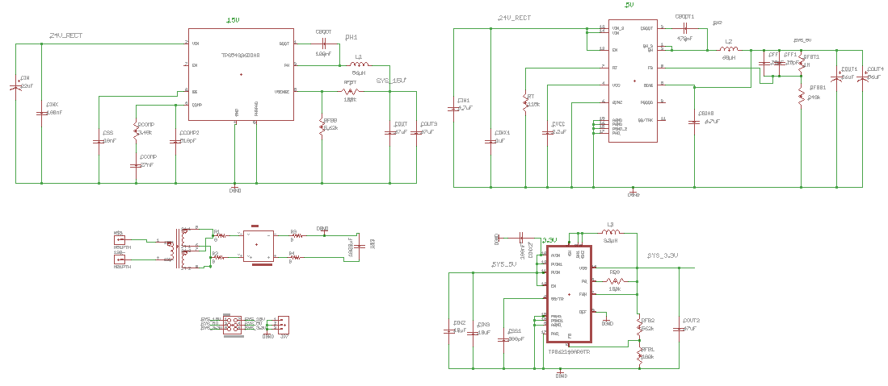
Front End Board
Microcontroller Board
Power Line Communication
Power Supply

Slide 33
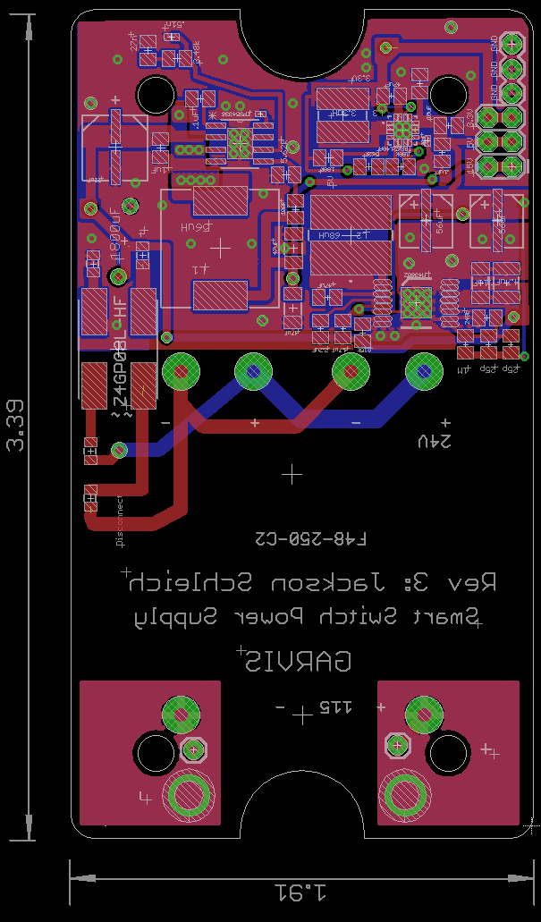
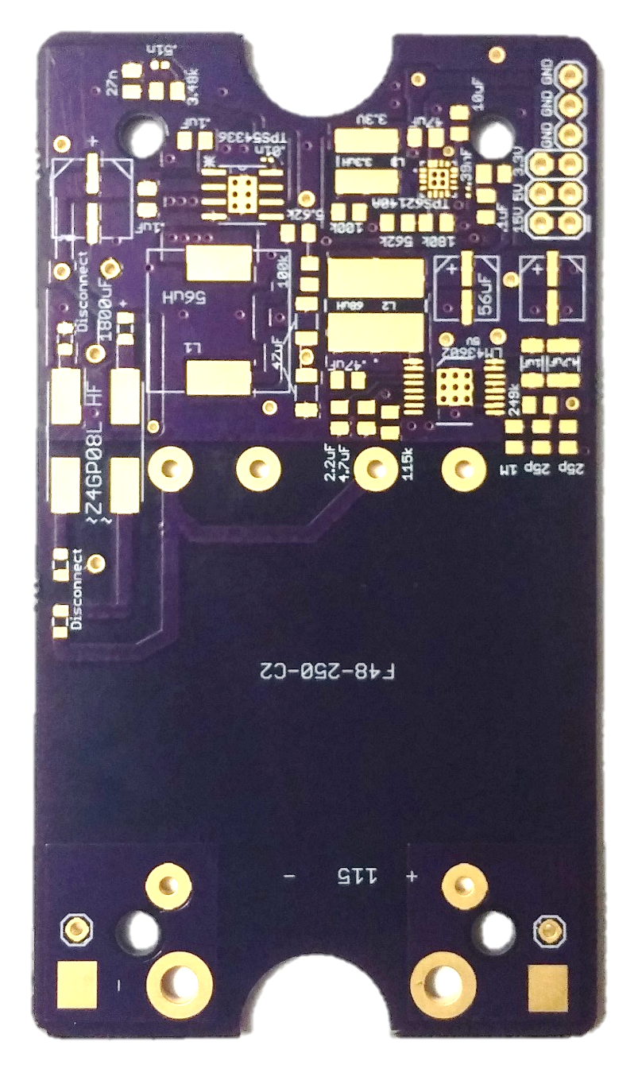
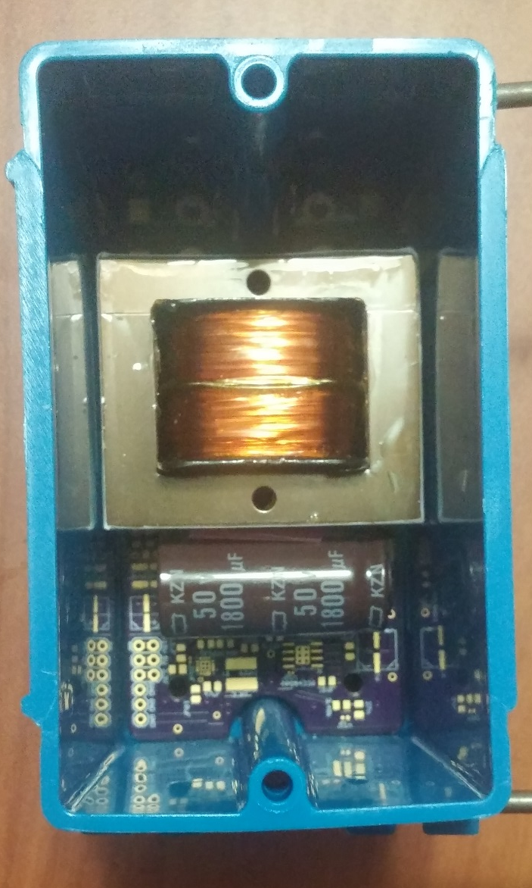
Front End Board
Microcontroller Board
Power Line Communication
Power Supply

Slide 34
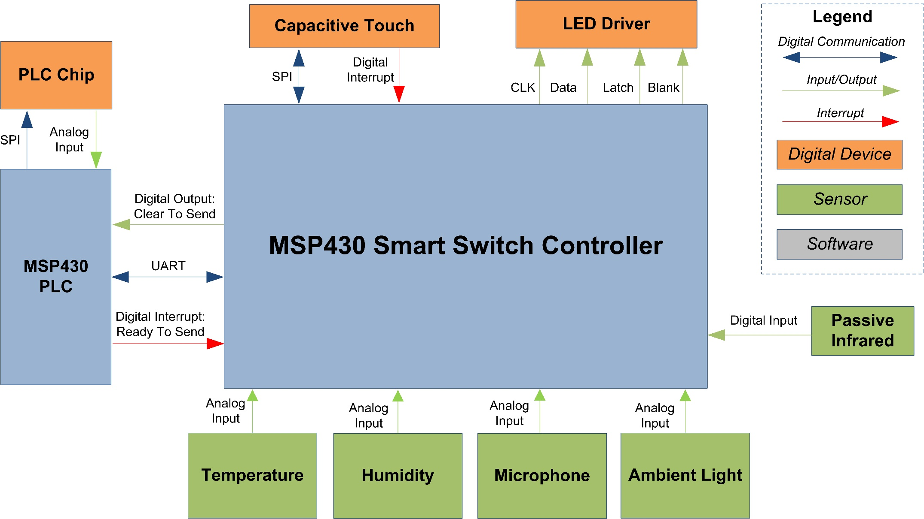
Smart Switch Interface
Notes:
Add animation for title/picture

Slide 35
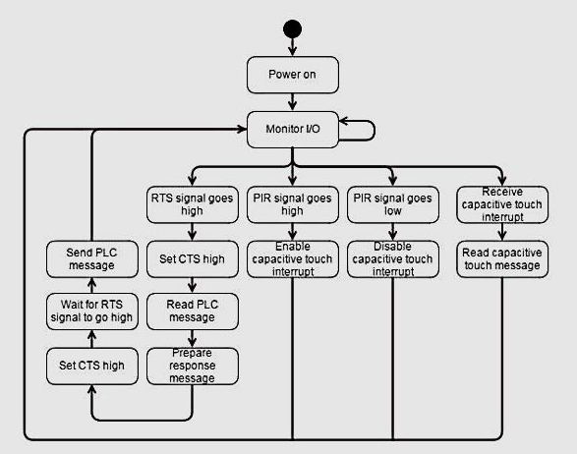
Smart Switch Software Path
Notes:
Make state diagram, add CTS/RTS interrupt system

Slide 36
Load Control
Glove
Load
Controller
Home Hardware
Central Manager
Vent
Controller
Home Hardware
Home HVAC
Smart Switch
User Interfaces
Automation Hardware

Slide 37
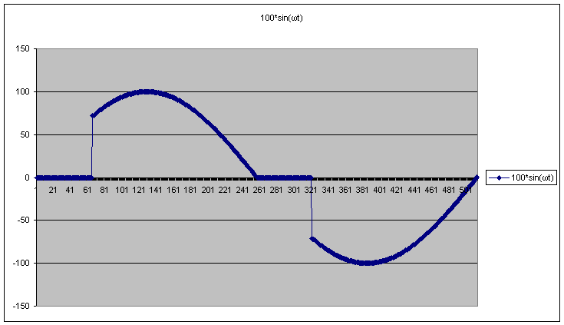
Load Control
Utilize Triacs for AC power control
Use power MOSFETS for DC control
Load Power Consumption Monitoring
Spec | Limit | Units
DC Voltage | 24 | Volts
DC Current | 5 | Amps
AC Voltage | 240 | Volts
AC Current | 20 | Amps
Notes:
Diagram showing how triac control works

Slide 38
Vent Control
Glove
Load
Controller
Home Hardware
Central Manager
Vent
Controller
Home Hardware
Home HVAC
Smart Switch
User Interfaces
Automation Hardware

Slide 39
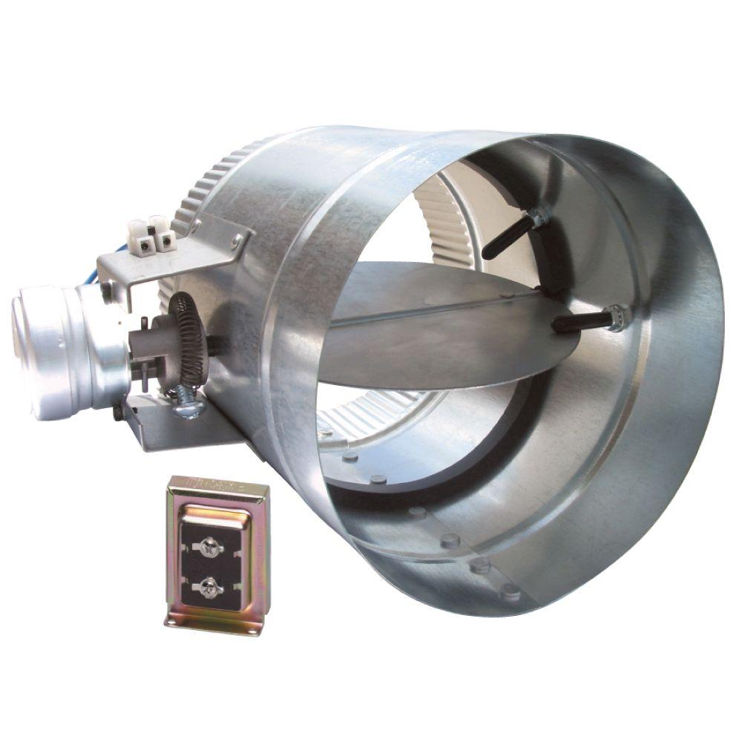
Vent Control
Electrically Actuated Vent to allow or restrict airflow into a room.
Communicate to Central manager over PLC
Measure temperature of airflow
Courtesy of SunCourt and Smarthome.com
Notes:
Update, add pictures

Slide 40
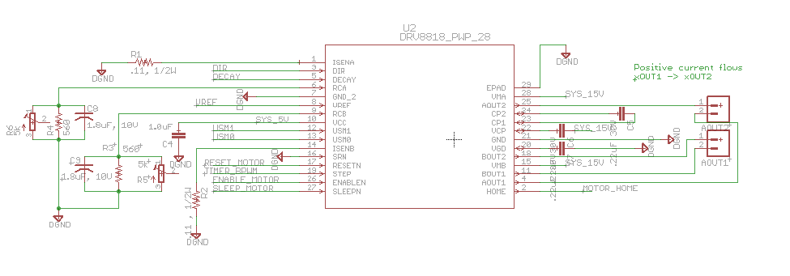
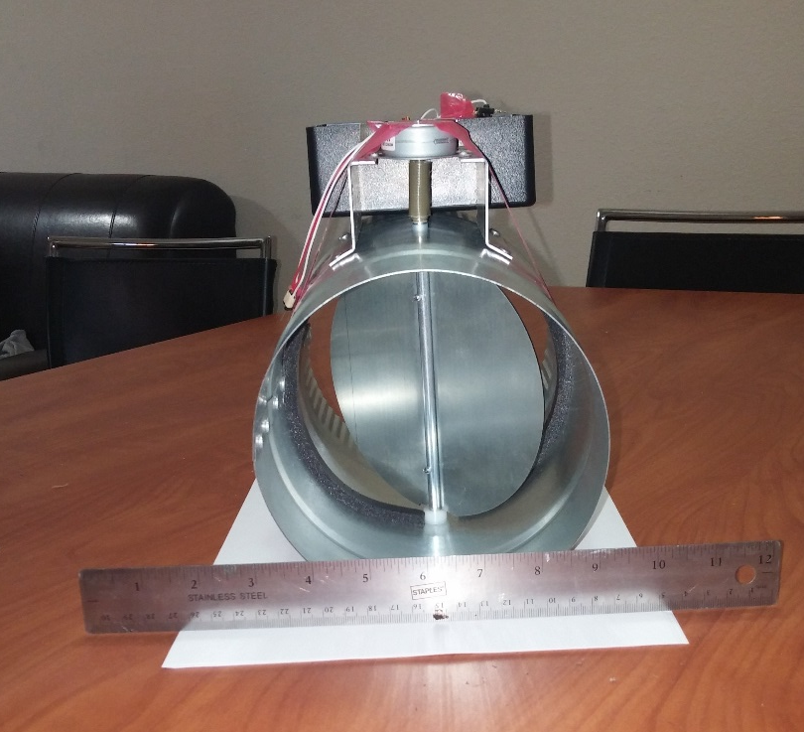
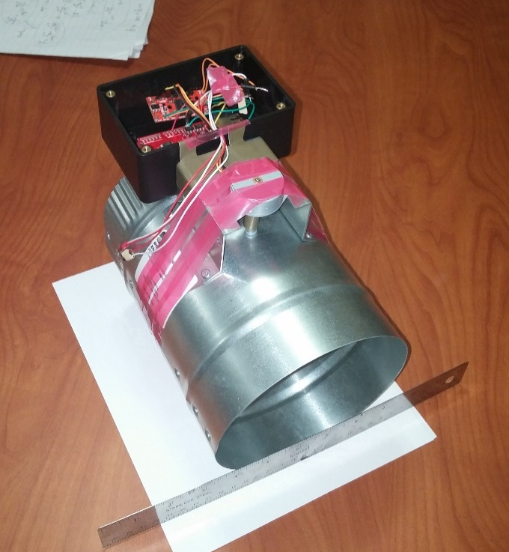
Vent Control
TI DRV8818
Stepper Motor Driver
Use Smart Switch boards for power, logic & PLC
Temperature sensor mounted inside vent
Notes:
Add pictures

Slide 41
Smart Glove
Glove
Load
Controller
Home Hardware
Central Manager
Vent
Controller
Home Hardware
Home HVAC
Smart Switch
User Interfaces
Automation Hardware

Slide 42
Glove Requirements
Capable of measuring degree of bend for each finger
Measure linear and radial acceleration fast and accurate enough to allow for hand gesture detection
Have an intuitive user friendly interface with feedback
Notes:
Combine this slide with next slide

Slide 43
Glove Hardware
Part Number | Manufacturer | Description | Range | Resolution | Interface
LSM303DLHC | STMicroelectronics | 3-axis Accelerometer | ±16g | 16 bits | I²C
L3GD20 | STMicroelectronics | 3-axis Gyroscope | 2000 °/s | 16 bits | I²C
FSL0022253ST | SpectraSymbol | Flex Sensor | 25 kΩ - 100 kΩ | 36 °/V | Analog
ATMEGA328 | Atmel | Microcontroller | N/A | N/A | N/A
CEM-C9745 | Challenge Electronics | Microphone | 100Hz-10kHz | N/A | Analog
PS1240 | TDK | Piezo Buzzer | 1.5kHz – 8kHz | N/A | Digital
063048 | Unionfortune | LiPo Battery | 2.75V – 4.2V | N/A | N/A

Slide 44
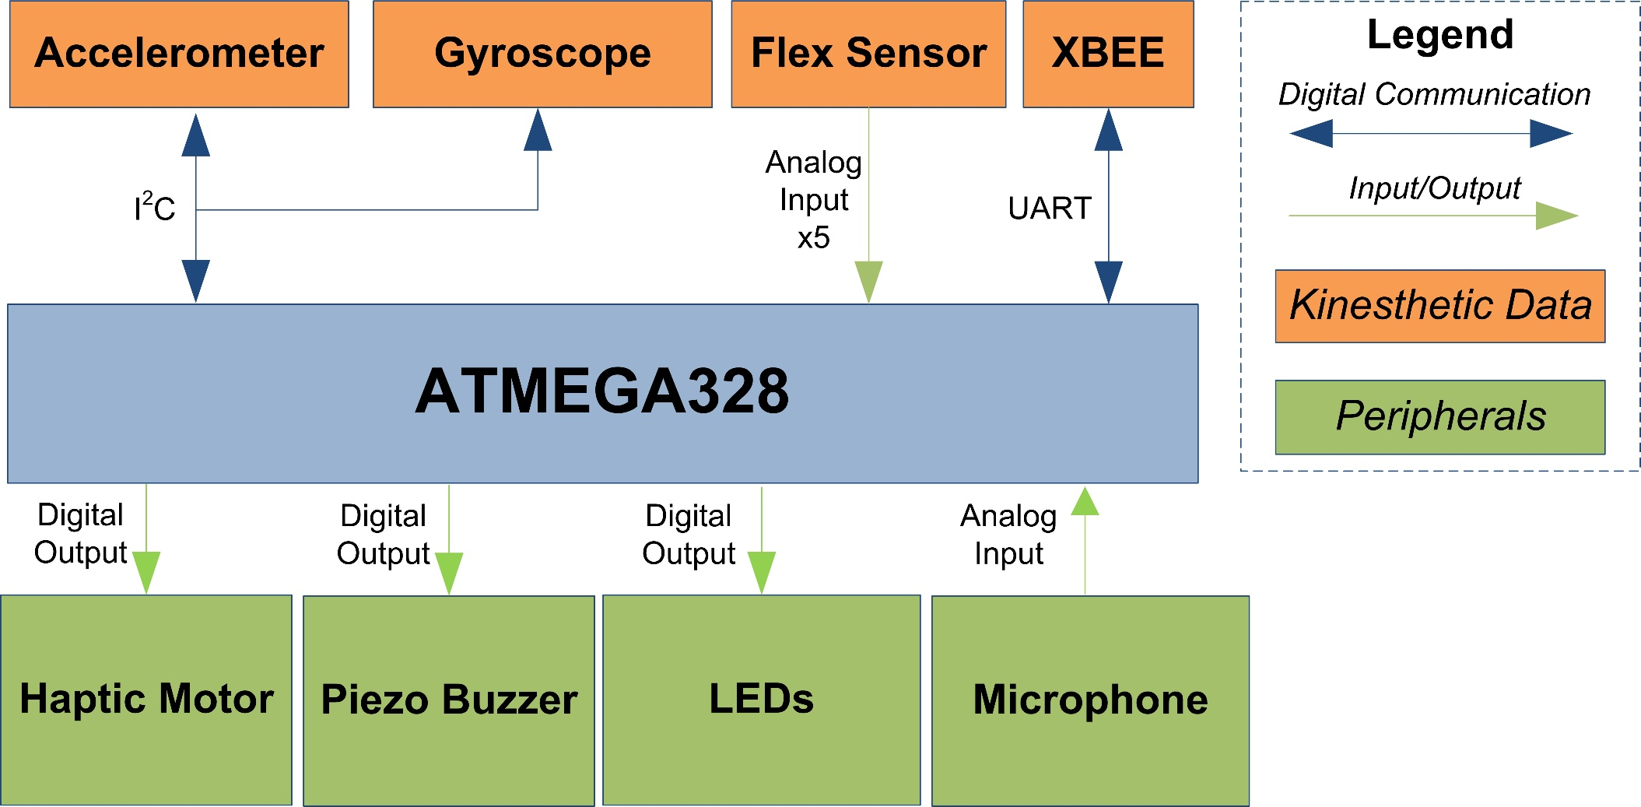
Glove Overview

Slide 45
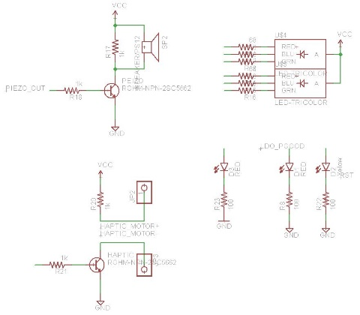
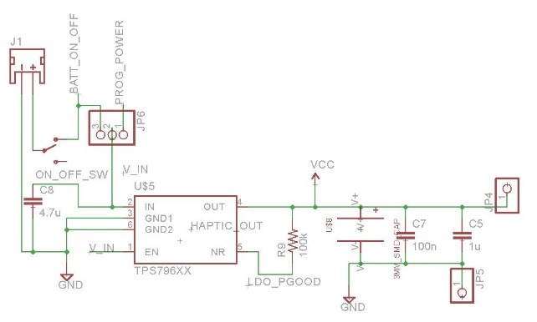
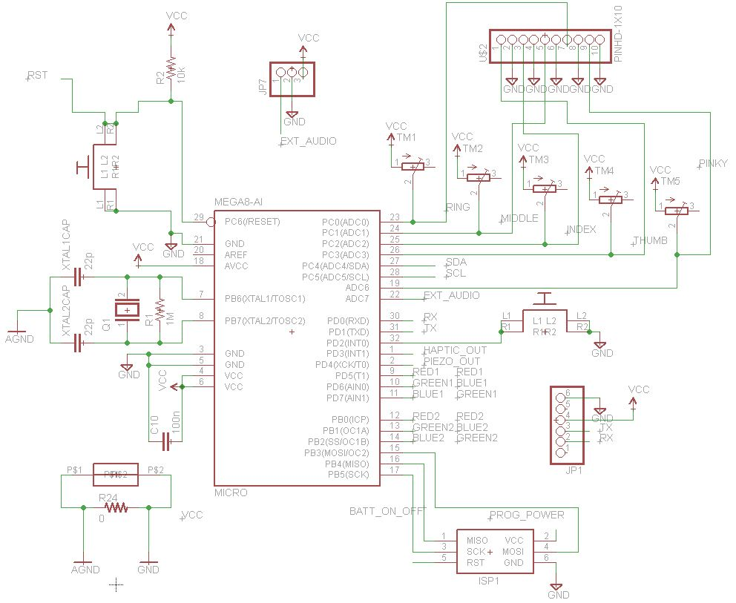
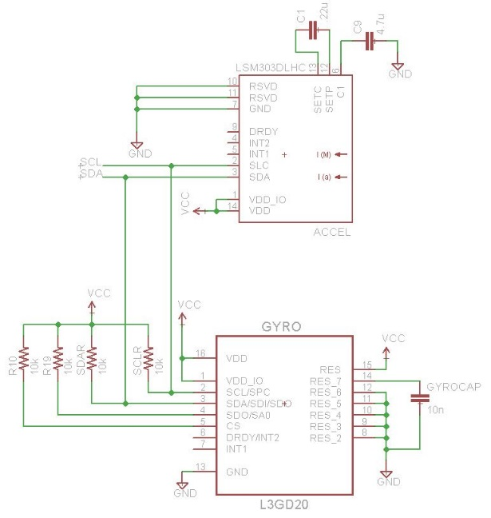
Glove Schematic

Slide 46
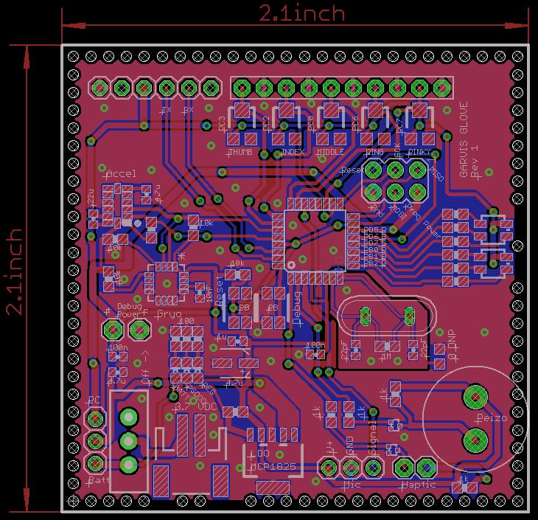
Glove PCB

Slide 47
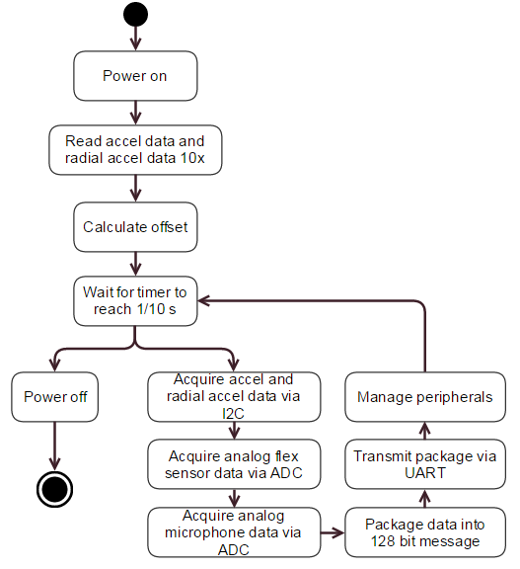
Glove State Diagram

Slide 48
Glove Software
Input Control
  Receives and un-packages raw sensor data from glove
Data Manager
  Stores all sensor data and provides it to the output control and gesture recognition algorithms
Command Creation Algorithms
  Converts raw analog data into usable sensor data
  Calculates what gesture was recognized and creates a command for the gesture
Output Control
  Sends commands to external applications

Slide 49
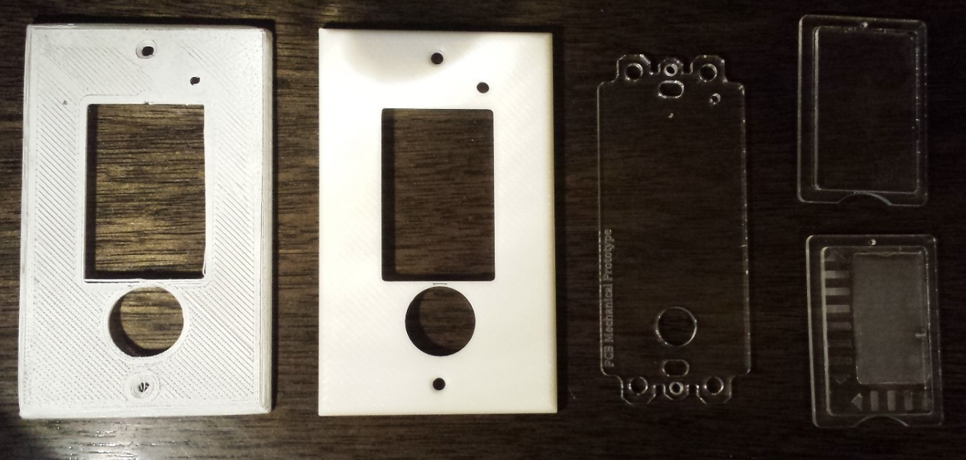
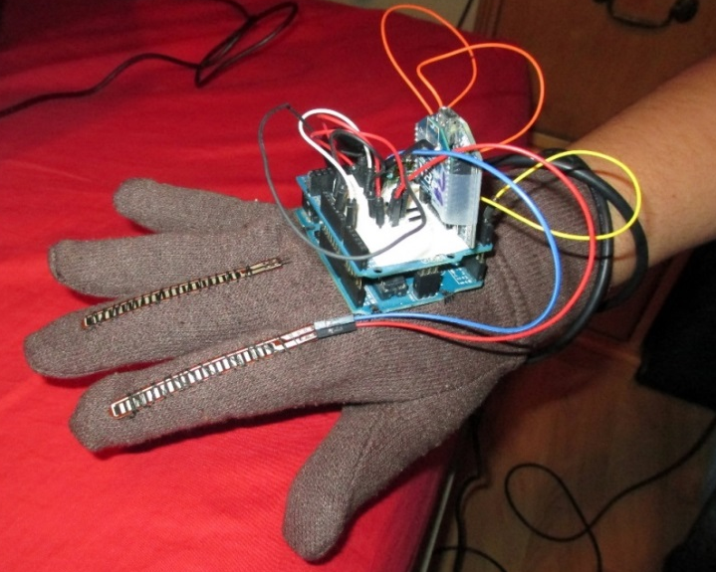
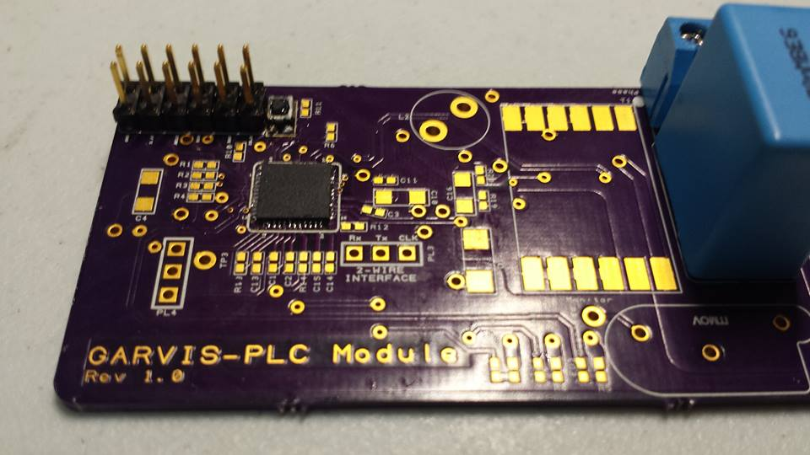
Prototypes
3D Printed Cover
3D Printed Cover (Higher Res)
Touch Board Mechanical Outline
Acrylic Touch Panels
Notes:
Add more pictures/slides

Slide 50
Finances
Item | Total Price | Supplier | Category
Beaglebone Black | $ 54.95 | Amazon | Hardware
4D systems LCD | $ 99.95 | Sparkfun | Prototyping
SainSmart LCD | $ 65.00 | Amazon | Prototyping
SunCourt Vent | $ 60.00 | Amazon | Parts
Power Supply v1 | $ 9.97 | Osh Park | PCB
Power Supply v2 | $ 32.30 | Osh Park | PCB
Glove | $ 22.00 | Osh Park | PCB
PLC Communication | $ 29.30 | Osh Park | PCB
Power Supply v1 | $ 98.20 | Digikey | Electronic Components
Power Supply v2 | $ 156.20 | Digikey | Electronic Components
Smart Glove | $ 91.33 | Digikey | Electronic Components
PLC Communication | $ 147.18 | Digikey | Electronic Components
Smart Switch | $ 42.09 | Digikey | Electronic Components
Breakout Boards | $ 73.10 | Sparkfun | Prototyping
Stepper motor | $ 6.95 | Sparkfun | Parts
Xbees | $ 46.90 | Sparkfun | Prototyping
Li-Ion Battery | $ 17.90 | Sparkfun | Parts
Miscellaneous | $ 39.70 | Multiple | Electronic Components
Prototyping | $ 15.99 | Multiple | Miscellaneous
Total | $ 1,109.01
Company | Amount
Duke Energy | $1725.50
Leidos | $ 700.00
SoarTech | $ 500.00
Total | $ 2925.50
Notes:
Add total funding, fix table

Slide 51
Progress
Notes:
Make legend bigger

Slide 52
Successes Summary
Central Manager
LCD Touchscreen Works
GUI prototype works
Smart Switch
Successfully controlling LED Driver chip
Successfully communicating with Capacitive Touch Chip
3D printed Smart Switch Cover
All Smart Switch PCBs fit in standard switch enclosure
Smart Glove
Smart glove prototype is functional and moving mouse on screen with accelerometer/gyroscope data
Glove PCB eliminates need for development board and fits on top of user’s hand
Overall
Majority of PCBs have been sent out

Slide 53
Moving Forward…
PLC communication code
Manufacturing of remaining PCBs
Testing all PCBs
Adaptive Algorithms
Server
Porting to Android App
Notes:
Organize

Slide 54
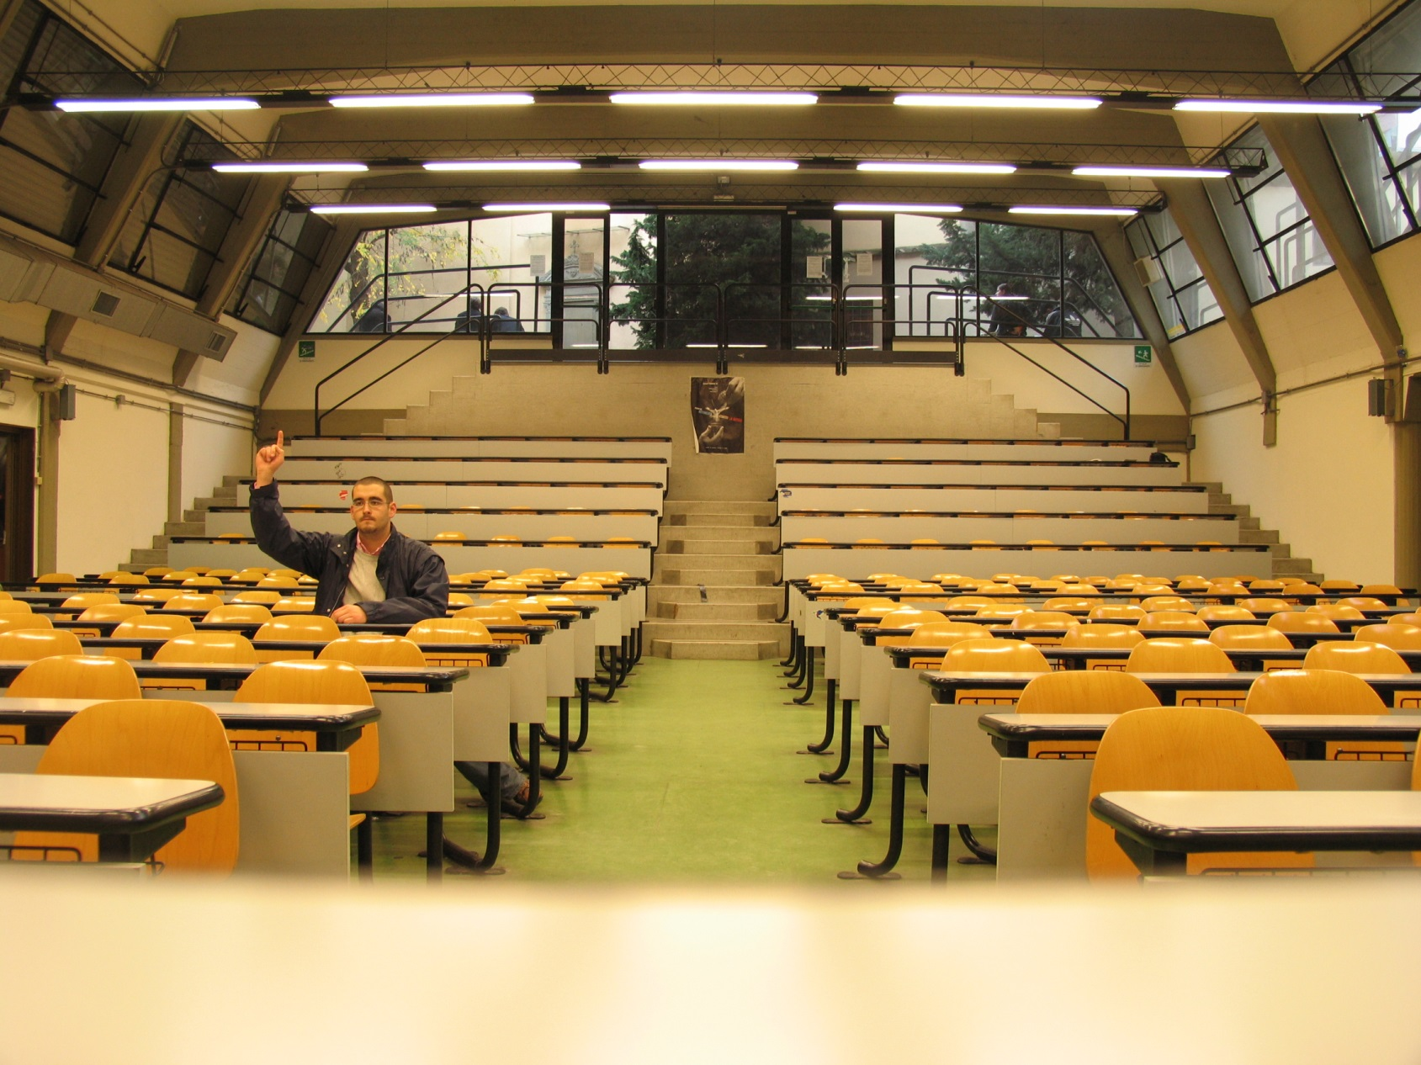

Questions?

