Slide 1
IPPA
Intelligent Programmable Prosthetic Arm

Slide 2
IPPA Team
Funded by the CECS Alumni Chapter
Matthew Bald – Computer Engineer
Ivette Carreras - Computer Engineer
Andrew Mendez - Computer Engineer

Slide 3
Goals & Objectives
Develop a low cost upper limb prosthetic that compares to commercial prosthetics in functionality
      Assist amputees in grasping tasks
      Perform a wide range of hand gestures
  Incorporate a management system that will allow the user to adjust the prosthetic gestures by
      Changing the available gestures in the prosthetic
      Creating new custom gestures, specific to their needs
Notes:
At the end the goal is : to provide a more functional and cheaper arm prosthetic for amputees

Slide 4
Specifications
Component | Parameter | Specification
Battery | Duration | 1 hour of normal usage, 5 min of continuous usage
Servos | Weight to hold | >=5lb
Communication | Range | <=8 meters
Force Sensor | Weight | 10g - 1kg
Distance Sensor | Distance | 0 – 1 in
Main Controller | Memory | 5 gestures
Notes:
Verify these specifications/ change as needed

Slide 5
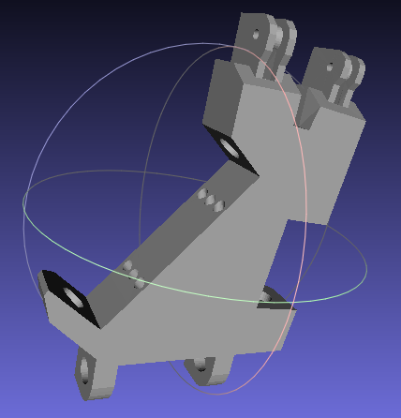
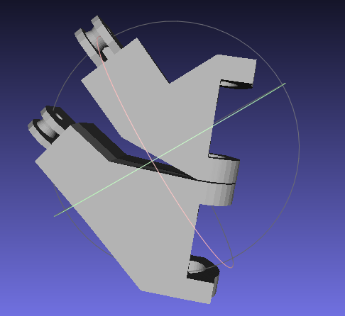
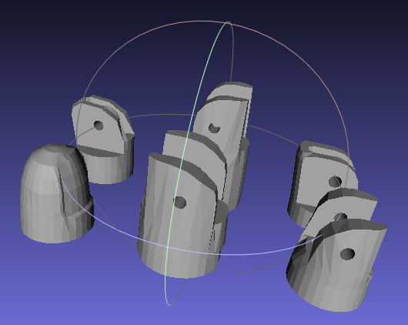
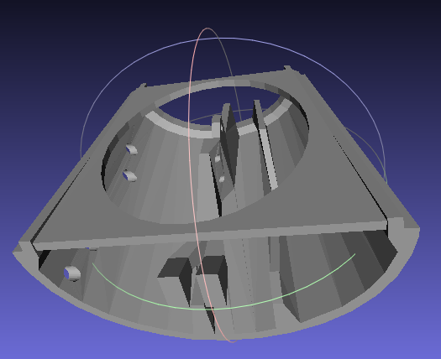
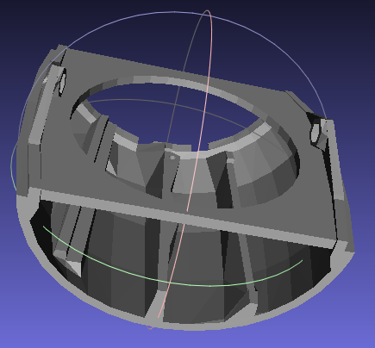
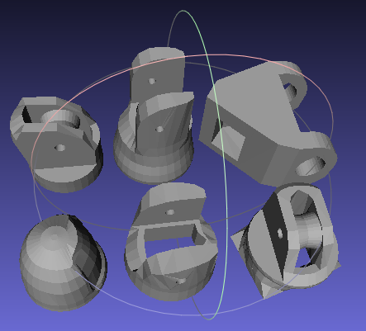
3D Printed Prosthetic

Slide 6
System Diagram

Slide 7
Main Controller

Slide 8
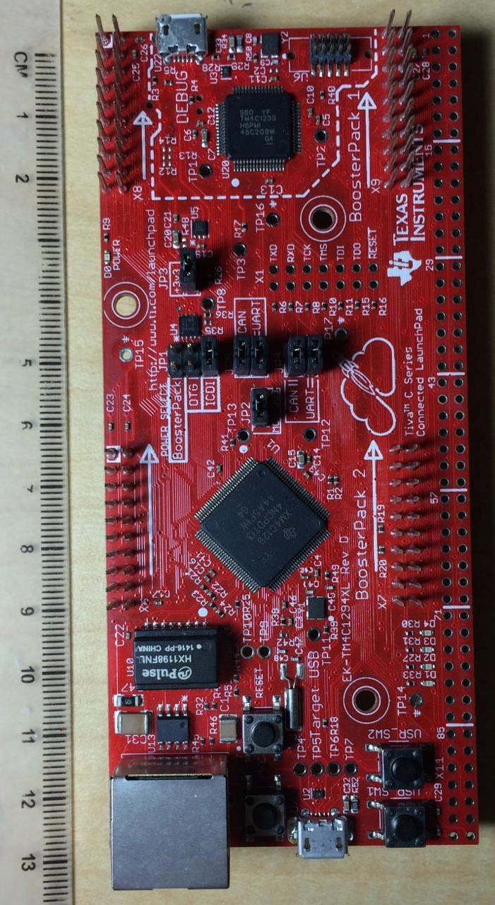
Main Controller
  Purpose: Coordinates all subsystems and runs the functions to automatically grasp objects and execute gestures
  Main Controller will be implemented using a TM4C1294NCPDT
  120MHz clock rate, 90 GPIO pins, 8 UART,
  1MB of memory, 256KB Flash,
  3.3-5v, 320mA max

Slide 9
Microcontroller
TM4C1294NCPDT
HC-06
ATMega328p
Bluetooth
Module
115200 baud
9600 baud
TX
RX
PC4
PC5
PA2
PA3
Servo
Controller
TX
RX
ATMega328p
PL3
PL2
PL1
PL0
Vin
Rechargeable battery
Sensor
Controller
5V, 320mA

Slide 10
Microcontroller
TM4C1294NCPDT
HC-06
ATMega328p
Bluetooth
Module
115200 baud
9600 baud
TX
RX
PC4
PC5
PA2
PA3
Servo
Controller
TX
RX
ATMega328p
PL3
PL2
PL1
PL0
Vin
Rechargeable battery
Sensor
Controller
5V, 320mA

Slide 11
Microcontroller
TM4C1294NCPDT
HC-06
ATMega328p
Bluetooth
Module
115200 baud
9600 baud
TX
RX
PC4
PC5
PA2
PA3
Servo
Controller
TX
RX
ATMega328p
PL3
PL2
PL1
PL0
Vin
Rechargeable battery
Sensor
Controller
5V, 320mA

Slide 12
Microcontroller
TM4C1294NCPDT
HC-06
ATMega328p
Bluetooth
Module
115200 baud
9600 baud
TX
RX
PC4
PC5
PA2
PA3
Servo
Controller
TX
RX
ATMega328p
PL3
PL2
PL1
PL0
Vin
Rechargeable battery
Sensor
Controller
5V, 320mA

Slide 13
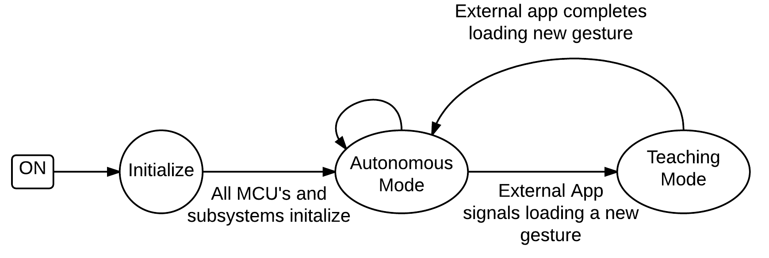
Software Overview

Slide 14
Software Overview

Slide 15
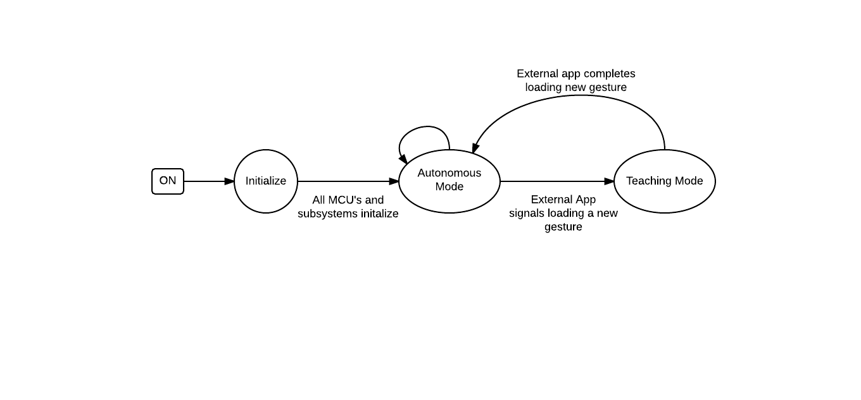
Software Overview

Slide 16
Software Overview

Slide 17
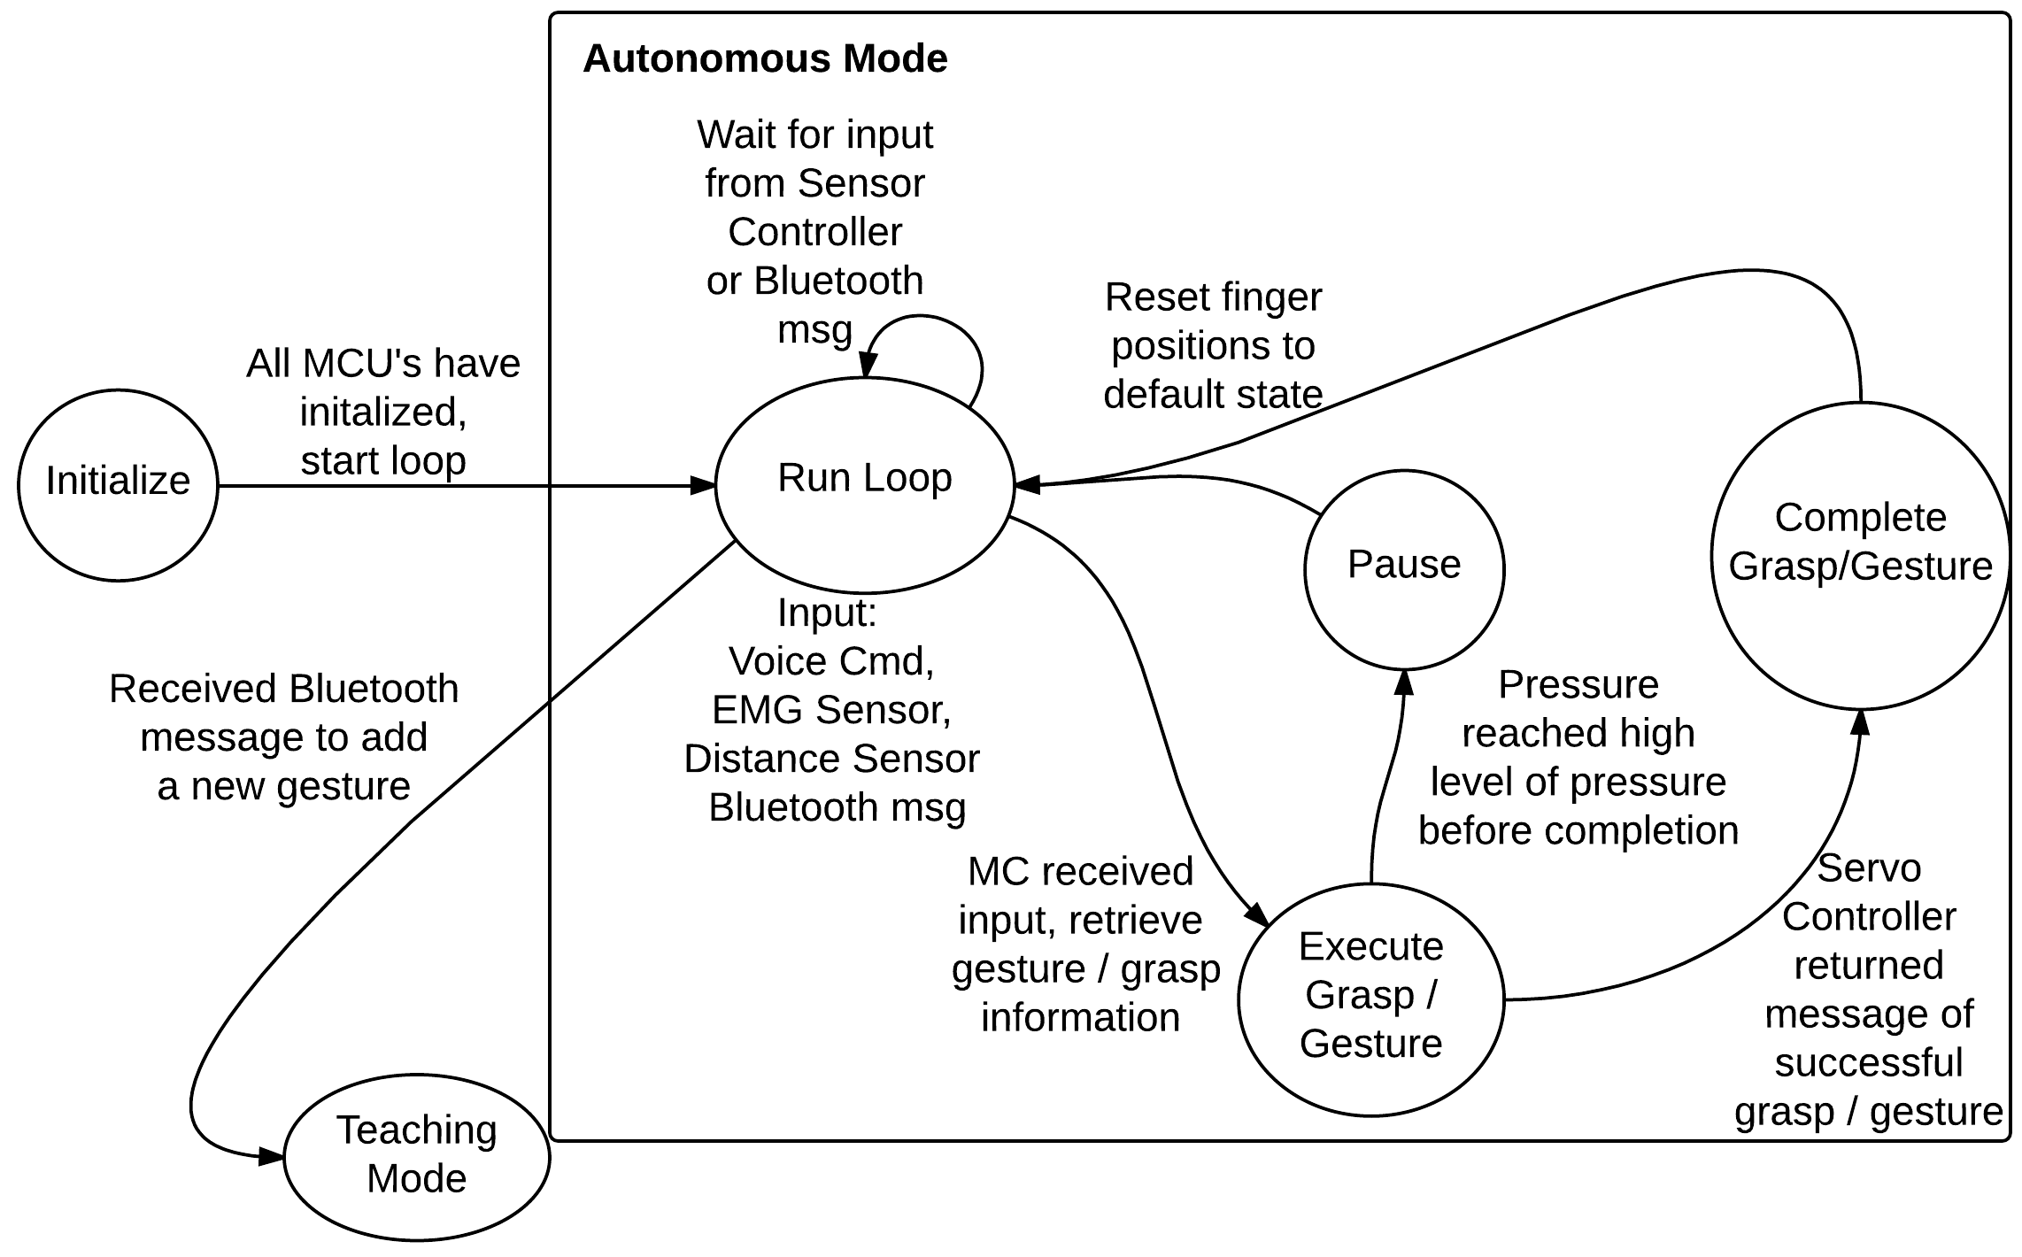
Autonomous Mode

Slide 18
Autonomous Mode

Slide 19
Autonomous Mode

Slide 20
Autonomous Mode

Slide 21
Autonomous Mode

Slide 22
Autonomous Mode

Slide 23
Autonomous Mode

Slide 24
Autonomous Mode

Slide 25
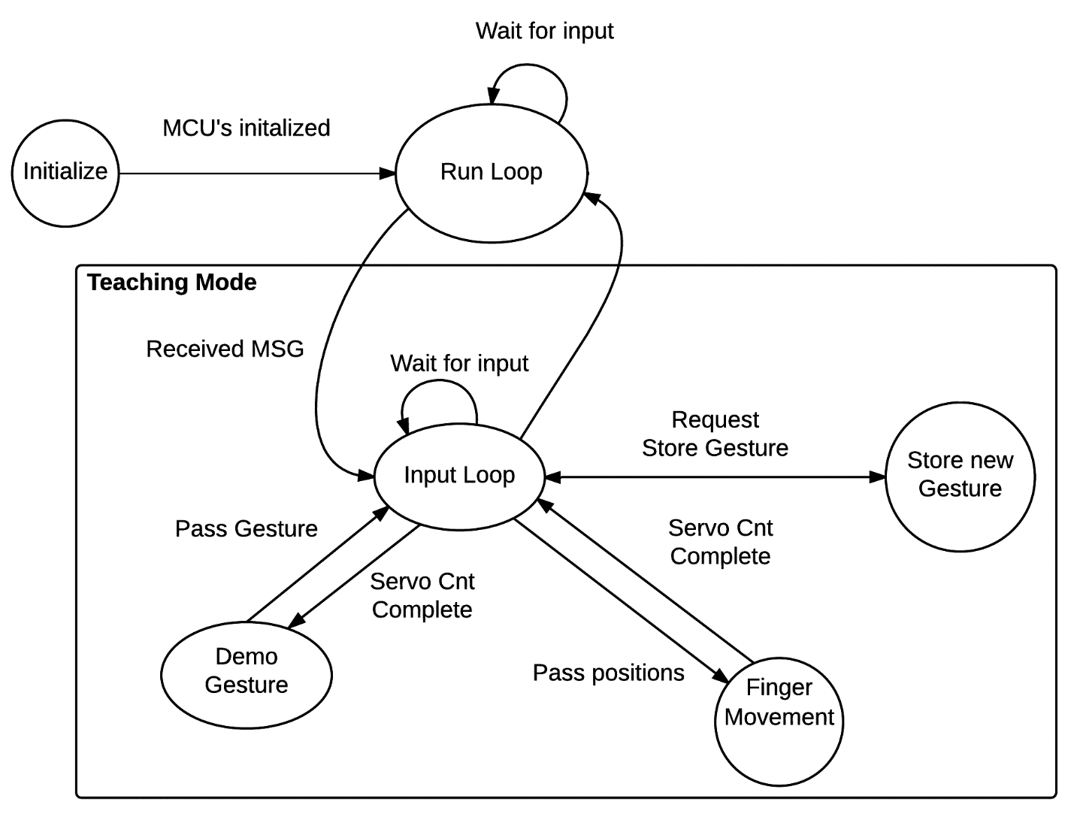
Teaching Mode

Slide 26
Teaching Mode

Slide 27
Teaching Mode

Slide 28
Teaching Mode

Slide 29
Teaching Mode

Slide 30
Teaching Mode

Slide 31
Teaching Mode

Slide 32
Teaching Mode

Slide 33
Teaching Mode

Slide 34
Teaching Mode

Slide 35
Servo Subsystem

Slide 36
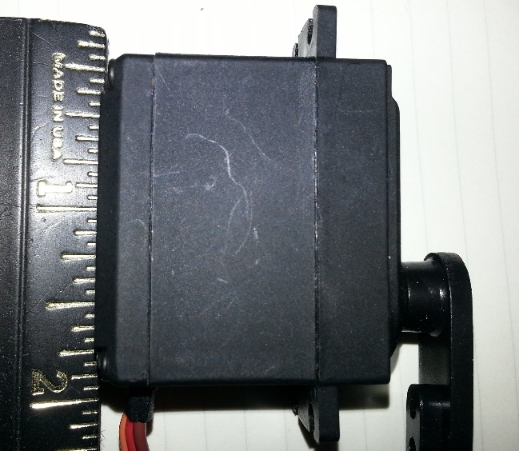
Servo Motors
  6V DC
  High torque
  Lock in place when powered
  Controlled by PWM from a microcontroller
  Small, portable, light(ish)
  Low cost
  Human Strength: 2 kg*cm – 36 kg*cm
Characteristic | Pololu 1501MG
Rotational range | 180°
Strength | 16 kg*cm
Weight | 2.11 ounces (each)
Cost | $20.00 (each)
Size | 1.6 “ L x 0.8 “ W x 1.55” H
Power Consumption | 500 mA
[1] Hand Grip Torque Strength. S. Keith Adams. Iowa State University.
Notes:
We have chosen to use an array of servo motors to control the fingers of our prosthetic individually. First of all, they are easy to control with a microcontroller, requiring no extra components besides a few resistors.
Servos have three pins: ground, voltage supply, and signal. The signal pin receives a PWM signal from the microcontroller, which is decoded by the motor and translates into an angle between 0 and 90 degrees. So, we don’t have to worry about reversing current or using extra transistors to allow the use of a larger power supply.
Servo motors are capable of generating strong torques, and when they are unpowered, or receiving no signal from the microcontroller, they remain locked into place.
They’re DC powered, small, portable, lightweight, and low cost.

Slide 37
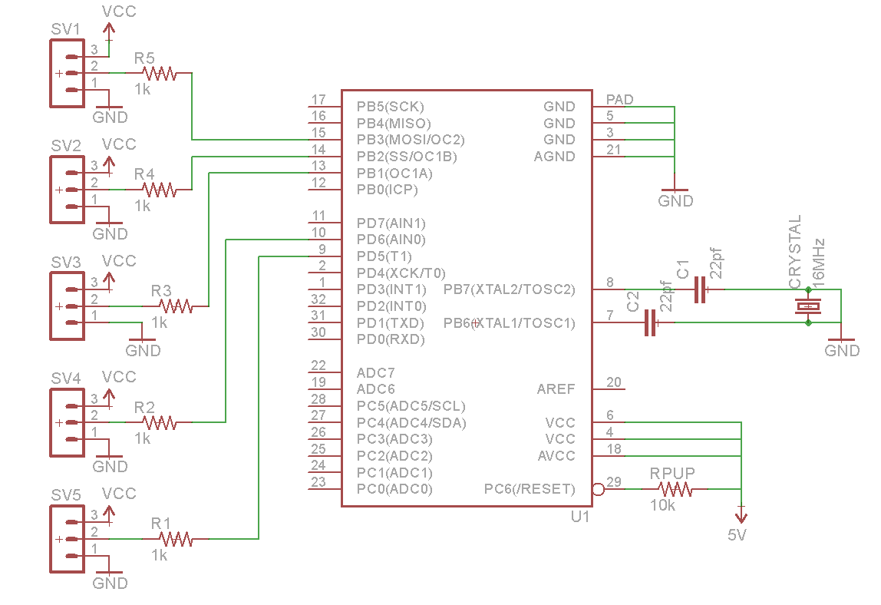
Servo Controller
  Receives positioning information from main controller
    UART packets
  Parses message
  move corresponding positions to corresponding servos
Notes:
The servo controller is used to decrease the work load of the main processor. It receives positioning information, final positions of servos and possibly a delay time via UART from the main controller. The main controller can then focus its processing power elsewhere, while the servo controller sends the appropriate PWM signals to all 5 servos.
The schematic on the right shows how we intend to connect the servos to our servo controller.

Slide 38
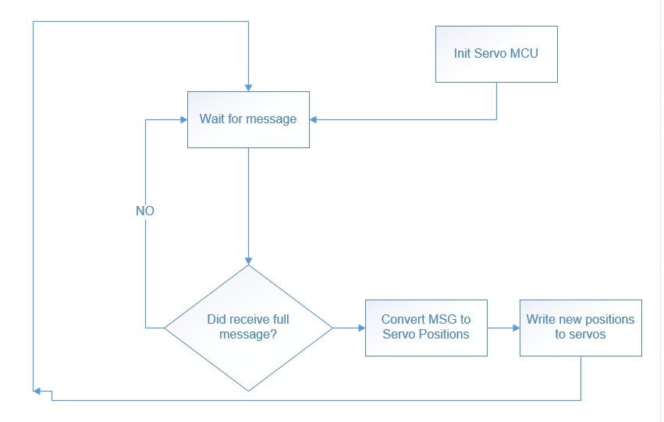
Software
Notes:
Let’s move the bottom row closer to the top

Slide 39
Sensor Subsystem
Notes:
Now I’ll go over the sensor subsystem

Slide 40
Overview of Sensors
  Electromyography (EMG)
    Will allow the wearer to trigger actions by flexing his/her upper arm muscles
  Force sensing resistors
    Allow the prosthetic to detect when too much or too little force is being applied & adjust accordingly
  Distance sensor
    Automatically trigger grasping gesture when the hand is placed close enough to an object (doorknob, drinking glass, etc)
Notes:
Here you can see a summary of the three different sensors we included in our prosthetic arm.
The EMG sensor will enable the wearer to have some physical control over what the prosthetic does. When a user flexes his/her upper arm muscle, it can trigger the arm to initiate or disengage a grasp.
The pressure sensors are intended to provide protection against damaging the servos, crushing objects, or human hands during a handshake. The arm will know whether a good grip has been established, or if too much pressure is being applied.
The distance sensor should provide increased robustness to automatic grasping. Meaning the user could initiate a grasp without input from the EMG or mobile application.

Slide 41
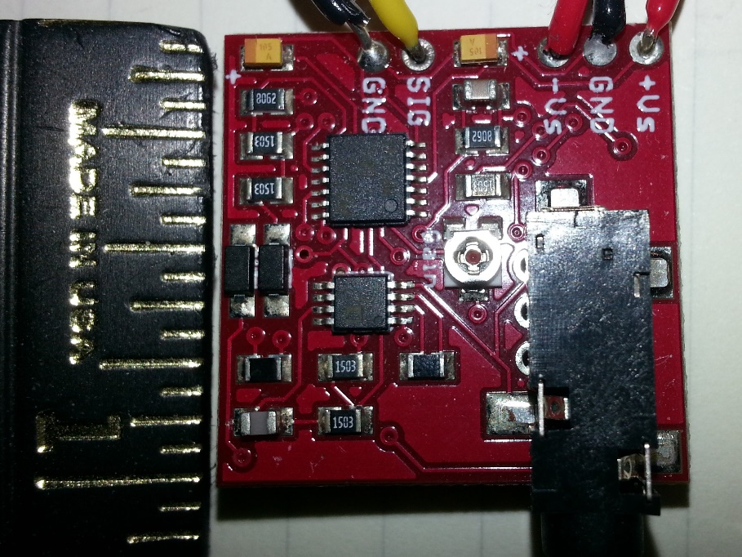
Electromyography (EMG) Sensor
  Advancer Technologies Muscle Sensor
  Amplifies electrical impulses generated by muscles
  Sensor pads removable, replaceable
  Adjustable gain
  Requires a positive & negative voltage supply
  Signal output goes to microcontroller
Notes:
When you flex a muscle, electrical impulses are generated by that muscle. These impulses can be detected and amplified by an EMG sensor, with the use of electrodes, which are conductive pads which you place on key muscle groups. These pads have a limited lifetime, but can be replaced and swapped out easily.
Advancer Technologies makes an EMG sensor board with a very small footprint, 1 inch by 1 inch, with adjustable gain, and output signal that can be fed directly into a microcontroller input pin.
It does require a positive and negative voltage supply, which I’ll take about in the power management section.

Slide 42
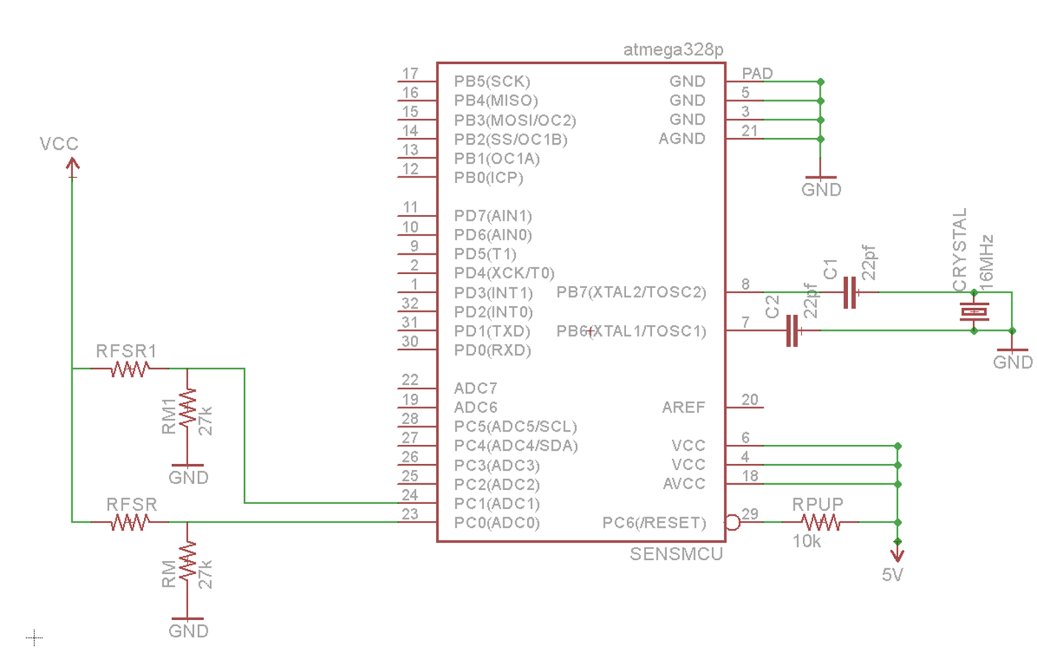
Force Sensors
  Force Sensitive Resistors
  Resistance value changes when pressure is applied
  Placed on areas of the hand with the most contact points on a held object
  Voltage divider circuit with an observing microcontroller
  Small, flat, cheap, flexible
Notes:
Force sensitive resistors are resistors that change value based on pressure being applied to them. They are cheap, small, practically flat, flexible, and easy to implement.
By creating a voltage divider circuit, we can measure the voltage on the bottom resistor and calculate the weight being placed on the FSR. We have two FSRs on our hand, placed on the middle finger and thumb.

Slide 43
Converting from Voltage to Force
Force = VFSR * 462.95 – 153.86
Notes:
This is the equation showing how to convert from detected voltage into weight on the sensor, provided on the datasheet. These are the values associated with a 3.3 kOhm resistor as the bottom resistor. Voltage on the sensor is read in by the MCU and run through the formula below the graph, which was found using linear regression. Our regression model had an r value of 0.94.

Slide 44
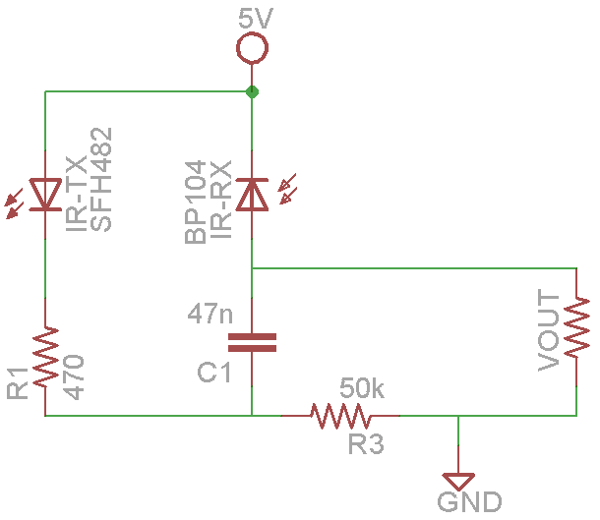
Distance Sensor
Chose to use an infrared sensor
  Can be calibrated to detect close objects, ultrasonic bottoms out too soon
Only want to trigger a gesture when an object is practically touching the hand
Placed in the palm of the hand
Notes:
We chose to construct a simple circuit to implement an infrared sensor as our distance sensor. Building our own circuit gave us more flexibility when integrating it into the arm. We have the sensor controller calibrated to detect when an object is very close to the sensor. We placed the sensor in the palm of the hand so it will trigger when an object is in an ideal position.

Slide 45
Sensor Processor
  Responsible for reading sensor readings
    Distance sensor, EMG sensor, 3 pressure sensors
  Checks the readings against thresholds
  Sets I/O pins connected to the main controller
    Emergency stop – Pressure being applied is too high
    EMG trigger – Clear muscle flex detected
    Proximity trigger – Object is very close to palm
Notes:
We decided to use an ATmega328 as our sensor MCU. It takes in data from the sensors and determines whether to alert the main controller or not. The algorithm is very simple, just checking whether the readings are above or below certain thresholds.
The PIR and EMG thresholds are determined at startup by taking the average of the first 10 readings since the thresholds can vary depending on lighting, positioning of the sensors, and the users physical characteristics. Readings from each sensor are fed into a queue, meaning the oldest values are replaced by the newest, and an average is calculated. If this average is different enough from the threshold, the main controller is alerted.
The force sensors detect weights above 800 grams and 1000 grams.

Slide 46
Power

Slide 47
Power Management
Battery powered, portability is required
Lithium Ion is the best option, light weight, high capacity, high performance, smaller than other options
Tenergy 7.4V 7800 mAh PCB protected Li-Ion battery (built in IC for charging & discharging)
Max discharge current of 7 Amps
108 mm long, 70 mm wide, 20 mm high
Only 0.3 lb
Notes:
The battery we chose to use is a 7.4V rechargeable lithium ion battery with a PCB to protect it from overcharging or over discharging. It has a 7800 mAh capacity and a max discharge current of 7 A. We also needed two 9V batteries to create +9 and –9 V for the EMG sensor.

Slide 48
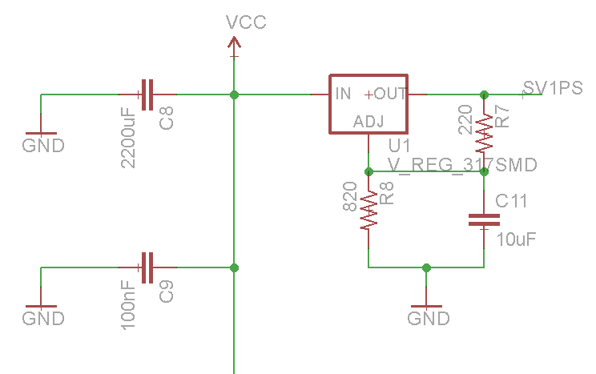
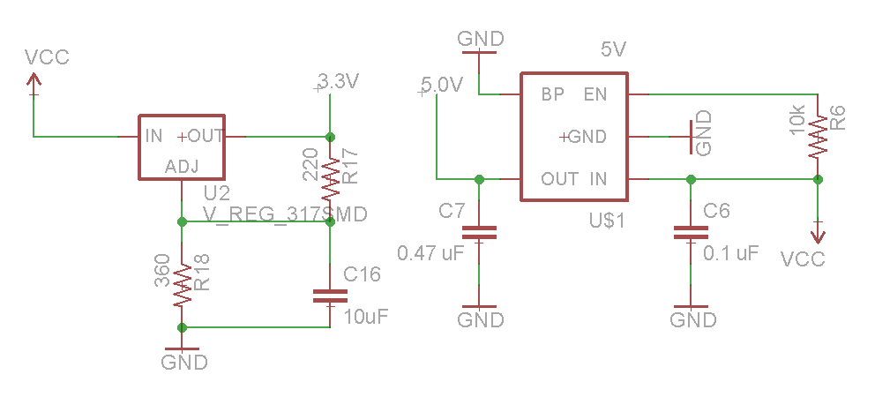
Power Management
  Voltage Regulators
  Non-Servo components consume 170 - 400 mA
  Servos consume at least 500 mA when in use, upwards to 2500 mA
    If entire system consumes 5400 mA, we would still have 1.5 hours of usage time
Notes:
We used voltage regulators to distribute power from our battery to the various components in the IPPA. The non-servo components consume between 170 and 400 mA from our battery, while the servos consume varying amounts. With no load, the servos total consumption is about 500 mA. With load, the servos can consume between 2500 – 5000 mA. If the system used 5400 mA continuously, the battery would drain after about an hour and a half.

Slide 49
Communication

Slide 50
Wireless Communication
  Communication between IPPA system and its mobile application
  Smartphones -> capable of Wi-Fi and Bluetooth communication
  Bluetooth
    Easier to implement
    Low power consumption
  Wi-Fi
  Enhanced features at a higher cost and higher power consumption
Factors | Wi-Fi | Bluetooth (Class 2)
Data Rate | 11Mbps - 150 Mbps | 1- 3Mbps
Range | 35 - 70 m | 10 m
Power Consumption | 4.7mW - 325mW | 2.5mW – 40mW
Price | $30 - $50 | $11 - $40
Security | WPA and WPA2 Encryption | PIN Code security
Notes:
Mention wifi is all three protocols

Slide 51
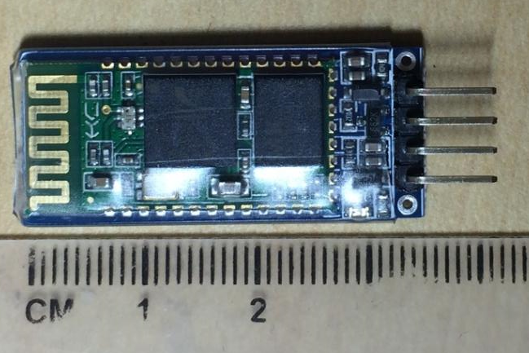
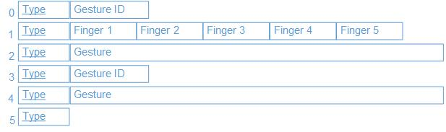
Communication Interface
  Custom packages will be used to transfer data from the app to the IPPA system
  9 Protocols
  The first byte will be used to identify package structure
  Bluetooth module will be transfer the data to/from the Main Controller MCU
Characteristics | HC-06
Manufacturer | KEDSUM
Price | $10.00
Power Consumption | 10 mW – 30 mW
I/O | TR/TX

Slide 52


IPPA Mobile Application
Android
  ~ 52.5% of the market
  Low cost devices
  Low publishing cost
  Existing (no cost) testing hardware
  Less implementation time needed
IOS
  ~41.4 % of the market
  Less accessible smartphones
  (due to cost)
  High publishing cost and restrictions
Development Environment
  Eclipse IDE
  GitHub Version Control
  Device and AVD simulation Testing
Notes:
Development Environment
Eclipse IDE
GitHub Version Control
Device and AVD simulation Testing

Slide 53
Mobile Application Features
Voice Commands
  Easy gesture triggering mechanism
    Using Google Services APIs
Teaching Mode
  Way to modify gestures available in the IPPA
  Demo created gestures before permanently copying them to the IPPA
  Create new customable gestures
    Starting and ending position of each finger
    Voice command triggering mechanism
    Sensor triggering mechanism

Slide 54
Application Flow
Notes:
The Bluetooth Package
- Talk about the interface built
- Talk about the service thread

Slide 55
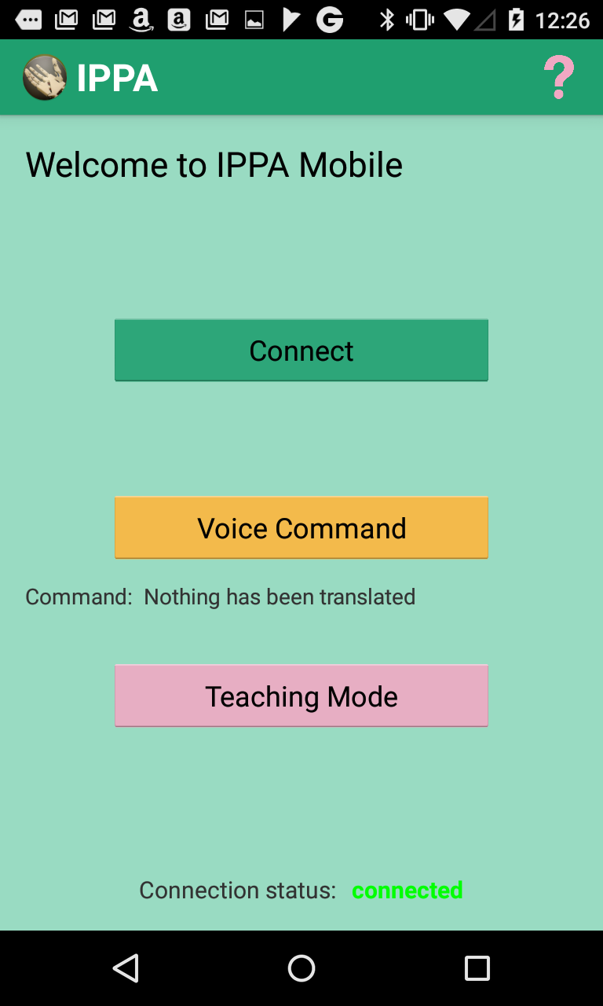
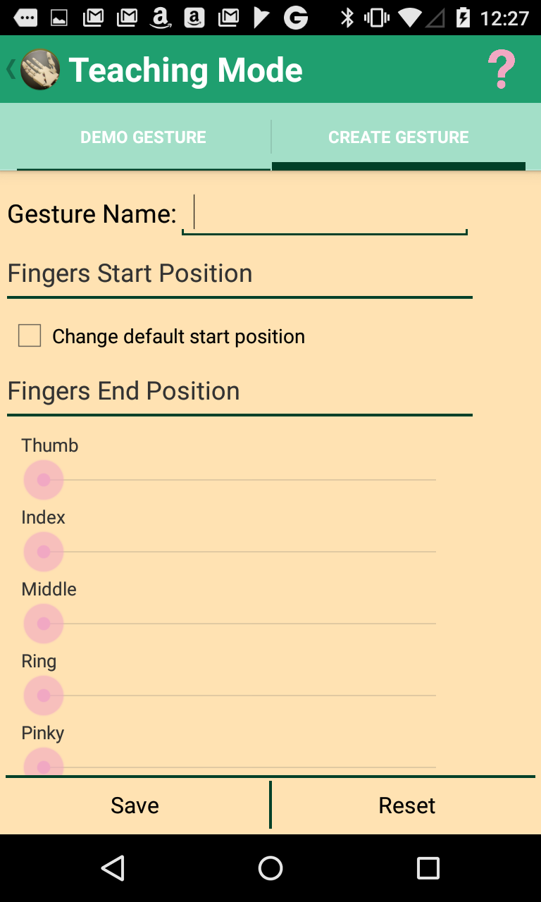
Prototype UI
Notes:
Update images

Slide 56
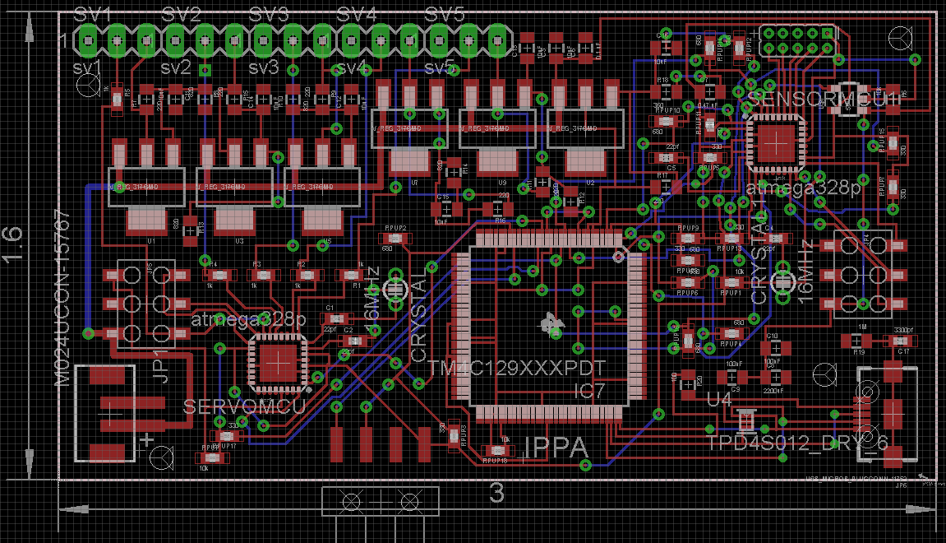
PCB Design
1.6”(h) x 3” (w) to fit inside the arm with the battery
All SMD components except for some of the headers
2 layers, one side with components
Oshpark chosen as the manufacturer
  Good price because of our board’s size
  Multiple copies
Notes:
This is a picture of our PCB layout. It was designed to be very compact, about 5 square inches. All of the components are surface mount, except for some of the headers. The board is 2 layer, with components on one side. Oshpark was chosen as our manufacturer because it was cheaper than other options given our board size and they send three copies for no extra charge.

Slide 57
Administrative Content

Slide 58
Final Product Cost
Quantity | Component | Individual Cost ($) | Total Cost ($)
5 | Servos | 19.99 | 99.95
1 | TM4C1294 | 19.99 | 19.99
2 | ATMega328p | 6.87 | 13.74
2 | Force sensitive resistors | 5.95 | 11.90
2 | Infared Emitters and Detectors | 1.95 | 3.90
1 | 7.4V Rechargeable Battery & charger | 111.95 | 111.95
1 | Fishing Line | 10 | 10
1 | Grip material | 5 | 5
1 | Printed Circuit Board | 30 | 30
1 | Bluetooth module | 8.99 | 8.99
1 | EMG module | 50 | 50
Quantity | Component | Individual Cost ($) | Total Cost ($)
2 | 5V Voltage Regulators | .67 | 1.34
2 | 3.3V Voltage Regulator | .67 | 1.34
5 | LM317 Adj. Voltage Regulator | 0.67 | 3.35
1 | 3D Printed Hand & forearm, 5 lbs. of ABS plastic | 300 | 300
2 | 25 MHz Crystal | .53 | 1.06
4 | 16MHz Crystal | .56 | 2.24
1 | Plastic Epoxy
Total |  |  | 674.75

Slide 59
Division of Labor
 | Mobile App | Servo Controller | Sensor Controller | System Controller | Power Subsystem
Andrew |  | Primary |  | Primary
Ivette | Primary
Matthew |  |  | Primary |  | Primary
 | Arm printing & Construction | Documentation | Material acquisition | PCB Design
Andrew
Ivette | Primary | Primary
Matthew |  |  | Primary | Primary

Slide 60

Questions

