Slide 1
SARS
Search and Retrieval System
Matthew Bahr, CpE
Brian Crabtree, CpE
Brendan Hall, CpE
Erick Makris, CpE

Slide 2
Motivation
•Simulate an autonomous search-and-retrieval mission using drones with real-world applications
•Gain experience in wireless communication, embedded programming, object detection, and hardware/software integration
•Design a multi-faceted system that is challenging, engaging, and most of all fun.
•Complete a project that satisfies UCF Senior Design requirements and provides us with experience for potential employers

Slide 3
System Overview
SARS is composed of 3 major sub-systems
Quadcopter
Rover
Linux Application
a.k.a. The Command Distribution Center (CDC)

Slide 4
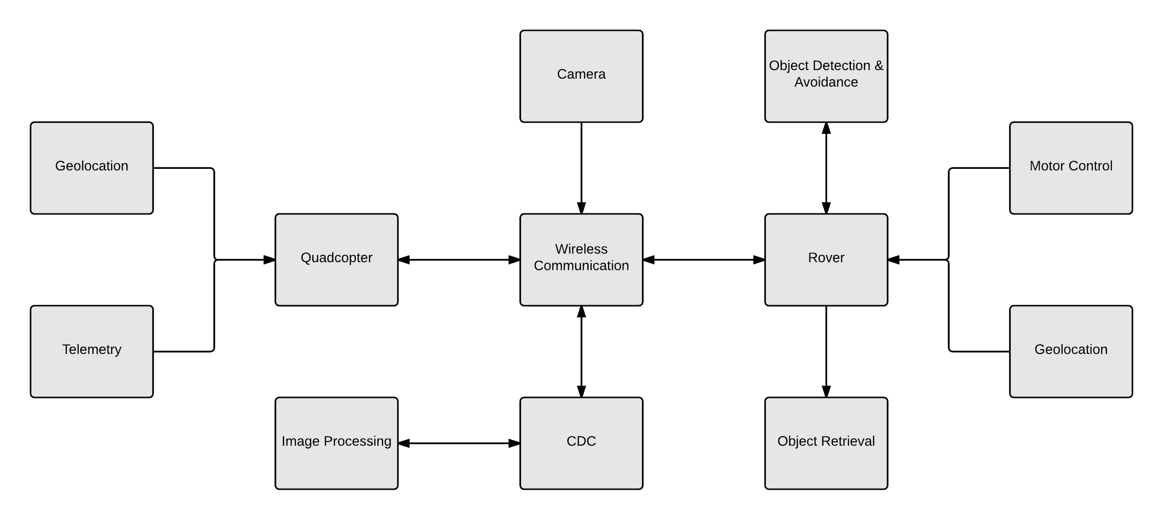
System Overview

Slide 5
Quadcopter Specifications
Capable of interfacing wirelessly with the SARS Command Distribution Center ( the “CDC” desktop application)
Capable of capturing high quality videos/images
Camera stabilization to facilitate image processing
Capable of calculating its GPS coordinates accurate to within 3 m
Capable of executing a planned mission by traveling to predesignated waypoints
Capable of hovering at a constant height between 5 ft and 25 ft with a variation in height no greater than 3 in.
Has battery life up to 10 minutes
Basic weatherproofing

Slide 6
CDC Specifications
Must be capable of sending and receiving GPS and other diagnostic information collected by the sensors on the quadcopter and on the rover.
Must be capable of providing stop and start commands to the rover and the quadcopter
Must display the live video feed from the quadcopter camera
Must be capable of extracting still images from the live video feed
Must handle the processing of image data to effectively identify a target object on the ground

Slide 7
Rover Specifications
Must be capable of interfacing wirelessly with the CDC desktop application
Must be capable of traveling up to 1000ft. on a single battery charge
Must have an object retrieval subsystem for picking up a target object
Must have an object detection subsystem that will be used for both avoiding obstacles and retrieving the object
Must be capable of carrying a payload of 5 lbs.
Must have basic weatherproofing

Slide 8
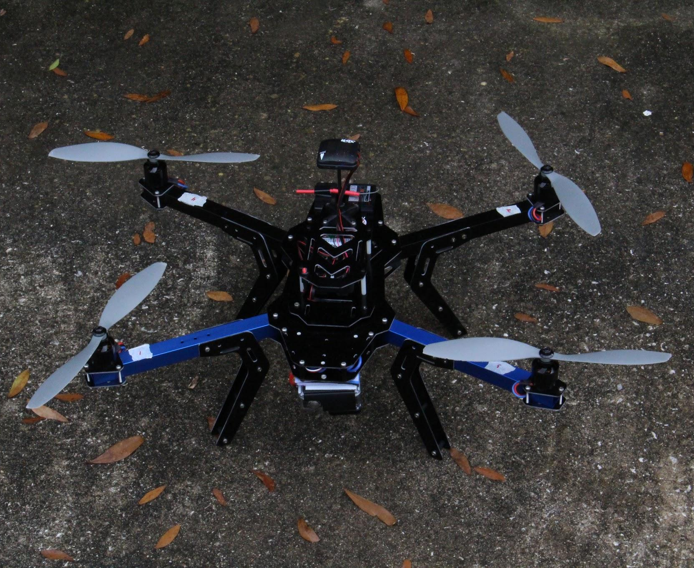
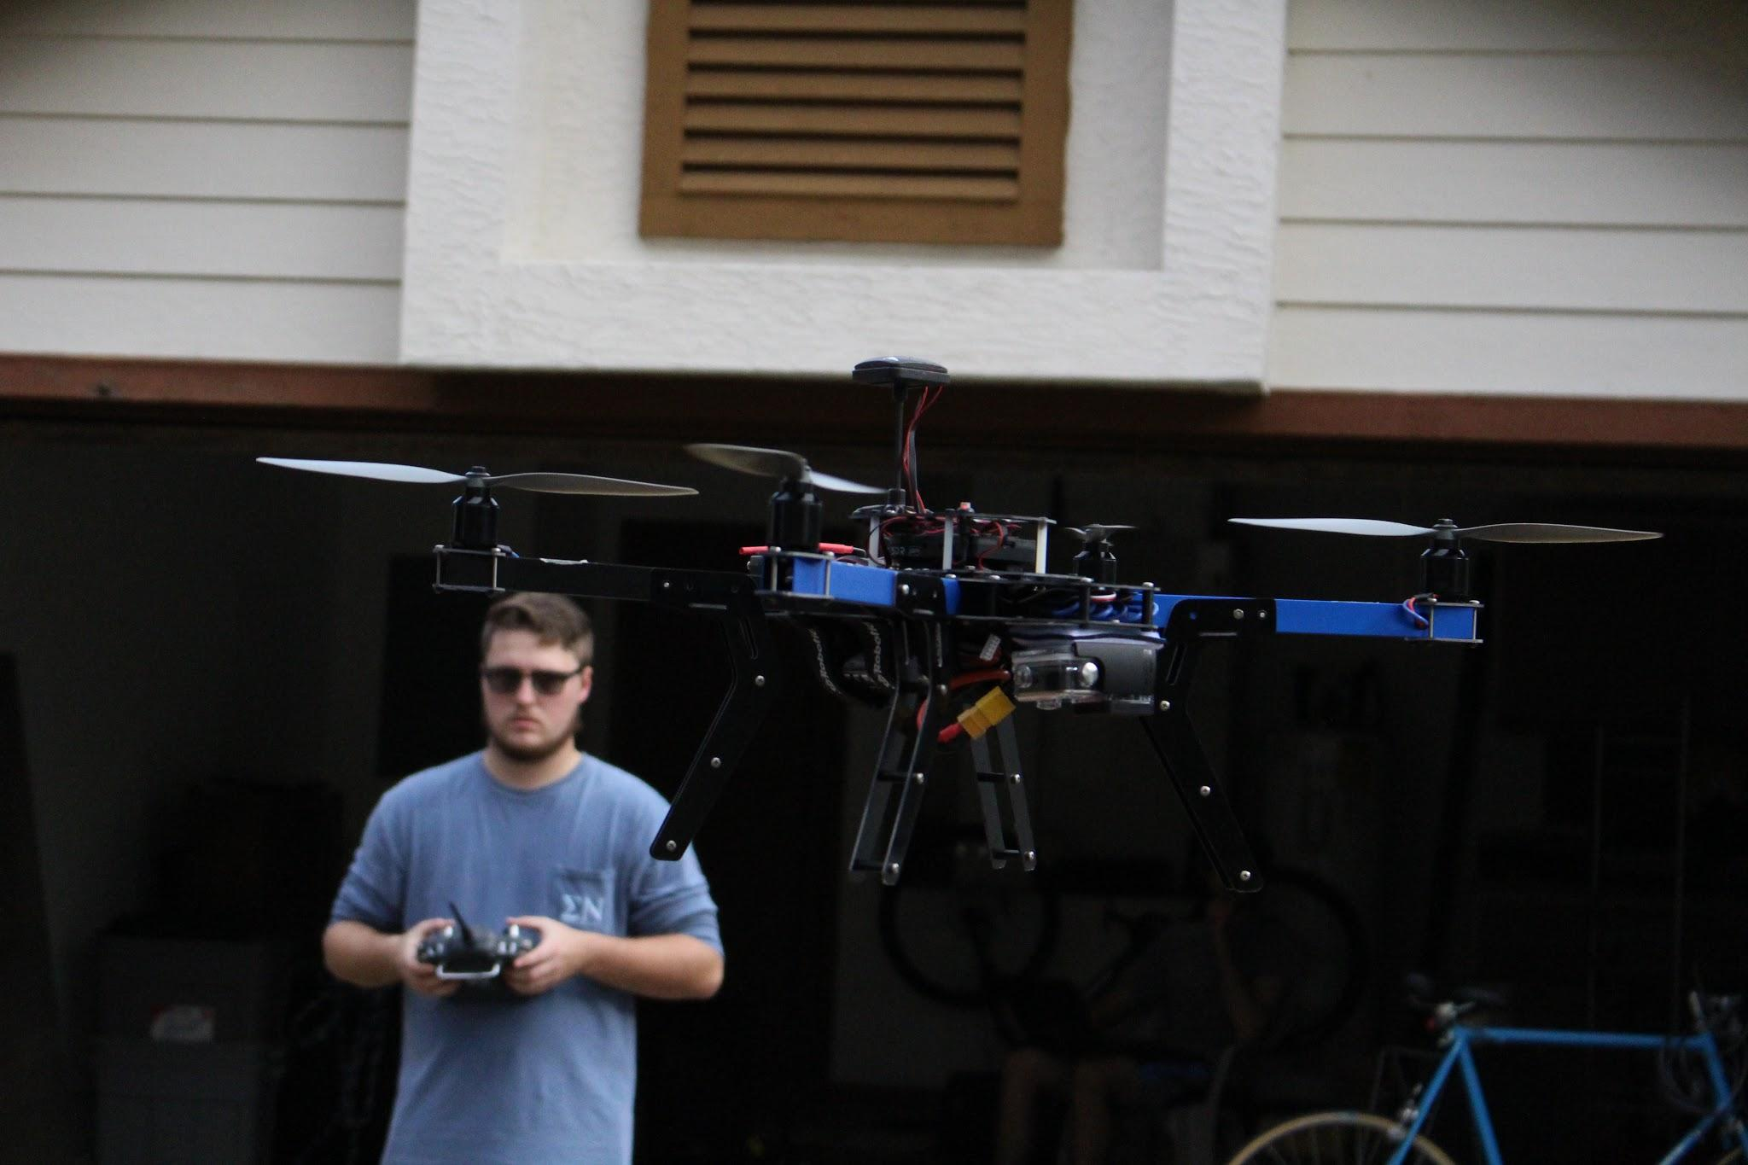
Quadcopter

Slide 9
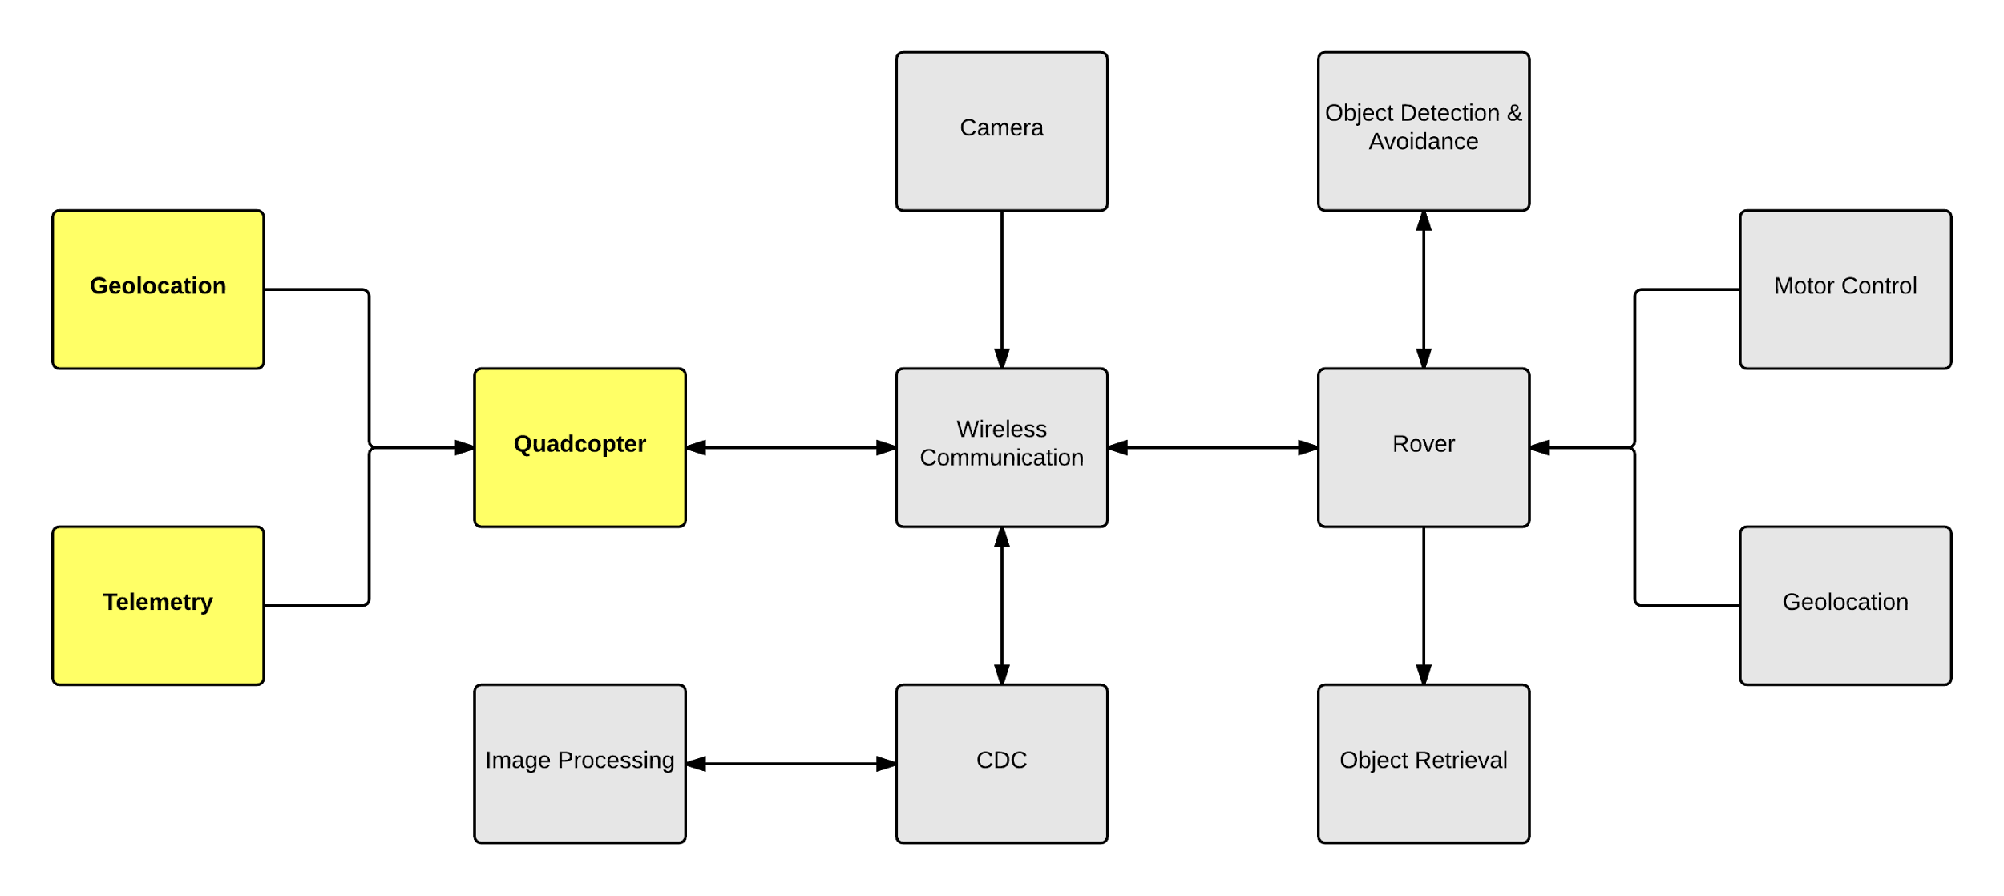
Quadcopter Subsystem

Slide 10
Arducopter
Open source multicopter UAV platform
Runs on the Pixhawk flight controller
Provides autonomous flight capability and is compatible with Mission Planner/QGroundControl and MAVLink Protocol
Robust online support community

Slide 11
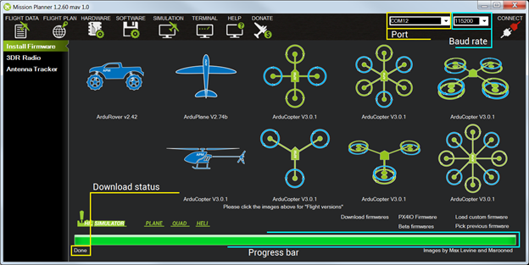
Mission Planner
Point-and-Click Waypoint navigation with Google Maps integration
Python-compatible flight code
Full hardware-in-the-loop simulation with desktop flight simulator
MAVLink protocol built-in
Easy to setup firmware and calibrate hardware
Accelerometer
Compass
RC telemetry
ESCs

Slide 12
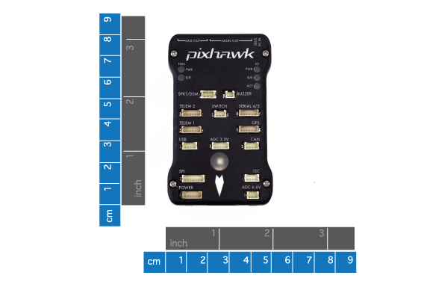
Pixhawk Flight Controller
L3GD20 3-axis 16-bit gyroscope
LSM303D 3-axis 14-bit 3D linear accelerometer and magnetometer
Invensense MPU 6000 3-axis accelerometer/gyroscope
MEAS MS5611 barometer
5x UART, SPI, and I2C serial capability
PPM Sum Signal
3.3 and 6.6 ADC inputs
External microUSB port

Slide 13
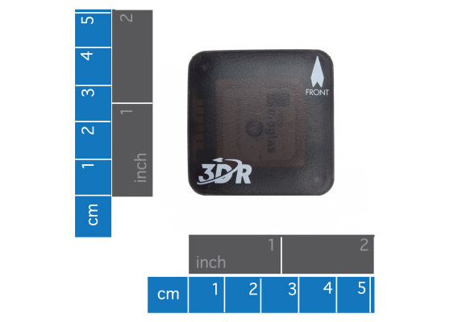
U-blox GPS
5 Hz update rate
Low noise 3.3 V regulator
I2C EEPROM for configuration storage
APM-compatible 6-pin DF13 connector
Exposed RX, TX, 5V, and GND pad

Slide 14
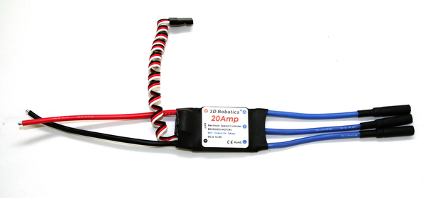
Electronic Speed Controllers (ESC)
3 start modes: normal, soft, and super-soft
Programmable throttle range
Separate voltage regulator for on-board microprocessor
Max supported motor speed: 70,000 RPM
20 A continuous current, 25 A burst current (10 sec max)
Battery Eliminator Circuit (BEC) output 5V 2A
Battery: 2-4 LiPo

Slide 15
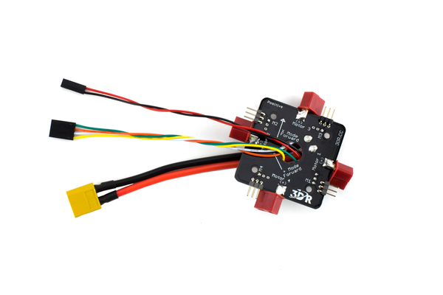
Power Distribution Board
 | 3DR Power Module
Max. Input Voltage | 18 V
Min. Input Voltage | 4.5 V
Max Current | 90 Amps
Weight | 38 g
Flight Battery Cable | 6" 14AWG red/black cable
ESC Cables | 4 female Deans connectors 1 XT60 connector

Slide 16
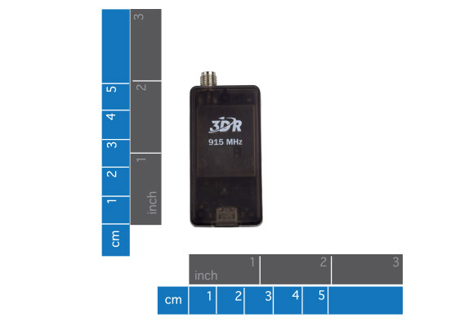
RC Telemetry Radios
915 MHz (US Standard)
6-position DF13 connector
-117 dBm receive sensitivity
2-way full-duplex communication through adaptive TDM
MAVLink protocol framing
Frequency Hopping Spread Spectrum (FHSS)
Error correction up to 25% of bit errors
Supply voltage” 4.7-6 VDC
Transmit current: v100 mA at 20 dBm
Receive current: 25 mA

Slide 17
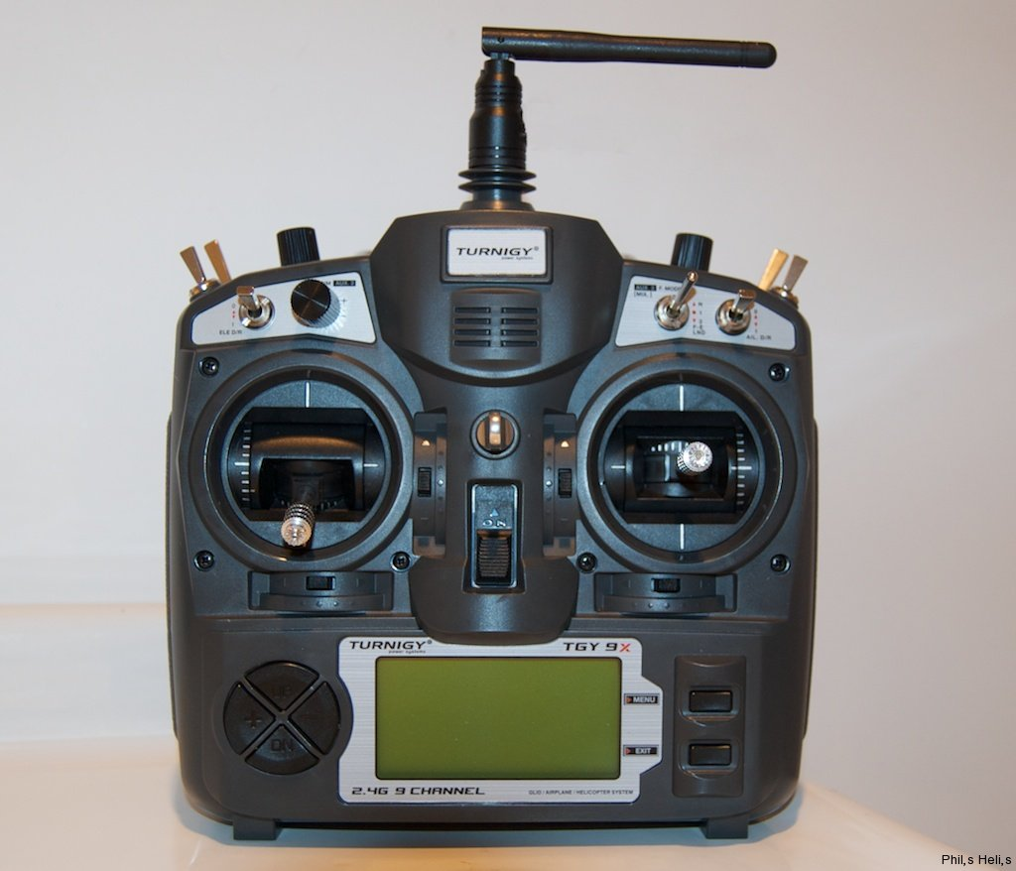
Turnigy 9x 9Ch Transmitter
8ch PWM (Pulse-Width modulation)
Mode 1
Right Stick: Throttle Aileron
Left Stick: Elevator and Rudder
2.5 GHz
Includes 9X8C-V2 8-channel receiver
Receiver weight: 18 g
LCD Display

Slide 18
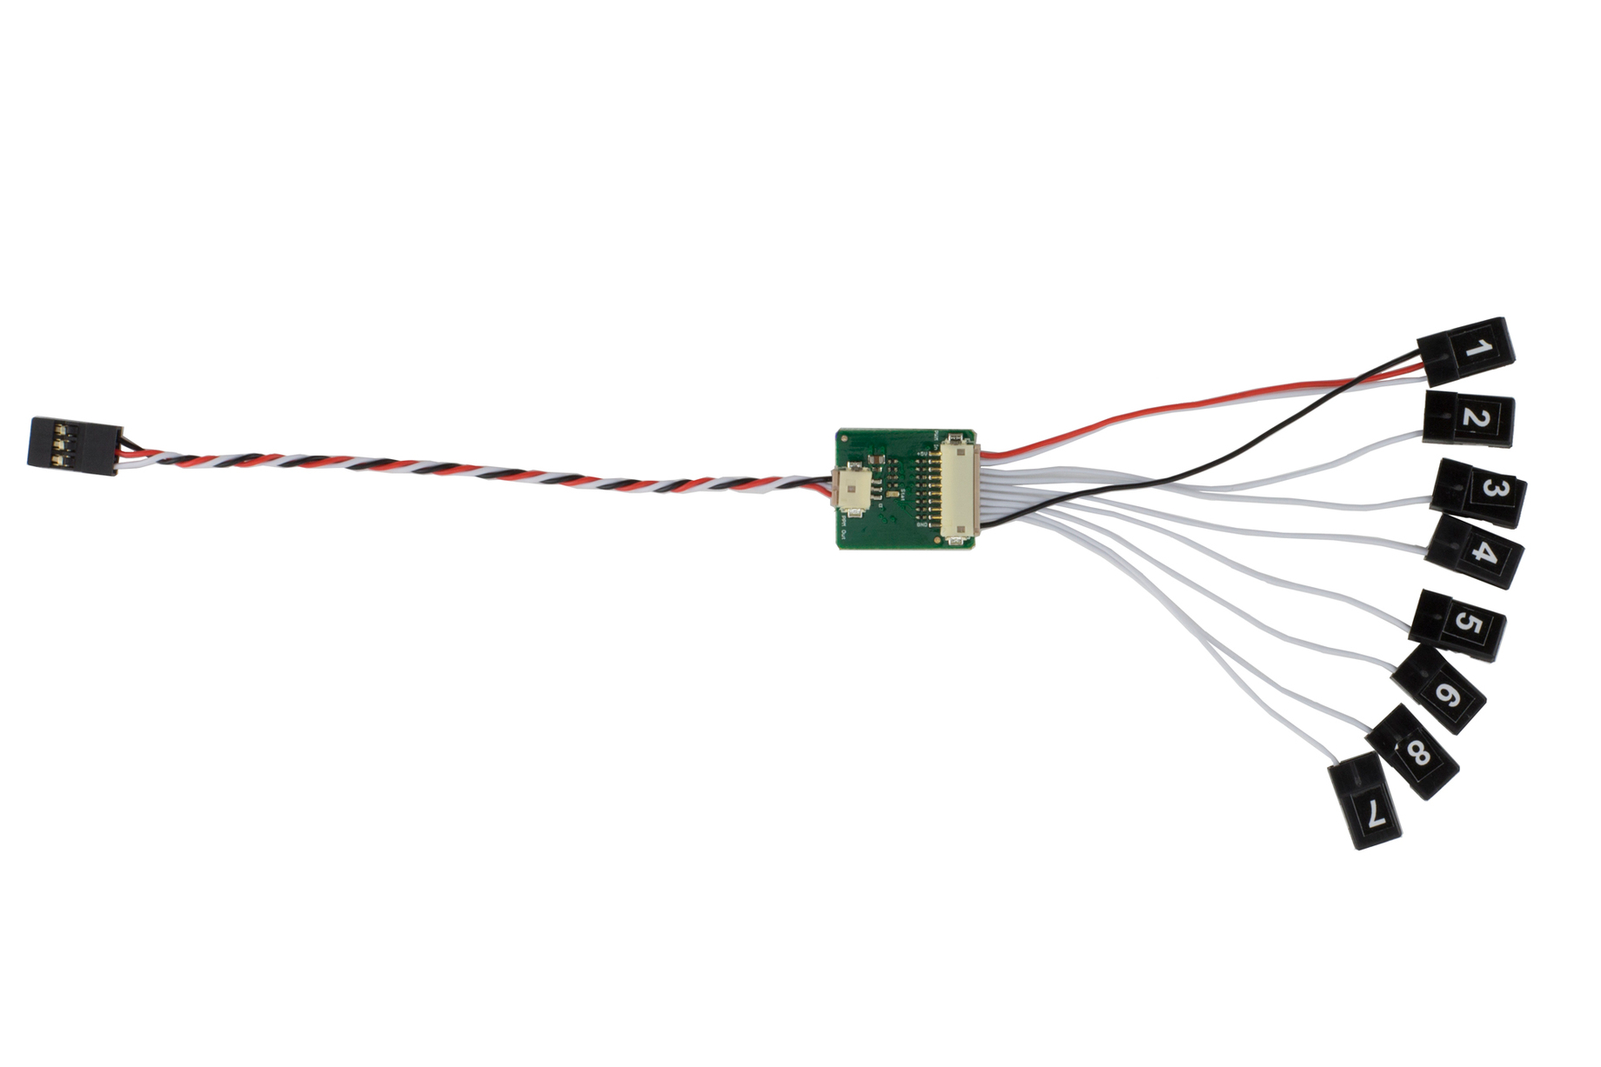
PPM Encoder
Converts PWM-only signals from 8-channel Turnigy Receiver to PPM-Sum signal for the Pixhawk
Faster processing
Reduced points of error

Slide 19
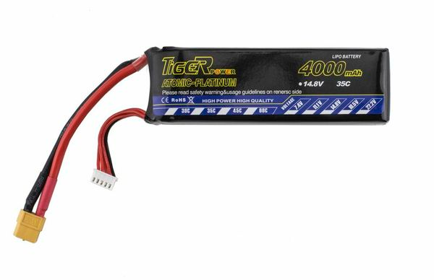
Battery
14.8 V
4000 mAh
XT60 Connector and JST-XH charging connector
Weight: 407 g

Slide 20
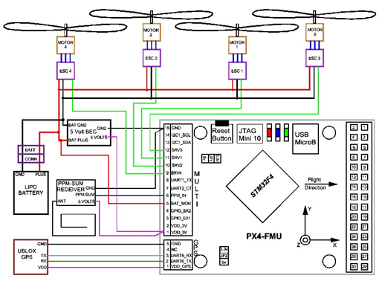
Quadcopter Wiring Diagram

Slide 21
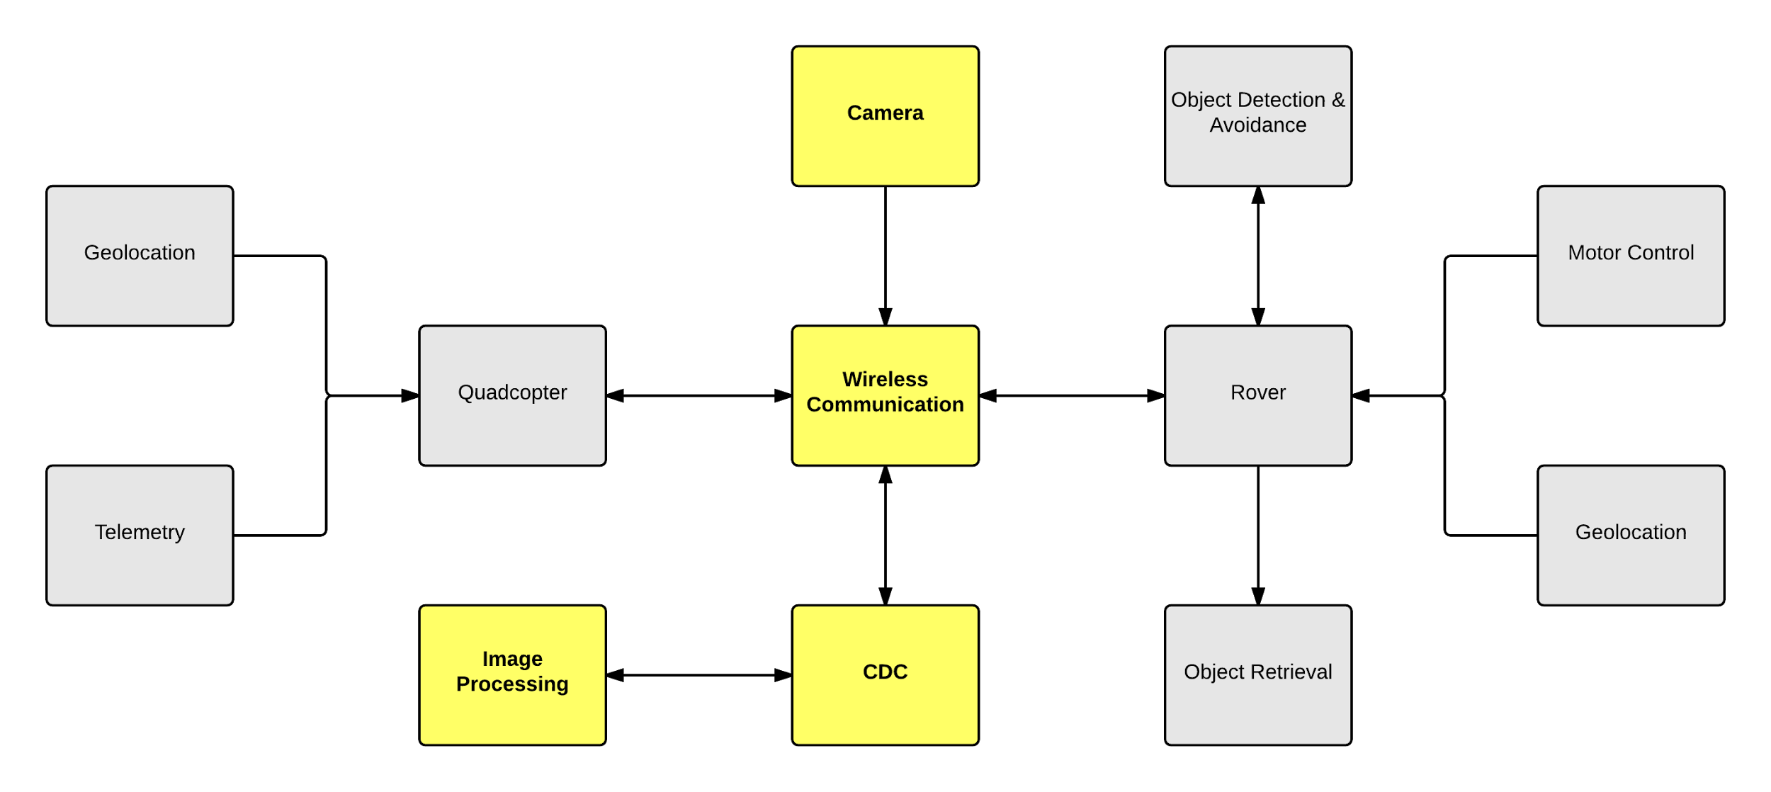
Application Subsystem

Slide 22
Camera Comparisons
 | GoPro Hero3 White | Raspberry Pi w/ PiCam
Pros | Wi-Fi capabilities High quality images Excellent battery life GoProController library Weatherproof | High quality images Lightweight and small Cost ($24.99)
Cons | Weight (4.8 oz) Cost ($199.99) | Connects directly to the Raspberry Pi’s CSI port

Slide 23
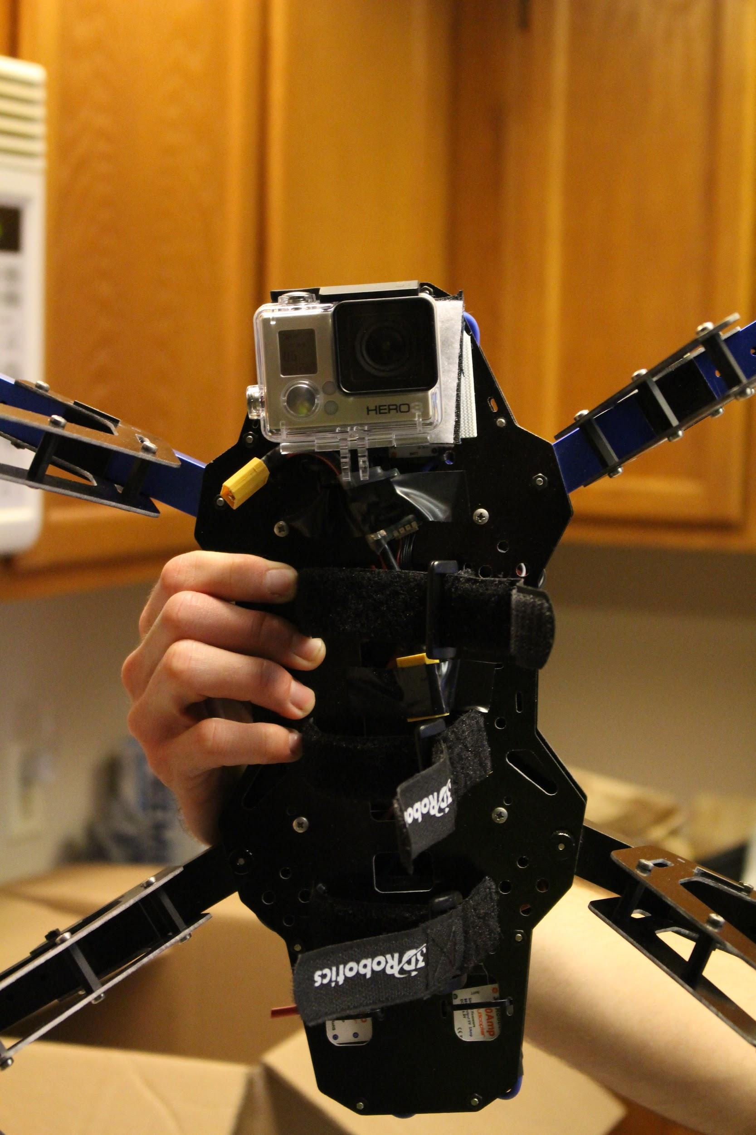
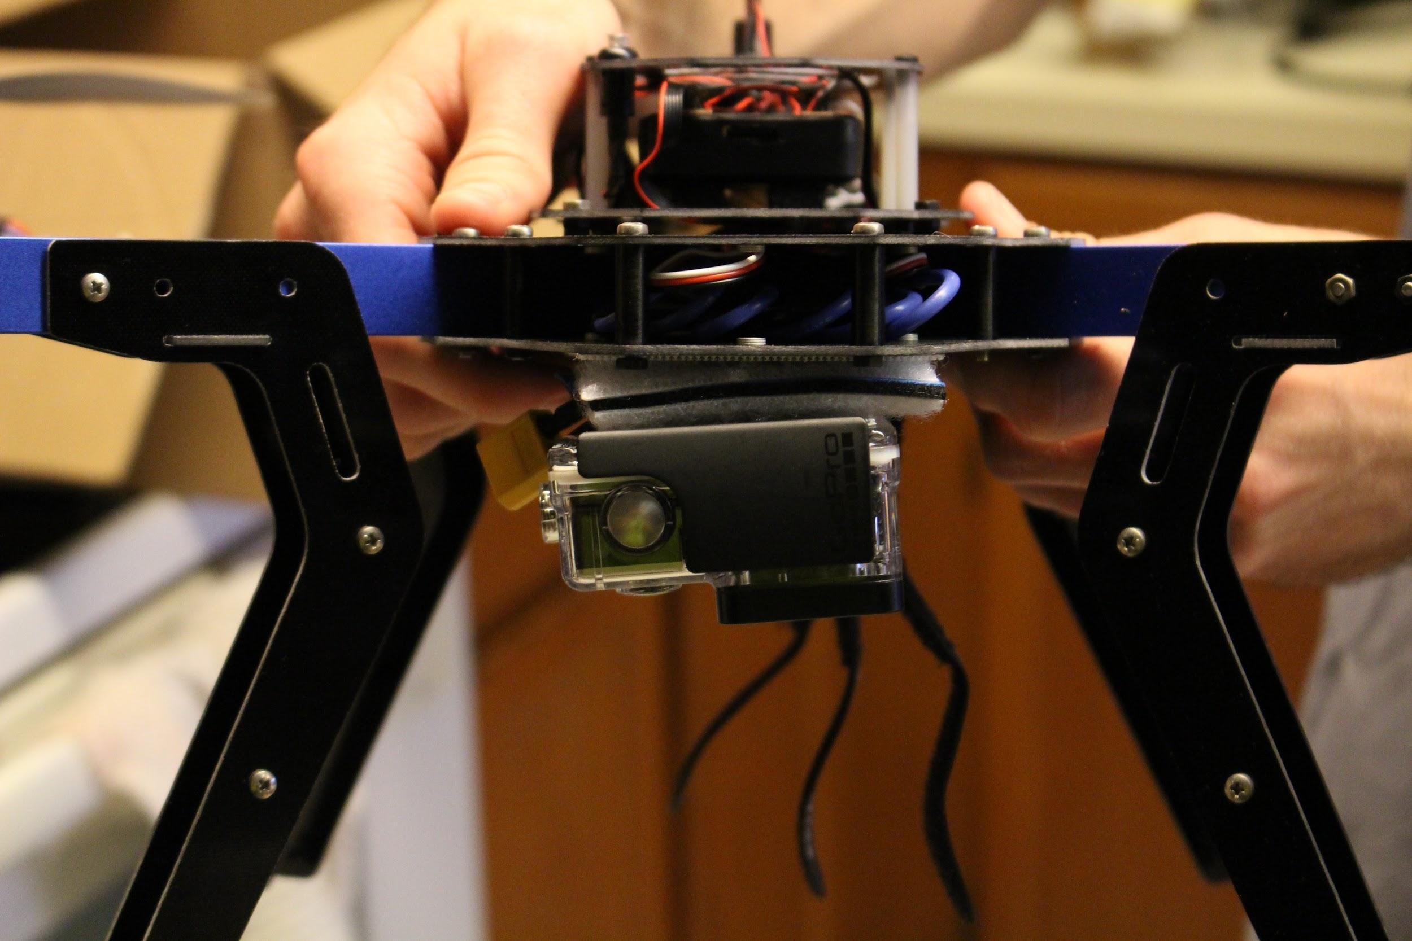
Camera Mount

Slide 24
Image Processing
To be run through the CDC desktop application.
Use OpenCV libraries for classifier training and object detection.
The opencv_traincascade application uses a variation of the AdaBoost algorithm to train the system.
Requires a large set of positive and negative sample images.

Slide 25
GoProController
Open source library for remotely monitoring and controlling a GoPro camera.
Uses the GoPro’s wireless ad-hoc connection
Allows frame extraction from the GoPro feed.
Effective up to 150 feet from the camera
Runs on Linux machines with compatible wireless cards.

Slide 26
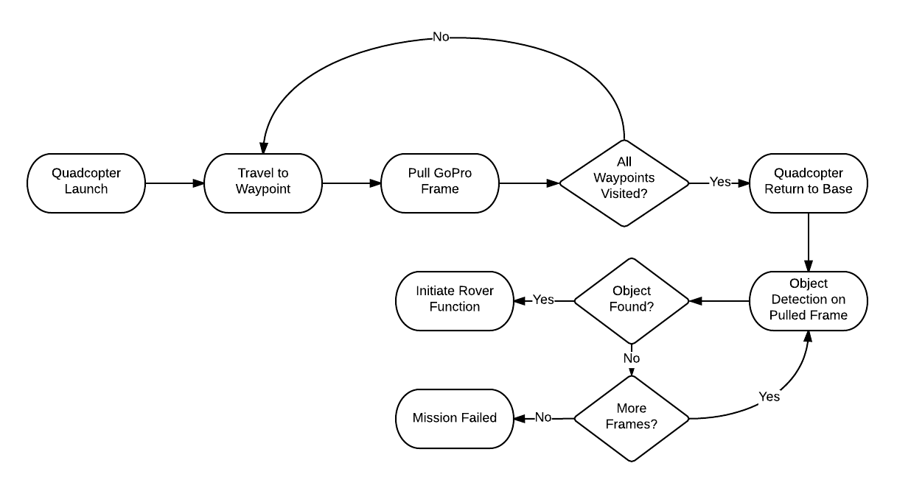
Software Activity Diagram

Slide 27
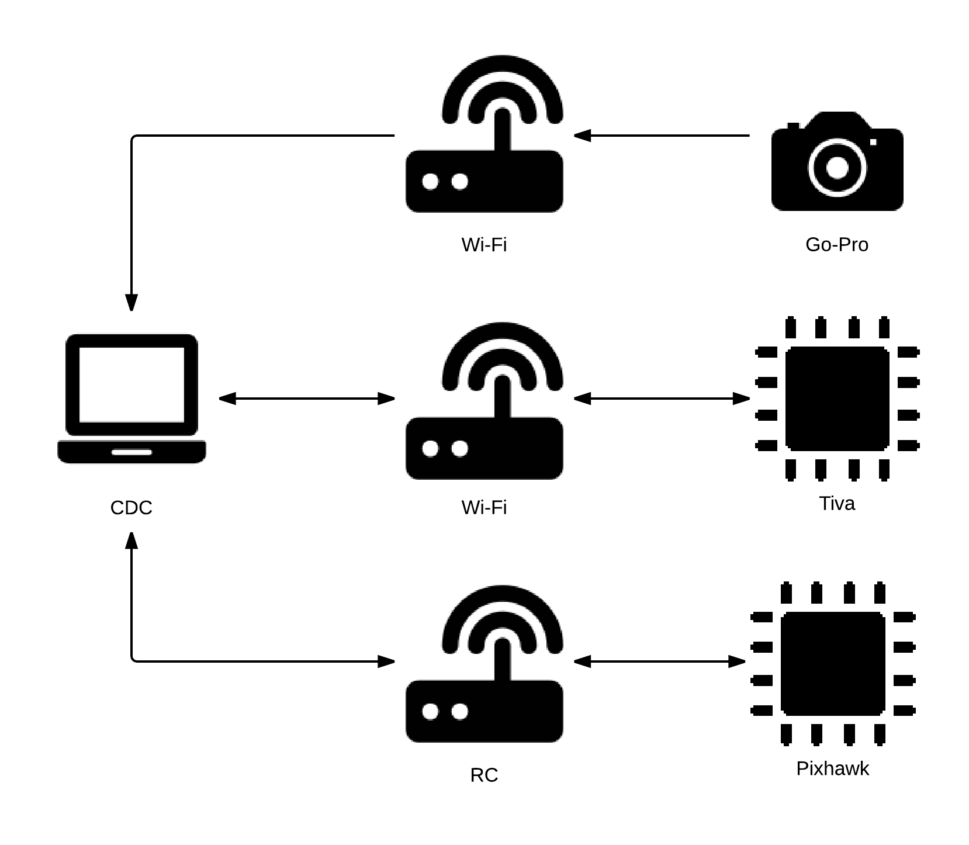
Wireless Communication

Slide 28
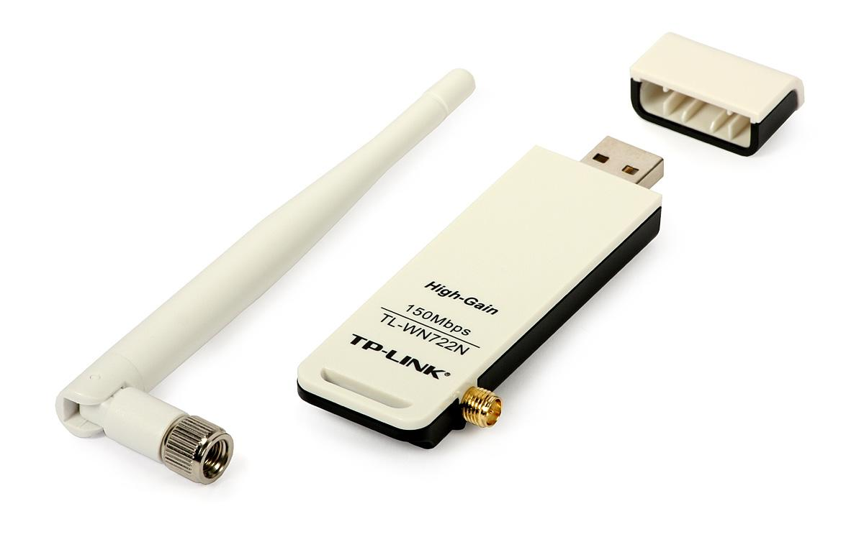
TP-LINK TL-WN722N
Supports IEEE 802.11 b/g/n
Up to 150Mbps with 802.11n
4dBi High Gain Antenna
Antenna is detachable and upgradeable
USB 2.0
Provides a dedicated ad-hoc connection to the Go-Pro camera

Slide 29
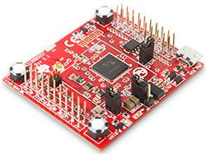
TI SimpleLink Wi-Fi CC3100
Embedded Wi-Fi network processor
TCP/IP stack and Wi-Fi driver
Supports IEEE 802.11 b/g/n
Integrated power management system handles supply voltages from 2.1V - 3.6V
Can be mounted directly on a PCB
TI provides layout reference
Communicates with Tiva using UART
Can trigger interrupts

Slide 30
CDC
Connects to Go-Pro via TP-LINK TL-WN722N
Displays live video feed from Go-Pro
Extracts still images from live video feed using GoProController library
Detects the target object using OpenCV libraries
Communicates with quadcopter using pymavlink library
Communicates with rover via Ti CC3100
Messages will be transmitted/received using sockets

Slide 31
CDC Development Tools
CDC application will be developed using Python
CDC will run on Debian/Ubuntu Linux distributions
GUI will be designed using Qt and PyQt
Embedded video player will be designed using libVLC

Slide 32
Why Python?
Python is fast, powerful, and easy to use
More focus on high-level algorithms
Less focus on specific implementation details
CDC has several Python library dependencies
We want to code in as few languages as possible
We don’t want to embed Python into C/C++

Slide 33
Qt / PyQt
Qt is a cross-platform application framework for designing and building GUI’s
GUI’s use the native look and feel of the OS
Binds applications to C++ code by default
Can bind applications to Python scripts instead using PyQt bindings
PyQt takes Qt UI forms and generates Python scripts

Slide 34
LibVLC
Open source media framework on which VLC is based
Can be used to embed media players with the same functionality as VLC
Python bindings available
Compatible with Qt/PyQt
Will be used to embed Go-Pro live video feed

Slide 35
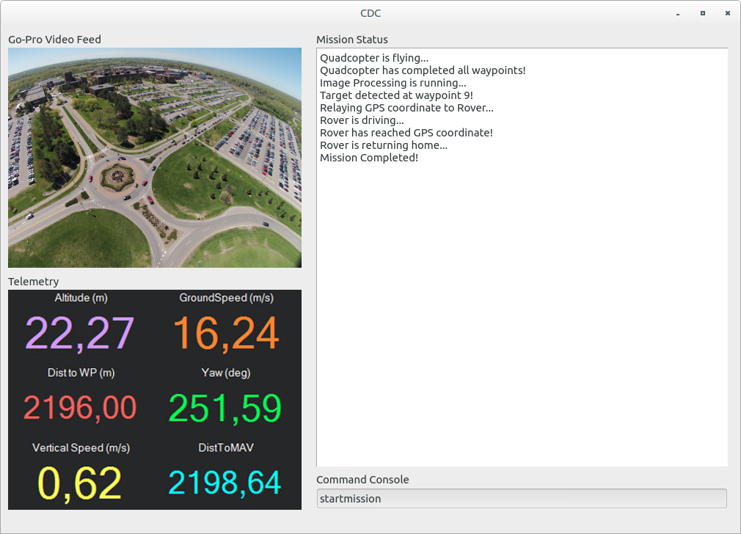
CDC GUI

Slide 36
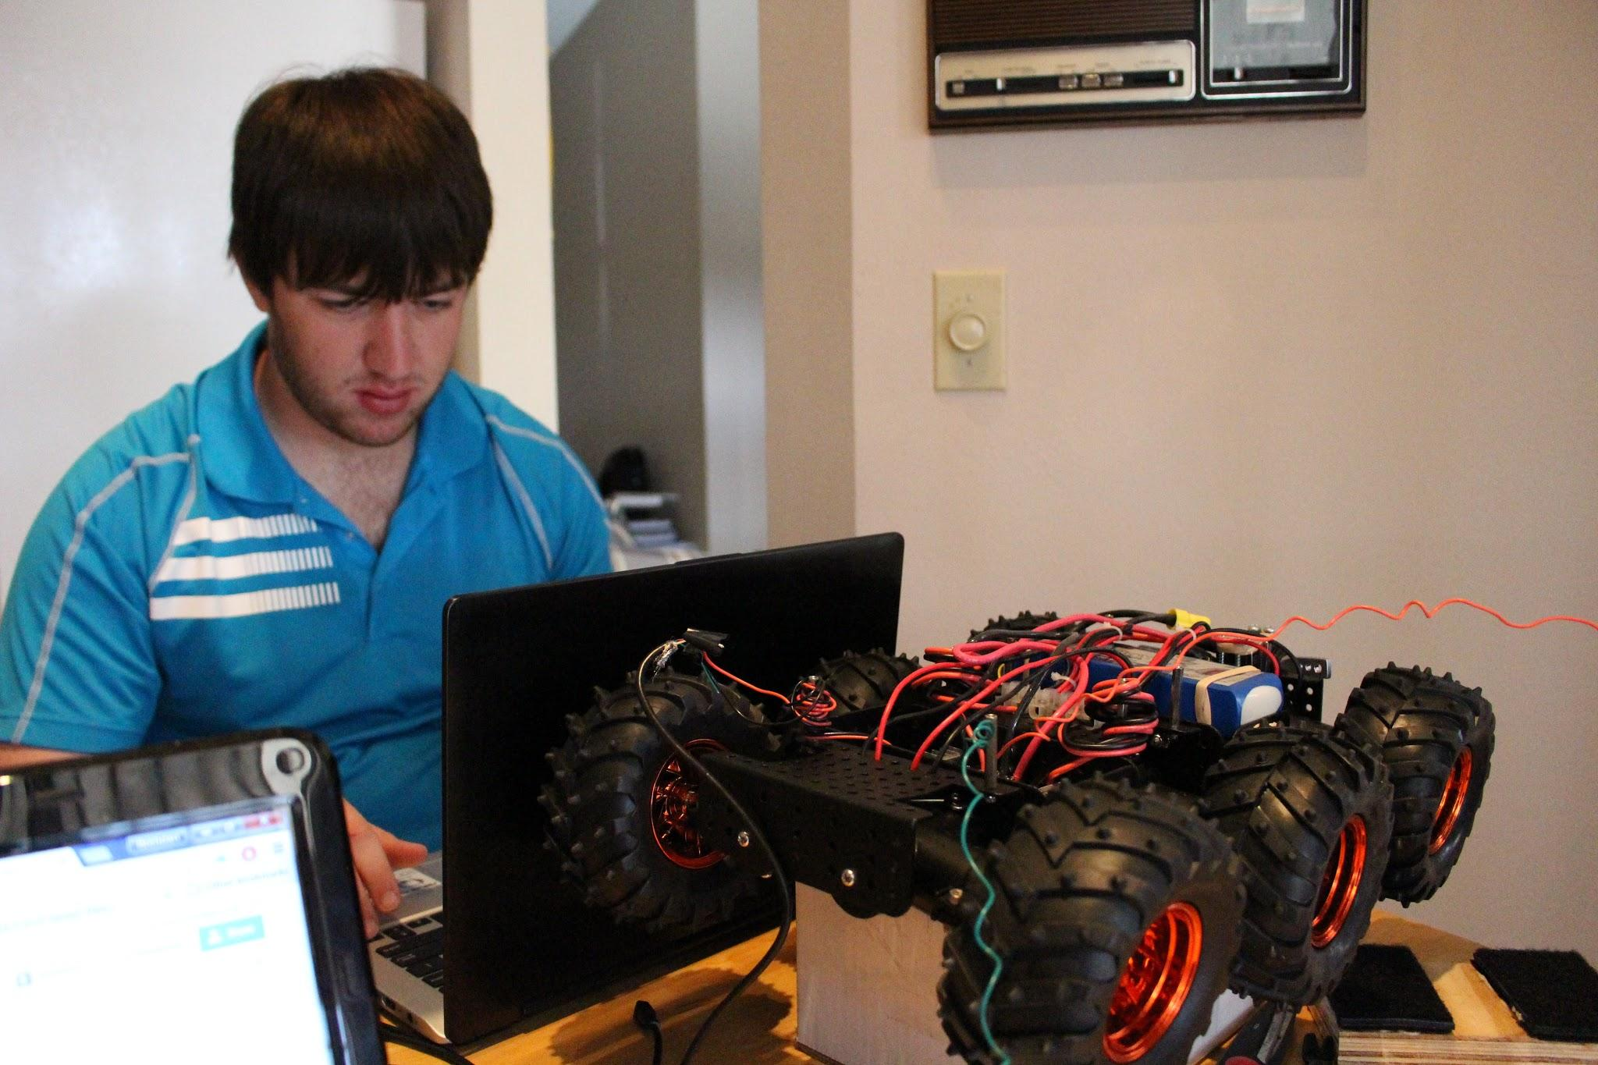
Rover

Slide 37
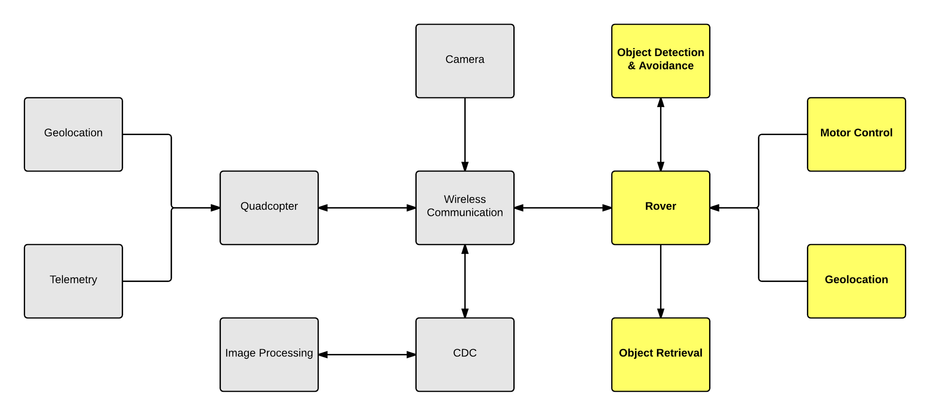
Rover Subsystem

Slide 38
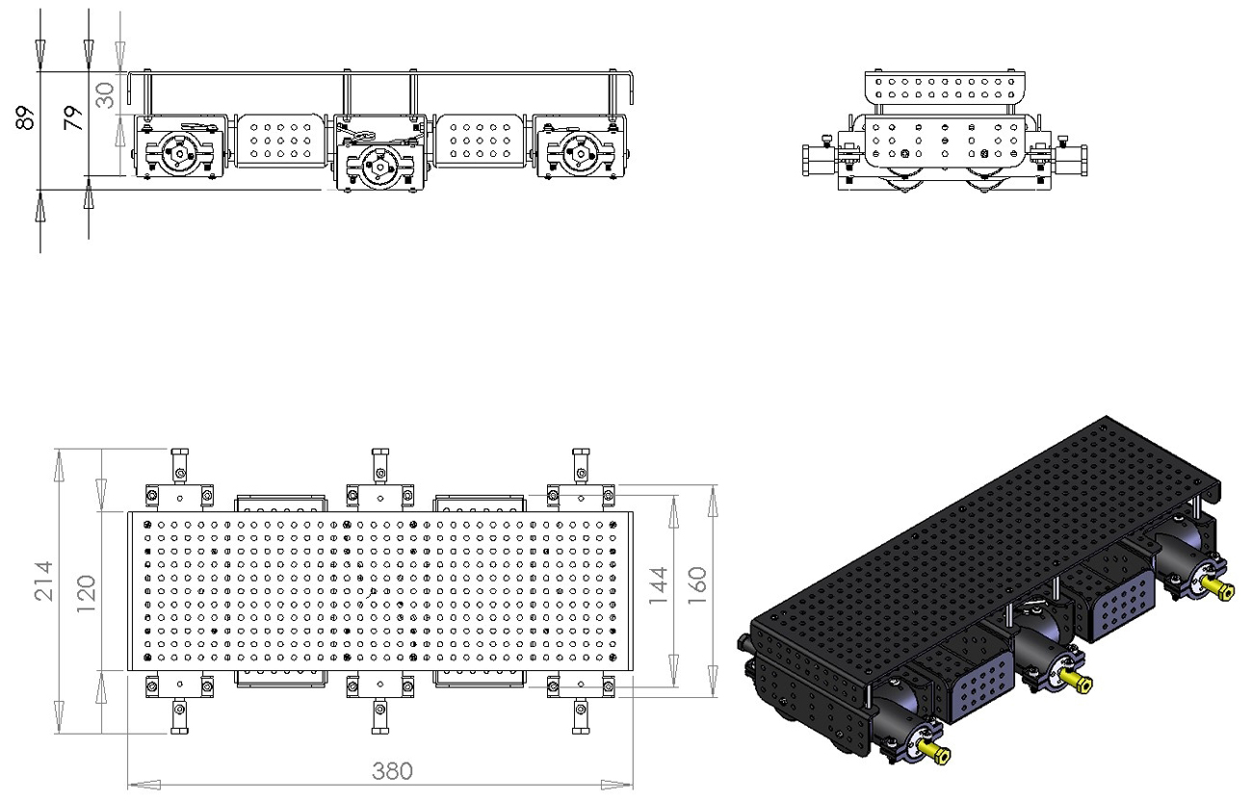
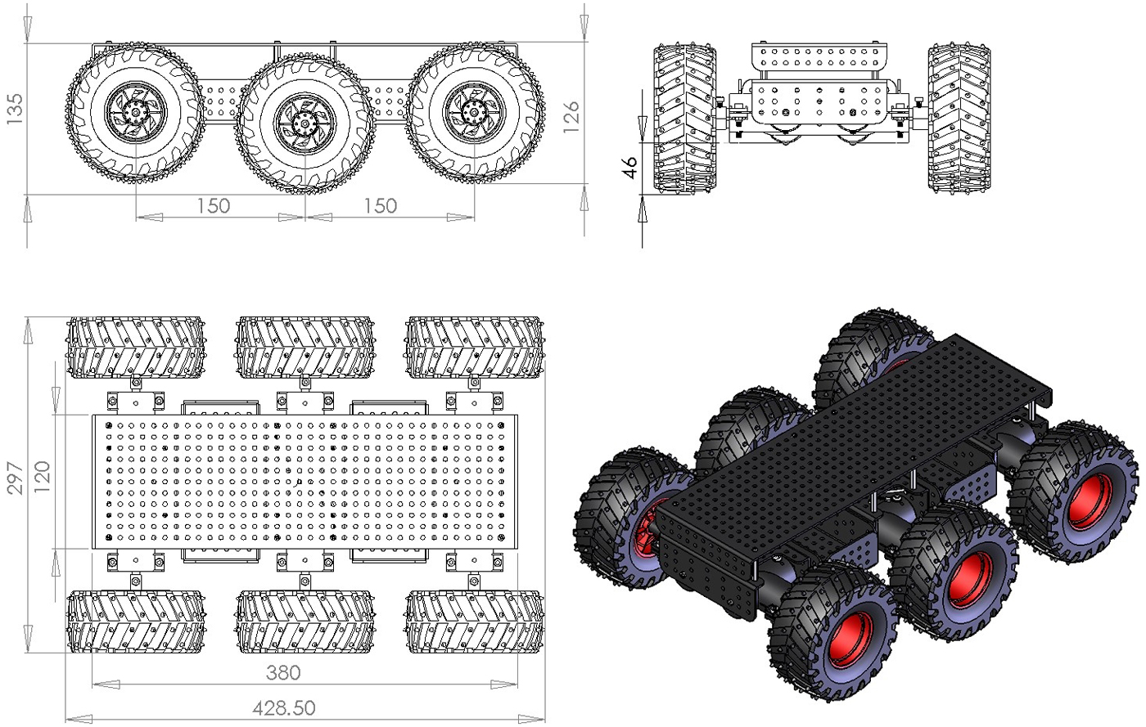
Chassis & Motors
Motors (6)
6VDC, 5.5A stall
10000RPM, 34:1 gear ratio
Output shaft 295RPM, stall torque 4Kg/cm

Slide 39
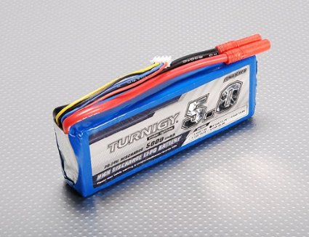
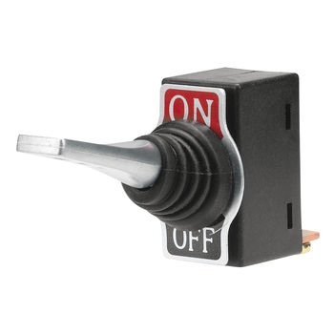
Battery & Power Switch
Battery
5000mAh
3S1P, 11.1V
20C const. discharge/30C peak
Power Switch
SPST Toggle
12VDC, 50A; 24VDC, 25A

Slide 40
Motor Controller
Sabertooth 2x25 Regenerative Motor Controller
2 channel control
25A continuous, 50A peak per channel
6-30V nominal
Serial command input (UART)
Thermal & overcurrent protection
5V 1A switch-mode BEC

Slide 41
Microcontroller Comparison
 | Tiva C | Concerto
Processing Core(s) | ARM Cortex M4 | ARM Cortex M3, TI C28X (FPU)
Operating Frequency | 120MHz | 100MHz
Flash Memory | 1024KB | 512KB
RAM | 256KB | 64KB
UART | 8 | 5
SSI/SPI | 4 (Bi, Quad, Advanced) | 4
I²C | 10 | 2
GPIO | 140 | 64
Average Chip Cost | ~$20 | ~$35

Slide 42
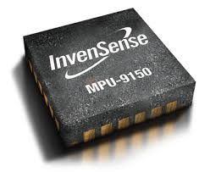
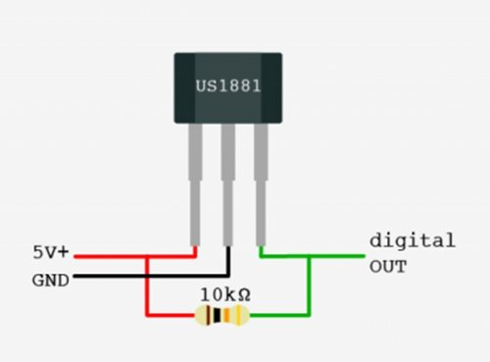
Sensors
Invensense MPU 9150
I2C communication
9 DOF
3 axis accelerometer
3 axis gyroscope
3 axis magnetometer
A3144 Hall Effect Sensors (GPIO)
PING))) Ultrasonic Sensor
2cm to 3m range
GPIO

Slide 43
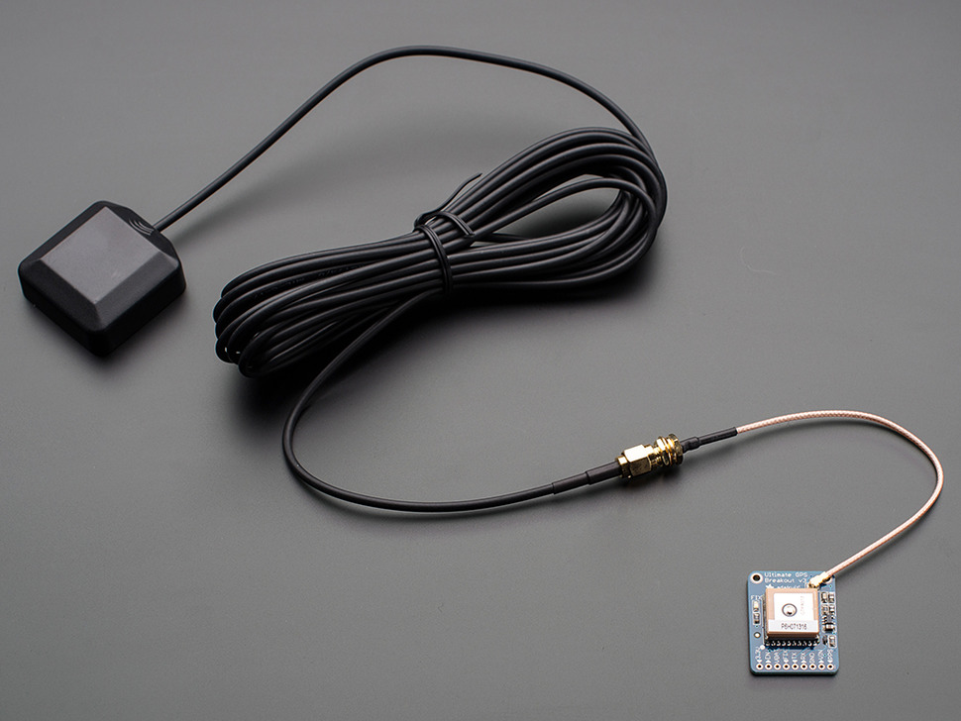
Adafruit Ultimate GPS Breakout
66 channels
10Hz updates
UART - NMEA Sentences
-165dBm sensitivity
Active antenna - 28dB gain

Slide 44
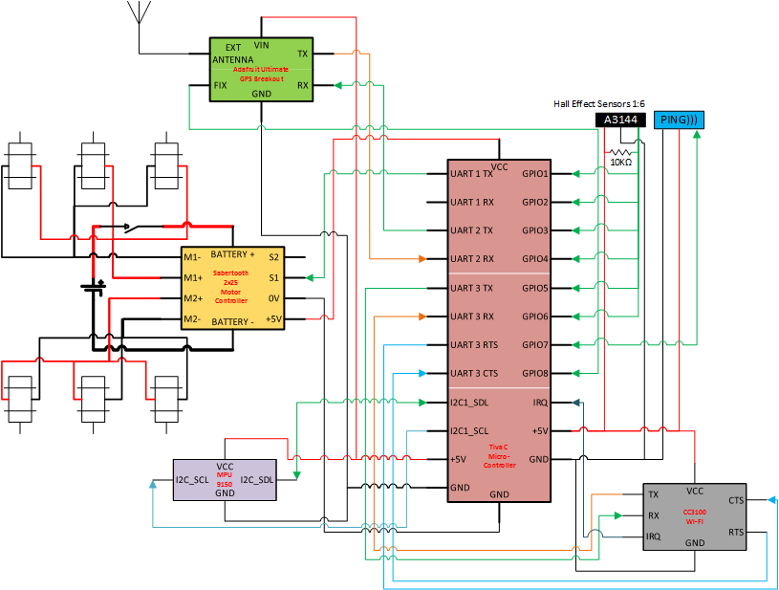
Rover Wiring Diagram

Slide 45
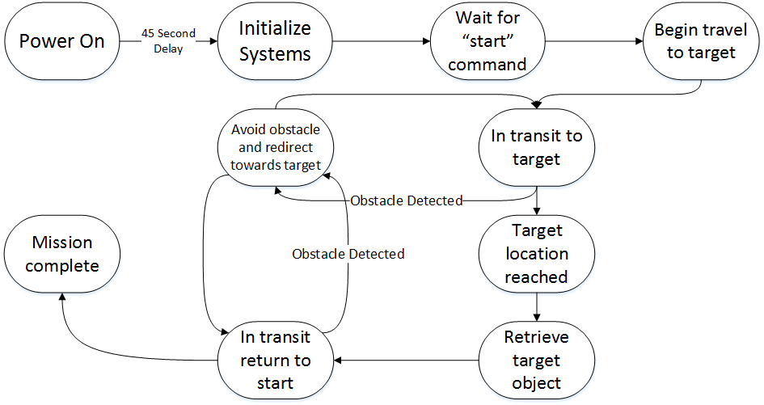
Rover Software Activity

Slide 46
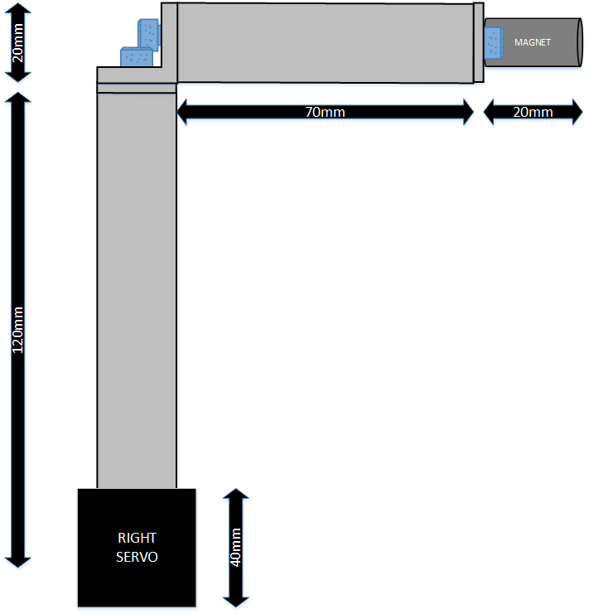
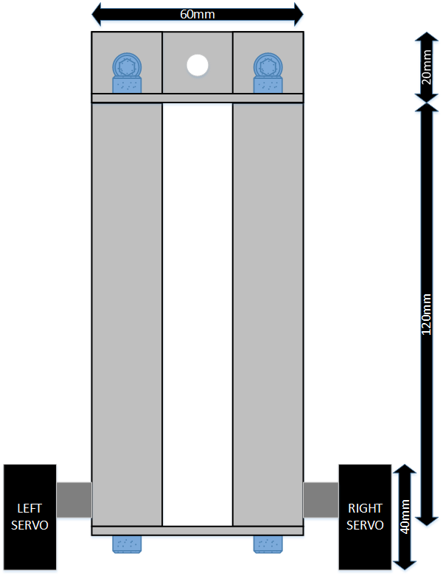
Object Retrieval Arm
Servos
6.5Kg*cm
.21sec/60°
Plastic Gears
Analog Feedback
5V
Arm
Aluminum
20mm x 20mm

Slide 47
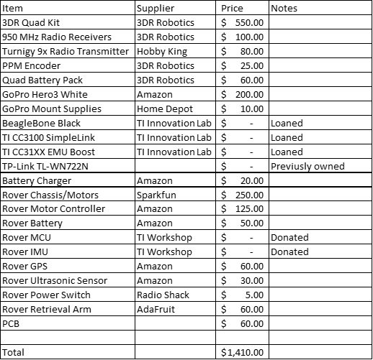
Budget

Slide 48
Budget

Slide 49
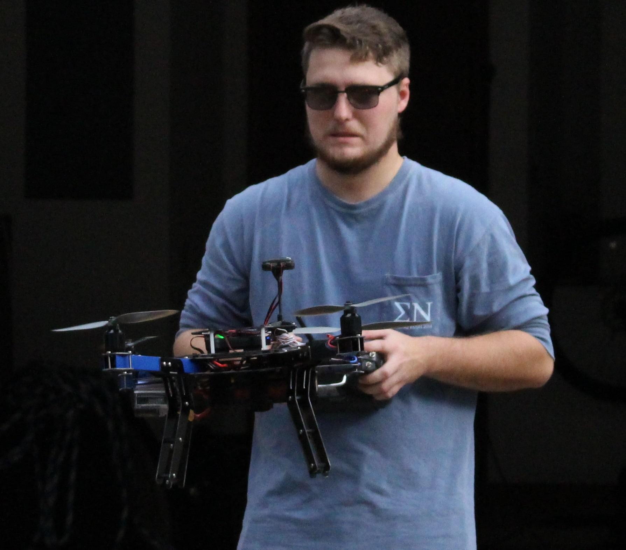
Issues/Concerns
Getting the quadcopter in the air
Object retrieval method
Peripheral interfacing on the rover
Problems with faulty parts and shipping errors

Slide 50
Work Distribution
 | Brendan | Brian | Erick | Matt
Quadcopter Hardware | X
Quadcopter Software | X |  | X | X
Rover Hardware |  | X
Rover Software |  | X | X
CDC | X | X | X | X
Wireless Communication |  |  | X
Image Processing |  |  |  | X

Slide 51
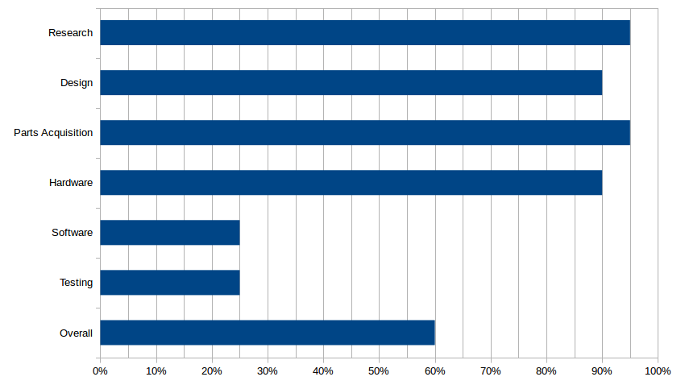
Progress

Slide 52
Questions?

